Slide 1

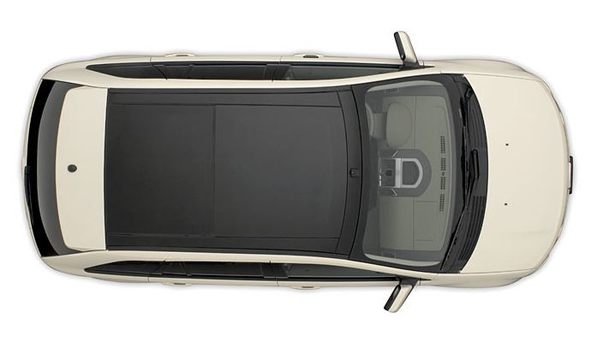
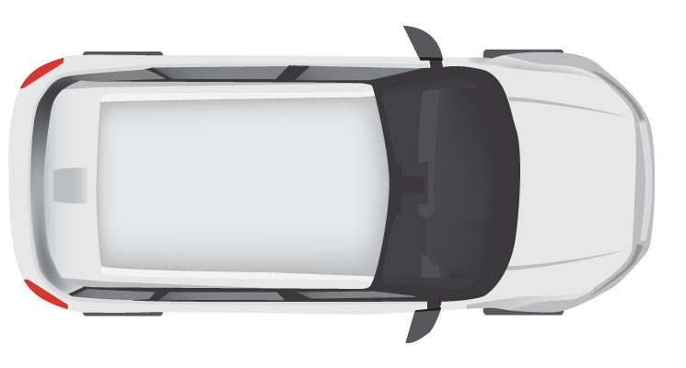
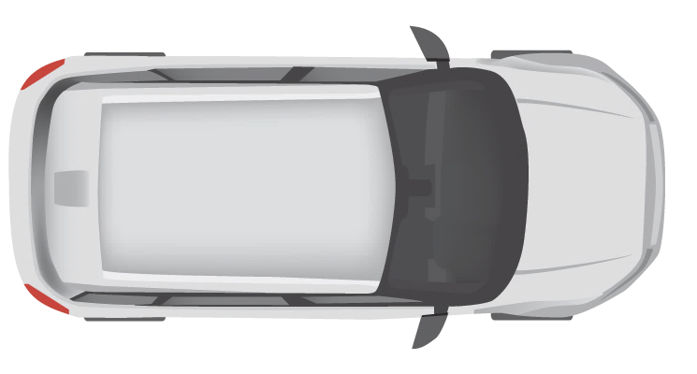
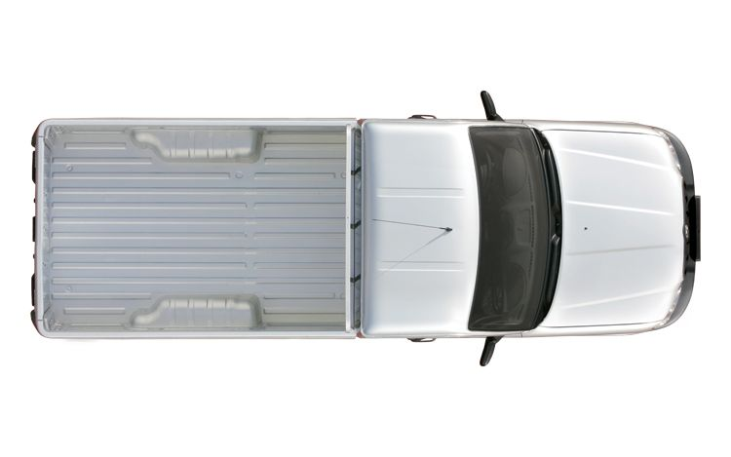



10 km
Entry Cam 1
Exit Cam 1
Entry Cam 2
Exit Cam 2
Entry Cam 3
Exit Cam 3
Measurements
Dashboard
TrafficControl
Service
Measurements
Service
CO2
Sensor

Slide 2
Camera
Simulation
Traffic
Control
Service
/entrycam
/exitcam
Measurements
Service
Measurements
Dashboard
/averageSpeed
/metrics
CO2 Sensor
Simulation
/co2Level

Slide 3
Measurements
Dashboard
Camera Simulation
CO2 Sensor Simulation
Traffic Control
Service
Measurements Service
Dashboard
Camera
Simulation
CO2 Sensor
Simulation
/entrycam
/exitcam
/average Speed
/co2 Level
/metrics
POST VehicleRegistered
Random
Interval
Store VehicleState
POST VehicleRegistered
Get VehicleState
Calculate Average Speed
POST AverageSpeedDetected
Calculate and store Overall Average Speed
[Every 15 seconds]
POST CO2LevelMeasured
Generate and store sample point
GET Metrics

Slide 4

111 KM/h
299 PPM

Slide 5



Redis
State Management
Camera
Simulation
Sidecar
Service invocation
Traffic
Control
Service
Sidecar
/entrycam
/exitcam
RabbitMQ
Measurements
Service
Measurements
Dashboard
Publish / Subscribe
/averageSpeed
/co2Level
/metrics
CO2 Sensor
Simulation
Sidecar

