Slide 1



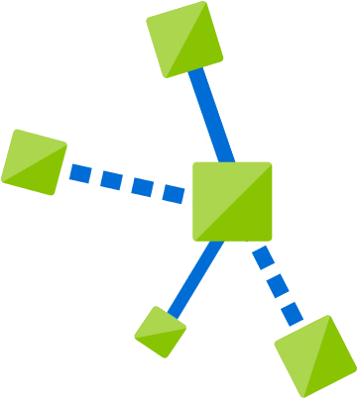

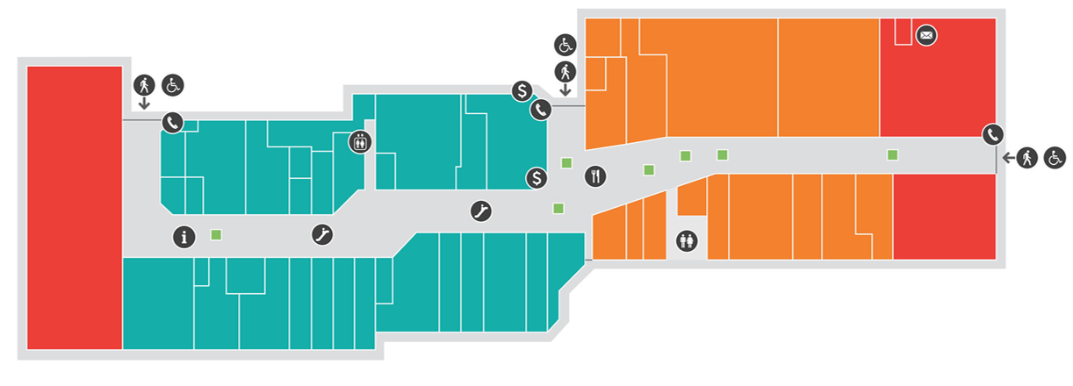
IoT Hub
Function
App
SignalR
Service
SensorEvents
Hub
Events queue
SignalRInfo
IoT Edge
Device
ASP.NET
Core App
IoT Edge Module
Hub

