Slide 1

AKESO · ICON × LYRA 2026
RECLAIM
YOUR USABLE
TIME.
An explainable energy + nutrition coach that turns plans into action.
ENERGY
NUTRITION
PLANNING
EXPLAINED
BUILT FOR STUDENTS
github.com/EdwinjJ1/akeso
AKESO · LESS GRIND. BETTER TIMING.
00
Notes:
Talk track: I believe most teams here have built an app, a website, or a tool to help people save time. Akeso does that too. But our bigger goal is to give people back time they already have, yet cannot use. A free hour is not useful if you have no energy, focus, or emotional capacity to act. Akeso is an explainable energy and nutrition coach that turns plans into action. [Sources] - Internal project overview: README.md - Product screenshots and mascot inherited from the team-provided source deck.

Slide 2
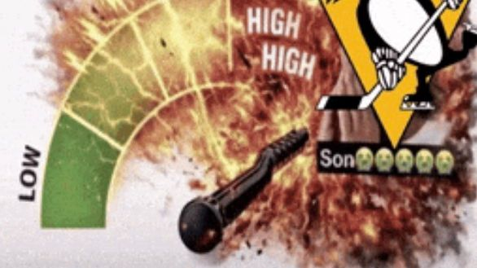

THE PROBLEM, IN TWO MEMES
YOUR ENERGY IS TRYING
TO TELL YOU SOMETHING.
WHEN YOUR BODY FEELS LIKE AN ALARM
WHEN EVERYTHING FINALLY FEELS EASY
The memes are the hook — Akeso does not measure or diagnose cortisol.
AKESO · ICON × LYRA HACKATHON 2026
01
Notes:
Talk track: These memes exaggerate two extremes: your body feels like an alarm, or suddenly everything feels easy. We are not claiming to measure cortisol. The serious question underneath the joke is this: why can the same person have a plan on both days, but only have the energy to execute it on one of them? [Sources] - Meme images inherited from the team-provided source deck; original public URLs were not recorded. - Medical boundary: README.md and docs/API_CONTRACT.md.

Slide 3
THE EXECUTION GAP
TIME AVAILABLE
ISN’T ALWAYS TIME USABLE.
PLANNED
READY TO ACT
5:00
?
Sleep + food + hydration + stress + mood shape what is usable.
The plan exists. The hours are on the calendar.
AKESO WORKS ON THIS GAP
Turn invisible blockers into one explainable next action.
AKESO · ICON × LYRA HACKATHON 2026
02
Notes:
Talk track: Most people do not have a planning problem. They already know what they want to do. The hard part is execution. Imagine a student with five hours blocked out for work. Those five hours exist on the calendar. But after five hours of sleep, poor nutrition, dehydration, or a stressful morning, how many of those hours are genuinely usable? We cannot add hours to the clock. We can work on the gap between time available and capacity to act. [Sources] - Illustrative scenario; no measured productivity outcome is claimed. - Product framing: README.md and docs/superpowers/specs/2026-07-22-demo-video-script-design.md.

Slide 4

01 · THE REAL PROBLEM
TIRED
DOESN’T MEAN
LAZY.
People feel the outcome — low energy — but the connected signals behind it stay scattered.
ONE SYSTEM
OUTCOME
CURRENT TOOLS
Food · Sleep · Water
“Why am I so low?”
Tasks, not the person
Plus stress and mood context.
The pattern is hard to see.
Every hour looks identical.
AKESO · ICON × LYRA HACKATHON 2026
03
Notes:
Talk track: That is why tired does not mean lazy. Low energy is the visible outcome, but the signals around it are scattered. Food, sleep, hydration, stress, and mood can all shape the day someone experiences. Most productivity tools only see the task, so they treat every hour as identical. Akeso starts with the person who has to perform the task. [Sources] - Product framing: README.md. - Current and planned signal boundaries: docs/API_CONTRACT.md and docs/superpowers/specs/2026-07-22-demo-video-script-design.md.

Slide 5
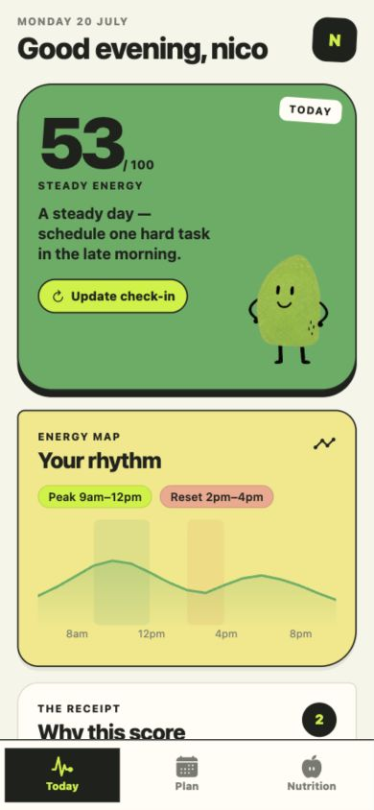
02 · OUR SOLUTION
A PERSONAL
ENERGY + NUTRITION
COACH.
Understand what may be shaping your energy — then turn that insight into food and routine choices you can actually follow.
NOW · CONNECTED SIGNALS
NOW · NUTRITION GUIDANCE
NEXT · EMOTION COACH
AKESO · ICON × LYRA HACKATHON 2026
04
Notes:
Talk track: Our solution is a personal energy and nutrition coach. In the MVP, Akeso connects a short daily check-in with an explainable energy picture, an energy-aware plan, and food guidance grounded in what the user actually has. It does not ask people to push harder. It helps them choose work, meals, and recovery that fit the day they actually have. [Sources] - Current product flow: README.md. - Energy, plan, and nutrition contracts: docs/API_CONTRACT.md.

Slide 6
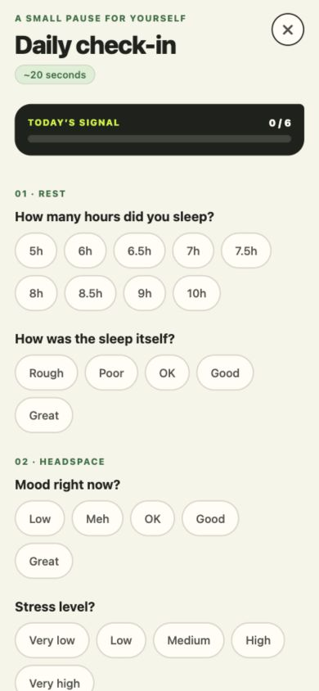
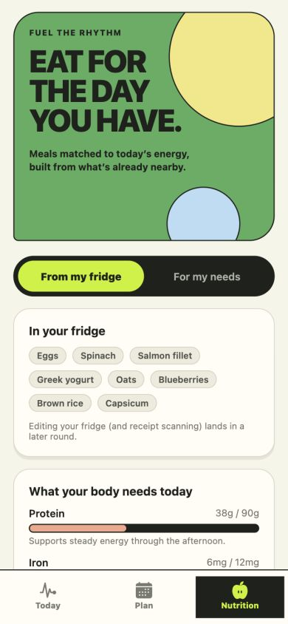
03 · HOW IT WORKS
20 SECONDS IN.
A CLEARER DAY OUT.
1 · CHECK IN
2 · ADJUST
3 · TAKE ACTION
Daily signals, one place
Your report anchors the score
Meals + routines for today
AKESO · ICON × LYRA HACKATHON 2026
05
Notes:
Talk track: The experience has three steps. First, the user checks in with a few signals. Second, they calibrate the result. This is not a mysterious black-box score: the user’s reported energy anchors the deterministic score. If the result does not reflect how they feel, they update the check-in and Akeso recalculates it. Third, Akeso turns that state into a realistic next action—such as moving demanding work to a stronger window, or suggesting a meal from ingredients already available. [Sources] - Scoring definition and user-reported energy mapping: docs/API_CONTRACT.md. - Rolling check-in recalculation flow: docs/superpowers/specs/2026-07-21-rolling-checkin-design.md.

Slide 7
04 · PERSONALISED, NOT MEDICALISED
NOT A DIAGNOSIS.
USEFUL SIGNAL.
1
Repeated food pattern
Very few iron-rich foods logged across several days.
2
Explain, without diagnosing
“This pattern may be worth addressing.”
3
One realistic next action
Spinach, eggs or salmon — using what is already nearby.
Persistent dizziness or fatigue should be discussed with a qualified health professional.
AKESO · ICON × LYRA HACKATHON 2026
06
Notes:
Talk track: Personalised does not mean medicalised. Akeso does not diagnose iron deficiency from a meal log. It can identify a repeated pattern, explain it cautiously, suggest one realistic food option, and recommend professional advice when symptoms persist. The goal is useful guidance without pretending to be a doctor. [Sources] - Safety and dietary-guidance rules: docs/API_CONTRACT.md. - Product boundary: README.md.

Slide 8
05 · MEASURABLE TIME SAVED
FROM SCATTERED DECISIONS
TO ONE GUIDED ROUTINE.
BEFORE · MANUAL
WITH AKESO
12:00
0:25
One check-in → energy insight → meal + routine suggestion
Calendar + task triage + meal decision + time blocking
11 MIN 35 SEC SAVED PER DAY
Measured demo workflow · validate with a wider user trial.
AKESO · ICON × LYRA HACKATHON 2026
07
Notes:
Talk track: Akeso gives time back in two ways. First, it removes daily decision friction. In our measured demo workflow, checking the calendar, ranking tasks, deciding what to eat, and building a plan took twelve minutes. Akeso reached the first useful recommendation in twenty-five seconds: eleven minutes and thirty-five seconds saved. That is one rehearsed workflow, not a population study, so wider user testing is our next validation step. Second, better timing helps people make more of the hours they already have. [Sources] - Measured team demo workflow: docs/superpowers/specs/2026-07-22-demo-video-script-design.md.

Slide 9
06 · TECHNICAL EXECUTION
BUILT TO EXPLAIN.
NOT TO PRETEND.
CLIENT
API
DATA
GUIDANCE
Expo App
→
Express
→
Supabase
→
Validated AI
Fast daily interaction
Validated contracts
Longitudinal patterns
Explains, not scores
DETERMINISTIC ENGINE
SCHEMA-VALIDATED OUTPUT
NOT A MEDICAL DEVICE
Core challenge: turning noisy lifestyle signals into useful guidance without overstating certainty.
AKESO · ICON × LYRA HACKATHON 2026
08
Notes:
Talk track: Under the hood, the Expo app talks to an Express API backed by Supabase. Deterministic TypeScript services calculate the authoritative energy result and plan. AI can explain schema-validated guidance, but it does not invent the score. That separation is important: the same input produces a consistent result, and uncertainty is communicated instead of hidden. [Sources] - Architecture overview: README.md. - API and scoring contracts: docs/API_CONTRACT.md. - Demo architecture narration: docs/superpowers/specs/2026-07-22-demo-video-script-design.md.

Slide 10
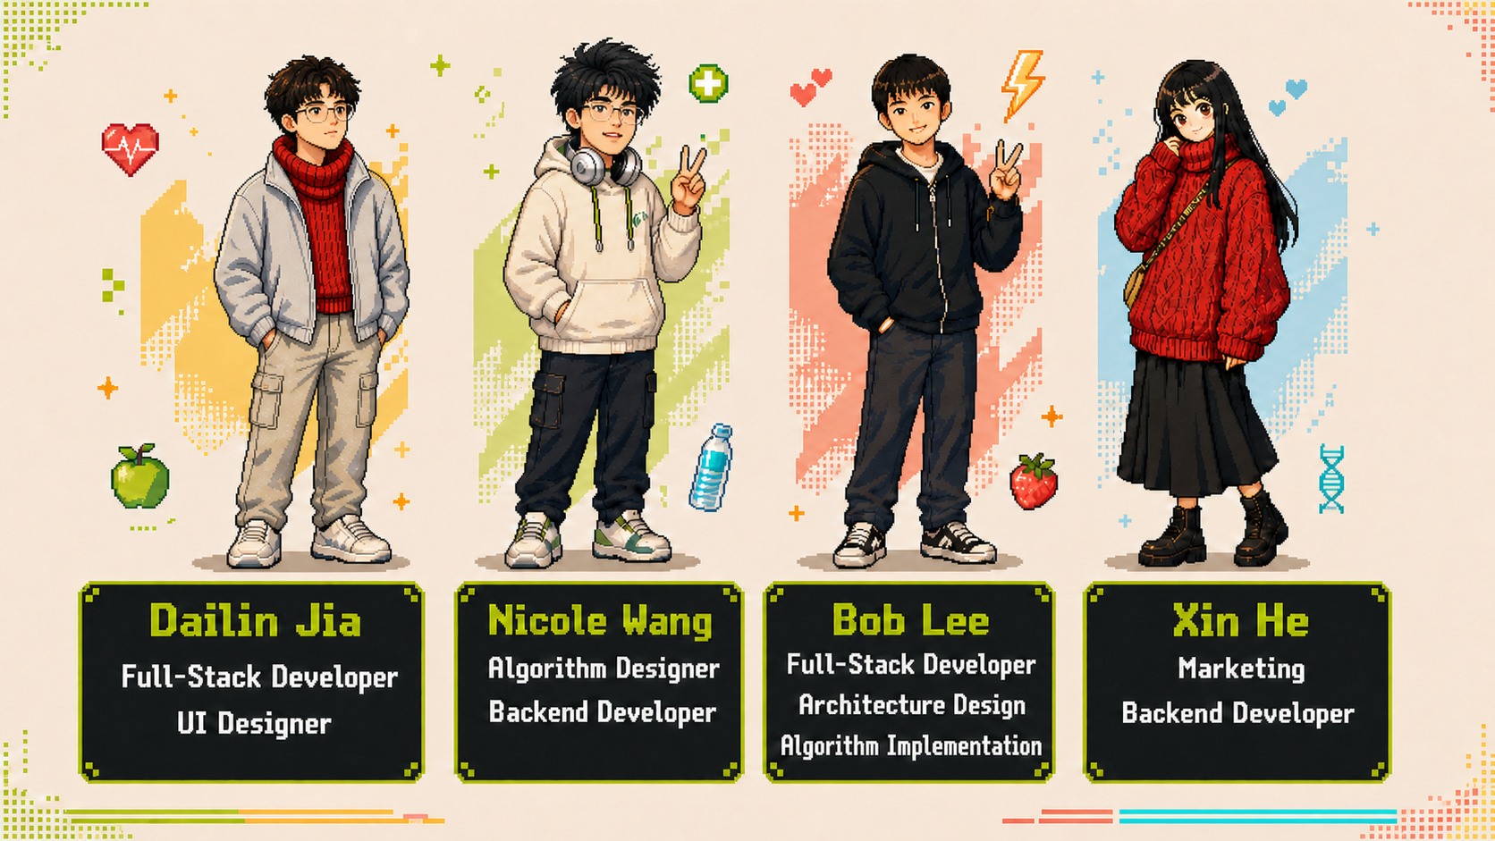
07 · THE TEAM
FOUR BUILDERS.
ONE ENERGY SYSTEM.
Full-stack · algorithms · architecture · marketing
AKESO · ICON × LYRA HACKATHON 2026
09
Notes:
Talk track: Akeso is built by four of us. Dailin Jia and Bob Lee cover full-stack development — Dailin also owns the UI design, and Bob leads the architecture and the algorithm implementation. Nicole Wang designed the energy algorithm and works across the backend. Xin He drives marketing and also contributes to the backend. Four people, one shared goal: making energy something you can understand and act on. [Sources] - Roles as listed on the team introduction card provided by the team.

Slide 11
08 · WHAT’S NEXT
UNDERSTAND
YOUR ENERGY.
FEED IT BETTER.
A more accessible path to personalised energy and nutrition guidance.
NEXT · EMOTION COACH
PHOTO FOOD LOGGING
WEEKLY PATTERNS
WEARABLES
EXPERT-REVIEWED GUIDANCE
github.com/EdwinjJ1/akeso
AKESO · LESS GRIND. BETTER TIMING.
10
Notes:
Talk track: Today, Akeso connects daily energy, planning, and nutrition. Next, we want to deepen the picture with an emotion coach, faster food logging, wearables, weekly patterns, and expert-reviewed guidance. Most tools save a few minutes. Akeso aims to do something deeper: help people reclaim the hours they are currently unable to use. We do not ask people to grind harder. We help them understand their energy and use it at the right time. Akeso: less grind, better timing. [Sources] - Current product and roadmap framing: README.md and the team-provided source deck.

