Slide 1
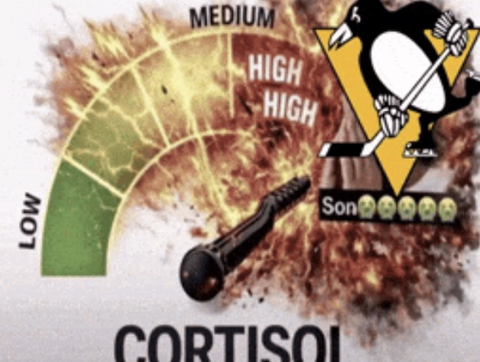

THE PROBLEM, IN TWO MEMES
YOUR ENERGY IS TRYING
TO TELL YOU SOMETHING.
WHEN YOUR BODY FEELS LIKE AN ALARM
WHEN EVERYTHING FINALLY FEELS EASY
The memes are the hook — Akeso does not measure or diagnose cortisol.
AKESO · ICON × LYRA HACKATHON 2026
01
Notes:
Open with the joke, but immediately make the serious point. The internet describes energy as either complete chaos or total calm. We do not claim to measure cortisol. What we care about is the question underneath the meme: why does my energy feel so different from one day to the next?

Slide 2

01 · THE REAL PROBLEM
TIRED
DOESN’T MEAN
LAZY.
People feel the outcome — low energy — but the connected signals behind it stay scattered.
ONE SYSTEM
OUTCOME
CURRENT TOOLS
Food · Sleep · Water
“Why am I so low?”
Tasks, not the person
Plus stress and mood context.
The pattern is hard to see.
Every hour looks identical.
AKESO · ICON × LYRA HACKATHON 2026
02
Notes:
Most people know when they feel tired, but they do not know what may be contributing to it. Nutrition, sleep, hydration, stress and mood are not five separate problems. They are connected signals shaping one daily energy state. Existing apps usually track only one category, so the relationship between the signals stays invisible.

Slide 3
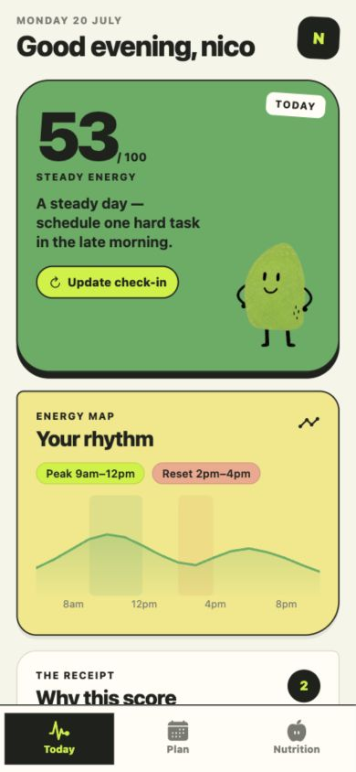
02 · OUR SOLUTION
A PERSONAL
ENERGY + NUTRITION
COACH.
Understand what may be shaping your energy — then turn that insight into food and routine choices you can actually follow.
NOW · CONNECTED SIGNALS
NOW · NUTRITION GUIDANCE
NEXT · EMOTION COACH
AKESO · ICON × LYRA HACKATHON 2026
03
Notes:
Akeso is a personal energy and nutrition coach in your pocket. Our difference is not five separate trackers. Akeso connects daily signals into one energy picture. Today, the MVP provides connected check-ins, explainable energy context and nutrition guidance. A dedicated emotion coach is explicitly part of our next stage, not a feature we are claiming today.

Slide 4
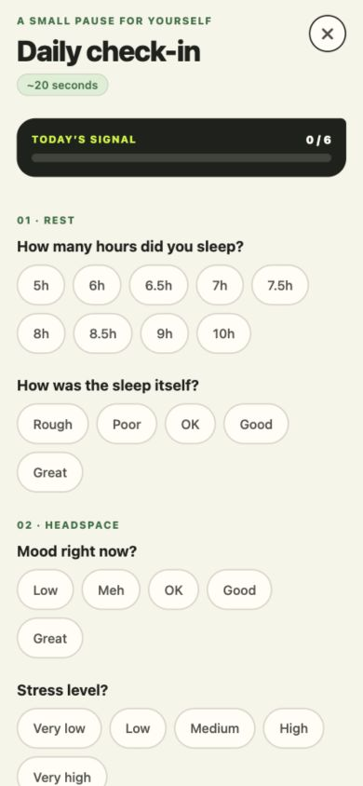
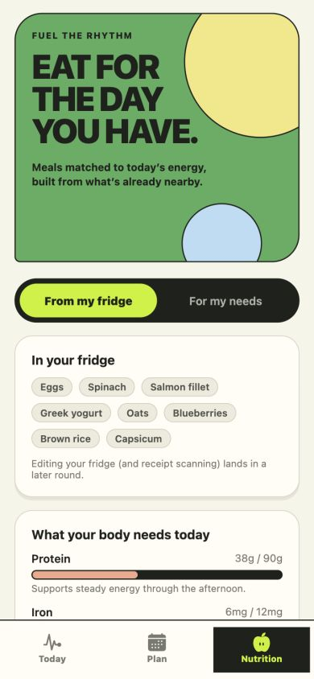
03 · HOW IT WORKS
20 SECONDS IN.
A CLEARER DAY OUT.
1 · CHECK IN
2 · CONNECT
3 · TAKE ACTION
Daily signals, one place
One explainable energy picture
Meals from what you have
AKESO · ICON × LYRA HACKATHON 2026
04
Notes:
The experience is deliberately lightweight. First, the user checks in on energy, sleep, food and hydration, with stress and mood recorded as contextual signals where available. Second, Akeso connects those inputs into an explainable energy picture. Third, it recommends meals from the user's own fridge. Planning is useful, but it is only one small output of the larger energy and nutrition system.

Slide 5
04 · PERSONALISED, NOT MEDICALISED
NOT A DIAGNOSIS.
A USEFUL PATTERN.
1
Repeated food pattern
Very few iron-rich foods logged across several days.
2
Explain, without diagnosing
“This pattern may be worth addressing.”
3
One realistic next action
Spinach, eggs or salmon — using what is already nearby.
Persistent dizziness or fatigue should be discussed with a qualified health professional.
AKESO · ICON × LYRA HACKATHON 2026
05
Notes:
Here is the important distinction. Akeso does not diagnose iron deficiency from a meal log. Instead, it can notice that someone repeatedly records meals with very few iron-rich foods. It can explain that pattern, suggest practical options such as spinach, eggs or salmon already in the fridge, and recommend professional advice if symptoms persist. Useful guidance without pretending to be a doctor.

Slide 6
05 · MEASURABLE TIME SAVED
FROM SCATTERED DECISIONS
TO ONE GUIDED ROUTINE.
BEFORE · MANUAL
WITH AKESO
12:00
0:25
One check-in → energy insight → meal + routine suggestion
Calendar + task triage + meal decision + time blocking
≈ 11 MINUTES SAVED PER DAY
Sample demo values — replace with the final measured median before presenting.
AKESO · ICON × LYRA HACKATHON 2026
06
Notes:
The hackathon asks us to demonstrate time saved. In our demo workflow, manually checking a calendar, ranking tasks, deciding what to eat and building a plan took around twelve minutes. Akeso produces the first useful recommendation after a short check-in. We will replace these sample values with the final measured trial before submission.

Slide 7
06 · TECHNICAL EXECUTION
BUILT TO EXPLAIN.
NOT TO PRETEND.
CLIENT
API
DATA
GUIDANCE
Expo App
→
Express
→
Supabase
→
Validated AI
Fast daily interaction
Validated contracts
Longitudinal patterns
Explains, not scores
DETERMINISTIC ENGINE
SCHEMA-VALIDATED OUTPUT
NOT A MEDICAL DEVICE
Core challenge: turning noisy lifestyle signals into useful guidance without overstating certainty.
AKESO · ICON × LYRA HACKATHON 2026
07
Notes:
We designed Akeso to be explainable and safe. The app is built with Expo, an Express API and Supabase. Deterministic TypeScript services calculate the energy result and recommendations. AI explains validated outputs rather than inventing the score. Our hardest challenge was turning noisy lifestyle signals into something useful without making medical claims, so we separate reported energy, possible context and professional escalation.

Slide 8

07 · WHAT’S NEXT
UNDERSTAND
YOUR ENERGY.
FEED IT BETTER.
A more accessible path to personalised energy and nutrition guidance.
NEXT · EMOTION COACH
PHOTO FOOD LOGGING
WEEKLY PATTERNS
WEARABLES
EXPERT-REVIEWED GUIDANCE
github.com/EdwinjJ1/akeso
AKESO · LESS GRIND. BETTER TIMING.
08
Notes:
Akeso's long-term vision is to understand energy over weeks, not just one day. The current product connects daily energy and nutrition signals. Next, we want a dedicated emotion coach, faster food logging through photos, wearable integrations, stronger longitudinal pattern detection, and guidance reviewed with nutrition professionals. Our goal is simple: help people understand their energy and feed it better.

