Slide 1
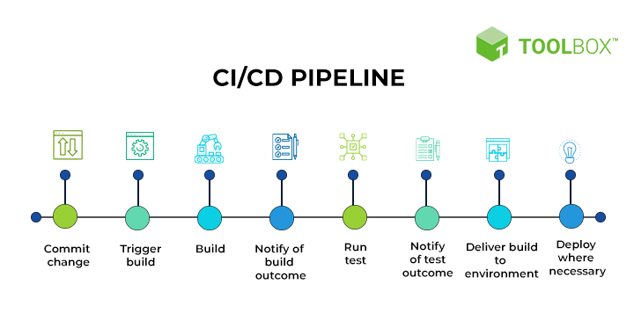
CI/CD
CI/CD is the combination of principles, practices, and capabilities that allow for software changes of all kinds to get users in a quick, repeatable, and safe manner. This allows for software developers to integrate their feature or service changes continuously and for IT and operations teams to deliver with the standards, security, and confidence businesses need.

Slide 2
CI/CD Benefits
Superior Quality Code
Accelerated Release Cycles
Loyal Customer Base
Detection & Isolation
Easy Maintenance & Updates
Cost Deduction

