Slide 1

Introduction
Goal : To predict if a loan would be repaid in full or defaulted. – Probability of default Model
A random sample of ~230k examples and 31 different variables between 2009 and 2015.
Questions:
  What Region is the most reliable?
  What is their purpose of borrowing?
  What makes you a good credit person?
  Which models perform better? Logistics Regression VS Random Forest

Slide 2
Preview
Data Exploration
  Target Variable
  Purpose/Credit Score/Income Category/Region
  Correlation
  Weight of Evidence/ Information Value
Model 1 – Logistics Regression
  Score Card
Model 2 – Random Forest
  Feature Importance
Conclusion and Sample Code

Slide 3
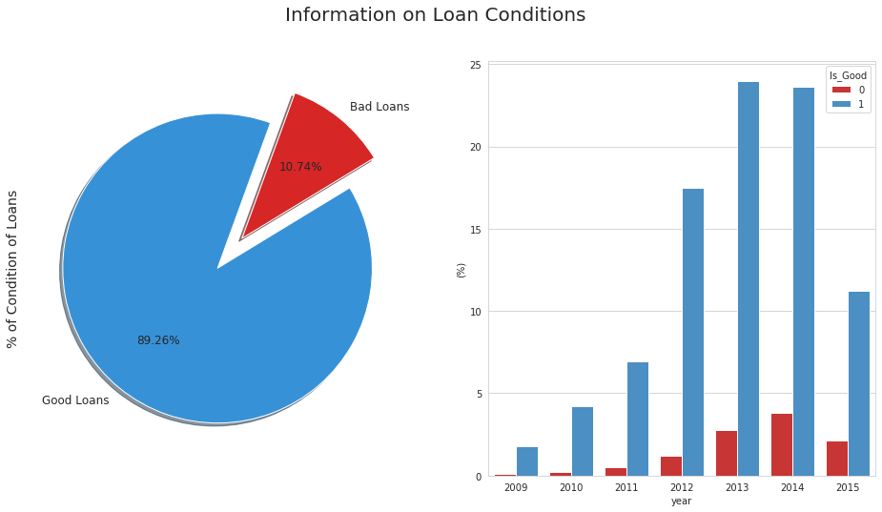
Target variable
89.26% of customers are good customers
  When we train our model, we might need to apply resampling or using cross validation
The amount of loans was extremely low in 2009, this is because of the consequence of financial crisis. However, it guardedly increase till 2014.

Slide 4
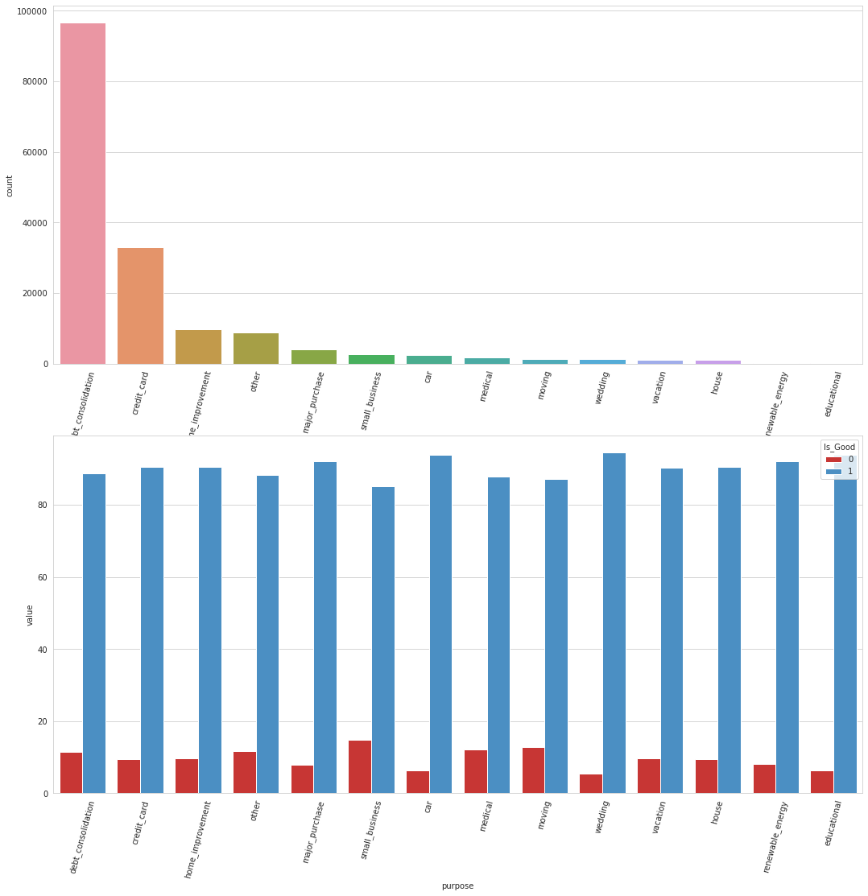
Purpose
Debt Consolidation is the main purpose of borrowing. 2nd Reason is credit card. These suggest that the main segment of customers is people who have financial difficulties
The highest default rate is customer who apply loan for small business. This is because the spending of a small business is always harder to control

Slide 5
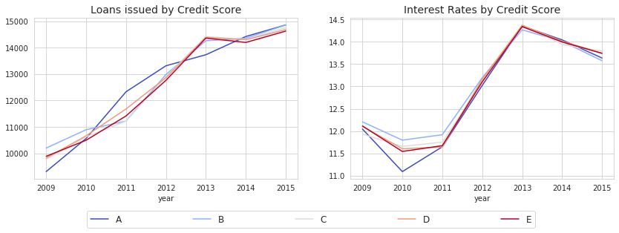
Credit score
Experian score
Binning:
In 2009 and 2013, this bank issued more B-to-E grade loans than the other years, which reflect the UK economy was not great at these periods.
As previously shown, the main purpose of the loans is debt consolidation. In this case, credit score will not have much effect on interest rate
Grade | Score
A | >960.1
B | 880.1 < x <960
C | 720.1 < x <800
D | 560 < x < 720
E | <560

Slide 6
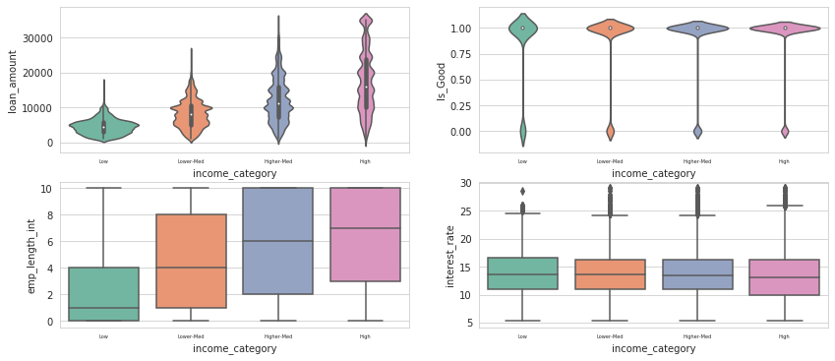
Income category
According to HMRC, above £70k is the definition of high income, and the median average pre-tax income is around £22.4k
Income has a positive correlation with loan_amount and emp_lenght
Higher Income customers likely to pay back
Interest looks constant, this company offer the similar interest rate plan
Grade | Score
Lower | <22.4k
Low-med | 22.41k -40k
High-med | 40.1k -70k
High | >70.1k

Slide 7
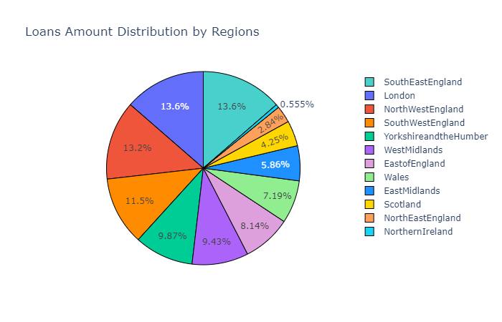
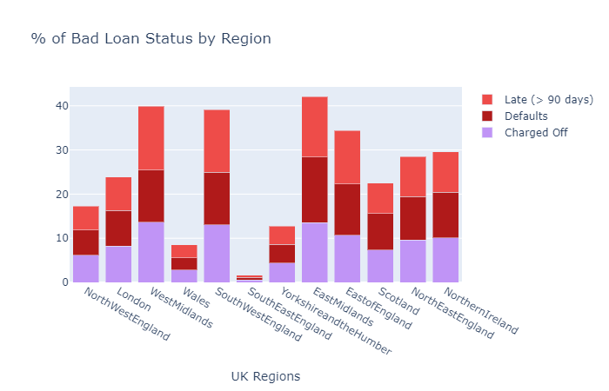
Regions
SouthEastEngland, London and NorthWestEngland have a large proportion of customers
SouthEastEngland has the lowest default rate. Considering the number of application, this is very impressive
WestMidland, SouthWestEngland and EastMidlands have ~40% of bad loans rate

Slide 8
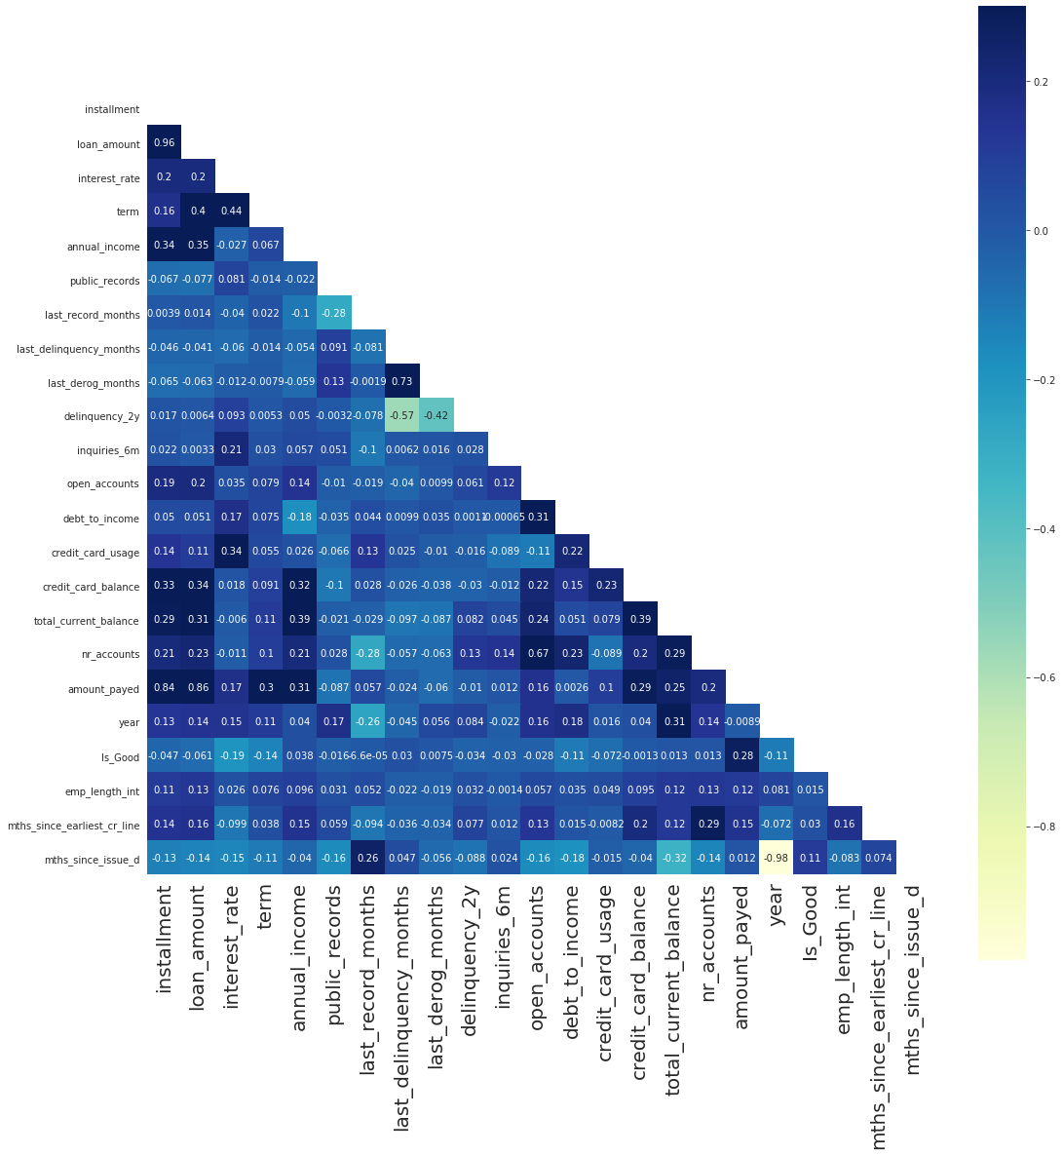
Correlation
Amount_pay has a very high correlation with Installment and loan_amount.
The correlation between Loan amount and instalment almost equal to. 1 Clearly, higher Loan amount require a longer time to pay. Given the fact that interest are almost fixed for everyone

Slide 9
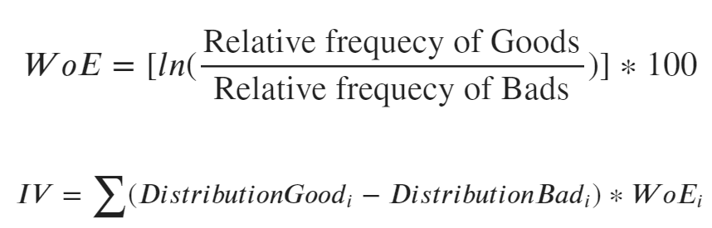
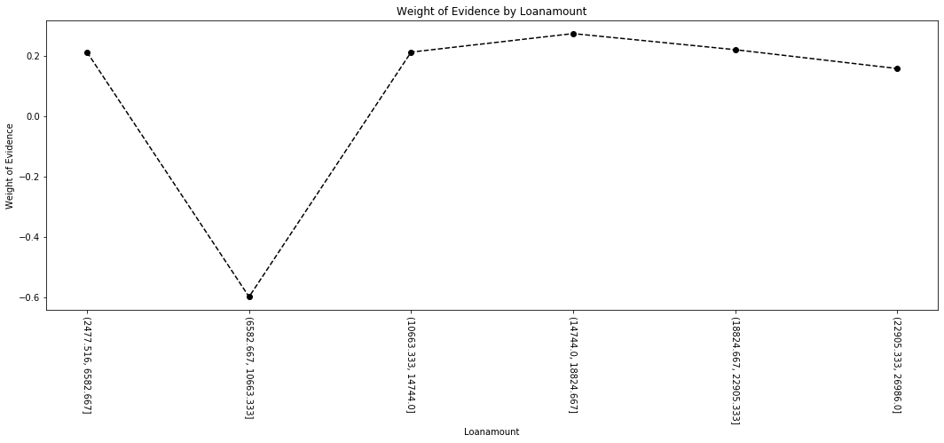
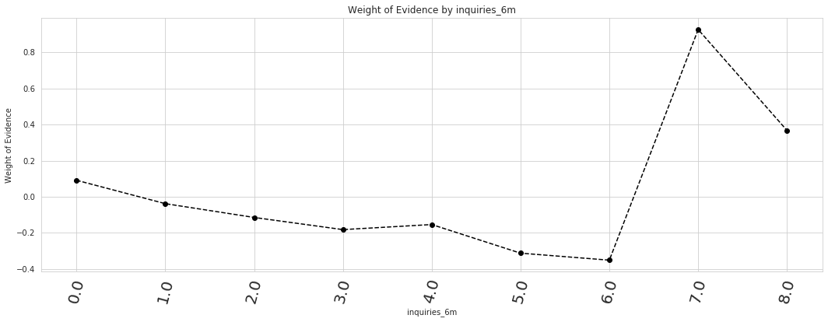
Weight of evidence and information value 1
Good
Bad
Weight of evidence (WOE) shows how well each features are spited
It helps to features re-engineer i.e. combine similar WOE
Binning is good for continuous variables

Slide 10
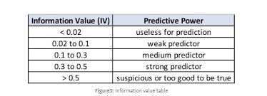
Weight of evidence and information value 2
Information Value shows how much predictive power it provides
0.02 is not useful for our prediction
If greater than 0.02, it contains some predictive power
Please refer to the Python code for more infomation

Slide 11
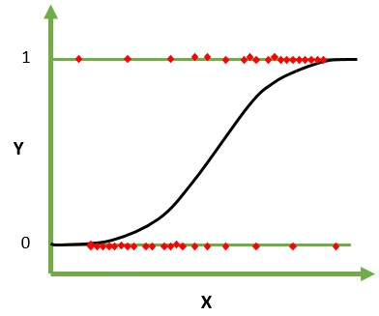
Model 1 – Logistics regression
Outcome is our response variable y - Good/Bad
Logistics regression create a decision boundary between both outcomes
It provides each feature coefficient – so we can build a score card from them

Slide 12
Model 1 – logistics regression
Y_hat_test_proba is the probability of being 1
ROC curves are a nice way to see how any predictive model can distinguish between the true positives and negatives. Please see code for more information
We will come back after
ID | loan_data_targets_test | y_hat_test_proba | y_hat_test
63747 | 1 | 0.917977892 | 1
114441 | 1 | 0.972890801 | 1
129058 | 0 | 0.10937088 | 0
118763 | 0 | 0.199301876 | 0
137489 | 1 | 0.900843686 | 1
#LR | Precision | Recall | F1-Score | Support
Bad | 0.84 | 0.58 | 0.69 | 3587
Good | 0.95 | 0.99 | 0.97 | 29276

Slide 13
Score Card
Feature name | Coefficients | Original feature name | Score - Final
Intercept | 0.035050459 | Intercept | 508
amount_payed:(21516.911, 56809.052] | 7.30303452 | amount_payed | 128
amount_payed:(14268.0, 21516.911] | 4.120385197 | amount_payed | 72
loan_amount:(999.999, 6300.0] | 3.844340053 | loan_amount | 67
amount_payed:(10060.525, 14268.0] | 2.037885316 | amount_payed | 36
loan_amount:(6300.0, 10000.0] | 1.481807232 | loan_amount | 26
interest_rate:(5.319, 9.67] | 1.442594112 | interest_rate | 25
year:2015 | 1.440036897 | year | 25
installment: <=152 | 1.307998363 | installment | 23
debt_to_income:(9.46, 14.03] | 0.113969314 | debt_to_income | 16
mths_since_issue_d:(48.999, 64.0] | 0.747368105 | mths_since_issue_d | 13
interest_rate:(9.67, 12.29] | 0.735742435 | interest_rate | 13
delinquency_2y:6.0 | 0.535050488 | delinquency_2y | 9
installment: 153-209 | 0.407119816 | installment | 7
Each feature has provided a score
Max score is 864
Amount_payed has the most effect on our score card.
Please click for more info:

Slide 14
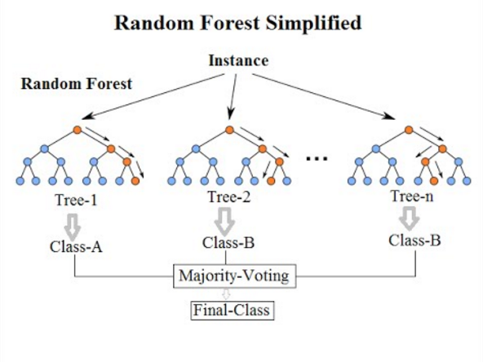
Model2 Random forest1
The random forest is a model made up of many decision trees. This model uses two key concepts that gives it the name random:
Random sampling of training data points when building trees
Random subsets of features considered when splitting nodes
RF is better
#RF | Precision | Recall | F1-Score | Support
Bad | 0.86 | 0.96 | 0.86 | 3479
Good | 0.98 | 0.98 | 0.98 | 29384
#LR | Precision | Recall | F1-Score | Support
Bad | 0.84 | 0.58 | 0.69 | 3587
Good | 0.95 | 0.99 | 0.97 | 29276

Slide 15
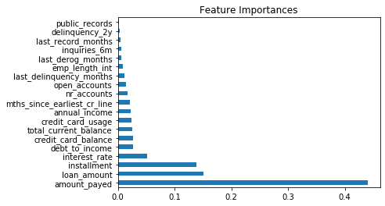
Feature importance
The red circle shows the top 5 features which affect our model, they contain over 85% of model explanation.
Retrain model only using these features.
Recall increase by 0.02 and F1Score increase by 0.01. This is because random noise have been removed.
#RF | Precision | Recall | F1-Score | Support
Bad | 0.86 | 0.89 | 0.87 | 3479
Good | 0.98 | 0.98 | 0.98 | 29384
#RF | Precision | Recall | F1-Score | Support
Bad | 0.86 | 0.86 | 0.86 | 3479
Good | 0.98 | 0.98 | 0.98 | 29384

Slide 16
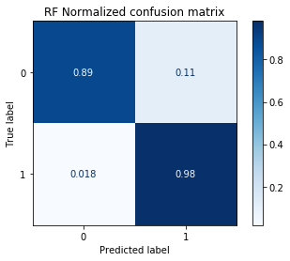
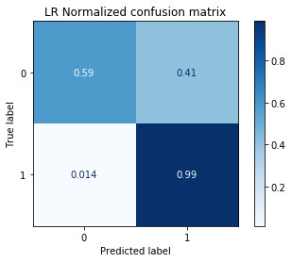
Model comparison
Depend on the situation, more interpretable? more predictive power? faster?
Logistics Regression is very interpretable and fast it gives a score of each feature.
Random Forest (RF) is a ensemble method which normally perform better than Logistics Regression. It handles imbalance data and outliers well. However it has a lot of parameters to tune, and computationally expensive.
Look at the confusion matrix, RF clearly preforms better than LR. Additionally, we would like the false positive rate to be low. The reason being is we do not want to accept customers application when they are actually a default.
Random forest is chosen

Slide 17
Conclusion
Data Visualization
  The main segment of customers: People who have financial difficulties
  Higher Income customers likely to pay back
  People from Southeast England have a higher rate to pay back
  Weight of Evidence for features Engineering
Model 1 – Logistic Regression
  Score Card
Model 2 – Random Forest
  Feature Importance
Random Forest will be used, since it gives a higher predictive power. Logistics Regression might need human assist to help to make decision – Score Card

