Slide 1

UI WEB DEVELOPMENT
(MR23-1CS0102)
UNIT-V
Bootstrap
UI Web Development
Unit 5
Department of CSE
Notes:
You can safely remove this slide. This slide design was provided by SlideModel.com – You can download more templates, shapes and elements for PowerPoint from http://slidemodel.com

Slide 2

Bootstrap
Bootstrap is the most popular HTML, CSS, and JavaScript framework for developing responsive, friendly websites. It is based on Html, CSS, JavaScript.
It facilitates users to develop a responsive website.
It is compatible with most of browsers like Chrome, Firefox, Internet Explorer, Safari and Opera etc.
It includes HTML and CSS based design templates for typography, forms, buttons, tables, navigation, modals, image carousels and many others.
UI Web Development
Unit 5
Department of CSE

Slide 3
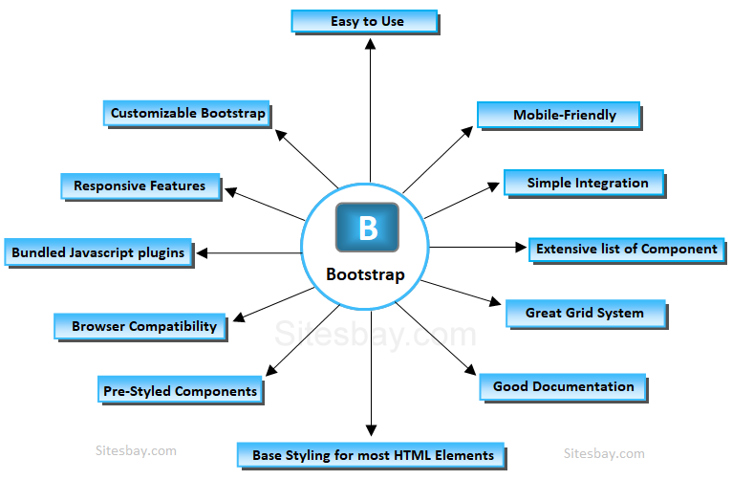
Features of Bootstrap
UI Web Development
Unit 5
Department of CSE

Slide 4
Bootstrap Container
In Bootstrap, container is used to set the content's margins dealing with the responsive behaviors of your layout. It contains the row elements and the row elements are the container of columns (known as grid system).
The container class is used to create boxed content.
There are two container classes in Bootstrap:
container
container-fluid
The .container class provides a responsive fixed width container
The .container-fluid class provides a full width container, spanning the entire width of the viewport
UI Web Development
Unit 5
Department of CSE

Slide 5
Why use Bootstrap
It is very easy to use. Anybody having basic knowledge of HTML and CSS can use Bootstrap.
It facilitates users to develop a responsive website.
It is compatible with most of browsers like Chrome, Firefox, Internet Explorer, Safari and Opera etc.
History of Bootstrap
Bootstrap was developed by Mark Otto and Jacob Thornton at Twitter. It was released as an open source product in August 2011 on GitHub.
How to use Bootstrap on the webpage?
There are two ways to start using Bootstrap on your own web site.
Download Bootstrap from getbootstrap.com.
Include Bootstrap from a CDN.
UI Web Development
Unit 5
Department of CSE

Slide 6
Use Bootstrap 5 via CDN (Content Delivery Network)
<!-- Latest compiled and minified CSS --> <link href="https://cdn.jsdelivr.net/npm/bootstrap@5.3.2/dist/css/bootstrap.min.css" rel="stylesheet"> <!-- Latest compiled JavaScript --> <script src="https://cdn.jsdelivr.net/npm/bootstrap@5.3.2/dist/js/bootstrap.bundle.min.js"></script>
CDN enables a quick way to serve files over the internet such as HTML, JavaScript, CSS, images, and videos. In Bootstrap’s case, the main Bootstrap JavaScript and Style Sheet files are being served over a CDN network.
UI Web Development
Unit 5
Department of CSE

Slide 7
Bootstrap Container Syntax
<html>
<body>
<div class="container"> ... </div>
</body>
</html>
Bootstrap container-fluid Syntax
<html>
<body>
<div class="container-fluid"> ... </div>
</body>
</html>
UI Web Development
Unit 5
Department of CSE

Slide 8
Bootstrap Container & Container-fluid Example
<html>
<head>
<link rel="stylesheet"
href="https://maxcdn.bootstrapcdn.com/bootstrap/3.4.1/css/bootstrap.min.css"/>
</head>
<body>
<div class="container" style="background-color: plum;">
<h1>container</h1>
<p>
These are container content
</p>
</div><br>
UI Web Development
Unit 5
Department of CSE

Slide 9
<div class="container-fluid" style="background-color: plum;">
<h1>container-fluid</h1>
<p>
These are container-fluid content
</p>
</div>
<script src="https://ajax.googleapis.com/ajax/libs/jquery/3.4.1/jquery.min.js"></script>
<script src="https://maxcdn.bootstrapcdn.com/bootstrap/3.4.1/js/bootstrap.min.js">
</script>
</body>
</html>
UI Web Development
Unit 5
Department of CSE

Slide 10
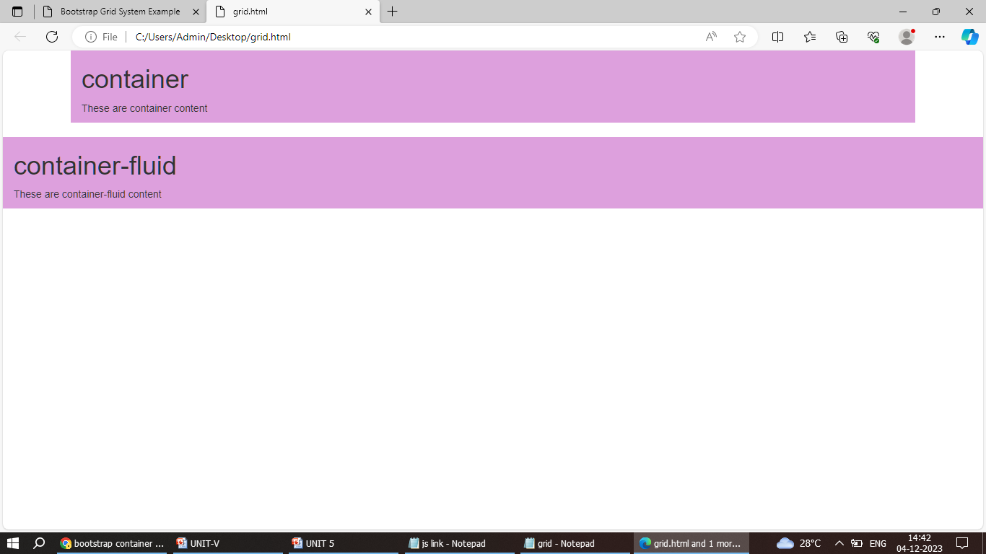
UI Web Development
Unit 5
Department of CSE

Slide 11
Container Border and Color
<div class="container p-5 my-5 border">
<h1>My First Bootstrap Page</h1>
<p>This container has a border and some extra padding and margins.
</p>
</div>
<div class= "container p-5 my-5 bg-dark text-white">
<h1>My First Bootstrap Page</h1>
<p>This container has a dark background color and a white text, and some extra padding and margins.
</p>
</div>
UI Web Development
Unit 5
Department of CSE

Slide 12
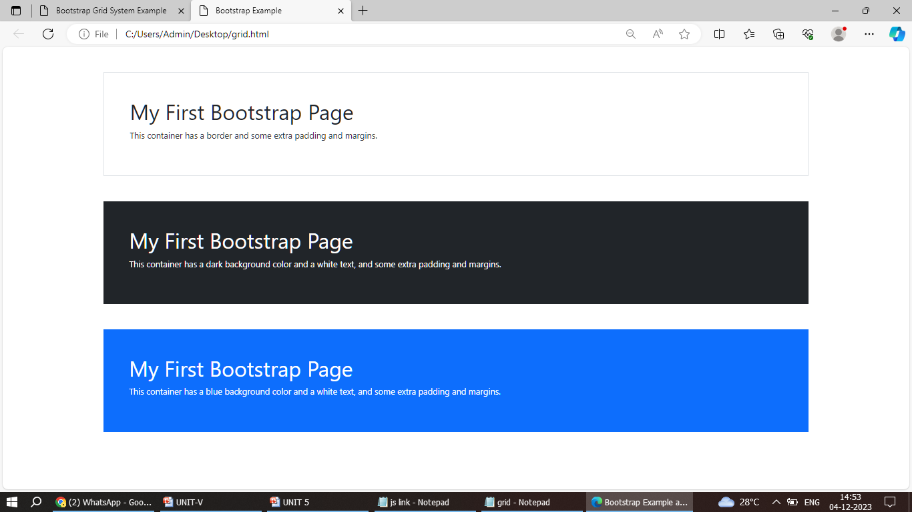
<div class= "container p-5 my-5 bg-primary text-white" >
<h1>My First Bootstrap Page</h1>
<p>This container has a blue background color and a white text, and some extra padding and margins.</p>
</div>
UI Web Development
Unit 5
Department of CSE

Slide 13
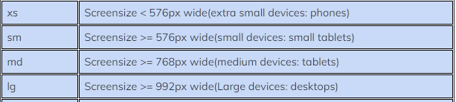
Bootstrap Grid System
Bootstrap includes a responsive, mobile first fluid grid system that appropriately scales up to 12 columns as the device or viewport size increases. It includes predefined classes for easy layout options
Bootstrap's grid system is built with flexbox.
The Bootstrap grid system has four classes:
xs (for phones)
sm (for tablets)
md (for desktops)
lg (for larger desktops)
UI Web Development
Unit 5
Department of CSE

Slide 14
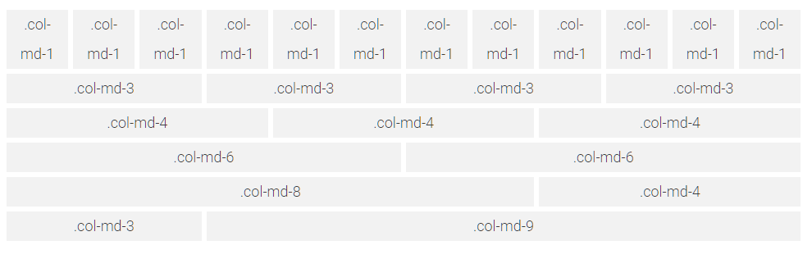
Bootstrap web page layout(Grid System)
The grid system is responsive, and the columns will re-arrange automatically depending on the screen size.
UI Web Development
Unit 5
Department of CSE

Slide 15
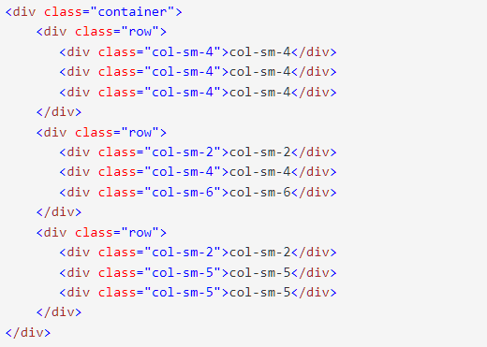

Bootstrap Grid Layout with Responsive Three Column
Output
UI Web Development
Unit 5
Department of CSE

Slide 16
Bootstrap Spinner
It is an indicator for the loading state of a particular component or a process
How do I add color to my Spinner?
We can use one of the text contextual classes such as
.text-primary class
.text-secondary class
.text-success class
.text-danger class
.text-warning class
.text-info class
.text-light class
.text-dark class
UI Web Development
Unit 5
Department of CSE

Slide 17
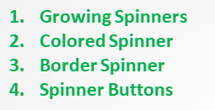

Types of Spinners
1. Growing Spinners
Growing Spinners​​ Use the .spinner-grow class if you want the spinner/loader to grow instead of "spin": Loading..
<div class="container">
<h2>Growing Spinners</h2>
<div class="spinner-grow text-muted">
<span class="sr-only">Loading</span>
</div>
Output
UI Web Development
Unit 5
Department of CSE

Slide 18
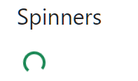
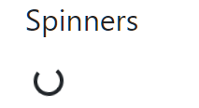
2. Colored Spinner
Use any text color utilites to add a color to the spinner:.
<div class="spinner-border text-success">
<span class="sr-only">Loading</span>
</div>
3. Border Spinner
Border Spinner is used for lightweight indicators.
<div class="container">
<h2>Spinners</h2>
<br>
<div class="spinner-border" role="status">
<span class="sr-only">Loading...</span>
</div>
</div>
Output
Output
UI Web Development
Unit 5
Department of CSE

Slide 19
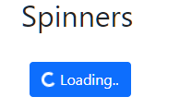
4. Spinner Buttons
The spinners within buttons are used to represent an action that is currently processing.
<button class="btn btn-primary">
<span class="spinner-border spinner-border-sm"></span>
Loading..
</button>
Note: sr-only means "this content is visible only to screen readers".
Output
UI Web Development
Unit 5
Department of CSE

Slide 20
Bootstrap Typography
Typography is a Bootstrap feature used to format and style text content. It can be used to add more design-focused font styles, align text, and customize headings, lists, paragraphs, and inline subheadings.
Headings, paragraphs, lists, and other inline elements can be created using Bootstrap's typography feature.
Headings
HTML headings are divided into <h1>to <h6>
By using Bootstrap typography, it is styled & formatted using respective classes as shown below:
UI Web Development
Unit 5
Department of CSE

Slide 21
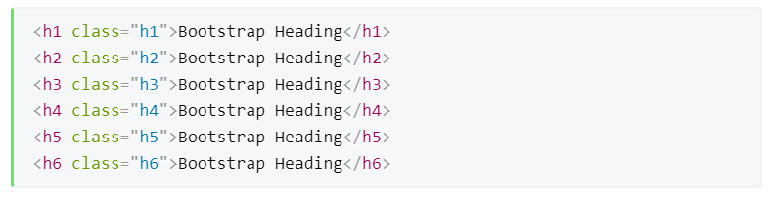
2. Responsive Headings
Responsive headings are one of the best things one can design using typography. The class “responsive” automatically adjusts the text in these elements according to the device size.
UI Web Development
Unit 5
Department of CSE

Slide 22
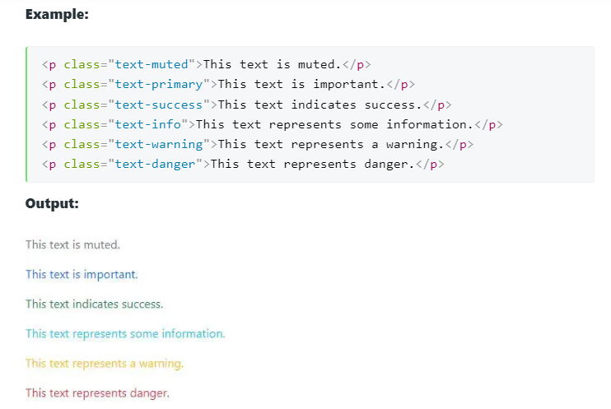
3. Contextual Colors
This is a different class used to convey meaning using different colors. It has different classes like
.text-muted,
.text-info,
.text-primary,
.text-success,
.text-warning,
.text-danger.
UI Web Development
Unit 5
Department of CSE

Slide 23
4. <abbr>
Developers use this tag to mark an abbreviation. Abbreviations have a default underline and gain a help cursor to provide additional context on hover and to users of assistive technologies
Example:
<p>There are so many countries in the world <abbr title="ind">India</abbr> is the best country</p>
5. <mark>
Developers use this tag to highlight text.
Example:
<h2>Bootstrap Typography</h2>
<p>This is used to <mark>highlight</mark> text.</p>
UI Web Development
Unit 5
Department of CSE

Slide 24
What is Pagination?
Paginations are built using HTML elements, and each page is hyperlinked to another page. For example, pagination can be used to navigate in between the search result pages
Let’s get started with paginations!
Bootstrap Pagination
First, add “.pagination” class to an unordered list
Next, add “.page-item” to each list item element and a “.page-link” class to every link inside the list item
UI Web Development
Unit 5
Department of CSE

Slide 25
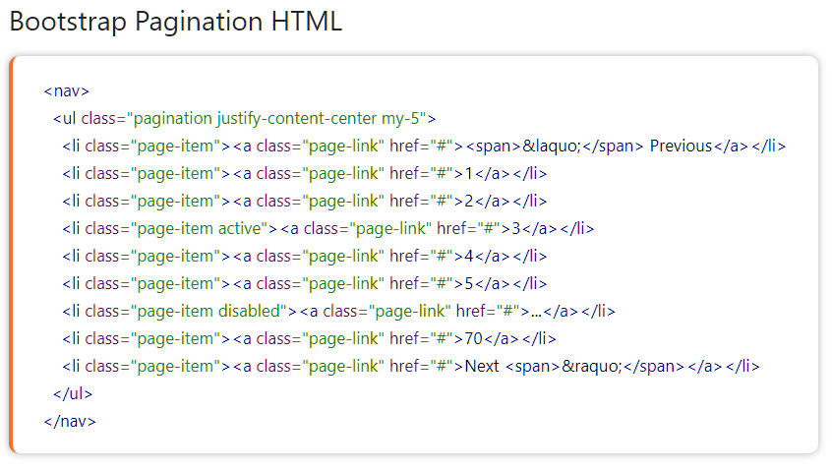
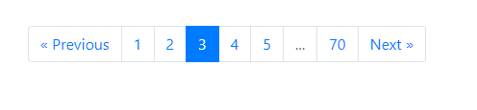
Output
UI Web Development
Unit 5
Department of CSE

Slide 26
Bootstrap Progress Bar
Bootstrap Progress Bars are used to show a user how far along he/she is in a process. To create a default progress bar, add a .progress class to a <div> element:
Example
<div class="container">
<h2>Basic Progress Bar</h2>
<div class="progress">
<div class="progress-bar" style="width: 60%">
60%
</div> Output
</div>
UI Web Development
Unit 5
Department of CSE

Slide 27
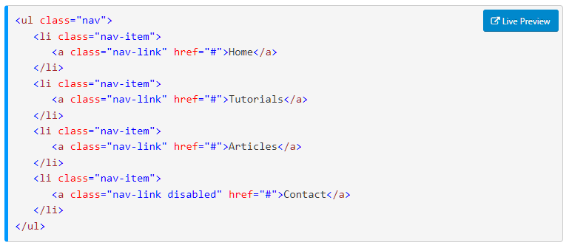

Bootstrap Basic Nav Menu
In bootstrap, we can create a basic navigation menu by adding the .nav class to <ul> element, .nav-item class to <li> element and .nav-link class to the menu items like as shown below.
Output
UI Web Development
Unit 5
Department of CSE

Slide 28
Alerts in Bootstrap
There are 8 different types of bootstrap alert. The following example will show you the most commonly used alerts, which are: success, error or danger, warning, and info alerts: The different types of alerts in Bootstrap are:
Primary alert
Secondary alert
Success alert
Danger alert
Warning alert
Info alert
Light alert
Dark alert
Bootstrap Alerts are used to provide an easy way to create predefined alert messages. A Bootstrap alert popup is a build-in component designed to provide feedback on typical users' actions.
The .alert class followed by contextual classes are used to display the alert message on website.
The alert classes are: .alert-success, .alert-info, .alert-warning, .alert-danger, .alert-primary, .alert-secondary, .alert-light and .alert-dark.
UI Web Development
Unit 5
Department of CSE

Slide 29
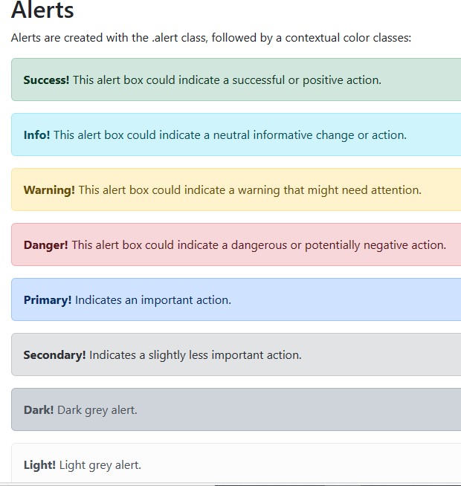

Example:
<!-- Success Alert -->
<div class="alert alert-success alert-dismissible fade show"> <strong>Success!</strong>
Your message has been sent successfully.
<button type="button" class="btn-close"
data-bs-dismiss="alert">
</button>
</div>
Bootstrap 5 - Alerts
Output
UI Web Development
Unit 5
Department of CSE

Slide 30
Bootstrap Carousel
Bootstrap Carousel is a JavaScript plugin that helps us create a slideshow or carousel of items, such as images or text. We can customize it with the provided styles and options.
The carousel can be controlled using navigation buttons and indicators.
UI Web Development
Unit 5
Department of CSE

Slide 31
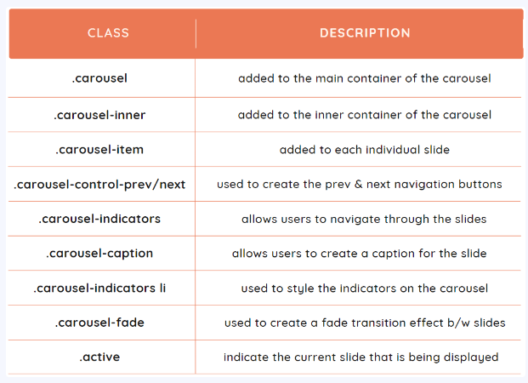
UI Web Development
Unit 5
Department of CSE

Slide 32
Example
<head><link rel="stylesheet" href="https://cdn.jsdelivr.net/npm/bootstrap@4.6.2/dist/css/bootstrap.min.css">
<script src="https://cdn.jsdelivr.net/npm/jquery@3.7.1/dist/jquery.slim.min.js"></script>
<script src="https://cdn.jsdelivr.net/npm/popper.js@1.16.1/dist/umd/popper.min.js">
</script>
<script src="https://cdn.jsdelivr.net/npm/bootstrap@4.6.2/dist/js/bootstrap.bundle.min.
js"></script>
<style>
/* Make the image fully responsive */
.carousel-inner img {
width: 100%;
height: 100%;
} </style></head>
Get these links from Bootstrap website
UI Web Development
Unit 5
Department of CSE

Slide 33
Example
<body><div id="demo" class="carousel slide" data-ride="carousel">
<!-- Indicators -->
<ul class="carousel-indicators">
<li data-target="#demo" data-slide-to="0" class="active"></li>
<li data-target="#demo" data-slide-to="1"></li>
<li data-target="#demo" data-slide-to="2"></li>
</ul>
<!-- The slideshow -->
<div class="carousel-inner">
<div class="carousel-item active">
<img src="la.jpg" alt="Los Angeles" width="1100" height="500">
</div>
<div class="carousel-item">
<img src="chicago.jpg" alt="Chicago" width="1100" height="500">
</div>
</div>
UI Web Development
Unit 5
Department of CSE

Slide 34
Example
<!-- Left and right controls -->
<a class="carousel-control-prev" href="#demo" data-slide="prev">
<span class="carousel-control-prev-icon"></span>
</a>
<a class="carousel-control-next" href="#demo" data-slide="next">
<span class="carousel-control-next-icon"></span>
</a>
</div>
<body>
UI Web Development
Unit 5
Department of CSE

Slide 35
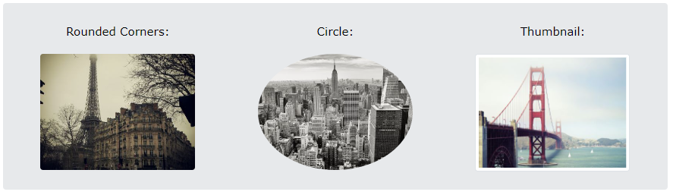
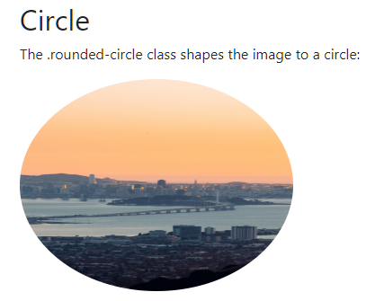
<div class="container mt-3">
<h2>Circle</h2>
<p>The .rounded-circle class shapes the image to a circle:</p>
<img src="image.jpg" class="rounded-circle" alt="Hills"
width="304" height="236">
</div>
Bootstrap Images
Bootstrap offers different classes for images to make their appearance better and also to make them responsive. Making an image responsive means that it should scale according to its parent element.
1. rounded
2. rounded-circle
3. img-thumbnail
Example
Output
UI Web Development
Unit 5
Department of CSE

Slide 36
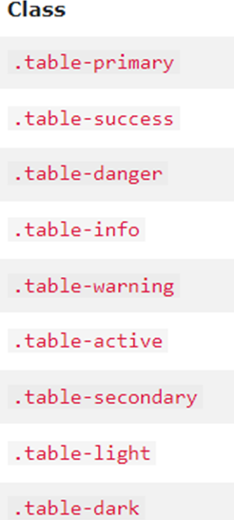
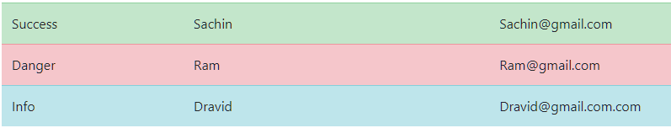
Bootstrap Tables
A basic Bootstrap 5 table has a light padding and horizontal dividers.
The .table class adds basic styling to a table
Tables –contextual classes
Example:
<tr class="table table-success">
<td>Success</td>
<td>Sachin</td>
<td>Sachin@gmail.com</td>
</tr>
Example:
<tr class="table table-danger">
<td>Success</td>
<td>Sachin</td>
<td>Sachin@gmail.com</td>
</tr>
Output
UI Web Development
Unit 5
Department of CSE

Slide 37
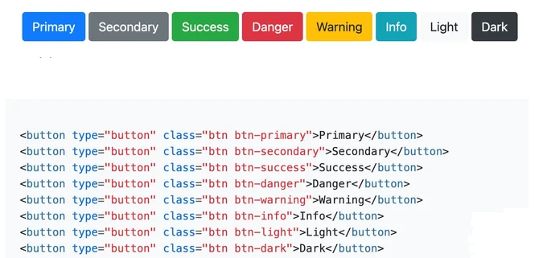

Bootstrap Buttons
The Bootstrap button class is .btn. Using this button class with a <button> element will create an unformatted button.
Example
<div class="container mt-3">
<h2>Background Color with Contrasting Text Color</h2>
<button type="button" class="btn btn-primary">Click me (primary)</button>
<div>
Output
Output
UI Web Development
Unit 5
Department of CSE

Slide 38
Bootstrap modals
The bootstrap modal plugin is a dialog box / popup window that is displayed on top of the current page
Example:
<body> <div class="container">
<h2>Modal Example</h2>
<!-- Trigger the modal with a button -->
<button type="button" class="btn btn-info btn-lg" data-toggle="modal" data-target="#myModal">Open Modal</button>
<!-- Modal -->
<div class="modal fade" id="myModal" role="dialog">
<div class="modal-dialog">
<!-- Modal content-->
<div class="modal-content">
<div class="modal-header">
<button type="button" class="close" data-dismiss="modal">&times;</button>
UI Web Development
Unit 5
Department of CSE

Slide 39
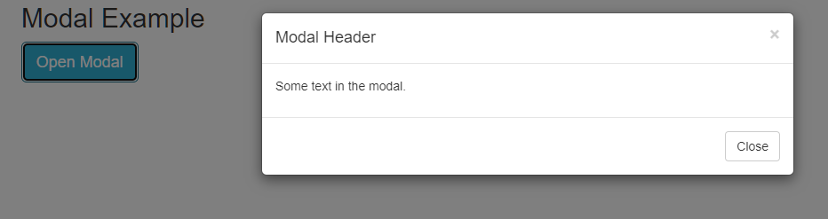
<h4 class="modal-title">Modal Header</h4>
</div>
<div class="modal-body">
<p>Some text in the modal.</p>
</div>
<div class="modal-footer">
<button type="button" class="btn btn-default" data-dismiss="modal">Close</button>
</div>
</div>
</div>
</div>
</div>
</body>
Output
UI Web Development
Unit 5
Department of CSE

Slide 40
Bootstrap Cards
A card in Bootstrap 5 is a bordered box with some padding around its content. It includes options for headers, footers, content, colors, etc.
The .card-header class adds a heading to the card and the .card-footer class adds a footer to the card
Add .card-img-top or .card-img-bottom to an <img> to place the image at the top or at the bottom inside the card.
Example
<body>
<div class="container mt-3">
<h2>Card Image</h2>
<div class="card" style="width:400px">
UI Web Development
Unit 5
Department of CSE

Slide 41
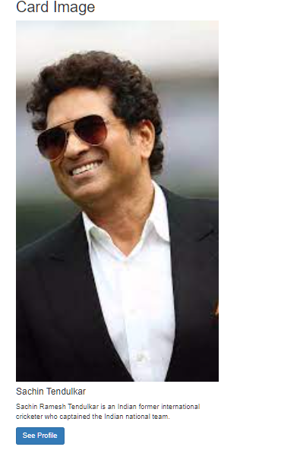
Output
<img class="card-img-top" src=“sachin.jpg" alt="Card image" style="width:100%">
<div class="card-body">
<h4 class="card-title">Sachin Tendulkar</h4>
<p class="card-text">Sachin Ramesh Tendulkar is
an Indian former international cricketer who
captained the Indian national team. </p>
<a href="#" class="btn btn-primary">See Profile</a>
</div>
</div>
</body>
UI Web Development
Unit 5
Department of CSE

Slide 42
Thank You
UI Web Development
Unit 5
Department of CSE

