Slide 1
Password Security

Slide 2

Password Security

Slide 3
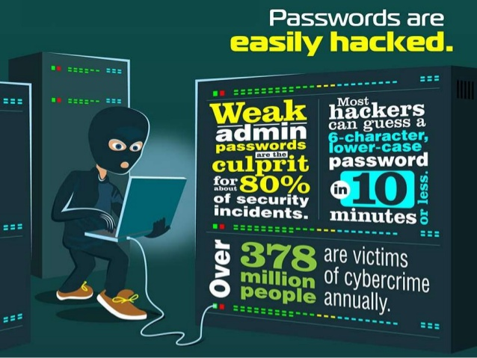
Password Security

Slide 4
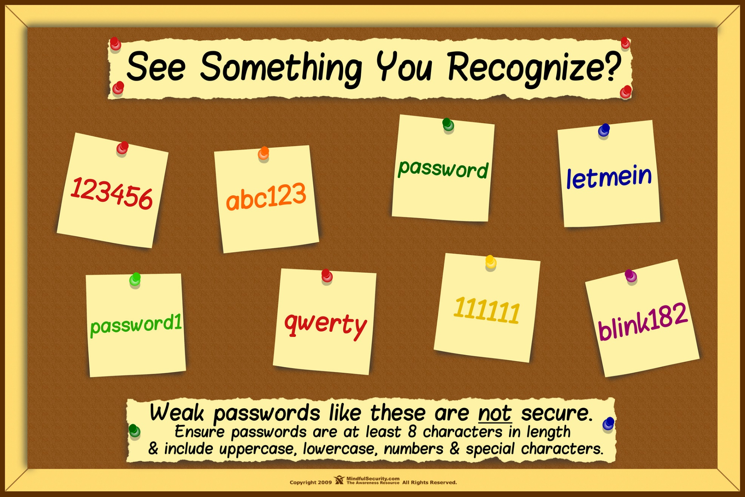
Password Security

Slide 5
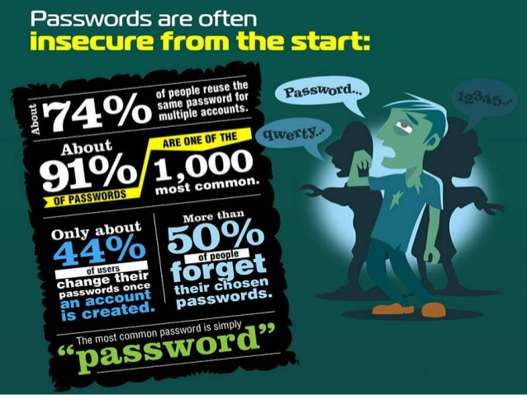
Password Security

Slide 6
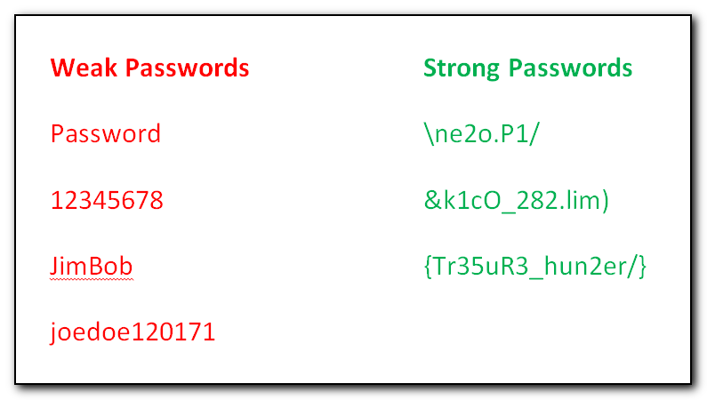
Password Security

Slide 7
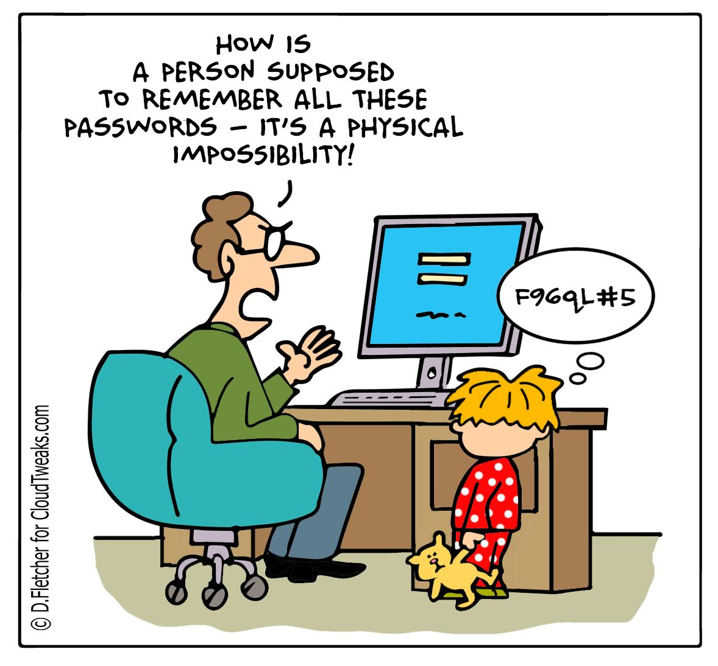
Password Security

Slide 8































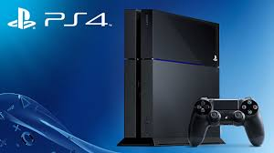
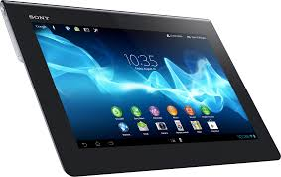








Password Security

Slide 9
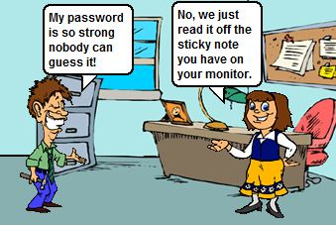
Password Security

Slide 10
Password Security
0704o$cysbtdelwspwhattlg19DB76

Slide 11
Password Security
XXXXXXXXXXXXXXXXXXXXXXXXXXX

Slide 12
Password Security
0704o$XXXXXXXXXXXXXXX19DB76

Slide 13
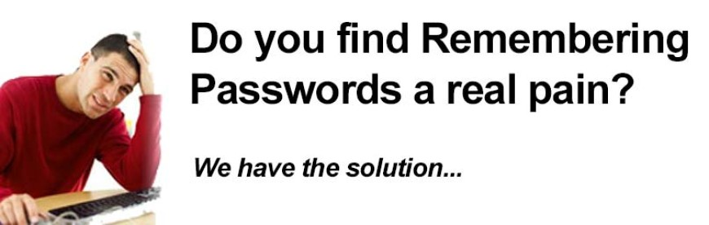
Password Security

Slide 14
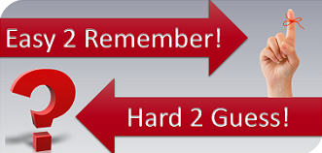
Password Security

Slide 15
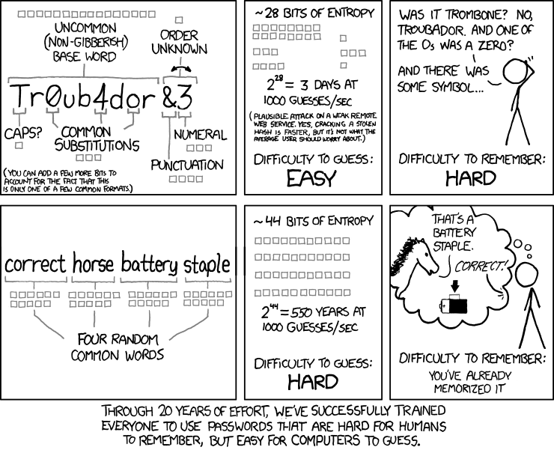
Password Security

Slide 16
Password Security

Slide 17
Password Security

Slide 18
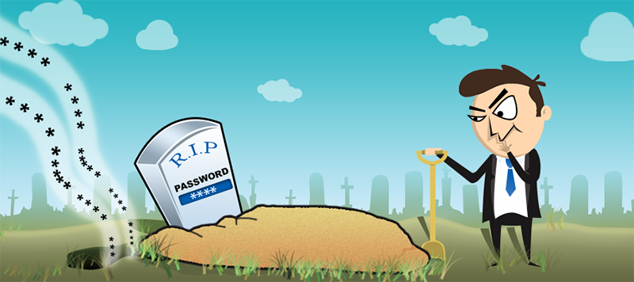
Password Security

Slide 19
Password Security
PASSPHRASE

Slide 20
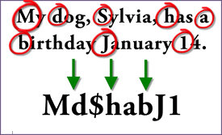
Password Security

Slide 21

Password Security
HOW SECURE IS MY PASSWORD?
https://howsecureismypassword.net

Slide 22

Password Security
Individualize

Slide 23
Password Security
Different Groups
Financial
Social Media
Entertainment
Education
Ect….

Slide 24
Password Security
0704o$XXXXXXXXXXXXXXX19DB76

Slide 25
Password Security
Oh, say can you see
by the dawn's early light
What so proudly we hailed
at the twilight's last gleaming
0704o$cysbtdelwspwhattlg19DB76

Slide 26
Password Security
THANK YOU

Slide 27
Password Security

