Slide 1
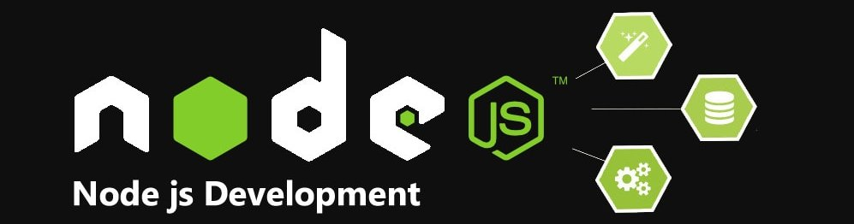


Slide 2


Slide 3


Slide 4
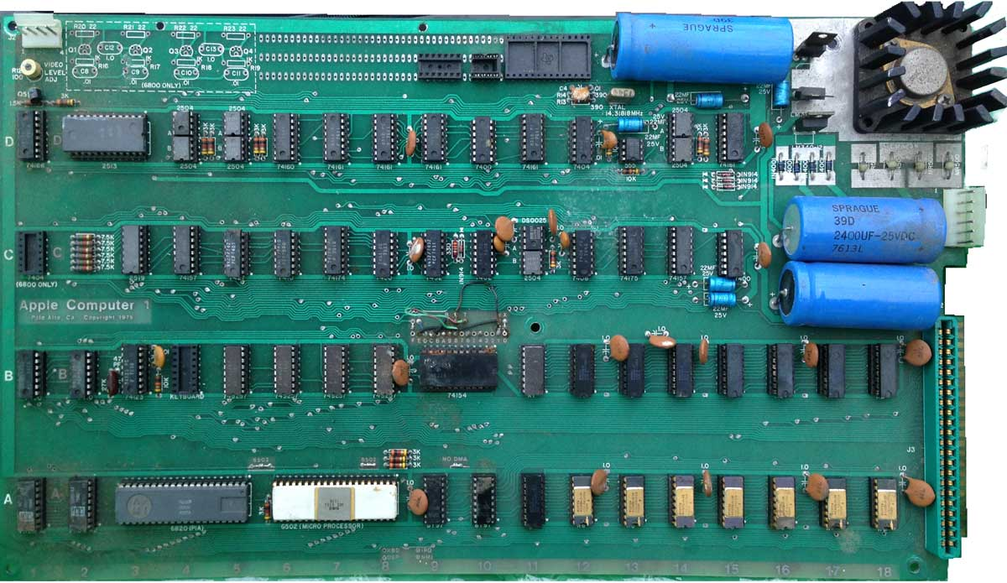

Slide 5
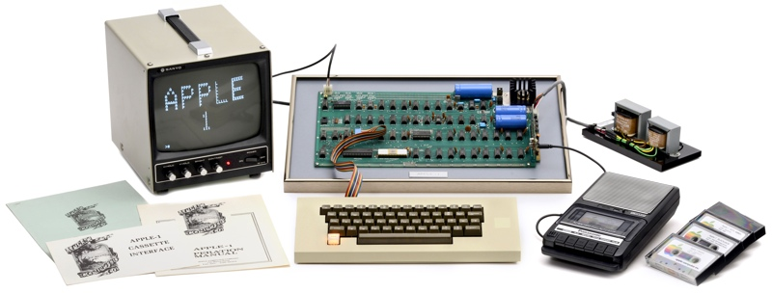

Slide 6

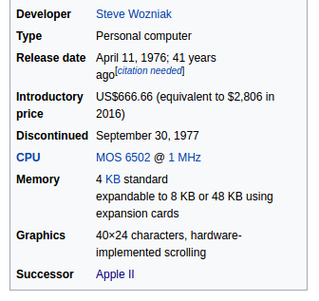

Slide 7
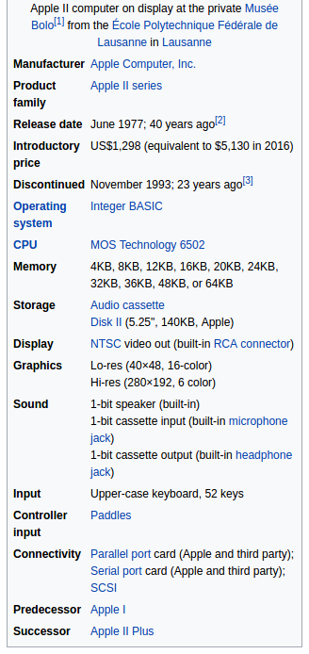

Slide 8

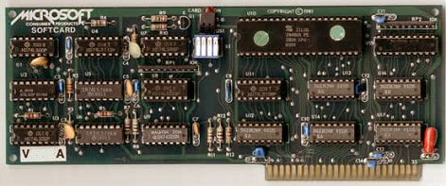

Slide 10
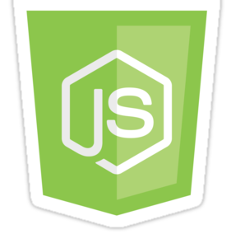

Slide 12

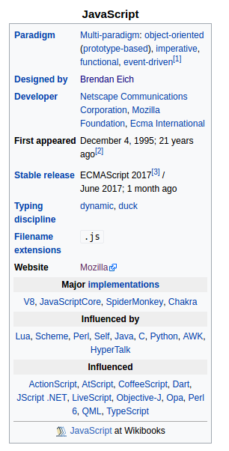


Slide 13
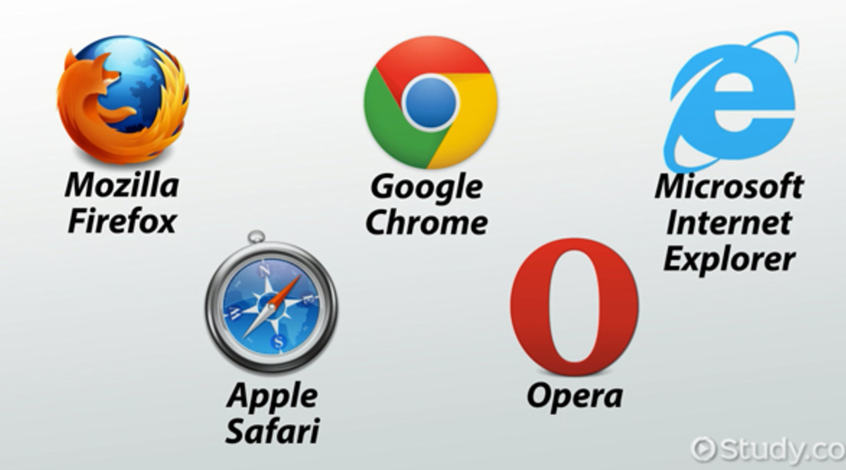

Slide 14
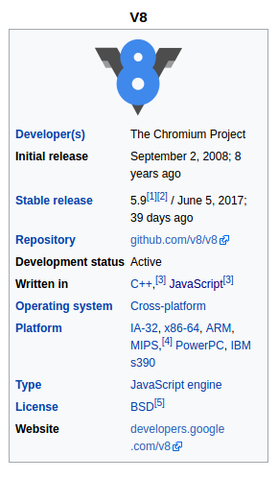

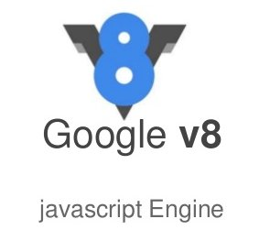

Slide 15
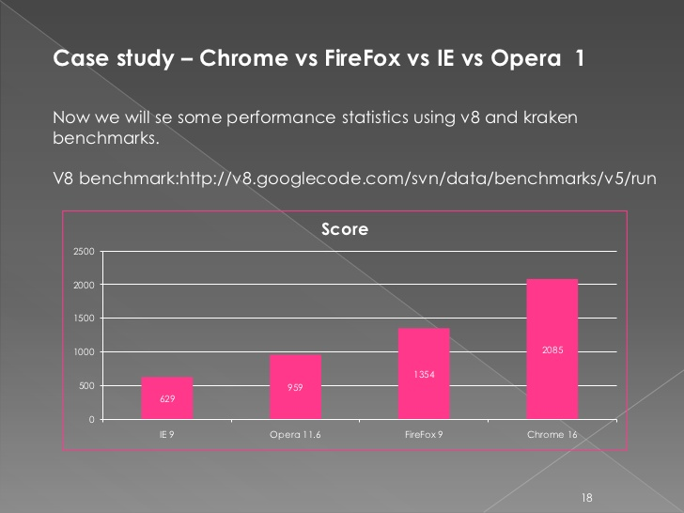

Slide 16
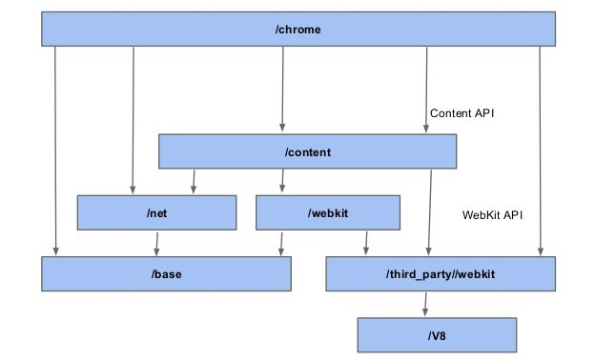

Slide 17
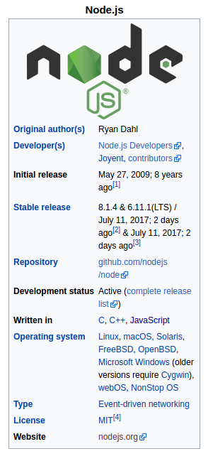


Slide 18


Slide 19


Slide 20


Slide 21


Slide 23
Node.js is a platform built on Chrome's JavaScript runtime for easily building fast and scalable network applications. Node.js uses an event-driven, non-blocking I/O model that makes it lightweight and efficient, perfect for data-intensive real-time applications that run across distributed devices.

Slide 24
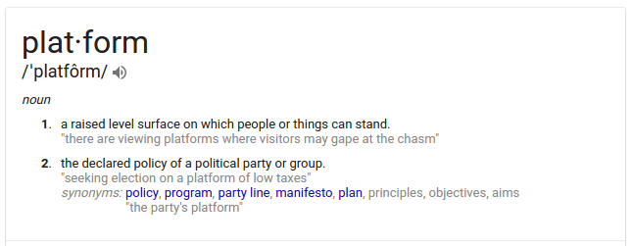

Slide 25










Slide 27


Slide 28


Slide 30
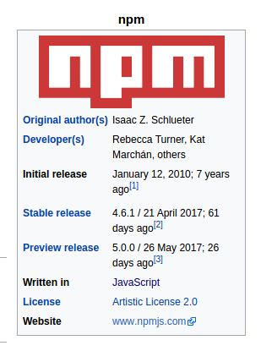


Slide 31

npm , short for Node Package Manager, is two things:
- first and foremost, it is an online repository for the publishing of open-source Node.js projects.
- second, it is a command-line utility for interacting with said repository that aids in package installation, version management, and dependency management

Slide 32


Slide 33

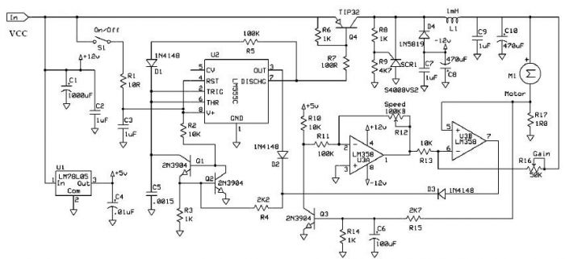

Slide 34



Slide 35



Slide 36
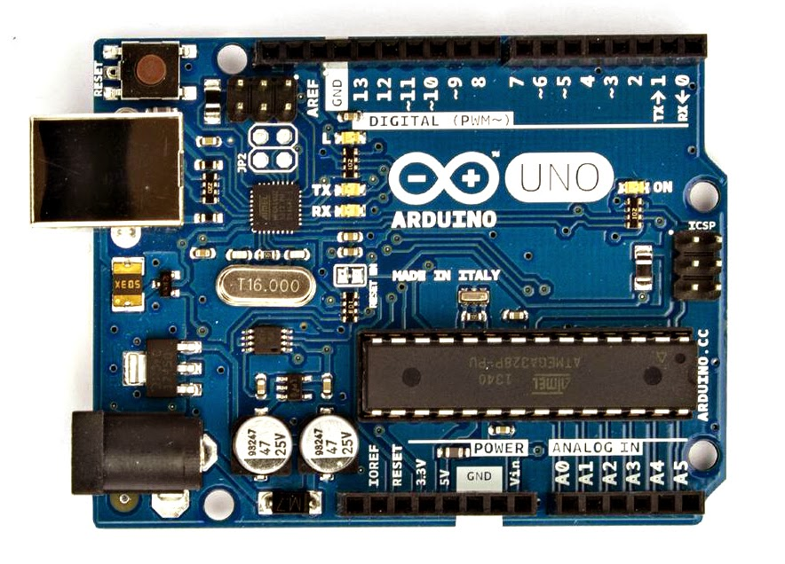

Slide 37


Slide 38
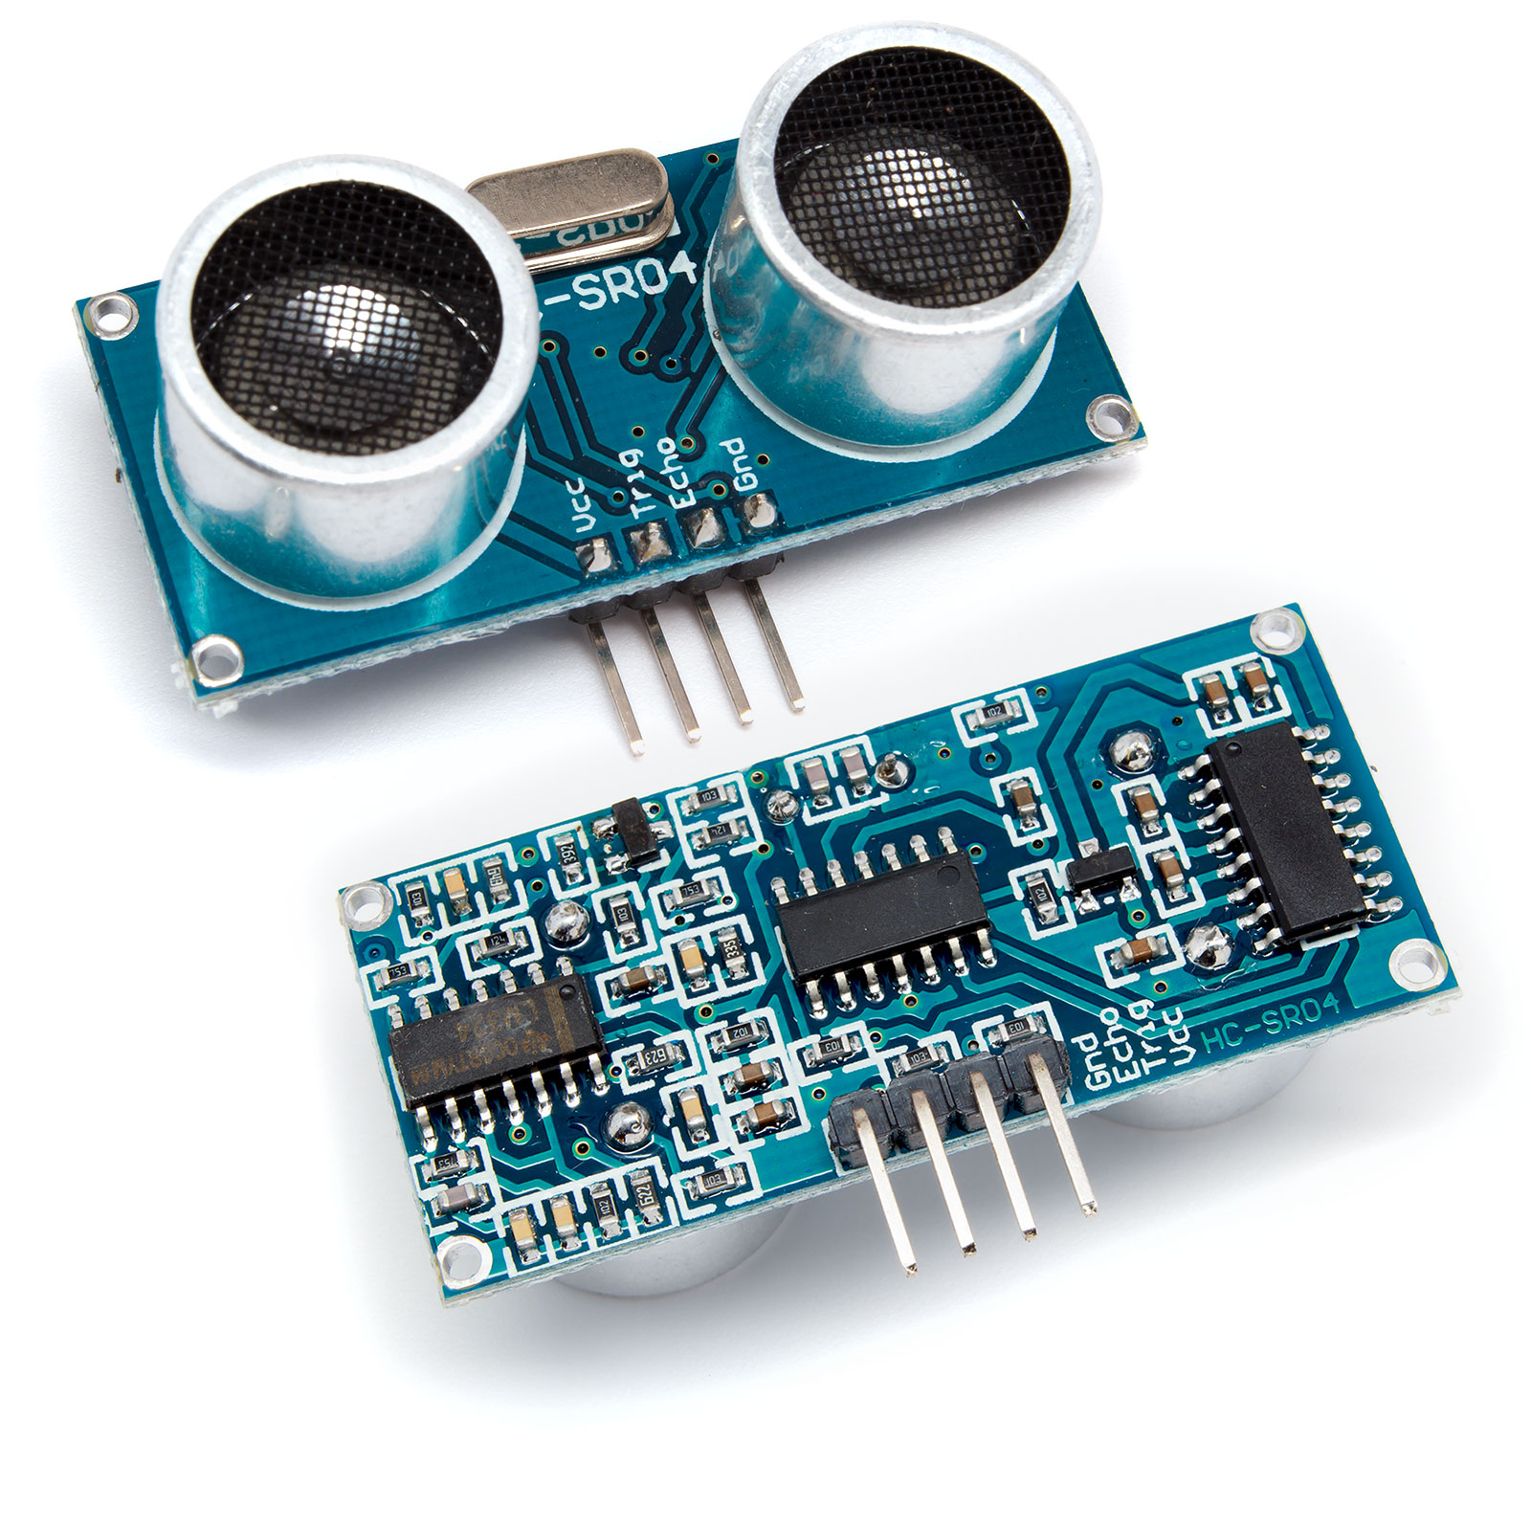


Slide 39
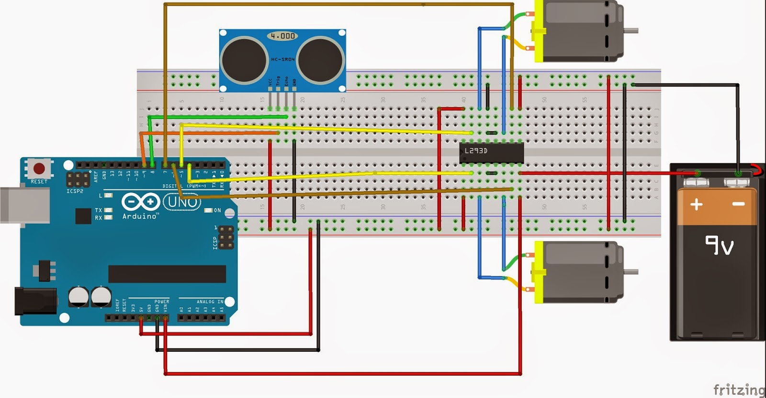

Slide 40
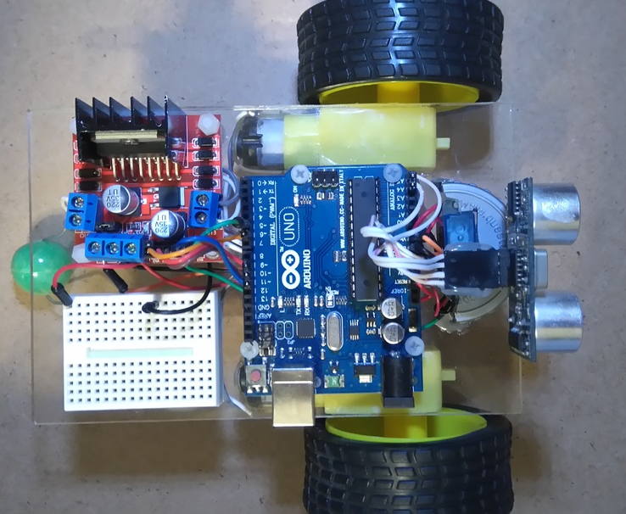

Slide 41
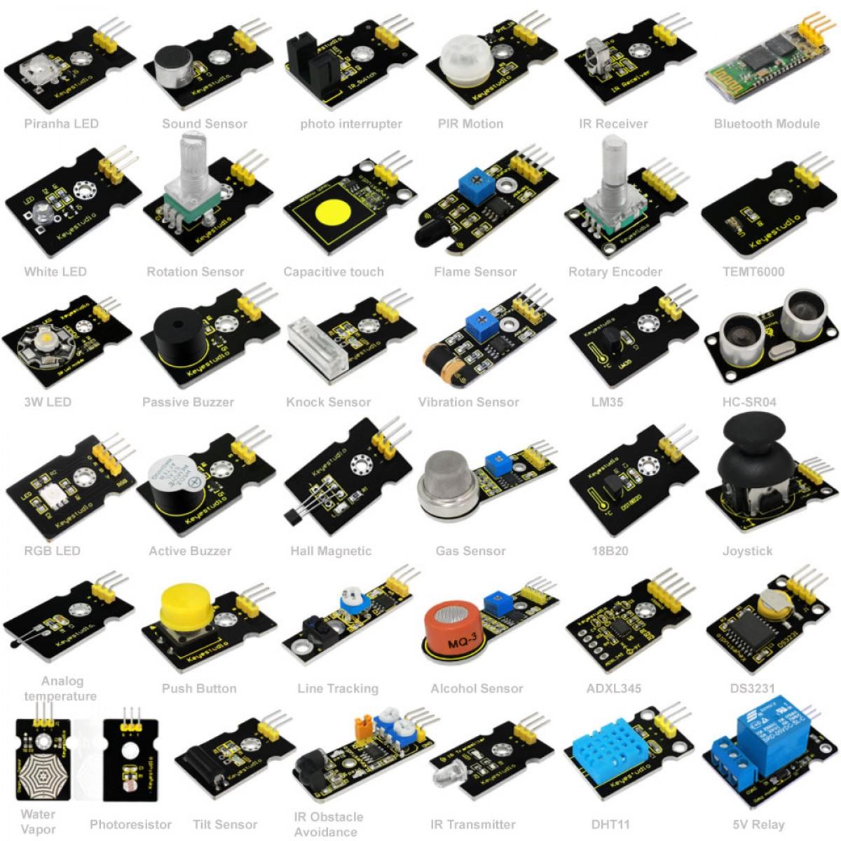

Slide 42
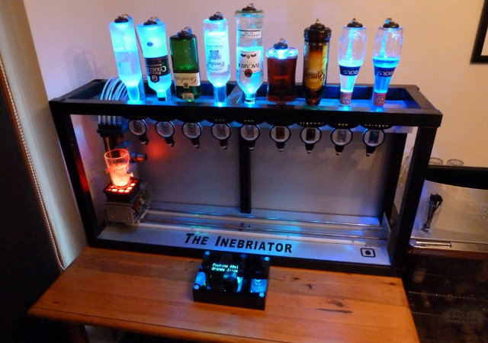



Slide 43
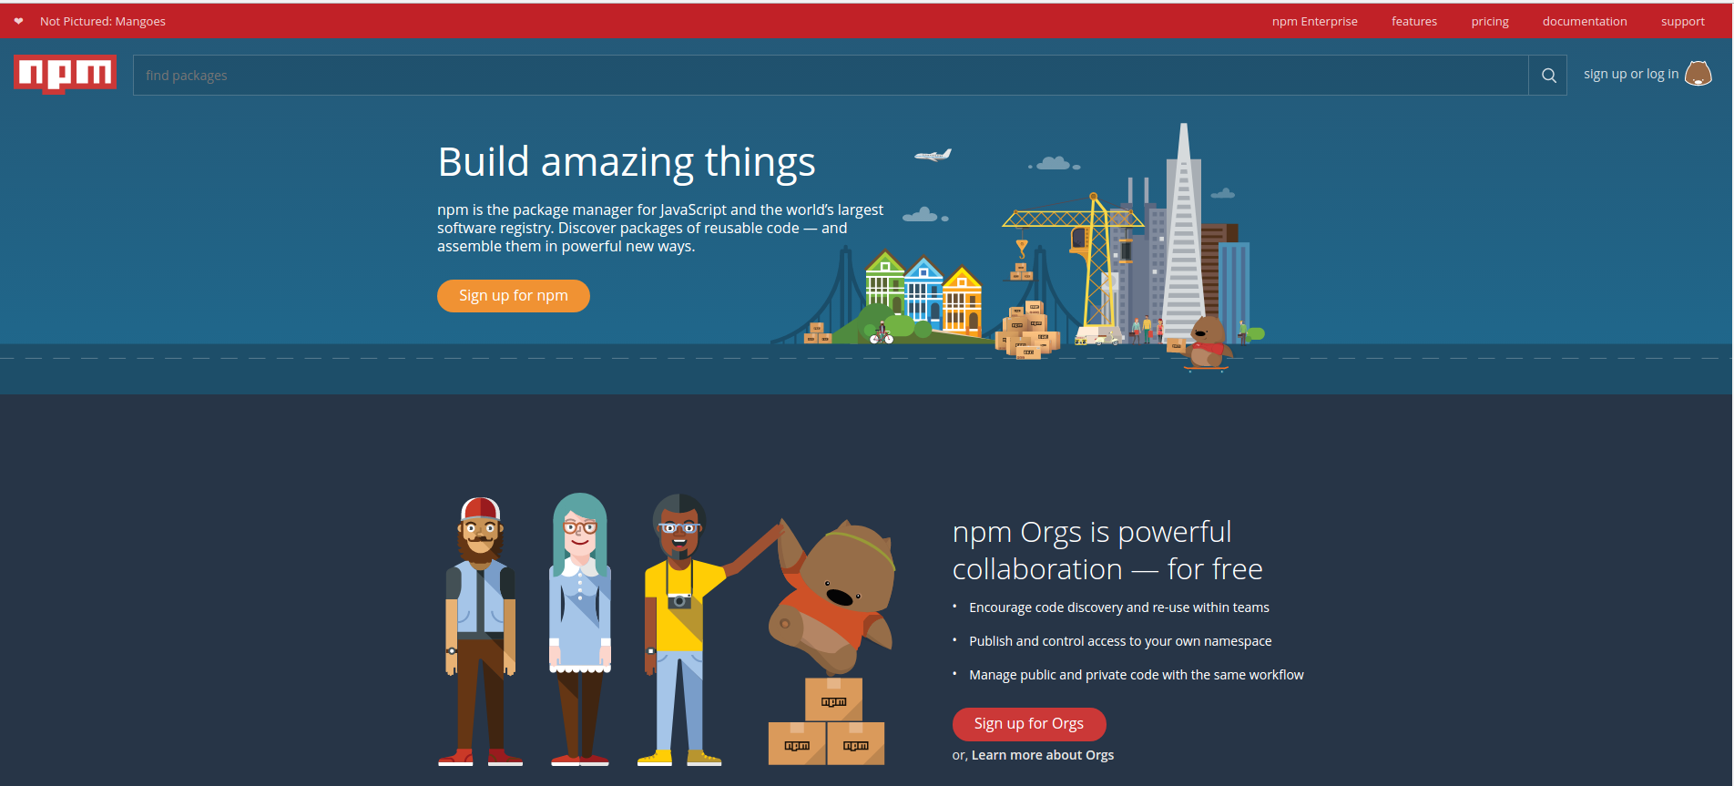

Slide 44



Slide 47
npm , short for Node Package Manager, is two things:
- first and foremost, it is an online repository for the publishing of open-source Node.js projects.
- second, it is a command-line utility for interacting with said repository that aids in package installation, version management, and dependency management

Slide 48
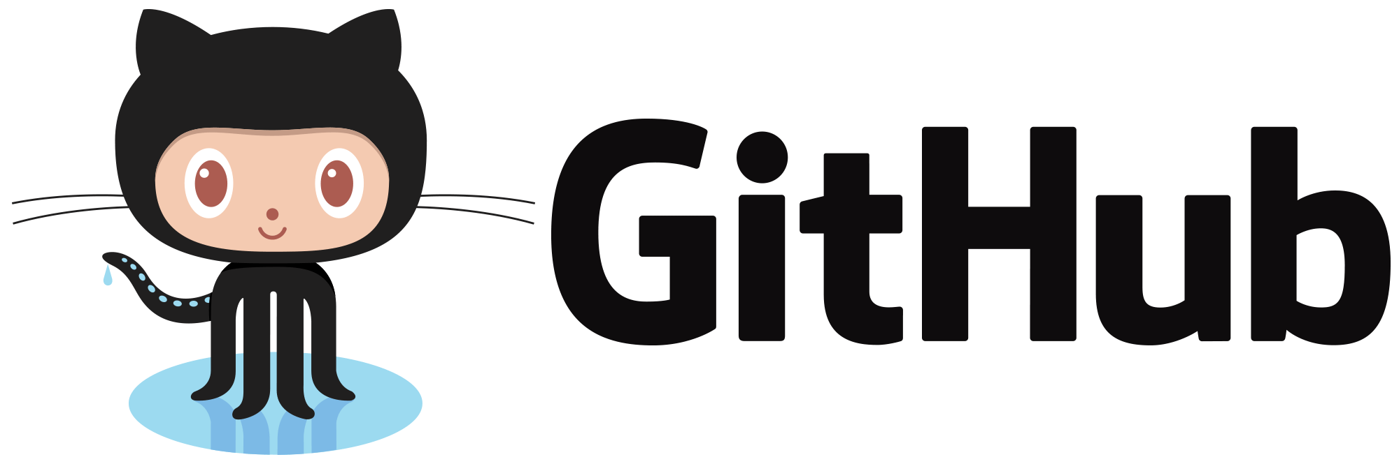
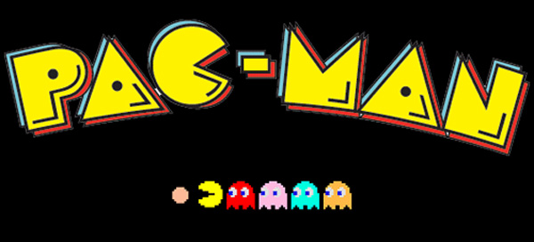


Slide 49
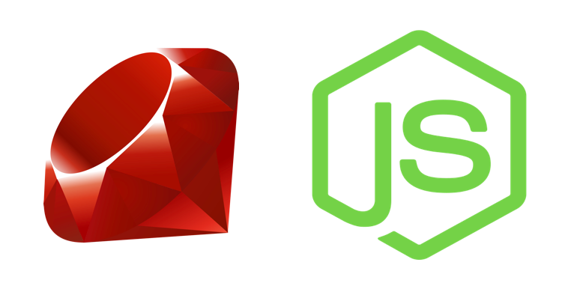

Slide 50
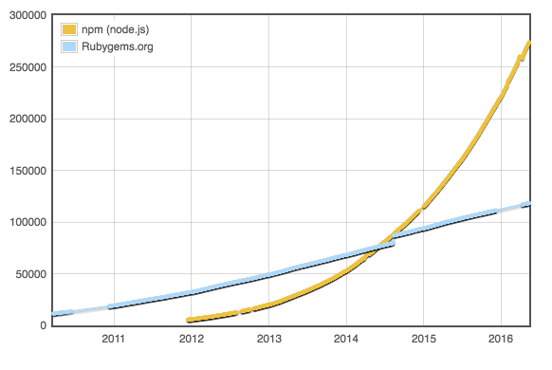

Slide 51
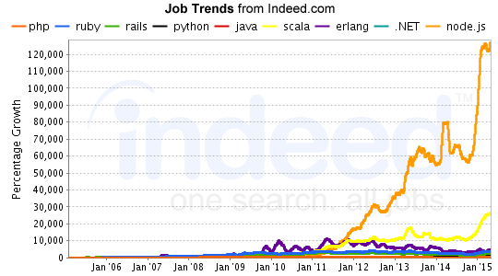

Slide 52

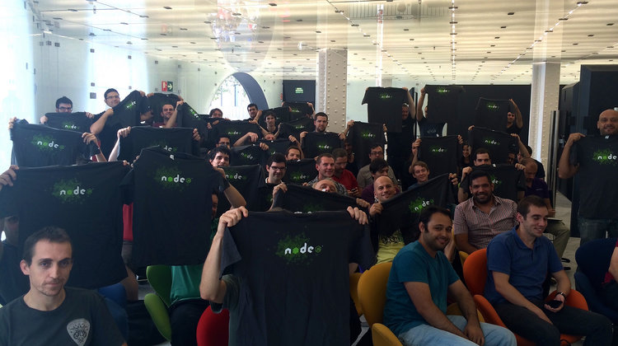

Slide 53










Slide 55


