Slide 1
Factors to Assets: Mapping Factor Exposures to Asset Allocations
Andrew Ang, PhD, Managing Director
Abhilash Babu, CFA, Vice President
Society of Quantitative Analysts October 20, 2016
FBSG-0356

Slide 2
BlackRock: Built for Factor Investing
Factor Investing is a strategic priority of the firm
“Advances in data science and analytics are highlighting the importance of factors, creating the potential for deeper understanding of these return drivers and their causes and effects”
- Larry Fink, Chairman’s Letter, April 10, 2016
BlackRock harnesses broad, persistent drivers of return through
Investment acumen
Integrated technology
Global reach
A robust range of products
BlackRock created the
FIRST FACTOR FUND
and has
40+ YEARS
of factor investing
experience
Source: BlackRock

Slide 3



Why factors now?
1
Investing is harder than ever
2
Diversification may fall short
3
Investment management can be expensive

Slide 4
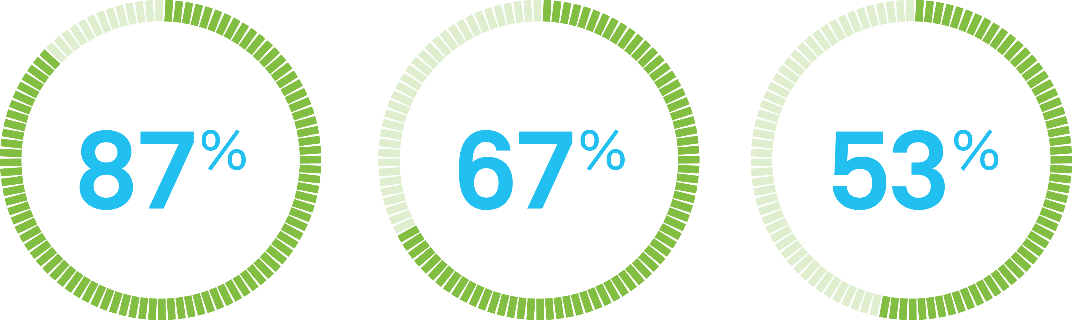
How widespread is factor adoption?
The Economist Intelligence Unit conducted a global survey of 200 executives from institutional investment firms to understand how they are utilizing factors and factor-based investing.
Overall investment process
Risk management & manager selection
Investment strategies
Strategic asset allocation at the enterprise level
Common language to evaluate managers’ aggregate exposures and return drivers
Deliberately target rewarded factors to seek to deliver returns and outcomes
This content is based on The Economist Intelligence Unit’s January 2016 global survey of 200 executives from institutional investment firms. The information contained herein is not a full representation of all survey results and more information can be obtained at https://www.blackrock.com/institutions/en-us/insights/investment-actions/the-rise-of-factor-investing.

Slide 5
Defining factors

Slide 6
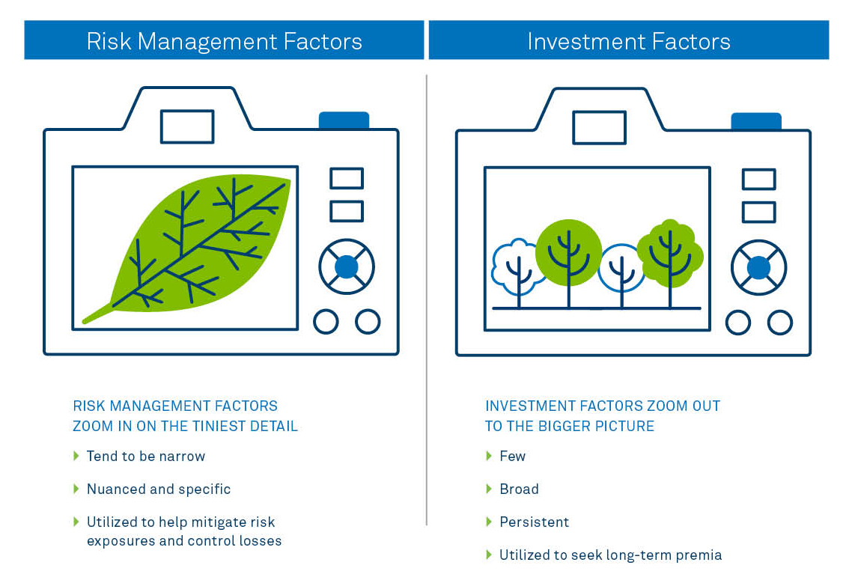
Risk factors vs investment factors

Slide 7


Factors explain returns both across and within asset classes
Macro factors determine levels
Style factors determine dispersion
Avg Value Stock
Value
Equity Market Level
Style Factors
Average Stock
Average Stock
Economic
Growth
Premium
Avg Growth Stock
Growth
Equity
Macro Factors
Value + Growth = Equity Market
Inflation
Premium
Interest Rate Prem
Risk Free Rate

Slide 8
Grouping asset classes based on fundamental macro factors
Common movements
Fundamental factors
Risky assets
Safe assets
Geo-political
Spreads
Other
Economic Growth
Inflation
+
Real Rates
Emerging Markets
Credit
Commodity
Notes:
Views can be expressed as factors, allowing investors to balance factors while allocating to traditional asset classes…

Slide 9
Defining investment factors Macro risk factors explained
These common economic factors are intuitive, applicable across all asset classes, and help explain the majority of asset class risk
Economic
Growth
Risk associated with global equity markets
Measured by broad-market equity index returns
Broad Risk Factor Exposures of Certain Asset Classes
Inflation
Risk of bearing exposure to changes in nominal prices
Measured by return of a long nominal bonds, short inflation-linked bonds portfolio
Examples:
Real Rates
Inflation- protected bonds
Real Rates
Risk of bearing exposure to real interest rate changes
Measured by inflation-linked bond returns
Real Rates
Inflation
Nominal bonds
Commodity
Risk associated with commodity markets
Measured by weighted GSCI Commodity index returns
Economic
Growth
FX
Emerging Markets
Global Equity
Credit
Real Rates
Inflation
Emerging Markets
Credit
Risk of default or spread widening
Measured by return of a long corporate bonds, short nominal bonds portfolio
USD-Denominated EM Debt
Real Rates
Inflation
Emerging Markets
Credit
FX
Global HY
Emerging Markets
Risk that emerging sovereign governments will change capital market rules
Measured by a portfolio of long EM equity and short DM equity, EM CDX and EM FX
Real Rates
Inflation
Emerging Markets
Economic
Growth
FX
Commodity
Global
Real Estate
FX
Risk associated with developed foreign currency exposure
Measured by a USD-denominated basket of EUR, JPY, GBP, CAD and AUD
Source: BlackRock, 10/18/2016

Slide 10
Factor, not asset, allocation

Slide 11
Factor, not just asset, allocation
Illiquid Alts
Liquid Active Funds
Style Factors
Index
Active
Smart Beta
Liquid
Illiquid
Transparent
Proprietary
Passive Funds
For illustrative purposes only. Sample allocation should not be construed as a recommended portfolio allocation.

Slide 12
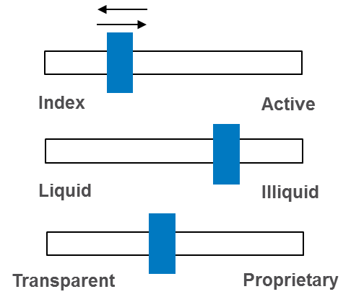
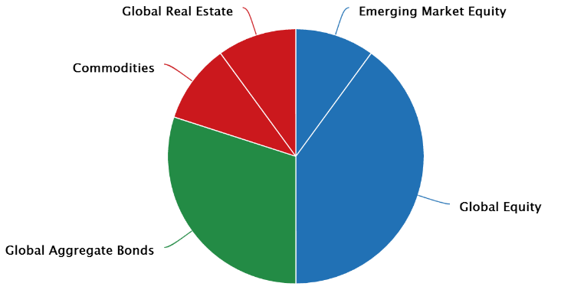
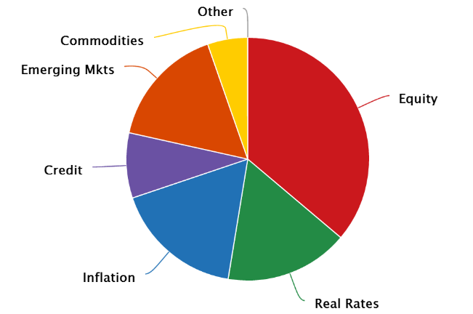
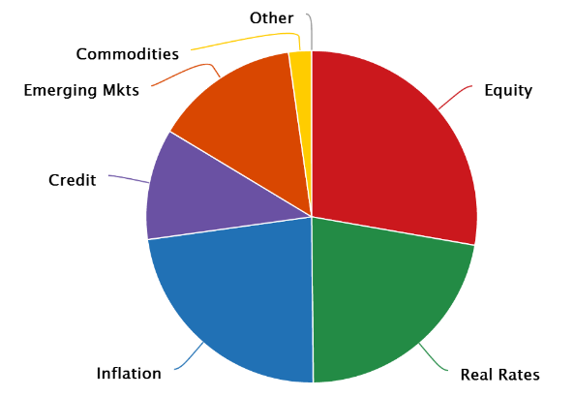
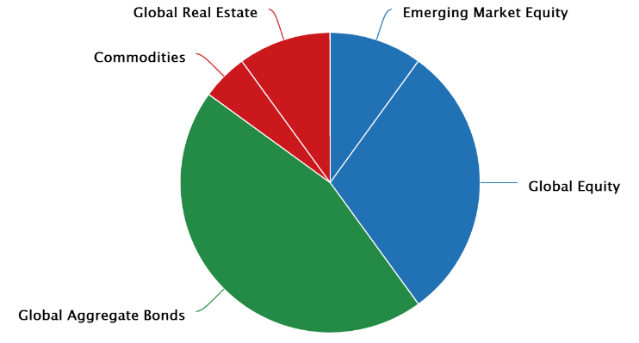
Factor allocation workflow
Analyze portfolios along factor dimensions, powering better investment decisions
What factors do you own?
What factors do you want?
How do you get there?
Current asset allocation
Allocate risk among factors based upon on specific investment objectives:
Return objectives
Risk tolerance
Liability profile
Income requirements
Current factor allocation
Desired factor allocation
Proposed capital allocation
For illustrative purposes only. Sample allocation should not be construed as a recommended portfolio allocation.
Notes:
Backup in case of issue with the demo

Slide 13
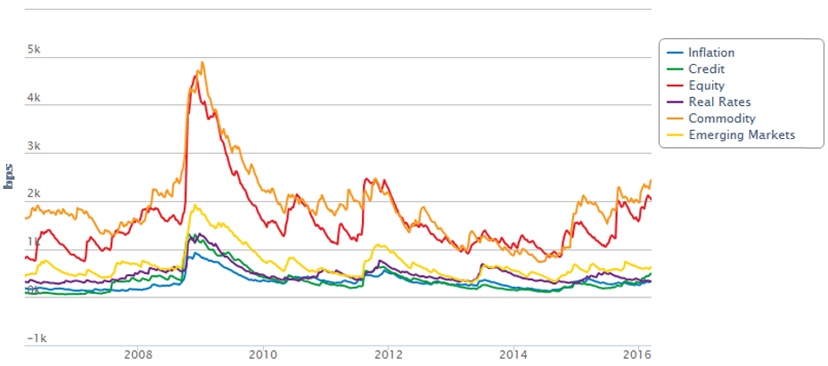
What factors do you want to own?
Understand factor behavior across various market environments and allocate factor risks
What factors do you want?
Allocate risk among factors based upon on specific investment objectives:
Return objectives
Risk tolerance
Liability profile
Income requirements
Desired factor allocation
Hypothetical Factor Volatilities, 2006 - 2016
For illustrative purposes only. Sample allocation should not be construed as a recommended portfolio allocation. Performance of desired factor allocation is hypothetical and is computed using Aladdin’s implied shocks stress testing framework. No representation is being made that any account, product or strategy will is likely to achieve results similar to those shown.Factor volatilities shown are realized volatilities of hypothetical factor returns.

Slide 14
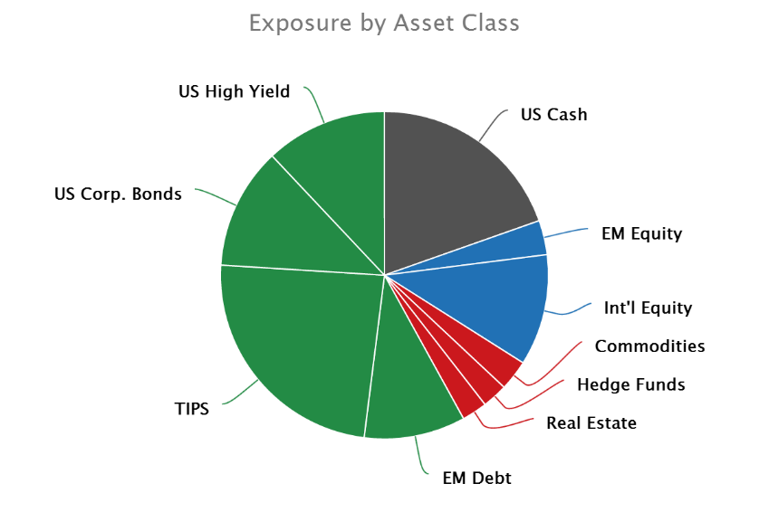
How do you get there?
Implement target factor allocations by allocating to assets
How do you get there?
Construct a robust asset allocation that expresses desired exposures
Seek to minimize tracking error and exposure mismatches from target factor allocation, subject to constraints:
Minimum trade size
No short sales
Expenses
Liquidity
Turnover
Active risk to secondary benchmarks
Investment universe is customizable and may contain liquid and illiquid asset classes
Proposed capital allocation
For illustrative purposes only. Sample allocation should not be construed as a recommended portfolio allocation.

Slide 15
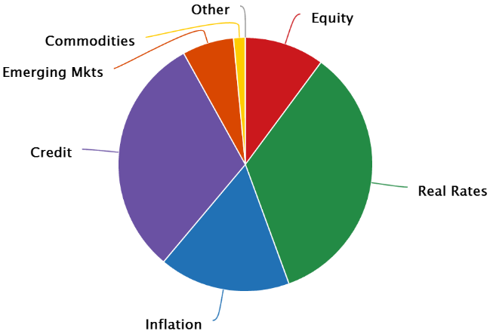
Examples
Translate factor allocations to asset allocations via optimization
Set Factor Allocation
Set Investment Universe
Compute Asset Allocation
Domestic Equity
Real Estate
Diversified Credit
Large Cap
Commodities
Farmland
Small Cap
Direct Lending
REITs
Event Driven
Risk Parity
Timber
Synthetic Overlay
TIPS
Smart Beta
Private Equity
Emerging Markets
Cash
ETFs
Real Return
Leveraged Loans
Core Fixed Income
Energy
Hedge Funds
Allocate risk among factors based upon on specific investment objectives:
Return objectives
Risk tolerance
Liability profile
Income requirements
Compute factor exposures of each asset
Seek to minimize tracking error and exposure misspecifications subject to illustrative constraints below:
Expense ratio: less than 0.40%
Minimum trade size: 2.5%
Illiquid allocation: less than 5%
No short-sales
For illustrative purposes only. Sample allocation should not be construed as a recommended portfolio allocation.
Notes:
Backup in case of issue with the demo

Slide 16
Assets to Factors

Slide 17
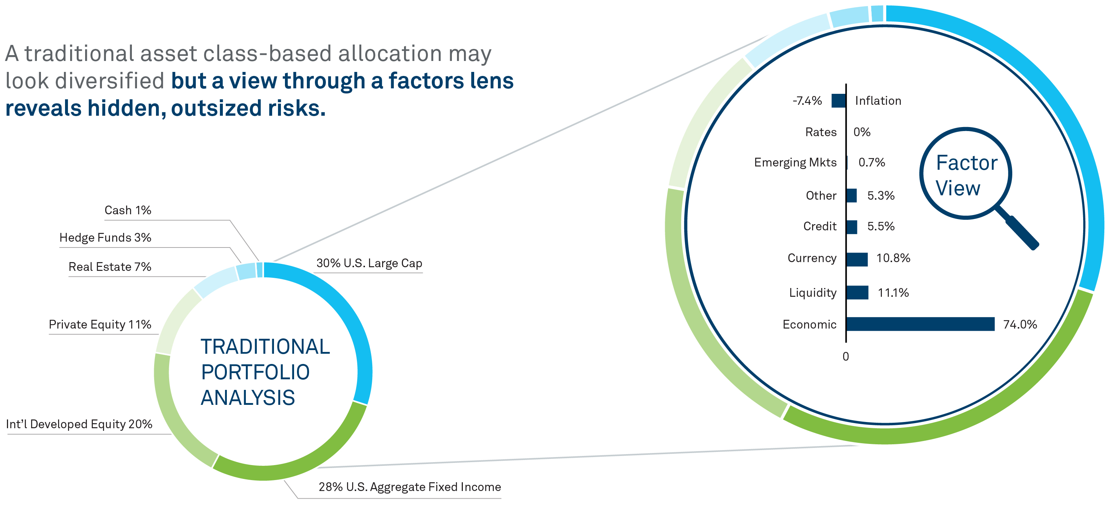
Traditional balanced portfolios may not be as balanced as you think
Contribution to risk by factor
Sample allocations are for illustrative purposes only and should not be construed as a recommended portfolio allocation.

Slide 18




Mapping Assets to Factors: What factors do you own?
Challenge:
Regressing exposures of mixed asset classes is liking throwing everything into a blender
Regressing every individual security in pension plan with benchmarks can be slow and prone to coverage gaps
Need “Rosetta Stone” to translate risk management factors into macro factors
Regress asset class returns (RACi) on macro factors (Fi)
Regress security returns (RSi) on macro factors (Fi)
$R_{ACi}=α_{1}F_{1}+α_{2}F_{2}$+…+$α_{6}F_{6}+ε$
$R_{Si}=α_{1}F_{1}+α_{2}F_{2}$+…+$α_{6}F_{6}+ε$
Too approximate – averages across asset class
Averages across time
Technically hard to achieve broad coverage
Averages across life of security
No data for IPOs and new issues
Aladdin already stores parametric description of all securities (risk management factors Ai):
✓
$R_{Si}=α_{1}A_{1}+α_{2}A_{2}$+………..+$α_{n}A_{n}+ε$
We can regress the risk management factors on the macro factors
$A_{i}={α′}_{1}F_{1}+{α′}_{2}F_{2}$+…+${α′}_{6}F_{6}+ε$
Current security attributes (key rate durations, equity fundamentals, etc.)
Broad coverage across millions of securities, funds, and whole investment plans
For illustrative purposes only.

Slide 19
Factors to Assets

Slide 20
Factors to Assets: An overspecified problem, but constraints narrow the feasible set
Desired Factor Exposures
Asset Classes
International Equity
Real Estate
Economic Growth
Mid Cap
Hedge Funds
Large Cap
Small Cap
Private Equity
Energy
Agriculture
Natural Gas
Credit
High Yield
Direct Lending
IG Bonds
Hedge Funds
EM Bonds
Private Debt
Leveraged Loans
ETFs
Commodity
Livestock
Energy
Agriculture
Natural Gas
Industrial Metals
Precious Metals
Timber
For illustrative purposes only.
Notes:
Views can be expressed as factors, allowing investors to balance factors while allocating to traditional asset classes…

Slide 21
Factors to Assets: Optimization Procedure
Problem:
Formally, we can define the objective of the Factors to Assets mapping as follows:
Given an investor-specified factor allocation (benchmark), we seek to determine a robust asset allocation that best matches this factor allocation, while respecting investor preferences (constraints).
Optimization Framework:
This corresponds to seeking to minimizing both active risk and squared exposure deviations with respect to a factor benchmark, while respecting the following constraints:
Fully Invested and Long-Only Constraints (unless solving for a completion portfolio)
Minimum trade sizes to eliminate extremely small holdings
Estimated expense ratios for each asset class
Asset class constraints
Liquidity tiers
Turnover (for completion portfolios)

Slide 22
Empirical Results: Investment Universe
We define our investment universe to consist of 15 asset classes
Public market assets are proxied to investable indices
Private assets are represented using model portfolios
Mapped to publicly traded asset classes after adjusting for characteristics specific to private asset classes (e.g., leverage, idiosyncratic risk, etc.)
To estimate macro factor exposures, we use a constrained, stepwise regression of asset returns onto macro factors
Constraints are informed by economic priors
E.g., government bonds are most affected by changes in inflation and real rates, and should not be exposed to other factors
Asset Class | Index Proxy
US Large Cap | S&P 500 Index
US Small Cap | Russell 2000 Index
Int'l Developed Equity | MSCI World Ex-US Index
EM Equity | MSCI Emerging Markets Index
Treasuries | Barclays Treasury Index
Credit | Barclays Credit Index
TIPS | Barclays TIPS Index
EM Fixed Income | JP Morgan EMBI Index
High Yield | Barclays High Yield Index
Commodities | S&P GSCI Commodity Index
Private Equity | Model Portfolio
Hedge Funds | Model Portfolio
Real Estate | Model Portfolio
Infrastructure | S&P Global Infrastructure Index
Cash | LIBOR 3 Month Index
Source: Greenberg, Babu, and Ang (2016), “Factors to Assets: Mapping Factor Exposures to Asset Allocations”, Journal of Portfolio Management.
Notes:
Backup in case of issue with the demo

Slide 23
Empirical Results: Target Factor Exposures
We target the factor exposures of a well-diversified portfolio*, denoted the factor benchmark
We make no claims that this set of exposures is optimal, but use this only as an example
The optimal choice of factor exposures varies with each investor
With more assets than factors, the problem is overspecified
Many distinct portfolios offer equivalent factor exposures
Constraints are pivotal in selecting the unique portfolio that closely matches factor benchmark exposures
Our objective function seeks to minimize active variance and exposure deviations versus the factor benchmark
This is equivalent to using a shrinkage estimator of the factor covariance matrix, which yields more robust portfolios with reduced turnover (see e.g., Ledoit and Wolf 2004)
We now show how to express these exposures using a series of approximately risk-equivalent portfolios, which are designed to satisfy different investability constraints
* This is a market-capitalization weighted average of 45 asset classes: https://www.blackrockblog.com/blackrock-capital-markets-assumptions/
Source: Greenberg, Babu, and Ang (2016), “Factors to Assets: Mapping Factor Exposures to Asset Allocations”, Journal of Portfolio Management. Factor benchmark exposures are hypothetical. No representation is being made that any account, product or strategy will is likely to achieve results similar to those shown.
Notes:
Backup in case of issue with the demo

Slide 24
Empirical Results: Unconstrained Optimization
An unconstrained optimization yields a hypothetical replicating portfolio that closely matches our target exposures, but there are some unintuitive aspects:
The replicating portfolio shows numerous small holdings, which are not economically meaningful
There are negative allocations to the Russell 2000 and Barclays U.S. High Yield indices, despite targeting net long factor exposures to Equity and Credit
Very small allocations to private assets may not be feasible due to fund investment requirements
Source: Greenberg, Babu, and Ang (2016), “Factors to Assets: Mapping Factor Exposures to Asset Allocations”, Journal of Portfolio Management. Replicating Portfolio Exposures and Replicating Portfolio Weights are hypothetical. No representation is being made that any account, product or strategy will is likely to achieve results similar to those shown.
Notes:
Backup in case of issue with the demo

Slide 26
Empirical Results: Low Expense Ratios
Many asset portfolios offer similar factor exposures, and constraints ultimately determine the optimal means of expressing a set of factor exposures – here, we target expense rather than liquidity
We impose the following constraints to construct a hypothetical portfolio with low expenses, and economically meaningful positions:
An upper bound of 0.20% on the portfolio’s expense ratio
A minimum trade size of 2.5%
Long-only constraints
The factor exposures are roughly identical to the previous portfolio
Allocations to assets with high expense ratios – such as alternatives – are limited
Holdings of asset classes with low expense ratios, such as the S&P 500 Index, are increased
Source: Greenberg, Babu, and Ang (2016), “Factors to Assets: Mapping Factor Exposures to Asset Allocations”, Journal of Portfolio Management. Replicating Portfolio Exposures and Replicating Portfolio Weights are hypothetical. No representation is being made that any account, product or strategy will is likely to achieve results similar to those shown.
Notes:
Backup in case of issue with the demo

Slide 27
Empirical Results: Completion Portfolios
An investor may already have an initial portfolio; in this case, they must construct a completion portfolio to change exposures
This requires minor changes to the optimization, including:
Constraining completion portfolio weights to sum to 0% (overlay portfolio)
We construct an overlay portfolio to change factor exposures of the Barclays Aggregate Bond Index (“Original Portfolio”) to those of the factor benchmark
The completion portfolio successfully changes the portfolio factor exposures to be in line with those of the factor benchmark’s
Source: Greenberg, Babu, and Ang (2016), “Factors to Assets: Mapping Factor Exposures to Asset Allocations”, Journal of Portfolio Management. Portfolio Exposures and Completion Portfolio Weights are hypothetical. No representation is being made that any account, product or strategy will is likely to achieve results similar to those shown.
Notes:
Backup in case of issue with the demo

Slide 28
Conclusion
We demonstrate a methodology for expressing a set of factor exposures as a combination of asset weights while reflecting real-world investor constraints.
Our procedure seeks to minimizes factor exposure deviations and active variance from the desired set of exposures, subject to investability constraints.
We employ shrinkage to help ensure that our optimized asset allocations are robust to small changes in target factor exposures
Constraints are crucial in selecting the unique asset class portfolio that best expresses factor exposures
With a mapping of factors to assets, investors can focus their allocation process on selecting which factor risks they are willing to bear in order to seek long-term risk premiums
Further areas of research include:
Determining an investor’s optimal set of macro factor exposures
Incorporating “alphas” – capital market constraints that are different from those employed by the factor representation
Notes:
Backup in case of issue with the demo

Slide 29
Appendix

Slide 30

Optimization Procedure
With N assets and K factors, the objective function can be stated as:
$argmin_{{ w}_{p}} (1−λ) {{(w}_{p}}^{T}A−{e_{b}}^{T}) {{{(w}_{p}}^{T}A−{e_{b}}^{T})}^{T}$ +$λ{{(w}_{p}}^{T}A−{e_{b}}^{T})∑{{{(w}_{p}}^{T}A−{e_{b}}^{T})}^{T}$ + $λ{w_{p}}^{T}Qw_{p}$
$$subject to the following constraints:$$
$${w_{p}}^{T}1 =1$$
$$w_{i}≥0 , i=1,…,N$$
$$w_{i}≥w_{min} if w_{i}≠0 , i=1,…,N$$
$$l_{j}≤ {w_{p}}^{T}π_{j}≤u_{j} ,j=1,…, M$$
Where we define the notations above as:
Source: Greenberg, Babu, and Ang (2016), “Factors to Assets: Mapping Factor Exposures to Asset Allocations”, Journal of Portfolio Management.
Notes:
Backup in case of issue with the demo

Slide 31
Portfolio Risk and Tracking Errors of Hypothetical Replicating Portfolios
Below are summary statistics for the four previous optimizations
All calculations are done using the Aladdin risk model with an as-of date of October 2015, and use 72 months of constant-weighted history
Imposing constraints yields higher tracking errors from the factor benchmark.
Nevertheless, in all scenarios, the majority of risk is contributed by macro factors
Example | Hypothetical Replicating Portfolio Risk (Benchmark Risk: 6.50%) | Tracking Error | Macro Factor Risk Contribution | Residual Risk Contribution
Unconstrained Optimization | 6.52% | 0.89% | 6.20% | 0.32%
Only Liquid Asset Classes | 6.52% | 0.93% | 6.31% | 0.21%
Lower Expense Ratio | 6.40% | 0.96% | 6.18% | 0.22%
Completion Portfolio | 6.53% | 1.00% | 6.30% | 0.23%
Source: Greenberg, Babu, and Ang (2016), “Factors to Assets: Mapping Factor Exposures to Asset Allocations”, Journal of Portfolio Management. The examples provided above are hypothetical. No representation is being made that any account, product or strategy will is likely to achieve results similar to those shown.
Notes:
Backup in case of issue with the demo

Slide 32
Important notes
THE INFORMATION CONTAINED HEREIN MAY BE PROPRIETARY IN NATURE AND HAS BEEN PROVIDED TO YOU ON A CONFIDENTIAL BASIS, AND MAY NOT BE REPRODUCED, COPIED OR DISTRIBUTED WITHOUT THE PRIOR CONSENT OF BLACKROCK, INC. (“BLACKROCK”). These materials are not an advertisement and are not intended for public use or dissemination.
This communication is not an offer and should not be deemed to be a contractual commitment or undertaking between the intended recipient of this communication and BlackRock but an indication of what services may be offered subject to a legally binding contract between the parties and therefore no reliance should be placed on this document or its content. Opinions, estimates and recommendations offered constitute our judgment and are subject to change without notice, as are statements of financial market trends, which are based on current market conditions. We believe the information provided here is reliable, but do not warrant its accuracy or completeness. This communication and its content represent confidential information. This material has been prepared for informational purposes only, and is not intended to provide, and should not be relied on for, accounting, legal or tax advice. You should consult your tax or legal advisor regarding such matters.
Performance and Fees
Past performance is not a guarantee or a reliable indicator of future results. Certain performance figures do not reflect the deduction of investment management fees, but they do reflect commissions, other expenses (except custody), and reinvestment of earnings. Such fees that a client may incur in the management of their investment advisory account may reduce the client's return. For example, assuming an annual gross return of 8% and an annual management/advisory fee of .40%, the net annualized total return of the portfolio would be 7.58% over a 5-year period. The “net of fees' performance figures reflect the deduction of actual investment advisory fees but do not reflect the deduction of custodial fees. All periods longer than one year are annualized.
Back-tested Index Data
Index returns are for illustrative purposes only and do not represent any actual fund performance. Index performance returns do not reflect any management fees, transaction costs or expenses. Indexes are unmanaged and one cannot invest directly in an index. Past performance does not guarantee future results.
Data for time periods prior to the index inception date is hypothetical and is provided for informational purposes only to indicate historical performance had the index been available over the relevant time period. Hypothetical data results are based on criteria applied retroactively with the benefit of hindsight and knowledge of factors that may have positively affected its performance, and cannot account for risk factors that may affect the actual fund performance. The actual performance of the strategy or fund may vary significantly from the hypothetical index performance due to transaction costs, liquidity or other market factors. Index methodology available upon request.
Indexes
It is not possible to invest directly in an index.
Forecast
This material is not intended to be relied upon as a forecast, research or investment advice, and is not a recommendation, offer or solicitation to buy or sell any securities or to adopt any investment strategy. The opinions may change as subsequent conditions vary. The information and opinions contained in this material are derived from proprietary and nonproprietary sources deemed by BlackRock to be reliable, are not necessarily all inclusive and are not guaranteed as to accuracy. There is no guarantee that any forecasts made will come to pass.
FBSG-0241

Slide 33
Important notes
Forward Looking Information
This material may contain “forward-looking” information that is not purely historical in nature. Such information may include, among other things, projections, forecasts, estimates of yields or returns, and proposed or expected portfolio composition. Moreover, where certain historical performance information of other investment vehicles or composite accounts managed by BlackRock, Inc. and/or its subsidiaries (together, “BlackRock”) has been included in this material and such performance information is presented by way of example only. No representation is made that the performance presented will be achieved, or that every assumption made in achieving, calculating or presenting either the forward-looking information or the historical performance information herein has been considered or stated in preparing this material. Any changes to assumptions that may have been made in preparing this material could have a material impact on the investment returns that are presented herein by way of example.
No Recommendation
These materials are neither an offer to sell nor a solicitation of any offer to buy shares in any fund. You may not rely upon these materials in evaluating the merits of investing in any fund that employs any of the strategies referred to herein. Any reference herein to any security and/or a particular issuer shall not constitute a recommendation to buy or sell, offer to buy, offer to sell, or a solicitation of an offer to buy or sell any such securities issued by such issuer.
Risk
Investing in the bond market is subject to certain risks including market, interest-rate, issuer, credit, and inflation risk. Mortgage and asset-backed securities may be sensitive to changes in interest rates, subject to early repayment risk, and while generally backed by a government, government-agency or private guarantor there is no assurance that the guarantor will meet its obligations. High-yield, lower-rated, securities involve greater risk than higher-rated securities; portfolios that invest in them may be subject to greater levels of credit and liquidity risk than portfolios that do not. Investors will, at times, incur a tax liability. Income from municipal bonds may be subject to state and local taxes and at times the alternative minimum tax. Derivatives may involve certain costs and risks such as liquidity, interest rate, market, credit, management and the risk that a position could not be closed when most advantageous. Investing in derivatives could lose more than the amount invested.
BlackRock makes no representations or warranties as to the accuracy or completeness of the information contained herein, and further nothing contained herein shall be relied upon as a promise by, or representation by, BlackRock whether as to past or future performance results. Past performance is not indicative or predictive of future performance.
Additional information is available on request. Information contained herein is believed to be reliable but BlackRock does not warrant its accuracy or completeness. Information contained herein represents BlackRock’s own opinions. There can be no assurance that the investment objectives of any strategy referred to herein will be achieved. An investment in any strategy referred to herein involves a high degree of risk, including the risk that the entire amount invested may be lost.
Strategy availability may be limited to certain investment vehicles; not all investment vehicles may be available to all investors. Please contact your BlackRock representative for more information.
THIS MATERIAL IS HIGHLY CONFIDENTIAL AND IS NOT TO BE REPRODUCED OR DISTRIBUTED TO PERSONS OTHER THAN THE RECIPIENT.
© 2016 BlackRock, Inc. All rights reserved. ALADDIN, BLACKROCK, BLACKROCK SOLUTIONS, and iSHARES are registered trademarks of BlackRock, Inc. or its subsidiaries in the United States and elsewhere.
FBSG-0241

