Slide 1
P.M presentation
FPPT.com

Slide 2
Executive Summary:
It is an administrative system that will help you in registering and following up on all of the
1-Student Affairs
2-Personnel affairs
3- School control
4- Student accounts and public school accounts

Slide 3
Executive Summary:
-A application that is a powerful interface for the school and a means of communication between the school administration, teachers, students and parents.
-A mobile application that enables the guardian to follow up on all the details of the student.

Slide 4
Purposes of the Project:
-You can record the attendance and departure of staff, student absence, follow-up to the school gate, delivery of textbooks, bus management, settings for creating and printing the class schedule, and many other administrative details.
-You can record the attendance and departure of staff, student absence, follow-up to the school gate, delivery of textbooks, bus management, settings for creating and printing the class schedule, and many other administrative details.

Slide 5
Purposes of the Project:
Follow up on everything related to the reception department and the school's security department.
Manage student accounts in an easy and more controlled way.
Saving wasted time and effort during school control work.
Organizing the administrative structure of the staff in the school and organizing the departments and sections of the Personnel Administration.-School library management

Slide 6
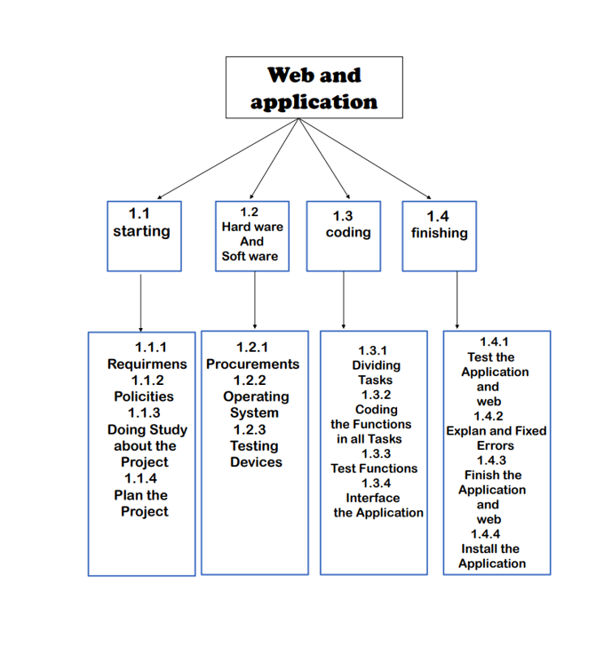
Work break structure

Slide 7
Work break structure
In the beginning, we set the plan and we saw the requirements that the project
needed and what conditions for it to be accepted

Slide 8
Work break structure
In the second and third step, we sea if the project work
and completed
In the last step, the project was tested and made sure
that it worked

