Slide 1
Python & snowflake data engineering challenge
AI-Driven Data Pipeline Implementation
Eesa Hassan
11/06/2025

Slide 2
Agenda
• Challenge Overview
• Task-by-Task Breakdown
• Learnings & Reflections
• AI Usage Summary
• Business Use Case
• Final Thoughts

Slide 3
Challenge Summary
Purpose of the Challenge
Wrong Title?
My Strategic Approach
Notes:
Explain what the challenge is about and how you planned to tackle it.

Slide 4
Wrong title?
I noticed that the title of the challenge document refers to an ‘AI Churn Model Challenge’, while the file name is ‘python-snowflake-data-engineering-challenge-v0.1.pdf’ and the main body focuses on a data quality pipeline.
My first thought were that you wanted me to create a churn prediction model without explicitly telling me. However, after considering that this is a data engineering apprenticeship and uploading the data set, task objectives/overview, and expected completion time to ChatGPT, the most possible reason for this is to test my attention to detail.
ChatGPT problem diagnoses:
This dataset only contains car listings, not user behavior over time, so you’d need to join this data with user interaction logs to train a true churn model.

Slide 5
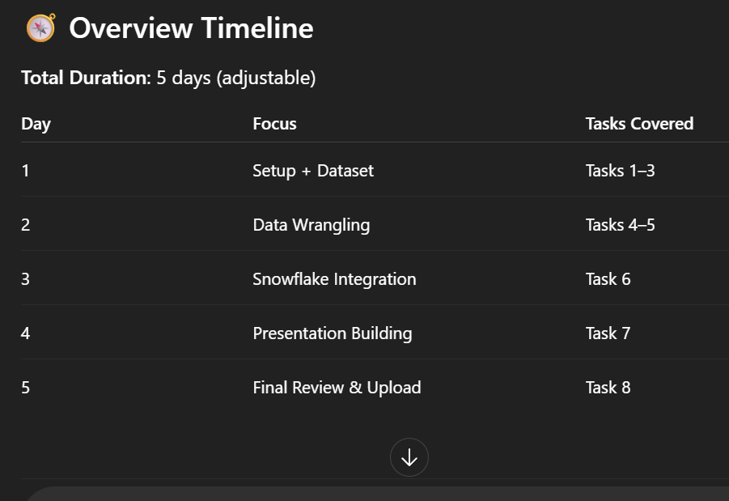
Creating Timeline
I uploaded the challenge PDF to ChatGPT and ran this prompt; “make me a detailed timeline/plan for this task”
This was my base guidance for the challenge
(I’ve only attached a screenshot of the timeline overview)

Slide 6
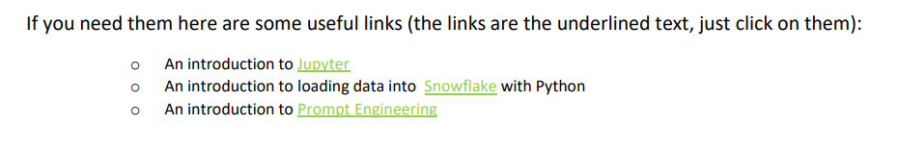
Read-up
I always like to have a basic understanding of what tools I’m working with and how they work before I utilise them which is why I have made it a habit to do research on anything prior to usage, be it tech related or not.
I used the recommended links in the pdf as well as ChatGPT to explain the core concepts.

Slide 7
Creating basic pptx template
I created a basic PowerPoint template using GAI to start.
The idea was to document as I progress and polish at the end.
I find this method is much more efficient and less mistake prone.

Slide 8
Task 1: Anaconda & Jupyter Setup
Read through tutorial
Screenshot of Anaconda and Jupyter installed
Miniconda install
Proof of Pandas library check

Slide 9
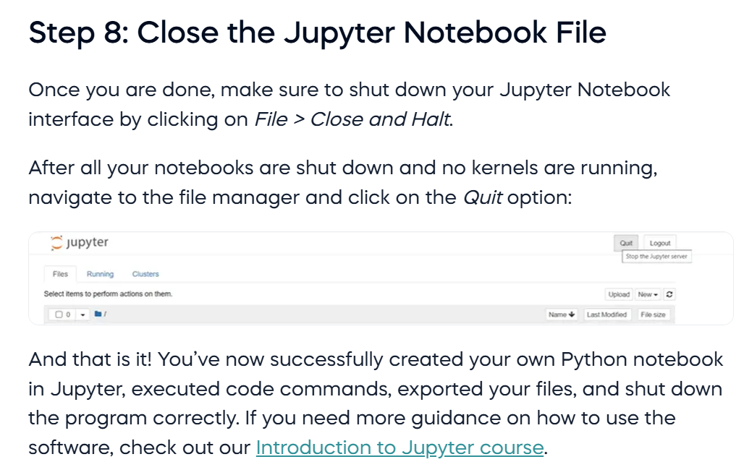
completing Jupyter Tutorial

Slide 10
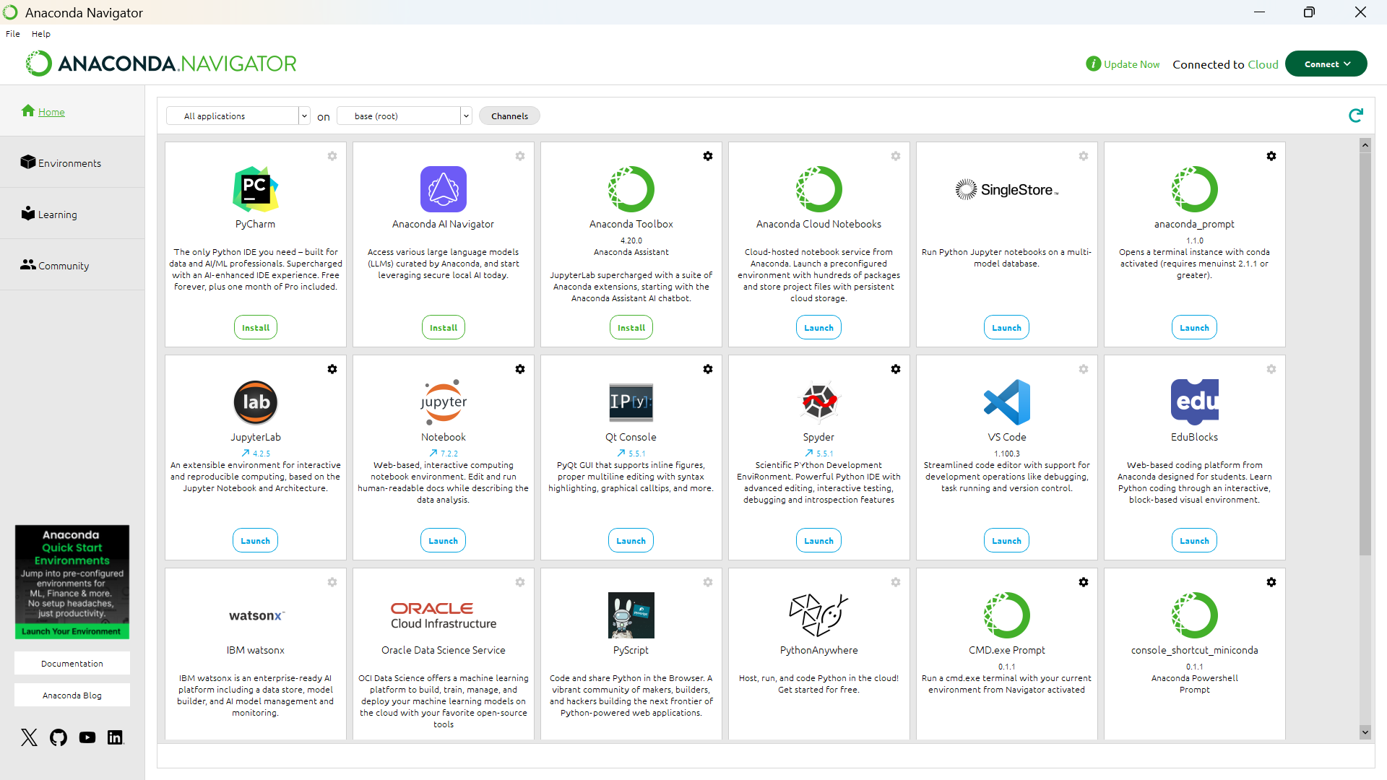
Anaconda with jupyter installed (windows)

Slide 11
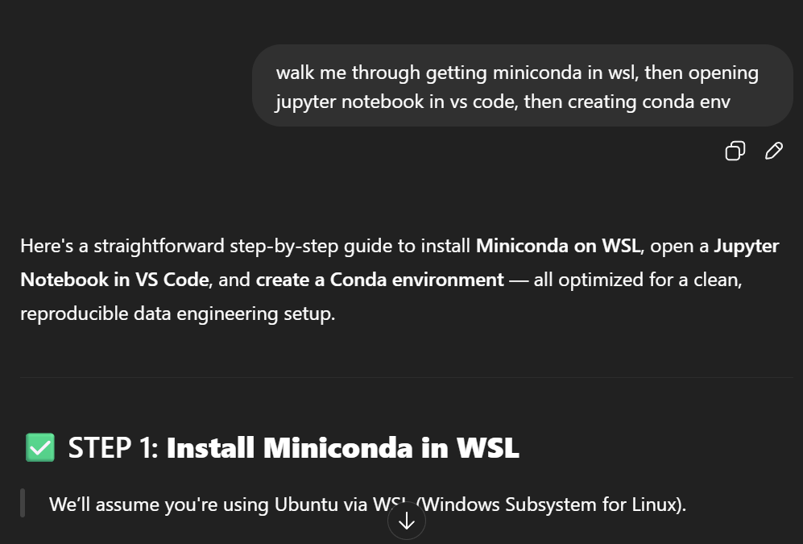
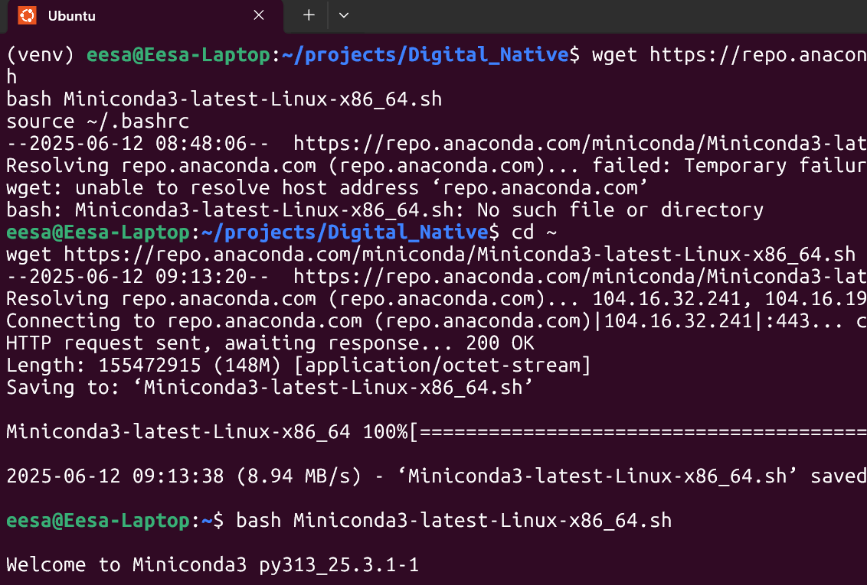
Miniconda install (WSL)
Notice I used a chain of commands in my prompt, it’s actually a very useful technique called ‘chain of thought’
I learnt it from the ‘introduction to prompt engineering’ article I read earlier
See task 7 ‘Problems and Fixes’ for why I installed miniconda in WSL

Slide 12
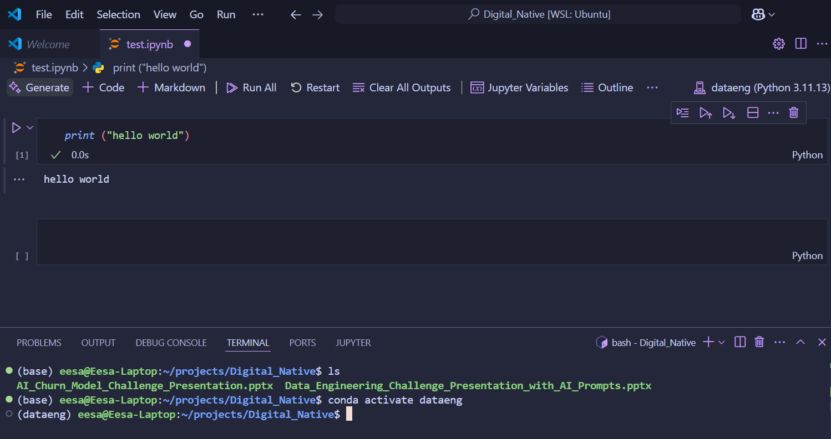
Opening jupyter notebook in Vs code

Slide 13
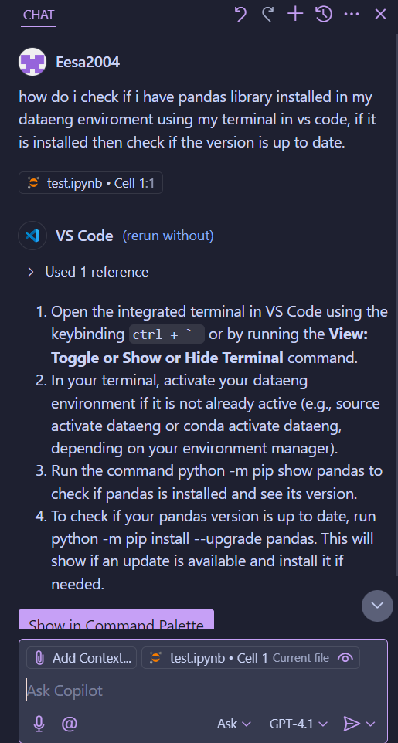
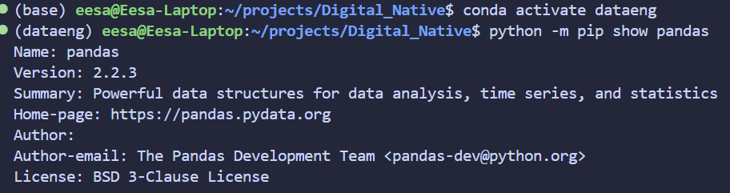
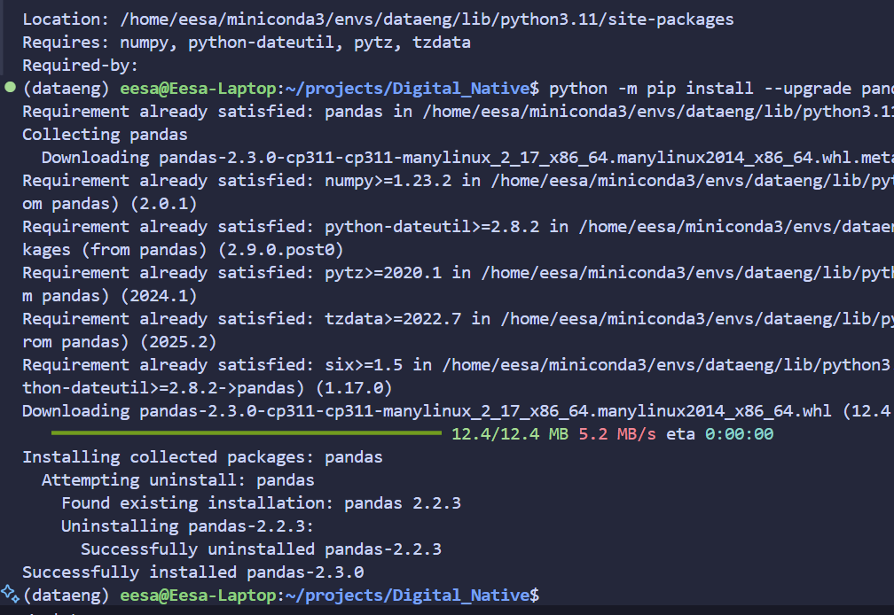
Pandas library check
(Asking Copilot)

Slide 14
Task 2: Data Importing/Downloading
Dataset Source
Stretch: Import directly into Jupyter
Downloaded files
Reflection: Importance of clean data
Notes:
Highlight if you used any automation like `opendatasets`.

Slide 15
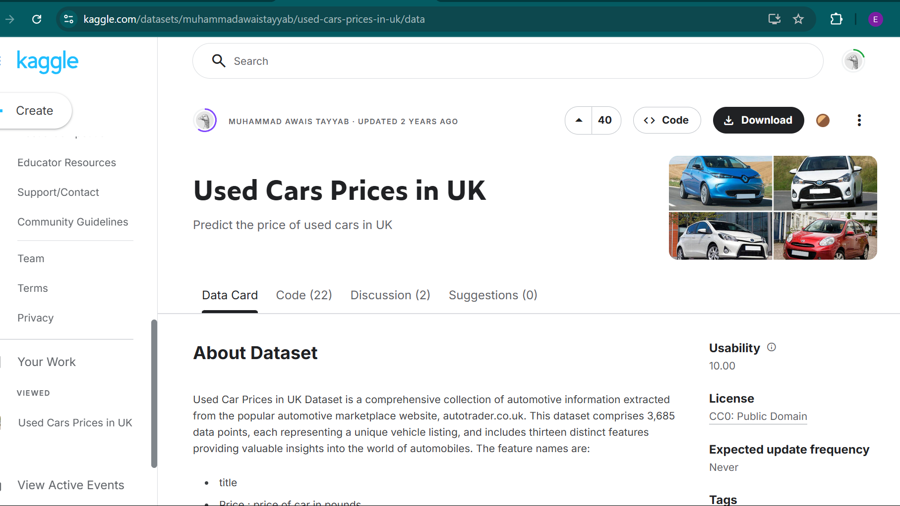
Dataset Source

Slide 16
Stretch: Importing Directly into jupyter
I ran this ChatGPT prompt;
‘walk me through step by step how to use Kaggle API to import data set directly into Jupyter in VS code in WSL, After each step await my confirmation of completion indicated with a simple '.' prompt from me before moving on to the next step ’
I have to say, this prompt had a very nice output.
Preparation definitely pays off ☺ (i.e. research on GPT prompting)
See coming slides for my solution (well… ChatGPT’s)

Slide 17
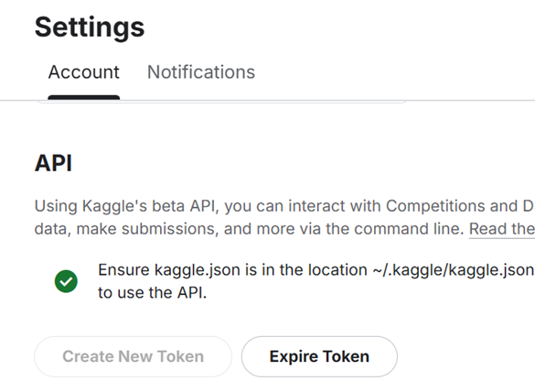
Creating API token

Slide 18
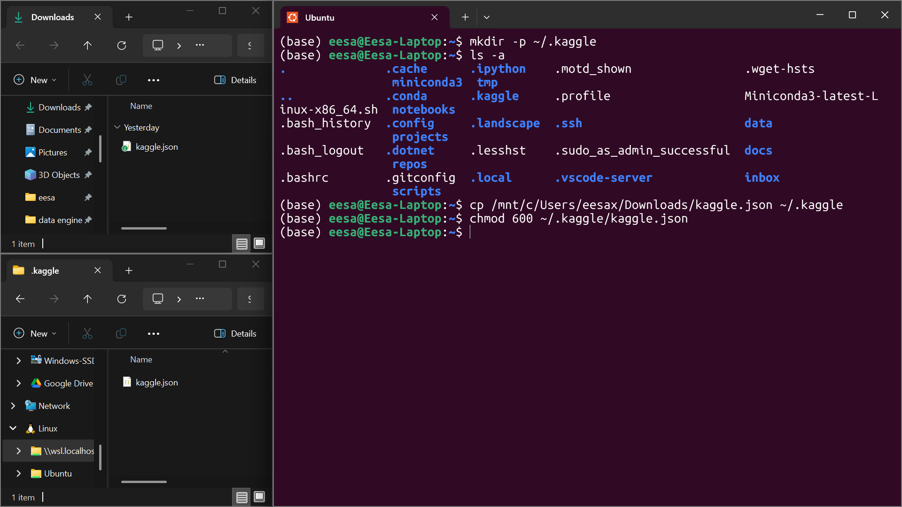
Adding Kaggle.Json to my WSL Environment

Slide 19
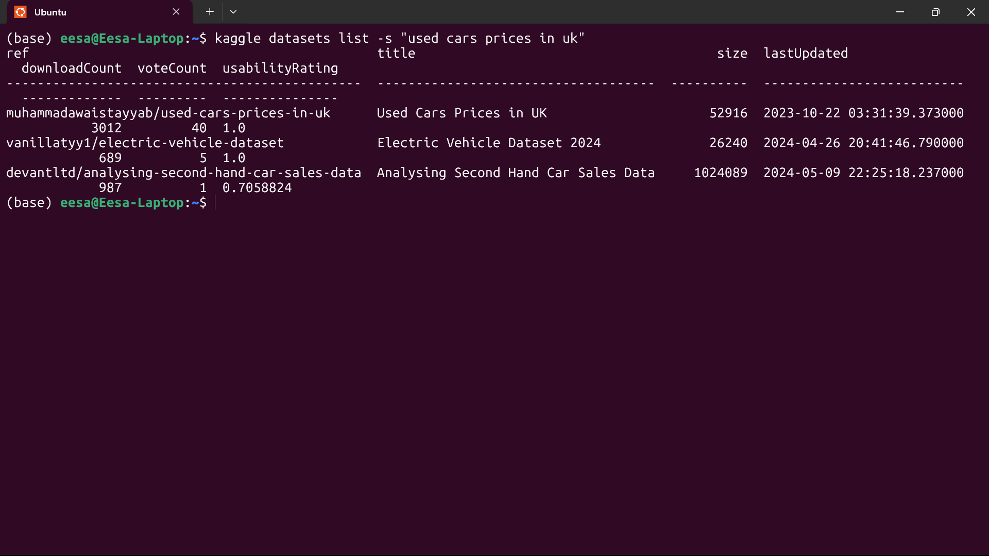
testing Kaggle API
(After Installing Kaggle with pip)
As you can see, I am now able to directly access Data sets from my terminal which I never knew was possible until today!!

Slide 20
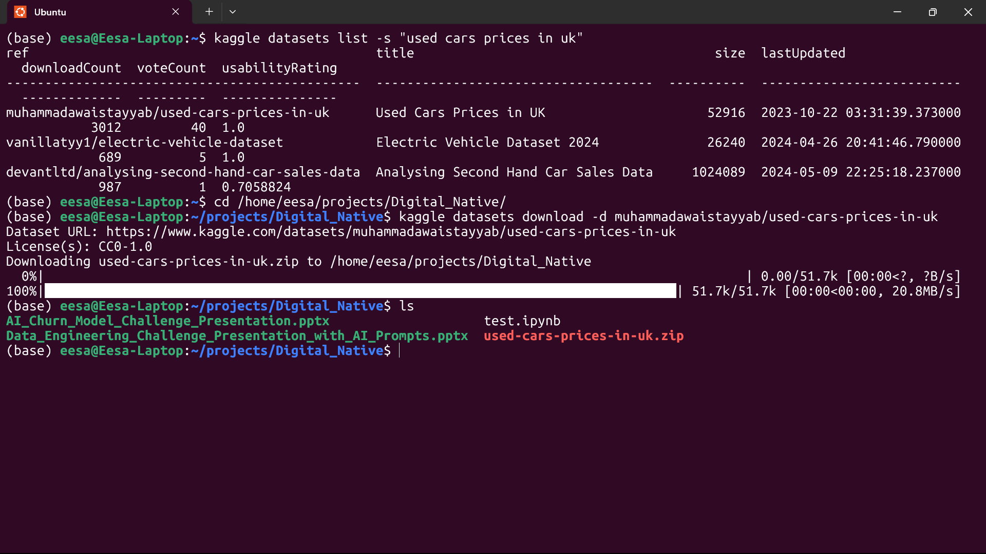
Downloading .zip file

Slide 21
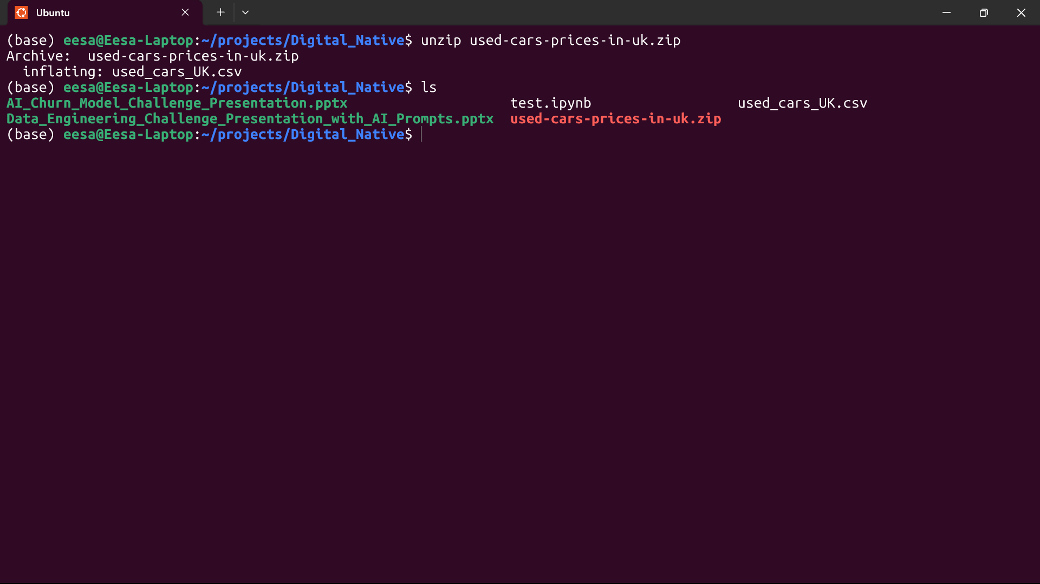
Extracting .csv from .zip file

Slide 22
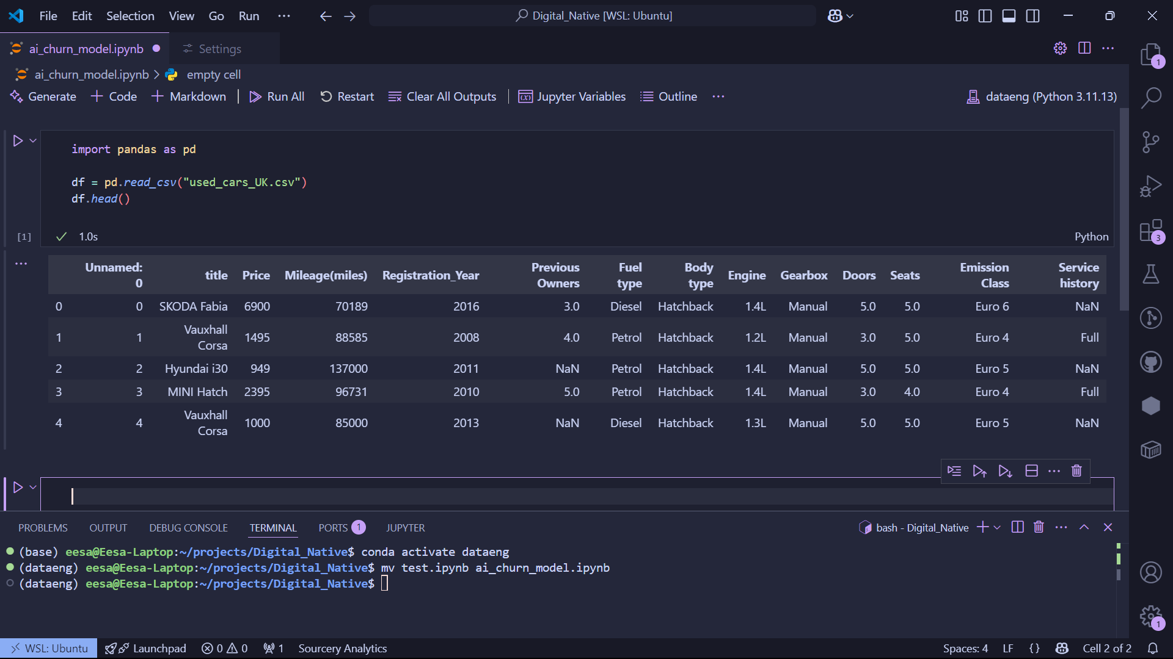
Loading set into jupyter notebook in vs code
(also checked the data with pandas head() function)

Slide 23
Task 3: Snowflake Account
Sign up
Read Documentation
Notes:
Mention why region and language selection matters.

Slide 24
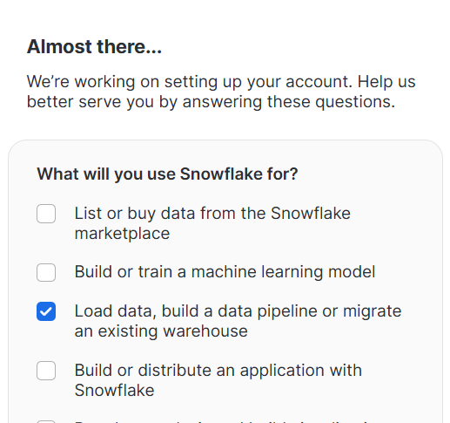
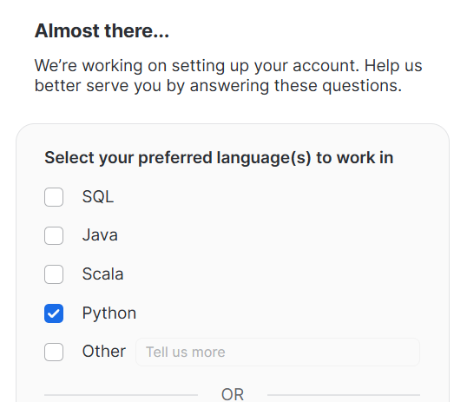
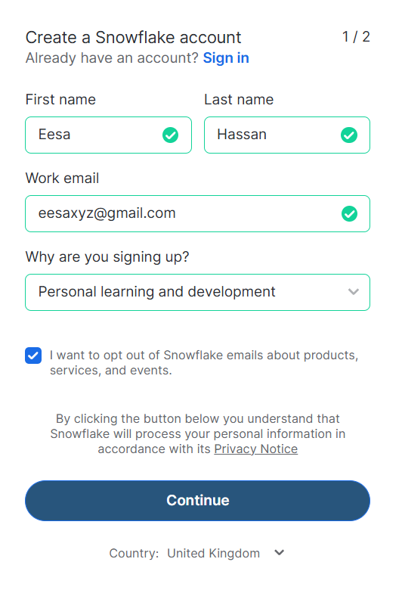
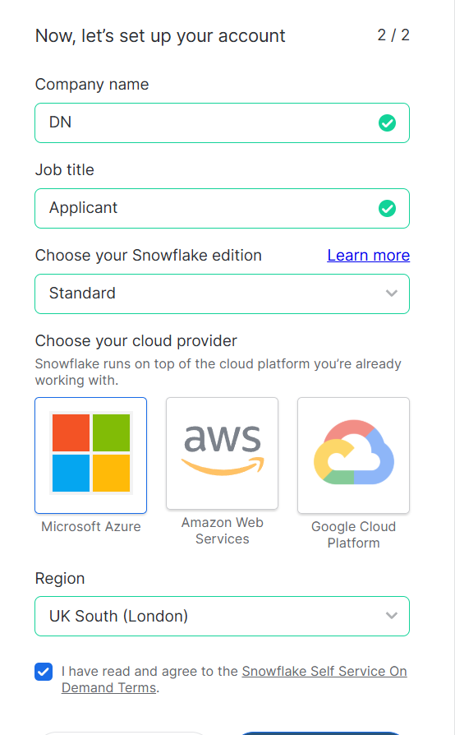
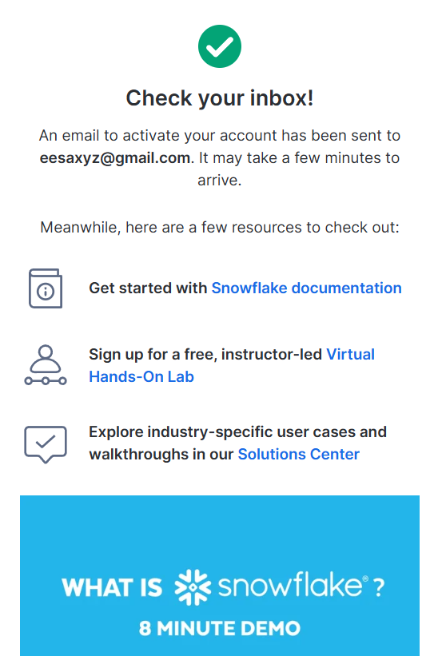
Singing up

Slide 25
Documentation

Slide 26
Task 4: opening & combining Files
Importing/files + head() output
combining files (Clarification)
Bonus: EDA or visualisation
Reflection: Importance of unified data
Notes:
Add a row count post-merge, show code snippets.

Slide 27
Loading set into jupyter notebook in vs code
(already completed this in stretch challenge for task 2)

Slide 28
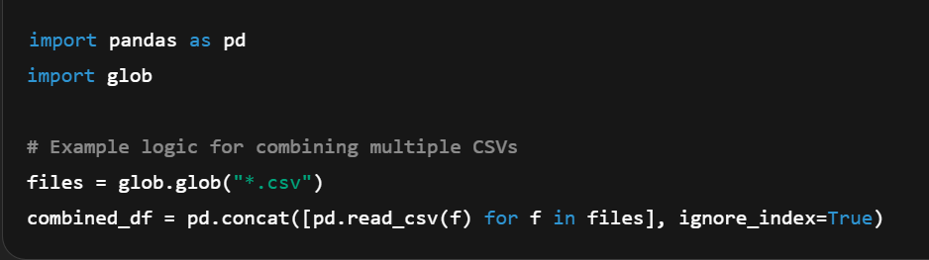
Combining Files (Clarification)
Although the instruction mentioned combining multiple files, the Kaggle dataset only contained one CSV file. (see task 7 ‘Problems and Fixes’)
This appeared to be a test of attention to detail.
What I would’ve done if there were multiple files:

Slide 29
Stretch: other information about data set
I ran this prompt in copilot for different information extraction methods:
‘give me some good techniques and practices a professional data engineer would use to find additional information about this csv file’
Then rather than letting copilot automatically implement them in my notebook, I manually did it (for educational purposes).
I included a few of them as follows…

Slide 30
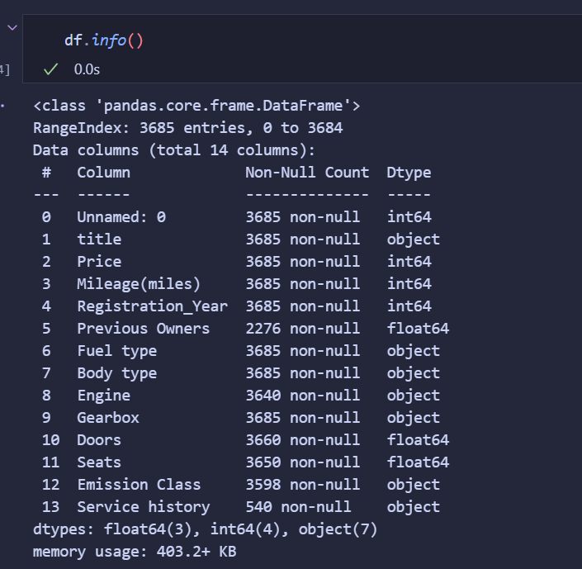
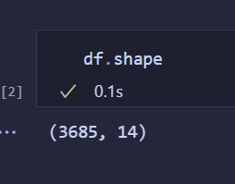
Check the shape of the data (which shows the number of rows and columns)
Key information about the data set columns (including column names, number of entries that aren’t null, and data types)
- Numbers (using null count and total) show that 85% of ‘Service history’ and 38% of ‘Previous Owners’ cell records are missing.

Slide 31
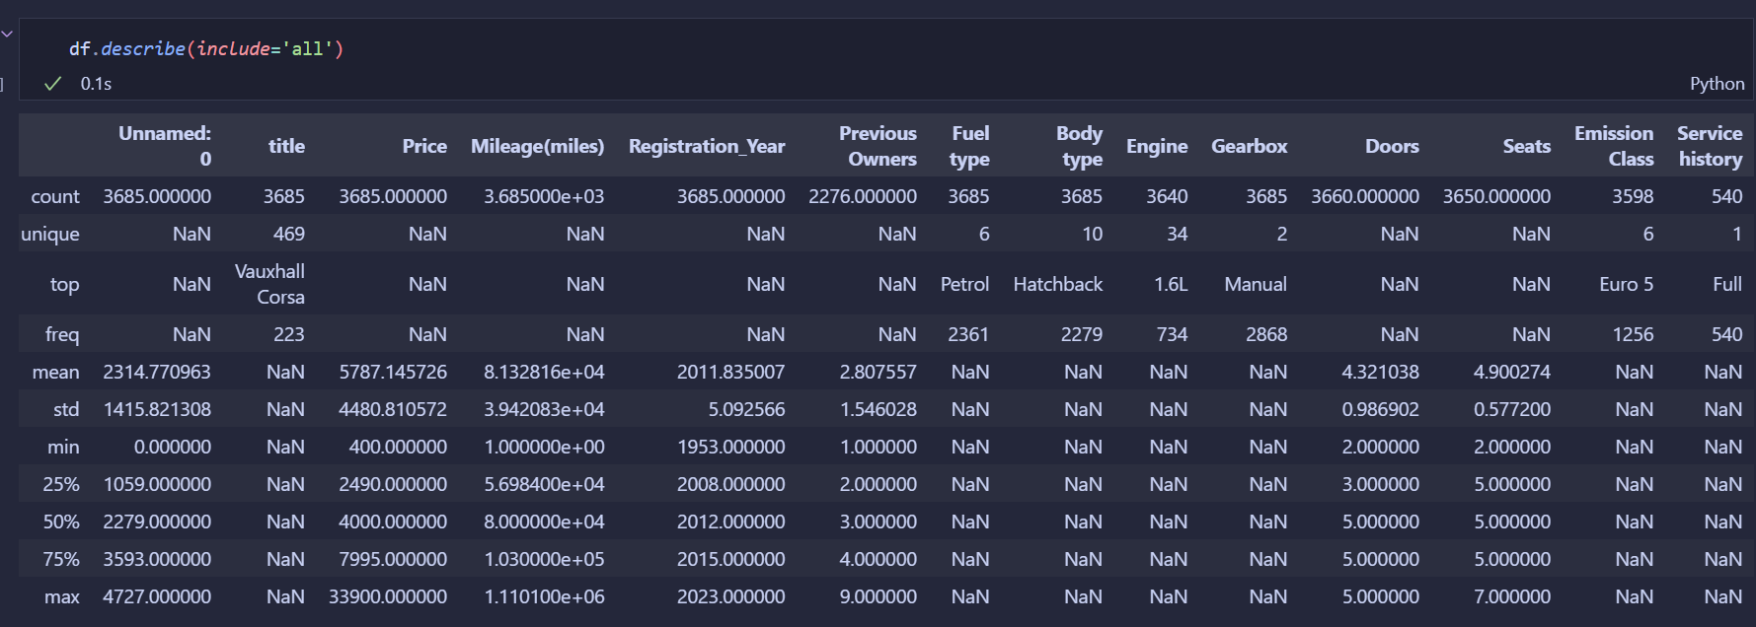
Provides a quick and comprehensive statistical summary of the Data.
This allows me to:
Understand the range and distribution of used cars attributes (e.g. cars registration year range from 1953 to 2023)
See the most common (top) attributes of used cars (e.g. most common fuel type is petrol)
Detect missing values and outliers
Summarize both numeric and categorical columns

Slide 33
Task 5: Data Quality
• Issues identified (in table)
• Cleaning code and logic
• Before vs After screenshots
• Reflection: Impact of clean data
Notes:
Show issues like nulls, type mismatches, outliers. Mention AI prompts if used.

Slide 35
Task 6: Snowflake DB Load
• Setup and connector code
• Screenshot of Snowflake DB view
• Any AI assistance used
• Reflection: Loading to cloud
Notes:
If you used Snowpark or `snowflake.connector`, explain it.

Slide 36
Task 7: Learnings & Reflections
What I’ve Learned
Problems & How I Solved Them (Fixes)
Business Use Case: Why this matters
What I Found Difficult
What I Would Do Differently
Do I Still Want A Data Engineer Career
Notes:
Include personal insights, business relevance, and your learning process.

Slide 37
What I’ve learnt
Never in my life did I think I would gain so many skills in such a short time.
Using Miniconda in WSL
Setting up Conda environments
Creating Jupyter Notebooks in VS code
Importing datasets directly into Jupyter Notebook from Kaggle API
Combining data files using Pandas
analysing data sets using Pandas
Identifying/addressing data quality issues
Importing pandas table into Snowflake using Python
Learning the basics of Prompt Engineering
Bonus: Completing a valuable project to showcase in my portfolio

Slide 38

Problems and fixes

Slide 39
Conda environment error
After opening a notebook in VS Code, I tried to run a test print command however it prompted me to create an environment
the conda environment set up was failing because I was in WSL (Troubleshooted using copilot)
Using ChatGPT I compared miniconda in WSL vs anaconda in Windows and listed the pros/cons
Summary: using WSL environment for everything is better for long-term data engineering career development.
Since I already use WSL for my projects, I decided to reinstall miniconda for WSL

Slide 40
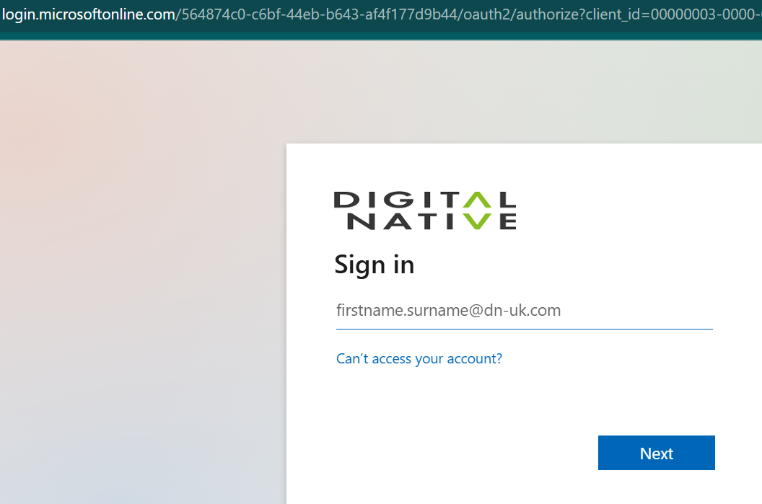
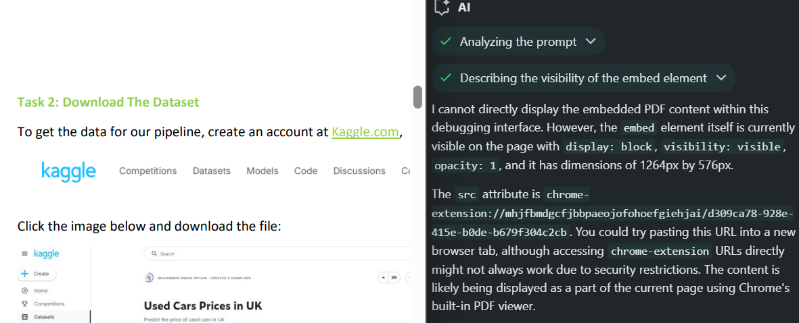
Kaggle HyperLink fault
I noticed that every time I clicked on the Kaggle.com hyperlink (in the challenge pdf provided),
it would take me to a Microsoft online sign in page.
So, I double checked it wasn’t me and inspected the html elements,
then I asked the inbuilt google ai assistance to show me the URL attached and…
GAI failed me ☹
I ended up just manually searching ‘kaggle.com’

Slide 41
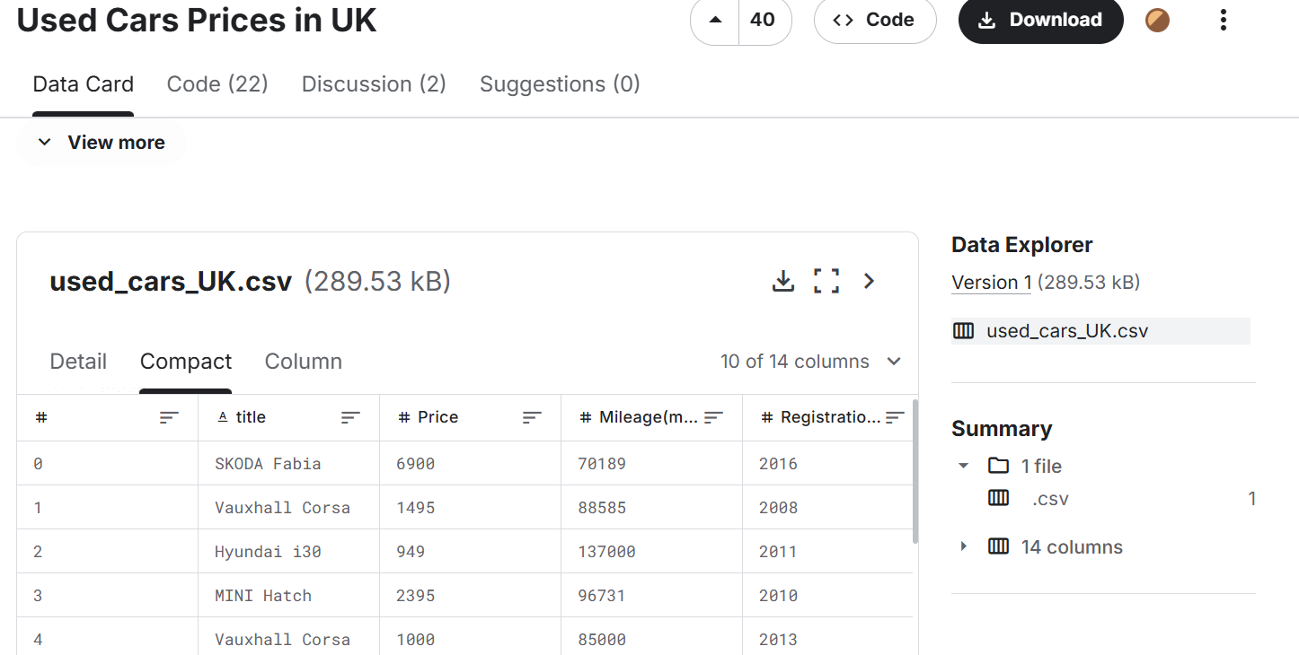

Task 4 mistake?
In task 4, it mentions how to import a single file before prompting the applicant to figure out how to combine all the files…
However, the data set on Kaggle only has one single CSV file.
I quickly made a few checks (see next slides)…

Slide 42
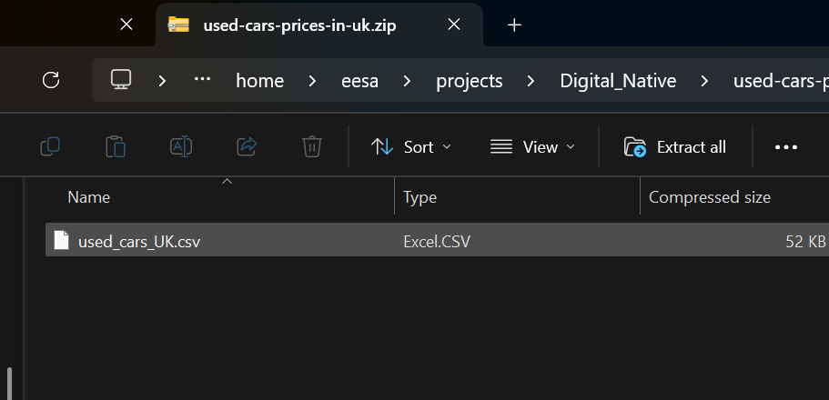
1st: Inspecting zip file
To verify I inspected the downloaded ZIP file and found only one CSV file.

Slide 43
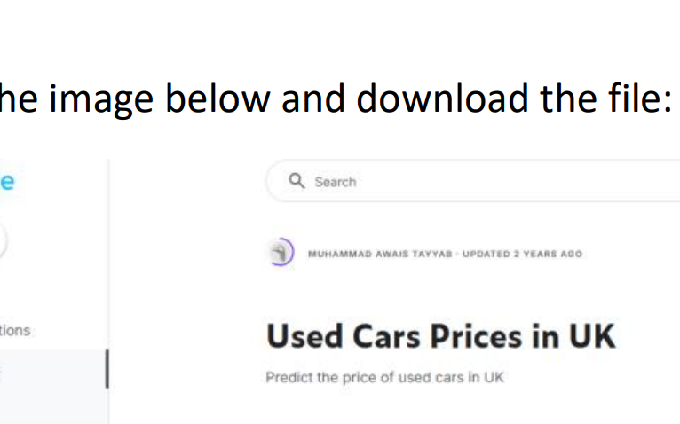
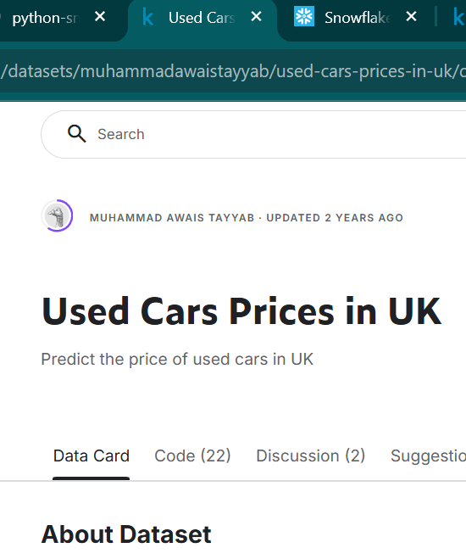
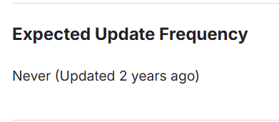
2^{nd:} checking data set update status
The screenshot provided in the PDF (left) matched the current update status (right)

Slide 44
AI Usage Summary
• Where I used AI (ChatGPT, Copilot, etc.)
• Example Prompts
• How I validated results
• Stretch use (automated code gen, docs lookup)
Notes:
Most will skip this — show you're deliberate and responsible with AI.

Slide 45
Final Reflections
• What Surprised Me
• Most Challenging Task
• Do I Still Want to Be a Data Engineer?
• Final Thoughts
Notes:
Be authentic. Mention what you enjoyed most and least.

Slide 46
Appendix
• Extra Screenshots
• Code Samples
• AI Sources
• Folder Structure
Notes:
This adds professionalism and transparency.

