Slide 1
Multimode Conditional Displacements
August 28, 2022
Eesh Gupta, Srivatsan Chakram

Slide 2
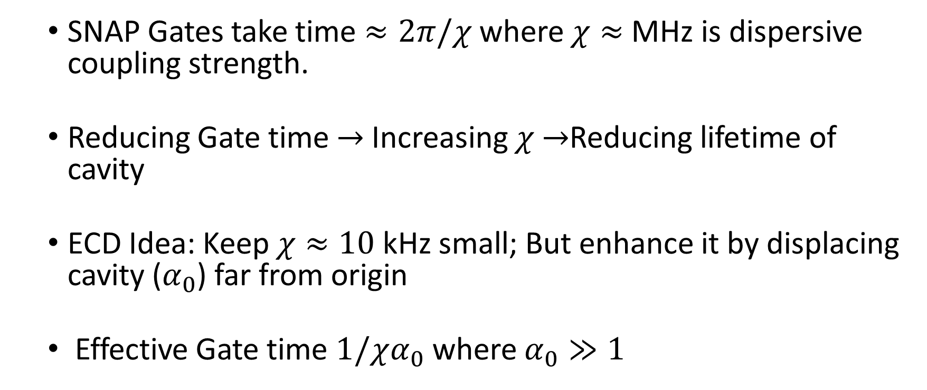
Motivation
SNAP Gates take time $≈2π/χ$ where $χ≈$ MHz is dispersive coupling strength.
Reducing Gate time $→$Increasing $χ$ $→$Reducing lifetime of cavity
ECD Idea: Keep $χ≈10$ kHz small; But enhance it by displacing cavity ($α_{0}$) far from origin
Effective Gate time $1/χα_{0}$ where $α_{0}≫1$

Slide 3




Achieving Conditional Displacements
Starting Point:
Using frame transformations, our objective is to isolate the following term from the ac-Stark Shift
where α is the displacement of the cavity mode. With such a term, we can realize a conditional displacement as follows
$β=−i χ$α$t$

Slide 4
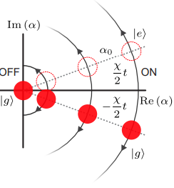



Conditional Displacements
$$χασ_{z}$$
$$(a+a^{†})$$
$$F ∗ x$$
Force
Displacement
A. Eickbusch, ..., R. Schoelkopf, M. Devoret. ArXiv preprint arXiv:2111.06414 (2021)

Slide 5
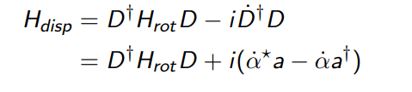
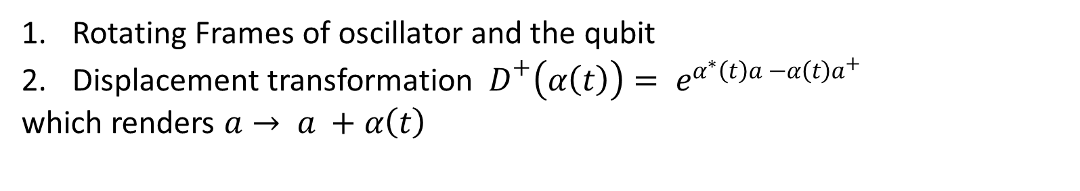
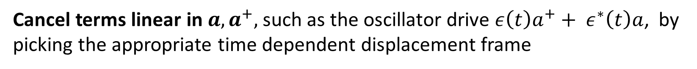
Dealing with Unwanted Terms I
Rotating Frames of oscillator and the qubit
Displacement transformation ${ D}^{+}\left(α\left(t\right)\right)= e^{α^{∗}\left(t\right)a −α\left(t\right)a^{+}}$
which renders $a→ a +α\left(t\right)$
Cancel terms linear in $a, a^{+},$such as the oscillator drive $ε\left(t\right)a^{+}+ ε^{∗}\left(t\right)a$, by picking the appropriate time dependent displacement frame
$\dot{α} = −iε\left(t\right)$ ${\dot{α}}^{∗}=iε^{∗}(t)$

Slide 6

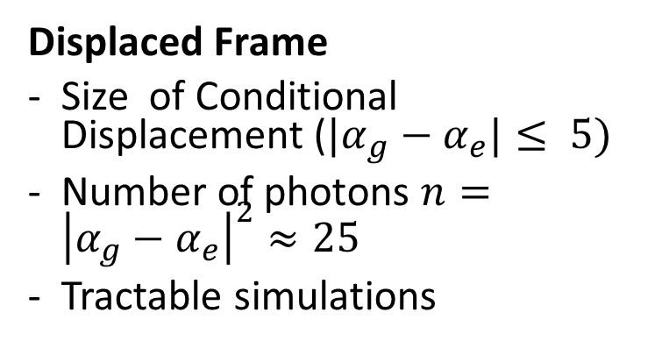


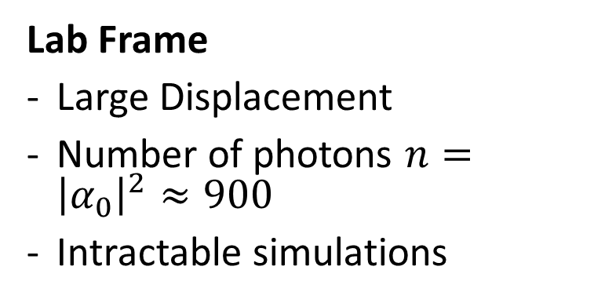






Implication: Disp. Frame Simulations
$$Im(α)$$
$$Im(α −α_{0})$$
$$|g⟩$$
$$|g⟩$$
$$α_{0}$$
$$Re(α)$$
$$Re(α−α_{0})$$
$$|e⟩$$
$$|e⟩$$
Lab Frame
Large Displacement
Number of photons $n={\left|α_{0}\right|}^{2}≈900$
Intractable simulations
Displaced Frame
Size of Conditional Displacement (${|α}_{g}−α_{e}|≤ 5)$
Number of photons $n={\left|α_{g}−α_{e}\right|}^{2}≈25$
Tractable simulations

Slide 7
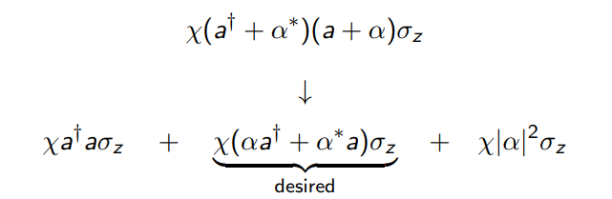
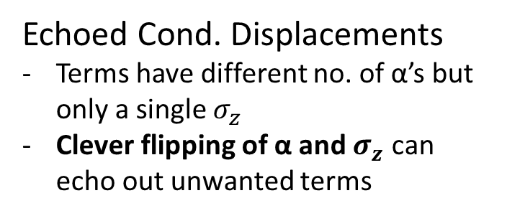
Dealing with Unwanted Terms II
The displaced frame transformation, however, divides the initial ac-Stark shift term into the following 3 terms
Sideband Drives
Make terms oscillate at different frequencies
Invoke RWA in a frame where only desired term is stationary
Echoed Cond. Displacements
Terms have different no. of α’s but only a single $σ_{z}$
Clever flipping of α and $σ_{z}$ can echo out unwanted terms

Slide 8
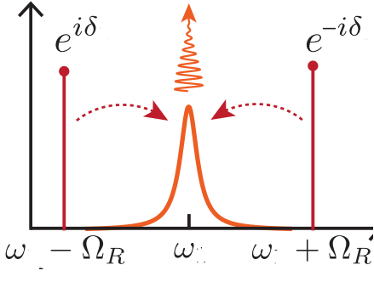


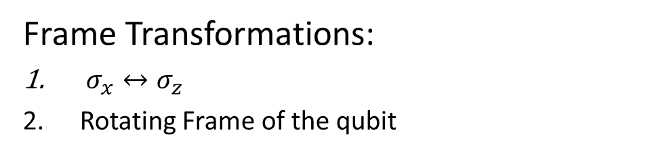

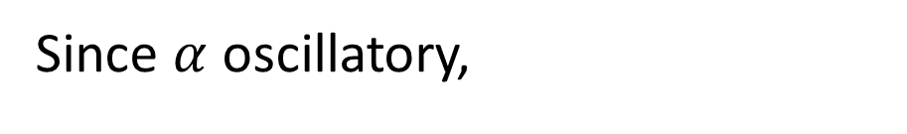








Sideband Drives
Since $α$ oscillatory,
https://arxiv.org/pdf/1608.06652.pdf
$$H=χa^{+}aσ_{z }+χ\left(αa^{+}+α^{∗}a\right)σ_{z}+χ{\left|α\right|}^{2}σ_{z}+Ω_{R}σ_{x}$$
$$ω=0$$
$$ω=Ω_{R }$$
$$ω={2Ω}_{R }$$
$$ε\left(t\right)∝α_{0}sin⁡(Ω_{R}t+δ)$$
Frame Transformations:
$σ_{x}↔σ_{z}$
Rotating Frame of the qubit
t
$$δ$$
$$Ω_{R}σ_{z}$$
$$Ω_{R}σ_{z}$$
$$α\left(t\right)∝α_{0}cos(Ω_{R}t+δ)$$
$$H=χα_{0}\left(a^{+}+a\right)⊗(σ_{x}\cos{δ+σ_{y}\sin{δ )}} + …$$
t
$$cos⁡(δ)$$
$$ω=0$$
$$ω≥ Ω_{R}$$
Shay Hacohen-Gourgy, …, Irfan Siddiqi. Nature 538-7626 (2016).

Slide 9
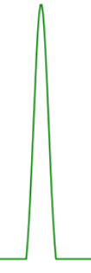
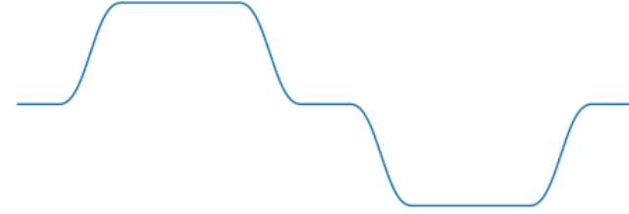








Echoed Cond. Disp.
$$α\left(t\right)$$
$$Ω(t)$$
t
Not completely
echoed out !
$$χa^{†}aσ_{z}$$
$$−χa^{†}aσ_{z}$$
Echo
$$χ\left(αa^{†}+α^{∗}a\right)σ_{z}$$
$$χ\left(αa^{†}+α^{∗}a\right)σ_{z}$$
$$χ{|α|}^{2}σ_{z}$$
$$−χ{|α|}^{2}σ_{z}$$
A. Eickbusch, ..., R. Schoelkopf, M. Devoret. ArXiv preprint arXiv:2111.06414 (2021)

Slide 10

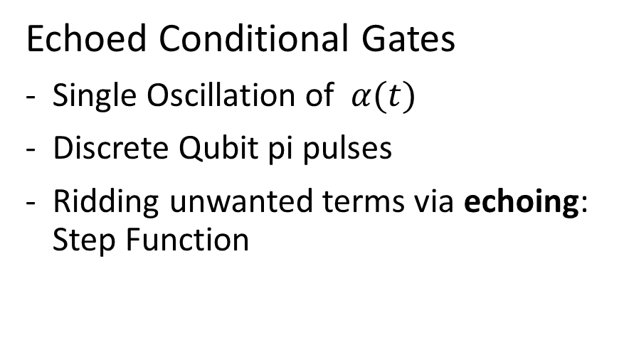

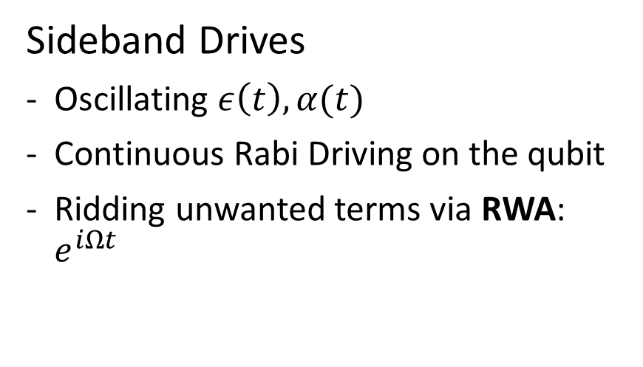






Comparison
$$ε\left(t\right)$$
$$ε\left(t\right)$$
$$t$$
$$δ$$
$$t_{w}$$
$$Ω\left(t\right)=Ω_{R}$$
$$Ω\left(t\right)$$
$$t$$
Sideband Drives
Oscillating $ε\left(t\right), α(t)$
Continuous Rabi Driving on the qubit
Ridding unwanted terms via RWA: $e^{iΩt}$
Echoed Conditional Gates
Single Oscillation of $α(t)$
Discrete Qubit pi pulses
Ridding unwanted terms via echoing: Step Function

Slide 11

What about Noise? Cavity Relaxation
Master Equation :
$$ρ=−i \left[H, ρ\right] + κ 𝒟\left(a\right)ρ$$
Displaced Frame Transf.
$$κ𝒟\left(a+α \right) \tilde{ρ}=κD\left(a\right)\tilde{ρ} − i [ \frac{iκ}{2}\left(α^{⋆}a −αa^{†}\right), \tilde{ρ} ]$$
New Term can be canceled in a similar way as the cavity drive as :
$\dot{α} = −iε\left(t\right)−\frac{κα}{2}$ ${\dot{α}}^{∗}=iε^{∗}\left(t\right)−\frac{κα^{∗ }}{2}$

Slide 12


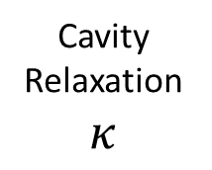
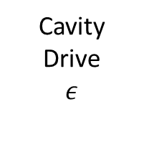

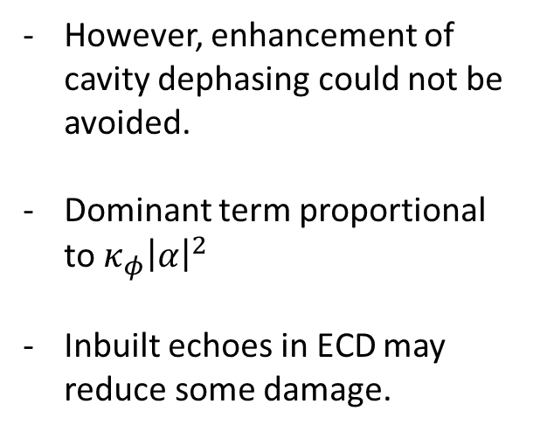

What about Noise? Cavity Relaxation and Dephasing
$$Im(α −α_{0})$$
However, enhancement of cavity dephasing could not be avoided.
Dominant term proportional to $κ_{φ}{\left|α\right|}^{2}$
Inbuilt echoes in ECD may reduce some damage.
Cavity Drive
$$ε$$
$$|g⟩$$
Cavity Relaxation $κ$
$$Re(α−α_{0})$$
$$|e⟩$$
Center of mass frame of Oscillator in its Phase Space

Slide 13
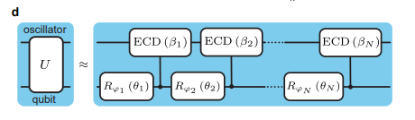
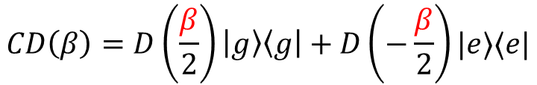
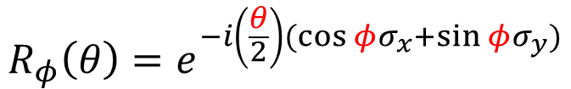
Implementation: Optimal Parameters
ECD and Sideband Drives, by themselves, do not offer universal control of both oscillator and qubit
Sol: Interleave parameterized qubit rotations between CD
Gate times are dependent on # of layers to realize high fidelity gates
$$CD\left(β\right)=D\left(\frac{β}{2}\right)\left|g\right\rangle \left\langle g\right|+D\left(−\frac{β}{2}\right)|e⟩⟨e|$$
$$R_{φ}\left(θ\right)=e^{−i\left(\frac{θ}{2}\right)(\cos{φ}σ_{x}+\sin{φ}σ_{y})}$$

Slide 14


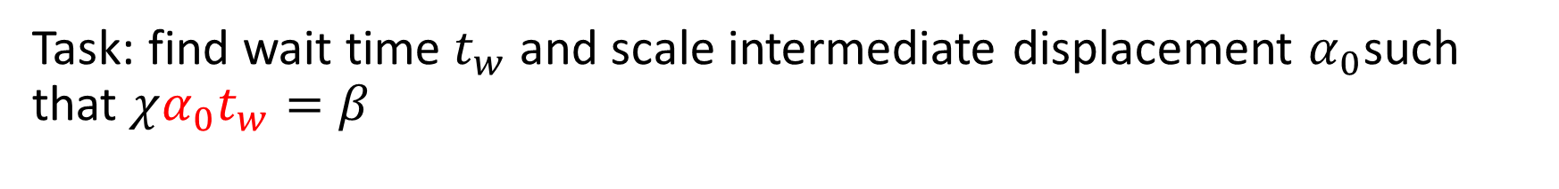







Implementation: Finding Pulses
Task: find wait time $t_{w}$ and scale intermediate displacement $α_{0}$such that $χα_{0}t_{w}=β$
ECD
Sideband
$$α_{0}$$
$$α_{0}$$
$$ε\left(t\right)∝α_{0}sin⁡(Ω_{R}t+δ)$$
$$ε\left(t\right)$$
$$t$$
$$t$$
$$δ$$
$$\frac{t_{w }}{2}$$
$$t_{w}$$
$$Ω\left(t\right)=Ω_{R}$$
$$Ω\left(t\right)$$
$$t$$
$$t$$

Slide 15
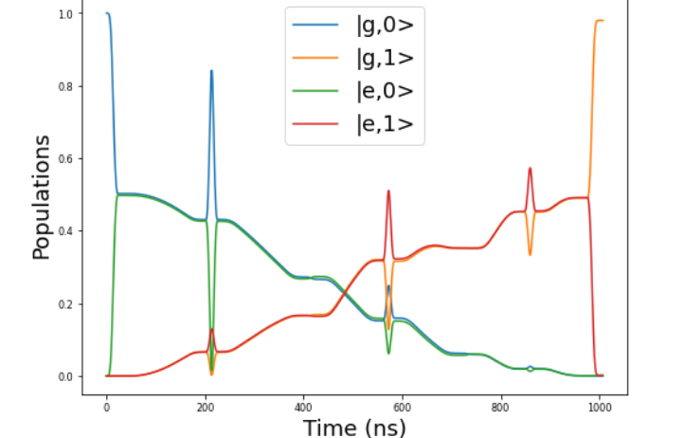
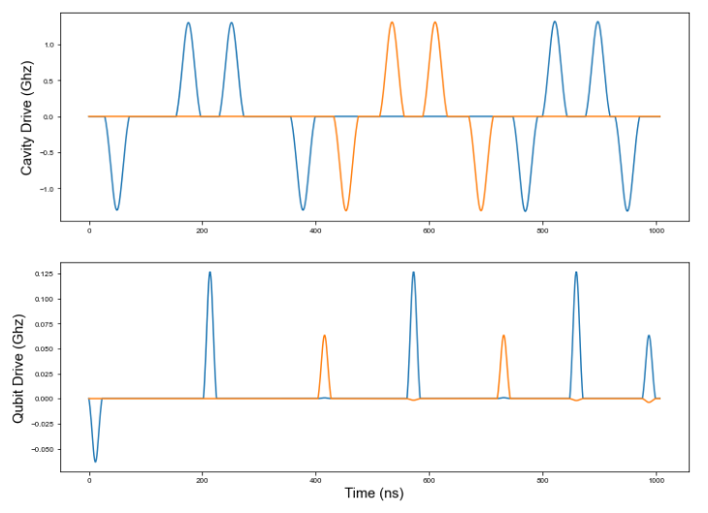
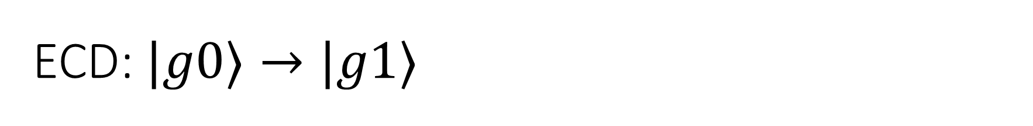
ECD: $|g0⟩→|g1⟩$

Slide 16
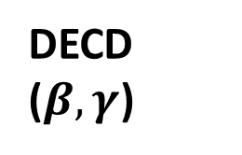





Two Mode ECD
Mode 1
DECD ($β,γ$)
Mode 1
ECD($γ$)
$$=$$
Mode 2
Mode 2
ECD($β$)
$$R_{φ}(θ)$$
Qubit
Qubit
$$R_{φ}(θ)$$
Generalizing ECD gate to 2 modes
Displacements on the two modes are not simultaneous (to avoid heating as observed in [*])
* Alec Eickbusch, Zhenghao Ding, …, Michel Devoret. W34. 00005. APS March Meeting (2022).

Slide 17
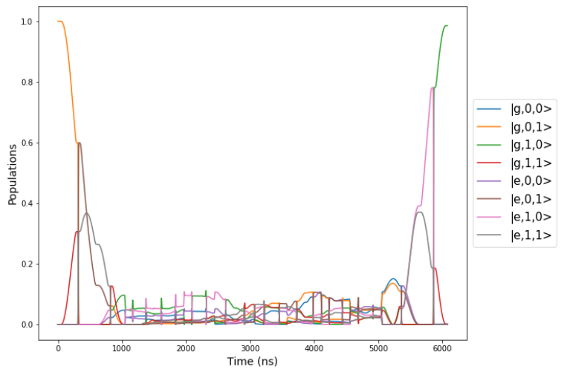
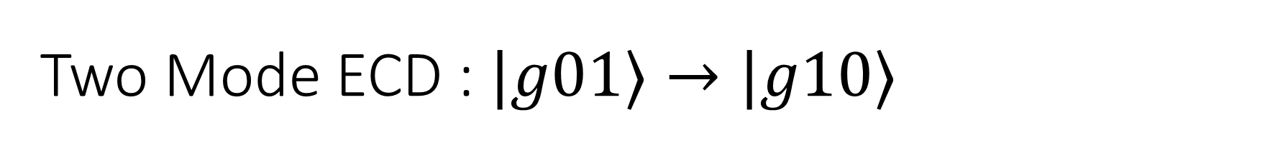
Two Mode ECD : $|g01⟩→|g10⟩$
Batch Optimizer Fidelity: 0.995308

Slide 18
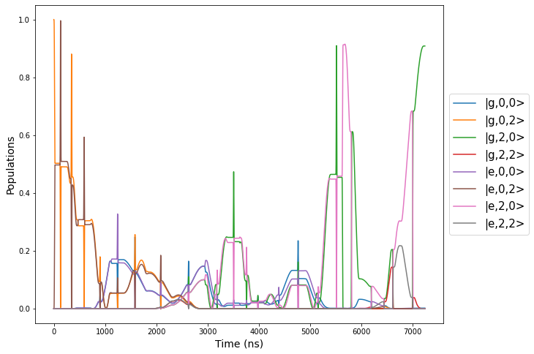
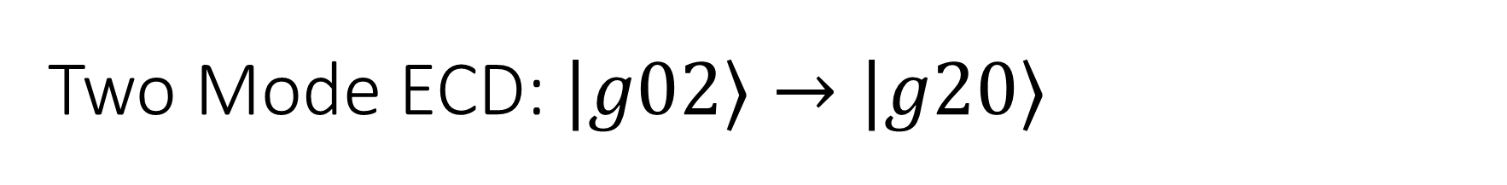
Two Mode ECD: $|g02⟩→|g20⟩$
Batch Optimizer Fidelity: 0.92192787

Slide 19
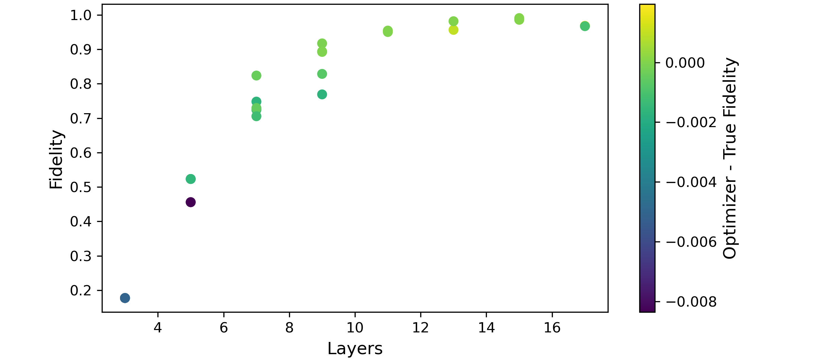
Two Mode ECD: Simultaneous State Transfer
$g01 →g10$and $g02 →g20$ (15 levels in each mode)

Slide 20
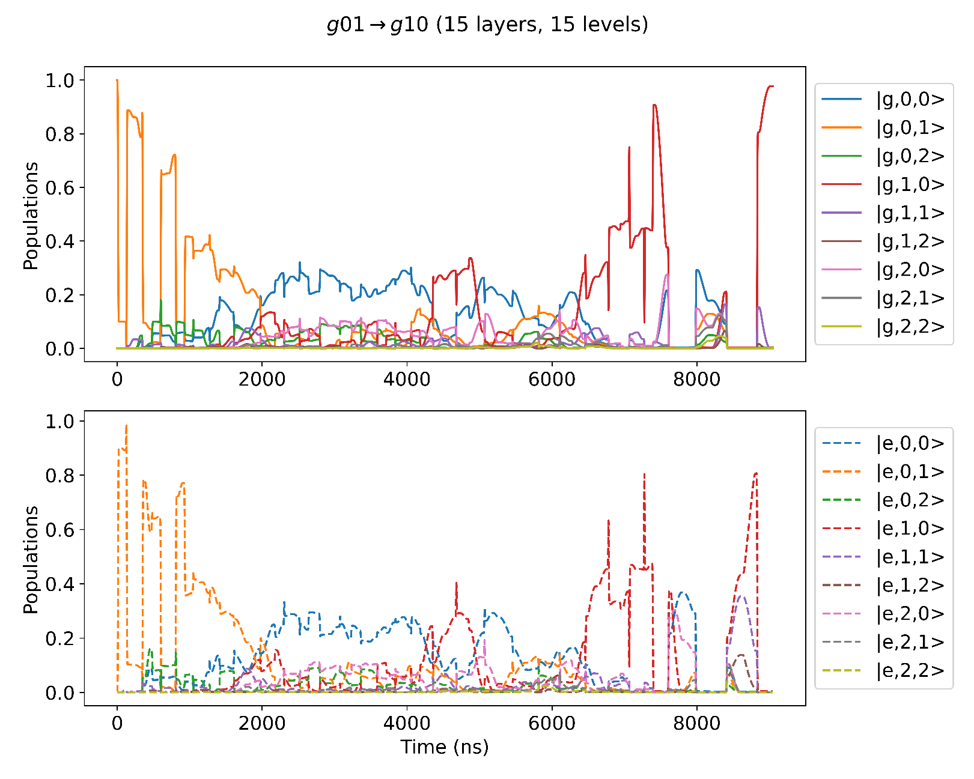
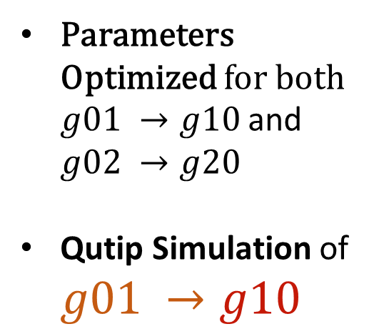
Two Mode ECD: Simultaneous State Transfer
Parameters Optimized for both $g01 →g10$and $g02 →g20$
Qutip Simulation of $g01 →g10$

Slide 21
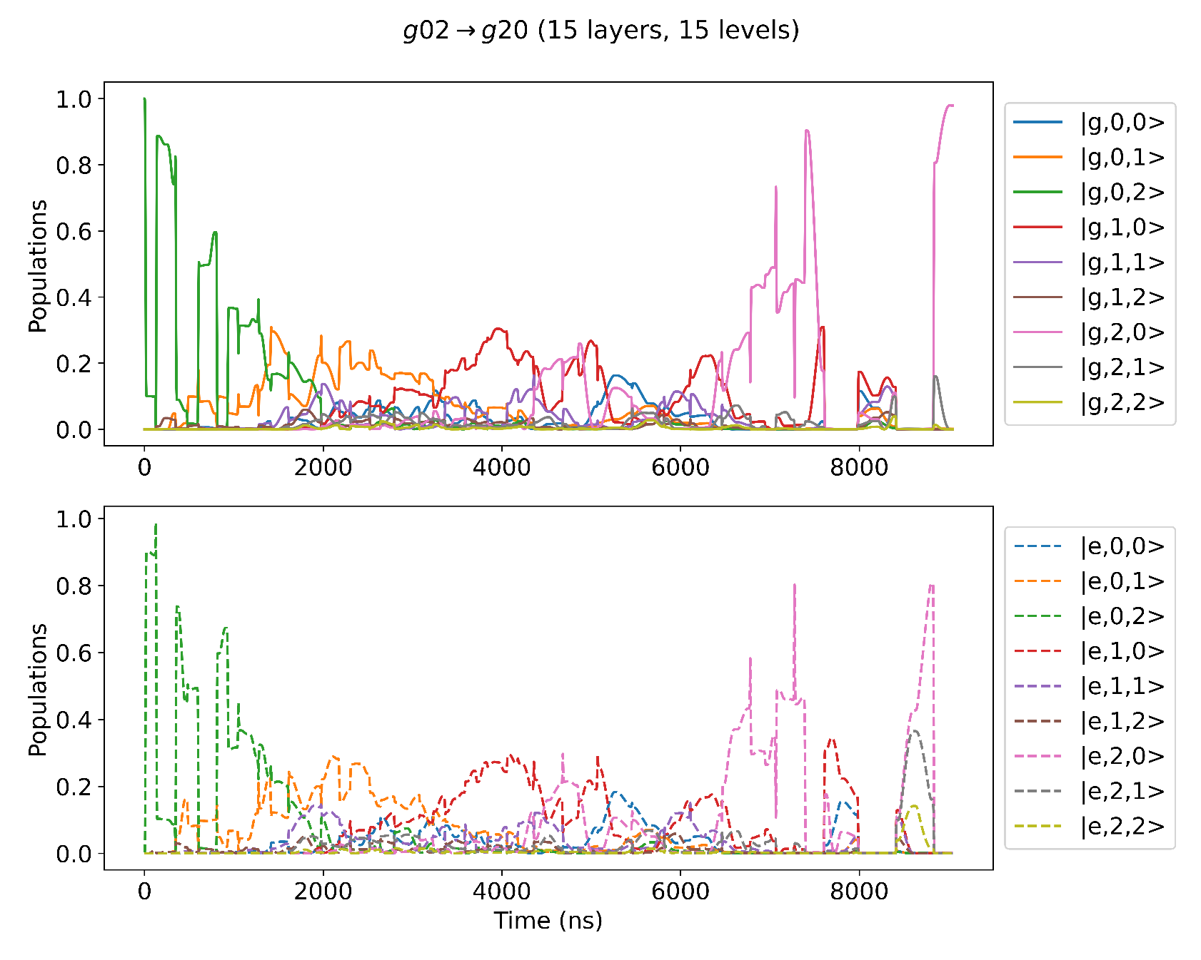
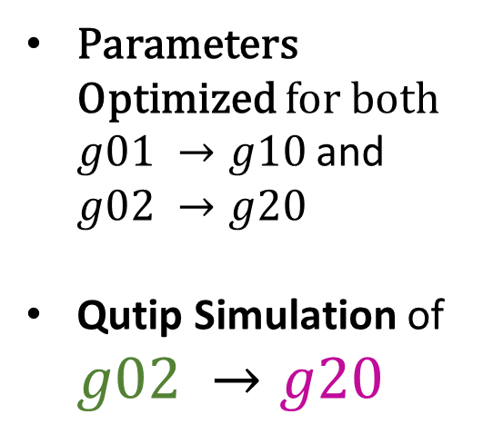
Two Mode ECD: Simultaneous State Transfer
Parameters Optimized for both $g01 →g10$and $g02 →g20$
Qutip Simulation of $g02 →g20$

Slide 22
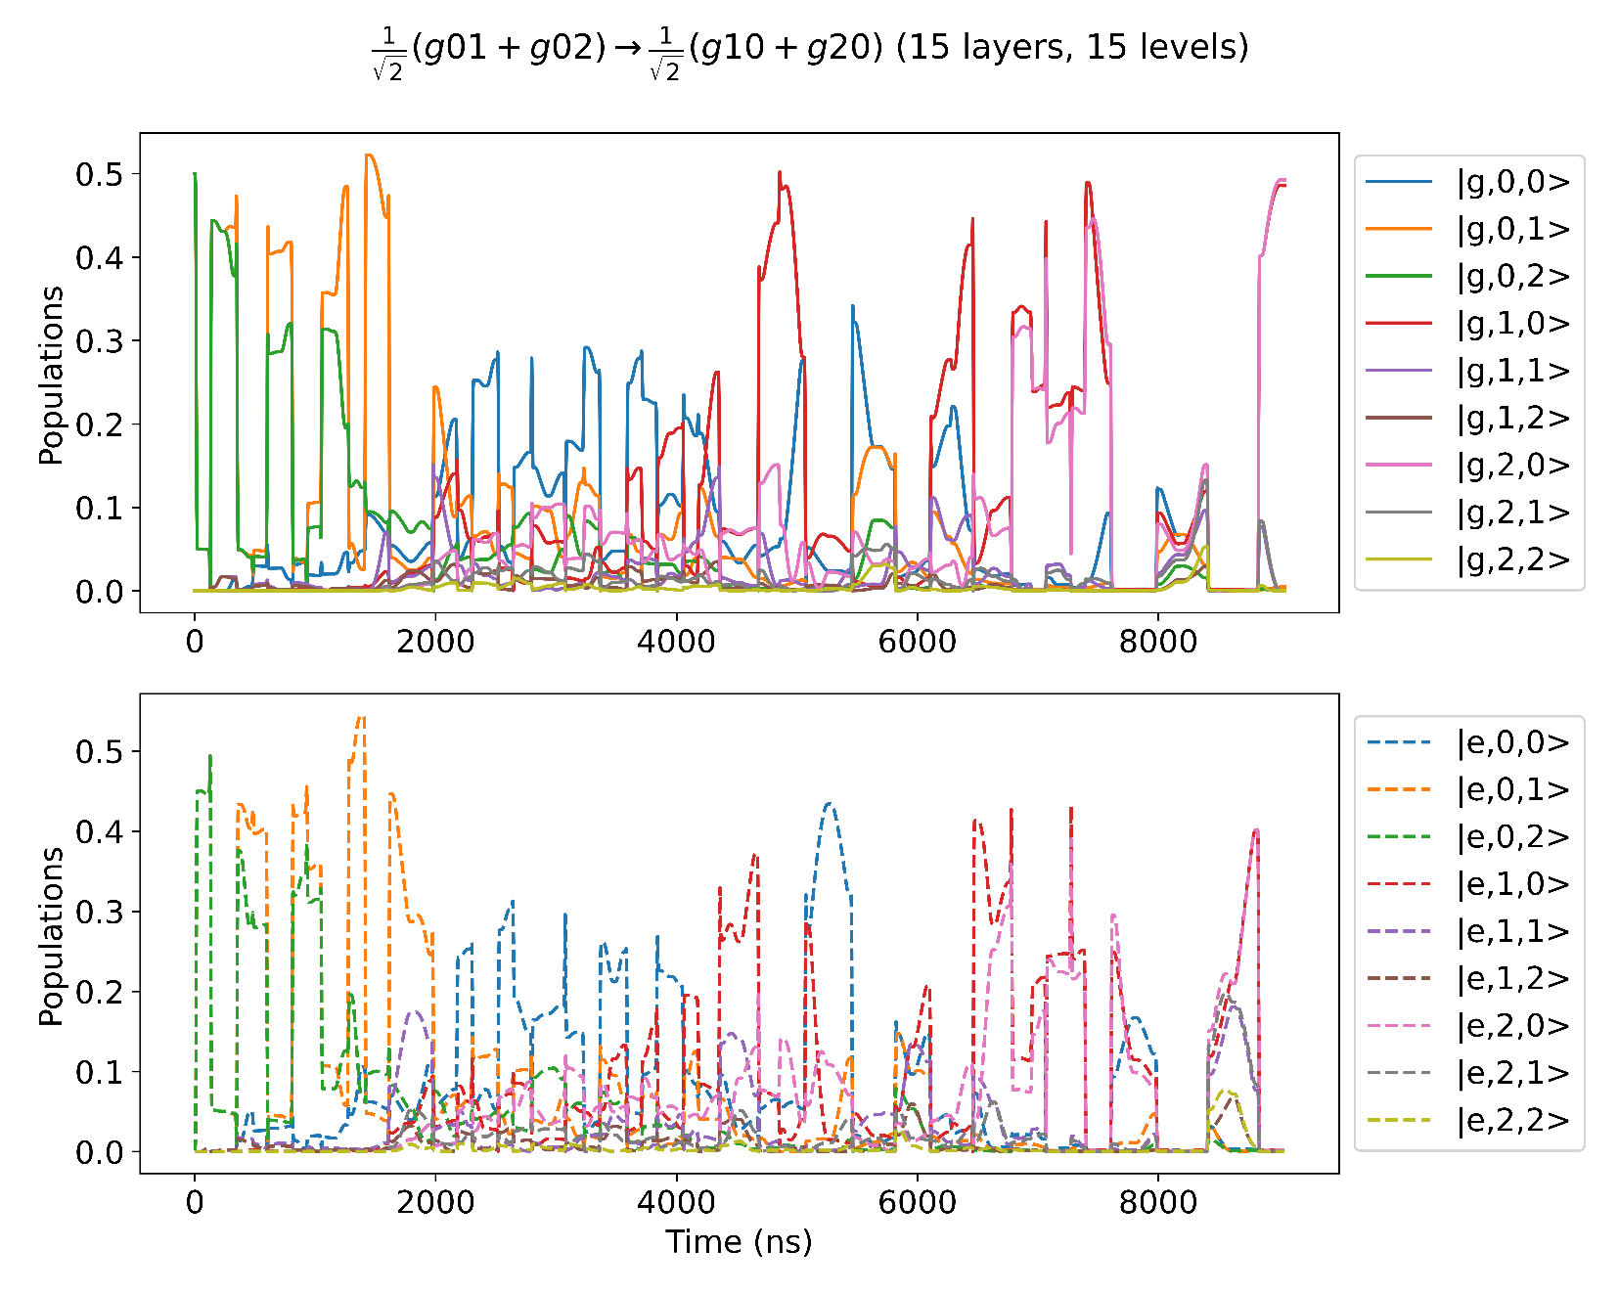
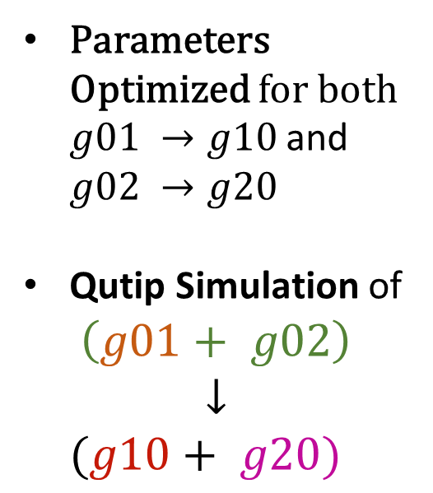
Two Mode ECD: Simultaneous State Transfer
Parameters Optimized for both $g01 →g10$and $g02 →g20$
Qutip Simulation of
$$\left(g01+ g02\right)$$
$$↓$$
$$(g10+ g20)$$

Slide 23


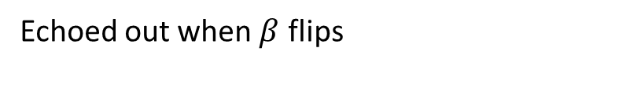


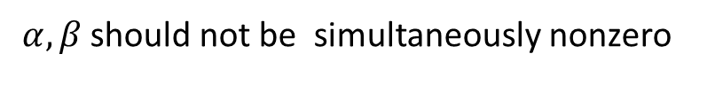

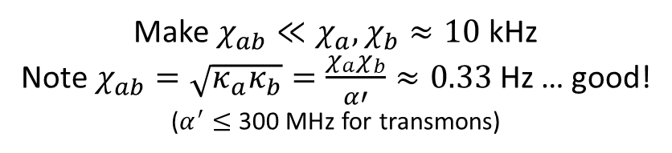
Two Mode ECD : Unwanted Cross Kerr Terms
Displaced Frame Transformation
$$χ_{ab}a^{+}a b^{+}b$$
$$χ_{ab}{(a}^{+}+α^{∗})(a+α)(b^{+}+β^{∗})(b+β)$$
Terms of form :
How to avoid :
$$χ_{ab}αβ a^{+}b^{+}$$
$α, β$should not be simultaneously nonzero
$$χ_{ab}{\left|α\right|}^{2}β b^{+}$$
Echoed out when $β$ flips
Make $χ_{ab}≪χ_{a}, χ_{b}≈10$kHz
Note $χ_{ab}=\sqrt{κ_{a}κ_{b}}=\frac{χ_{a}χ_{b}}{α′}≈0.33$Hz … good!
($α^{′}≤$ 300 MHz for transmons)
$χ_{ab}{\left|α\right|}^{2}b^{+}b$

Slide 24
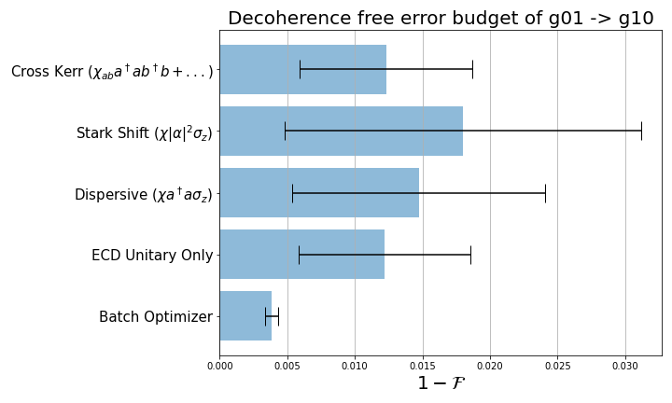
Two Mode ECD : QuTip Noise Simulations

Slide 25
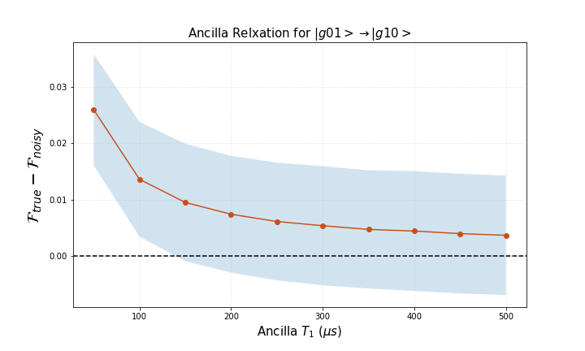
Two Mode ECD : QuTip Noise Simulations
Ancilla with better coherence times such as flux protected qubits may improve gate fidelities.

Slide 26


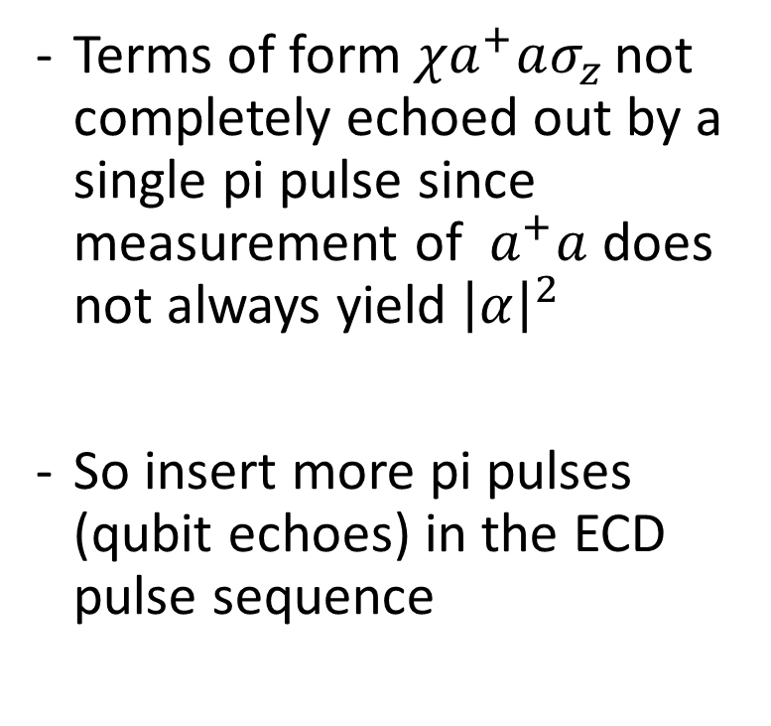

Meta Echoes
ECD($γ$)
Oscillator
ECD($β$)
Terms of form $χa^{+}aσ_{z }$not completely echoed out by a single pi pulse since measurement of $a^{+}a$ does not always yield ${\left|α\right|}^{2}$
So insert more pi pulses (qubit echoes) in the ECD pulse sequence
Qubit
ECD($γ$)
ECD($γ$)
Oscillator
ECD($β/2$)
ECD($β/2$)
$$π$$
Qubit

Slide 27
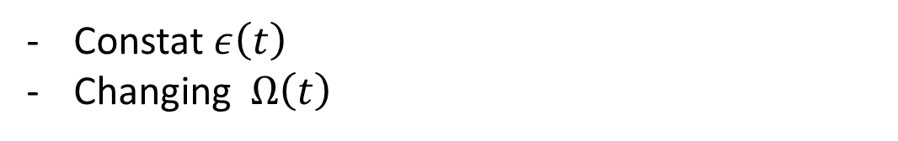




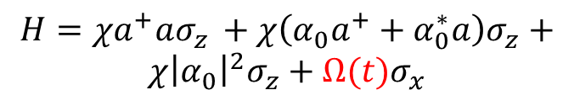



Circle Grape
Sideband Drives
Changing $ε\left(t\right)$
Constant $Ω\left(t\right)$
Circle Grape
$$α_{0}$$
$$ε\left(t\right)$$
$$H=χa^{+}aσ_{z }+χ\left(α_{0}a^{+}+α_{0}^{∗}a\right)σ_{z}+$$
$$χ{\left|α_{0}\right|}^{2}σ_{z}+Ω(t)σ_{x}$$
$$ε\left(t\right)$$
$$δ$$
$$t_{w}$$
$$Ω\left(t\right)$$
Sent to Optimizer
$$Ω\left(t\right)=Ω_{R}$$
Constat $ε\left(t\right)$
Changing $Ω\left(t\right)$
Similarly grap-ifying Sideband Drives?
Sending $δ(t)$ to the optimizer

Slide 28
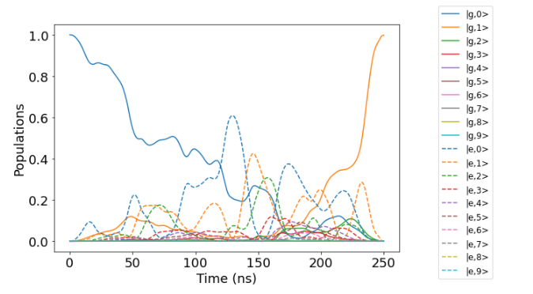
Circle Grape

