Slide 1
Multimode Conditional Displacements
August 30, 2022
Eesh Gupta, Srivatsan Chakram

Slide 2
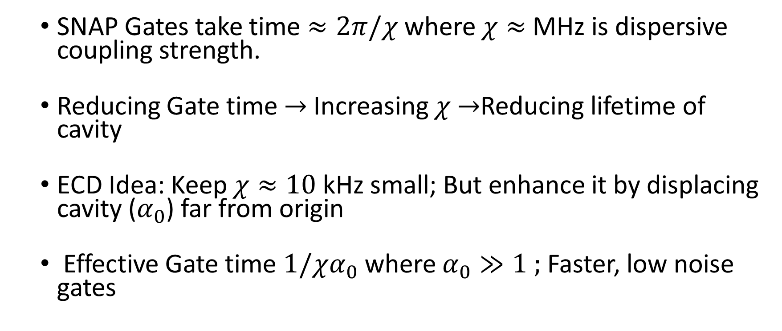
Motivation
SNAP Gates take time $≈2π/χ$ where $χ≈$ MHz is dispersive coupling strength.
Reducing Gate time $→$Increasing $χ$ $→$Reducing lifetime of cavity
ECD Idea: Keep $χ≈10$ kHz small; But enhance it by displacing cavity ($α_{0}$) far from origin
Effective Gate time $1/χα_{0}$ where $α_{0}≫1 ;$ Faster, low noise gates

Slide 3




Achieving Conditional Displacements
Starting Point:
Using frame transformations, our objective is to isolate the following term from the ac-Stark Shift
where α is the displacement of the cavity mode. With such a term, we can realize a conditional displacement as follows
$β=−i χ$α$t$

Slide 4
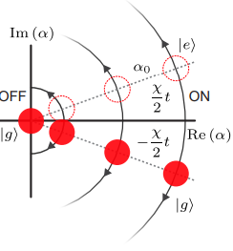



Conditional Displacements
$$χασ_{z}$$
$$(a+a^{†})$$
$$F ∗ x$$
Force
Displacement
A. Eickbusch, ..., R. Schoelkopf, M. Devoret. ArXiv preprint arXiv:2111.06414 (2021)

Slide 5
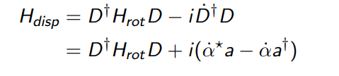
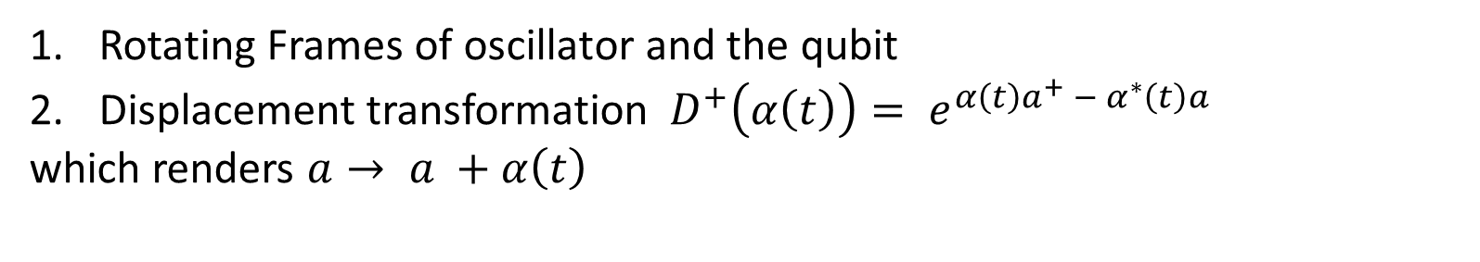
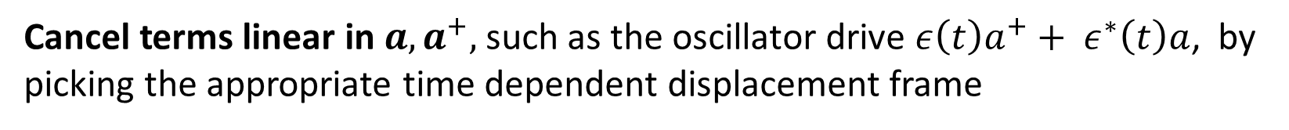
Dealing with Unwanted Terms I
Rotating Frames of oscillator and the qubit
Displacement transformation ${ D}^{+}\left(α\left(t\right)\right)= e^{{α\left(t\right)a^{+} − α}^{∗}\left(t\right)a }$
which renders $a→ a +α\left(t\right)$
Cancel terms linear in $a, a^{+},$such as the oscillator drive $ε\left(t\right)a^{+}+ ε^{∗}\left(t\right)a$, by picking the appropriate time dependent displacement frame
$\dot{α} = −iε\left(t\right)$ ${\dot{α}}^{∗}=iε^{∗}(t)$

Slide 6

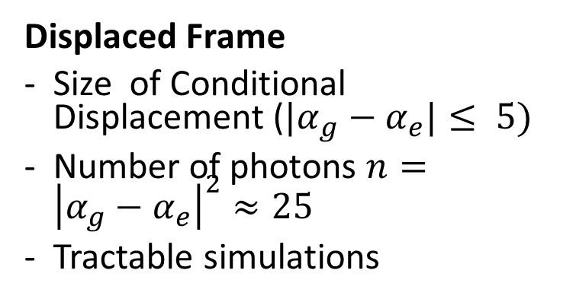


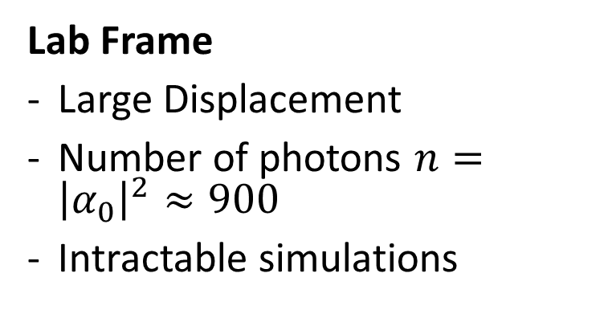






Implication: Disp. Frame Simulations
$$Im(α)$$
$$Im(α −α_{0})$$
$$|g⟩$$
$$|g⟩$$
$$α_{0}$$
$$Re(α)$$
$$Re(α−α_{0})$$
$$|e⟩$$
$$|e⟩$$
Lab Frame
Large Displacement
Number of photons $n={\left|α_{0}\right|}^{2}≈900$
Intractable simulations
Displaced Frame
Size of Conditional Displacement (${|α}_{g}−α_{e}|≤ 5)$
Number of photons $n={\left|α_{g}−α_{e}\right|}^{2}≈25$
Tractable simulations

Slide 7
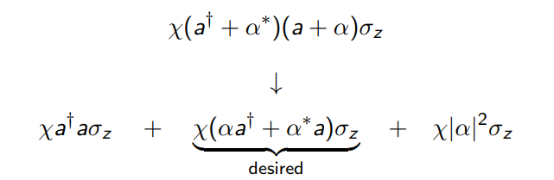
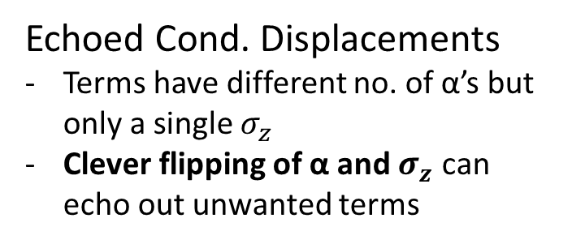
Dealing with Unwanted Terms II
The displaced frame transformation, however, divides the initial ac-Stark shift term into the following 3 terms
Sideband Drives
Make terms oscillate at different frequencies
Invoke RWA in a frame where only desired term is stationary
Echoed Cond. Displacements
Terms have different no. of α’s but only a single $σ_{z}$
Clever flipping of α and $σ_{z}$ can echo out unwanted terms

Slide 8
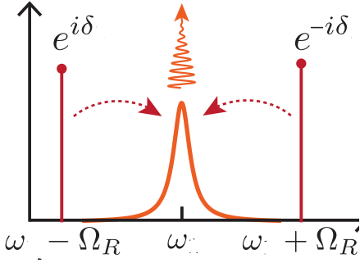


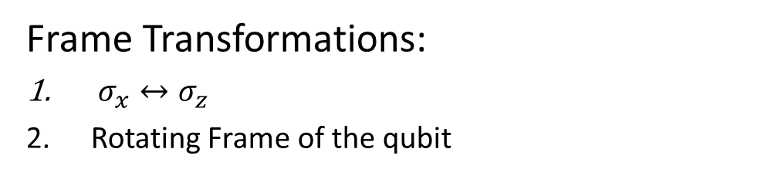

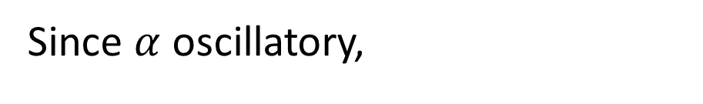








Sideband Drives
Since $α$ oscillatory,
https://arxiv.org/pdf/1608.06652.pdf
$$H=χa^{+}aσ_{z }+χ\left(αa^{+}+α^{∗}a\right)σ_{z}+χ{\left|α\right|}^{2}σ_{z}+Ω_{R}σ_{x}$$
$$ω=0$$
$$ω=Ω_{R }$$
$$ω={2Ω}_{R }$$
$$ε\left(t\right)∝α_{0}sin⁡(Ω_{R}t+δ)$$
Frame Transformations:
$σ_{x}↔σ_{z}$
Rotating Frame of the qubit
t
$$δ$$
$$Ω_{R}σ_{z}$$
$$Ω_{R}σ_{z}$$
$$α\left(t\right)∝α_{0}cos(Ω_{R}t+δ)$$
$$H=χα_{0}\left(a^{+}+a\right)⊗(σ_{x}\cos{δ+σ_{y}\sin{δ )}} + …$$
t
$$cos⁡(δ)$$
$$ω=0$$
$$ω≥ Ω_{R}$$
Shay Hacohen-Gourgy, …, Irfan Siddiqi. Nature 538-7626 (2016).

Slide 9
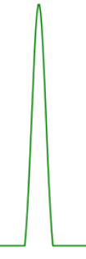
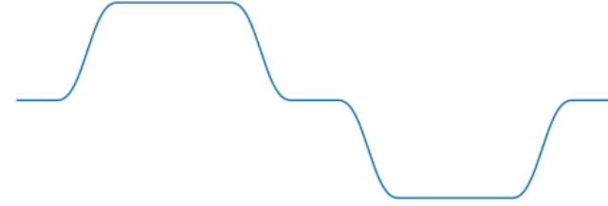








Echoed Cond. Disp.
$$α\left(t\right)$$
$$Ω(t)$$
t
Not completely
echoed out !
$$χa^{†}aσ_{z}$$
$$−χa^{†}aσ_{z}$$
Echo
$$χ\left(αa^{†}+α^{∗}a\right)σ_{z}$$
$$χ\left(αa^{†}+α^{∗}a\right)σ_{z}$$
$$χ{|α|}^{2}σ_{z}$$
$$−χ{|α|}^{2}σ_{z}$$
A. Eickbusch, ..., R. Schoelkopf, M. Devoret. ArXiv preprint arXiv:2111.06414 (2021)

Slide 10


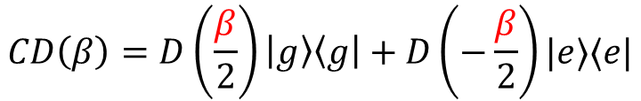
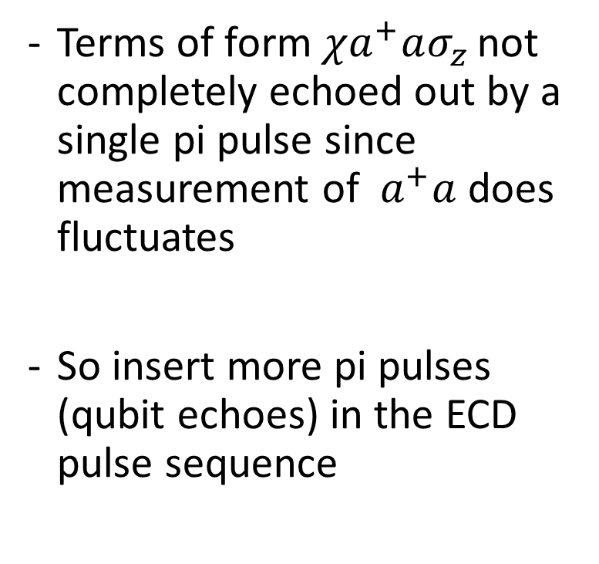

Idea: Meta Echoes
ECD($γ$)
Oscillator
ECD($β$)
Terms of form $χa^{+}aσ_{z }$not completely echoed out by a single pi pulse since measurement of $a^{+}a$ does fluctuates
So insert more pi pulses (qubit echoes) in the ECD pulse sequence
Qubit
ECD($γ$)
ECD($γ$)
Oscillator
ECD($β/2$)
ECD($β/2$)
$$π$$
Qubit

Slide 11

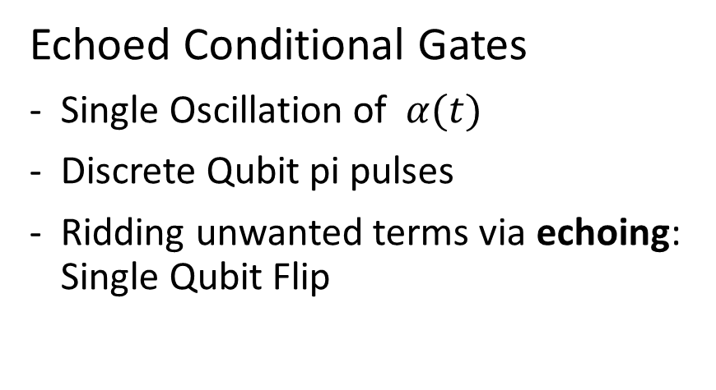

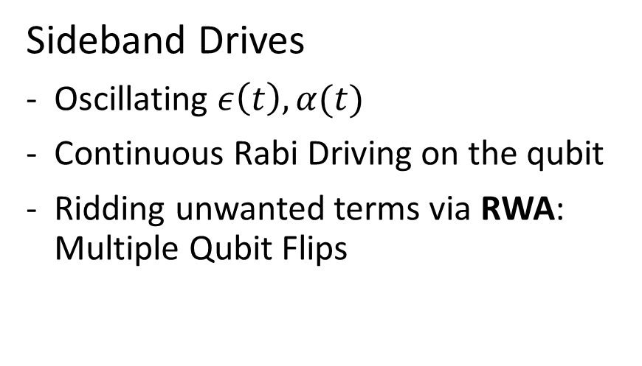






Comparison
$$ε\left(t\right)$$
$$ε\left(t\right)$$
$$t$$
$$δ$$
$$t_{w}$$
$$Ω\left(t\right)=Ω_{R}$$
$$Ω\left(t\right)$$
$$t$$
Sideband Drives
Oscillating $ε\left(t\right), α(t)$
Continuous Rabi Driving on the qubit
Ridding unwanted terms via RWA: Multiple Qubit Flips
Echoed Conditional Gates
Single Oscillation of $α(t)$
Discrete Qubit pi pulses
Ridding unwanted terms via echoing: Single Qubit Flip

Slide 12
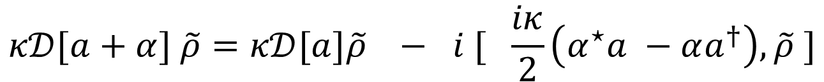

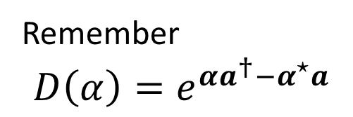
What about Noise? Cavity Relaxation
Master Equation :
$$ρ=−i \left[H, ρ\right] + κ 𝒟[a]ρ$$
Displaced Frame Transf.
$$κ𝒟[a+α] \tilde{ρ}=κ𝒟[a]\tilde{ρ} − i [ \frac{iκ}{2}\left(α^{⋆}a −αa^{†}\right), \tilde{ρ} ]$$
Remember
$$D\left(α\right)=e^{{αa^{†}−α}^{⋆}a}$$

Slide 13


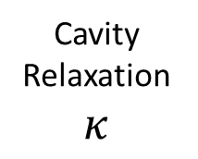
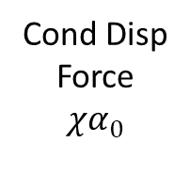


What about Noise? Cavity Relaxation
$$Im(α −α_{0})$$
Cond Disp Force
$$χα_{0}$$
$$|g⟩$$
Cavity Relaxation $κ$
$$Re(α−α_{0})$$
$$|e⟩$$
Center of mass frame of Oscillator in its Phase Space

Slide 14

What about Noise? Cavity Relaxation
Master Equation :
$$ρ=−i \left[H, ρ\right] + κ 𝒟\left(a\right)ρ$$
Displaced Frame Transf.
$$κ𝒟\left(a+α \right) \tilde{ρ}=κD\left(a\right)\tilde{ρ} − i [ \frac{iκ}{2}\left(α^{⋆}a −αa^{†}\right), \tilde{ρ} ]$$
New Term can be canceled in a similar way as the cavity drive as :
$\dot{α} = −iε\left(t\right)−\frac{κα}{2}$ ${\dot{α}}^{∗}=iε^{∗}\left(t\right)−\frac{κα^{∗ }}{2}$

Slide 15
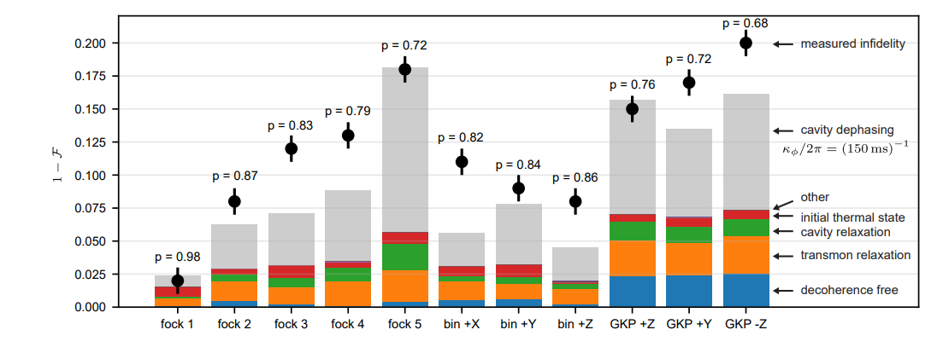
What about Noise? Cavity Dephasing
However, enhancement of cavity dephasing could not be avoided; proportional to $κ_{φ}{\left|α\right|}^{2}$
!!!
A. Eickbusch, ..., R. Schoelkopf, M. Devoret. ArXiv preprint arXiv:2111.06414 (2021)

Slide 16
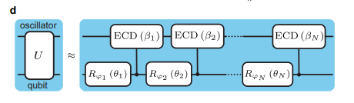
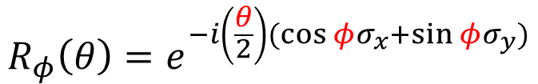
Implementation: Optimal Parameters
ECD and Sideband Drives, by themselves, do not offer universal control of both oscillator and qubit
Sol: Interleave parameterized qubit rotations between CD
Gate times are dependent on # of layers to realize high fidelity gates
$$CD\left(β\right)=D\left(\frac{β}{2}\right)\left|g\right\rangle \left\langle g\right|+D\left(−\frac{β}{2}\right)|e⟩⟨e|$$
$$R_{φ}\left(θ\right)=e^{−i\left(\frac{θ}{2}\right)(\cos{φ}σ_{x}+\sin{φ}σ_{y})}$$

Slide 17


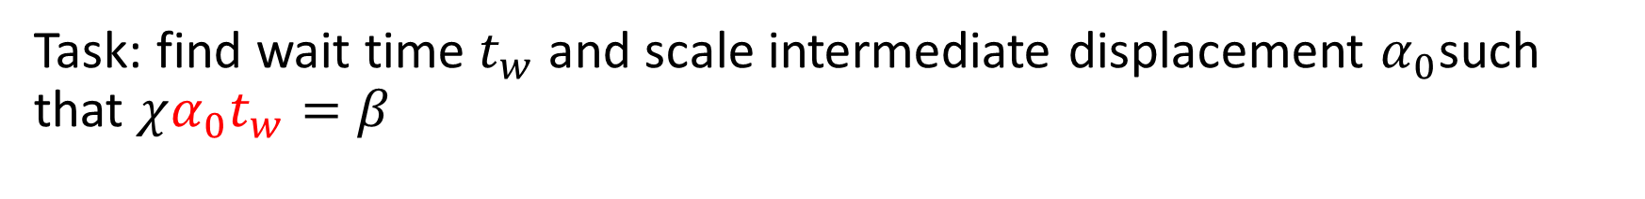







Implementation: Finding Pulses
Task: find wait time $t_{w}$ and scale intermediate displacement $α_{0}$such that $χα_{0}t_{w}=β$
ECD
Sideband
$$α_{0}$$
$$α_{0}$$
$$ε\left(t\right)∝α_{0}sin⁡(Ω_{R}t+δ)$$
$$ε\left(t\right)$$
$$t$$
$$t$$
$$δ$$
$$\frac{t_{w }}{2}$$
$$t_{w}$$
$$Ω\left(t\right)=Ω_{R}$$
$$Ω\left(t\right)$$
$$t$$
$$t$$

Slide 18
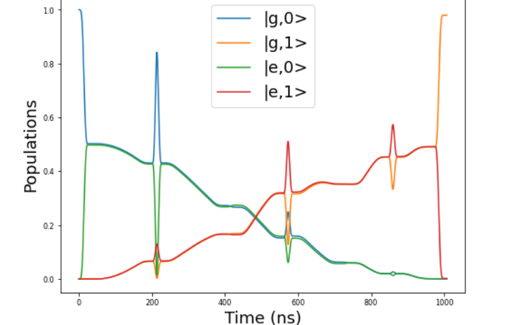
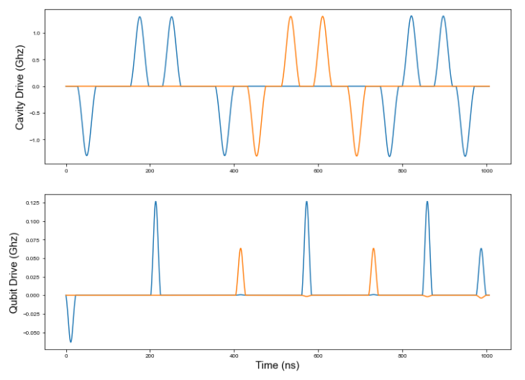
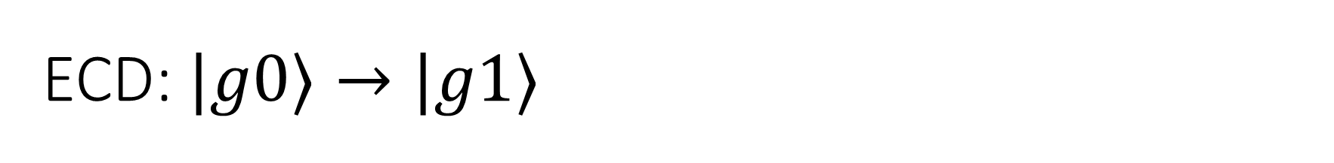
ECD: $|g0⟩→|g1⟩$
Qubit Echoes

Slide 19
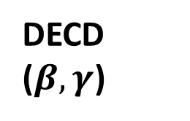

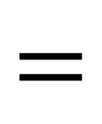



Two Mode ECD
Mode 1
DECD ($β,γ$)
Mode 1
ECD($γ$)
$$=$$
Mode 2
Mode 2
ECD($β$)
$$R_{φ}(θ)$$
Qubit
Qubit
$$R_{φ}(θ)$$
Generalizing ECD gate to 2 modes
Displacements on the two modes are not simultaneous (to avoid heating as observed in [*])
* Alec Eickbusch, Zhenghao Ding, …, Michel Devoret. W34. 00005. APS March Meeting (2022).

Slide 20
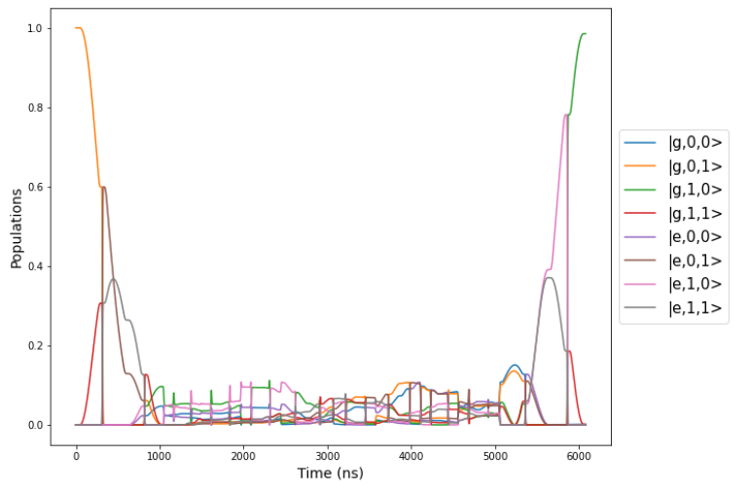
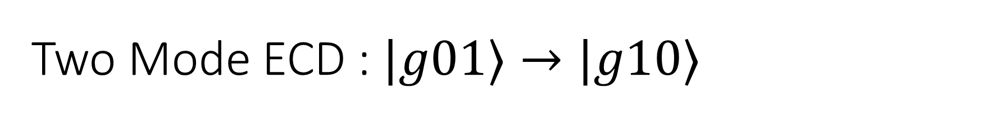
Two Mode ECD : $|g01⟩→|g10⟩$
Batch Optimizer Fidelity: 0.995
Qutip Fidelity : 0.985
Layers: 10
Mode level Truncation : 20

Slide 21
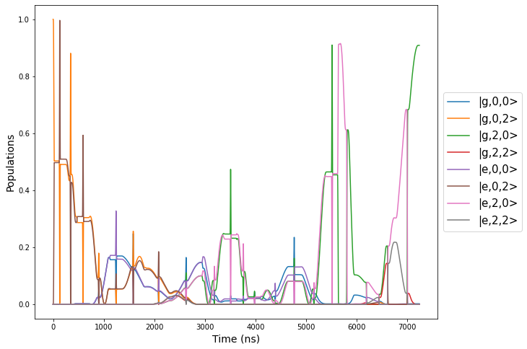
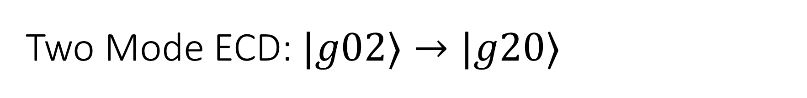
Two Mode ECD: $|g02⟩→|g20⟩$
Batch Optimizer Fidelity: 0.921
Qutip Fidelity : 0.900
Layers: 10
Mode level Truncation : 20

Slide 22
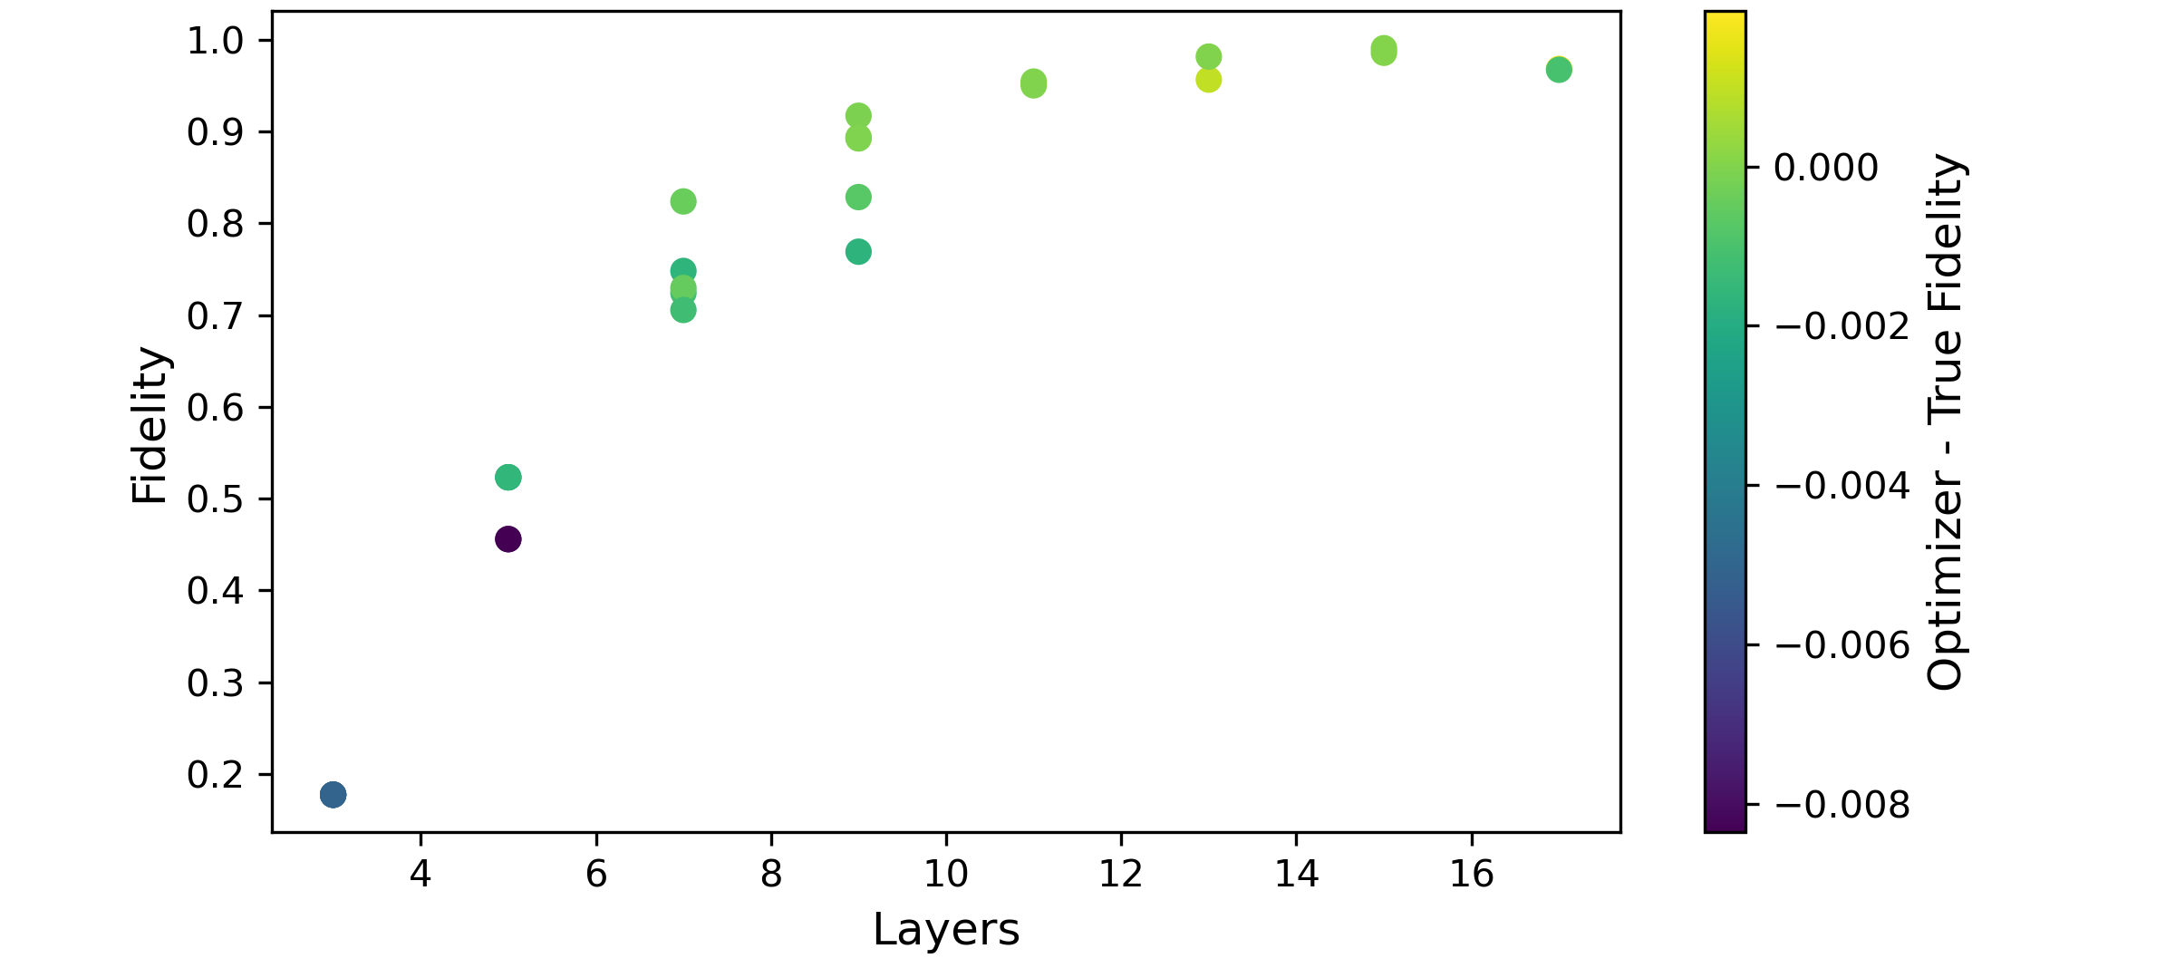
Two Mode ECD: Simultaneous State Transfer
$g01 →g10$and $g02 →g20$ (15 levels in each mode)

Slide 23
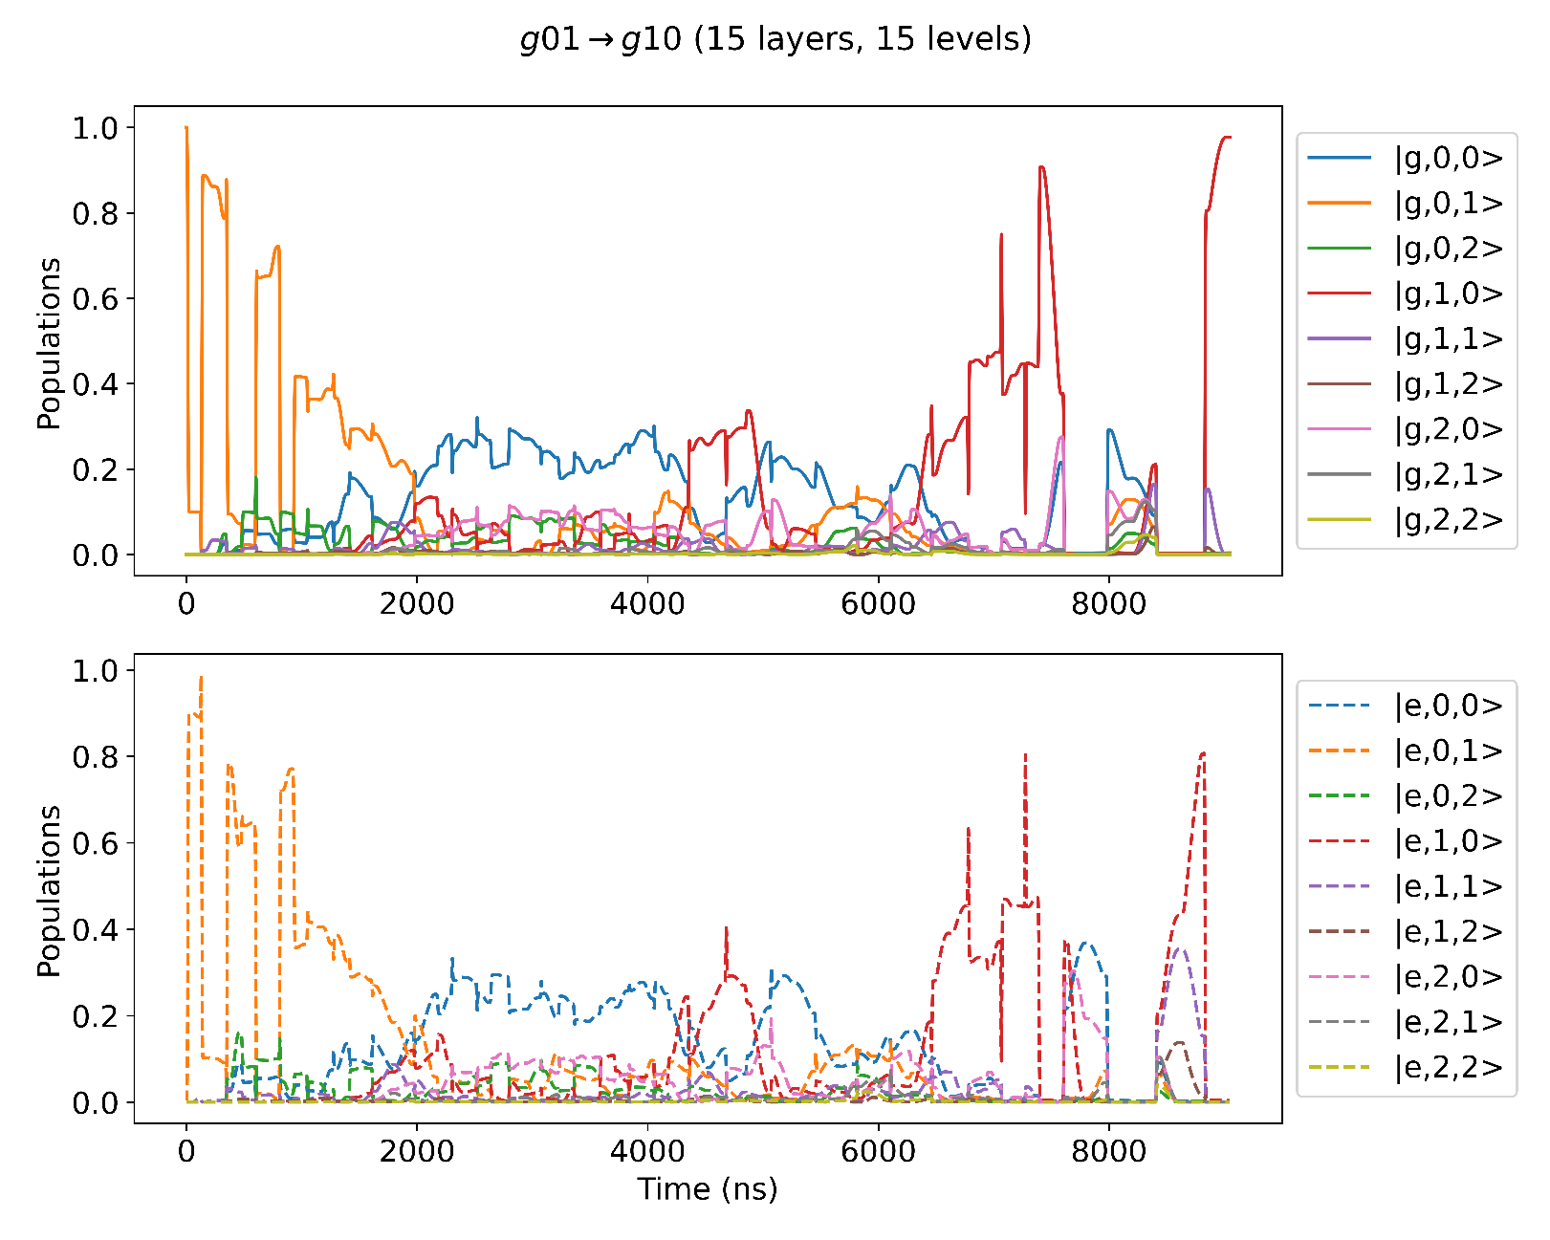
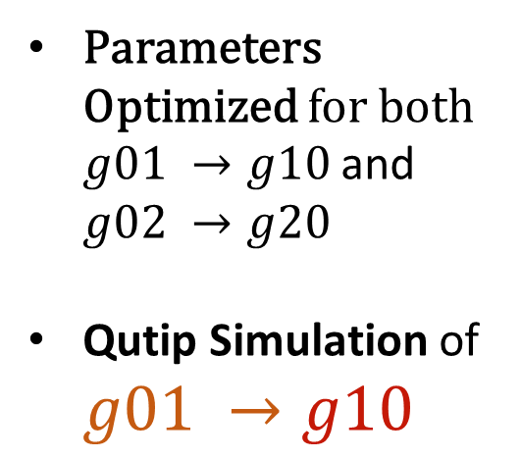
Two Mode ECD: Simultaneous State Transfer
Parameters Optimized for both $g01 →g10$and $g02 →g20$
Qutip Simulation of $g01 →g10$

Slide 24
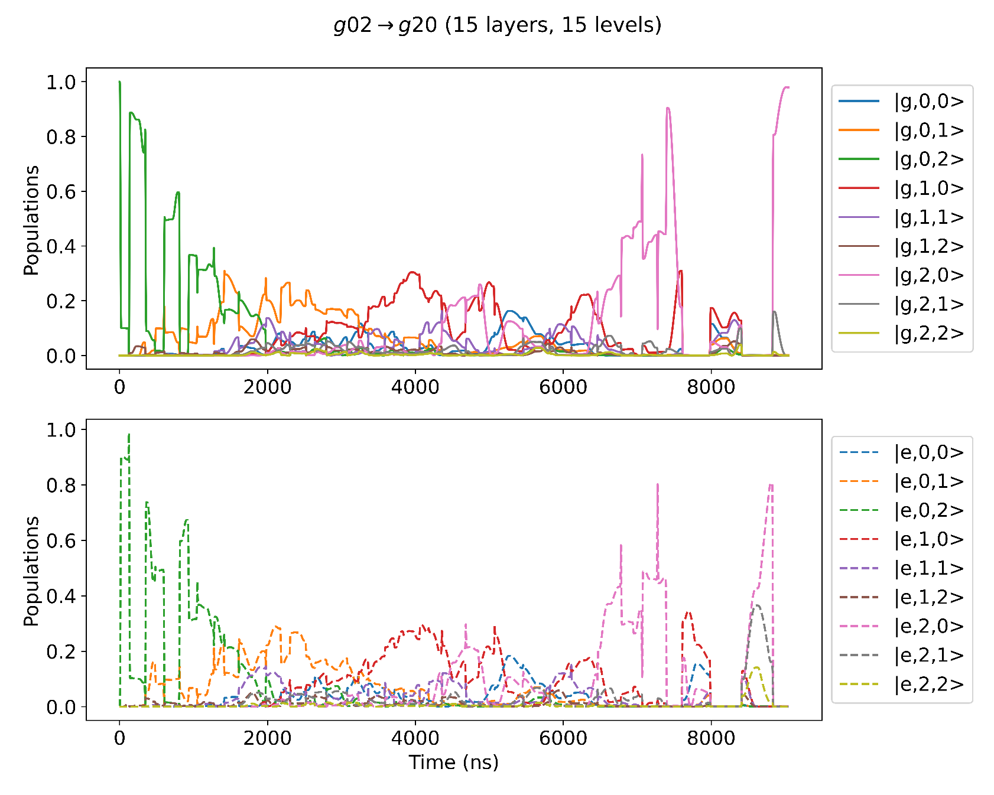
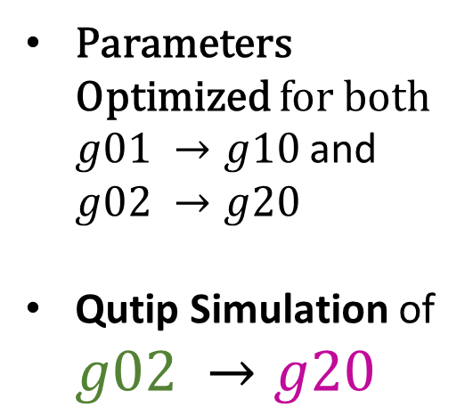
Two Mode ECD: Simultaneous State Transfer
Parameters Optimized for both $g01 →g10$and $g02 →g20$
Qutip Simulation of $g02 →g20$

Slide 25
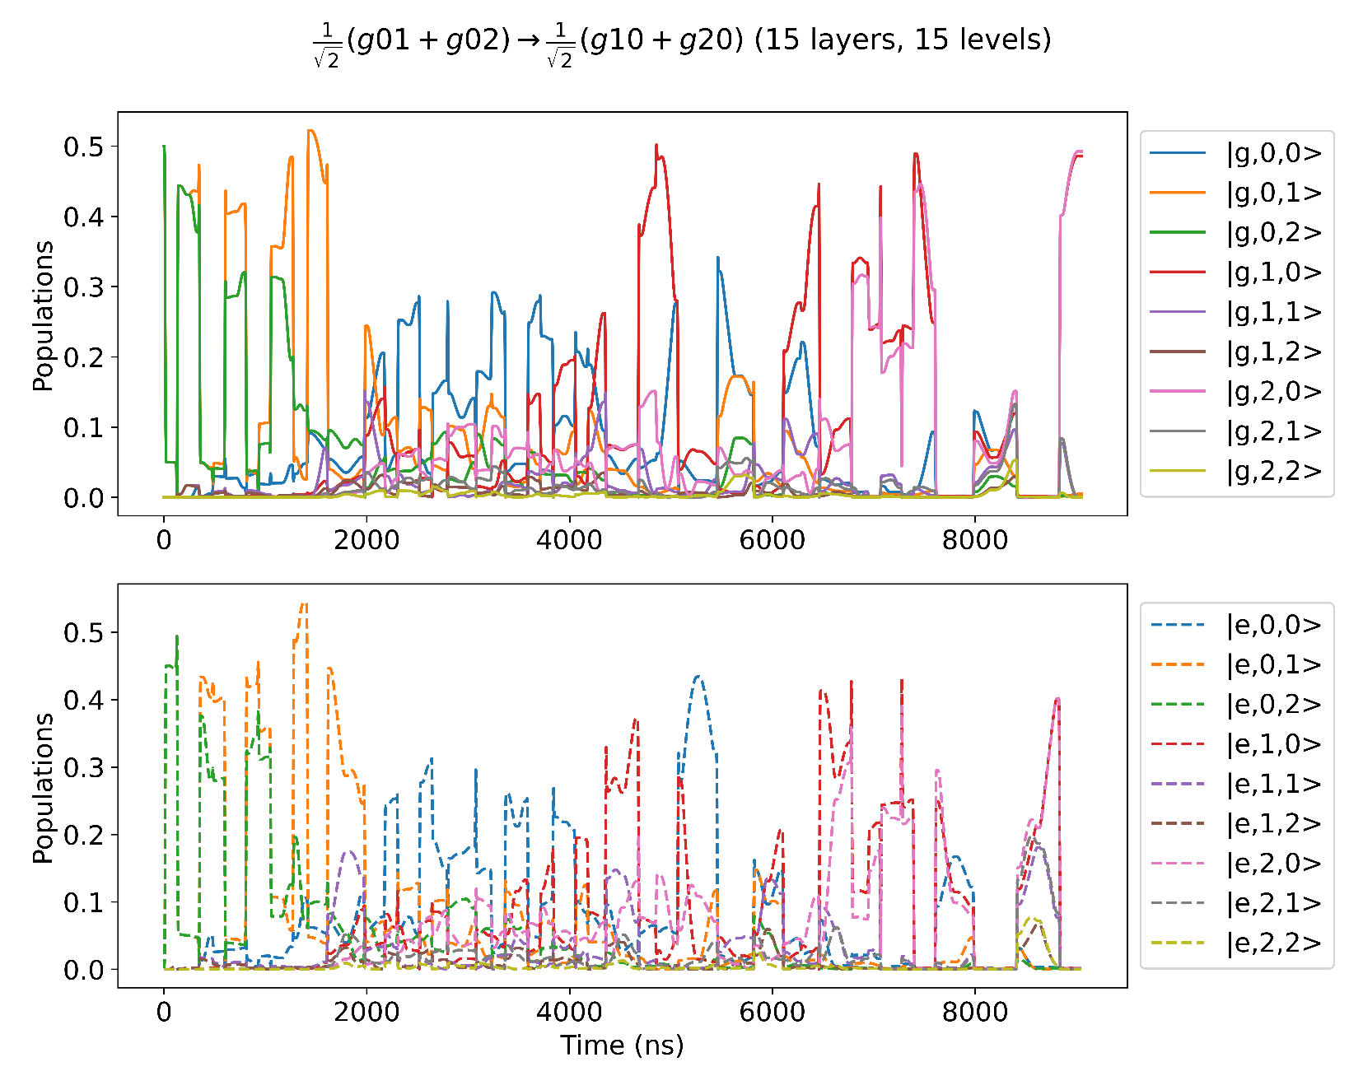
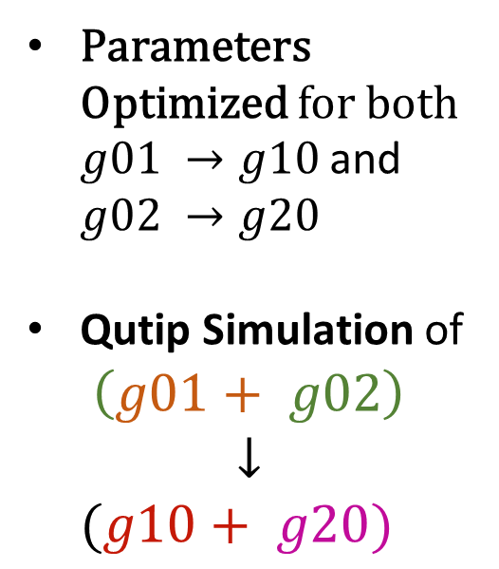
Two Mode ECD: Simultaneous State Transfer
Parameters Optimized for both $g01 →g10$and $g02 →g20$
Qutip Simulation of
$$\left(g01+ g02\right)$$
$$↓$$
$$(g10+ g20)$$

Slide 26


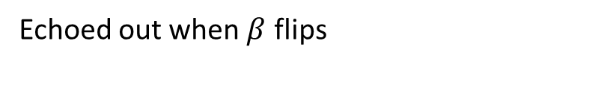


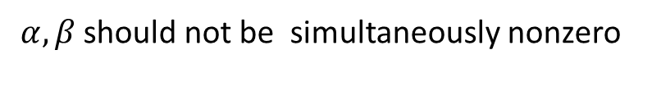

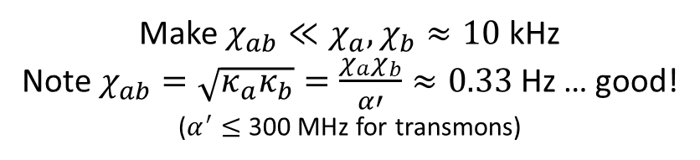
Two Mode ECD : Unwanted Cross Kerr Terms
Displaced Frame Transformation
$$χ_{ab}a^{†}a b^{†}b$$
$$χ_{ab}{(a}^{†}+α^{∗})(a+α)(b^{†}+β^{∗})(b+β)$$
Terms of form :
How to avoid :
$$χ_{ab}αβ a^{†}b^{†}$$
$α, β$should not be simultaneously nonzero
$$χ_{ab}{\left|α\right|}^{2}β b^{†}$$
Echoed out when $β$ flips
Make $χ_{ab}≪χ_{a}, χ_{b}≈10$kHz
Note $χ_{ab}=\sqrt{κ_{a}κ_{b}}=\frac{χ_{a}χ_{b}}{α′}≈0.33$Hz … good!
($α^{′}≤$ 300 MHz for transmons)
$χ_{ab}{\left|α\right|}^{2}b^{†}b$

Slide 27
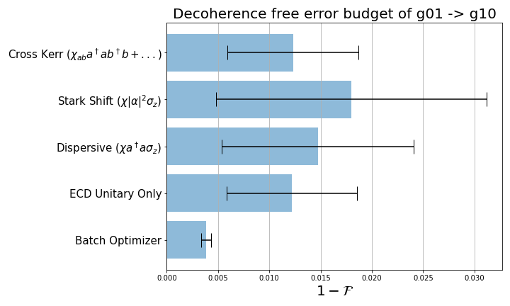
Two Mode ECD : QuTip Noise Simulations

Slide 28
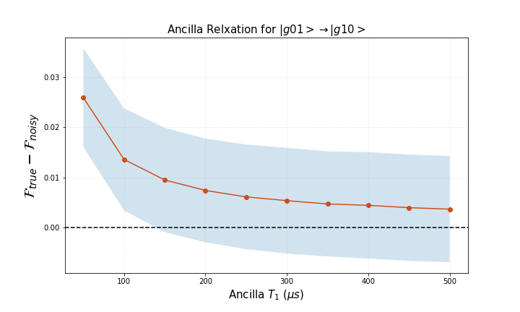
Two Mode ECD : QuTip Noise Simulations
Ancilla with better coherence times such as flux protected qubits may improve gate fidelities.

Slide 29
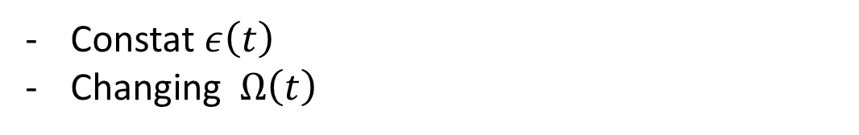








Circle Grape
Sideband Drives
Changing $ε\left(t\right)$
Constant $Ω\left(t\right)$
Circle Grape
$$α_{0}$$
$$ε\left(t\right)$$
$$H=χa^{+}aσ_{z }+χ\left(α_{0}a^{+}+α_{0}^{∗}a\right)σ_{z}+$$
$$χ{\left|α_{0}\right|}^{2}σ_{z}+Ω(t)σ_{x}$$
$$ε\left(t\right)$$
$$δ$$
$$t_{w}$$
$$Ω\left(t\right)$$
Sent to Optimizer
$$Ω\left(t\right)=Ω_{R}$$
Constat $ε\left(t\right)$
Changing $Ω\left(t\right)$
Similarly grap-ifying Sideband Drives?
Sending $δ(t)$ to the optimizer

Slide 30

Circle Grape Results

Slide 31

Conclusion
Conditional Displacement $→$fast, high fidelity alternative to SNAP
3 ways to realize CD gates:
Sideband Drives
Echoed CD
Circle GRAPE
Challenges
Cavity Dephasing Error
Modeling Cavity Errors (Decay operators change in Dispersive Frame)
Optimizing Layer Count (ECD too slow compared to Circle GRAPE)

Slide 32

Extras

Slide 33



Slide 34


Slide 35


