Slide 1
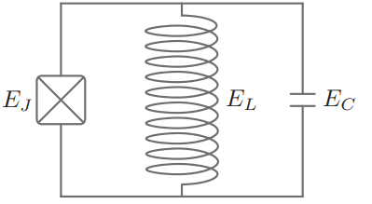
Noise Protection in Multimode Circuits: Bifluxon
Eesh Gupta
December 9, 2022

Slide 2
Contents
Single Mode Circuits
Towards Full Noise Protection: Bifluxon

Slide 3
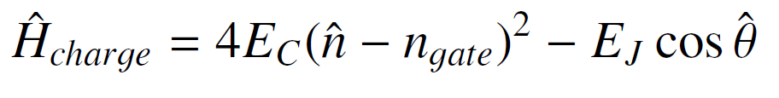

1. Single Mode Circuits
Flux Mode
Charge Mode
Islands store integer number of Cooper pairs
JJ allows tunneling of cooper pairs, producing anharmonic spectrum
Notes:
Superconudcting qubits can be classified into two categories: charge qubits and flux qubits.
Charge qubits
Charge qubits host a pair of disconnected superconuductors or \textit{islands}. Such islands can store integer number of Cooper pairs. The addition of a nonlinear element such as the Josephson Junction allows tunneling of Cooper pairs such that the computational subspace is isolated.
Promiment examples of charge modes include the Cooper pair box and the Transmon circuits. The former operates in regime where \(E_C \gtrsim E_J\), realizing a \textit{light} charge mode since the mass \(C\) of fictious particle is inversely proportional to \(E_C\). On the other hand, the latter transmon circuit operates in the regime where \(E_C \ll E_J\), realizing a \textit{heavy} charge mode.
Flux Qubits
On the other hand, flux mode hosts a \textit{loop} of superconudcting wire which stores integer number of flux quanta.
Examples: Fluxonium

Slide 4
1. Single Mode Circuits
Flux Mode
Charge Mode
Loops store integer number of flux quanta
Notes:
Charge qubits
Charge qubits host a pair of disconnected superconuductors or \textit{islands}. Such islands can store integer number of Cooper pairs. The addition of a nonlinear element such as the Josephson Junction allows tunneling of Cooper pairs such that the computational subspace is isolated.
Promiment examples of charge modes include the Cooper pair box and the Transmon circuits. The former operates in regime where \(E_C \gtrsim E_J\), realizing a \textit{light} charge mode since the mass \(C\) of fictious particle is inversely proportional to \(E_C\). On the other hand, the latter transmon circuit operates in the regime where \(E_C \ll E_J\), realizing a \textit{heavy} charge mode.
Flux Qubits
On the other hand, flux mode hosts a \textit{loop} of superconudcting wire which stores integer number of flux quanta.
Examples: Fluxonium

Slide 5


2. Dephasing
Protection requires minimizing $\frac{∂E_{01}}{∂λ}$ where external parameter $λ=n_{g}$
Strategy: Remove $n_{g}$from $\hat{H}$ and transfer it to Boundary Conditions
$$ψ\left(θ\right)=e^{2πn_{g}}ψ\left(θ+2π\right)$$
Notes:
Longer dephasing times requires minimizing the energy dispersion \(E_{01} (\lambda)\) as a result of change in some external parameter \(\lambda\)
For charge qubits, this required localizing the wavefunctions in phase space (or flux quanta) such that the fluctuations in external parameter i.e. the gate charge \(\delta n_g\) had minimal effects on the potential and the wavefunctions. %[Lecture 17]
Why?
To ridd the Hamiltonian of the gate charge, the dependence on ng was transferred to boundary conditions.
If wavefunction is localized in phase space, then on boundaries its small; so n_g has minimal effect on the wavefunctions and thus the spectra.

Slide 6
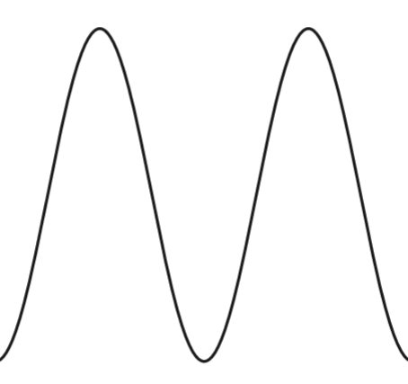

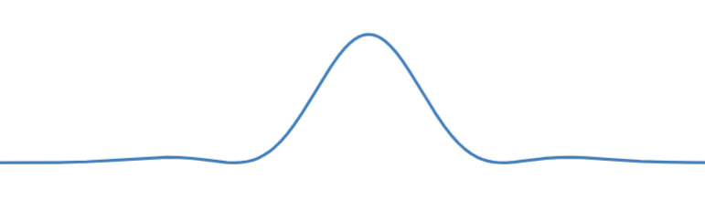
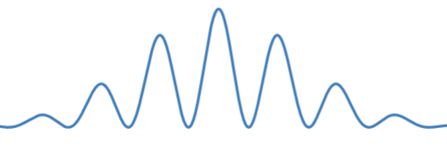






2. Dephasing
$$E_{J}≤E_{C}$$
$$E_{J}≫E_{C}$$
$$θ$$
$$θ$$
$$θ$$
$$θ$$
The change to boundary condition affects w.f. of CPB states but not those of transmon states

Slide 7




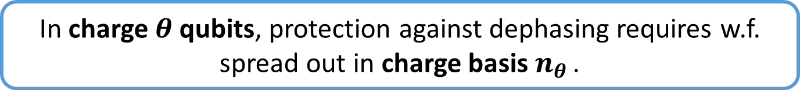
2. Dephasing
Since $n_{θ}, θ$ are conjugate variables, want delocalization in charge basis
$$E_{J}≫E_{C}$$
$$θ$$
$$n_{θ }$$
In charge $θ$ qubits, protection against dephasing requires w.f. spread out in charge basis $n_{θ }$.

Slide 8
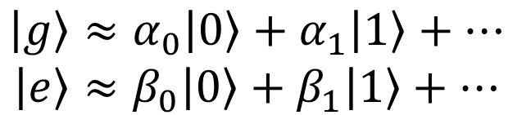
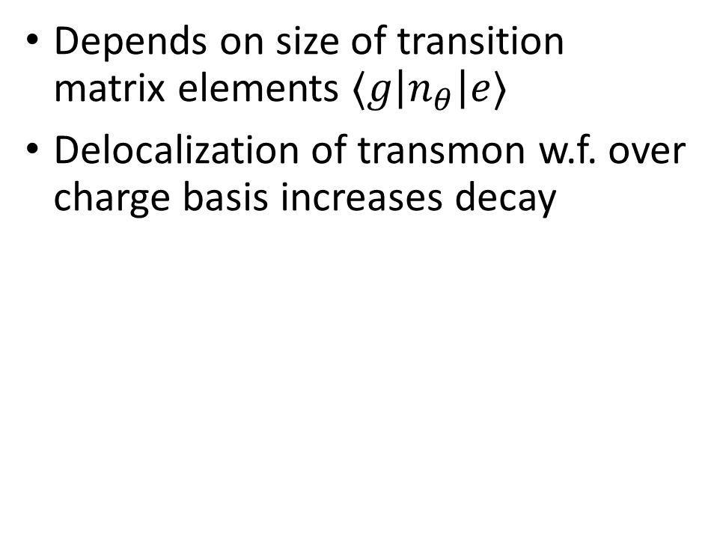

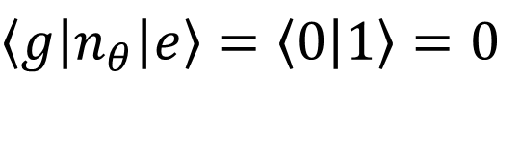


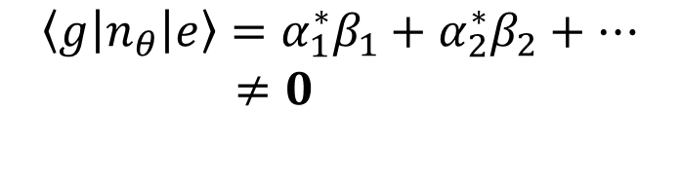
3. Decay
Depends on size of transition matrix elements $⟨g\left|n_{θ}\right|e⟩$
Delocalization of transmon w.f. over charge basis increases decay
Cooper pair wavefunctions rep in charge basis is wrong!
$$E_{J}≤E_{C}$$
$$\left|g\right\rangle ≈\left|0\right\rangle$$
$$\left|e\right\rangle ≈\left|1\right\rangle$$
$\left\langle g\left|n_{θ}\right|e\right\rangle =\left\langle 0 | 1\right\rangle =0$
Cooper Pair Box
$$E_{J}≫E_{C}$$
$$\left|g\right\rangle ≈α_{0}\left|0\right\rangle +α_{1}\left|1\right\rangle +…$$
$$\left|e\right\rangle ≈β_{0}\left|0\right\rangle +β_{1}\left|1\right\rangle +…$$
$$\left\langle g\left|n_{θ}\right|e\right\rangle =α_{1}^{∗}β_{1}+α_{2}^{∗}β_{2}+…$$
$≠0$
Transmon
Notes:
As wavefunctions of Transmon states have a greater spread over charge states as compared to CPB, this results in a large transition matrix elements for the number/charge operator
This can be seen by considering the wavefunction in the Cooper Pair Box limit and the transmon limit.
In the CPB limit, the transition matrix element is just the overlap between orthogonal charge states which is 0. (g and e occupy different charge states)
However in the transmon limit, this element is now a nonzero number b/c g and e have nonzero contributions from the same charge states
As a result, bit flip errors increase as phase flip errors decrease.

Slide 9
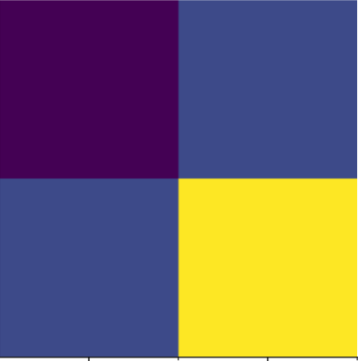



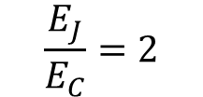

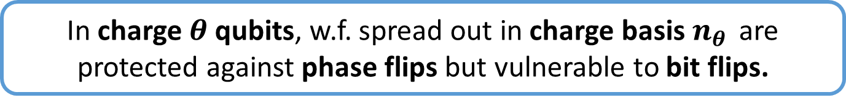
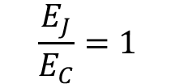




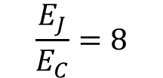
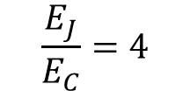

3. Decay
Charge Matrix elements$⟨i\left|n_{θ}\right|j⟩$ computed in scqubits
$$\frac{E_{J}}{E_{C}}=1$$
$$\frac{E_{J}}{E_{C}}=2$$
$$\frac{E_{J}}{E_{C}}=4$$
$$\frac{E_{J}}{E_{C}}=8$$
$$≈0.8$$
$$|g⟩$$
$$|e⟩$$
$$|g⟩$$
$$|e⟩$$
Transmon-like
$$≈0$$
In charge $θ$ qubits, w.f. spread out in charge basis $n_{θ }$ are protected against phase flips but vulnerable to bit flips.

Slide 10
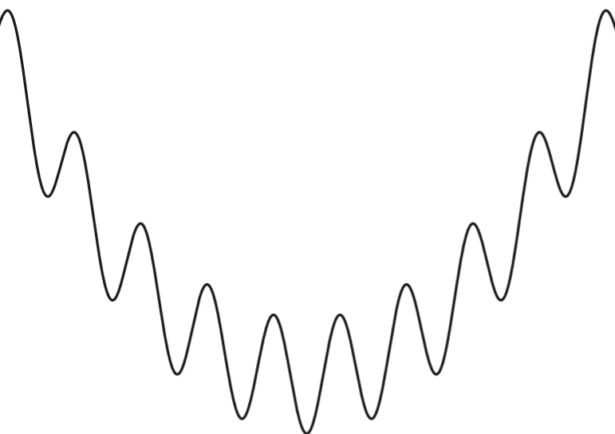




4. Fluxonium Fares Better
Since control knob $φ_{ext}$, dephasing protection requires delocalization in phase space
But again, at expense of large $\left|\left\langle g\left|φ\right|e\right\rangle \right|$
$$E_{L}≪E_{J}<E_{C}$$
Light regime
$$φ$$
$$φ$$
Notes:
Wheras dephasing protection in charge qubits required delocalization of wavefunction in charge space, flux qubits like fluxonium require delocalization in flux space. This is because control knob here is the external flux instead of charge. In other words, we operate in the “light” regime.
Similar to previous case, in this light regime, the phase matrix elements are large , increasing bit flip errors
While fluxonium also requires a tradeoff – localizing wavefunction within the potential in phase space (heavy fluxonium) – this compromise is not as bad as that in the transmon case due to fundamental assymtry between charge and flux fluctuations; experimentally, amplitude of flux fluctuations are 2 orders of magnitude smaller than charge fluctuations. So we don’t lose too much on dephasing by going in the opposite “heavy” regime.
Heavy fluxoniums typically have longer lifetimes than transmon; but the tradeoff problem persists.

Slide 11
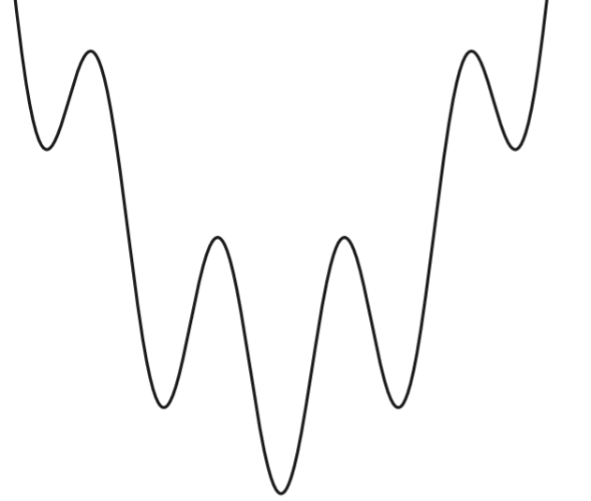





4. Fluxonium Fares Better
Experimentally, phase fluctuations $≪$ charge fluctuations
Can make heavier without losing too much on dephasing.
$$φ$$
$$φ$$
$$E_{L}≪E_{J}<E_{C}$$
$${E_{C}≈E}_{L}≪E_{J}$$
Light regime
Heavy regime
A. Gyenis, … , D. Schuster. PRX Quantum 2-3 (2021).

Slide 12




5. Upshot
 | Charge Qubits | Flux Qubits
Phase Flip Protection
Bit Flip Protection
$$θ$$
$$φ$$
$$θ$$
$$φ$$
Single Mode Circuits cannot be simultaneously protected against bit flip and phase flip errors

Slide 13
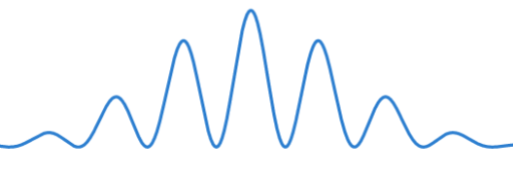




5. Upshot
 | Charge Qubits | Flux Qubits
Phase Flip Protection
Bit Flip Protection
$$n_{θ }$$
$$φ$$
$$n_{θ}$$
$$φ$$
Single Mode Circuits cannot be simultaneously protected against bit flip and phase flip errors

Slide 14
Contents
Single Mode Circuits
Single Mode Circuits cannot be simultaneously protected against bit flip and phase flip errors
Towards Full Noise Protection: Bifluxon

Slide 15





5. Marriage of Modes
$$≈$$
$$+$$
$$θ$$
$$φ$$
$$0−π$$
,
Bifluxon
$$H = 4E_{C}^{θ}{\left(n_{θ} − n_{gate}\right)}^{2} + 4E_{C}^{φ} n_{φ}^{2} + E_{L}\frac{{\left(φ− 2πφ_{ext}\right)}^{2}}{2} − 2E_{J}\cos{θ}\cos{φ}$$
A. Gyenis, … , D. Schuster. PRX Quantum 2-3 (2021).
Notes:
In the “hard” regime, these circuits can be approximated as two coupled modes: charge-like and the flux-like modes
Why So? On first glance, theta is compact (as in CPB, transmons) while phi is extended (as in fluxonium)
These modes are nonlinearly coupled through the josephson energy term
While “hard” regime typically offers exponential protection against dephasing and bit flips, its difficult to realize because of
Large inductances for making the flux mode light
Stray capacitances in the circuit

Slide 16
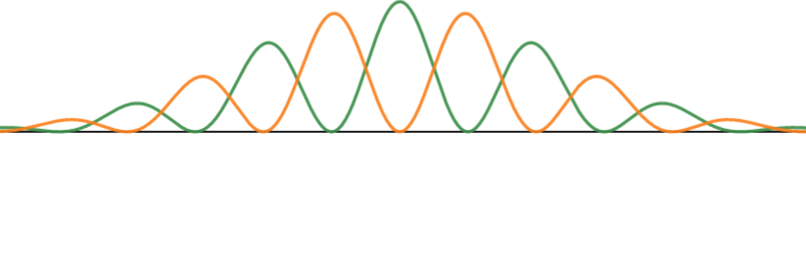
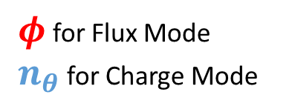


6. Wavefunctions in separate regions
$$|g⟩$$
$$|e⟩$$
$φ$ for Flux Mode
$n_{θ}$ for Charge Mode
Earlier:
Wavefunctions confined to a single axis
Delocalized g and e states can be easily connected by local operators ( bit flip )
Notes:
Earlier, wavefunctions could be either
localized (dephasing errors increase) and have small matrix elements (bit flip errors decrease)
Or delocalized (dephasing errors decrease) and have large matrix elements (bit flip errors increase)
Now, we can have best of both worlds: delocalized wavefunctions but with small matrix elements
Put another way,
Nearly degenerate 0,1 levels (good for dephasing b/c of small energy dispersion)
These levels will have opposite parity and transitions between opposite parties are prevented due to symmetry of the system.

Slide 17
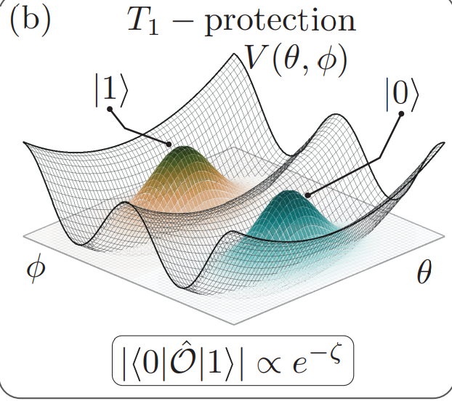
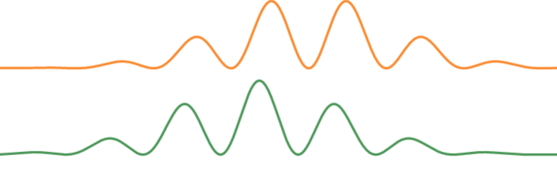


6. Wavefunctions
$$|g⟩$$
$$|e⟩$$
$$θ$$
$$φ$$
Now:
Wavefunction not confined to a single axis / dimension
Delocalized G and e can occupy different regions, reducing bit-flip errors
A. Gyenis, … , D. Schuster. PRX Quantum 2-3 (2021).

Slide 18
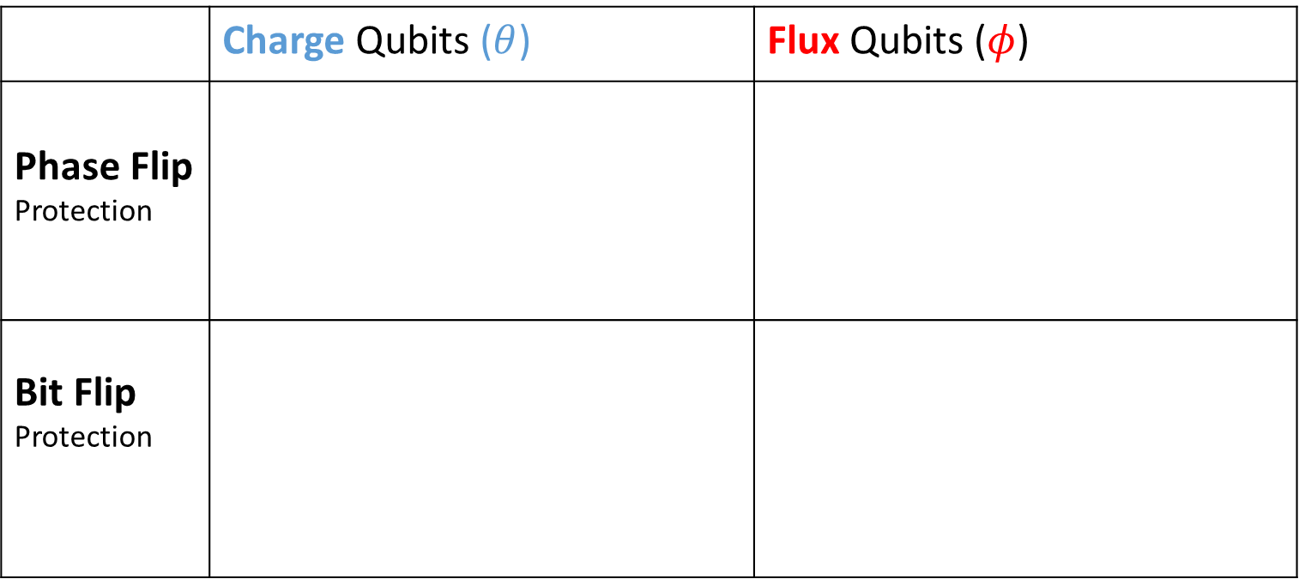
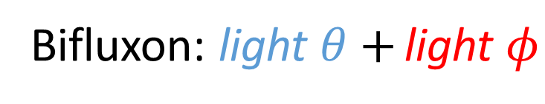
7. Bifluxon
 | Charge Qubits ($θ$) | Flux Qubits ($φ$)
Phase Flip Protection
Bit Flip Protection
$$θ$$
$$φ$$
$$θ$$
$$φ$$
Bifluxon: light $θ+$ light $φ$

Slide 19
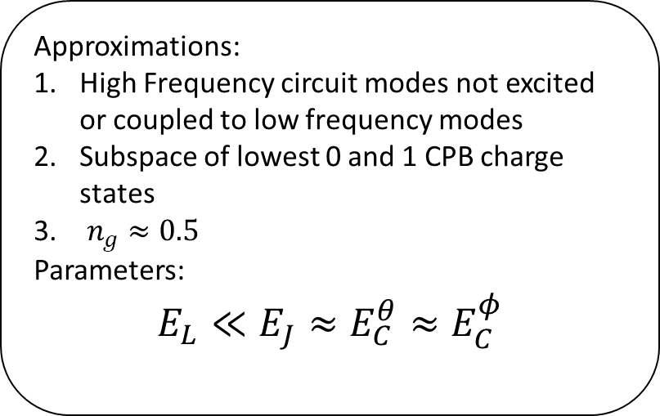



7. Bifluxon
$$H = 4E_{C}\left(\frac{1}{2}−n_{g}\right) + 4E_{C}^{φ} n_{φ}^{2} +$$
$$E_{L}(φ−2πφ_{ext}) − 2E_{J}\cos{\frac{φ}{2}}σ_{x}$$
$$C_{g}$$
$$V_{g}$$
$$n_{ }$$
Approximations:
High Frequency circuit modes not excited or coupled to low frequency modes
Subspace of lowest 0 and 1 CPB charge states
$n_{g}≈0.5$
Parameters:
$$E_{L}≪E_{J}≈E_{C}^{θ}≈E_{C}^{φ}$$
$$E_{J}$$
$$E_{J}$$
$$Φ_{ext}$$
$${−φ/2}_{ }$$
$${+φ/2}_{ }$$
$$E_{L }$$
light $θ$, light $φ$
K. Kalashnikov, … , M. Gershenson, M. Bell. PRX Quantum 1-1 (2020).

Slide 20
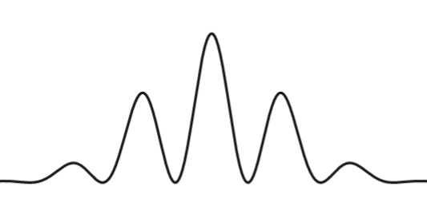
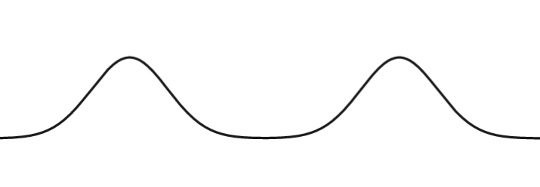
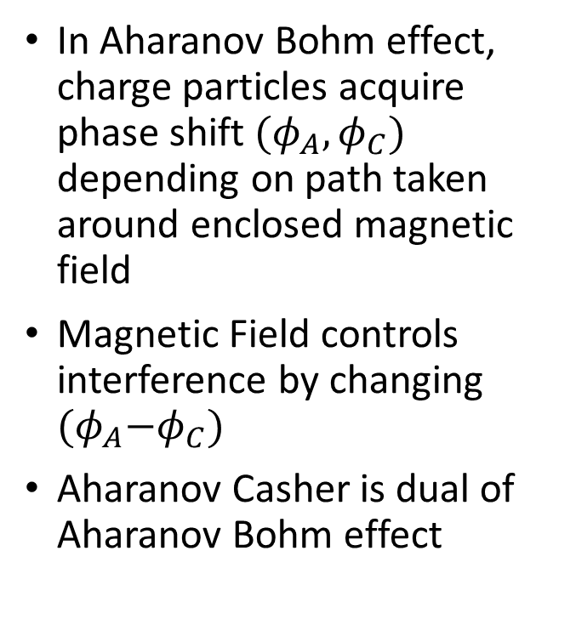
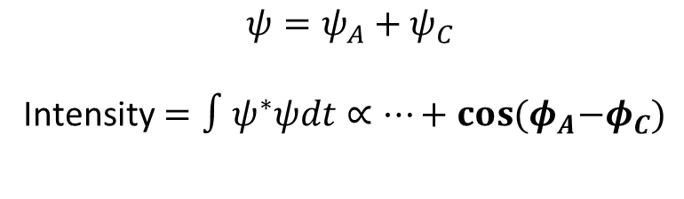




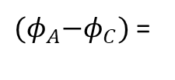
8. Aharanov Casher Effect
Fringes move but the pattern does not change! Figure is wrong
In Aharanov Bohm effect, charge particles acquire phase shift$(φ_{A}, φ_{C})$ depending on path taken around enclosed magnetic field
Magnetic Field controls interference by changing ${(φ}_{A}−φ_{C})$
Aharanov Casher is dual of Aharanov Bohm effect
$$ψ_{A }∝e^{iφ_{A}}$$
B
e
$$ψ_{C }∝e^{iφ_{C}}$$
${(φ}_{A}−φ_{C})$ =
$$0$$
$$\frac{π}{2}$$
$$ψ=ψ_{A}+ψ_{C}$$
Intensity$=∫ψ^{∗}ψdt∝…+\cos{{(φ}_{A}−φ_{C})}$
Notes:
Dual of Aharanov Bohm -> Two trajectories a charge particle can take and the presence of magnetic field; the particle attains a phase difference depending on the path taken
This phase difference causes interference [show double slit]; if magnetic field tuned, the interference pattern could be destroyed
Similar stuff happens here but instead of a charge particle, we have magnetic field particle – fluxon.
Explain via pauli matrices; if n_g not 1/2, then E_C mixes the plus and minus states
But when n_g = ½, then no transitions between + and – allowed; flux tunneling supression

Slide 21

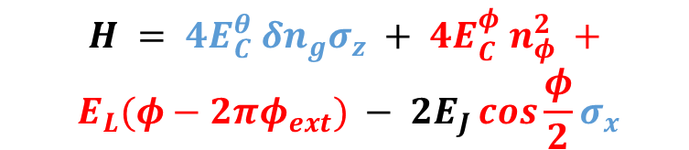


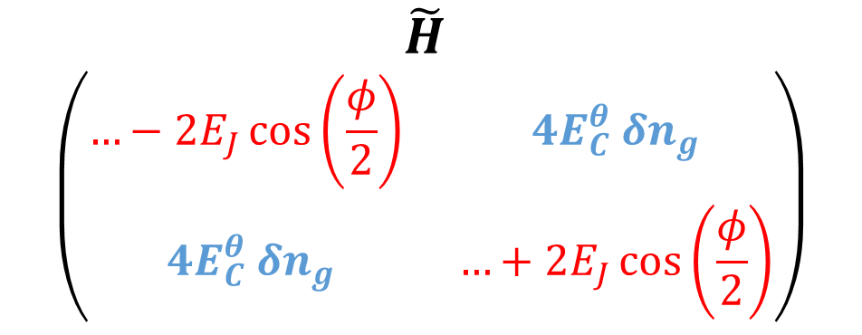
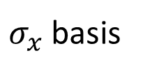

8. Aharanov Casher Effect
$$\tilde{H}$$
$$\left(\begin{matrix}…−2E_{J}\cos\left(\frac{φ}{2}\right) & 4E_{C}^{θ} δn_{g} \\ 4E_{C}^{θ} δn_{g} & …+2E_{J}\cos\left(\frac{φ}{2}\right)\end{matrix}\right)$$
$$H = 4E_{C}^{θ} δn_{g}σ_{z} + 4E_{C}^{φ} n_{φ}^{2} +$$
$$E_{L}(φ−2πφ_{ext}) − 2E_{J}\cos{\frac{φ}{2}}σ_{x}$$
$$|+⟩$$
$σ_{x}$basis
$$|−⟩$$
$$|+⟩$$
$$|−⟩$$
Interference between $\left|±\right\rangle$ states controlled by $δn_{g}=0.5 − n_{g}$

Slide 22
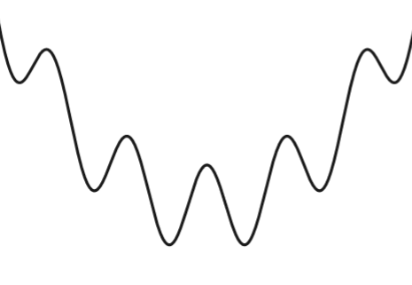
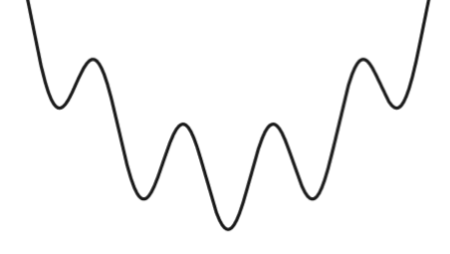
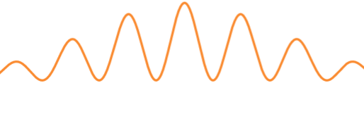











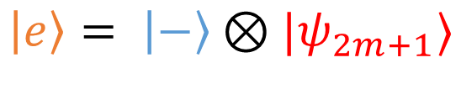

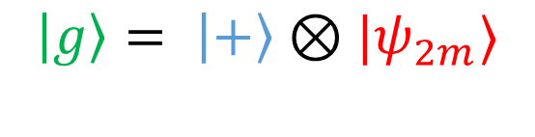




9. Two Fluxoniums
$$H_{±}= 4E_{C}^{φ} n_{φ}^{2} +E_{L}\left(φ−2πφ_{ext}\right)∓ 2E_{J}\cos{\frac{φ}{2}}$$
$$φ$$
$$−4π$$
$$0$$
$$4π$$
$$φ$$
$$−4π$$
$$0$$
$$4π$$
$$2πφ$$
$$−2$$
$$0$$
$$2$$
$$2πφ$$
$$−2$$
$$0$$
$$2$$
$$\left|g\right\rangle = \left|+\right\rangle ⊗|ψ_{2m}⟩$$
$$\left|e\right\rangle = \left|−\right\rangle ⊗|ψ_{2m+1}⟩$$
Notes:
Charge states $\left|±\right\rangle$ determine the sign of the effective Josephson energy term
Change in signs corresponds to change of potential landscape: the local minima of fluxonium-like potential occurs at odd *2pi in one case and at even*2pi at other
The wavefunctions in the two cases peak at different points
This can be interpreted as the loop storing even or odd flux quanta

Slide 23
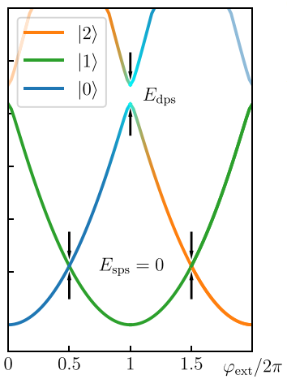

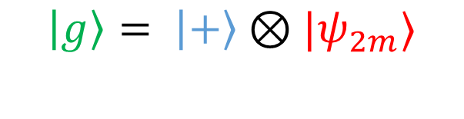
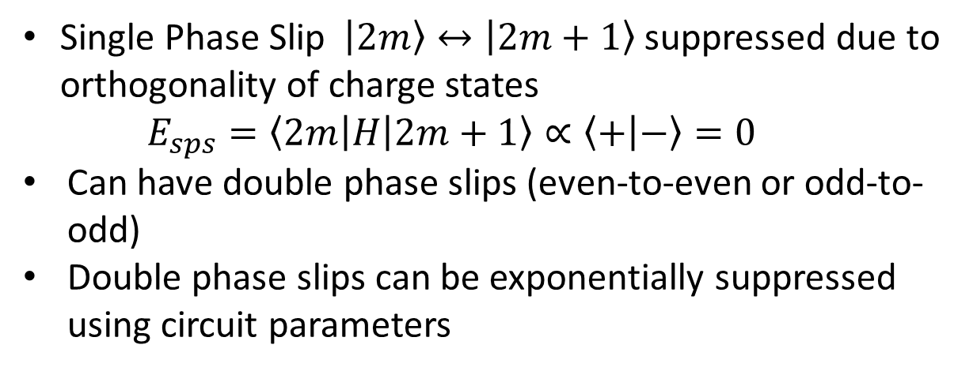
9. Two Fluxoniums
$$\left|g\right\rangle = \left|+\right\rangle ⊗|ψ_{2m}⟩$$
$$\left|e\right\rangle = \left|−\right\rangle ⊗|ψ_{2m+1}⟩$$
Single Phase Slip $\left|2m\right\rangle ↔\left|2m+1\right\rangle$ suppressed due to orthogonality of charge states
$$E_{sps}=\left\langle 2m\left|H\right|2m+1\right\rangle ∝\left\langle + | −\right\rangle =0$$
Can have double phase slips (even-to-even or odd-to-odd)
Double phase slips can be exponentially suppressed using circuit parameters
Logical states store odd or even flux quanta depending on the charge mode state
K. Kalashnikov, … , M. Gershenson, M. Bell. PRX Quantum 1-1 (2020).

Slide 24

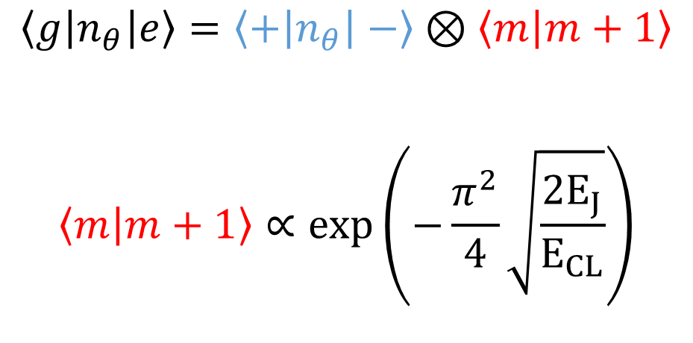
10. Noise Protection: Decay
Local operators of $θ,φ$ modes cannot connect $\left|g\right\rangle ↔|e⟩$
Flux Noise Induced Decay
Charge Noise Induced Decay
$$\left\langle g\left|n_{θ}\right|e\right\rangle =\left\langle +\left|n_{θ}\right|−\right\rangle ⊗\left\langle m | m+1\right\rangle$$
$$\left\langle m | m+1\right\rangle ∝exp\left(−\frac{π^{2}}{4}\sqrt{\frac{{2E}_{J}}{E_{CL}}}\right)$$
$$\left\langle g\left|φ\right|e\right\rangle =\left\langle +|−\right\rangle ⊗\left\langle m | φ|m+1\right\rangle$$
$$=0$$
K. Kalashnikov, … , M. Gershenson, M. Bell. PRX Quantum 1-1 (2020).

Slide 25
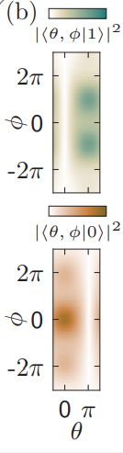







10. Noise Protection: Decay
$$|g⟩$$
$$|e⟩$$
$$θ=π$$
$$|−⟩$$
$$−2E_{J}\cos{θ}\cos{\frac{φ}{2}}$$
$$θ$$
$$θ=0$$
$$|+⟩$$
$$φ$$
Top View:
$$|g⟩$$
$$|e⟩$$
A. Gyenis, … , D. Schuster. PRX Quantum 2-3 (2021).

Slide 26



11. Noise Protection: Dephasing
Insesitive to flux noise induced dephasing (light flux mode)
Sensitive to charge noise induced dephasing (light charge mode)
Charge mode cannot be made heavier in bifluxon by tuning $C_{g}$
$$C_{θ}=C_{g}+\frac{2C_{0}C_{J}}{C_{0}+C_{J}}$$
$$C_{φ}=C_{L}+\frac{C_{0}+C_{J}}{2}$$
Original Supplement
$$C_{θ}={2C}_{J}+\frac{2C_{0}C_{g}}{C_{0}+C_{g}}$$
$$C_{φ}=C_{L}+\frac{C_{0}+C_{J}}{2}$$
Corrected Quantization
(Vatsan’s Notes)
K. Kalashnikov, … , M. Gershenson, M. Bell. PRX Quantum 1-1 (2020).
Notes:
Local operators cannot connect g and e
Theta local ops – flux quanta
Phi local ops – charge + -
Flux noise induced dephasing: protected because of light flux mode – exponential suppression
But not charge induced dephasing because of light charge mode- not exponential sensitivity

Slide 27




12. Outlook
Experiment:
100 $μs$ improvement in T1 time from unprotected to protected regime (best $T_{1}=125 μs$)
Low $T_{2}=0.7 μs$ due to charge noise fluctuations
Difficulties:
Design: Large inductors, small stray capacitances
Control: Lift protection to enact gates
$$P_{excited}$$
K. Kalashnikov, … , M. Gershenson, M. Bell. PRX Quantum 1-1 (2020).

Slide 28
Summary
Single Mode Circuits and Partial Noise Protection
Single Mode Circuits cannot be simultaneously protected against bit flip and phase flip errors
Towards Full Noise Protection: Bifluxon
Underlying Symmetry of the Hamiltonian leads to simultaneous protection against both bit flip and phase flip errors

Slide 29


Extra 1: Cooper pair Tunneling in $0−π$
Assume $L→∞$
Agustin Di Paolo et al 2019 New J. Phys. 21 043002
Notes:
Whereas Bifluxon only allows tunneling of pairs of fluxons, 0-pi only allows pairs of charge states to tunnel across.
This occurs because cooper pair tunneling across one junction is mirrored by that across the other (to make the charge on either sides of the capcitor plates equal)
Effectively, we have a new element that allows tunneling of a pair of cooper pairs
Note here no current flows through inductor as we have assumed L -> infty

Slide 30



Extra 1: Cooper pair Tunneling in $0−π$
Assume $L→∞$
$$+2e$$
$$−2e$$
Agustin Di Paolo et al 2019 New J. Phys. 21 043002

Slide 31


Extra 1: Cooper pair Tunneling in $0−π$
Assume $L→∞$
$$+2e$$
$$+2e$$
$$−2e$$
$$−2e$$
Agustin Di Paolo et al 2019 New J. Phys. 21 043002

Slide 32



Extra 1: Cooper pair Tunneling in $0−π$
Symmetry: Only Pairs of Cooper Pairs allowed to tunnel!
$H_{T}=\frac{{−E}_{J}}{2}\sum_{m}{(|m⟩\left\langle m+2\right|+c.c.)}$
$$+2e$$
$$+2e$$
$$−2e$$
$$H_{T}=−E_{J}cos⁡(2φ)$$
$$−2e$$
In Bifluxon, we had $cos⁡(φ/2)$
Symmetry in the effective Hamiltonian change in periodicity of the cosine potential
Agustin Di Paolo et al 2019 New J. Phys. 21 043002
Notes:
Since we have 2 Cooper pairs tunneling, we also have a change in the form of the superconducting phase across the junction
Why so? When deriving the Josephson energy, we connected the M state with m+1; now its m with m+2 [show through equations]
So the josephson energy of the $θ$ mode is pi periodic instead of 2 pi periodic.
Interesting to note that Bifluxon also changes the periodicity of the josephson energy but that of the $φ$ mode.

Slide 33
Bifluxon: Circuit Quantization
Source: Vatsan’s Notes

Slide 34



Slide 35



Slide 36



Slide 37



