Slide 1
Cross-talk Free Control of Multimode Cavities with Conditional Displacements

Slide 2

Motivation
Weak coupling -> slower gates but less error propagation
Strong Coupling -> faster gates but more error propagation
Maintain weak coupling but $χα_{0}$ schemes enhance effective interaction strength

Slide 3
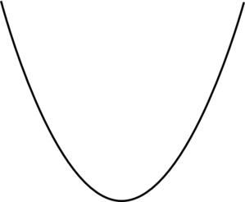
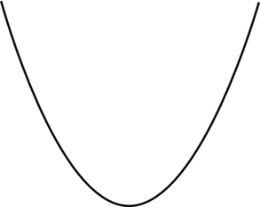



Cross Talk Errors
$N$ non-target modes
Gate Speed ${ g}_{gate}=χα_{max}$
Coherent Errors: $ε_{coh}=\frac{Nχ}{g_{gate}}=\frac{N}{α_{max}}$
Contrast: $\frac{ε_{coh}}{{ g}_{gate}}=\frac{4N}{A}$
$$χ={\left(\frac{g}{Δ}\right)}^{2}A$$
$$α_{max}=\sqrt{n_{crit}}=\frac{Δ}{2g}$$

Slide 4
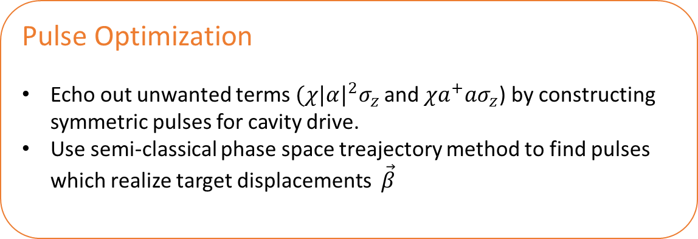
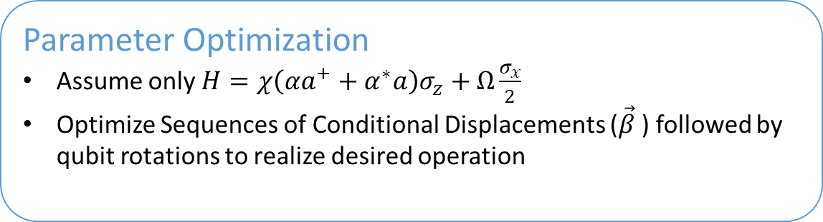
Prev. Work: Echoed Cond. Disp.
Parameter Optimization
Assume only $H=χ\left(αa^{+}+α^{∗}a\right)σ_{z}+Ω\frac{σ_{x}}{2}$
Optimize Sequences of Conditional Displacements ($\vec{β}$) followed by qubit rotations to realize desired operation
Pulse Optimization
Echo out unwanted terms$(χ{|α|}^{2}σ_{z}$ and $χa^{+}aσ_{z}$) by constructing symmetric pulses for cavity drive.
Use semi-classical phase space treajectory method to find pulses which realize target displacements $\vec{β}$
A. Eickbusch, ..., R. Schoelkopf, M. Devoret. ArXiv preprint arXiv:2111.06414 (2021)

Slide 5
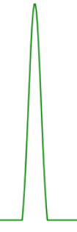
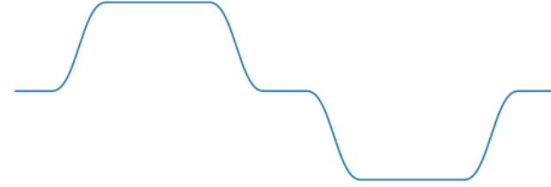








Prev. Work: Echoed Cond. Disp.
$$α\left(t\right)$$
$$Ω(t)$$
t
Not completely
echoed out !
$$χa^{+}aσ_{z}$$
$$−χa^{+}aσ_{z}$$
Echo
$$χ\left(αa^{+}+α^{∗}a\right)σ_{z}$$
$$χ\left(αa^{+}+α^{∗}a\right)σ_{z}$$
$$χ{|α|}^{2}σ_{z}$$
$$−χ{|α|}^{2}σ_{z}$$
A. Eickbusch, ..., R. Schoelkopf, M. Devoret. ArXiv preprint arXiv:2111.06414 (2021)

Slide 6


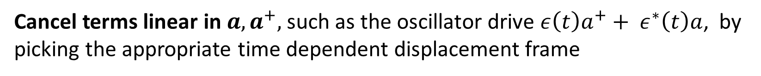




Prev Work: ECD: Evolution in Phase Space
$$ε\left(t\right)$$
$$Ω\left(t\right)$$
$$t$$
$$α\left(t\right)$$
t
$$|g⟩$$
$$|e⟩$$
$$Im(α)$$
$$Re(α)$$

Slide 7

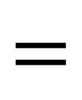



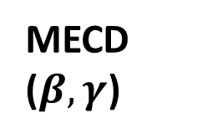
Multimode ECD
Mode 1
MECD ($β,γ$)
Mode 1
ECD($γ$)
$$=$$
Mode 2
Mode 2
ECD($β$)
$$R_{φ}(θ)$$
Universal Control for Two Modes
Not simultaneously driving each mode to prevent heating of modes [1,2]
Qubit
Qubit
$$R_{φ}(θ)$$
[1] Diringer, Asaf A., et al. arXiv preprint arXiv:2301.09831 (2023). [2] Alec Eickbusch, et al. W34. 00005. APS March Meeting (2022).

Slide 8


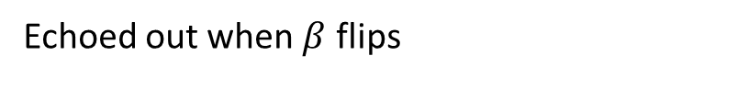


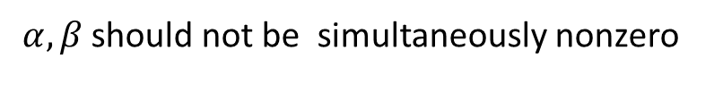

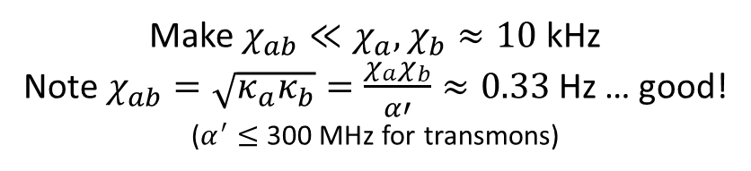
Two Mode ECD : Unwanted Cross Kerr Terms
Displaced Frame Transformation
$$χ_{ab}a^{+}a b^{+}b$$
$$χ_{ab}{(a}^{+}+α^{∗})(a+α)(b^{+}+β^{∗})(b+β)$$
Terms of form :
How to avoid :
$$χ_{ab}αβ a^{+}b^{+}$$
$α, β$should not be simultaneously nonzero
$$χ_{ab}{\left|α\right|}^{2}β b^{+}$$
Echoed out when $β$ flips
Make $χ_{ab}≪χ_{a}, χ_{b}≈10$kHz
Note $χ_{ab}=\sqrt{κ_{a}κ_{b}}=\frac{χ_{a}χ_{b}}{α′}≈0.33$Hz … good!
($α^{′}≤$ 300 MHz for transmons)
$χ_{ab}{\left|α\right|}^{2}b^{+}b$

Slide 9
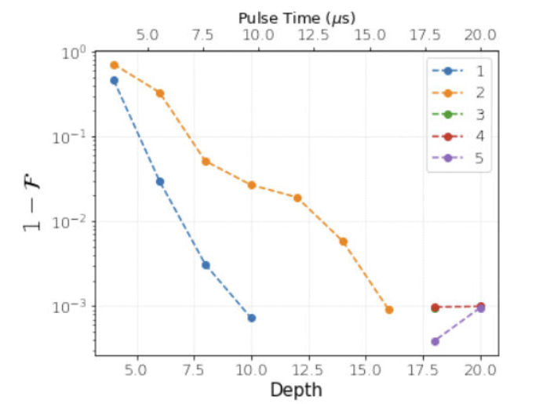

Two Mode ECD: State Transfer
$$g⊗\left|0n\right\rangle →g⊗|n0⟩$$

Slide 10



Two Mode ECD: State Transfer
$$g⊗\left( \left|n0\right\rangle → | 0n\right\rangle )$$
$$g⊗(\left|0\right\rangle →|n⟩)$$
$$g⊗(\left|n\right\rangle →|0⟩)$$
Notes:
Compare with Single Mode ECD Results

Slide 11
Multimode ECD: Error Budget

Slide 12
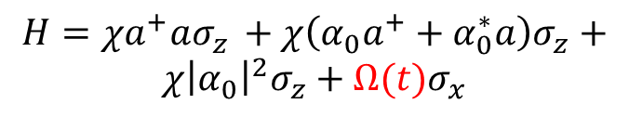
Circle Grape
Continuous version
Currently uses simulatenous drives
Phase Space Dynamics
$$H=χa^{+}aσ_{z }+χ\left(α_{0}a^{+}+α_{0}^{∗}a\right)σ_{z}+$$
$$χ{\left|α_{0}\right|}^{2}σ_{z}+Ω(t)σ_{x}$$
Sent to Optimizer

Slide 13
Comparing Grape and MECD
ECD

Slide 14
Circle Grape Results

Slide 15
Conclusions and Future Work
Suppression of cross-talk errors by chi alpha schemes
Multimode schemes limited to 1/chi alphase instead of the squared for driving modes separately

Slide 16

Multimode ECD
Mode 1
MECD ($β,γ$)
Mode 1
ECD($γ$)
$$=$$
Mode 2
Mode 2
ECD($β$)
$$R_{φ}(θ)$$
Qubit
Qubit
$$R_{φ}(θ)$$
$$MECD\left(β, γ\right)=\left(\begin{matrix}D_{1}\left(−\frac{β}{2}\right)D_{2}\left(\frac{γ}{2} \right) & 0 \\ 0 & D_{1}\left(\frac{β}{2}\right)D_{2}\left(−\frac{γ}{2}\right)\end{matrix}\right)$$
Notes:
$$MECD\left(β, γ\right)=D_{1}\left(−\frac{β}{2}\right)D_{2}\left(\frac{γ}{2} \right) \left|g\right\rangle \left\langle g\right|+D_{1}\left(\frac{β}{2}\right)D_{2}\left(−\frac{γ}{2}\right) \left|e\right\rangle \left\langle e\right|$$
Not simultaneously driving each mode to prevent heating of modes (cite CNOD paper)
Downside: speed of gates is $1/χα_{0}$

Slide 19
Aim
Control schemes based on conditional displacements – Echoed Conditional Displacements and Circle GRAPE – act in weak dispersive regime, mitigating ancilla errors
Multimode generalizations of these control techniques also show immunity to cross-talk errors
Simulations/ applied in experiment in Spring 2023

Slide 20
Theory Background

Slide 21
Introduction to CD
SNAP and GRAPE; dispersive coupling stronger; errors
Figure

Slide 22



Achieving Conditional Displacements
Starting Point:
Using frame transformations, our objective is to isolate the following term from the ac-Stark Shift
where α is the displacement of the cavity mode. With such a term, we can realize a conditional displacement as follows
$β=−i χ$α$t$

Slide 23
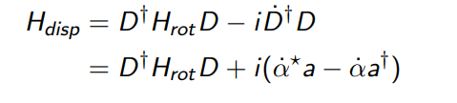
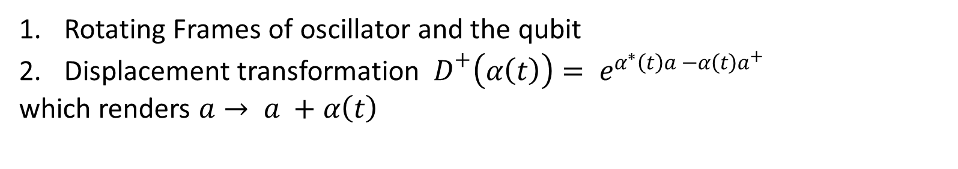
Dealing with Unwanted Terms I
Rotating Frames of oscillator and the qubit
Displacement transformation ${ D}^{+}\left(α\left(t\right)\right)= e^{α^{∗}\left(t\right)a −α\left(t\right)a^{+}}$
which renders $a→ a +α\left(t\right)$
Cancel terms linear in $a, a^{+},$such as the oscillator drive $ε\left(t\right)a^{+}+ ε^{∗}\left(t\right)a$, by picking the appropriate time dependent displacement frame
$\dot{α} = −iε\left(t\right)$ ${\dot{α}}^{∗}=iε^{∗}(t)$

Slide 24
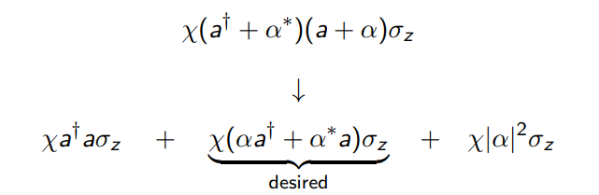
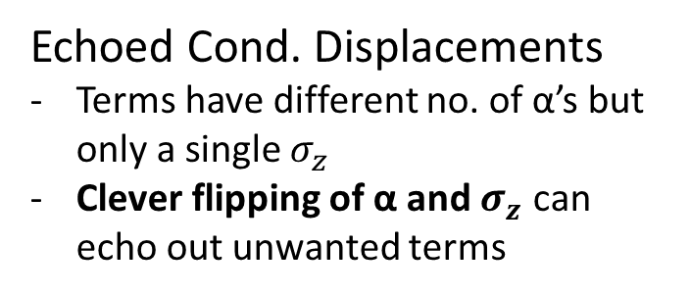
Dealing with Unwanted Terms II
The displaced frame transformation, however, divides the initial ac-Stark shift term into the following 3 terms
Sideband Drives
Make terms oscillate at different frequencies
Invoke RWA in a frame where only desired term is stationary
Echoed Cond. Displacements
Terms have different no. of α’s but only a single $σ_{z}$
Clever flipping of α and $σ_{z}$ can echo out unwanted terms

Slide 25
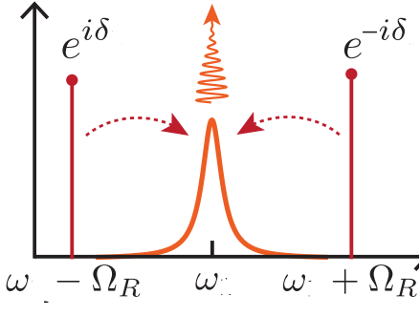


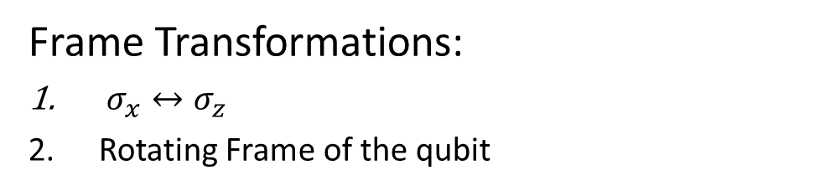

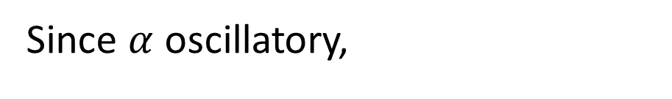








Sideband Drives
Since $α$ oscillatory,
https://arxiv.org/pdf/1608.06652.pdf
$$H=χa^{+}aσ_{z }+χ\left(αa^{+}+α^{∗}a\right)σ_{z}+χ{\left|α\right|}^{2}σ_{z}+Ω_{R}σ_{x}$$
$$ω=0$$
$$ω=Ω_{R }$$
$$ω={2Ω}_{R }$$
$$ε\left(t\right)∝α_{0}sin⁡(Ω_{R}t+δ)$$
Frame Transformations:
$σ_{x}↔σ_{z}$
Rotating Frame of the qubit
t
$$δ$$
$$Ω_{R}σ_{z}$$
$$Ω_{R}σ_{z}$$
$$α\left(t\right)∝α_{0}cos(Ω_{R}t+δ)$$
$$H=χα_{0}\left(a^{+}+a\right)⊗(σ_{x}\cos{δ+σ_{y}\sin{δ )}} + …$$
t
$$cos⁡(δ)$$
$$ω=0$$
$$ω≥ Ω_{R}$$
Shay Hacohen-Gourgy, …, Irfan Siddiqi. Nature 538-7626 (2016).

Slide 26

ECD
$$α\left(t\right)$$
$$Ω(t)$$
t
Not completely
echoed out !
$$χa^{+}aσ_{z}$$
$$−χa^{+}aσ_{z}$$
Echo
$$χ\left(αa^{+}+α^{∗}a\right)σ_{z}$$
$$χ\left(αa^{+}+α^{∗}a\right)σ_{z}$$
$$χ{|α|}^{2}σ_{z}$$
$$−χ{|α|}^{2}σ_{z}$$
A. Eickbusch, ..., R. Schoelkopf, M. Devoret. ArXiv preprint arXiv:2111.06414 (2021)

Slide 27
Evolution in Phase Space
$$ε\left(t\right)$$
$$Ω\left(t\right)$$
$$t$$
$$α\left(t\right)$$
t
$$|g⟩$$
$$|e⟩$$
$$Im(α)$$
$$Re(α)$$

Slide 28

Conditional Displacement
Resultant unitary: $ECD(β) = D\left(\frac{β}{2}\right)\left|e\right\rangle ⟨g| + D(−\frac{β}{2})\left|g\right\rangle ⟨e|$

Slide 29

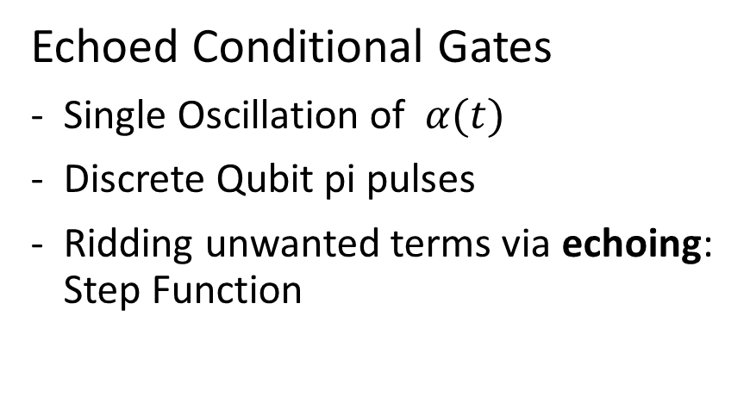

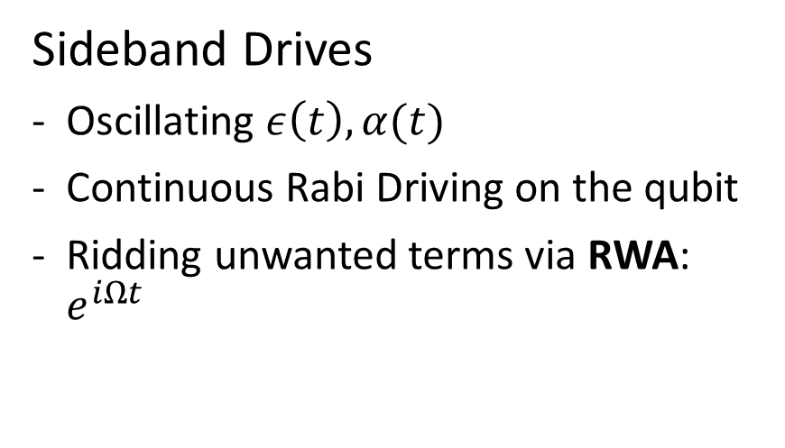






Comparison
$$ε\left(t\right)$$
$$ε\left(t\right)$$
$$t$$
$$δ$$
$$t_{w}$$
$$Ω\left(t\right)=Ω_{R}$$
$$Ω\left(t\right)$$
$$t$$
Sideband Drives
Oscillating $ε\left(t\right), α(t)$
Continuous Rabi Driving on the qubit
Ridding unwanted terms via RWA: $e^{iΩt}$
Echoed Conditional Gates
Single Oscillation of $α(t)$
Discrete Qubit pi pulses
Ridding unwanted terms via echoing: Step Function

Slide 30
ECD 1
Pulse sequences and gate optimization

Slide 31
ECD 2
Fig of single mode task; physics

Slide 32
Towards Double ECD (gate opt)

Slide 34
Sideband Drives

Slide 35
Circle Grape

