Slide 1
Multimode Conditional Gates
May 24, 2022

Slide 2
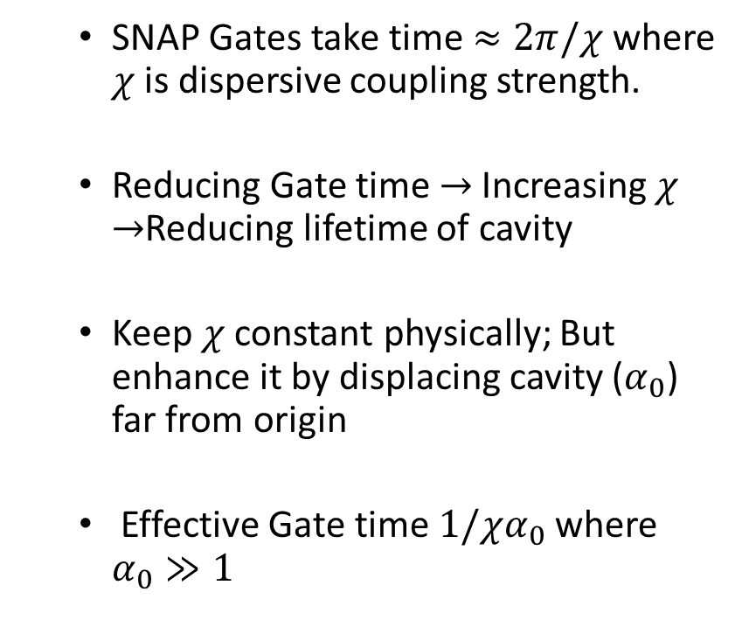
Why Conditional Displacements
SNAP Gates take time $≈2π/χ$ where $χ$ is dispersive coupling strength.
Reducing Gate time $→$Increasing $χ$ $→$Reducing lifetime of cavity
Keep $χ$ constant physically; But enhance it by displacing cavity ($α_{0}$) far from origin
Effective Gate time $1/χα_{0}$ where $α_{0}≫1$

Slide 3
Achieving Conditional Displacements
Starting Point:

Slide 4
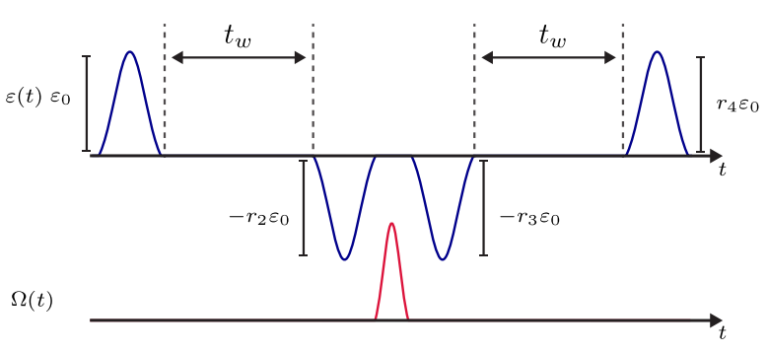
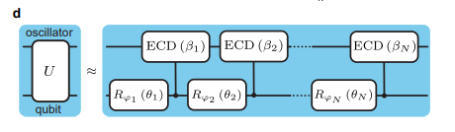
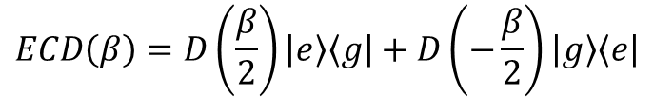
ECD: Two Optimization Tasks
1. Finding Angles: Displacements and Qubit Rotations
2. Finding Pulses: Corresponding to the angles from (1.)
$$ECD\left(β\right)=D\left(\frac{β}{2}\right)\left|e\right\rangle \left\langle g\right|+D\left(−\frac{β}{2}\right)\left|g\right\rangle \left\langle e\right|$$

Slide 5



Upshots
Mode 1
DECD ($β,γ$)
Mode 2
Aim: Generalize ECD idea to two modes coupled to an ancilla qubit
Progress:
Qutip Simulations of Single Mode ECD
Created Parameter Optimizer to find angles for DECD
Current Problem:
Mismatch in fidelities reported by parameter optimizer and Qutip
Qubit
Mode 1
ECD($γ$)
Mode 2
ECD($β$)
Qubit

Slide 6
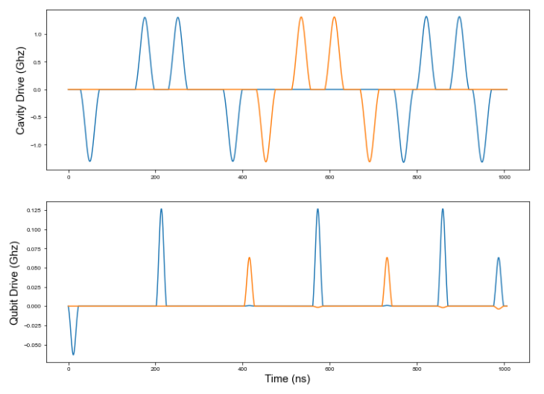
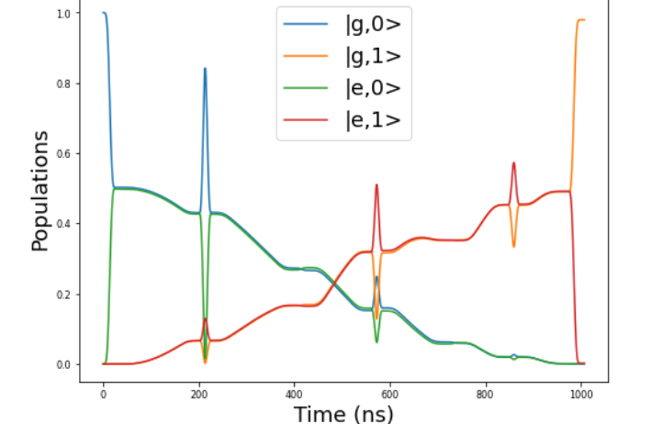
ECD: Qutip Simulations
Aim: Verifying the action of pulses given by Alec’s ECD repo

Slide 7
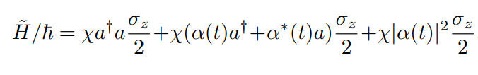



ECD: Undesired Terms
$$σ_{z} → {−σ}_{z}$$
$$α → −α$$
Single Mode
Undesired Terms to be ‘echoed’ out
Hamiltonian in Displaced Frame:
Dominant, Desired Term
Generator of Condition Displacement
Two Mode (Spectator Mode)
Displaced Frame Transformation
$$ηa^{+}a b^{+}b$$
$$η{(a}^{+}+α^{⋆}(t))(a+α(t)) b^{+}b$$

Slide 8
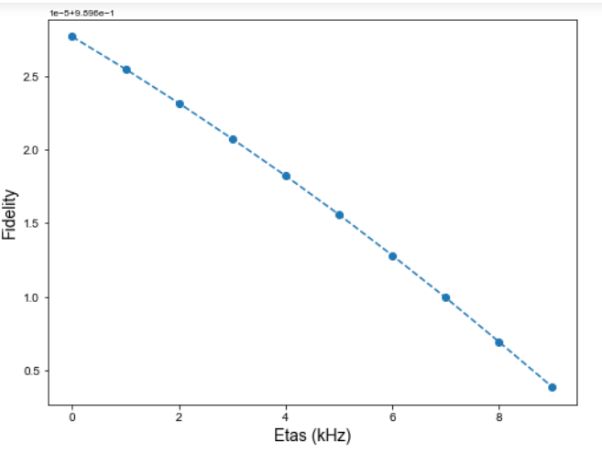
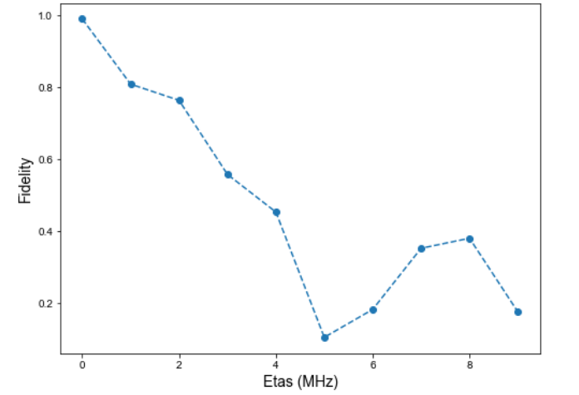

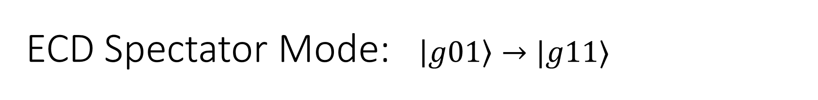
ECD Spectator Mode: $\left|g01\right\rangle →|g11⟩$
Upshot: ECD Gates are robust against spectator modes as long as mode-mode coupling is $η≈$KHz

Slide 9

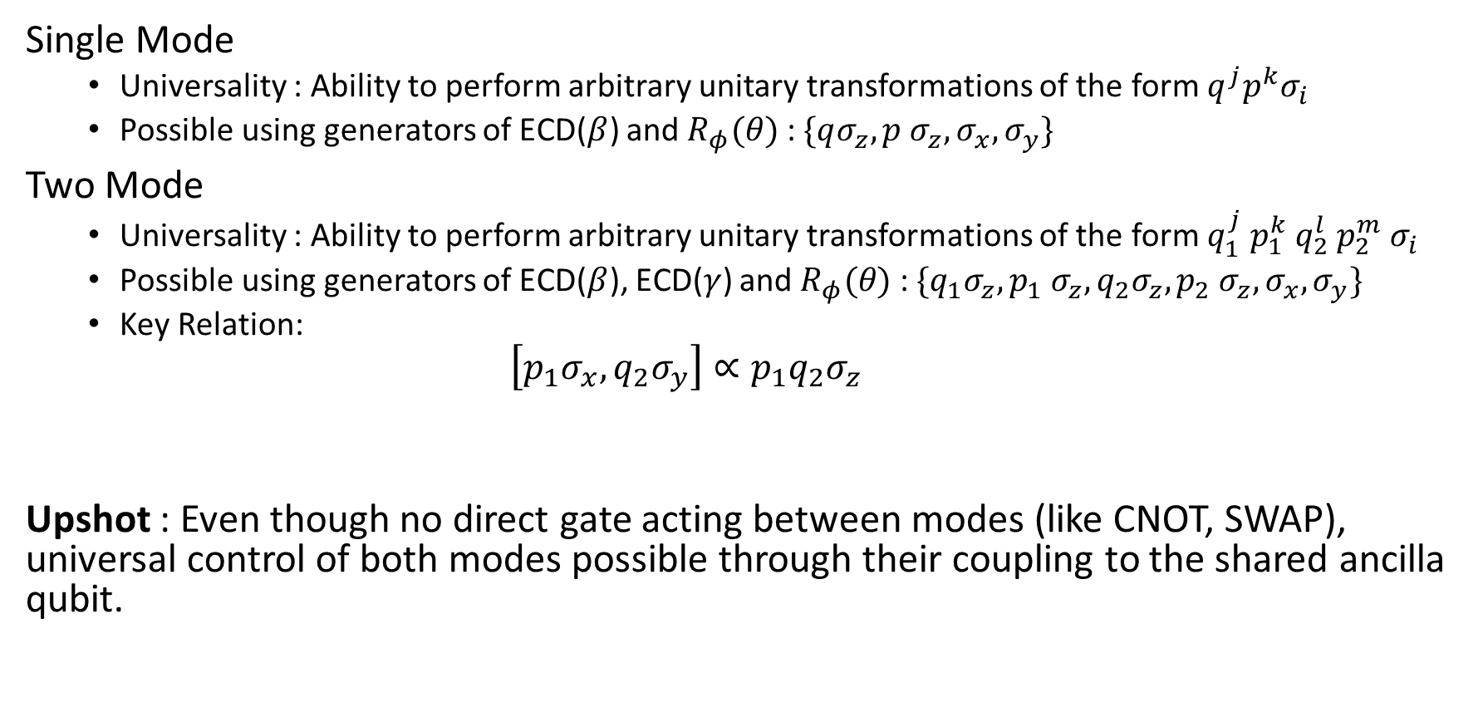
Double ECD : Universality
Key
$$p=\frac{1}{\sqrt{2}}\left(a^{+}+a\right)$$
$$q=\frac{1}{\sqrt{2}}\left(a^{+}−a\right)$$
Single Mode
Universality : Ability to perform arbitrary unitary transformations of the form ${q^{j}p}^{k}σ_{i}$
Possible using generators of ECD($β$) and $R_{φ}(θ)$ : $\{qσ_{z}, p σ_{z}, σ_{x}, σ_{y}\}$
Two Mode
Universality : Ability to perform arbitrary unitary transformations of the form ${q_{1}^{j} p_{1}^{k} q_{2}^{l} p_{2}^{m} σ}_{i}$
Possible using generators of ECD($β$), ECD($γ$) and $R_{φ}(θ)$ : $\{q_{1}σ_{z}, p_{1} σ_{z}, {q_{2}σ_{z}, p_{2} σ_{z}, σ}_{x}, σ_{y}\}$
Key Relation:
$$\left[p_{1}σ_{x}, q_{2}σ_{y}\right]∝p_{1}q_{2}σ_{z}$$
Upshot : Even though no direct gate acting between modes (like CNOT, SWAP), universal control of both modes possible through their coupling to the shared ancilla qubit.

Slide 10
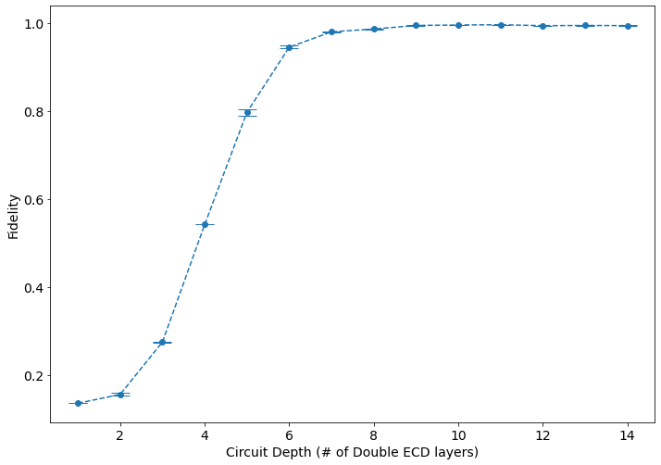
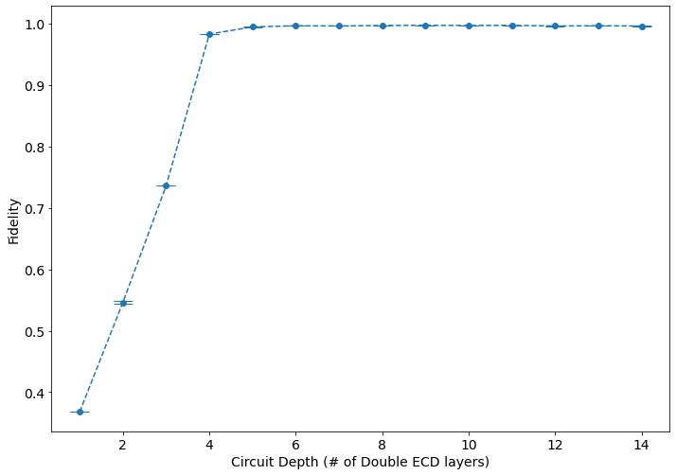


Double ECD: Param Optimization
$$\left|g01\right\rangle →|g10⟩$$
$$\left|g00\right\rangle →|g10⟩$$

Slide 11
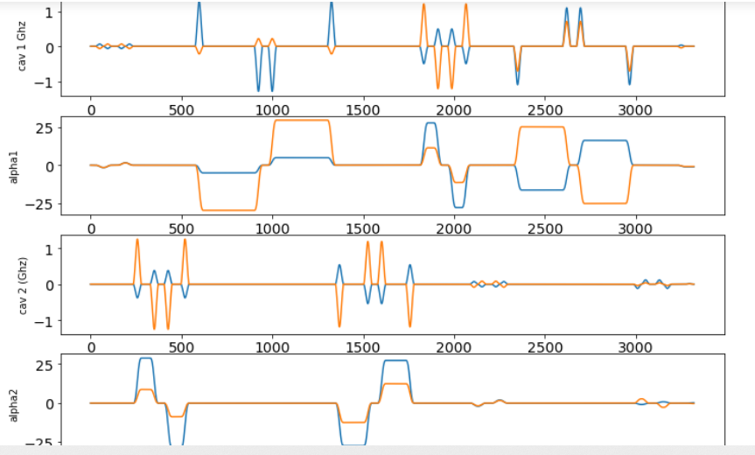
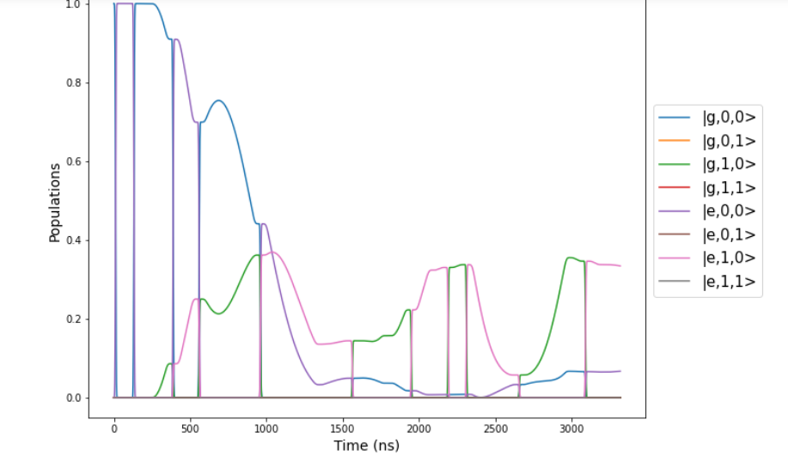

Double ECD: Resultant Qutip Simulation
Problem: Qutip simulations not consistent with DECD param optimizer in terms of reported fidelities.
$$\left|g00\right\rangle →|g10⟩$$

Slide 12
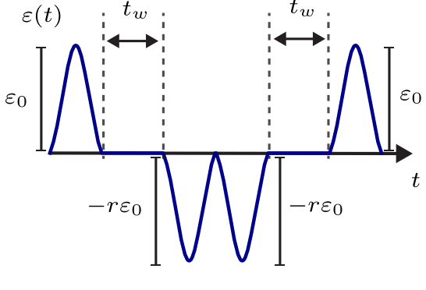


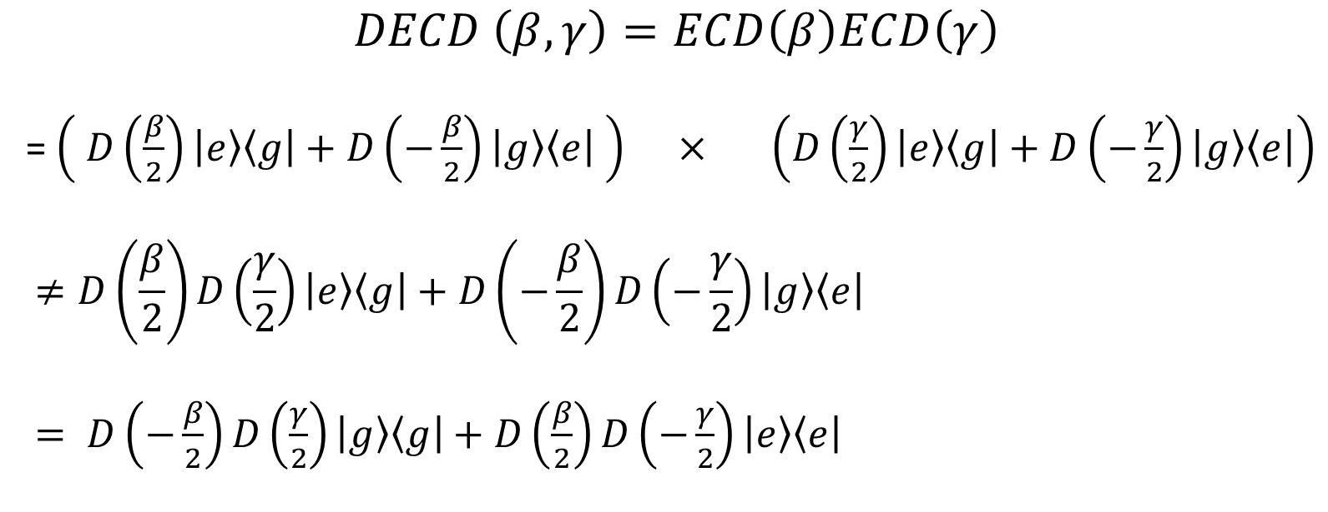
Double ECD: Possible Fix
$$DECD \left(β, γ\right)=ECD\left(β\right)ECD\left(γ\right)$$
= $\left( D\left(\frac{β}{2}\right)\left|e\right\rangle \left\langle g\right|+D\left(−\frac{β}{2}\right)\left|g\right\rangle \left\langle e\right| \right) × \left(D\left(\frac{γ}{2}\right)\left|e\right\rangle \left\langle g\right|+D\left(−\frac{γ}{2}\right)\left|g\right\rangle \left\langle e\right|\right)$
$$≠D\left(\frac{β}{2}\right)D\left(\frac{γ}{2}\right)\left|e\right\rangle \left\langle g\right|+D\left(−\frac{β}{2}\right)D\left(−\frac{γ}{2}\right)\left|g\right\rangle \left\langle e\right|$$
$= D\left(−\frac{β}{2}\right)D\left(\frac{γ}{2}\right)\left|g\right\rangle \left\langle g\right|+D\left(\frac{β}{2}\right)D\left(−\frac{γ}{2}\right)\left|e\right\rangle \left\langle e\right|$
Simulatneous displacement o the two modes -> Heating effects

Slide 13
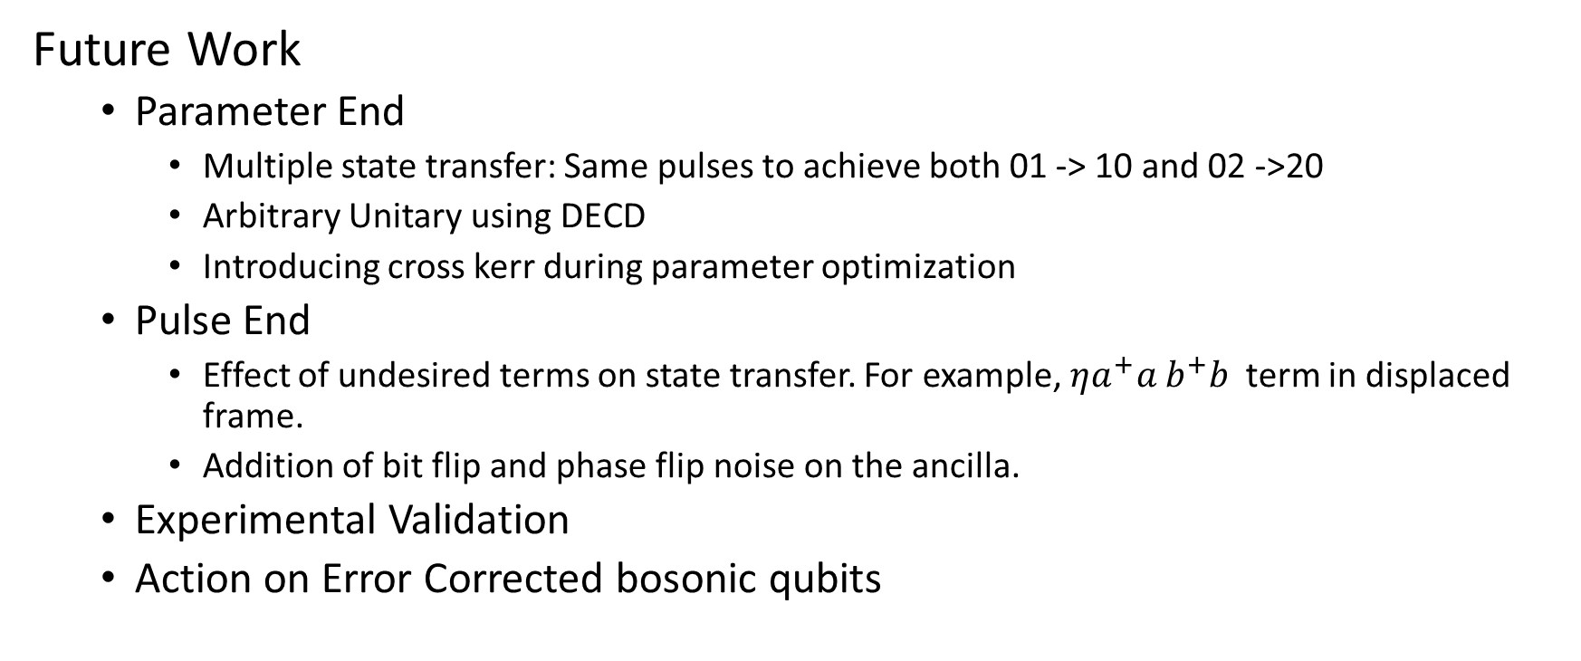

Up next
Mode 1
DECD ($β,γ$)
Mode 2
Future Work
Parameter End
Multiple state transfer: Same pulses to achieve both 01 -> 10 and 02 ->20
Arbitrary Unitary using DECD
Introducing cross kerr during parameter optimization
Pulse End
Effect of undesired terms on state transfer. For example, $ηa^{+}a b^{+}b$ term in displaced frame.
Addition of bit flip and phase flip noise on the ancilla.
Experimental Validation
Action on Error Corrected bosonic qubits
Qubit

Slide 14

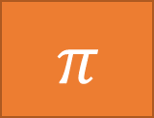





Meta Echoes
ECD($γ$)
Oscillator
ECD($β$)
Qubit
$$R_{φ}\left(θ\right)$$
ECD($γ$)
ECD($γ$)
Oscillator
ECD($β/2$)
ECD($β/2$)
$$π$$
Qubit
$$R_{φ}\left(θ/2\right)$$
$$R_{φ}\left(θ/2\right)$$

