Slide 1
Noise Protection in Multimode Circuits: Bifluxon
Eesh Gupta

Slide 2
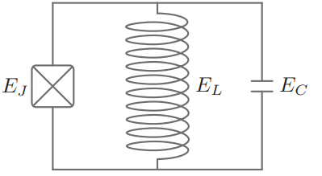
Contents
Single Mode Circuits
Towards Full Noise Protection: Bifluxon

Slide 3
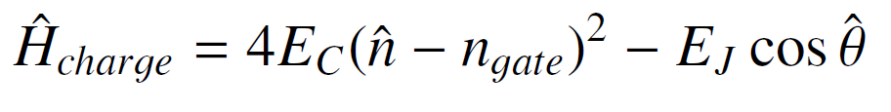

1. Single Mode Circuits
Flux Mode
Charge Mode
Islands store integer number of Cooper pairs
JJ allows tunneling of cooper pairs, producing anharmonic spectrum

Slide 4
1. Single Mode Circuits
Flux Mode
Charge Mode
Loops store integer number of flux quanta
Notes:
Charge qubits
Charge qubits host a pair of disconnected superconuductors or \textit{islands}. Such islands can store integer number of Cooper pairs. The addition of a nonlinear element such as the Josephson Junction allows tunneling of Cooper pairs such that the computational subspace is isolated.
Promiment examples of charge modes include the Cooper pair box and the Transmon circuits. The former operates in regime where \(E_C \gtrsim E_J\), realizing a \textit{light} charge mode since the mass \(C\) of fictious particle is inversely proportional to \(E_C\). On the other hand, the latter transmon circuit operates in the regime where \(E_C \ll E_J\), realizing a \textit{heavy} charge mode.
Flux Qubits
On the other hand, flux mode hosts a \textit{loop} of superconudcting wire which stores integer number of flux quanta.
Examples: Fluxonium

Slide 5
2. Dephasing from Control Knob
Longer dephasing times requires minimizing the energy dispersion \(E_{01} (\lambda)\) as a result of change in some external parameter \(\lambda\)
For charge qubits, this required localizing the wavefunctions in phase space (or flux quanta) such that the fluctuations in external parameter i.e. the gate charge \(\delta n_g\) had minimal effects on the potential and the wavefunctions. %[Lecture 17]
Why?
To ridd the Hamiltonian of the gate charge, the dependence on ng was transferred to boundary conditions.
If wavefunction is localized in phase space, then on boundaries its small; so n_g has minimal effect on the wavefunctions and thus the spectra.

Slide 6


2. Dephasing
Protection requires minimizing $\frac{∂E_{01}}{∂λ}$ where external parameter $λ=n_{g}$
Strategy: Remove $n_{g}$from $\hat{H}$ and transfer it to Boundary Conditions
$$ψ\left(θ\right)=e^{2πn_{g}}ψ\left(θ+2π\right)$$

Slide 7
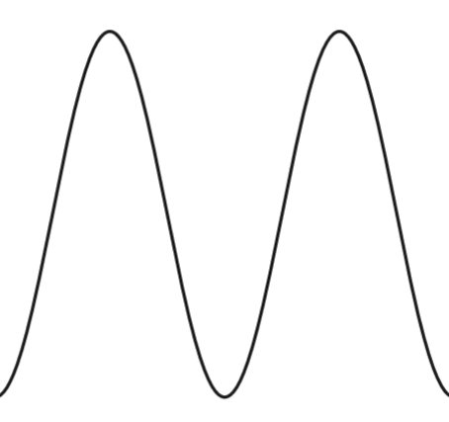
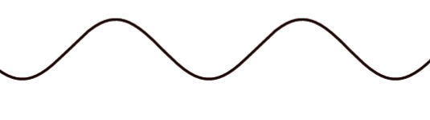
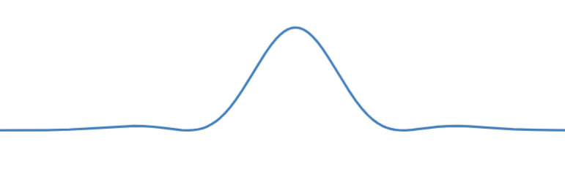
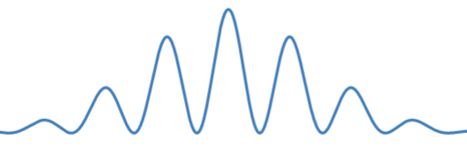






2. Dephasing
$$E_{J}≤E_{C}$$
$$E_{J}≫E_{C}$$
$$θ$$
$$θ$$
$$θ$$
$$θ$$
The change to boundary condition affects wavefunctions of CPB but not so much for transmon

Slide 8
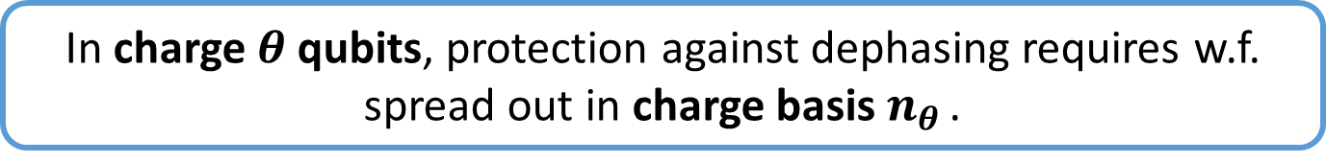




2. Dephasing
Since $n_{θ}, θ$ are conjugate variables, want delocalization in charge basis
$$E_{J}≫E_{C}$$
$$θ$$
$$n_{θ }$$
In charge $θ$ qubits, protection against dephasing requires w.f. spread out in charge basis $n_{θ }$.

Slide 9
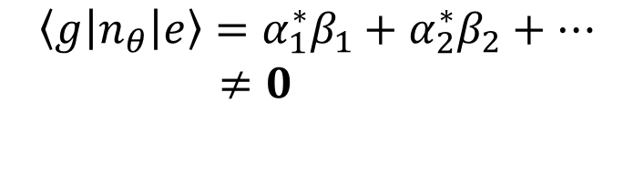

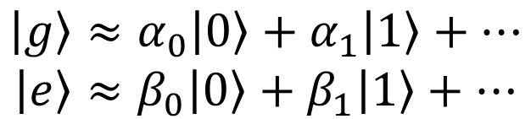
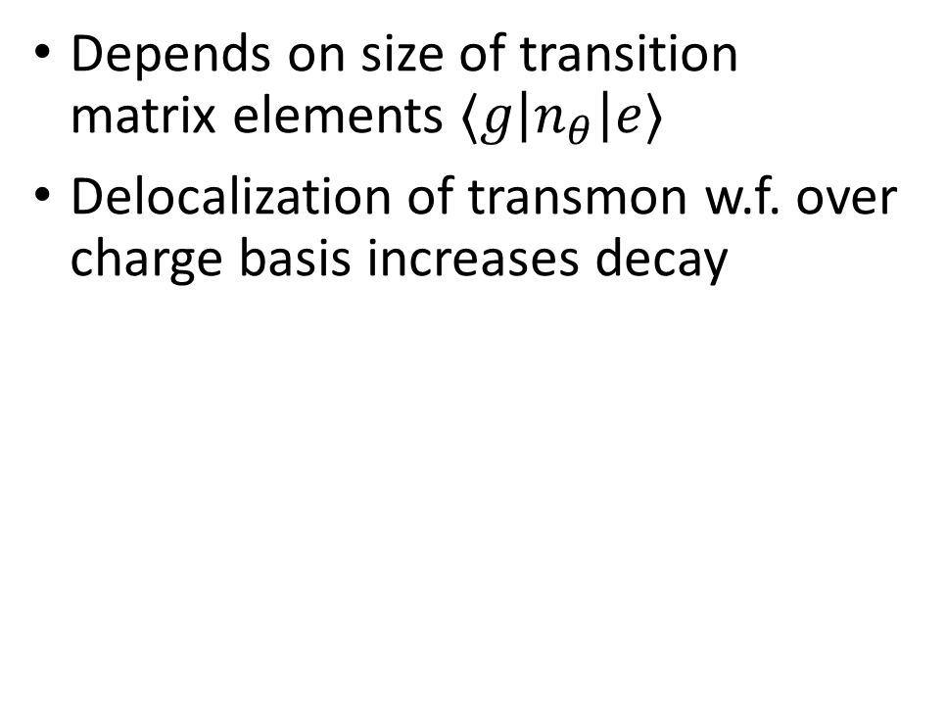

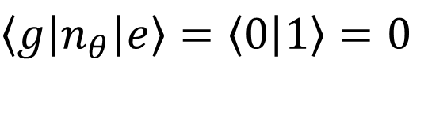

3. Decay
Depends on size of transition matrix elements $⟨g\left|n_{θ}\right|e⟩$
Delocalization of transmon w.f. over charge basis increases decay
$$E_{J}≤E_{C}$$
$$\left|g\right\rangle ≈\left|0\right\rangle$$
$$\left|e\right\rangle ≈\left|1\right\rangle$$
$\left\langle g\left|n_{θ}\right|e\right\rangle =\left\langle 0 | 1\right\rangle =0$
Cooper Pair Box
$$E_{J}≫E_{C}$$
$$\left|g\right\rangle ≈α_{0}\left|0\right\rangle +α_{1}\left|1\right\rangle +…$$
$$\left|e\right\rangle ≈β_{0}\left|0\right\rangle +β_{1}\left|1\right\rangle +…$$
$$\left\langle g\left|n_{θ}\right|e\right\rangle =α_{1}^{∗}β_{1}+α_{2}^{∗}β_{2}+…$$
$≠0$
Transmon

Slide 10
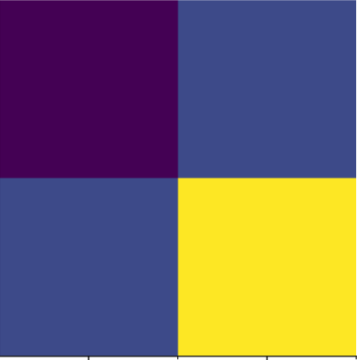



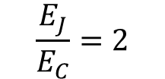

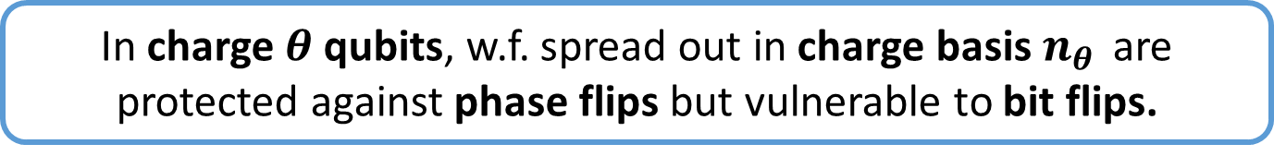
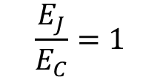




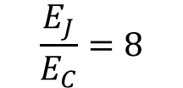
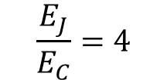

3. Decay
Charge Matrix elements$⟨i\left|n_{θ}\right|j⟩$ computed in scqubits
$$\frac{E_{J}}{E_{C}}=1$$
$$\frac{E_{J}}{E_{C}}=2$$
$$\frac{E_{J}}{E_{C}}=4$$
$$\frac{E_{J}}{E_{C}}=8$$
$$≈0.8$$
$$|g⟩$$
$$|e⟩$$
$$|g⟩$$
$$|e⟩$$
Transmon-like
$$≈0$$
In charge $θ$ qubits, w.f. spread out in charge basis $n_{θ }$ are protected against phase flips but vulnerable to bit flips.

Slide 11
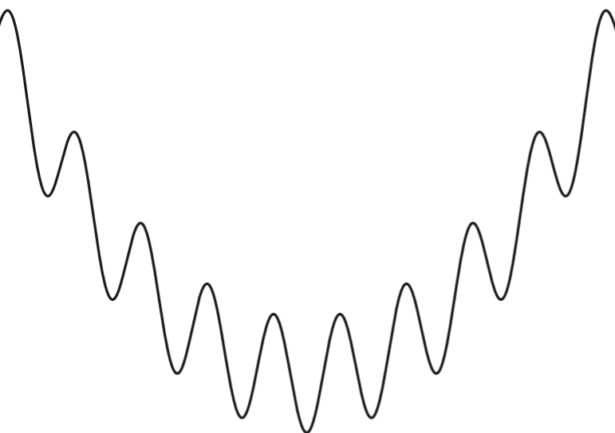




4. Fluxonium Fares Better
Since control knob $φ_{ext}$, dephasing protection requires delocalization in phase space
But again, at expense of large $\left|\left\langle g\left|φ\right|e\right\rangle \right|$
$$E_{L}≪E_{J}<E_{C}$$
Light regime
$$φ$$
$$φ$$

Slide 12
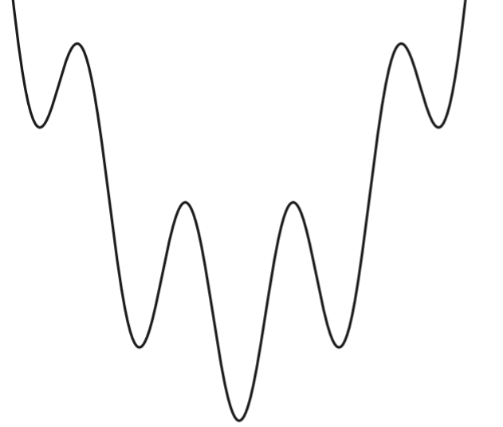





4. Fluxonium Fares Better
Experimentally, phase fluctuations $≪$ charge fluctuations
Can make heavier without losing too much on dephasing.
$$φ$$
$$φ$$
$$E_{L}≪E_{J}<E_{C}$$
$${E_{C}≈E}_{L}≪E_{J}$$
Light regime
Heavy regime

Slide 13




5. Upshot
 | Charge Qubits | Flux Qubits
Phase Flip Protection
Bit Flip Protection
$$θ$$
$$φ$$
$$θ$$
$$φ$$
Single Mode Circuits cannot be simultaneously protected against bit flip and phase flip errors

Slide 14
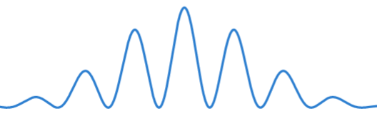




5. Upshot
 | Charge Qubits | Flux Qubits
Phase Flip Protection
Bit Flip Protection
$$n_{θ }$$
$$φ$$
$$n_{θ}$$
$$φ$$
Single Mode Circuits cannot be simultaneously protected against bit flip and phase flip errors

Slide 15
Contents
Single Mode Circuits
Single Mode Circuits cannot be simultaneously protected against bit flip and phase flip errors
Towards Full Noise Protection: Bifluxon

Slide 16





5. Marriage of Modes
$$≈$$
$$+$$
$$θ$$
$$φ$$
$$0−π$$
,
Bifluxon
$$H = 4E_{C}^{θ}{\left(n_{θ} − n_{gate}\right)}^{2} + 4E_{C}^{φ} n_{φ}^{2} + E_{L}\frac{{\left(φ− 2πφ_{ext}\right)}^{2}}{2} − 2E_{J}\cos{θ}\cos{φ}$$

Slide 17
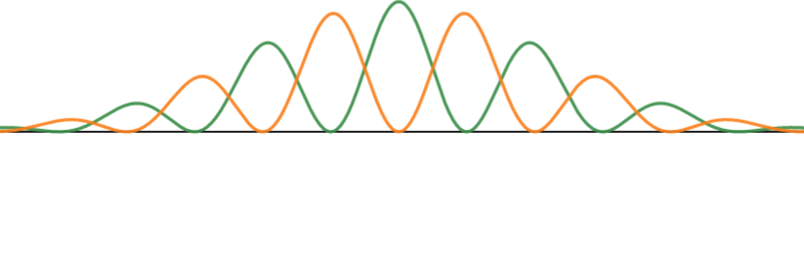

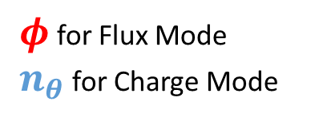

6. Wavefunctions in separate regions
$$|g⟩$$
$$|e⟩$$
$φ$ for Flux Mode
$n_{θ}$ for Charge Mode
Earlier:
Wavefunctions confined to a single axis
Delocalized g and e states can be easily connected by local operators ( bit flip )

Slide 18
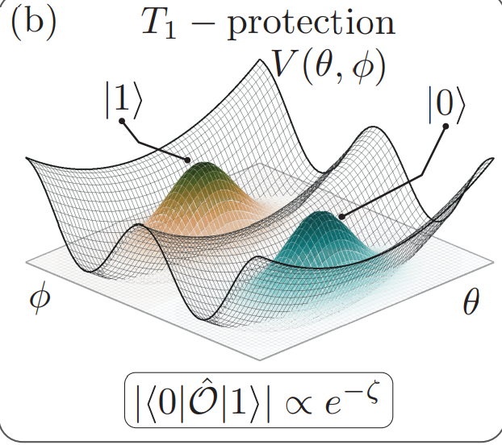
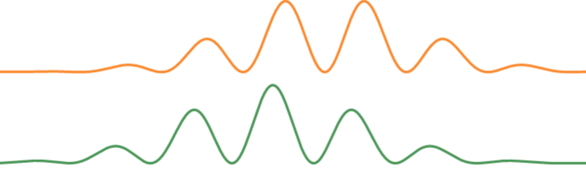


6. Wavefunctions
$$|g⟩$$
$$|e⟩$$
$$θ$$
$$φ$$
Now:
Wavefunction not confined to a single axis / dimension
Delocalized G and e can occupy different regions, reducing bit-flip errors

Slide 19
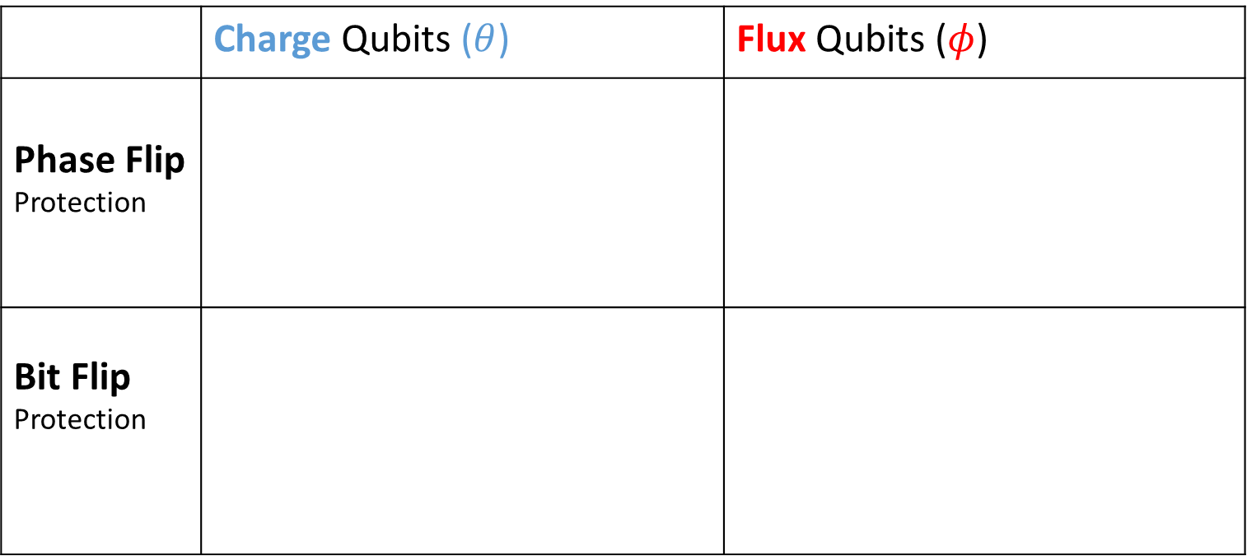
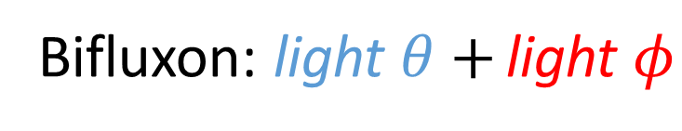
7. Bifluxon
 | Charge Qubits ($θ$) | Flux Qubits ($φ$)
Phase Flip Protection
Bit Flip Protection
$$θ$$
$$φ$$
$$θ$$
$$φ$$
Bifluxon: light $θ+$ light $φ$

Slide 20
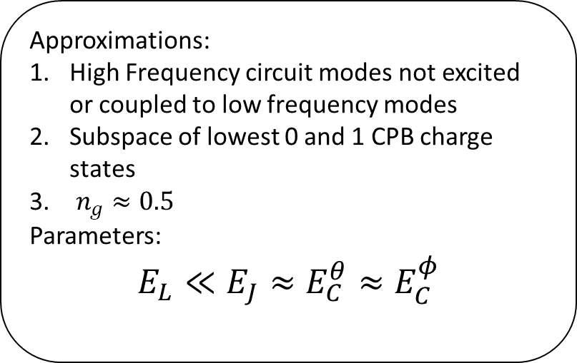


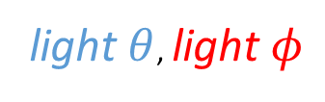
7. Bifluxon
$$H = 4E_{C}\left(\frac{1}{2}−n_{g}\right) + 4E_{C}^{φ} n_{φ}^{2} +$$
$$E_{L}(φ−2πφ_{ext}) − 2E_{J}\cos{\frac{φ}{2}}σ_{x}$$
$$C_{g}$$
$$V_{g}$$
$$n_{ }$$
Approximations:
High Frequency circuit modes not excited or coupled to low frequency modes
Subspace of lowest 0 and 1 CPB charge states
$n_{g}≈0.5$
Parameters:
$$E_{L}≪E_{J}≈E_{C}^{θ}≈E_{C}^{φ}$$
$$E_{J}$$
$$E_{J}$$
$$Φ_{ext}$$
$${−φ/2}_{ }$$
$${+φ/2}_{ }$$
$$E_{L }$$
light $θ$, light $φ$

Slide 21
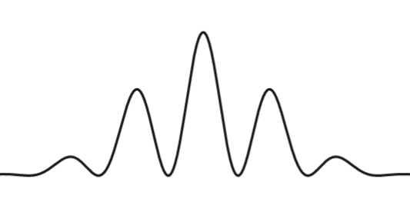
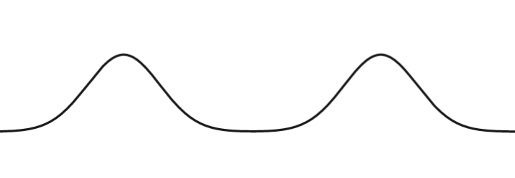
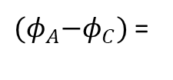

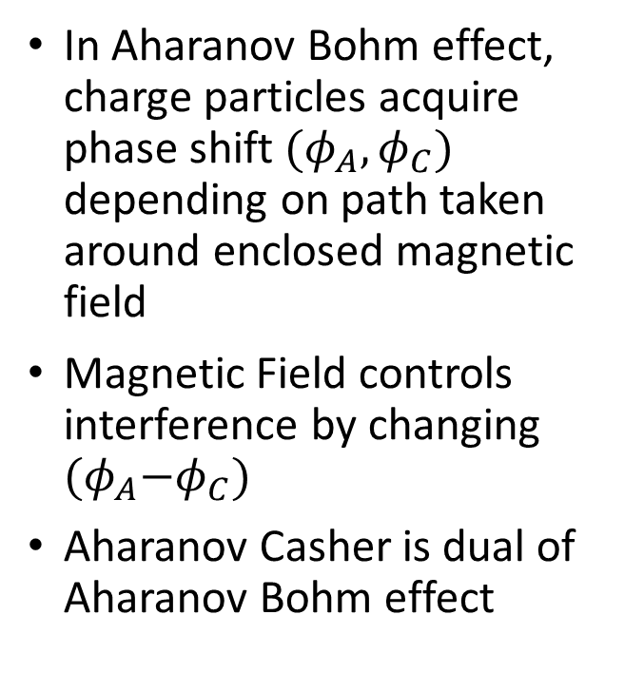
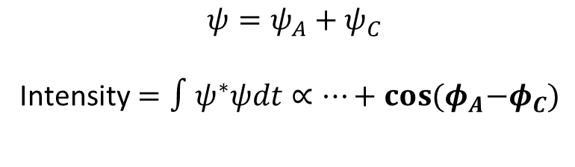



8. Aharanov Casher Effect
In Aharanov Bohm effect, charge particles acquire phase shift$(φ_{A}, φ_{C})$ depending on path taken around enclosed magnetic field
Magnetic Field controls interference by changing ${(φ}_{A}−φ_{C})$
Aharanov Casher is dual of Aharanov Bohm effect
$$ψ_{A }∝e^{iφ_{A}}$$
B
$$ψ_{C }∝e^{iφ_{C}}$$
${(φ}_{A}−φ_{C})$ =
$$0$$
$$\frac{π}{2}$$
$$ψ=ψ_{A}+ψ_{C}$$
Intensity$=∫ψ^{∗}ψdt∝…+\cos{{(φ}_{A}−φ_{C})}$

Slide 22

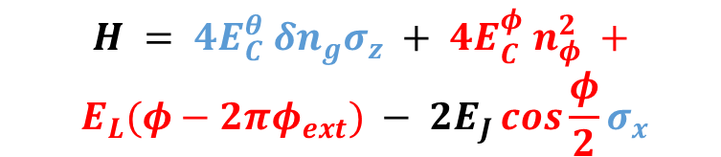


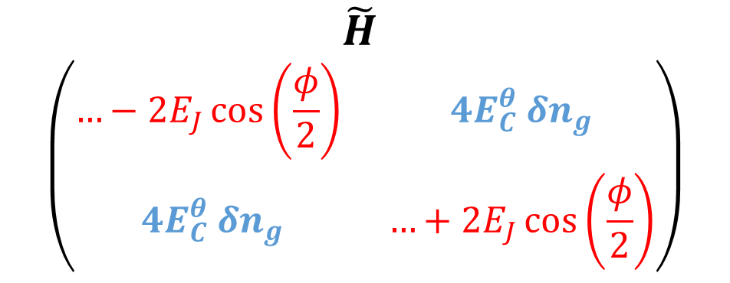
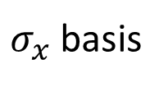

8. Aharanov Casher Effect
$$\tilde{H}$$
$$\left(\begin{matrix}…−2E_{J}\cos\left(\frac{φ}{2}\right) & 4E_{C}^{θ} δn_{g} \\ 4E_{C}^{θ} δn_{g} & …+2E_{J}\cos\left(\frac{φ}{2}\right)\end{matrix}\right)$$
$$H = 4E_{C}^{θ} δn_{g}σ_{z} + 4E_{C}^{φ} n_{φ}^{2} +$$
$$E_{L}(φ−2πφ_{ext}) − 2E_{J}\cos{\frac{φ}{2}}σ_{x}$$
$$|+⟩$$
$σ_{x}$basis
$$|−⟩$$
$$|+⟩$$
$$|−⟩$$
In bifluxon, interference between $\left|±\right\rangle$ controlled by $δn_{g}=0.5 − n_{g}$

Slide 23
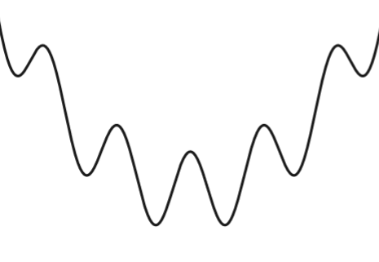
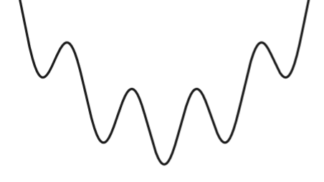
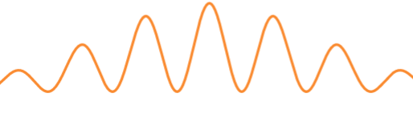











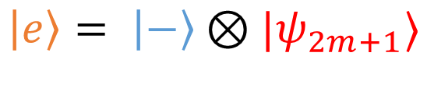

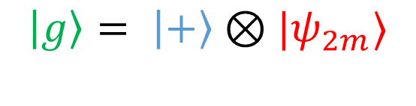




9. Two Fluxoniums
$$H_{±}= 4E_{C}^{φ} n_{φ}^{2} +E_{L}\left(φ−2πφ_{ext}\right)∓ 2E_{J}\cos{\frac{φ}{2}}$$
$$φ$$
$$−4π$$
$$0$$
$$4π$$
$$φ$$
$$−4π$$
$$0$$
$$4π$$
$$2πφ$$
$$−2$$
$$0$$
$$2$$
$$2πφ$$
$$−2$$
$$0$$
$$2$$
$$\left|g\right\rangle = \left|+\right\rangle ⊗|ψ_{2m}⟩$$
$$\left|e\right\rangle = \left|−\right\rangle ⊗|ψ_{2m+1}⟩$$

Slide 24
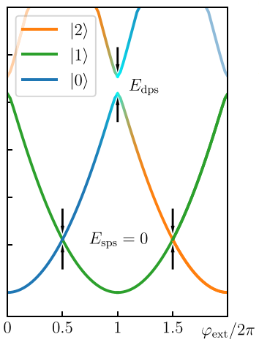

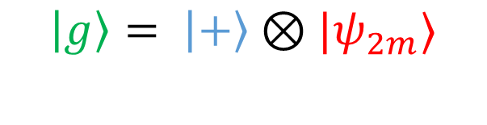
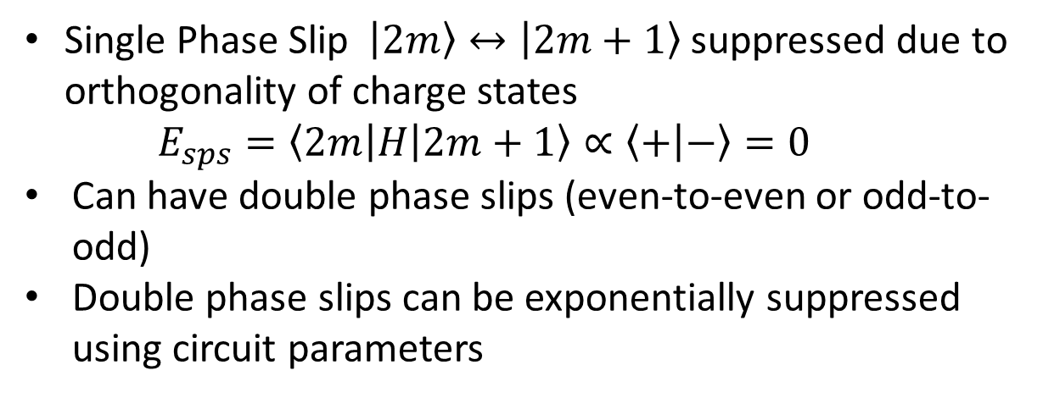
9. Two Fluxoniums
$$\left|g\right\rangle = \left|+\right\rangle ⊗|ψ_{2m}⟩$$
$$\left|e\right\rangle = \left|−\right\rangle ⊗|ψ_{2m+1}⟩$$
Single Phase Slip $\left|2m\right\rangle ↔\left|2m+1\right\rangle$ suppressed due to orthogonality of charge states
$$E_{sps}=\left\langle 2m\left|H\right|2m+1\right\rangle ∝\left\langle + | −\right\rangle =0$$
Can have double phase slips (even-to-even or odd-to-odd)
Double phase slips can be exponentially suppressed using circuit parameters
Logical states store odd or even flux quanta depending on the charge mode state

Slide 25
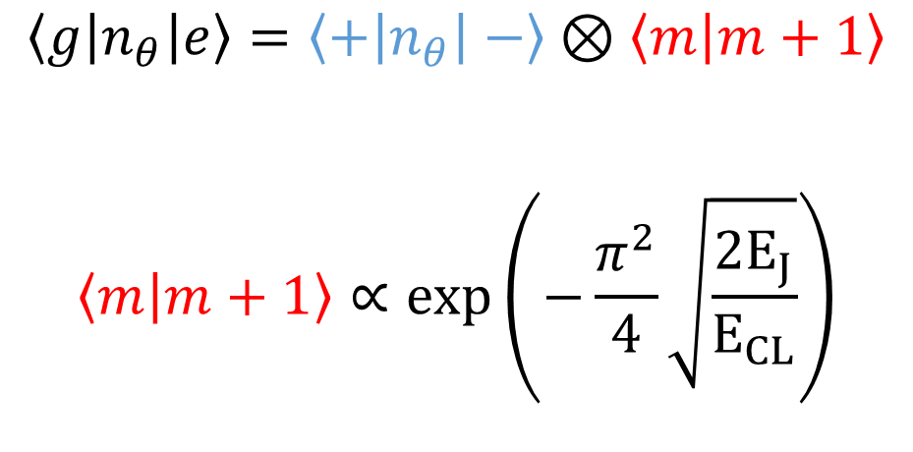

10. Noise Protection: Decay
Local operators of $θ,φ$ modes cannot connect $\left|g\right\rangle ↔|e⟩$
Flux Noise Induced Decay
Charge Noise Induced Decay
$$\left\langle g\left|n_{θ}\right|e\right\rangle =\left\langle +\left|n_{θ}\right|−\right\rangle ⊗\left\langle m | m+1\right\rangle$$
$$\left\langle m | m+1\right\rangle ∝exp\left(−\frac{π^{2}}{4}\sqrt{\frac{{2E}_{J}}{E_{CL}}}\right)$$
$$\left\langle g\left|φ\right|e\right\rangle =\left\langle +|−\right\rangle ⊗\left\langle m | n_{φ}|m+1\right\rangle$$
$$=0$$

Slide 26





10. Noise Protection: Decay
$$|g⟩$$
$$|e⟩$$
$$θ=π$$
$$|−⟩$$
$$−2E_{J}\cos{θ}\cos{\frac{φ}{2}}$$
$$θ$$
$$θ=0$$
$$|+⟩$$
$$φ$$
Decay protection can be also visualized through wavefunctions-in-separate-regions picture

Slide 27



11. Noise Protection: Dephasing
Insesitive to flux noise induced dephasing (light flux mode)
Sensitive to charge noise induced dephasing (light charge mode)
Charge mode cannot be made heavier in bifluxon by tuning $C_{g}$
$$C_{θ}=C_{g}+\frac{2C_{0}C_{J}}{C_{0}+C_{J}}$$
$$C_{φ}=C_{L}+\frac{C_{0}+C_{J}}{2}$$
Original Supplement
$$C_{θ}={2C}_{J}+\frac{2C_{0}C_{g}}{C_{0}+C_{g}}$$
$$C_{φ}=C_{L}+\frac{C_{0}+C_{J}}{2}$$
Corrected Quantization
(Vatsan’s Notes)

Slide 28




12. Outlook
Experiment:
100 $μs$ improvement in T1 time from unprotected to protected regime (best $T_{1}=125 μs$)
Low $T_{2}=0.7 μs$ due to charge noise fluctuations
Difficulties:
Design: Large inductors, small stray capacitances
Control: Lift protection to enact gates
$$P_{excited}$$

Slide 29
Contents
Single Mode Circuits and Partial Noise Protection
Single Mode Circuits cannot be simultaneously protected against bit flip and phase flip errors
Towards Full Noise Protection: Bifluxon
Underlying Symmetry of the Hamiltonian leads to simultaneous protection against both bit flip and phase flip errors

Slide 30


Extra 1: Cooper pair Tunneling in $0−π$
Assume $L→∞$

Slide 31


Extra 1: Cooper pair Tunneling in $0−π$
Assume $L→∞$
$$+2e$$
$$−2e$$

Slide 32


Extra 1: Cooper pair Tunneling in $0−π$
Assume $L→∞$
$$+2e$$
$$+2e$$
$$−2e$$
$$−2e$$

Slide 33

Since we have 2 Cooper pairs tunneling, we also have a change in the form of the superconducting phase across the junction
Why so? When deriving the Josephson energy, we connected the M state with m+1; now its m with m+2 [show through equations]
So the josephson energy of the $θ$ mode is pi periodic instead of 2 pi periodic.
Interesting to note that Bifluxon also changes the periodicity of the josephson energy but that of the $φ$ mode.

Slide 34
2. Dephasing from Control Knob
Cooper Pair Box
Transmon

Slide 35
3. Decay from Delocalization
As wavefunctions of Transmon states have a greater spread over charge states as compared to CPB, this results in a large transition matrix elements for the number/charge operator
This can be seen by considering the wavefunction in the Cooper Pair Box limit and the transmon limit.
In the CPB limit, the transition matrix element is just the overlap between orthogonal charge states which is 0. (g and e occupy different charge states)
However in the transmon limit, this element is now a nonzero number b/c g and e have nonzero contributions from the same charge states
As a result, bit flip errors increase as phase flip errors decrease.

Slide 36
4. Fluxonium fares better than Transmon
Wheras dephasing protection in charge qubits required delocalization of wavefunction in charge space, flux qubits like fluxonium require delocalization in flux space. This is because control knob here is the external flux instead of charge. In other words, we operate in the “light” regime.
Similar to previous case, in this light regime, the phase matrix elements are large , increasing bit flip errors
While fluxonium also requires a tradeoff – localizing wavefunction within the potential in phase space (heavy fluxonium) – this compromise is not as bad as that in the transmon case due to fundamental assymtry between charge and flux fluctuations; experimentally, amplitude of flux fluctuations are 2 orders of magnitude smaller than charge fluctuations. So we don’t lose too much on dephasing by going in the opposite “heavy” regime.
Heavy fluxoniums typically have longer lifetimes than transmon; but the tradeoff problem persists.

Slide 37


