Slide 1

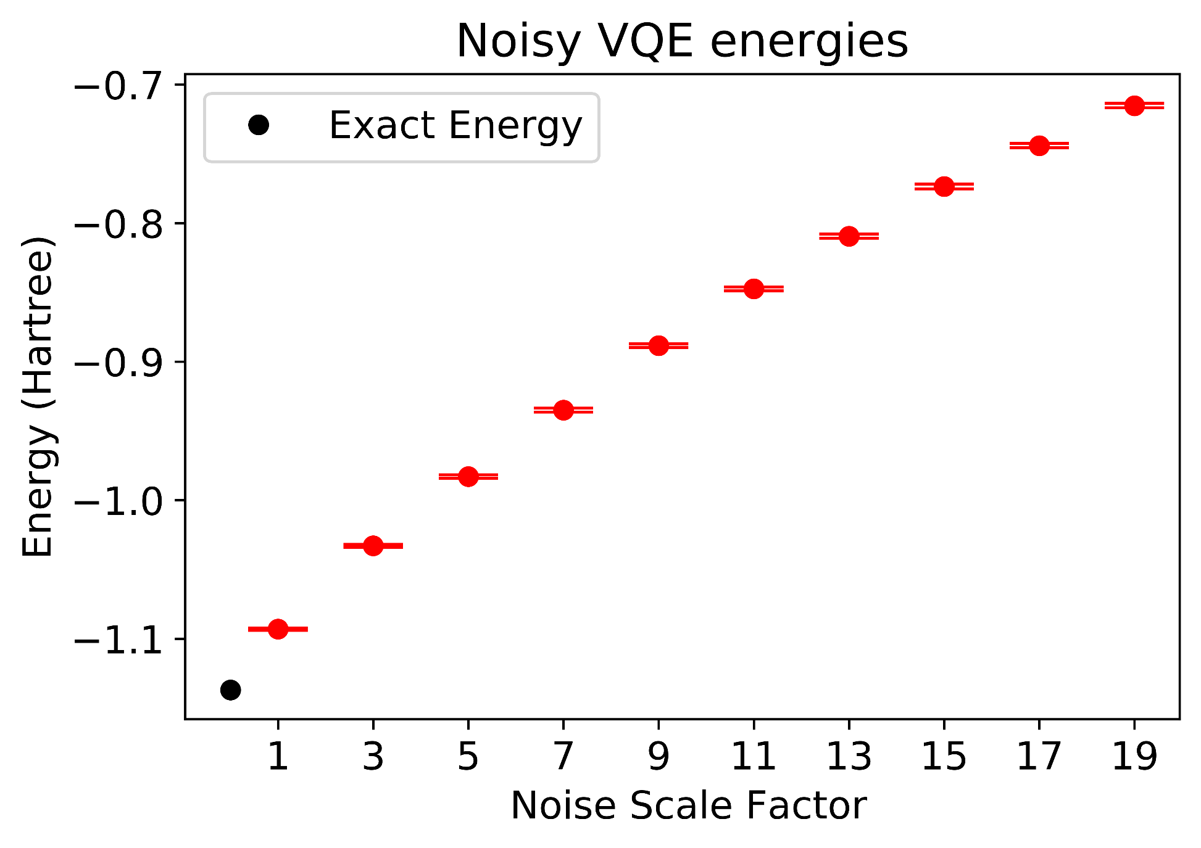
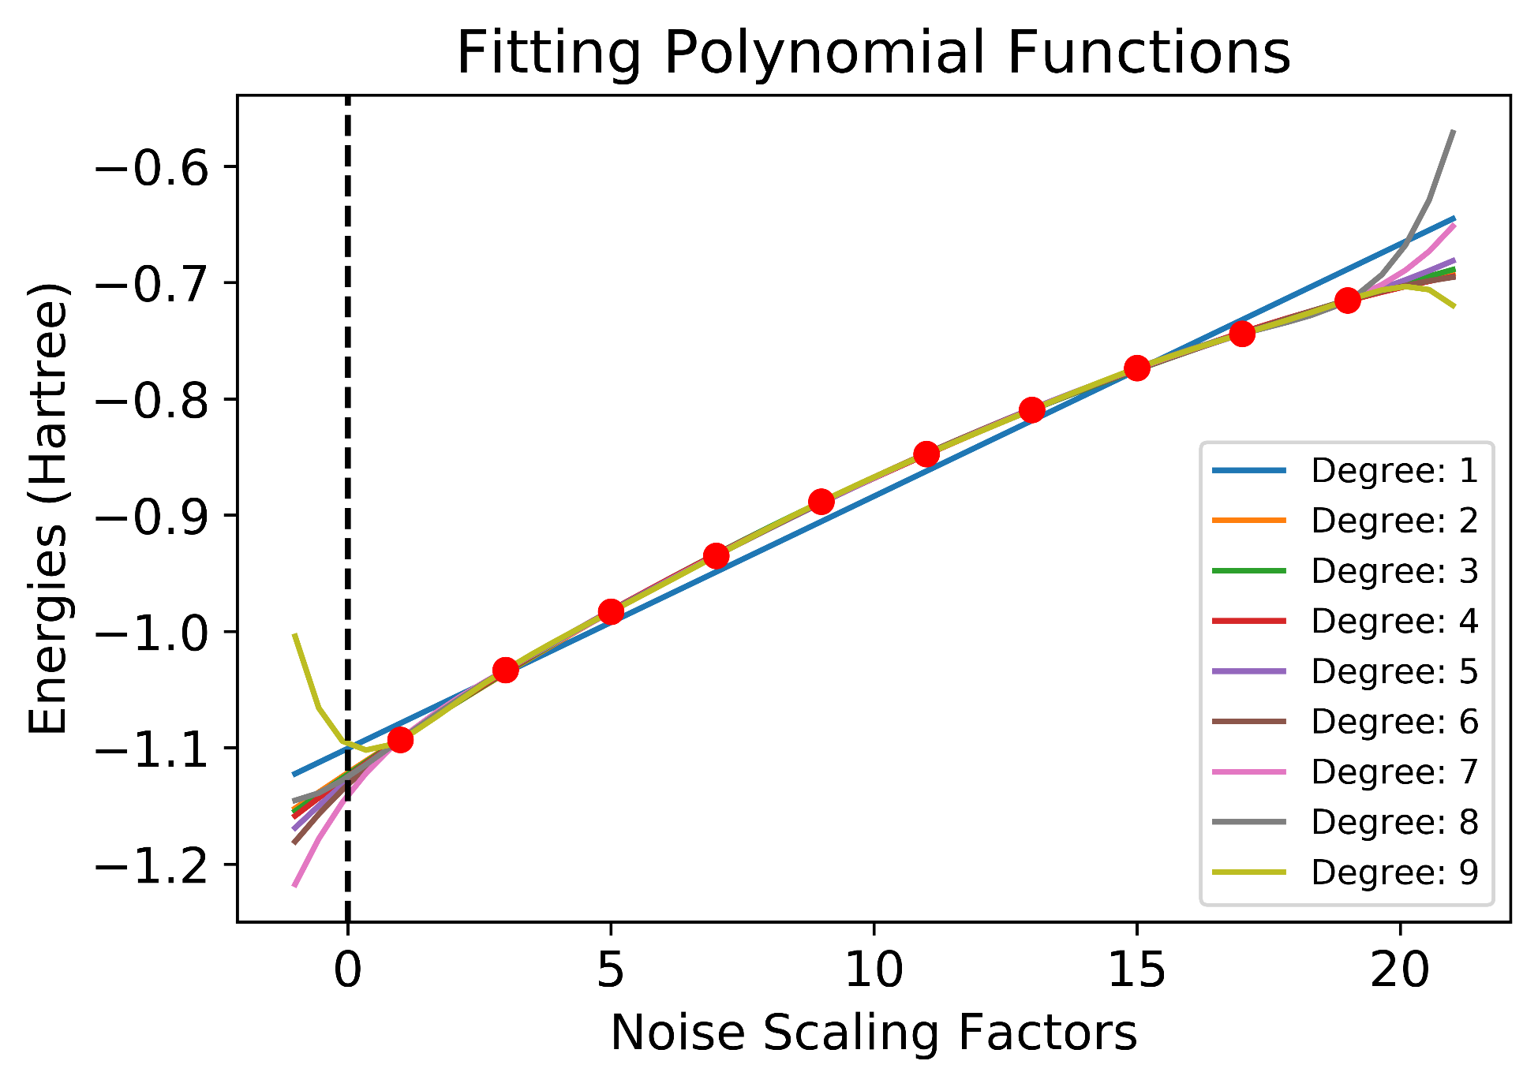
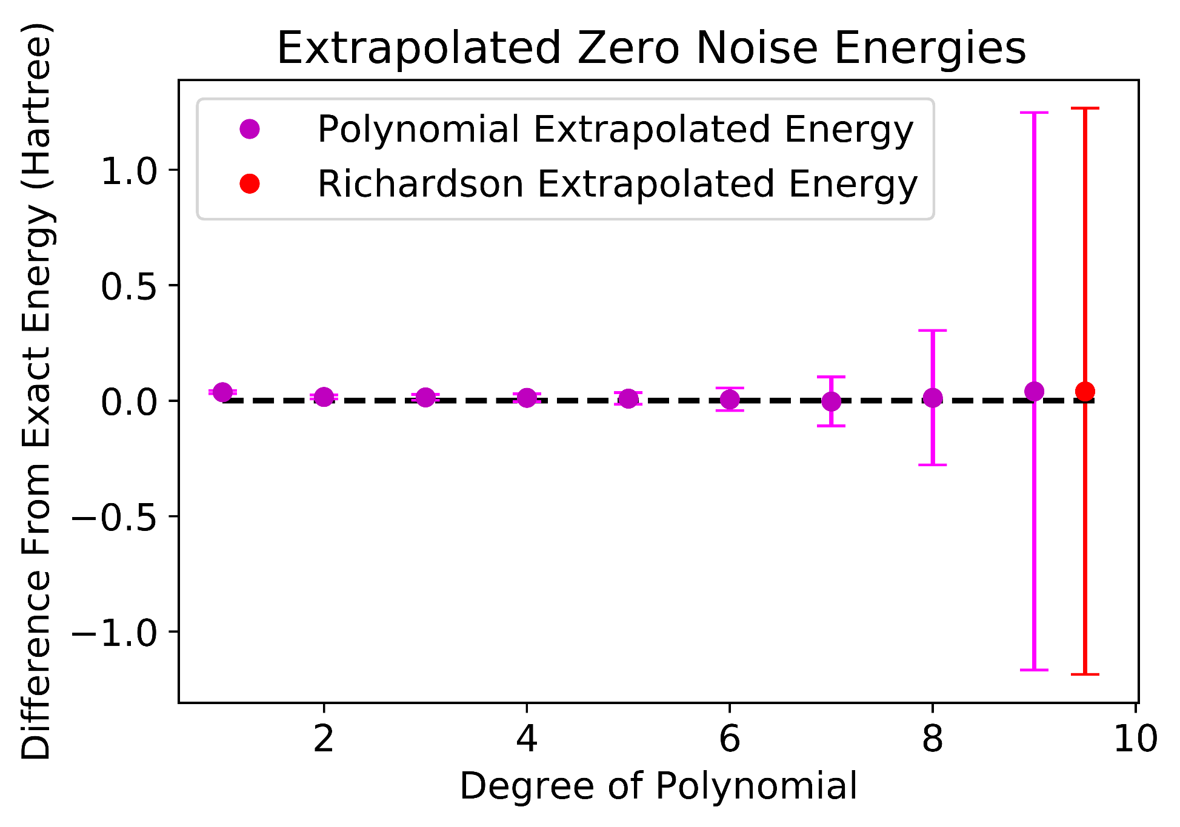
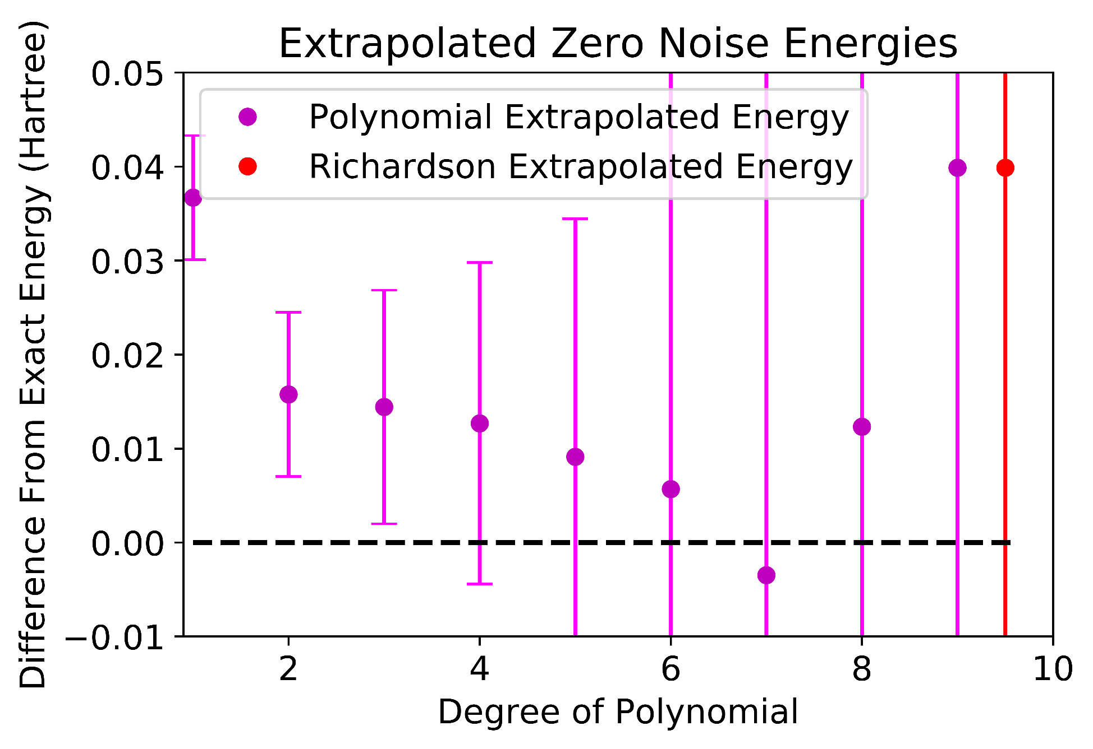
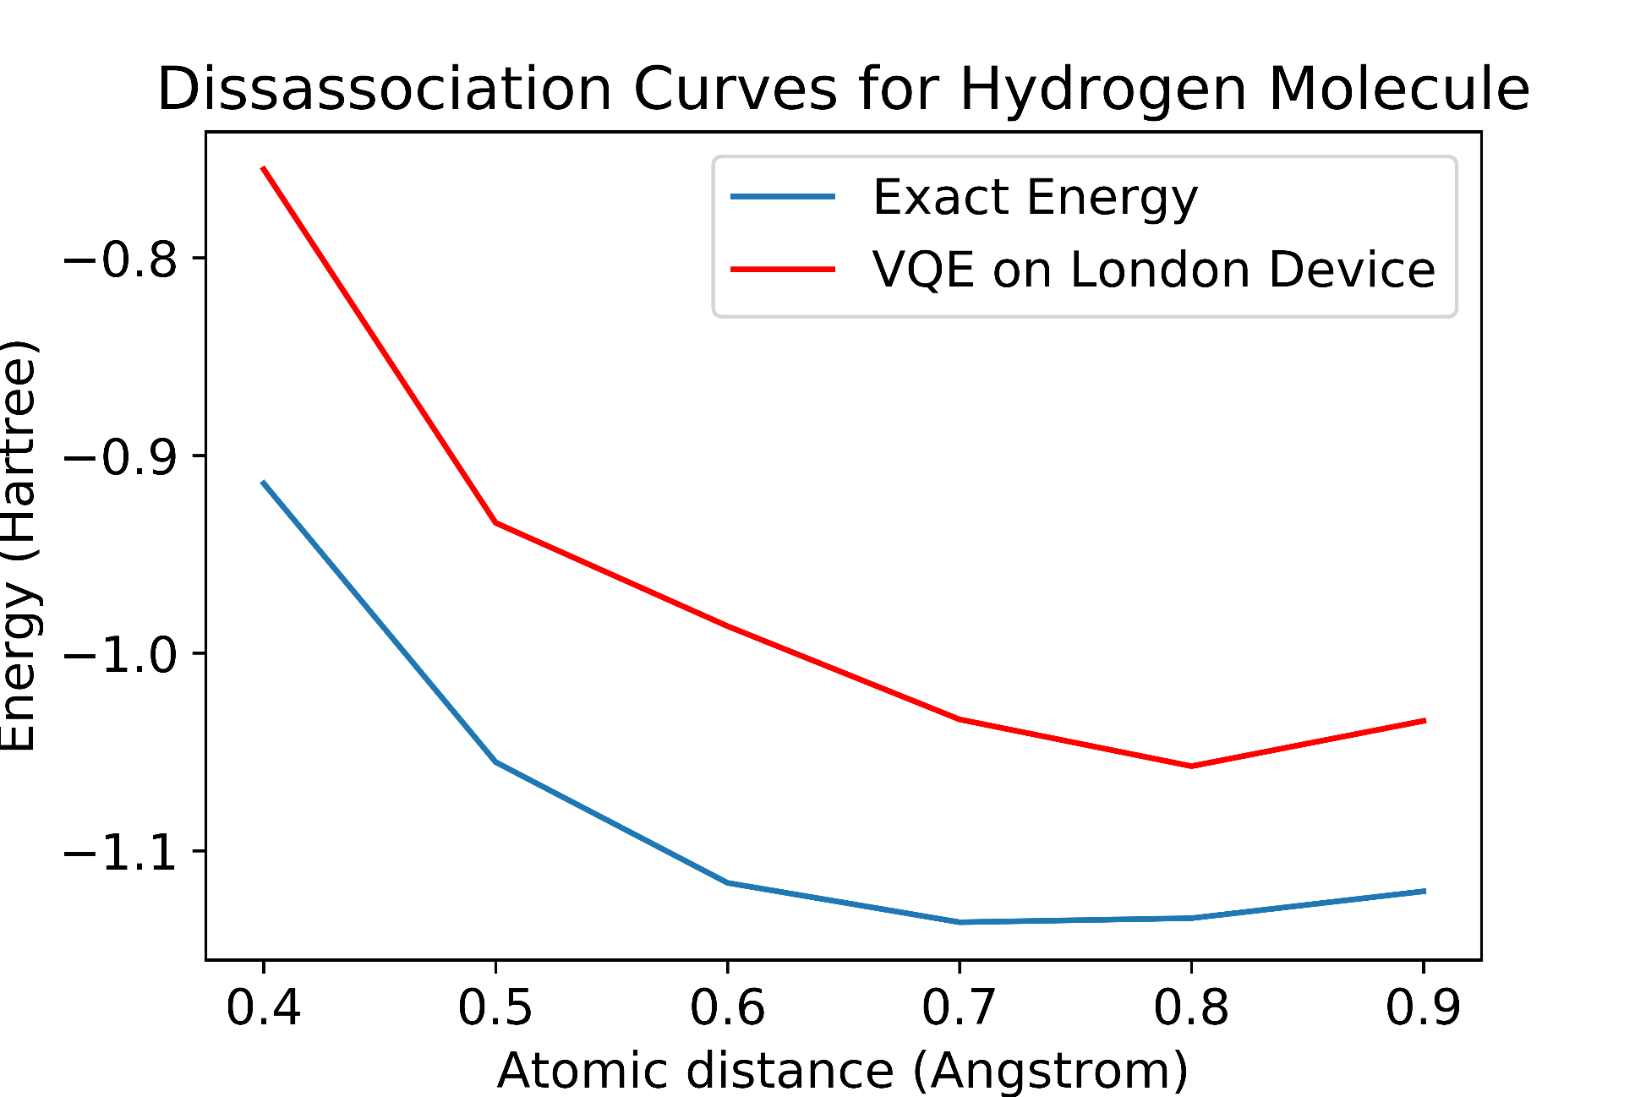
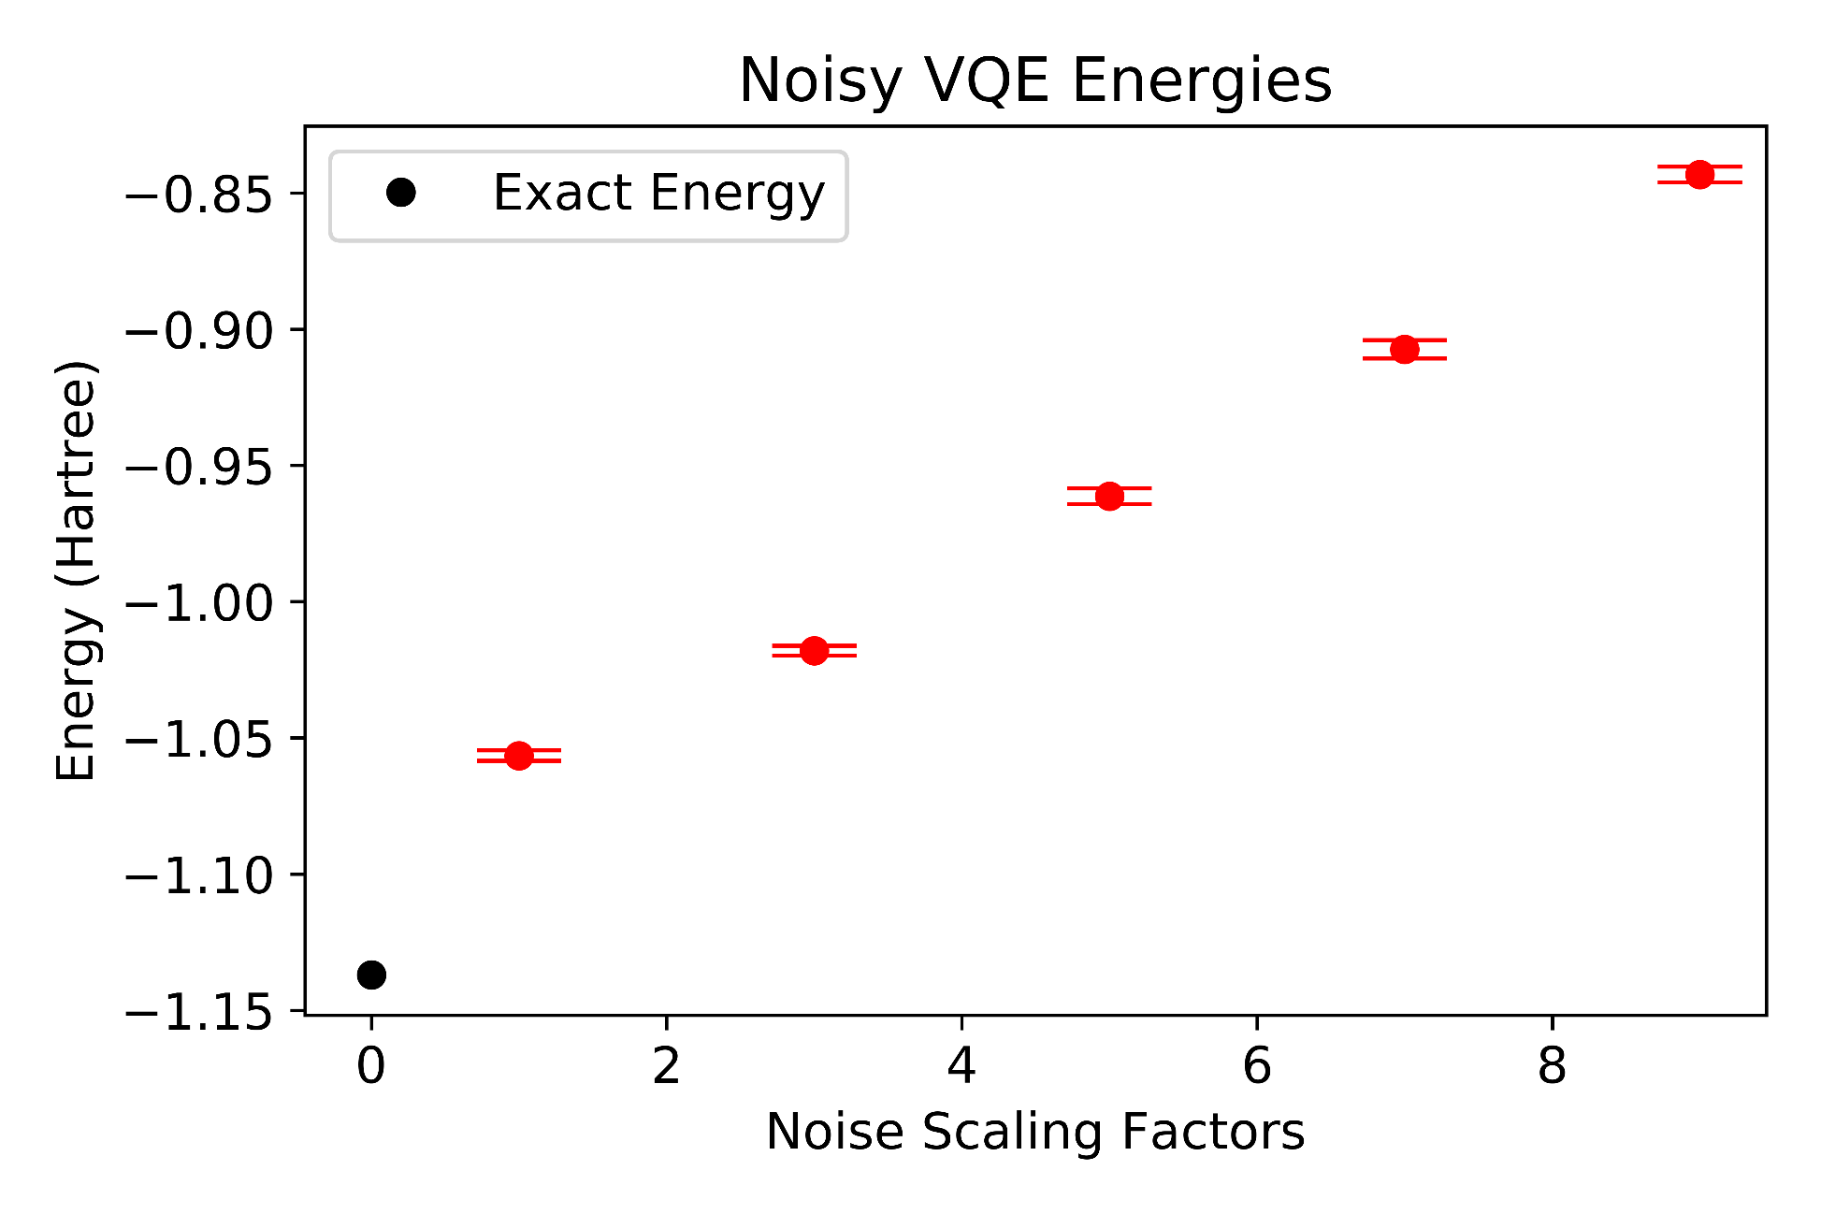
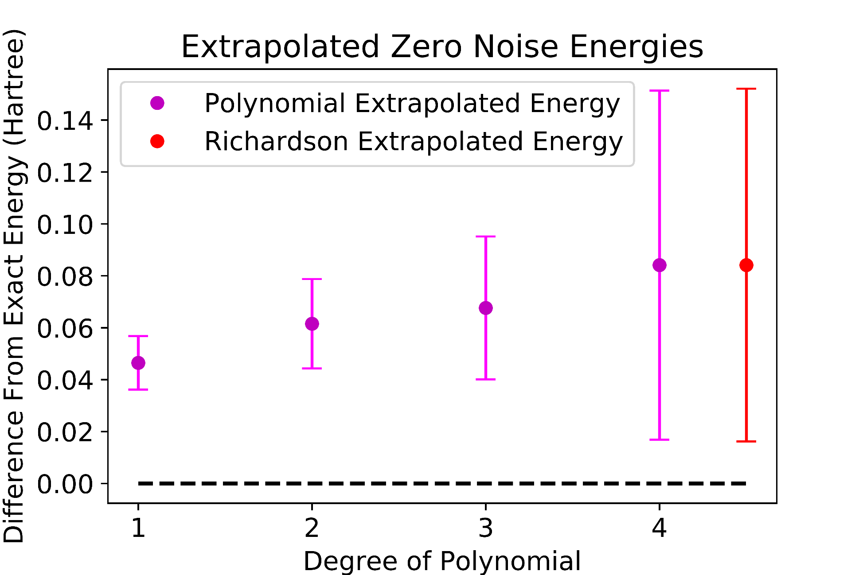


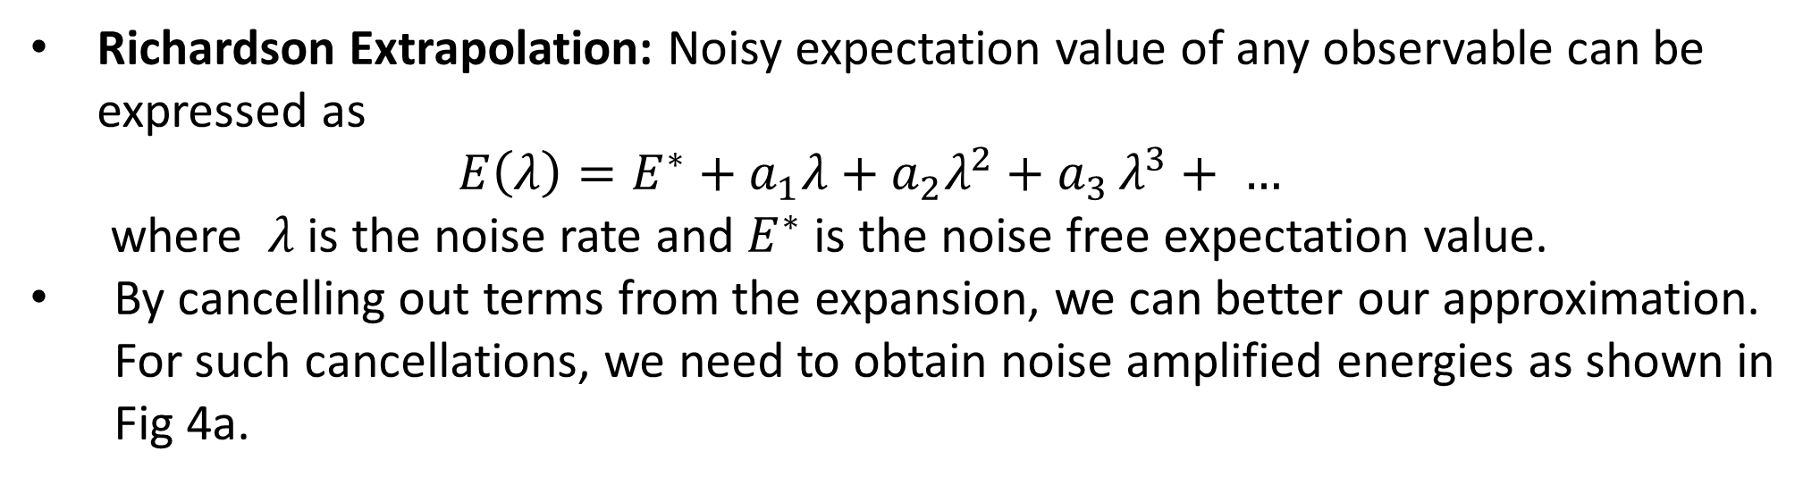


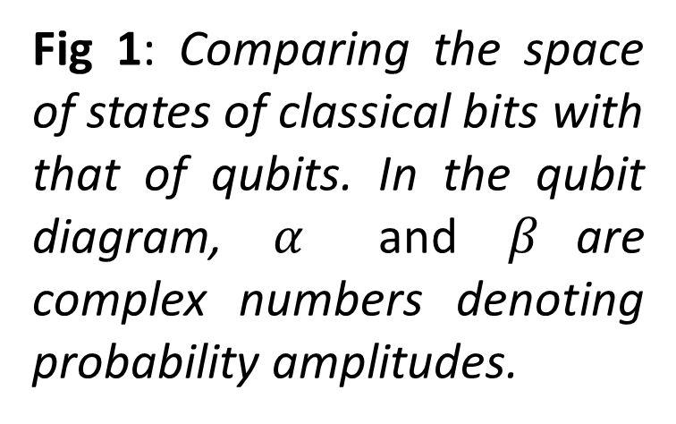



Error Mitigating Quantum Computations of Molecular Ground States
Eesh Gupta, Stephen Schnetzer, Rikab Gambhir
Department of Physics and Astronomy, Rutgers University, Piscataway, NJ
Abstract
Results
Methods
Quantum Computers have the potential to solve chemistry problems of great industrial importance but near term devices are susceptible to errors. Thus, error mitigation techniques like Richardson Extrapolation are being explored to reduce the effect of errors. In this project, we compare the Richardson method with a simpler polynomial-fitting method to determine the zero noise ground state energy of the hydrogen molecule. Results and implications are discussed.
Fig 3: Using noise model simulation of IBM’s quantum computer at London, we compare Richardson technique with polynomial fitting technique in improving the VQE-computed ground state energy of the Hydrogen molecule. Noise was amplified while optimizing in the VQE process.
To compare the Richardson and the polynomial fitting techniques, we ran VQE algorithm on the hydrogen molecule and extrapolated the results.
Noise could be amplified during the optimization phase of VQE or afterwards.
Since the dominant source of noise on IBM’s quantum computers are two qubit gates, we can add redundant CNOT gates to amplify the noise rate.
Background
Fig 1: Comparing the space of states of classical bits with that of qubits. In the qubit diagram, $α$ and $β$are complex numbers denoting probability amplitudes.
$$0$$
$$|0⟩$$
$$α\left|0\right\rangle +β|1⟩$$
Bit
Qubit
$$λ$$
$$3λ$$
Fig 3a : As the noise is increased the deviation of the calculate ground state energy from the exact value increases.
Fig 5: The addition of a pair of noisy CNOT gates triples the noise rate $λ.$
$$1$$
$$|1⟩$$
Fig 3b : Using Least Squares to fit polynomial functions through the noise energies.
Conclusion & Future Work
Quantum Computers use quantum mechanical properties such as superposition and entanglement to perform computations.
Recently, a hybrid quantum-classical algorithm – Variational Quantum Eigensolver (VQE) – has been devised which optimizes electrons in molecular orbitals to minimize the energy of molecular systems.
However quantum computers are plagued with errors due to hardware deficiencies like imperfect qubits and quantum gates.
Constrained by the number of qubits, error mitigation techniques are being explored to reduce the effects of errors.
Zero noise extrapolated energy obtained via polynomial fitting is more precise and accurate than that obtained via Richardson technique.
Richardson method is overfitting the data, resulting in large error bars as shown in Fig 3c and Fig 4b.
It also performs worse in terms of accuracy, resulting in greater divergence from exact energy as shown in Fig 3c and Fig 4b.
We plan to improve the technique by amplifying the noise in finer steps in order to obtain an improved fit.
Also, zero noise extrapolated energies we obtained are not within chemical accuracy.
We will then investigate other error mitigation strategies such as probabilistic error cancellation and quantum subspace expansion to obtain improved accuracy of the ground state energy
H
H
Fig 3c : Uncertainty of zero noise energy extrapolated by Richardson is worse than that by lower degree polynomials.
Fig 3d : Zooming into Fig 3c, zero energy extrapolated by Richardson is worse than that of lower degree polynomials.
Li
H
O
Fig 6: We also plan to apply these techniques to more complex molecules like Lithium Hydride and Water.
H
H
Fig 4: Using IBM’s quantum computer at London, we compare Richardson technique with polynomial fitting technique in improving the VQE-computed ground state energy of the Hydrogen molecule. Noise was amplified after optimizing parameters in VQE.
Acknowledgements
Fig 2: As we stretch 2 hydrogen atoms apart, we compute the minimum energy of the molecule using VQE on IBM’s noisy quantum computer at London and compare it with the exact energy .
I would like to thank Professor Stephen Schnetzer foremost for his continued guidance and patience throughout this adventure. Special thanks to Rikab Gambhir and Professor Mark Hillery for insightful discussions. Lastly, I want to thank Aresty Research Center for this opportunity.
Error Mitigation Techniques
References
Richardson Extrapolation: Noisy expectation value of any observable can be expressed as
$$E\left(λ\right)=E^{∗}+a_{1}λ+a_{2}λ^{2}+a_{3 }λ^{3}+ …$$
where $λ$is the noise rate and $E^{∗}$ is the noise free expectation value.
By cancelling out terms from the expansion, we can better our approximation. For such cancellations, we need to obtain noise amplified energies as shown in Fig 4a.
Gadi Aleksandrowicz et al. Qiskit: An open-source framework for quantum computing, 2019.
McArdle S, Endo S, Aspuru-Guzik A, Benjamin S, Yuan X. Quantum computational chemistry. Rev. Mod. Phys. 2018;92. https://arxiv.org/abs/1808.10402v3. doi: 10.1103/RevModPhys.92.015003.
Temme K, Bravyi S, Gambetta JM. Error mitigation for short-depth quantum circuits. Phys Rev Lett. 2017;119(18):180509. https://link-aps-org.proxy.libraries.rutgers.edu/doi/10.1103/PhysRevLett.119.180509. doi: 10.1103/PhysRevLett.119.180509.
Polynomial Extrapolation: Given energies at various noise scaling factors, we can fit polynomial function using nonlinear least squares and then evaluate those functions at zero noise.
Fig 4a: As we amplify noise in the optimized circuit, the energies diverge more and more from the exact energy .
Fig 4b: Zero Noise energy extrapolated by Richardson is both worse in precision and accuracy than that extrapolated by lower degree polynomial fits.

