Slide 1

Eesh Gupta
Abstract
Methods and Materials
 | ghhhhhhhhhhhhhgggggggg
Background
Results
Future Direction
Acknowledgements
References

Slide 2
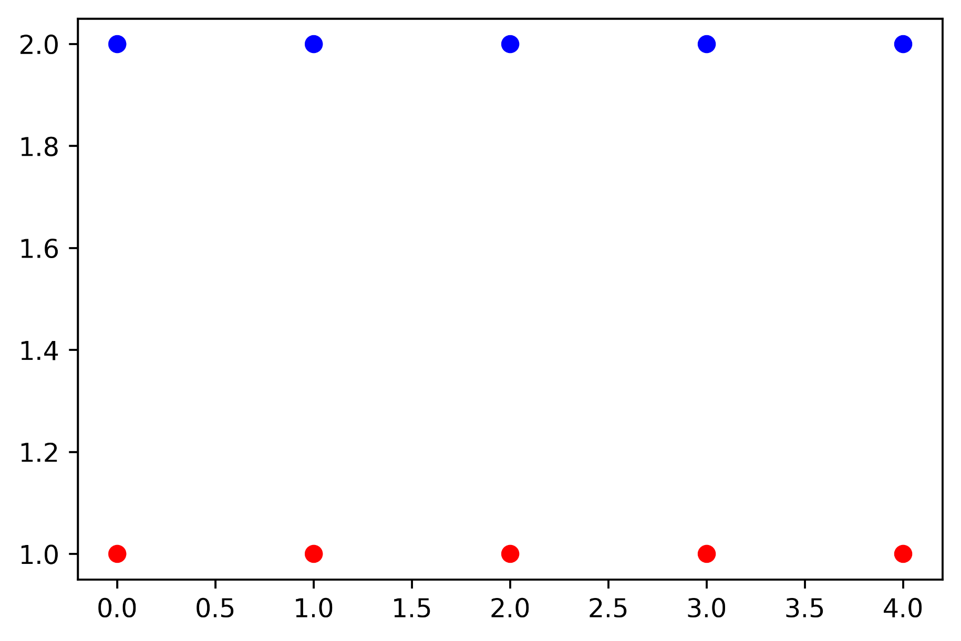
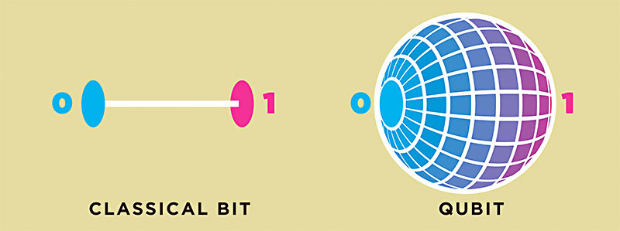
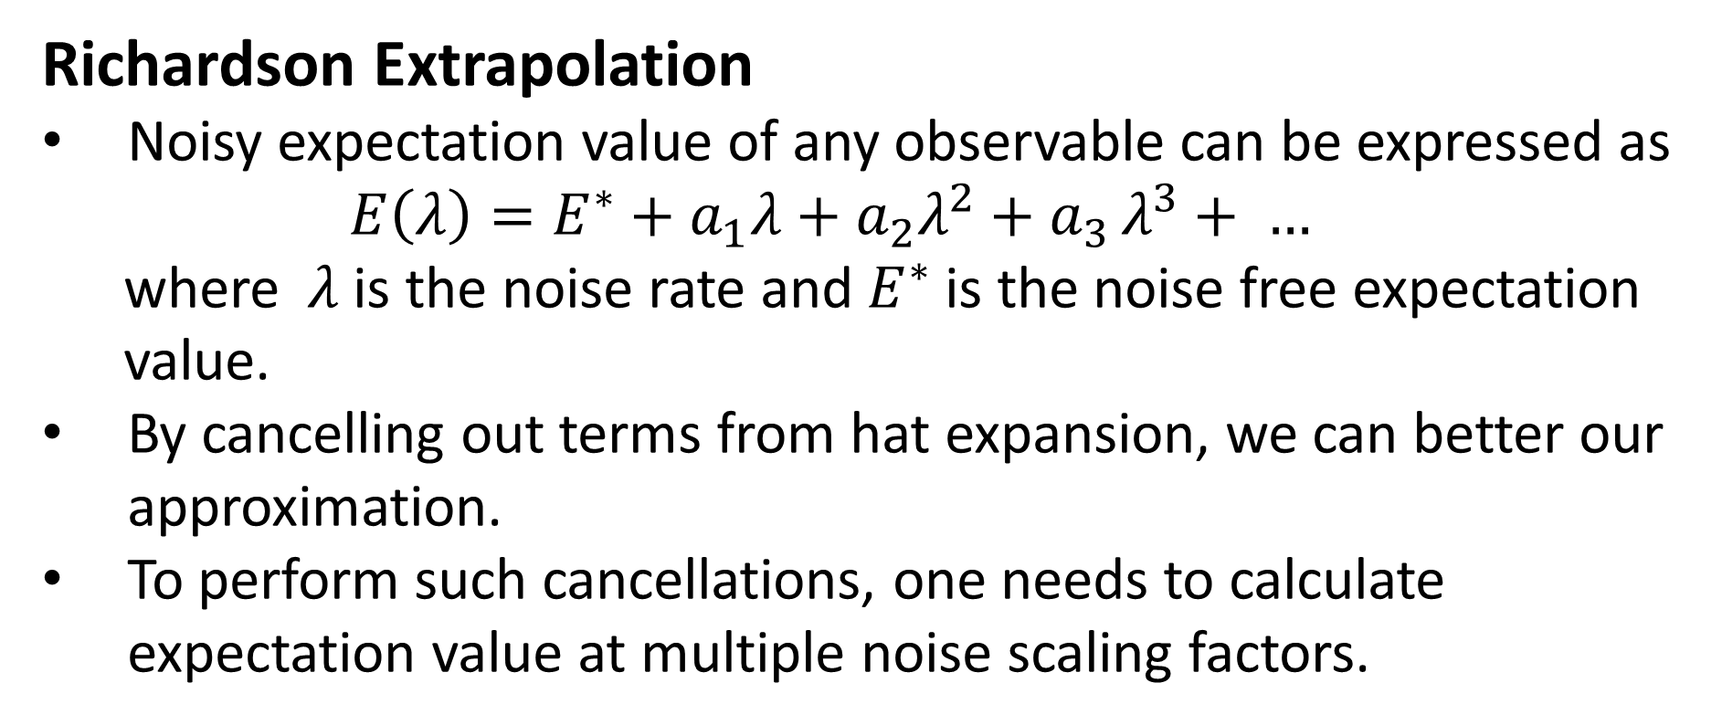
Error Mitigating Quantum Computations of Molecular Ground States
Eesh Gupta, Stephen Schnetzer, Rikab Gambhir
Department of Physics and Astronomy, Rutgers University, Piscataway, NJ
Objective
Noise Amplification
Improve upon a popular error mitigation technique in the literature
The dominant source of errors on IBM quantum computers are 2 qubit gates.
Then noise can be amplified by adding redundant CNOT gates.
Introduction
Quantum computers have the potential to solve classically intractable chemistry problems of great industrial importance.
Background
CNOT Amplification: On an ideal quantum computer, these circuits are logically equivalent. However, on a noisy quantum computer, the addition of redundant CNOT gates triples the noise rate in the latter circuit.
Recently, a hybrid quantum-classical algorithm – Variational Quantum Eigensolver (VQE) – has been devised which optimizes electrons in molecular orbitals to minimize the energy of molecular systems.
However quantum computers are plagued with errors due to hardware deficiencies like imperfect qubits and quantum gates.
Due to such errors, energies computed by the VQE algorithm are rarely within chemical accuracy.
Constrained by the number of qubits, error mitigation techniques are being explored to reduce the effects of errors.
Methods
Prepared Hydrogen molecule with interatomic separation of 0.74 angstroms
Chose 5 noise scaling factors – 1,3,5,7,9
For each amplification factor, ran VQE on IBM’s London Quantum Computer multiple times
Extrapolated using both Richardson and polynomial fitting techniques.
Compared the ‘zero error’ solutions.
Zero Noise extrapolated energies by lower degree polynomials are more precise than that by Richardson Technique.
Results
Conclusion
Model of a qubit. Qubits are very small and delicate systems, where even the smallest of interactions with photons can result in leakage of information
We were successful in improving upon the Richardson technique
However, our ‘zero noise’ energy is still not within chemical accuracy of 0.001 Hartree.
Error Mitigation Techniques
Richardson Extrapolation
Noisy expectation value of any observable can be expressed as
$$E\left(λ\right)=E^{∗}+a_{1}λ+a_{2}λ^{2}+a_{3 }λ^{3}+ …$$
where $λ$is the noise rate and $E^{∗}$ is the noise free expectation value.
By cancelling out terms from hat expansion, we can better our approximation.
To perform such cancellations, one needs to calculate expectation value at multiple noise scaling factors.
Future Work
Comparing these techniques for larger molecules like Lithium Hydride
Exploring other error mitigation methods to improve accuracy of results.
Polynomial Extrapolation:
Given energies at various noise scaling factors, we can fit polynomial function using nonlinear least squares.
Evaluating these functions at 0 noise, we can extrapolate noise free energy.
As noise worsens, the VQE-computed ground state energy of the hydrogen molecule diverges more from the exact energy
Acknowledgements
I would like to thank my faculty mentor Stephen Schnetzer for guiding me through this adventure, Rikab Gambhir and Mark Hillery for insightful discussions and my family for their neverending support.

Slide 3
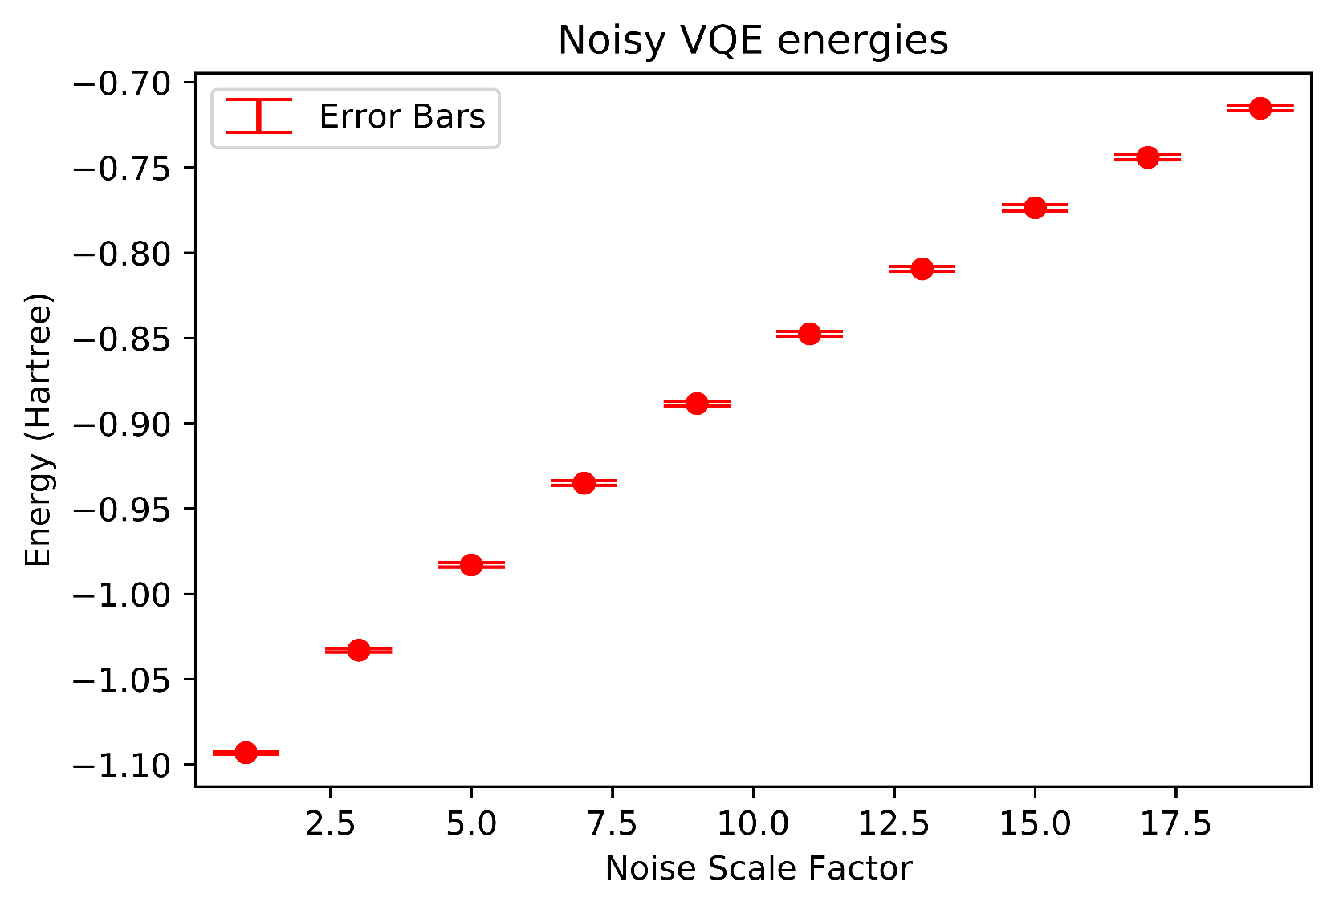
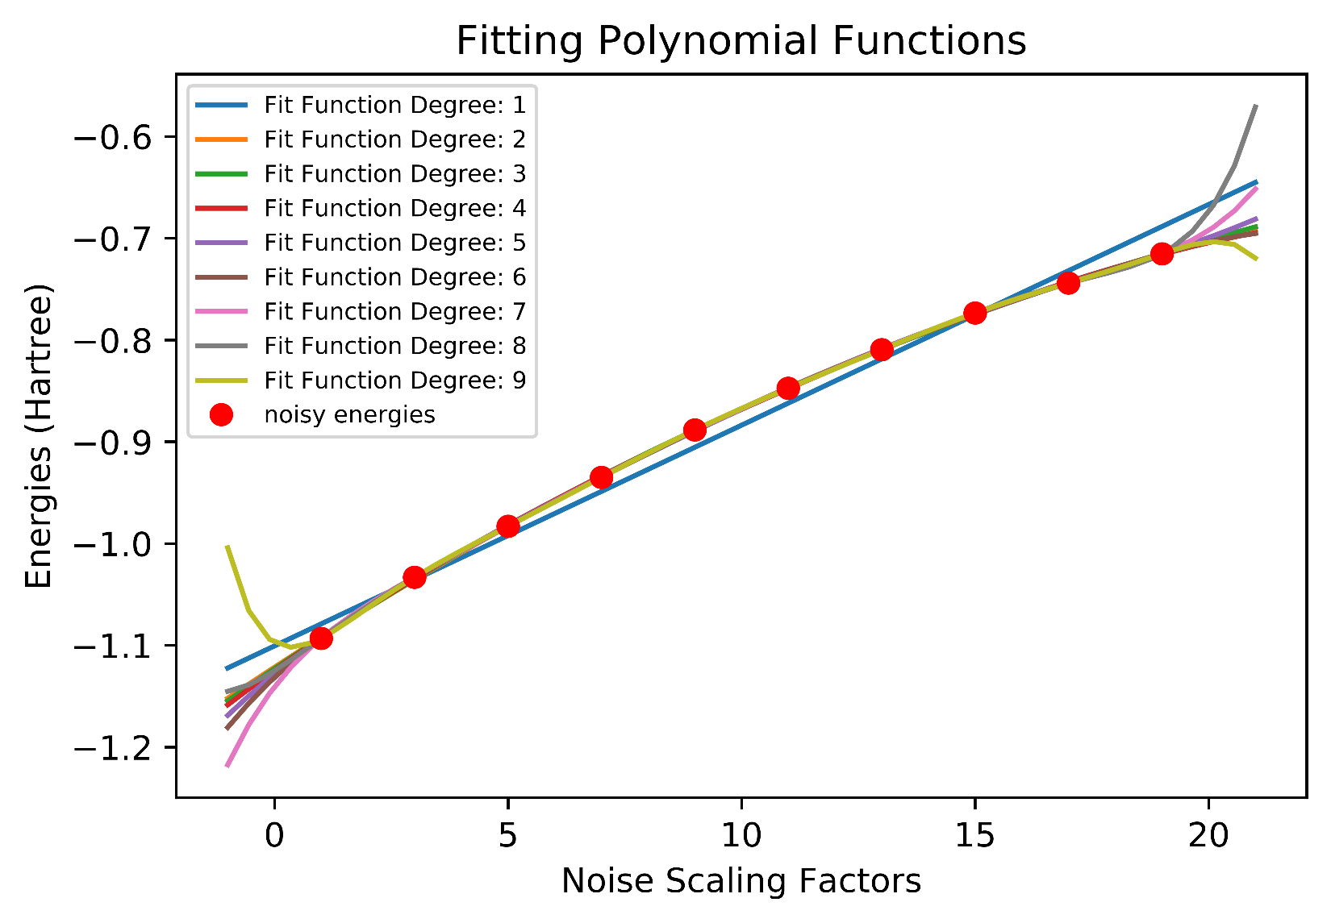
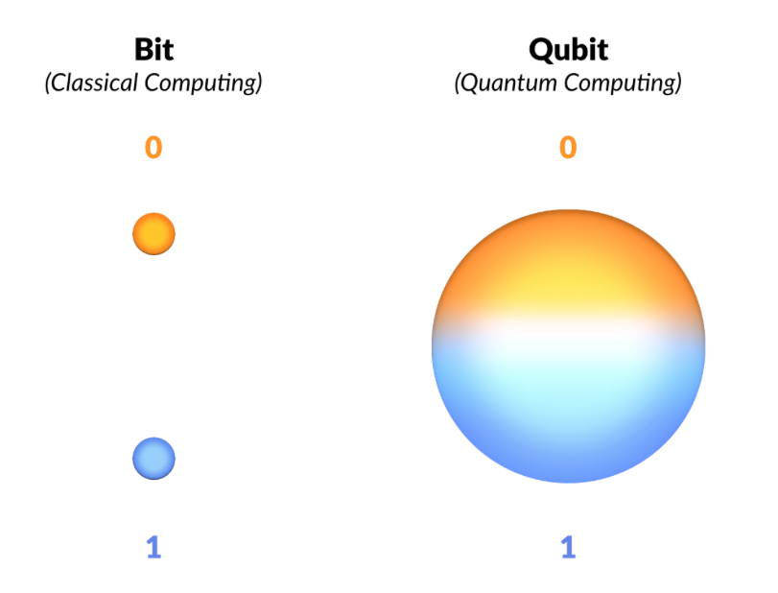
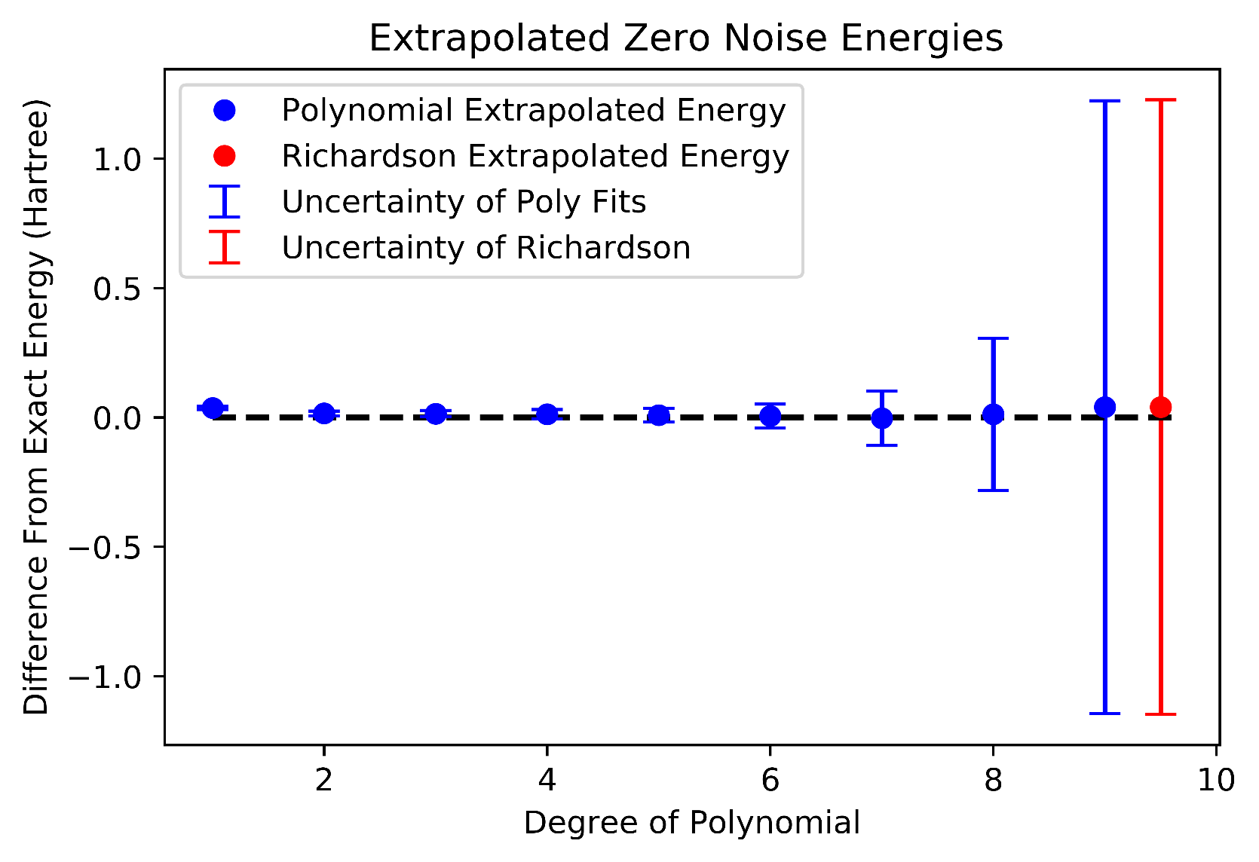
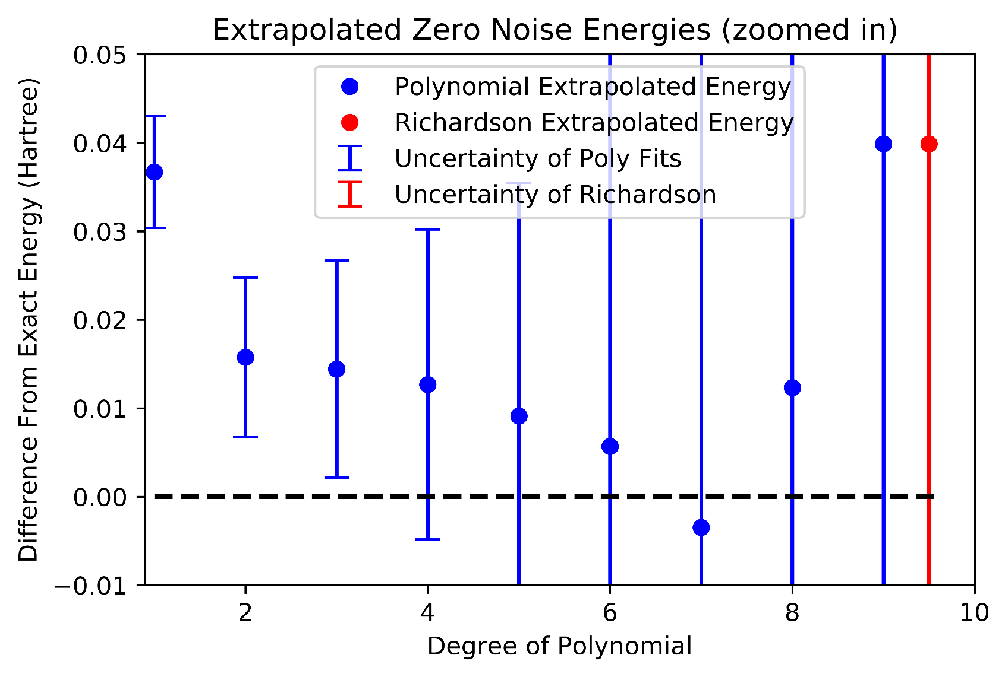

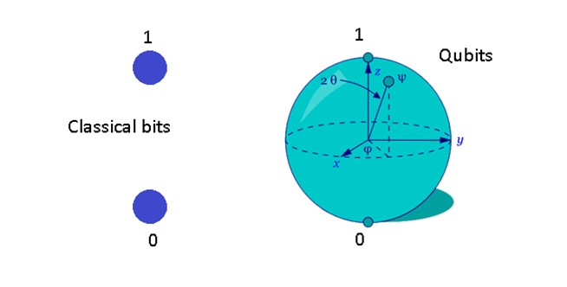
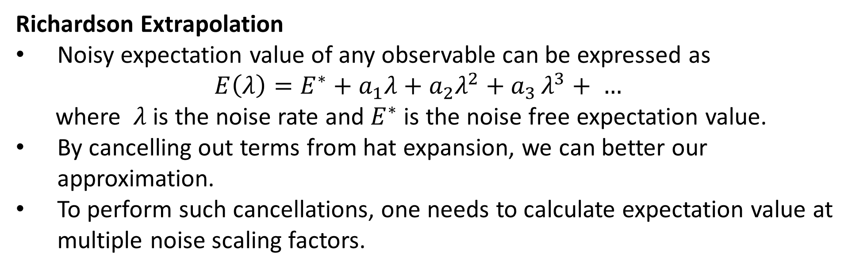
Error Mitigating Quantum Computations of Molecular Ground States
Eesh Gupta, Stephen Schnetzer, Rikab Gambhir
Department of Physics and Astronomy, Rutgers University, Piscataway, NJ
Abstract
Results
Methods
Fig 4: Using noise model simulation of IBM’s quantum computer at London, we compare Richardson technique with polynomial fitting technique in improving the VQE-computed ground state energy of the Hydrogen molecule
Background
Quantum Computers use quantum mechanical properties such as superposition and entanglement to perform computations.
Recently, a hybrid quantum-classical algorithm – Variational Quantum Eigensolver (VQE) – has been devised which optimizes electrons in molecular orbitals to minimize the energy of molecular systems.
However quantum computers are plagued with errors due to hardware deficiencies like imperfect qubits and quantum gates.
Fig 4a : As noise gets worse, the energies get worse as well. Exact energy here is -1.13 Hartree.
Fig 4b : Using Least Squares to fit polynomial functions through the noise energies.
Fig 1: Comparing the space of states of classical bits with that of qubits.
Conclusion & Future Work
We were successful in improving upon the Richardson technique
However, our ‘zero noise’ energy is still not within chemical accuracy of 0.001 Hartree.
Constrained by the number of qubits, error mitigation techniques are being explored to reduce the effects of errors.
Fig 2: Due to such errors, energies computed by the VQE algorithm are rarely within chemical accuracy.
Fig 4c : Uncertainty of zero noise energy extrapolated by Richardson is worse than that by lower degree polynomials.
Fig 4d : Zero energy extrapolated by Richardson is worse than that of lower degree polynomials.
Acknowledgements
Error Mitigation Techniques
I would like to thank my faculty mentor Stephen Schnetzer for guiding me through this adventure, Rikab Gambhir and Mark Hillery for insightful discussions and my family for their neverending support.
Richardson Extrapolation
Noisy expectation value of any observable can be expressed as
$$E\left(λ\right)=E^{∗}+a_{1}λ+a_{2}λ^{2}+a_{3 }λ^{3}+ …$$
where $λ$is the noise rate and $E^{∗}$ is the noise free expectation value.
By cancelling out terms from hat expansion, we can better our approximation.
To perform such cancellations, one needs to calculate expectation value at multiple noise scaling factors.
References
Polynomial Extrapolation:
Given energies at various noise scaling factors, we can fit polynomial function using nonlinear least squares.
Evaluating these functions at 0 noise, we can extrapolate noise free energy.

Slide 4
Background
Quantum bits and gates are very sensitive to noise from environment, resulting in erroneous results.
Richardson Extrapolation:
Noisy expectation value of any observable can be expressed as
$$E\left(λ\right)=E^{∗}+a_{1}λ+a_{2}λ^{2}+a_{3}λ^{3}$$
where $λ$is the noise rate and $E^{∗}$ is the noisefree expectation value.
By cancelling out terms from hat expansion, we can better our approximation
Noise Amplification:
The dominant source of errors on IBM quantum computers are 2 qubit gates.
Then noise can be amplified by adding redundant CNOT gates.

Slide 5
Model of a qubit. Qubits are very small and delicate systems, where even the smallest of interactions with photons can result in leakage of information

Slide 6
Choose 5 different noise scaling factors
Run VQE multiple times for each factor
Analyz
Choose 5 noise scaling factors
For each amplification factor
Run VQE on Quantum Computer multiple times
Extrapolate using both Richardson and polynomial fitting techniques.
Compare the ‘zero error’ solutions.
Choose 5 different noise scaling factors and setup the hydrogen molecule
For each amplification factor, run VQE on IBMQ London device multiple times.
Extrapolate using both Richardson and polynomial fiiting techniques and Compare Results

Slide 7
Methodology
Choose 5 noise scaling factors
For each amplification factor
Run VQE on Quantum Computer multiple times
Extrapolate using both Richardson and polynomial fitting techniques.
Compare the ‘zero error’ solutions.

Slide 8
Conclusion
We were successful in improving upon the Richardson technique
However, our ‘zero noise’ energy is still not within chemical accuracy of 0.001 Hartree.

