Slide 1
Updates on Multimode ECD (Theory)
August 4, 2023

Slide 2
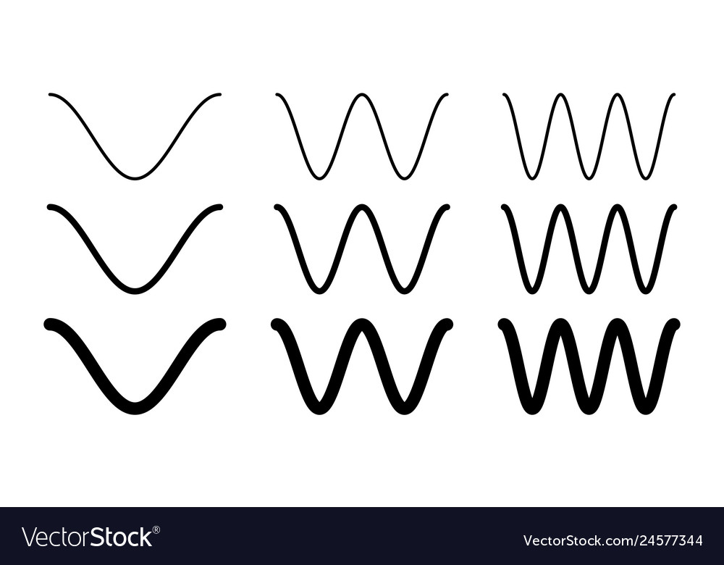
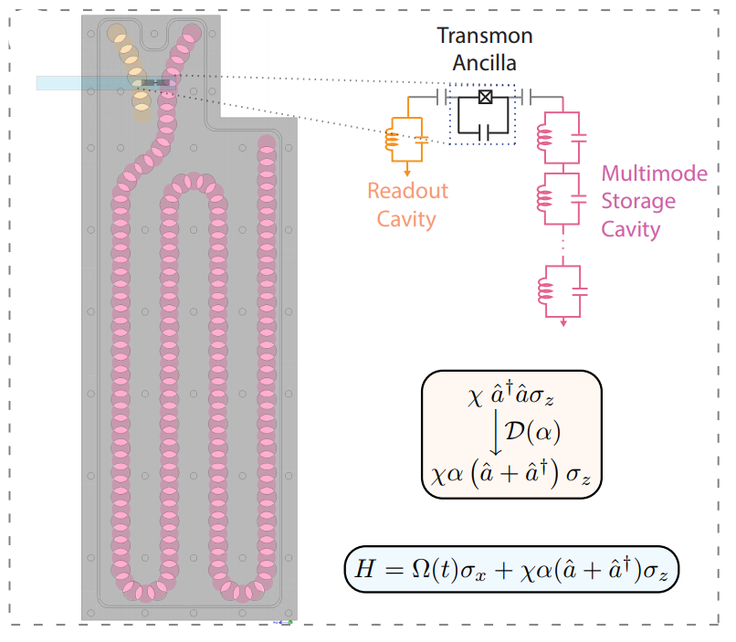
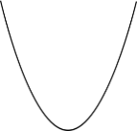
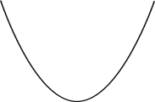



Aim
$$f$$
Ancilla Transmon
$$e$$
$$g$$
$$χ$$
Target Mode
Spectator Modes
Enact high-speed multimode gate operations while reducing propagation of ancilla errors into the cavity.

Slide 3






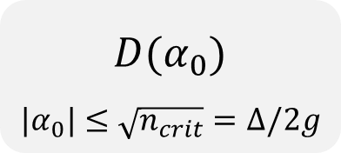



Displacement Enhanced Interactions
$$Im(α)$$
$$|g⟩$$
Large cavity displacements as a switch to enhance cavity-ancilla interaction strength
$$α_{0}$$
$$O$$
$$Re(α)$$
$$|e⟩$$
Weak $χ/2π \sim 30$ kHz but strong $χα_{0}/2π \sim 1$ MHz
$$χa^{†}aσ_{z}$$
$$χ{ (α_{0}a}^{†}+α_{0}^{∗}a) σ_{z}$$
$$D(α_{0})$$
$${|α}_{0}|≤\sqrt{n_{crit}}=Δ/2g$$
Eickbusch, A., Sivak, V., Ding, A.Z. et al. Nat. Phys. 18, 1464–1469 (2022)
Hacohen-Gourgy, S., Martin, L., Flurin, E. et al. Nature 538, 491–494 (2016).

Slide 4
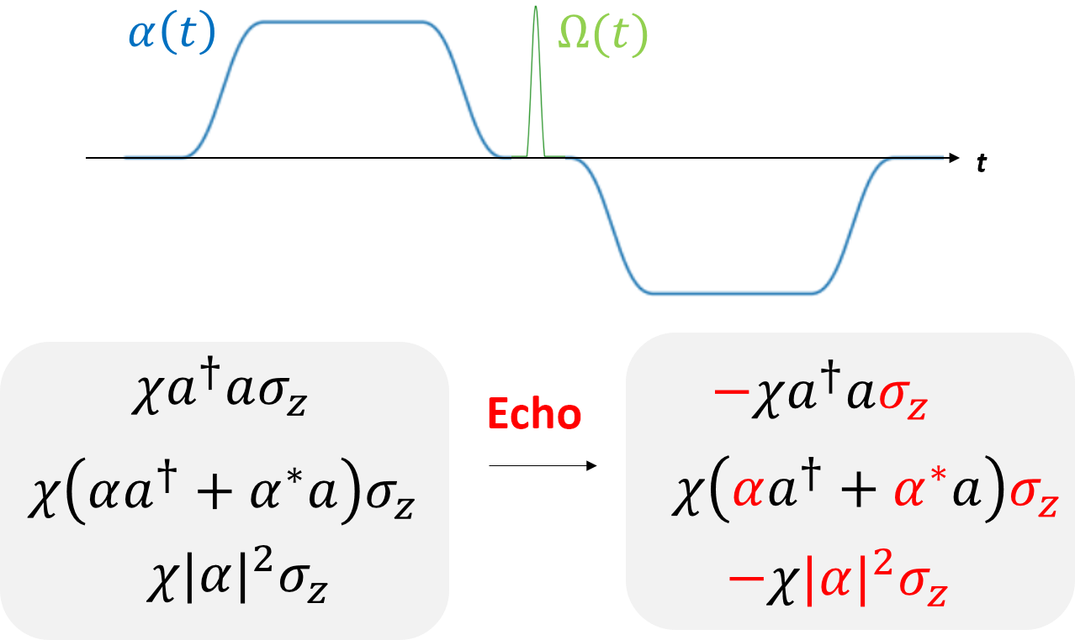
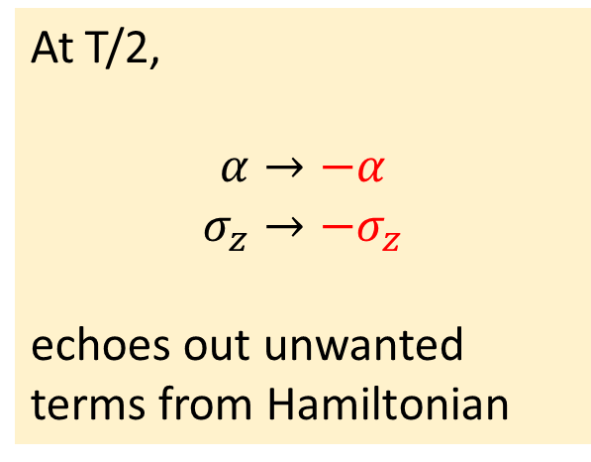
Echoed Conditional Displacements
At T/2,
$$α→−α$$
$$σ_{z}→−σ_{z}$$
echoes out unwanted terms from Hamiltonian

Slide 5
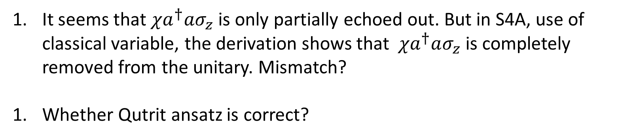

Q: Echo of $χa^{†}aσ_{z}$ partial?
It seems that $χa^{†}aσ_{z}$ is only partially echoed out. But in S4A, use of classical variable, the derivation shows that $χa^{†}aσ_{z}$ is completely removed from the unitary. Mismatch?
Whether Qutrit ansatz is correct?

Slide 6

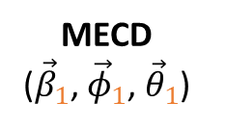
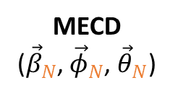
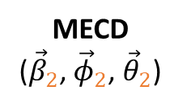





Multimode ECD
Find pulse parameters $\vec{β}, \vec{γ }, \vec{φ}, \vec{θ}$which realize a target unitary $U$
Mode 1
$$U$$
MECD
(${\vec{β}}_{N}$, ${\vec{φ}}_{N}$, ${\vec{θ}}_{N}$)
MECD
(${\vec{β}}_{1}$, ${\vec{φ}}_{1}$, ${\vec{θ}}_{1}$)
MECD
(${\vec{β}}_{2}$, ${\vec{φ}}_{2}$, ${\vec{θ}}_{2}$)
Mode 2
$$≈$$
Ancilla
ECD(${\vec{β}}_{12}$)
ECD(${\vec{β}}_{11}$)
$$R_{φ_{11}}(θ_{11})$$
$$R_{φ_{12}}(θ_{12})$$

Slide 7
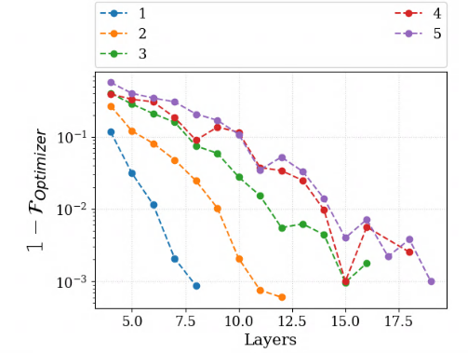
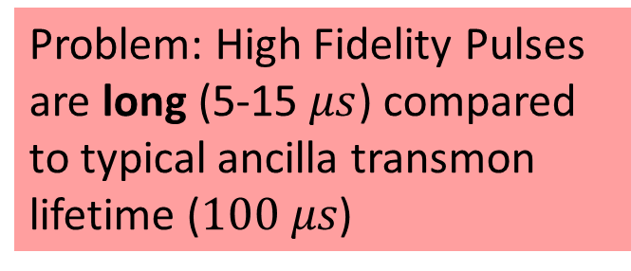
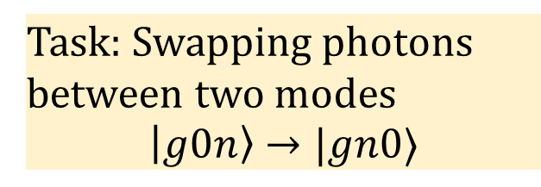
Multimode ECD
Task: Swapping photons between two modes
$$\left|g0n\right\rangle →|gn0⟩$$
Problem: High Fidelity Pulses are long (5-15 $μs$) compared to typical ancilla transmon lifetime ($100 μs$)

Slide 8
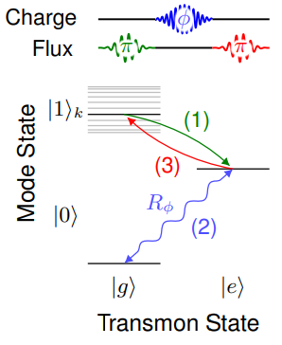
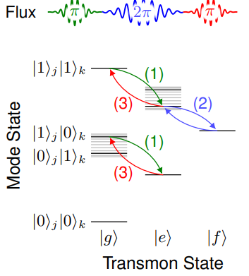
Idea: f -state
Naik et. al required f-state of the transmon to perform multimode gates.
Maybe f-state can help find ECD sequences with lower layer count.
Naik, R.K., Leung, N., Chakram, S. et al. Nat Commun 8, 1904 (2017).

Slide 9
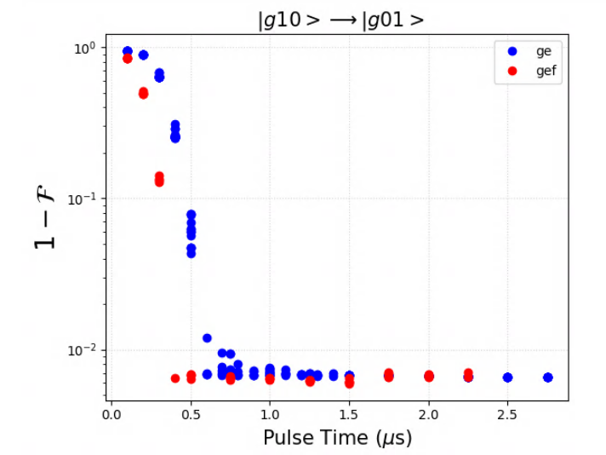
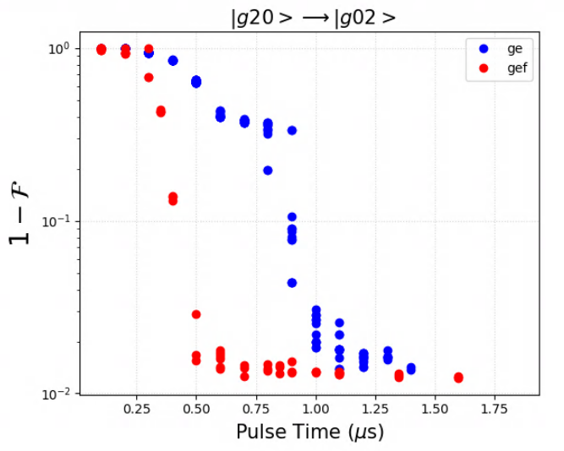
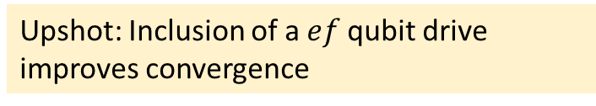
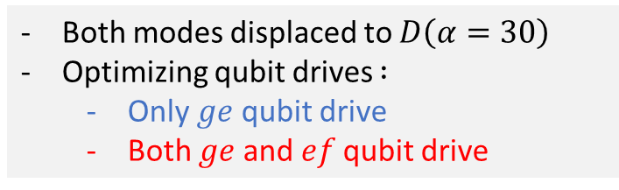
Circle GRAPE with f state
Data collection in progress!
Both modes displaced to $D\left(α=30\right)$
Optimizing qubit drives $:$
Only $ge$qubit drive
Both $ge$ and $ef$qubit drive
Upshot: Inclusion of a $ef$qubit drive improves convergence

Slide 10
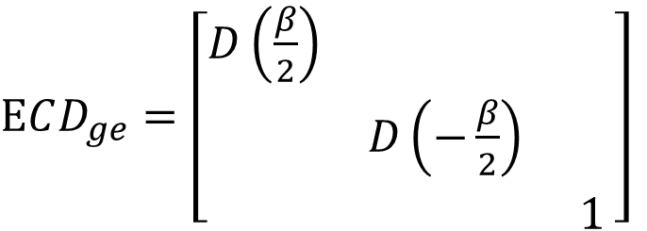
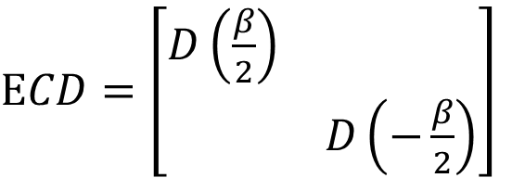
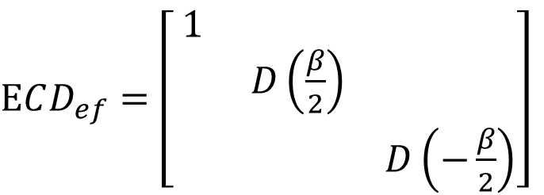
ECD with f-state
Objective: Realize ECD gates with qutrit ancilla
$ECD_{ge}=\left[\begin{matrix}D\left(\frac{β}{2}\right) & & \\ & D\left(−\frac{β}{2}\right) & \\ & & 1\end{matrix}\right]$
$ECD=\left[\begin{matrix}D\left(\frac{β}{2}\right) & \\ & D\left(−\frac{β}{2}\right)\end{matrix}\right]$
$ECD_{ef}=\left[\begin{matrix}1 & & \\ & D\left(\frac{β}{2}\right) & \\ & & D\left(−\frac{β}{2}\right)\end{matrix}\right]$

Slide 11
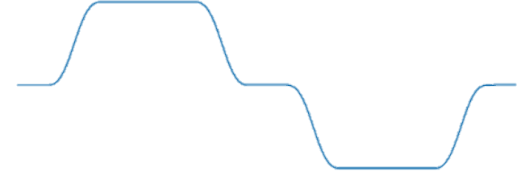



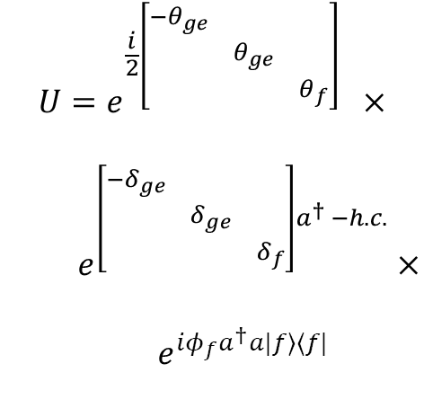
$$ECD_{ge}$$
Question: What pulse sequence would realize $ECD_{ge}$?
Note that $H=χa^{†}aσ_{ge}^{z}+χa^{†}a|f⟩⟨f|+ε \left(t\right)a^{†}+ε^{⋆}\left(t\right)a$
Dispersive Interaction
Cavity Drive
$$U=e^{\frac{i}{2}\left[\begin{matrix}{−θ}_{ge} & & \\ & θ_{ge} & \\ & & θ_{f}\end{matrix}\right]} ×$$
$e^{\left[\begin{matrix}−δ_{ge} & & \\ & δ_{ge} & \\ & & δ_{f}\end{matrix}\right]a^{†} −h.c.}×$
$e^{iφ_{f}a^{†}a|f⟩⟨f|}$
$$π_{ge}$$
$$α\left(t\right)$$
t
Realizes the Unitary

Slide 12





$$ECD_{ge}$$
$$π_{ge}$$
$$α\left(t\right)$$
t
$$Im(α)$$
$$|g⟩$$
$$Re(α)$$
$$|e⟩$$

Slide 13
$$ECD_{ge}$$
$$π_{ge}$$
$$α\left(t\right)$$
t
$$Im(α)$$
$$|g⟩$$
$$Re(α)$$
$$|e⟩$$

Slide 14
$$ECD_{ge}$$
$$π_{ge}$$
$$α\left(t\right)$$
t
$$Im(α)$$
$$|g⟩$$
$$Re(α)$$
$$|e⟩$$

Slide 15
$$ECD_{ge}$$
$$π_{ge}$$
$$α\left(t\right)$$
t
$$Im(α)$$
$$|g⟩$$
$$Re(α)$$
$$|e⟩$$

Slide 16
$$ECD_{ge}$$
$$π_{ge}$$
$$α\left(t\right)$$
t
$$Im(α)$$
$$|g⟩$$
$$Re(α)$$
$$|e⟩$$

Slide 17
$$ECD_{ge}$$
$$π_{ge}$$
$$α\left(t\right)$$
t
$$Im(α)$$
$$|g⟩$$
$$Re(α)$$
$$|e⟩$$

Slide 18
$$ECD_{ge}$$
$$π_{ge}$$
$$α\left(t\right)$$
t
$$Im(α)$$
$$|g⟩$$
$$Re(α)$$
$$|e⟩$$

Slide 19
$$ECD_{ge}$$
$$π_{ge}$$
$$α\left(t\right)$$
t
$$Im(α)$$
$$|g⟩$$
$$Re(α)$$
$$|e⟩$$

Slide 20
Now adding in f state

Slide 21

$$ECD_{ge}$$
$$π_{ge}$$
$$α\left(t\right)$$
t
$$Im(α)$$
$$|g⟩$$
$$|f⟩$$
$$Re(α)$$
$$|e⟩$$

Slide 22

$$ECD_{ge}$$
$$π_{ge}$$
$$α\left(t\right)$$
t
$$Im(α)$$
$$|g⟩$$
$$Re(α)$$
$$|f⟩$$
$$|e⟩$$

Slide 23
$$ECD_{ge}$$
$$π_{ge}$$
$$α\left(t\right)$$
t
$$Im(α)$$
$$|g⟩$$
$$Re(α)$$
$$|f⟩$$
$$|e⟩$$

Slide 24
$$ECD_{ge}$$
$$π_{ge}$$
$$α\left(t\right)$$
t
$$Im(α)$$
$$|g⟩$$
$$Re(α)$$
$$|f⟩$$
$$|e⟩$$

Slide 25
$$ECD_{ge}$$
$$π_{ge}$$
$$α\left(t\right)$$
t
$$Im(α)$$
$$|g⟩$$
$$Re(α)$$
$$|f⟩$$
$$|e⟩$$

Slide 26

$$ECD_{ge}$$
$$π_{ge}$$
$$α\left(t\right)$$
t
$$Im(α)$$
$$|g⟩$$
$$Re(α)$$
$$|f⟩$$
$$|e⟩$$

Slide 27

$$ECD_{ge}$$
$$π_{ge}$$
$$α\left(t\right)$$
t
$$Im(α)$$
$$|g⟩$$
$$Re(α)$$
$$|f⟩$$
$$|e⟩$$

Slide 28
$$ECD_{ge}$$
$$π_{ge}$$
$$α\left(t\right)$$
t
$$Im(α)$$
$$|g⟩$$
$$Re(α)$$
$$|f⟩$$
$$|e⟩$$

Slide 29
$$ECD_{ge}$$
Question: What pulse sequence would realize $ECD_{ge}$?
Note that $H=χa^{†}aσ_{ge}^{z}+χa^{†}a|f⟩⟨f|+ε \left(t\right)a^{†}+ε^{⋆}\left(t\right)a$
Dispersive Interaction
Cavity Drive
$$U=e^{\frac{i}{2}\left[\begin{matrix}{−θ}_{ge} & & \\ & θ_{ge} & \\ & & θ_{f}\end{matrix}\right]} ×$$
$e^{\left[\begin{matrix}−δ_{ge} & & \\ & δ_{ge} & \\ & & δ_{f}\end{matrix}\right]a^{†} −h.c.}×$
$e^{iφ_{f}a^{†}a|f⟩⟨f|}$
$$π_{ge}$$
$$α\left(t\right)$$
t
Realizes the Unitary

Slide 30






New form of $ECD_{ge}(β)$
$$α\left(t\right)$$
$$π_{ef}$$
$$π_{ge}$$
t
$$ECD_{ef}(−β/2)$$
$$ECD_{ef}(β/2)$$
$$ECD_{ef}(−β/2)$$
$$Im(α)$$
$$|g⟩$$
$$|f⟩$$
$$Re(α)$$
$$|e⟩$$

Slide 31
New form of $ECD_{ge}(β)$
$$α\left(t\right)$$
$$π_{ef}$$
$$π_{ge}$$
t
$$ECD_{ef}(−β/2)$$
$$ECD_{ef}(β/2)$$
$$ECD_{ef}(−β/2)$$
$$Im(α)$$
$$|g⟩$$
Claim:
$$|f⟩$$
$$Re(α)$$
$$|e⟩$$

Slide 32






Summary
Generalized ECD to multimode system
Inclusion of ef qubit drive improved convergence
ECD with Qutrit ancilla (In progress)
Coming up with a pulse sequence to realize $ECD_{ge}$
$$α\left(t\right)$$
$$π_{ef}$$
$$π_{ge}$$
t
$$ECD_{ef}(−β/2)$$
$$ECD_{ef}(β/2)$$
$$ECD_{ef}(−β/2)$$

Slide 33
Scratch

Slide 34
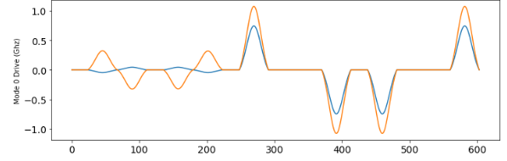
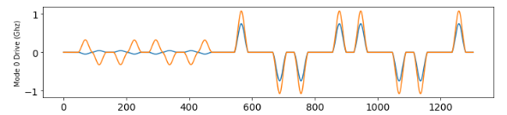
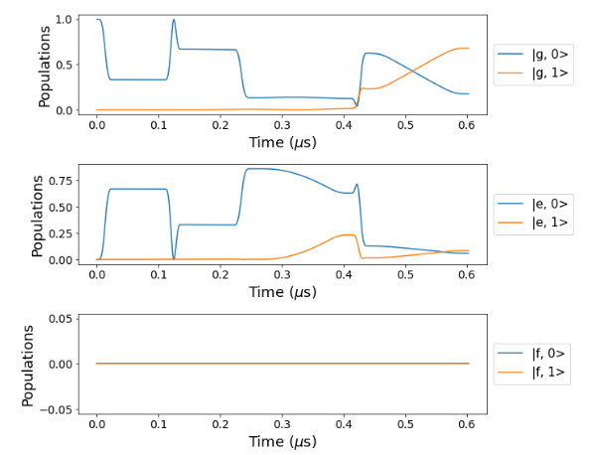
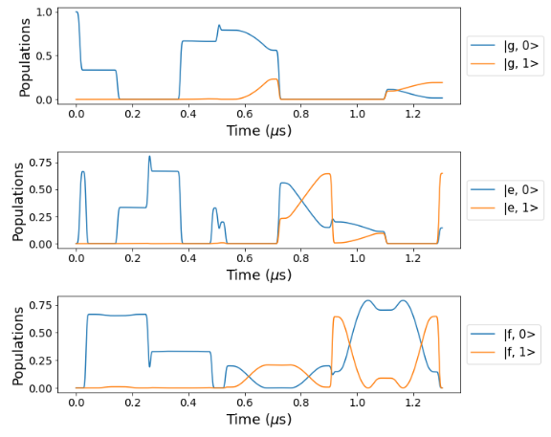

Slide 35
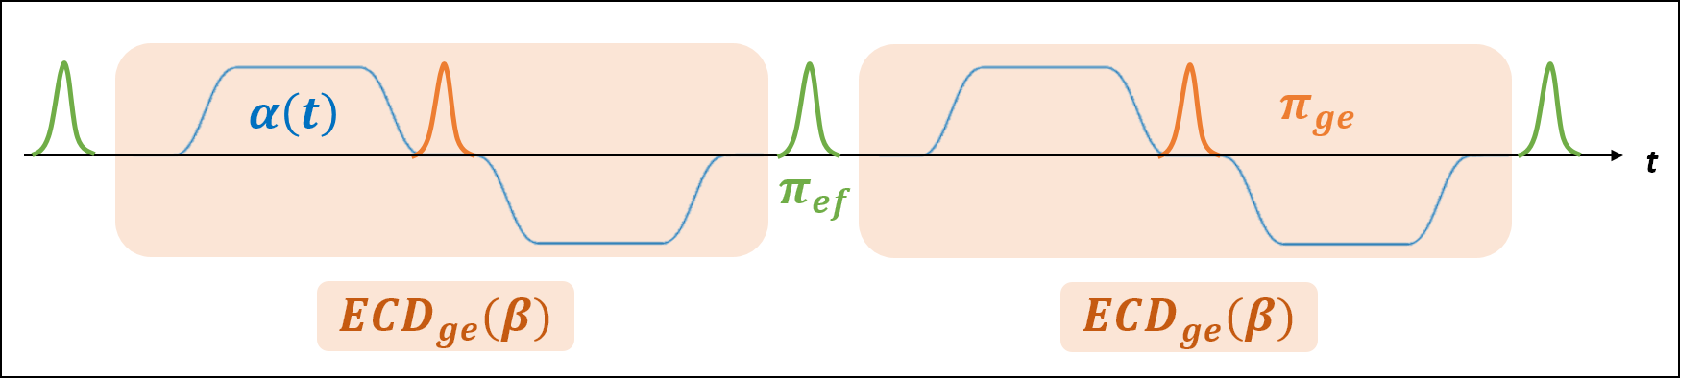

First Guess for $ECD_{ge}$
Question: Does the following pulse sequence echo out the unwanted f-state terms?
Not completely
$U=e^{\frac{i}{2}\left(θ_{ge}−θ_{f}\right)σ_{ge}^{z} } ×e^{\left[\begin{matrix}δ_{f} & & \\ & δ_{ge} & \\ & & {−δ}_{ge}\end{matrix}\right]a^{†} −h.c.}×$ $e^{iφ_{f}a^{†}a|g⟩⟨g|}×e^{\left[\begin{matrix}{−δ}_{ge} & & \\ & δ_{f} & \\ & & δ_{ge}\end{matrix}\right]a^{†} −h.c.}× e^{iφ_{f}a^{†}a|e⟩⟨e|}$

Slide 36
New form of $ECD_{ge}(β)$
$$α\left(t\right)$$
$$π_{ef}$$
$$π_{ge}$$
t
$$ECD_{ef}(−β/2)$$
$$ECD_{ef}(β/2)$$
$$ECD_{ef}(−β/2)$$
$$Im(α)$$
$$|g⟩$$
$$|f⟩$$
$$Re(α)$$
$$|e⟩$$

Slide 37
New form of $ECD_{ge}(β)$
$$α\left(t\right)$$
$$π_{ef}$$
$$π_{ge}$$
t
$$ECD_{ef}(−β/2)$$
$$ECD_{ef}(β/2)$$
$$ECD_{ef}(−β/2)$$
$$Im(α)$$
$$|g⟩$$
$$|f⟩$$
$$Re(α)$$
$$|e⟩$$

Slide 38
New form of $ECD_{ge}(β)$
$$α\left(t\right)$$
$$π_{ef}$$
$$π_{ge}$$
t
$$ECD_{ef}(−β/2)$$
$$ECD_{ef}(β/2)$$
$$ECD_{ef}(−β/2)$$
$$Im(α)$$
$$|g⟩$$
$$|f⟩$$
$$Re(α)$$
$$|e⟩$$

Slide 39
New form of $ECD_{ge}(β)$
$$α\left(t\right)$$
$$π_{ef}$$
$$π_{ge}$$
t
$$ECD_{ef}(−β/2)$$
$$ECD_{ef}(β/2)$$
$$ECD_{ef}(−β/2)$$
$$Im(α)$$
$$|g⟩$$
$$|f⟩$$
$$Re(α)$$
$$|e⟩$$

Slide 40
New form of $ECD_{ge}(β)$
$$α\left(t\right)$$
$$π_{ef}$$
$$π_{ge}$$
t
$$ECD_{ef}(−β/2)$$
$$ECD_{ef}(β/2)$$
$$ECD_{ef}(−β/2)$$
$$Im(α)$$
$$|g⟩$$
$$|f⟩$$
$$Re(α)$$
$$|e⟩$$

Slide 41
New form of $ECD_{ge}(β)$
$$α\left(t\right)$$
$$π_{ef}$$
$$π_{ge}$$
t
$$ECD_{ef}(−β/2)$$
$$ECD_{ef}(β/2)$$
$$ECD_{ef}(−β/2)$$
$$Im(α)$$
$$|g⟩$$
$$|f⟩$$
$$Re(α)$$
$$|e⟩$$

Slide 42
New form of $ECD_{ge}(β)$
$$α\left(t\right)$$
$$π_{ef}$$
$$π_{ge}$$
t
$$ECD_{ef}(−β/2)$$
$$ECD_{ef}(β/2)$$
$$ECD_{ef}(−β/2)$$
$$Im(α)$$
$$|g⟩$$
$$|f⟩$$
$$Re(α)$$
$$|e⟩$$

Slide 43
New form of $ECD_{ge}(β)$
$$α\left(t\right)$$
$$π_{ef}$$
$$π_{ge}$$
t
$$ECD_{ef}(−β/2)$$
$$ECD_{ef}(β/2)$$
$$ECD_{ef}(−β/2)$$
$$Im(α)$$
$$|g⟩$$
$$|f⟩$$
$$Re(α)$$
$$|e⟩$$

