Slide 1
Digital Procurement Board Demo
Dashboard-led story for material cost, savings, production, buyers, suppliers and forecasting
40-minute recommended flow
Prepared as a visual discussion aid
All values in this deck are illustrative synthetic examples.

Slide 2
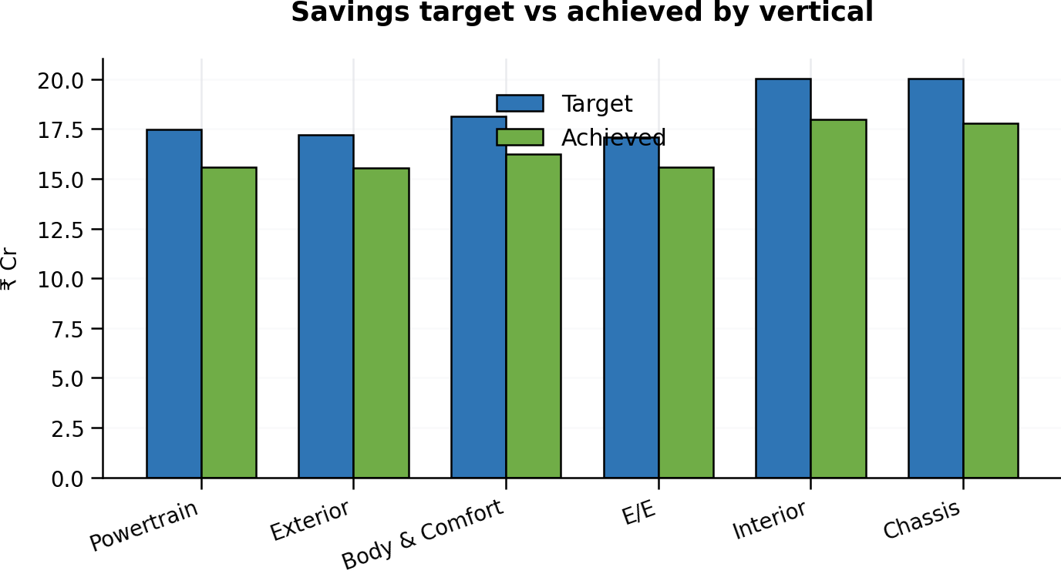
1. Executive Procurement Command Centre
Start with outcomes, not navigation
Material Cost
Savings Achieved
Savings vs Target
YoY Production
Open Exceptions
₹1,248 Cr
₹42.6 Cr
91%
+8.2%
17
• Kodiaq has the largest illustrative material-cost base
• Five exceptions make it the strongest live drill-down candidate
• Savings are near target, but pipeline conversion remains important
BOARD INSIGHT: Use one selected model across all screens to create a single coherent board narrative.
ILLUSTRATIVE / SYNTHETIC DEMO DATA — NOT ACTUAL ŠKODA BUSINESS DATA
2

Slide 3
2. Material Cost Movement
Car → Vertical → Part
Baseline Cost/Car
Current Cost/Car
Net Movement
Variance
₹14.20 L
₹14.66 L
+₹46,000
+3.2%
Net movement by vertical (₹ lakh/car)
• Powertrain drives approximately 48% of the total increase
• ECU and turbocharger are the first part-level review points
• Drill-down explains both price driver and accountability
Powertrain
+0.22
Exterior
+0.08
Body & Comfort
+0.10
E/E
+0.08
Interior
-0.01
Chassis
-0.01
BOARD INSIGHT: Concentrate management attention on Powertrain before broadening the review to other verticals.
ILLUSTRATIVE / SYNTHETIC DEMO DATA — NOT ACTUAL ŠKODA BUSINESS DATA
3

Slide 4
3. Material Cost Savings
Separate realized value from pipeline
Annual Target
Achieved
Validated Pipeline
Gap
₹46.8 Cr
₹42.6 Cr
₹6.9 Cr
₹4.2 Cr
• Pipeline is sufficient to close the full-year target gap
• Powertrain and Electrical/Electronics hold the largest conversion opportunity
• Show buyer and part ownership for each major opportunity
BOARD INSIGHT: The issue is conversion, not opportunity availability; set a clear cadence on the validated pipeline.
ILLUSTRATIVE / SYNTHETIC DEMO DATA — NOT ACTUAL ŠKODA BUSINESS DATA
4

Slide 5
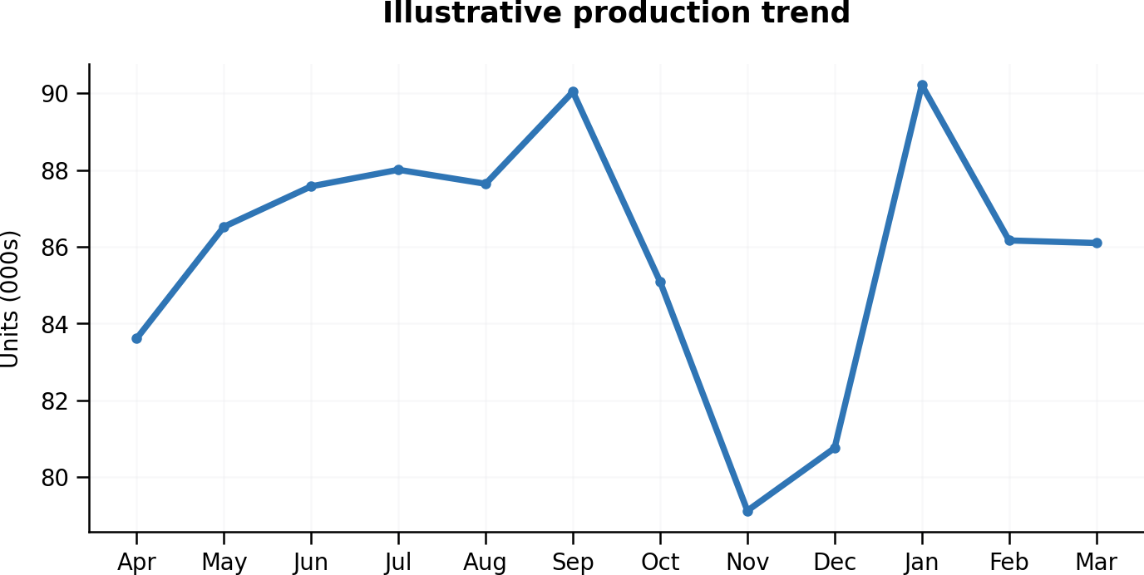
4. Production Comparison
Prior year vs current year with cost-per-vehicle context
Prior-Year Units
Current-Year Units
YoY Growth
Cost/Vehicle
52,200
56,480
+8.2%
+3.2%
• Production has increased year over year
• Cost per vehicle has also increased
• Therefore, cost movement cannot be attributed to volume alone
BOARD INSIGHT: Use per-vehicle cost to isolate procurement performance from production-volume changes.
ILLUSTRATIVE / SYNTHETIC DEMO DATA — NOT ACTUAL ŠKODA BUSINESS DATA
5

Slide 6
5. Buyer Workspace
Role-based actionability
Assigned Spend
Savings Target
Savings Achieved
Open Opportunity
Overdue
₹186 Cr
₹8.5 Cr
₹7.3 Cr
₹2.4 Cr
6
Top actions
• Buyer sees only assigned verticals and parts
• Action list links opportunity to owner and aging
• Top three actions can add ₹1.1 Cr
ECU negotiation
₹0.6 Cr
12 days
Turbo alloy validation
₹0.3 Cr
8 days
Seat technical validation
₹0.2 Cr
5 days
BOARD INSIGHT: Move from performance reporting to a short, value-ranked action list.
ILLUSTRATIVE / SYNTHETIC DEMO DATA — NOT ACTUAL ŠKODA BUSINESS DATA
6

Slide 7
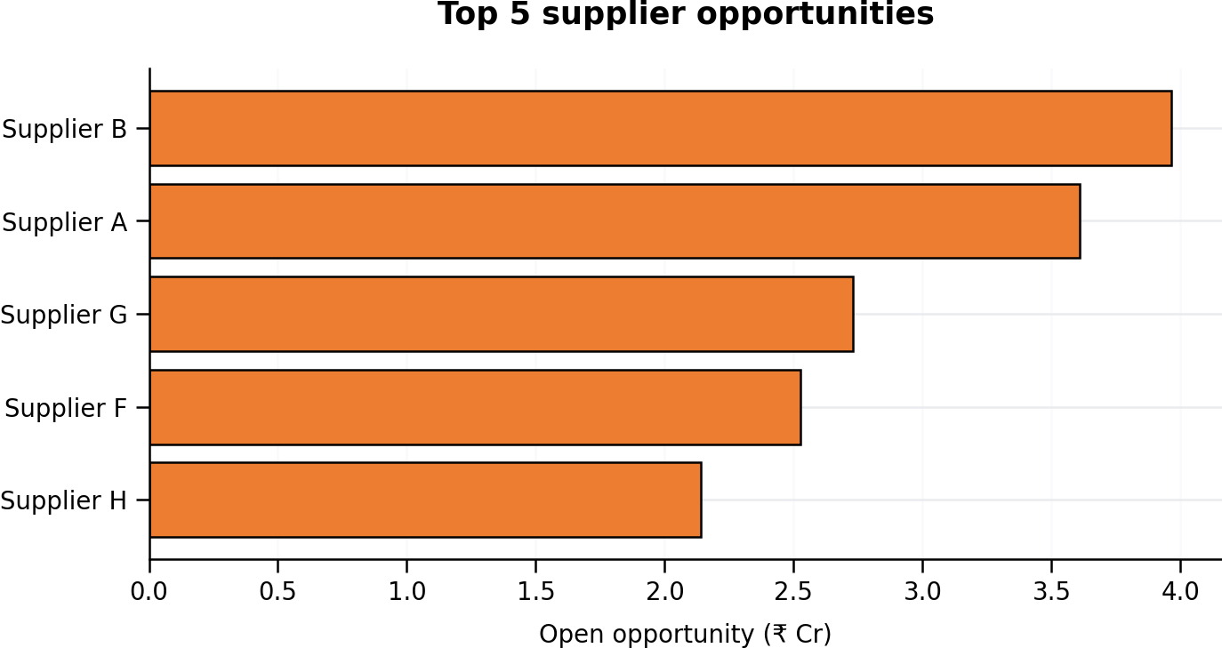
6. Top 5 Suppliers
Balance spend, savings, price movement and open opportunity
Top-5 Spend
Savings Achieved
Open Opportunity
Largest Exposure
₹418 Cr
₹18.7 Cr
₹7.3 Cr
Supplier C
• Supplier C combines highest opportunity with elevated price variance
• Supplier A requires alloy/FX linkage negotiation
• Supplier E merits an FX exposure review
BOARD INSIGHT: Prioritize Supplier C for board-sponsored escalation and focused negotiation.
ILLUSTRATIVE / SYNTHETIC DEMO DATA — NOT ACTUAL ŠKODA BUSINESS DATA
7

Slide 8
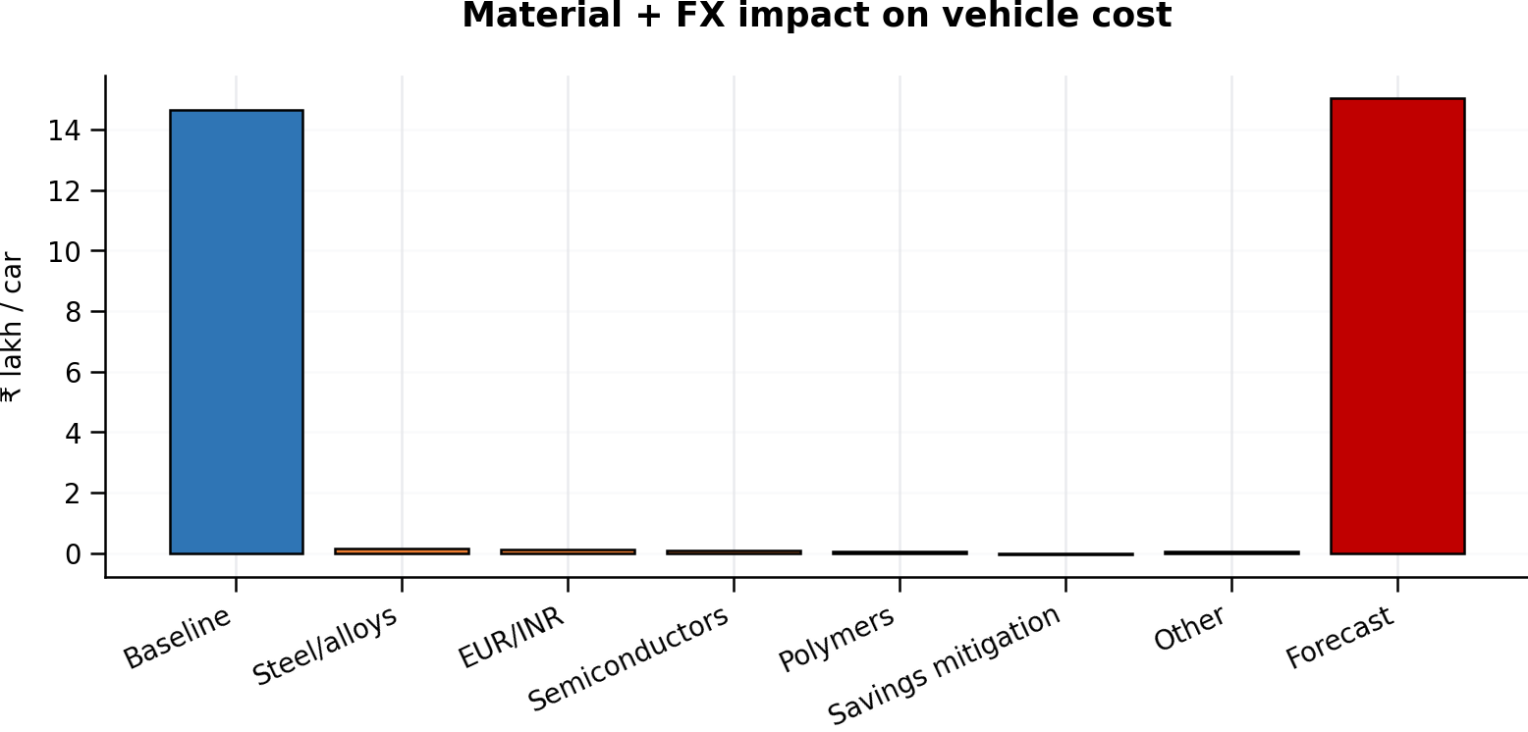
7. Forecast & Vehicle Cost Impact
Material + forex → part → vertical → overall cost per car
Baseline Cost/Car
Forecast Cost/Car
Increase
Annual Exposure
₹14.66 L
₹15.04 L
₹38,000
₹38 Cr
• Steel/alloys: ₹0.14 L/car
• EUR exposure: ₹0.11 L/car
• These two drivers create around two-thirds of the projected increase
• Use sourcing and hedging scenarios together
BOARD INSIGHT: The base forecast suggests a 2.6% cost-per-car increase; steel and EUR exposure are the first mitigation levers.
ILLUSTRATIVE / SYNTHETIC DEMO DATA — NOT ACTUAL ŠKODA BUSINESS DATA
8

Slide 9
8. Sample Data Model
Cars → Verticals → Parts → Buyers → Suppliers
Verticals
• Fact grain: Month × Car × Part
• Parts own Vertical, Buyer and Supplier keys
• Bridge supports parts used across multiple cars
• Supports drill-down and scenario analysis
Cars
Car–Part Bridge
Parts
Buyers
Suppliers
Monthly Fact
BOARD INSIGHT: Use a star schema and explicit bridge table to keep drill-down logic transparent and scalable.
ILLUSTRATIVE / SYNTHETIC DEMO DATA — NOT ACTUAL ŠKODA BUSINESS DATA
9

Slide 10
9. Board Takeaways & Recommended Next Step
Close on decision value
Visibility
Accountability
One view of cost, savings, production and exceptions
Buyer and supplier ownership down to part level
Foresight
Action
Material and FX exposure translated to cost per car
Prioritized interventions linked to measurable value
BOARD INSIGHT: Next step: confirm client terminology and sample masters, then replace synthetic values with approved data while preserving the dashboard story.
ILLUSTRATIVE / SYNTHETIC DEMO DATA — NOT ACTUAL ŠKODA BUSINESS DATA
10

Slide 11
SKODA DIGITAL PROCUREMENT
Power BI Wireframe
Wireframe 1 — Executive Procurement Command Centre
Model: Kodiaq
Period: FY25
Single-screen board summary with persistent slicers and cross-filtering
Plant: All
Scenario: Base
Material Cost
Savings
Production
Forecast Cost/Car
Exceptions
₹1,248 Cr
+3.2%
₹42.6 Cr
91% target
56,480
+8.2%
₹15.04 L
+2.6%
17
5 critical
Material cost and savings trend
Cost by model
Exception status
Kodiaq
286
Critical
5
Kushaq
252
High
4
Slavia
231
Medium
6
Kylaq
198
Superb
164
Low
2
■ Material cost ■ Savings
Executive exception table
Recommended actions
Model
Vertical
Driver
Impact
Owner
Status
1 Escalate Supplier C
2 Convert ₹4.2 Cr savings gap
3 Review steel + EUR mitigation
Kodiaq
Powertrain
FX + alloy
₹0.22 L
Buyer A
Critical
Kushaq
E/E
Semiconductor
₹0.09 L
Buyer D
High
Slavia
Exterior
Polymer
₹0.05 L
Buyer B
Medium
BOARD INSIGHT: Kodiaq is the recommended drill-down because it combines the largest cost base with the highest exception count.
ILLUSTRATIVE / SYNTHETIC DEMO DATA — WIREFRAME ONLY
11

Slide 12
SKODA DIGITAL PROCUREMENT
Power BI Wireframe
Wireframe 2 — Material Cost Movement Drill-down
Model: Kodiaq
Period: FY25
Interactive hierarchy: Car → Vertical → Part → Supplier
Plant: All
Scenario: Base
Baseline/Car
Current/Car
Net Movement
Top Driver
Parts Flagged
₹14.20 L
₹14.66 L
+3.2%
₹46,000
per car
Powertrain
48%
12
4 critical
Kodiaq › Powertrain › Engine Control Unit › Supplier C
Vertical contribution to cost movement
Part-level variance
Selected part detail
Powertrain
0.22
ECU
0.12
Part: Engine Control Unit
Vertical: Powertrain
Supplier: Supplier C
Buyer: Buyer A
Commodity: Semiconductor
Currency: EUR
Action: Commercial escalation
Body & Comfort
0.1
Turbocharger
0.07
Exterior
0.08
Infotainment
0.06
E/E
0.08
Interior
-0.01
Front bumper
0.05
Chassis
-0.01
Seat mechanism
0.04
BOARD INSIGHT: Powertrain explains nearly half the increase; use ECU and turbocharger as the first two drill-down examples.
ILLUSTRATIVE / SYNTHETIC DEMO DATA — WIREFRAME ONLY
12

Slide 13
SKODA DIGITAL PROCUREMENT
Power BI Wireframe
Wireframe 3 — Buyer & Supplier Performance
Model: Kodiaq
Period: FY25
Role-based action dashboard with value-ranked opportunities
Plant: All
Scenario: Base
Assigned Spend
Savings Achieved
Open Opportunity
Overdue Actions
Top Supplier
₹186 Cr
₹7.3 Cr
86% target
₹2.4 Cr
6
Supplier C
₹2.6 Cr opp.
Buyer portfolio — opportunity vs achieved
Top supplier opportunity
Action aging
ECU
1.1
Supplier C
2.6
>15 days
2
Turbo
0.8
Supplier E
1.5
8–15 days
4
Seat mech.
0.5
Supplier D
1.3
1–7 days
6
Cooling
0.7
Supplier A
1.1
Bumper
0.4
Supplier B
0.8
On track
9
Bar length = open opportunity (₹ Cr)
Priority action table
Priority
Part
Supplier
Action
Value
Age
Next Gate
1
ECU
Supplier C
Complete negotiation
₹0.6 Cr
12d
Board escalation
2
Turbo
Supplier A
Validate alloy linkage
₹0.3 Cr
8d
Commercial close
BOARD INSIGHT: Closing the top three buyer actions can add ₹1.1 Cr; Supplier C is the highest-value escalation.
ILLUSTRATIVE / SYNTHETIC DEMO DATA — WIREFRAME ONLY
13

Slide 14
SKODA DIGITAL PROCUREMENT
Power BI Wireframe
Wireframe 4 — Forecast & Vehicle Cost Impact
Model: Kodiaq
Period: FY25
Scenario-based view translating material and FX movement into cost per car
Plant: All
Scenario: Base
Baseline Cost/Car
Forecast Cost/Car
Material Impact
FX Impact
Annual Exposure
₹14.66 L
₹15.04 L
+2.6%
₹27,000
per car
₹11,000
per car
₹38 Cr
10k cars
Forecast trend — steel index and EUR/INR
Vehicle-cost impact drivers
Scenario sensitivity
Steel/alloys
0.14
Favorable
₹14.48 L
-₹18 Cr
EUR/INR
0.11
Semi.
0.08
Base
₹15.04 L
+₹38 Cr
Polymers
0.04
Stress
₹15.29 L
+₹63 Cr
■ Steel index ■ EUR/INR
Mitigation
-0.05
Mitigation decision strip
Sourcing: renegotiate alloy index linkage | Treasury: review EUR hedge | Supplier: escalate semiconductor exposure | Savings: protect ₹0.05 L/car mitigation
BOARD INSIGHT: Steel/alloys and EUR exposure create roughly two-thirds of the projected increase and should be the first mitigation levers.
ILLUSTRATIVE / SYNTHETIC DEMO DATA — WIREFRAME ONLY
14

