Slide 1
MEMBER 6 — ISSD
Private should
stay private.
Dirty COW • CVE-2016-5195
A local kernel race that changed protected file bytes
and enabled a fresh UID-0 login.
COW → LIVE DUMMY DEMO → RECORDED ACCOUNT PROOF → DEFENCES
Notes:
Introduce Dirty COW, CVE-2016-5195, as a historical local kernel race. Copy-on-write should keep a process's private changes separate from the original file. This vulnerability can break that boundary and modify data an ordinary user cannot normally write. Member 5's example was in a deliberately privileged application; here the vulnerable component is the kernel. Explain this before the live demonstration. The fresh work took place on 9 October 2026 in the separate SEED12 guest. Suggested 40 seconds.

Slide 2
ISSD / MEMBER 6 / MECHANISM
Where private isolation breaks
The control and the exploit use different memory-write paths.
Normal COW control
Dirty COW race
O_RDONLY file
Writable MAP_PRIVATE mapping
memcpy changes a private copy
O_RDONLY + read-only MAP_PRIVATE
Writer: pwrite to /proc/self/mem
Discard: MADV_DONTNEED
Backing file unchanged
Vulnerable kernel → file changes
pwrite uses a virtual process address. The race is inside kernel COW/page handling.
SEED Dirty COW • Wenliang Du / SEED Labs • Recorded findings: 9 Oct 2026
2
Notes:
Trace the normal lane first: read-only-opened file, writable private mapping, private copy changes and backing file stays intact. Then trace the attack: target O_RDONLY, PROT_READ plus MAP_PRIVATE, one worker repeatedly writing its own /proc/self/mem and another repeatedly discarding mapping state with MADV_DONTNEED. The kernel's concurrent COW/page handling is the vulnerable boundary. pwrite's offset is a virtual address in this process; the program did not gain ordinary file-write permission. The diagram is conceptual, not a measured kernel trace. Suggested 50 seconds.

Slide 3
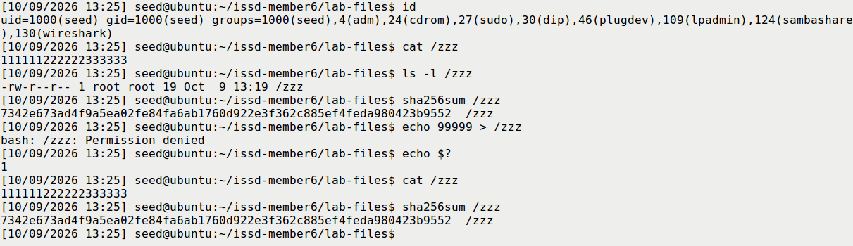
ISSD / MEMBER 6 / ENVIRONMENT
Normal file permissions were already restrictive
Recorded environment: Ubuntu 12.04.2 • i686 / 32-bit • kernel 3.5.0-37-generic
seed UID 1000 | root:root 0644 target | seed-owned 0755 binaries | native ext4
Actual S04 excerpt. Package: 3.5.0-37.58~precise1 / linux-lts-quantal. No Set-UID installation.
SEED Dirty COW • Wenliang Du / SEED Labs • Recorded findings: 9 Oct 2026
3
Notes:
State the actual environment: Ubuntu 12.04.2, i686/32-bit, kernel 3.5.0-37-generic, package 3.5.0-37.58~precise1 from linux-lts-quantal, seed UID 1000. The directory name Labs_20.04 does not change the official requirement for the old image. The programs were built on guest ext4 and remained seed-owned 0755; no Set-UID installation was used. Point to S04: root:root 0644, original digits and Permission denied. Its normal file protection works. These are recorded observations, with the actual full environment in S02. Suggested 45 seconds.

Slide 4
ISSD / MEMBER 6 / LIVE DEMO
Switch to the live dummy demonstration
Prepare Part 0 first. Use the same guest terminal and a new run label.
1 Protection
2 Normal COW
3 Bounded race
id • permissions • original file
Ordinary write should be denied.
./cow_control
Private stars; backing file original.
15-second classroom trial
Read and verify the whole file.
bash run_trial.sh dummy 15 "$RUN"
Timing miss? Preserve it and show recorded S07: exact success, 0 integer seconds / 30-second bound.
SEED Dirty COW • Wenliang Du / SEED Labs • Recorded findings: 9 Oct 2026
4
Notes:
Use the already-prepared same Ubuntu terminal and LIVE_COMMANDS. Show id, permissions and the original file. Attempt the ordinary write, then run cow_control and reread the file/hash. Only after that baseline passes, run the supplied wrapper with the new label and 15-second limit. Describe the actual result and verify complete bytes/metadata. Do not promise a win. If this run times out or is partial, preserve it and show recorded S07 from 9 October, explicitly labelled recorded. The original fresh-t1-01 used a 30-second bound and measured 0 integer seconds; no finer time or kernel attempt count was measured. Return to slide 5. Suggested 90 seconds.

Slide 5
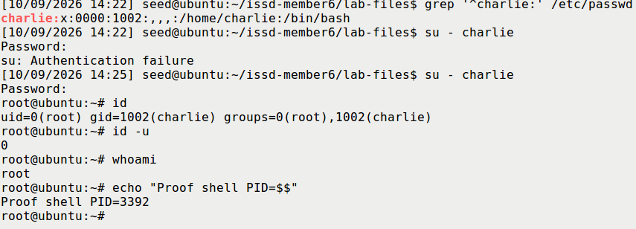
ISSD / MEMBER 6 / ACCOUNT IMPACT
Recorded file change → fresh UID-0 login
Task 2: only charlie’s UID field changed. All other bytes and root:root 0644 were retained.
Original UID 1001 → field 0000 → fresh non-sudo login: UID 0 | GID stays 1002
S10 excerpt, 9 Oct 2026. First authentication failed; retry succeeded. Full original and recordings retained.
SEED Dirty COW • Wenliang Du / SEED Labs • Recorded findings: 9 Oct 2026
5
Notes:
Say clearly: this is recorded Task 2 evidence from 9 October. Charlie began at UID 1001 and GID 1002. The sole fresh-t2-01 race, run as seed, changed only the four-character UID field to 0000; all other file bytes and mode/owner stayed the same. The first authentication failed for an unestablished reason. The retry was another non-sudo su - charlie, followed by actual id, id -u = 0 and whoami root. The numeric UID is the privilege proof; GID remained 1002. The proof shell was exited before full restoration and a new UID-1001 login. Use backup slides 8/9 for the exact diff or restoration, or the labelled native-recording fallback if time allows. Suggested 50 seconds with the static proof; full video needs extra time.

Slide 6
ISSD / MEMBER 6 / DEFENCES
Fix the kernel; verify the restored state
All four required countermeasure themes. Optional patched comparison: not performed; discussion only.
Patch the kernel
Maintain updates
Install the vendor fix and confirm
the fixed kernel is actually booted.
Use a supported OS and track
package-family backports.
Limit local execution
Monitor escalation
Reduce unnecessary local access
and untrusted code execution.
Check account integrity, numeric
UID-0 entries and privileged sessions.
Verified afterward: old root shell ended • exact baseline • new UID 1001 login • cleanup
SEED Dirty COW • Wenliang Du / SEED Labs • Recorded findings: 9 Oct 2026
6
Notes:
Cover all four allocation themes: patch the kernel and boot the fixed version; maintain a supported updated OS; limit unnecessary local accounts/untrusted code execution; monitor account integrity, unexpected numeric UID-0 entries and privileged sessions. Monitoring aids detection and does not repair COW. Standard target permissions were already restrictive. Member 5's symlink protection or removing unrelated Set-UID bits cannot fix this kernel bug. The optional patched comparison was not performed; discussion only. Our final full baseline and fresh UID-1001 login passed; no test shell/attacker or dummy remained, and evidence was exported before normal shutdown. Close with private changes must remain private. Suggested 60 seconds. Run LIVE_DEMO Part 3 after the live session.

Slide 7
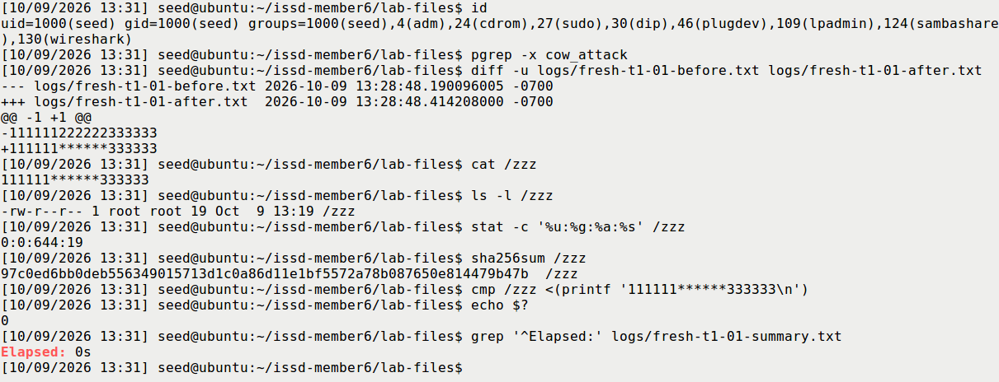
ISSD / MEMBER 6 / BACKUP — DUMMY RESULT
Recorded Task 1: the actual backing file changed
fresh-t1-01 • 30-second limit • 0 integer elapsed seconds • no finer runtime or attempt count measured
S07 readability excerpt: complete diff, fresh read, root:root 0644 / 19 bytes and exact-byte comparison.
SEED Dirty COW • Wenliang Du / SEED Labs • Recorded findings: 9 Oct 2026
7
Notes:
Use this if the new live race does not succeed or the lecturer asks for complete backing-file verification. S07 is an actual 9 October framebuffer excerpt. It shows the full before/after diff, fresh cat, root:root 0644 and 19 bytes, complete expected-byte comparison returning 0 and the original elapsed reading. The attacker was already stopped. This recorded result does not change or replace the outcome of a later live attempt.

Slide 8
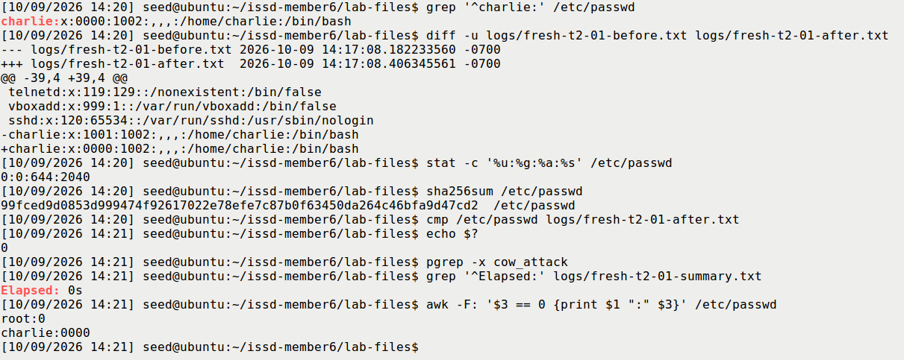
ISSD / MEMBER 6 / BACKUP — ACCOUNT DIFF
Recorded Task 2: exact UID-only replacement
One ordinary-seed trial. 2040 bytes before and after; four-character UID field at byte offset 2002.
S09b: live file equals the saved after-copy; full-file verification separately confirms no other changes.
SEED Dirty COW • Wenliang Du / SEED Labs • Recorded findings: 9 Oct 2026
8
Notes:
Point to both complete charlie lines in the diff: 1001 became 0000; the GID remains 1002 and other fields match. The verifier compared all 2040 bytes, not just this displayed line. Metadata remained root:root 0644. The numeric UID-0 query found root and charlie after the attack. Explain why a broad search for a number or a one-byte overwrite would be unsuitable, and why the actual original UID was discovered rather than assumed. The two original zero positions stay zero; four is the field width, not the number of necessarily different bytes.

Slide 9
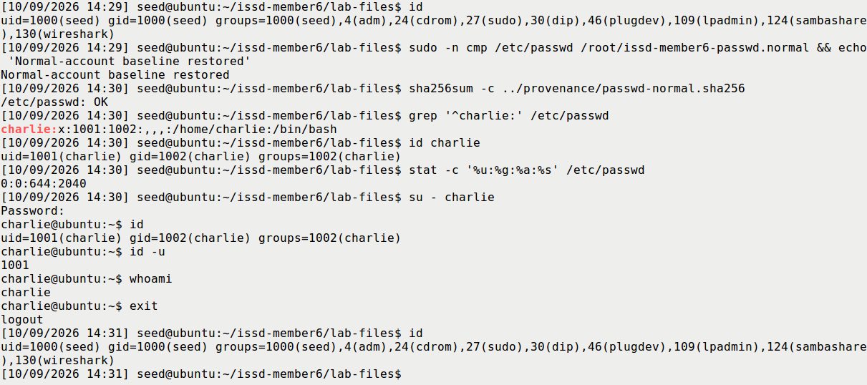
ISSD / MEMBER 6 / BACKUP — RESTORATION
Restoration is a fresh-login check too
Proof shell PID 3392 was exited first. Exact normal bytes and a new ordinary login both passed.
S11 excerpt. Existing process credentials survive file edits; close privileged shells before restoration.
SEED Dirty COW • Wenliang Du / SEED Labs • Recorded findings: 9 Oct 2026
9
Notes:
This is S11, after proof shell PID 3392 had ended and been checked absent. The protected full-file comparison and original hash pass. A new non-sudo charlie login reports UID 1001, GID 1002 and whoami charlie, then exits to seed. Restoring a database does not revoke credentials already held by a process. S13 separately establishes no experiment/su/root shell, original root-only UID-0 list, absent dummy and ordinary binaries. Both transcripts and the final archive were closed and verified before shutdown.

Slide 10
ISSD / MEMBER 6 / BACKUP — REFERENCES
Sources, evidence and assistance
Completed practical evidence is distinct from the future classroom demonstration.
Wenliang Du / SEED Labs — Dirty COW Attack Lab (2017)
seedsecuritylabs.org/Labs_20.04/Software/Dirty_COW/
Historical SEED12 manual • mmap(2) • madvise(2) • proc_pid_mem(5)
Ubuntu CVE-2016-5195 information • supplied Member 6 allocation
REPORT.pdf | LIVE_DEMO.pdf | SLIDE_NOTES.pdf | video/TASK2_FALLBACK.mp4
CC BY-NC-SA 4.0 attribution retained. GPT-6 Astra / OpenCode assisted execution and preparation;
authentication was interactive. No oral rehearsal or course upload is claimed.
SEED Dirty COW • Wenliang Du / SEED Labs • Recorded findings: 9 Oct 2026
10
Notes:
Attribute the task/exploit pattern to Wenliang Du / SEED Labs, Copyright 2017, CC BY-NC-SA 4.0. The report includes the official task/source, historical VM manual, Linux memory-interface manuals, vendor CVE information and lecturer allocation. The four supplied C/build/trial files were unchanged. GPT-6 Astra through OpenCode helped with public guest command delivery, genuine captures, verification and document preparation; the user supplied host settings views and entered passwords interactively. The folder name does not identify the model used. No oral delivery or upload has occurred automatically.

