Slide 1
VrikkaTwin
A kidney digital twin that warns of heat- and sick-day kidney injury up to 72 hours ahead, for people with hypertension and CKD
Team Monarch · Vellore Institute of Technology
Happiest Health Digital Twin Challenge 2026
Research prototype: synthetic data and fictional personas only; not a medical device

Slide 2
The problem: silent kidney injury in heatwaves and sick days
Usually mild, usually recovers, and invisible at home unless someone tests creatinine
• India's 2024 heat season: 67,637 suspected heatstroke cases and 374 deaths, 1 Mar - 27 Jul 2024 (NCDC surveillance; Lok Sabha reply)
• The 'triple whammy' (ACE inhibitor / ARB + diuretic + NSAID): kidney-injury rate ratio 1.31 overall and 1.82 in the first 30 days (Lapi et al., BMJ 2013, 487,372 people)
• Sweat on top of a diuretic, a fever, a Combiflam from the pharmacy: the injury builds over days, while the next creatinine test is weeks away
• Who needs what: the doctor (whom to test today), the patient and family (what to do, in their language), the ASHA worker (when to escalate)
VrikkaTwin · Team Monarch, Vellore Institute of Technology · synthetic data and fictional personas only

Slide 3
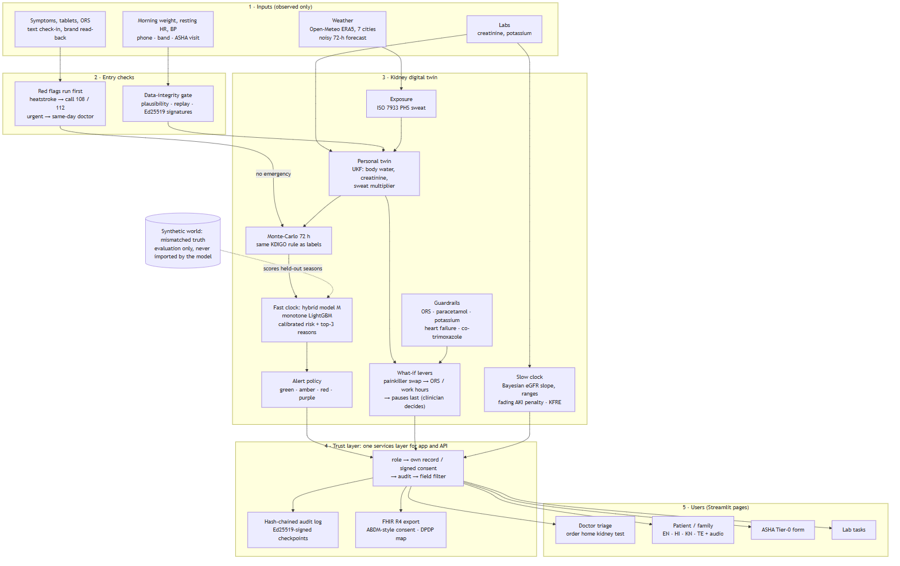
How VrikkaTwin works
Observed data only -> personal twin -> 72-hour simulation -> calibrated, explained risk -> safe actions, through one trust layer
VrikkaTwin · Team Monarch, Vellore Institute of Technology · synthetic data and fictional personas only

Slide 4
The twin and the fast clock
• Personal twin: an Unscented Kalman Filter over total and extracellular water deficit, creatinine, a personal sweat multiplier and dry weight, updated every morning from weight and resting heart rate (missing readings allowed)
• Exposure: ISO 7933 heat-strain model on real Open-Meteo weather and the person's routine; drugs with their own effect half-lives; mass-conserving creatinine kinetics
• Every morning the twin simulates the next 72 hours 200 times on a noisy forecast and applies the same KDIGO rule (08:00 creatinine) used for the labels
• Hybrid model M: LightGBM on 25 monotone core features, isotonic calibration, top-3 reasons in English, Hindi, Kannada and Telugu
• Alerts with budgets set in advance: red (doctor review + home kidney test) and amber (self-care), with hysteresis and 72-hour de-duplication
VrikkaTwin · Team Monarch, Vellore Institute of Technology · synthetic data and fictional personas only

Slide 5
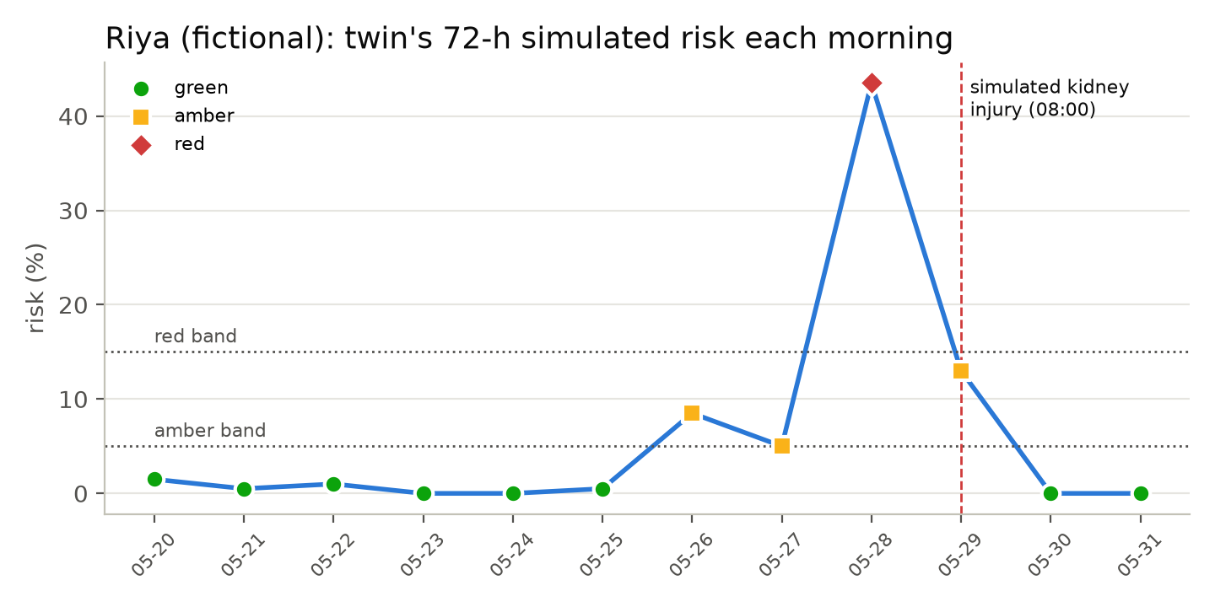
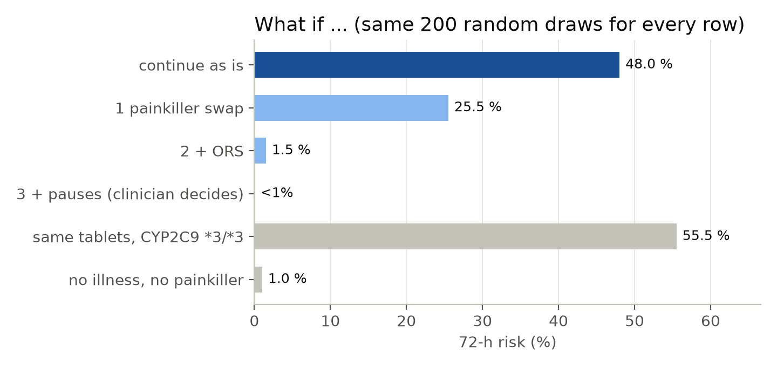
Riya (fictional), 68, Nagpur: the morning before
ARB + chlorthalidone + Combiflam, fever from day 2. Red the morning before her simulated injury (lead 23 h); the naive heat-index rule fired on 12 of 12 days
Levers in the agreed order: painkiller swap -> ORS / work hours -> medicine pauses last, badged 'individualised, weak evidence (Think Kidneys 2018), clinician decides'. Patient text never says 'stop your medicine'.
VrikkaTwin · Team Monarch, Vellore Institute of Technology · synthetic data and fictional personas only

Slide 6
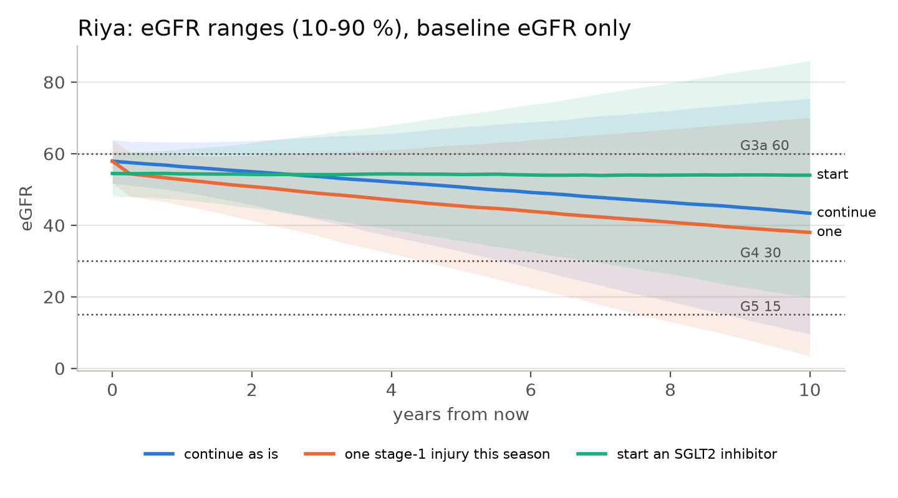
The slow clock: ranges, never a single number
Bayesian eGFR slope with registry priors; each stable lab narrows the range
• Riya, eGFR in 10 years: 10-76 (wide: no serial labs yet)
• One stage-1 injury this season is associated with -7.8 to -2.9 mL/min/1.73 m² at 10 years (one Indian diabetic kidney disease cohort, n = 274; extrapolated without diabetes)
• Penalty applied once for any injury and fading; SGLT2 inhibitor effect from EMPA-KIDNEY as an input
• KFRE shown only where valid (eGFR 10-59 with a urine albumin result)
VrikkaTwin · Team Monarch, Vellore Institute of Technology · synthetic data and fictional personas only

Slide 7
Safety first
Red flags run before any model; guardrails sit on every piece of advice
• Emergency (confusion, fainting, seizure, unresponsive, 40 °C or more): 'Call 108 / 112 now', no kidney score shown (NCDC heat-illness action plan)
• Urgent (no urine 12 h, cola urine with muscle pain after heat or work, vomiting that keeps no fluid down 6 h): same-day doctor, level at least red
• ORS withheld with heart failure, eGFR < 30 or potassium >= 5.5 (WHO ORS has 75 mmol/L sodium, 20 potassium)
• Paracetamol total across brands vs the daily ceiling; potassium >= 6.0 always means a same-day repeat; co-trimoxazole never cancels a kidney alert; beta-blockers, anticoagulants and insulin are never offered as pauses
• Never '0 %' (shown as '<1%' with its interval); eGFR tagged 'not reliable' while creatinine is changing; not designed for under-18s, pregnancy or eGFR < 15
VrikkaTwin · Team Monarch, Vellore Institute of Technology · synthetic data and fictional personas only

Slide 8
Trust by construction
One services layer for the app and the API: role -> consent -> audit
• ABDM-style consent artefact (purpose, requester, data types, expiry), Ed25519-signed and checked on every read; one-click revoke takes effect at once (test S11)
• HMAC hash-chained audit log with Ed25519-signed checkpoints: an edit breaks the chain; a forger with the HMAC key still fails the signed checkpoint (live tamper demo)
• Data-integrity gate: implausible values, weight jumps, stale time stamps, replayed nonces and unsigned device messages are rejected and audited (test S10)
• Each role sees only its fields (ASHA: level and red flags; lab: the test; admin: no clinical data); names encrypted at rest; FHIR R4 export; DPDP Act 2023 mapping
VrikkaTwin · Team Monarch, Vellore Institute of Technology · synthetic data and fictional personas only

Slide 9
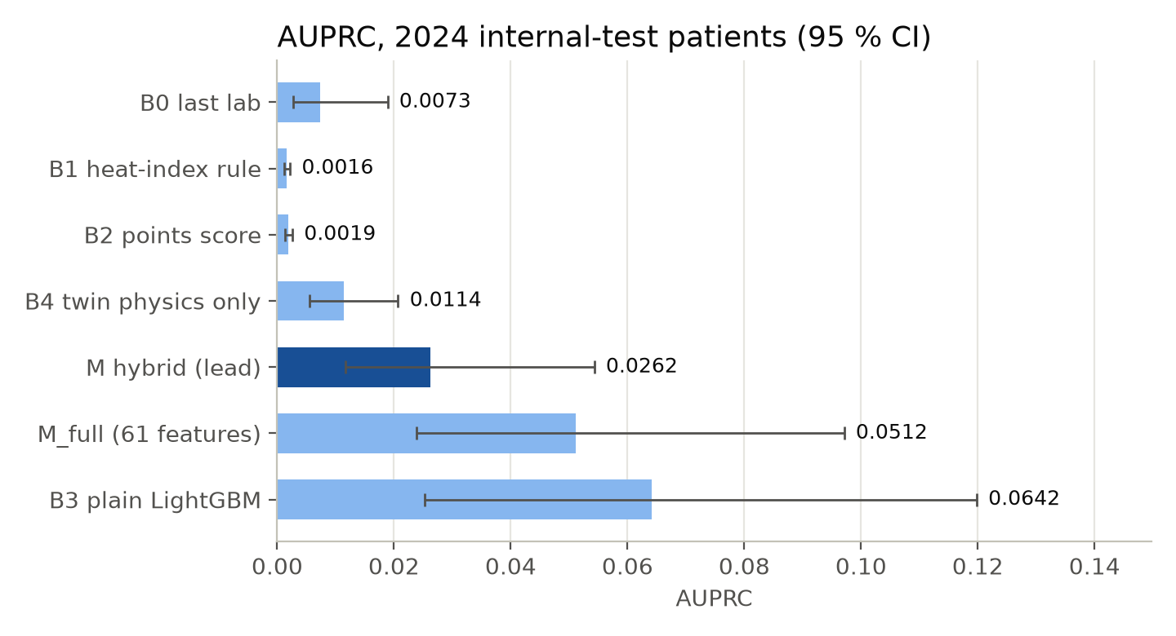
Results on the synthetic world (headline: mismatched simulator)
Positive-day prevalence 0.14 %; 2024 internal-test patients; held-out 2025 / 2026 seasons used once
• Pre-registered rule: M leads (beats B0 / B1 / B2; paired CIs exclude 0)
• Honest: a plain LightGBM (B3) beats M on this world (difference -0.0380, CI -0.0789 to -0.0047); M wins on the matched world and carries the what-if
• Red alerts catch 43 / 29 / 26 % of injuries with 16.5 / 18.7 / 22.1 alerts per injury caught (2024 / 2025 / 2026)
• Median lead 23 h: the pre-registered >= 24 h target is missed
VrikkaTwin · Team Monarch, Vellore Institute of Technology · synthetic data and fictional personas only

Slide 10
Reality checks on real data and literature
Held-out checks were never used for tuning
• R1a labelling vs official mimic-code KDIGO (MIMIC-IV demo): 99.29 % agreement - pass
• R1b 24-h creatinine forecast (MIMIC + eICU): kinetic filter 0.556 vs carry-forward 0.532 mg/dL - carry-forward wins
• R3 slow clock on Tawam (491 patients): C-index 0.836 vs baseline eGFR alone 0.834 - as good, not better
• R4 healthy real people (PMData, 13 people, 1845 days): 0 red alerts
• L1 triple vs double therapy: RR 2.3 (1.69-3.03) in the band 1.1-2.5
• L4 heavy outdoor worker: cross-shift AKI 0 % vs ~50 % in cane cutters - stated limitation
• Heat share of injuries: 7-27 % depending on assumptions (central 10 %)
VrikkaTwin · Team Monarch, Vellore Institute of Technology · synthetic data and fictional personas only

Slide 11
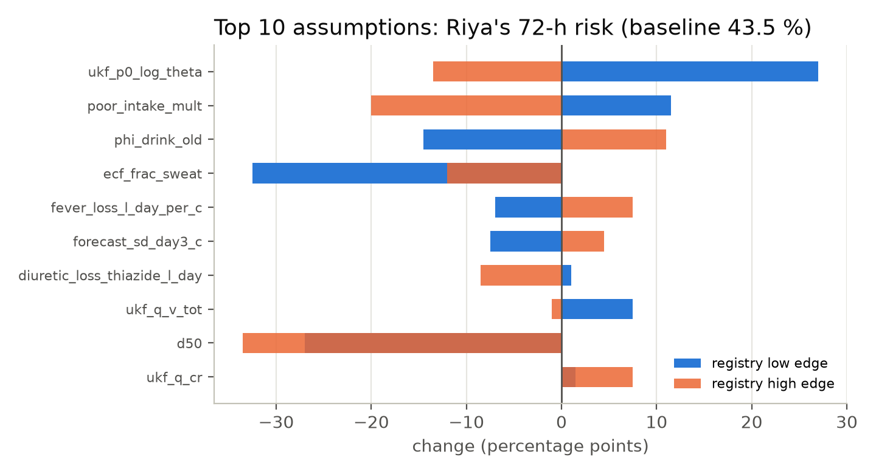
Robustness and sensitivity (frozen model, reported as they came out)
• headline: AUPRC 0.0178, red sensitivity 28 %
• perfect forecast: AUPRC 0.0169, red sensitivity 26 %
• no wearable band: AUPRC 0.0231, red sensitivity 26 %
• everyone Tier 0: AUPRC 0.0209, red sensitivity 24 %
• 50 % band days missing: AUPRC 0.0183, red sensitivity 28 %
• sensor noise x2: AUPRC 0.0157, red sensitivity 28 %
• Every variant's AUPRC confidence interval overlaps the headline's: no measurable change (a weekly weight carries the signal)
• Re-generated cohort and features reproduce the reported held-out AUPRC: yes
• Drinking fraction ranks 3 of 81 screened assumptions
VrikkaTwin · Team Monarch, Vellore Institute of Technology · synthetic data and fictional personas only

Slide 12
What we do not claim
• Synthetic validation only: no dataset links wearables, heat, medicines and serial outpatient creatinine
• Creatinine rises only after filtration has fallen; older people with low muscle mass may be under-detected
• Lead-time target missed; a plain LightGBM beat the hybrid model on the mismatched world; R1b lost to carry-forward; heavy outdoor workers' transient rises are under-represented
• Hindi, Kannada and Telugu text and two urgent messages await native-speaker and clinician review
• Not a medical device: a prospective clinical study and CDSCO review would come first
VrikkaTwin · Team Monarch, Vellore Institute of Technology · synthetic data and fictional personas only

Slide 13
Try it
Everything runs locally from the repository
• python -m streamlit run app/Home.py -> http://localhost:8501 (one-click demo logins per role)
• python -m uvicorn vrikka.api.main:app -> http://127.0.0.1:8000/docs
• Pages: Doctor Triage · Patient Twin · Patient and Family · ASHA Field · Lab Tasks · Trust Center · Time Machine · Evaluation
• Every number in the app, README and these slides is read from reports/*.json; the evaluation plan was committed before any model was trained (reports/EVAL_PLAN.md)
Triage demo: 2025-05-19, 65 of 4962 held-out test patients red.
VrikkaTwin · Team Monarch, Vellore Institute of Technology · synthetic data and fictional personas only

