Slide 1



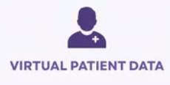
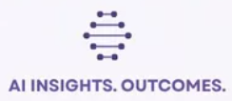
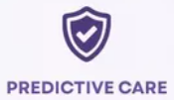
VrikkaTwin
A kidney digital twin for heatwaves and sick days
Team Monarch
Harshita Kumar & Eeshan Gupta
Vellore Institute of Technology (VIT), Vellore
Happiest Health Digital Twin Challenge 2026 · "Vrikka" is Sanskrit for kidney
Wearables measure the heat.
Labs measure the kidney.
VrikkaTwin decides when to look.
Notes:
Hello, we are Team Monarch, Harshita Kumar and Eeshan Gupta from VIT Vellore. Our project is VrikkaTwin. Vrikka means kidney in Sanskrit. It is a digital twin that protects the kidneys of people with high blood pressure or weak kidneys during Indian heatwaves and sick days. Everything you will see runs on synthetic data and fictional patients, as the challenge rules require.
1

Slide 2




Meet Riya: one hot week, three ordinary choices
Day 1-6
Riya (fictional), 68, Nagpur
Heat: she sweats, drinks too little
Lives at home · high blood pressure · early kidney decline
Day 7
  Takes a BP pill (ARB) and a water pill (diuretic) every day
  Knee pain: buys an ibuprofen painkiller (e.g. Combiflam) over the counter
  May 2024: Nagpur touches 45 °C, then she catches a fever
Fever starts; painkiller 3× a day
Day 8
Kidney filtration quietly falls
Every choice is normal. Together, they can injure her kidneys within days, and nobody is watching.
Day 9
Acute kidney injury (creatinine up)
2
Notes:
Meet Riya. She is fictional, 68, and lives in Nagpur. She takes a blood pressure pill and a water pill. Her knee hurts, so she buys Combiflam. In May the city touches 45 degrees and she catches a fever. Each choice is normal. Together they can injure her kidneys in two or three days. Her next kidney test is months away, so nobody notices.
2

Slide 3
The problem
Why heat, sickness and common pills hurt Indian kidneys, and why nobody sees it coming
3
Notes:
Let us first look at how big this problem is and why it happens.
3

Slide 4



This is not rare: the people at risk number in crores
315 M
138 M
67,637
+82%
Indians with high blood pressure
Indians with chronic kidney disease, 2nd highest in the world
suspected heatstroke cases and 374 deaths, 1 Mar - 27 Jul 2024
kidney-injury rate in the first 30 days of BP pill + water pill + painkiller
ICMR-INDIAB, Lancet Diabetes Endocrinol 2023
GBD 2023 (Lancet, 2025), via PTI report
NCDC surveillance, Lok Sabha reply, Aug 2024
Lapi et al., BMJ 2013, 487,372 patients
And it is getting hotter: the ILO projects India will lose 5.8% of working hours to heat stress by 2030.
4
Notes:
This is not a rare problem. 315 million Indians have high blood pressure. 138 million have chronic kidney disease, second only to China. In 2024, India recorded 67,637 suspected heatstroke cases and 374 deaths between March and July. And a British study of nearly half a million people found that the combination of a blood pressure pill, a water pill and a painkiller raised kidney injury by 82 percent in the first month. The ILO projects that heat will cost India 5.8 percent of working hours by 2030.
4

Slide 5
Why it happens: heat drains water, pills switch off the valves
1 · Water loss
2 · Safety valves switched off
3 · Low kidney reserve
Sweat in heat, fever, vomiting or loose motions drain body water. Older people feel less thirst.
Kidneys protect filtration with two 'valves'. Painkillers (NSAIDs) block the inlet valve; BP pills (ACE-inhibitors/ARBs) block the outlet; water pills remove more water.
Age 60+, chronic kidney disease, diabetes or heart failure leave less room for error.
Result: acute kidney injury (AKI) in 1-3 days, defined by KDIGO as a creatinine rise of ≥0.3 mg/dL in 48 h. Usually mild and reversible, but repeated injuries are linked to faster long-term decline.
5
Notes:
Why does it happen? Three things meet. First, water loss from sweat, fever, vomiting or diarrhoea. Second, the kidney keeps filtering using two tiny valves. Painkillers block the inlet valve, blood pressure pills of the ACE-inhibitor or ARB type block the outlet valve, and water pills remove even more water. Third, older people and people with weak kidneys have less reserve. The result is acute kidney injury within one to three days. It is usually mild and recovers, but repeated injuries are linked to faster kidney decline.
5

Slide 6



Today: the danger lives in a window nobody watches
Minutes to hours
1 to 3 days
Months to years
Heat alarms and heat-stress wearables
Kidney injury from heat + sickness + pills
Chronic kidney risk tests
Warn about overheating, not about kidneys or medicines
No routine tool watches this window
Need a blood draw; ignore today's heat and illness
  Kidney blood tests happen every 3-12 months, so a 3-day injury is usually missed.
  Heat alerts are the same for everyone, not tied to a person's medicines or kidneys.
  Painkillers are sold over the counter, and Combiflam-type pills are a household habit.
  Blanket 'sick-day rules' have weak evidence; UK guidance supports individual assessment for high-risk patients (Think Kidneys, 2018). That individual assessment is exactly what a twin can do.
6
Notes:
Today, tools exist for minutes and for years. Heat alarms warn about overheating within the hour. Chronic kidney tests look months or years ahead. But the dangerous window of one to three days is empty. Kidney tests happen every few months. Heat alerts are the same for everyone. Painkillers are over the counter. And UK experts say blanket sick-day rules have weak evidence, but individual assessment of high-risk patients is reasonable. That individual assessment is exactly what a digital twin can do.
6

Slide 7
If nothing changes: one bad week can echo for years
What one missed injury can mean
Riya's slow clock (projection, 10-90% range)
Scenario | Median eGFR in 10 years
Continue as is | 43
One stage-1 kidney injury this season | 38
Start an SGLT2 inhibitor now | 54
  A hospital visit that a cheap action could have prevented: one pill swapped, ORS, a ₹189 creatinine test
  Any intercurrent AKI was associated with 1.83 mL/min/yr extra eGFR loss in an Indian diabetic kidney cohort (Trichy, n = 274)
  Faster progress toward dialysis, which many families cannot afford
  Doctors only find out at the next routine test, after the damage
eGFR in mL/min/1.73 m². Ranges are wide (e.g. 9.6-75.5 for 'continue'); these are illustrative projections from published effect sizes, not prognosis. Source: reports/slowclock_demo.json.
Prevention is cheap. Knowing who to act on, today, is the missing piece.
7
Notes:
If nothing changes, the injury is found late or never. In one Indian diabetic kidney cohort, having an intercurrent kidney injury was associated with an extra 1.83 millilitres per minute per year of kidney function loss. That is an association, not proof of cause. Our slow clock shows what this could mean for Riya as a projection: median kidney function in ten years drops from 43 to 38 after one injury, and rises to 54 with a kidney-protective SGLT2 inhibitor. The ranges are wide, and we show them honestly. The key point: prevention is cheap. The missing piece is knowing who to act on today.
7

Slide 8

Our answer: VrikkaTwin
A living virtual copy of each at-risk patient that decides when to look and what to change
8
Notes:
Now, our solution.
8

Slide 9


The idea: exposure → organ → decision
Exposure
Organ
Decision
Wearables, home scale and weather measure what hits the kidney: heat, weight loss, heart rate, fever
Labs measure the kidney itself: creatinine and eGFR, but only every few months
The twin bridges the gap: who needs a test today, which pill to review, what to change
Fast clock · next 72 hours
Probability of acute kidney injury, with plain-language reasons and safer what-if choices
Slow clock · next 10 years
Projected kidney function as honest ranges, and what each decision does to it
9
Notes:
Our key idea is simple. A watch cannot measure the kidney. It measures exposure: heat, weight loss, heart rate, fever. Labs measure the organ, but only every few months. The twin bridges the two and decides when the lab should look and which medicine the doctor should review. It runs two clocks: a fast clock for the next 72 hours, and a slow clock for the next ten years.
9

Slide 10
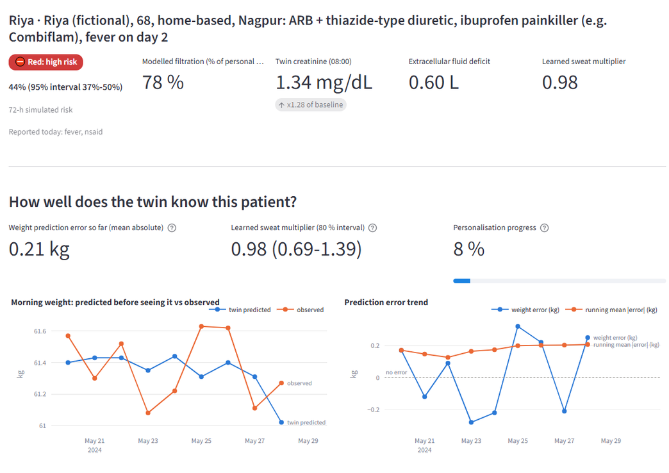


Why this is a true digital twin, not just a risk score
Personalised
Each patient has their own hidden state: body water, creatinine, kidney reserve, learned sweat rate, CYP2C9 gene
Continuously synchronised
A 5-state Unscented Kalman Filter updates every morning from weight and heart rate, and resets when a lab result arrives
Simulatable
The doctor changes pills, fluids or work hours on the virtual patient and sees the 72-hour risk and 10-year range change
Live proof: the twin predicts Riya's morning weight before seeing it (mean error 0.21 kg, about the scale's noise) and is still learning her sweat rate (0.98, 80% interval 0.69-1.39).
10
Notes:
What makes this a real twin? Three properties. It is personalised: each patient has their own hidden state. It is continuously synchronised: an Unscented Kalman Filter updates every morning from weight and heart rate and resets when a lab result arrives. And it is simulatable: the doctor can try a decision on the virtual patient first. On the right is our 'how well does the twin know this patient' panel. The twin predicts Riya's morning weight before seeing it, with a mean error of 0.21 kilograms, about the noise of a home scale.
10

Slide 11


Who it serves, even without a smartwatch
Doctor
Patient & family
ASHA worker
Lab
Sorted risk list, reasons, what-if, one-click home test
Traffic light in their language with audio, and safe actions
Tier-0 visit form, red-flag check, Telugu by default
Home-collection test orders; a result resets the twin
Tier 0 · No wearable
Tier 1 · Basic band + scale
Tier 2 · Richer devices
ASHA visit or phone check-in + free weather + clinic labs
Daily weight, resting heart rate, steps, sleep
Home BP cuff, HRV, skin temperature
≈ ₹0 extra
band ≈ ₹1,500
optional
A creatinine blood test costs about ₹189 (Apollo 24|7, Delhi listing). The twin rations tests: it decides who needs one today, instead of adding tests for everyone.
11
Notes:
VrikkaTwin has four users: the doctor, the patient and family, the ASHA worker, and the lab. It also works at three tiers. Tier zero needs no wearable at all: an ASHA visit or a phone check-in, free weather data and clinic labs. Tier one adds a basic band and a scale, about 1,500 rupees. The twin rations the expensive step: it decides who needs a 189-rupee creatinine test today.
11

Slide 12
How it works
Data fusion, architecture, the physiology engine and a day in the life of the twin
12
Notes:
Let us look inside.
12

Slide 13

Data fusion: static health record + live wearable stream
Static / historical (simulated EHR)
Dynamic / real-time (simulated wearables)
  Demographics: age, sex, weight, city, occupation, housing
  Past diagnoses: hypertension, diabetes, CKD stage, heart failure, prior AKI
  Lab results: creatinine, eGFR (CKD-EPI 2021), potassium, UACR
  Medicines: Indian brand names mapped to drug class (e.g. Telma-H, Combiflam)
  Genetic marker: CYP2C9 (*3 allele ≈ 0.11 in IndiGenomes) changes ibuprofen exposure
  Resting heart rate, HRV, steps, sleep (Fitbit / Apple Health-style)
  Morning weight from a home scale (water lost)
  Home BP (optional)
  Hourly weather: temperature, humidity, sun (real 2024-26 Open-Meteo / ERA5)
  Check-ins: fever, vomiting, tablets taken, ORS, work hours
Twin
Exactly the two streams the challenge asks for. Genotypes are simulated from published Indian allele frequencies; CPIC 2020 gives recommendations for ibuprofen, none for diclofenac or aceclofenac, so we apply no gene effect there.
13
Notes:
This is the fusion the challenge asks for. The static stream is a simulated health record: demographics, past diagnoses, lab results, medicines with Indian brand names, and a real genetic marker, CYP2C9, which slows how some people clear ibuprofen. The dynamic stream is simulated wearable data: heart rate, HRV, steps, sleep, morning weight, plus real hourly weather from 2024 to 2026 and daily check-ins. The twin fuses both, every day.
13

Slide 14
Architecture
Data sources
Trust layer
Twin engine
Decisions
Apps & exports
Synthetic EHR cohort
Data-integrity gate
Heat → sweat (ISO 7933)
LightGBM + calibration
Doctor / Patient
Wearable / scale streams
ABDM-style consent
Body water → kidney
Alert policy
ASHA / Lab
Real weather (ERA5)
Role-based access (6)
Creatinine kinetics
Slow clock (Bayes)
Trust Center
Patient & ASHA check-ins
HMAC audit chain
UKF personal twin
What-if + guardrails
Time Machine
Lab results
Ed25519 checkpoints
Monte-Carlo 72-h risk
Red flags first
FHIR R4 · FastAPI
Python 3.12 · Streamlit UI calls one services layer that enforces role + consent + audit on every read; the same services sit behind FastAPI. Full diagram: deliverables/architecture.pdf.
14
Notes:
Here is the architecture. Data enters through a trust layer that checks integrity, consent and roles, and writes every action to a tamper-evident audit log. The twin engine turns weather and activity into sweat, body water, kidney filtration and creatinine, and a personal Unscented Kalman Filter keeps each twin in sync. The decision layer combines the twin with a calibrated LightGBM model, an alert policy, the slow clock, what-if levers, guardrails and red flags. Everything is served to role-based apps and can be exported as FHIR R4.
14

Slide 15
Mechanism: from today's weather to tomorrow's kidney
Heat → sweat
Two water deficits
Kidney filtration
Creatinine
72-h risk
ISO 7933 predicted-heat-strain model × the person's learned sweat rate
Total water (seen by the scale) and extracellular water (felt by the kidney)
Autoregulation curve; painkiller, BP pill and water pill effects with real wear-off times
Mass-conserving kinetics, incl. haemoconcentration; read at 08:00 like a lab
200 Monte-Carlo futures with a noisy weather forecast; risk = share that meets KDIGO
Every morning the loop closes: the twin predicts today's weight and heart rate, compares them with the real readings, corrects its hidden state and learns the person's sweat rate. A lab result resets creatinine. Then a calibrated LightGBM model turns the twin's state into the alert.
15
Notes:
The mechanism has five steps. Weather and activity give a sweat rate using the international heat-strain standard, ISO 7933, multiplied by the person's learned sweat rate. Losses go into two water deficits: total water, which the scale sees, and extracellular water, which the kidney feels. The kidney's autoregulation curve, together with the three drugs and their wear-off times, gives filtration. Creatinine follows a mass-conserving model and is read at 8 a.m. like a lab. Two hundred simulated futures give the 72-hour risk. Every morning the loop closes: the twin compares its prediction with the real reading and corrects itself.
15

Slide 16

A day with VrikkaTwin
1 · 07:00
2 · 08:00
3 · 09:00
Morning weight, resting HR and check-in arrive (or the ASHA visits)
The twin updates Riya's hidden state and creatinine estimate
Risk for the next 72 h; red flags are checked first
4 · Morning
5 · Review
6 · Same day
Doctor sees the sorted list, the reasons and tomorrow's Kidney Weather
Doctor tries changes on the twin: painkiller swap, ORS, pauses
One click orders a home kidney test; the lab result resets the twin
16
Notes:
Here is a day with VrikkaTwin. At 7 a.m., the morning weight, heart rate and check-in arrive, or an ASHA worker enters them. At 8, the twin updates. At 9, it computes the 72-hour risk, checking red flags first. The doctor sees a sorted list with reasons and tomorrow's kidney weather, tries changes on the twin, and with one click orders a home kidney test. When the lab result arrives, the twin resets.
16

Slide 17
The product, screen by screen
Real screenshots from our working prototype (synthetic data, fictional personas)
17
Notes:
Now let us see the working prototype, screen by screen.
17

Slide 18
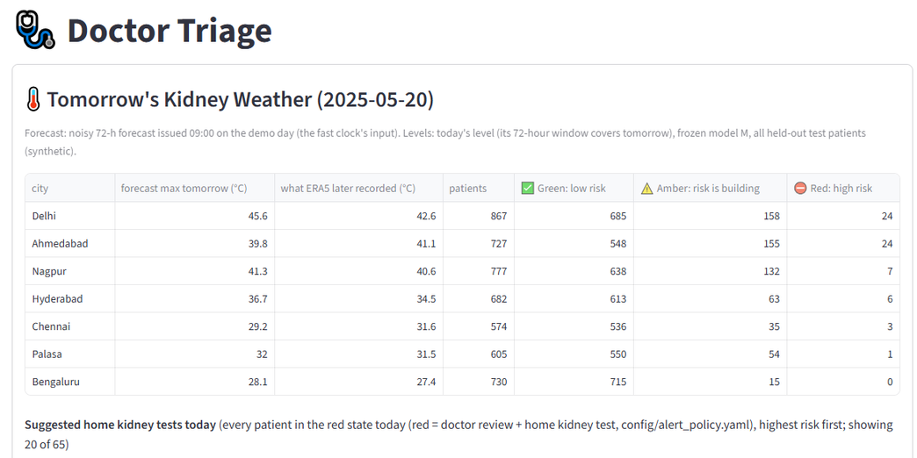
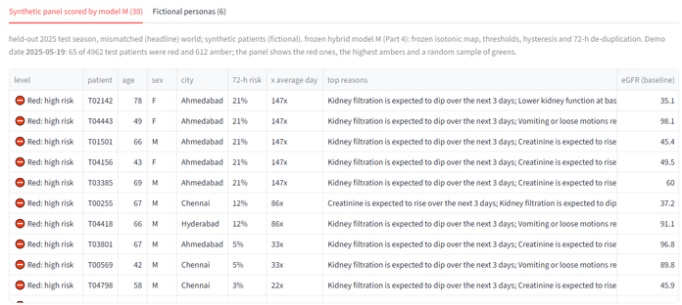
Doctor Triage: who needs attention today, and why
  Tomorrow's Kidney Weather: forecast per city with green / amber / red counts, e.g. Delhi 45.6 °C: 685 / 158 / 24 of 867 patients
  Suggested home kidney tests today: every red patient, highest risk first, with the main reason
  Never colour alone: every level has an icon and a word
  One click: order a home test or download a FHIR R4 record
Held-out 2025 test season, mismatched simulator, frozen model M. Demo date 19 May 2025: 65 of 4,962 synthetic patients red, 612 amber.
18
Notes:
This is the doctor's triage page. At the top is Tomorrow's Kidney Weather: the forecast for each city and how many patients are expected to be green, amber or red. For example, Delhi at 45.6 degrees has 24 red patients out of 867. Below is the list of suggested home kidney tests, highest risk first, with the main reason in plain words. Levels always have an icon and a word, not just a colour.
18

Slide 19
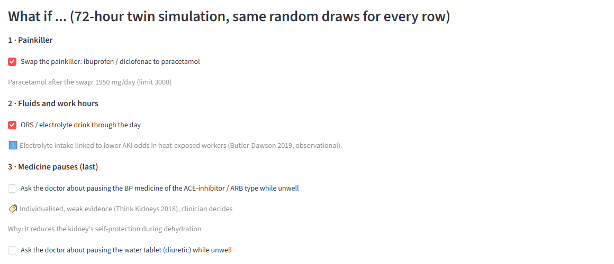
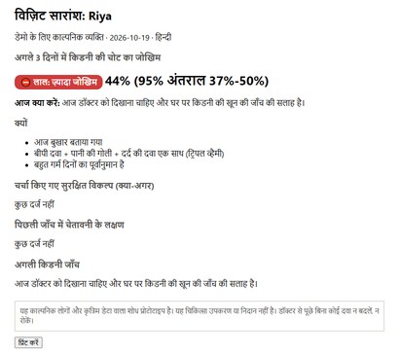
Patient Twin: try a decision on the virtual patient first
Riya, day 8 (72-hour risk, synthetic)
Continue as is
48%
1 · Swap ibuprofen → paracetamol
25.5%
2 · + ORS 1 L/day
1.5%
3 · + pause ARB & diuretic*
<1%
One-click printable visit summary in the patient's language (Hindi shown), with the disclaimer.
Same tablets, CYP2C9 poor metaboliser
55.5%
*Medicine pauses come last: individualised, weak evidence (Think Kidneys 2018), clinician decides. Guardrails block unsafe levers (heart failure, potassium ≥ 5.5, paracetamol ceiling 3 g/day if 65+).
Source: reports/demo_numbers.json. The patient view never says 'stop your medicine'; it says 'talk to your doctor first'.
19
Notes:
This is the heart of the twin: the what-if panel. On Riya's red day, the twin estimates a 48 percent risk if nothing changes. Swapping the ibuprofen painkiller for paracetamol brings it to 25.5 percent. Adding ORS brings it to 1.5 percent. Pausing her BP pill and water pill takes it below 1 percent, but that comes last, because the evidence for pauses is weak and the clinician decides. The same tablets in a genetic poor metaboliser give 55.5 percent. Guardrails block unsafe suggestions, and the doctor can print a visit summary in the patient's language.
19

Slide 20
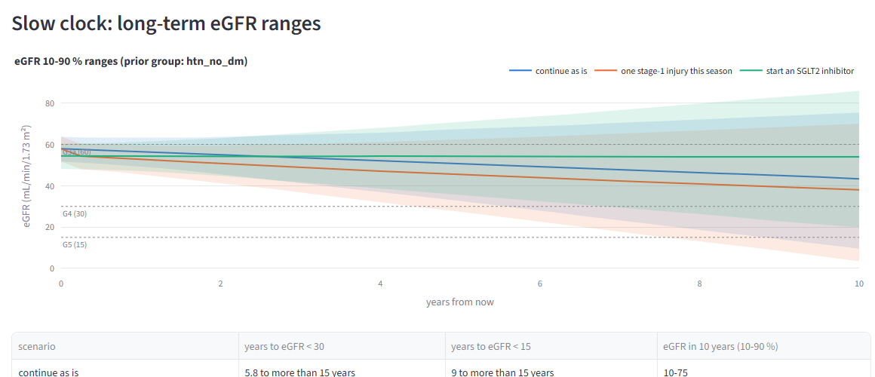
Slow clock: what this season means for the next 10 years
  Bayesian eGFR slope from the patient's own past labs and a group prior
  Three scenarios: continue, one stage-1 injury this season, start an SGLT2 inhibitor
  SGLT2 effect from EMPA-KIDNEY: 1.37 mL/min/yr slower decline (95% CI 1.16-1.59)
  Always a 10-90% range, labelled 'projection'; KFRE shown only where valid (eGFR 10-59 + UACR)
The AKI penalty fades over time and is 'associated with', from one Indian diabetic kidney disease cohort (n = 274); extrapolated for non-diabetics.
20
Notes:
The slow clock projects kidney function for ten years. It fits a Bayesian slope to the patient's own labs and compares three scenarios: continue as is, one mild kidney injury this season, or starting an SGLT2 inhibitor, using the EMPA-KIDNEY trial effect. We always show a range and call it a projection, because the evidence is not precise enough for a single number.
20

Slide 21
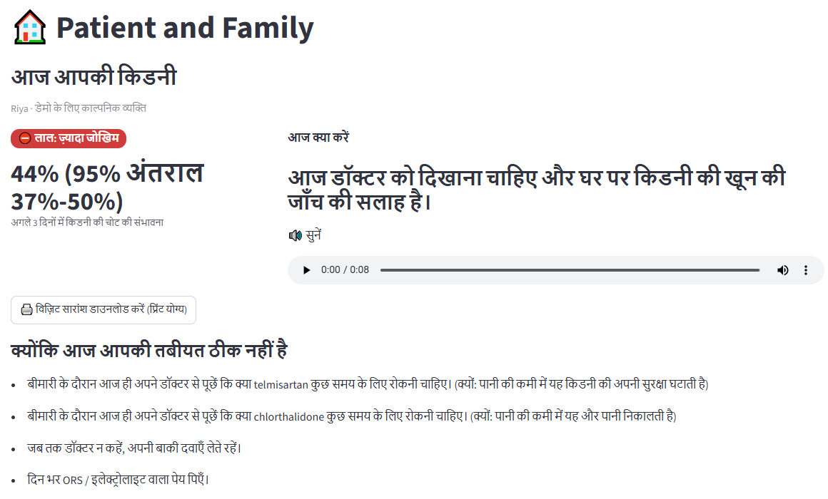
Patient & family: in their language, with their voice
  4 languages: English, हिन्दी, ಕನ್ನಡ, తెలుగు (Indian translations marked 'draft' until native-speaker review)
  Listen button: 28 pre-recorded spoken alerts work offline
  Plain words, never 'AKI'; red / amber / green with an icon and a word
  Check-in with red flags first; types Indian brand names, e.g. 'Combiflam' → ibuprofen + paracetamol
  Patient controls consent: stop sharing with the doctor, ASHA, lab or family in one tap
21
Notes:
For the patient and family, everything is in their language: English, Hindi, Kannada or Telugu, with a listen button that plays a pre-recorded alert, so it works even with low literacy. The patient sees a traffic light, today's action and sick-day guidance. Check-ins understand Indian brand names. And the patient decides who can see their data.
21

Slide 22
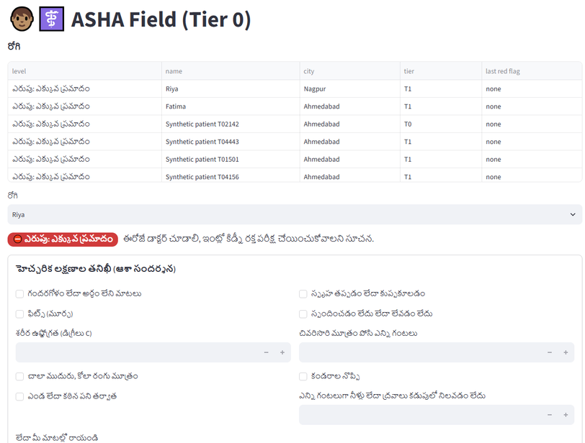
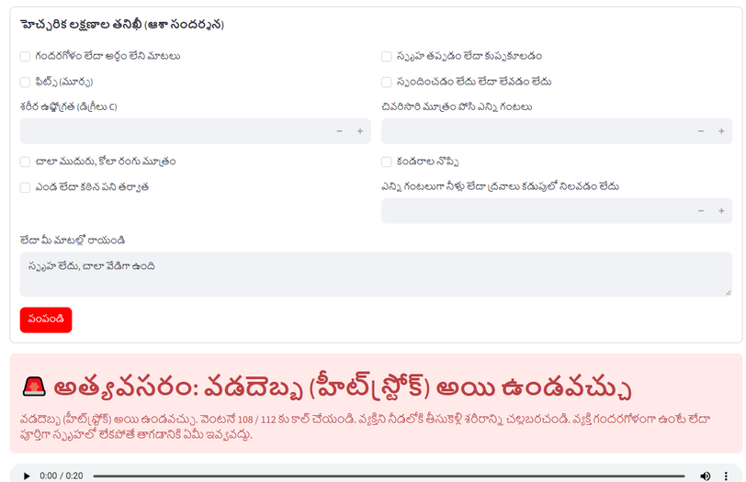

ASHA Tier 0 and red flags: safety before any score
Possible heatstroke
Confusion, fainting, seizure, unresponsive or ≥40 °C → call 108 / 112, cool the person, nothing by mouth if not fully awake. No kidney score is shown.
Heatstroke definition and first aid follow India's National Action Plan on Heat Related Illnesses (NCDC/MoHFW). Two URGENT messages (no urine 12 h; cola-coloured urine with muscle pain) await clinician review of wording.
22
Notes:
For villages without wearables, the ASHA worker uses a Tier-zero form, in Telugu by default. Red flags always run before any model. If someone is confused, faints, has a seizure or a temperature of 40 degrees, the app shows an emergency screen: call 108 or 112, cool the person, give nothing by mouth if they are not fully awake. No kidney score is shown, because this is an emergency, not a prediction. This follows India's national heat-illness action plan.
22

Slide 23
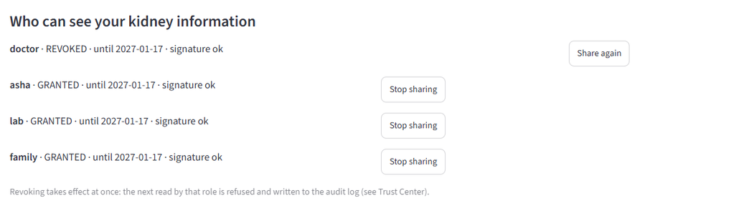


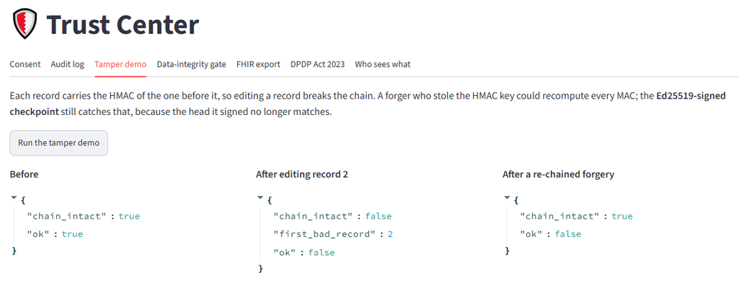

Trust Center: privacy you can demonstrate
ABDM-style consent
Ed25519-signed, checked on every read; revoke takes effect at once
6 roles, field-level
ASHA never sees genotype; lab sees only test orders
Tamper-evident audit
HMAC chain + signed checkpoints catch even a re-chained forgery
FHIR R4 + DPDP map
Standard export; 8 DPDP Act provisions mapped
Synthetic data only; no real patient data is used anywhere. Tested in tests/test_trust.py.
23
Notes:
Privacy is not a badge here; it works. Consent is an ABDM-style signed artefact checked on every read. When Riya revokes the doctor's access, the next read is refused and logged. Six roles see only the fields they need. Every action goes into an HMAC hash chain with signed checkpoints, so even a forger who recomputes the chain is caught, as the tamper demo shows. Records export as FHIR R4, and we map our controls to the DPDP Act.
23

Slide 24
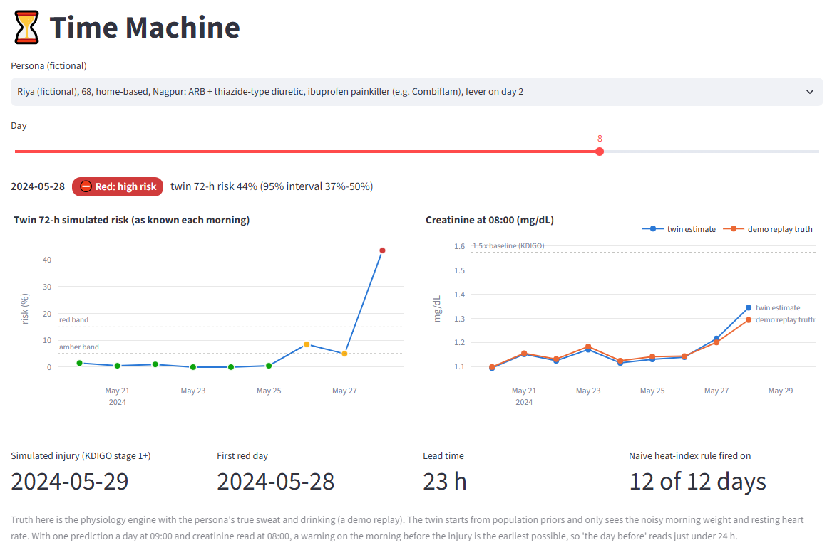
Time Machine: Riya's heatwave on real 2024 weather
23 h
warning before the simulated injury (red on 28 May, injury on 29 May)
12 of 12
days on which a simple heat-index rule fired for Riya, too often to act on
Green
all 12 days for her neighbour in the same heat, who drinks ORS and takes no painkiller
The twin starts from population priors and sees only noisy morning weight and heart rate; it never sees the simulated truth. Riya's fever began the day before the injury, so about a day is the earliest possible warning.
24
Notes:
The Time Machine replays Riya's heatwave on real 2024 Nagpur weather. Her twin turns red on 28 May, 23 hours before the simulated injury. Her fever started only the day before, so this is the earliest warning possible. A simple heat-index rule fired on all 12 days, which is too often to act on, while her well-hydrated neighbour stays green in the same heat. That is the difference between a heat alarm and a personal twin.
24

Slide 25
Evidence and results
How we built honest data, and what the numbers really say
25
Notes:
Now the evidence: how we built the data, and our honest results.
25

Slide 26
Data: synthetic by necessity, checked against reality
Why synthetic
No circular grading
The 'truth' simulator is deliberately different from the twin: other kidney equations, hidden causes the twin cannot see (sepsis-like illness, muscle breakdown), wider patient variation. Headline results use this mismatched world.
No open dataset links heat, wearables and medicines to daily creatinine for outpatients. The challenge rules allow synthetic data, so we built an enriched high-risk heat-season cohort.
10,000
2 × 5,000
training patients (2024 season)
7
held-out test patients (2025, 2026)
Real open data used for checks
  MIMIC-IV & eICU demos: real creatinine, KDIGO labelling
  PMData: real Fitbit noise → heart-rate noise 4.04 bpm
  UCI CKD and Tawam (UAE, 491 patients): lab realism, slow clock
  Rejected: BD-KDD (implausible values), OSF data (no licence)
164
Indian cities on real hourly weather
parameters, each with a source (27 cited, 6 to verify, 131 assumptions)
26
Notes:
We could not find any open dataset that links heat, wearables and medicines to daily creatinine for people at home, so, as the rules allow, we built a synthetic cohort: 10,000 training patients and two held-out test seasons of 5,000 each, on real weather from seven Indian cities. Every one of 164 parameters has a source and a label. Crucially, the truth simulator is deliberately different from our twin, so we are not grading our own homework. We then checked every component we could against real open data, and we rejected datasets that failed our checks.
26

Slide 27
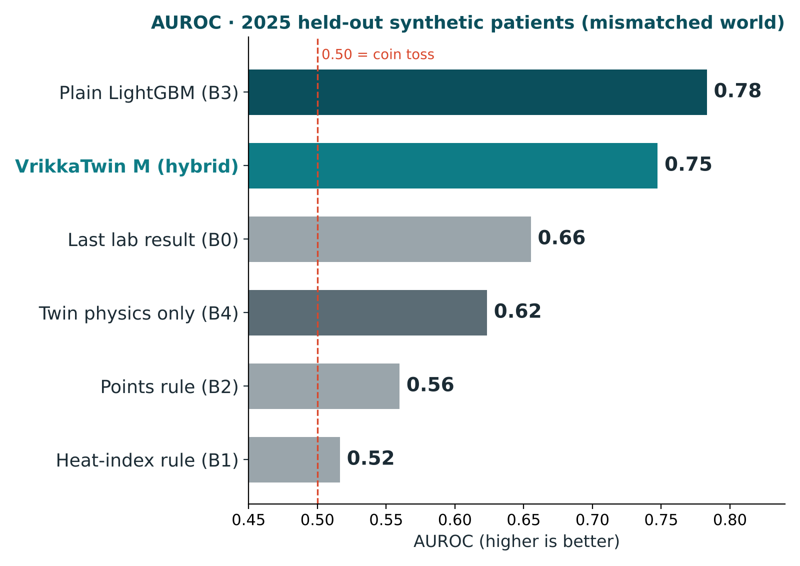
Results: the twin beats the rules clinics use today
54%
of injuries got an amber or red warning (29% red)
18.7
alerts per injury caught, inside a budget of ≤ 0.5 red per 100 patient-days
0.90
AUROC when the world matches the twin (optimistic ceiling)
Synthetic (enriched high-risk heat-season cohort), mismatched simulator, 2025 held-out season, frozen model; prevalence 0.14% of days. Source: reports/metrics.json. 2026 season: M AUROC 0.73, plain LightGBM 0.77.
27
Notes:
Here are the results on 2025 patients the model never saw, in the deliberately mismatched world. Today's rules, a heat-index rule, a points rule and the last lab result, score between 0.52 and 0.66 AUROC. Our hybrid model scores 0.75. 54 percent of injuries got an amber or red warning, with a strict alert budget of half a red alert per 100 patient-days, about 19 alerts per injury caught. When the world matches the twin, AUROC reaches 0.90. We are also honest: a plain LightGBM without the twin scores slightly higher on this metric. The next slide explains why we still lead with the twin.
27

Slide 28



Honest scorecard: what passed, what did not
PASS · Labelling matches official MIMIC code
PASS · No false red alerts on real healthy people
99.29% agreement (1,272 values)
0 per 100 person-days (PMData, 1,845 days)
PASS · Triple-whammy effect in calibrated range
EQUAL · Slow-clock ranking (Tawam, real)
C-index 0.836 vs 0.834 baseline eGFR
RR 2.3 vs Lapi 1.31-1.82 (calibration)
MISSED · Lead-time target ≥ 24 h
FAIL · Creatinine filter on ICU data
23 h median: warnings come the day before
Carry-forward wins (0.53 vs 0.56 mg/dL)
FAIL · Cross-shift rises in cane cutters
LOSS · Hybrid vs plain LightGBM (AUPRC)
Exertion & muscle effects under-modelled
Plain wins on accuracy alone
Why we still lead with the twin: a plain classifier cannot simulate a decision, explain it physiologically, personalise from one person's scale, or say when to test.
28
Notes:
We pre-registered our targets before training, so here is the honest scorecard. Our labelling matches the official MIMIC code 99.3 percent. Healthy real people got zero false red alerts. The triple-whammy effect sits in the calibrated range. The slow clock ranks real patients as well as baseline kidney function, not better. We missed the 24-hour lead-time target by one hour, because warnings come the day after a fever starts. The creatinine filter lost to carry-forward on ICU data, heavy outdoor workers' short-term rises are under-modelled, and a plain model scores higher on accuracy alone. We still lead with the twin because a plain classifier cannot simulate a decision, explain it, personalise it, or tell you when to test.
28

Slide 29


What makes VrikkaTwin different
The empty 72-hour window
Decisions, not just scores
Genetics that changes the model
Kidney injury from heat + sickness + pills, between heat alarms (minutes) and kidney tests (years)
What-if levers with evidence badges and clinical guardrails
CYP2C9 changes ibuprofen exposure inside the physiology
Honest science
Privacy that works
Built for Bharat
Mismatched simulator, pre-registered metrics, failures shown
Consent on every read, signed audit, FHIR R4, DPDP map
4 languages, audio, brand-name pills, ASHA Tier 0, red flags first
29
Notes:
What makes us different? We work in the empty 72-hour window. We give decisions, not just scores. Our genetic marker actually changes the model. Our science is honest: a mismatched simulator, pre-registered metrics and failures shown. Privacy works in the demo. And it is built for India: four languages, audio, Indian brand names, ASHA tier zero and red flags first.
29

Slide 30
Impact and next steps
How it could plug into Happiest Health, and what we would do next
30
Notes:
Finally, impact and next steps.
30

Slide 31


How VrikkaTwin could plug into Happiest Health
Specialty clinics
Diagnostics with home collection
An early-warning and triage list for endocrinology, personal-physician and future kidney patients
The twin decides who needs a kidney test today and creates the home-collection task
Digital healthcare
Corporate wellness
Could serve as a 'kidney safety' module next to virtual consults: red alerts route to a doctor
A heat-season programme for field workforces: delivery, construction, facilities
"Proactive, not reactive": the twin turns a one-time test into a daily, personal safety net.
31
Notes:
How could this help Happiest Health? Its specialty clinics could use the triage list. Its diagnostics arm with home collection could receive the twin's 'test today' tasks. Its digital healthcare unit could add VrikkaTwin as a kidney safety module next to virtual consults. And its corporate wellness work could run a heat-season programme for field workers. It matches the summit theme: proactive, not reactive.
31

Slide 32
Limits we state openly, and the road ahead
Limitations
Roadmap
  Validated on synthetic patients; no real outpatient AKI labels exist openly
  Creatinine rises only after filtration falls; low muscle mass can hide injury in older people
  Dehydration alone cannot cause AKI in a healthy, drug-free twin (red flags cover severe cases)
  Heavy outdoor workers' short-term rises under-modelled
  Translations and two urgent messages await expert review · not a medical device
1
Prospective pilot
A PHC or clinic with consented patients, weekly weights, routine creatinine, under ethics approval
2
Real devices and ABDM
Band + scale pairing; ABDM sandbox consent; hosted deployment
3
Clinical review
Nephrologist and pharmacist review of rules; native-speaker review
4
New modules
Potassium, exertion physiology, transplant (CYP3A5)
32
Notes:
We state our limits openly. Everything is validated on synthetic patients, because real outpatient labels do not exist openly. Creatinine lags behind filtration, and older people with low muscle mass can hide an injury. Our next step is a prospective pilot with a clinic and consented patients, real device pairing, ABDM sandbox consent, and review by a nephrologist, a pharmacist and native speakers.
32

Slide 33
Tech stack, licence and repository
Physiology & twin
pythermalcomfort 4.6.1 (ISO 7933) · filterpy 1.4.5 (UKF) · numpy · scipy · kfre 0.1.18
Language
Python 3.12
Machine learning
LightGBM 4.7.0 (monotone, isotonic calibration) · scikit-learn 1.9.1 · SHAP · lifelines
Tests
218 passed (1 skipped)
Licence
App & API
Streamlit 1.65.0 (8 role-based pages) · FastAPI · Plotly · gTTS audio · rapidfuzz brand matching
MIT (code)
Folder
Monarch_Vellore-Institute-of-Technology
Security & interop
cryptography (Ed25519, Fernet) · HMAC audit chain · JWT · FHIR R4 · DuckDB (MIMIC checks)
Repo
github.com/Eeshan842004/VrikkaTwin_Monarch
Data licences per source in data/README.md; restricted (ODbL) data is fetched by download scripts, never committed.
33
Notes:
Our stack is Python: pythermalcomfort for heat strain, filterpy for the Kalman filter, LightGBM for the risk model, Streamlit for the app, FastAPI for the API and cryptography for the trust layer. 218 tests pass. The code is MIT licensed and available on GitHub.
33

Slide 34
Thank you
VrikkaTwin protects the kidneys of people on BP pills, painkillers or with weak kidneys during Indian heatwaves and sick days, and tells the doctor which pill to review and when to test.
Research prototype · synthetic data and fictional personas · not a medical device
Harshita Kumar · Eeshan Gupta · Team Monarch, VIT Vellore
github.com/Eeshan842004/VrikkaTwin_Monarch
Notes:
To close: VrikkaTwin protects the kidneys of people on blood pressure pills, painkillers or with weak kidneys during Indian heatwaves and sick days. It tells the doctor which pill to review and when to test. Thank you. We are happy to take your questions.
34

