Slide 1
WRAVAL - Writing Assistant eVALuation
Amazon Science

Slide 2
WRAVAL: Writing Assistant eVALuation
Gabriel Bénédict

Slide 3
Motivation
LM
AGI -> Reasoning, planning, etc.
LLM
SLM
AGI -> Reasoning, planning, etc.
AGI -> Reasoning, planning, etc.
industrial settings
tone change (e.g., funny, serious, professional)
non-reasoning tasks

Slide 4
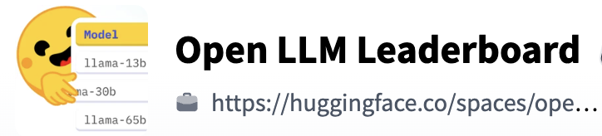

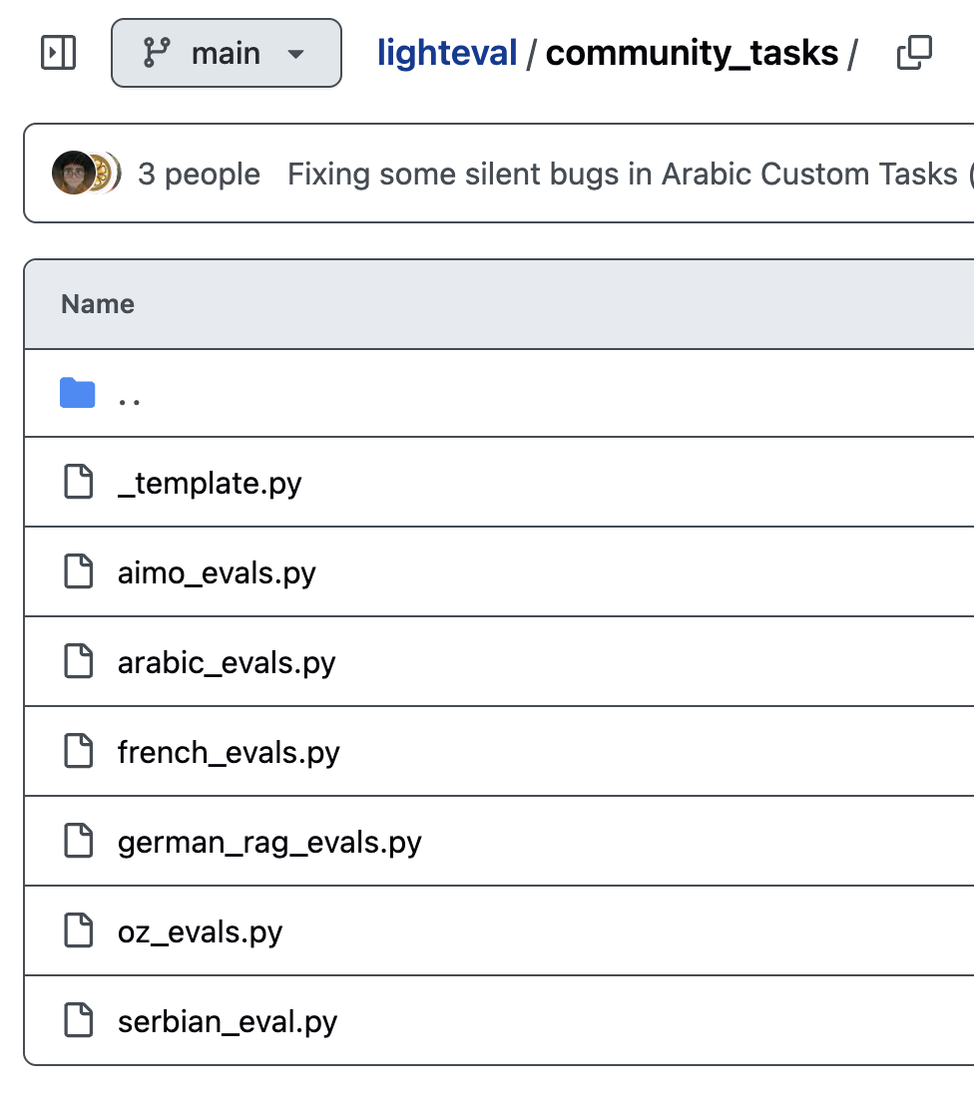
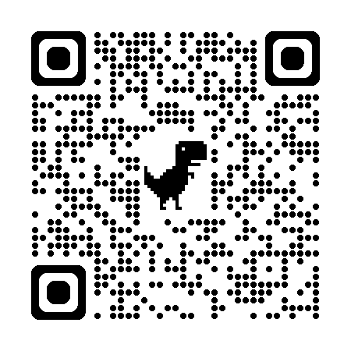
What evaluation frameworks are out there already?

Slide 5
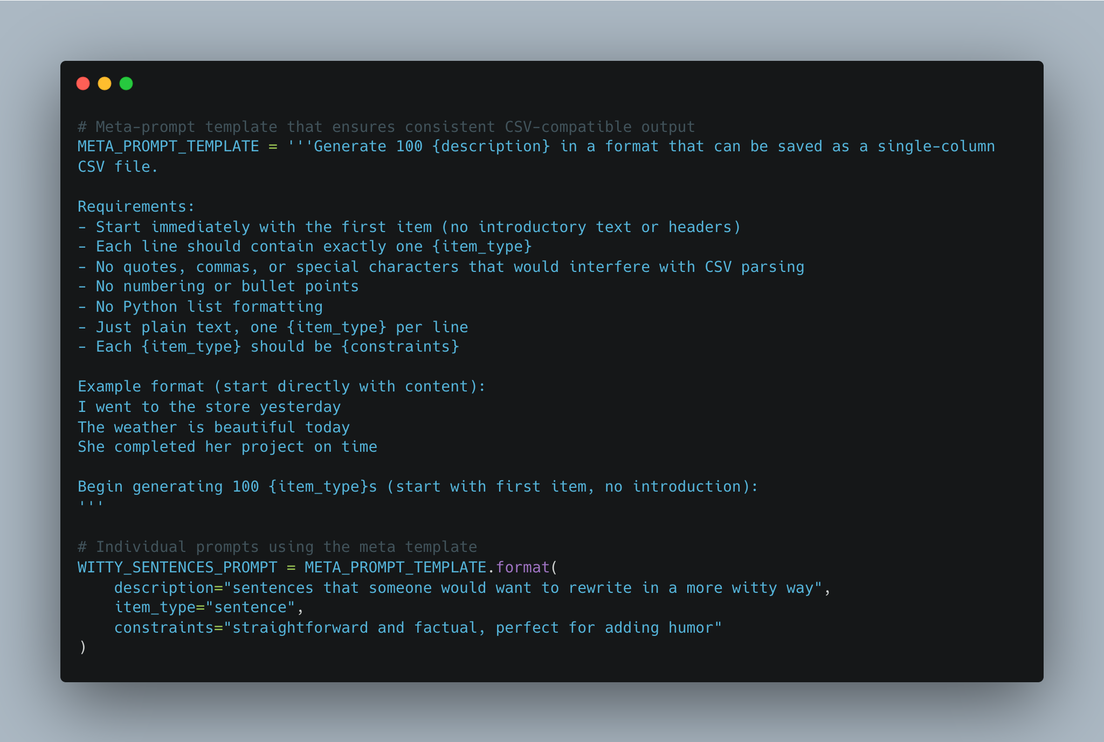
The WRAVAL Pipeline
Synthetic data generation
Deploy Sagemaker endpoint
Inference [Bedrock / Sagemaker endpoint]
LLM-as-a-judge
Human-as-a-judge [Mturk / colleagues]

Slide 6
Evaluation Metrics
Primary dimensions:
Task completion
Writing quality
Contextual appropriateness
Factual accuracy

Slide 7
Dataset Composition
308 diverse writing scenarios
Sourced from real user needs
Balanced across different writing tasks
Multiple domains and complexity levels

Slide 8
Methodology
Two-stage evaluation process
Expert annotators
Standardized scoring rubrics
Inter-annotator agreement measures

Slide 9
Key Findings
Systematic assessment of AI assistants
Identification of strengths/weaknesses
Comparative analysis capabilities
Areas for improvement in AI writing tools

Slide 10
Applications & Impact
Benchmark for AI writing assistants
Tool for improving AI models
Framework for quality assessment
Industry standard potential

Slide 11
Possible Next Steps
Implement wraval as a HF Lighteval custom task
Release a finetuning library?

Slide 12
Resources
Unsloth Dataset Guide

