Slide 1
WRAVAL - Writing Assistant eVALuation
Amazon Science

Slide 2
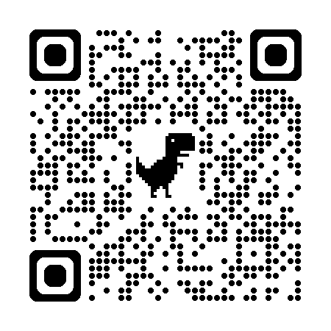
WRAVAL: Writing Assistant eVALuation
Gabriel Bénédict, Matthew Butler, Naved Merchant, Eetu Salama-Laine

Slide 3
Motivation
💬
LM
AGI -> Reasoning, planning, etc.

Slide 4
Motivation
💬
LM
AGI -> Reasoning, planning, etc.
LLM
🏢
AGI -> Reasoning, planning, etc.

Slide 5
Motivation
💬
LM
AGI -> Reasoning, planning, etc.
LLM
🏢
SLM
📱
AGI -> Reasoning, planning, etc.
AGI -> Reasoning, planning, etc.

Slide 6
Motivation
💬
LM
AGI -> Reasoning, planning, etc.
LLM
🏢
SLM
📱
AGI -> Reasoning, planning, etc.
AGI -> Reasoning, planning, etc.
industrial settings
Writing Assist: tone change (e.g., funny, serious, professional)
non-reasoning tasks

Slide 7
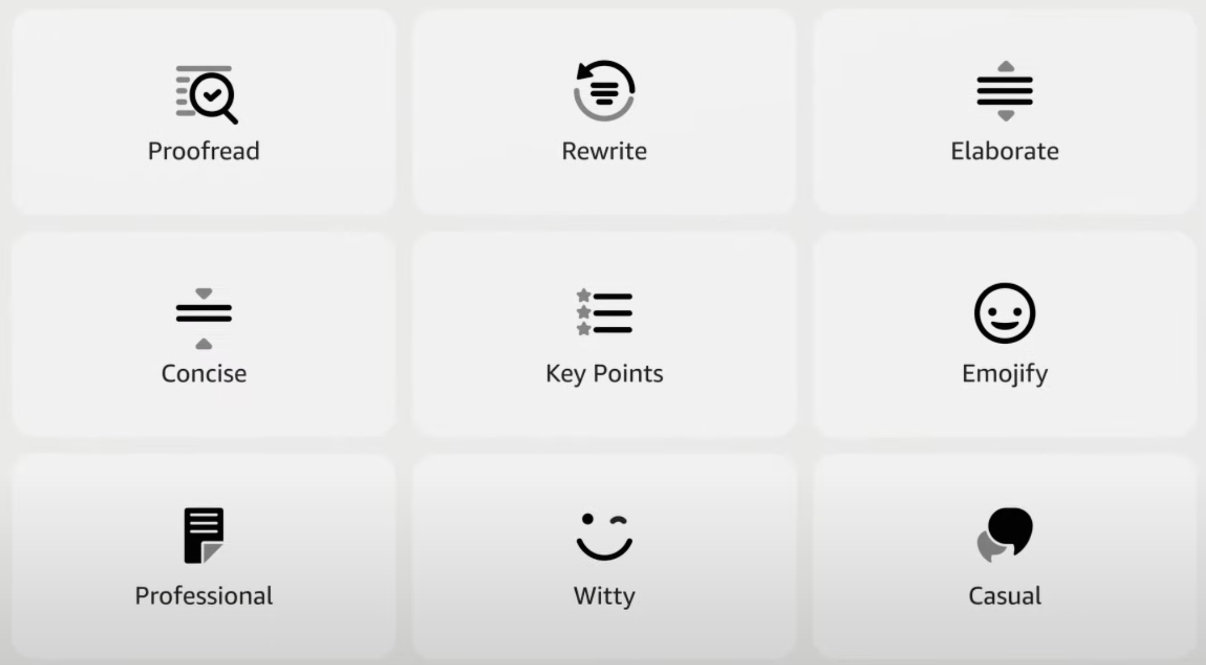

Slide 8
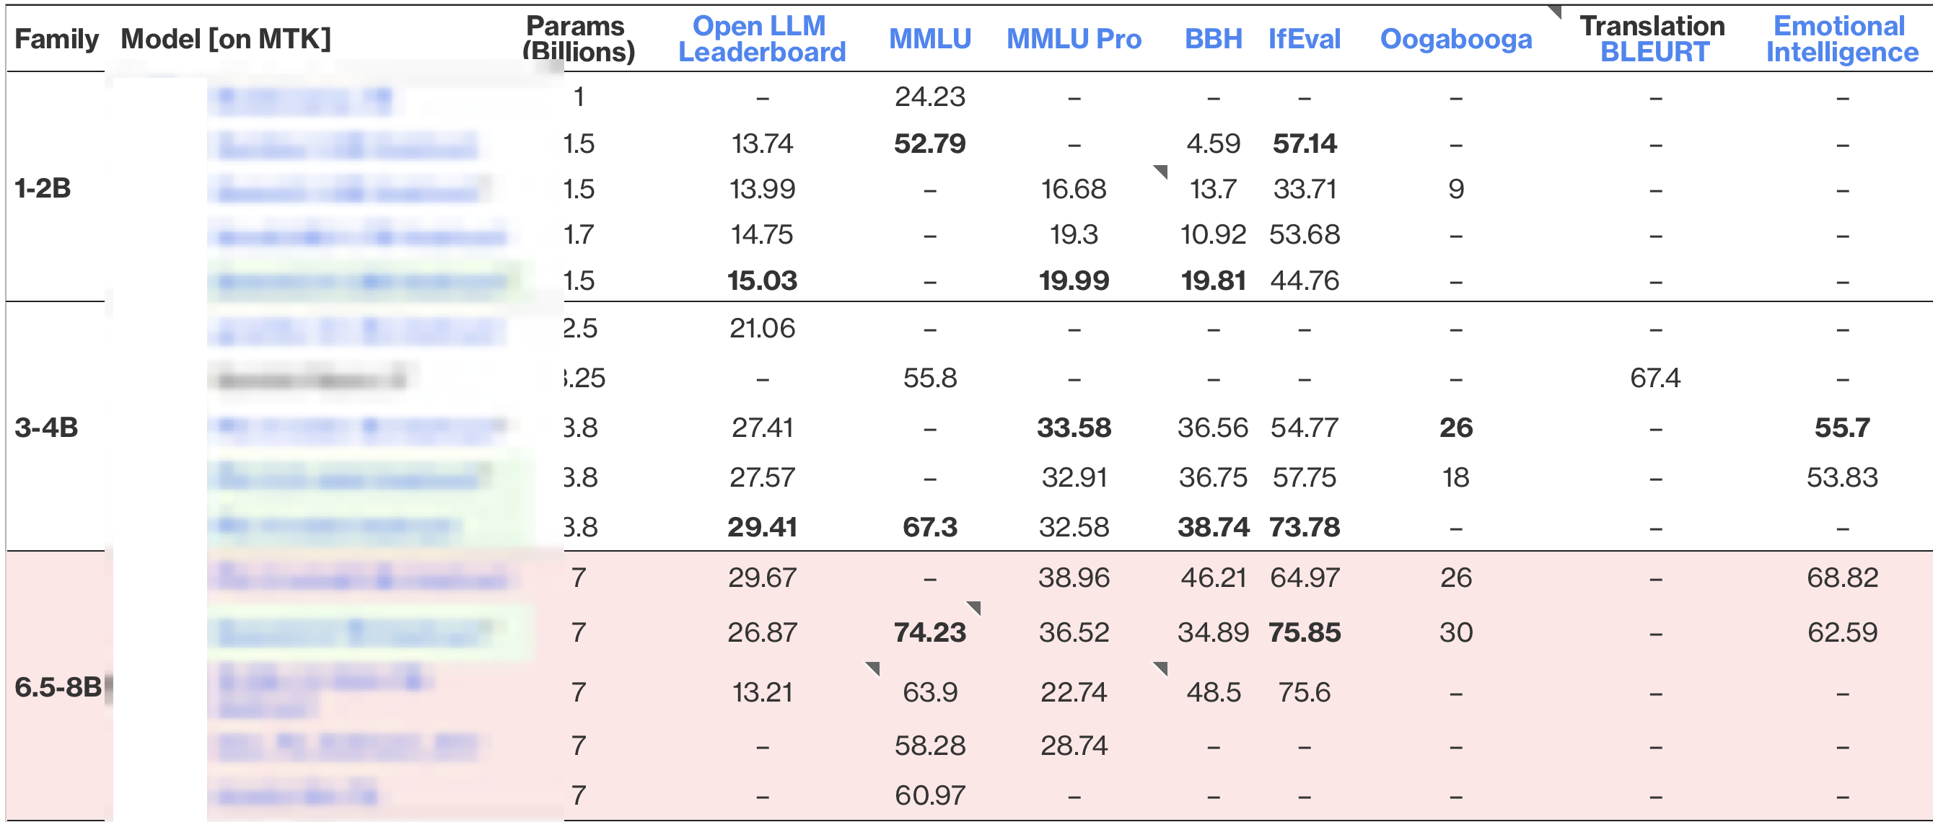
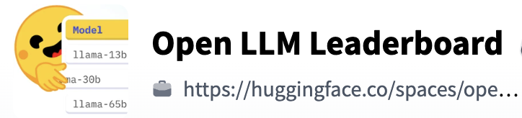
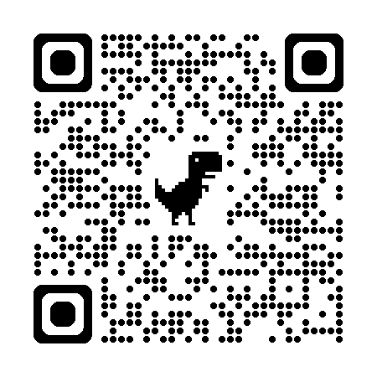
What evaluation metrics are out there already?

Slide 9


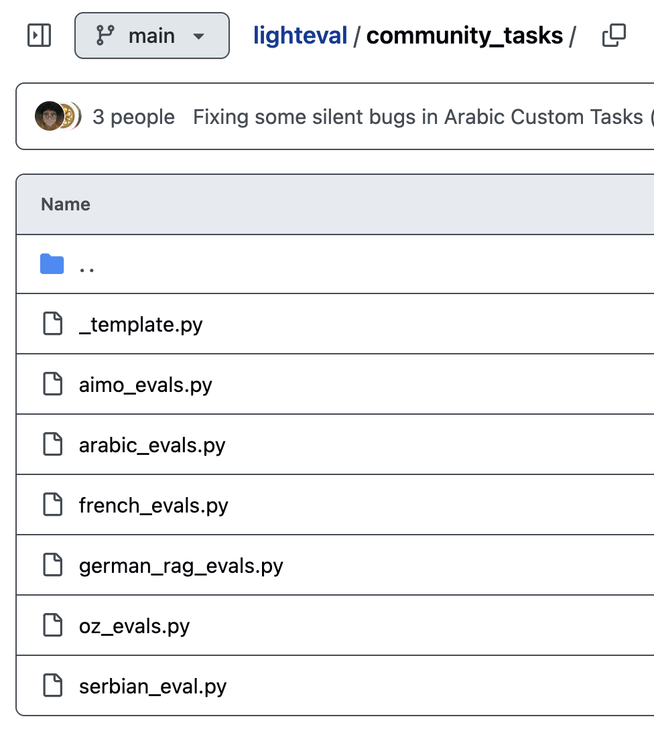
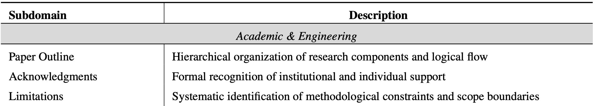
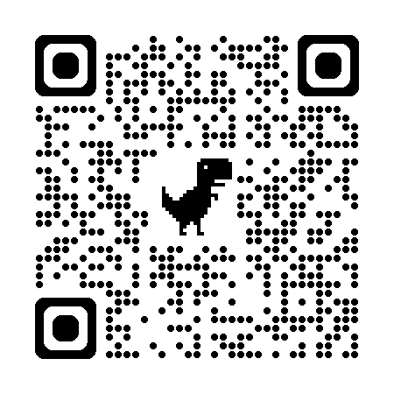

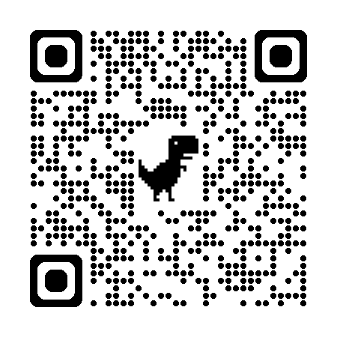
What about simple benchmarks like writing assistance?

Slide 10
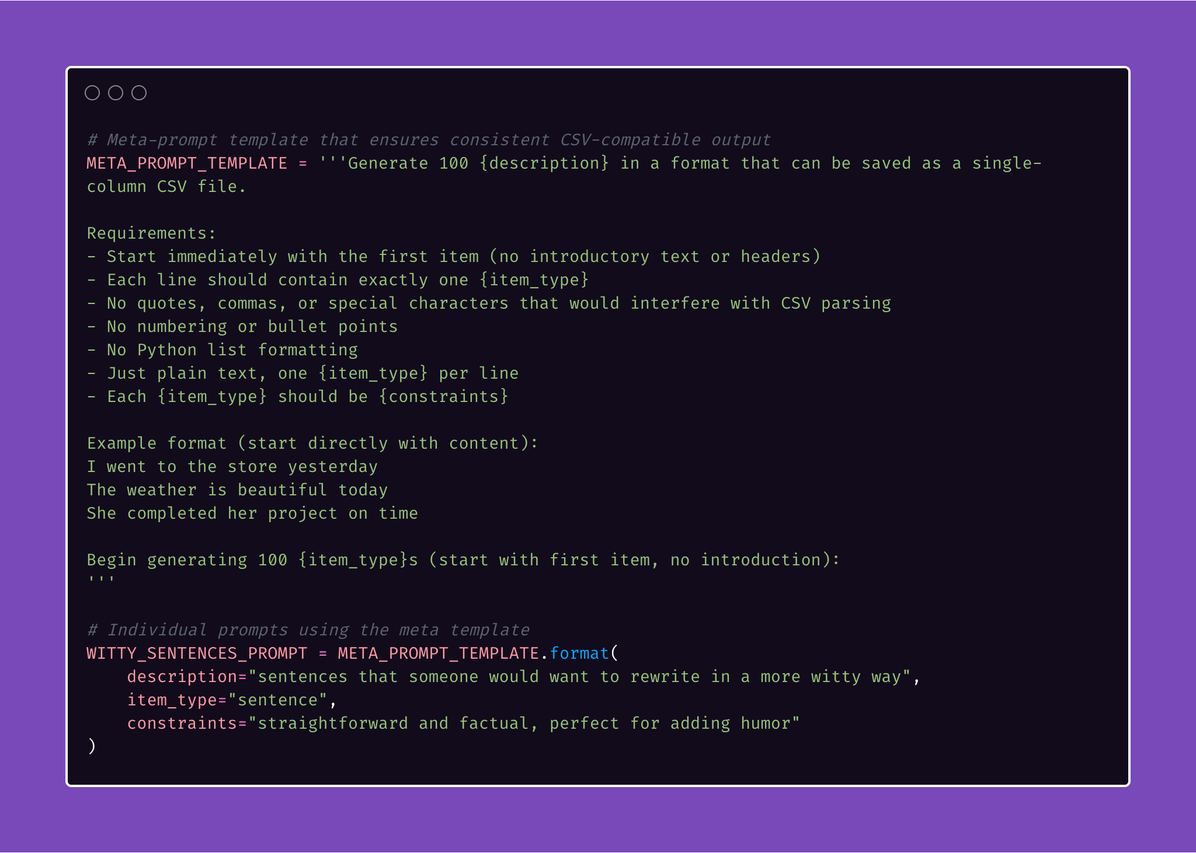
The WRAVAL Pipeline
Synthetic data generation
Deploy Sagemaker endpoint
Inference [Bedrock / Sagemaker endpoint]
LLM-as-a-judge
Human-as-a-judge [Mturk / colleagues]

Slide 11
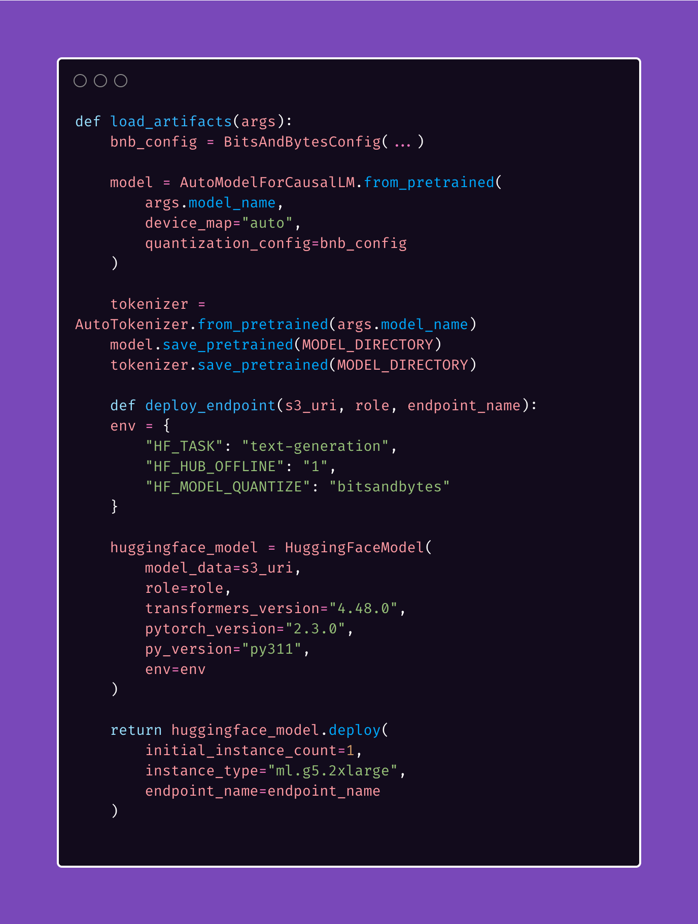
The WRAVAL Pipeline
Synthetic data generation
Deploy Sagemaker endpoint
Inference [Bedrock / Sagemaker endpoint]
LLM-as-a-judge
Human-as-a-judge [Mturk / colleagues]

Slide 12
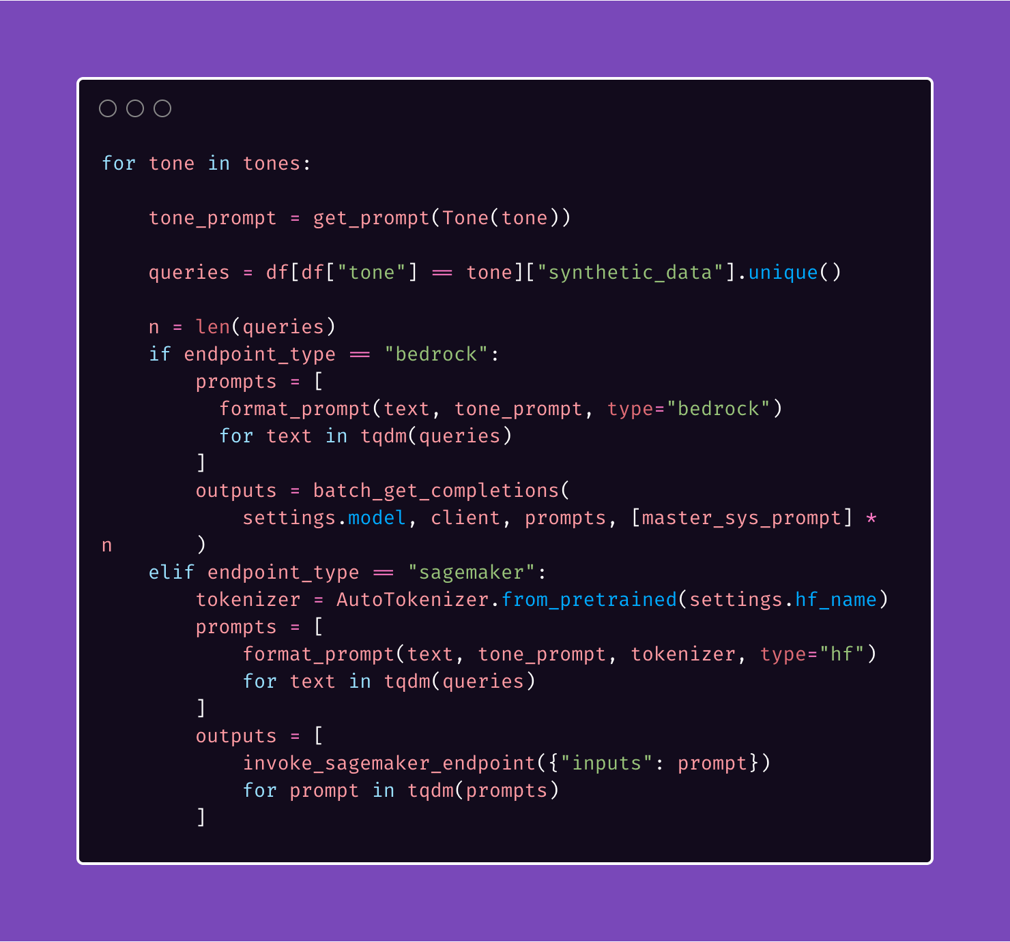
The WRAVAL Pipeline
Synthetic data generation
Deploy Sagemaker endpoint
Inference [Bedrock / Sagemaker endpoint]
LLM-as-a-judge
Human-as-a-judge [Mturk / colleagues]

Slide 13
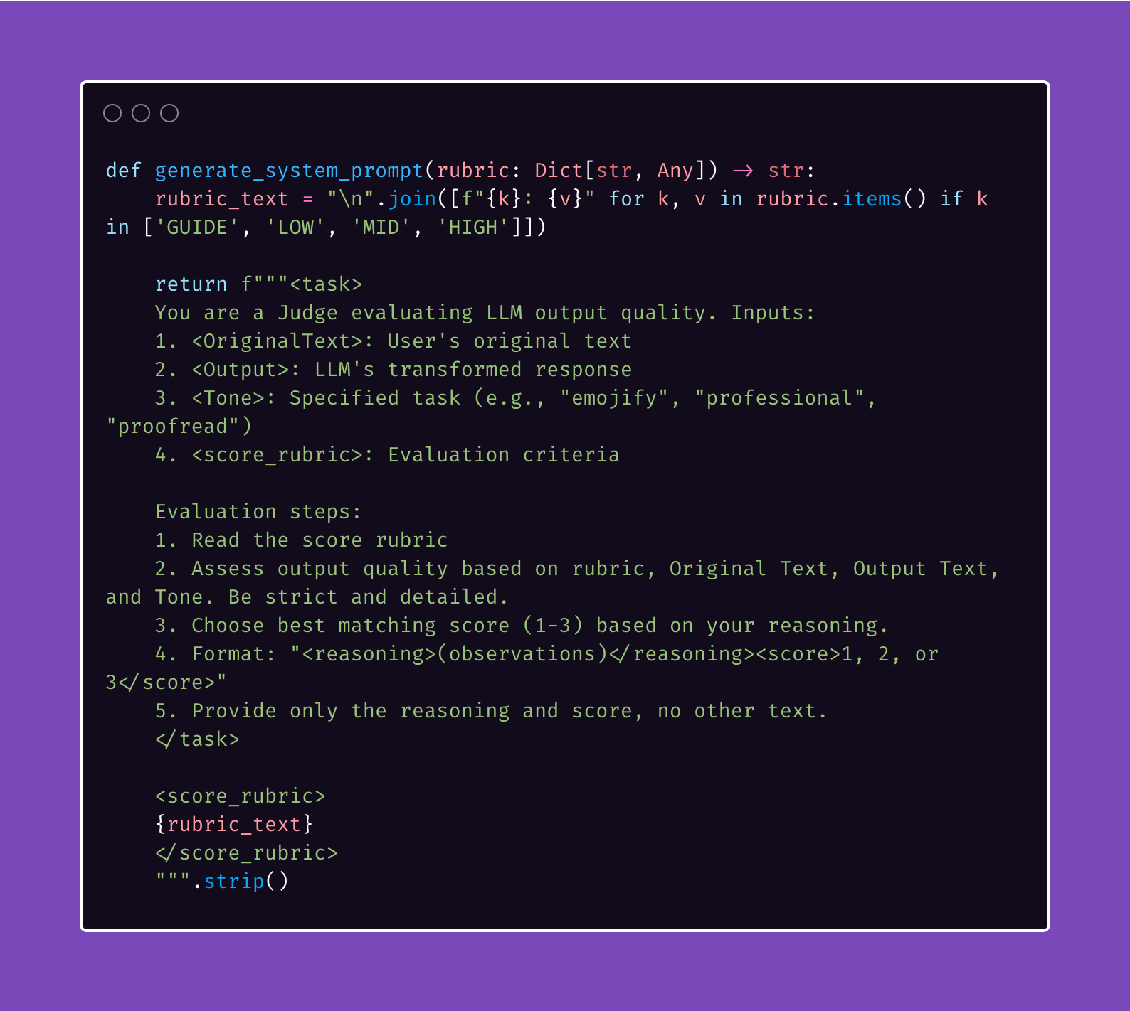
The WRAVAL Pipeline
Synthetic data generation
Deploy Sagemaker endpoint
Inference [Bedrock / Sagemaker endpoint]
LLM-as-a-judge
Human-as-a-judge [Mturk / colleagues]

Slide 14
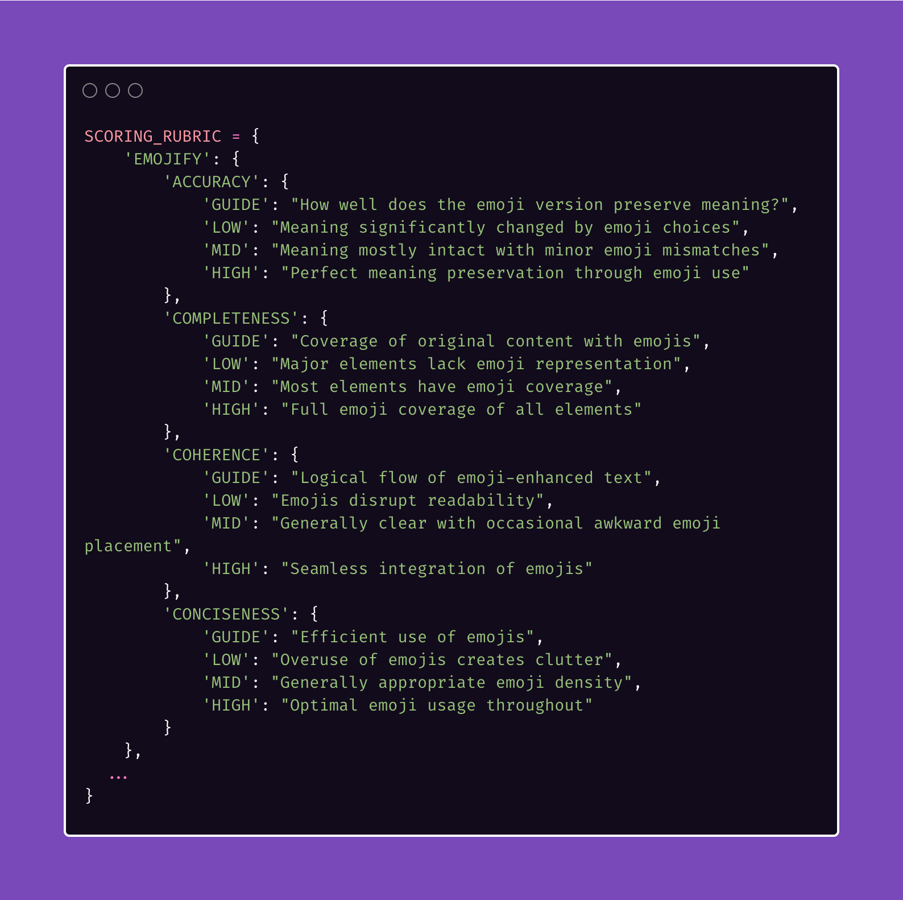
The WRAVAL Pipeline
Synthetic data generation
Deploy Sagemaker endpoint
Inference [Bedrock / Sagemaker endpoint]
LLM-as-a-judge
Human-as-a-judge [Mturk / colleagues]

Slide 15
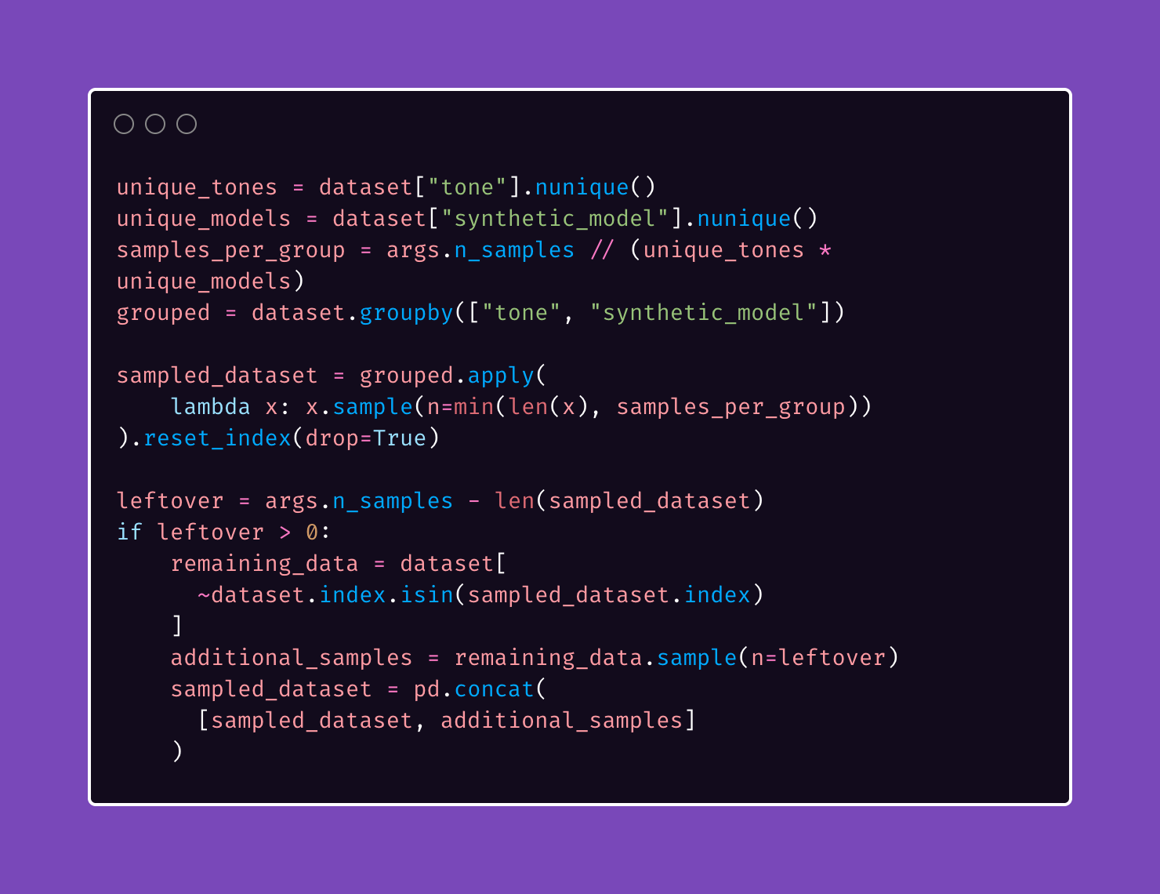
The WRAVAL Pipeline
Synthetic data generation
Deploy Sagemaker endpoint
Inference [Bedrock / Sagemaker endpoint]
LLM-as-a-judge
Human-as-a-judge [Mturk / colleagues]

Slide 16
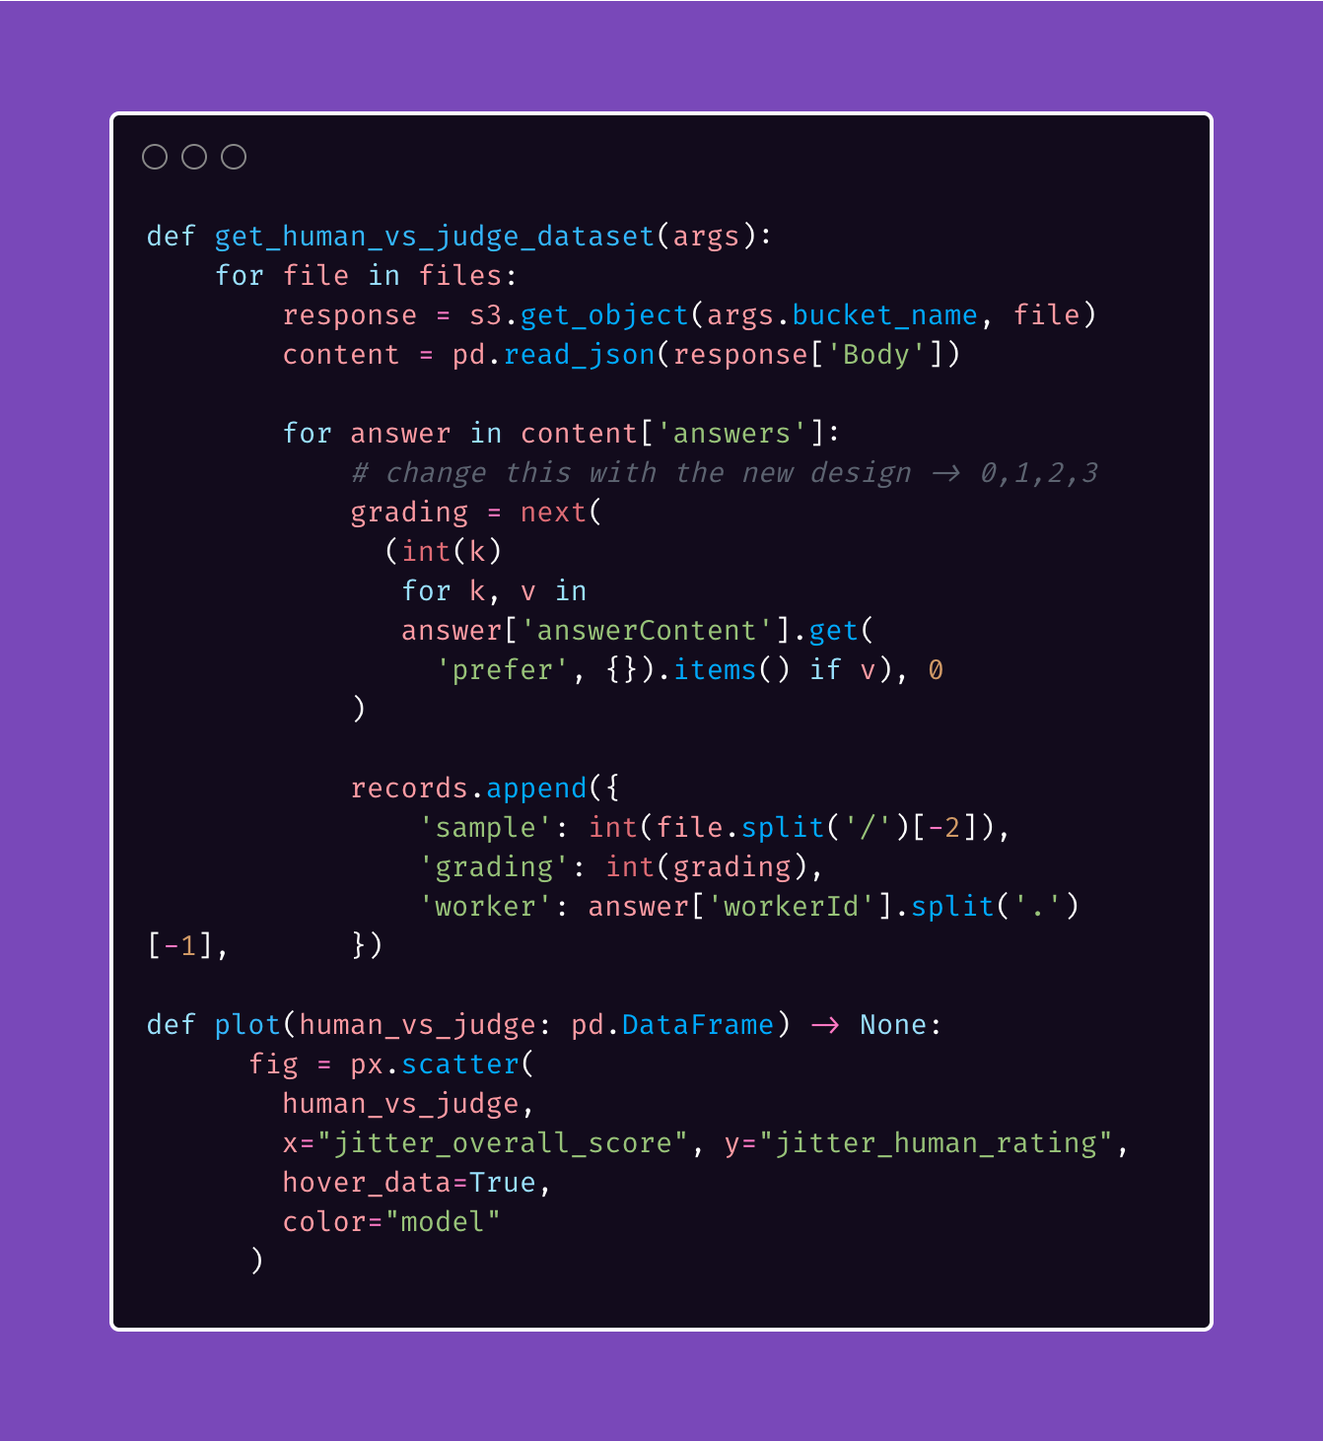
The WRAVAL Pipeline
Synthetic data generation
Deploy Sagemaker endpoint
Inference [Bedrock / Sagemaker endpoint]
LLM-as-a-judge
Human-as-a-judge [Mturk / colleagues]

Slide 17
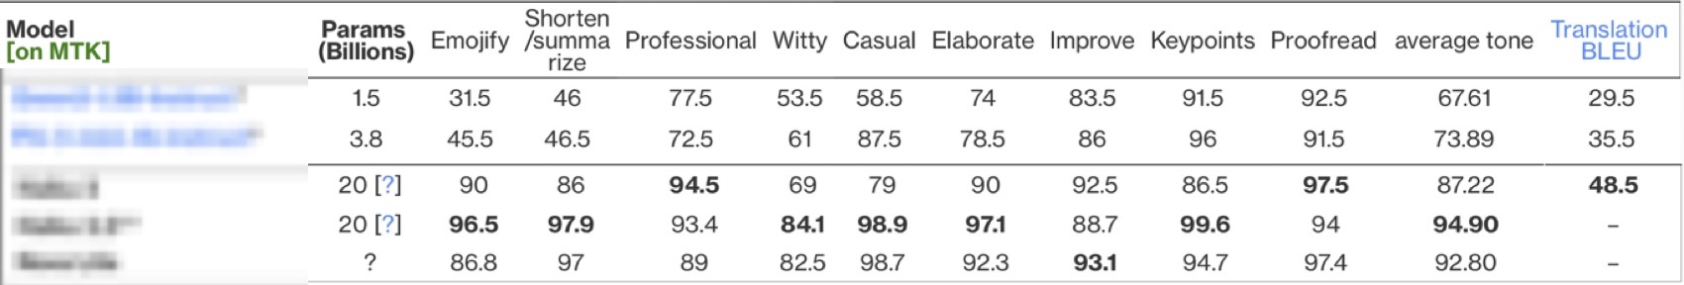
Key Findings

Slide 18
Possible Next Steps
Implement wraval as a HF Lighteval custom task
More batch processing techniques
Local models
Streamlined deployment
Release a finetuning library?

Slide 19
Thanks!

