Slide 1
Is the Mars Curiosity Rover taking a selfie?
Scott Armstrong
DSI 2020, 9 June 2020

Slide 2
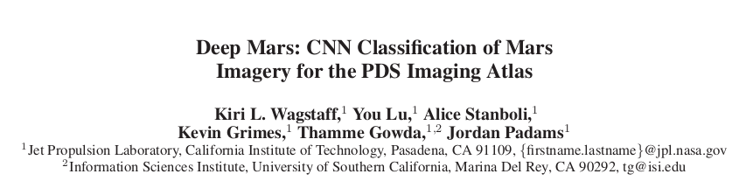



Dataset

Slide 3
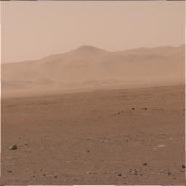
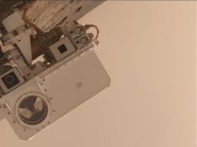
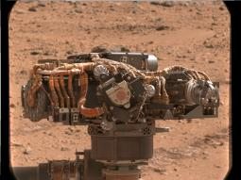
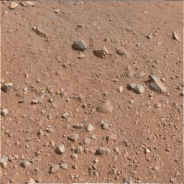
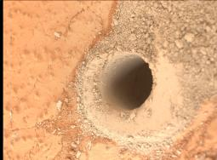
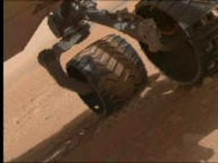
Images
#nofilter

Slide 4
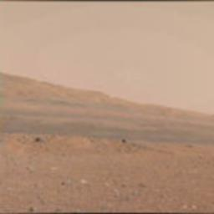


Processing
imageTrain.csv
id, pixel 1, pixel 2, …
0, 124, 103, …
1, 114, 148, …
...

Slide 5
Distributed Training
Scala (Java) → Spark is cross-platform
Computer #2
Main Computer
Spark Worker
Spark Master
Router
Computer #3
Spark Worker
Spark Worker
Master
Runs main process, distributing requests among workers
Worker
Completes requests of master and sends back result

Slide 6
Results
MLP NN → 11% accuracy
Linear SVM → 17% accuracy
Random Forest → 75% accuracy
- 256 trees
- max depth 16 nodes

Slide 7
Next Steps
Improve images
- Color
- Larger images
- Augmentation
Improve distribution
- Distributed file management
- Image processing in Scala

