Slide 1
A Tutorial to
DirectShow
Ruigang Yang
August, 2001

Slide 2

What is DirectShow
A part of the DirectX family
Play almost any type of media
Dx8.1
DirectX
DirectShow
DirectDraw
DirectPlay
Direct3D
DirectMusic
Notes:
A few years ago, Microsoft introduced a media streaming layer on top of DirectX that was meant to handle pretty much any type of media you could throw at it, called DirectShow. It's included in DirectX Media, which also includes DirectAnimation (mostly web page stuff), DirectX Transform (more web page stuff), and the old Direct3D Retained Mode that used to be part of the standard DirectX collection. This tutorial will show you how to play back standard media types in your game or application using DirectShow from C++. Microsoft doesn't offer the DirectX Media SDK for download, so you either have to order a CD or look in the latest Platform SDK.

Slide 3
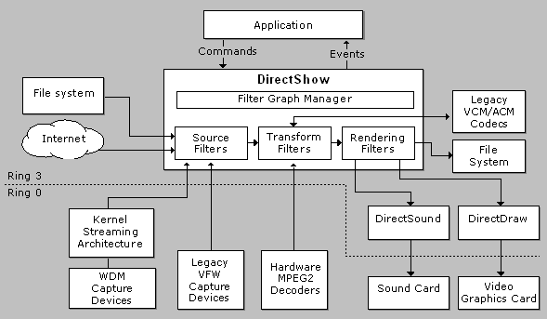
DirectShow Overview
Notes:
A collection of components allows easy play back of multi-media streams

Slide 4
Pros and Cons
Benefits
  Very very flexible architecture
  Reusable components (filters)
Downside
  You are doomed with M$
  Learn the Window programming
  MFC (you don’t have to, but better to)
Notes:
Change from a 1394 camera to a analog cameras, -- one line.
Change from live capture to AVI playback, a few lines.
You can convert from one format to another without writing any code
You can mix several streams

Slide 5
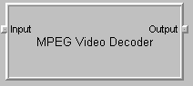
DirectShow Filters
The basic building block, which can
  Read files.
  Get video from a video capture device.
  Code/decode streams
  Pass data to the graphics or sound card.
An sample MPEG filter
Notes:
Here is a typical transform filter. Note that a filter can have multiple input and output

Slide 6
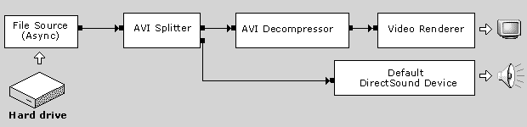
Filter Graph
Several filters connected together to perform a specific task

Slide 7
Filter Graph Manager
High-level API to the APP
Controls the data flow in the filters
Simple API
  AddFilter, queryInterface
  Run, stop, and pause

Slide 8
Demo
Graph Builder
(mssdk→DirectX utility→Graph Builder)

Slide 9
Writing a Dshow App.
DirectShow API through COM interface
Component Object Model (COM)
  Getting a pointer to the interface
    ptr = CoCreateInstance(…)
  Release the pointer after you are done
    ptr->Release()

Slide 10
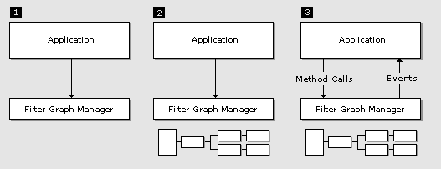
Three steps
Create filter graph ganager (FGM)
Create the filter graph (through FGM)
Run the graph and respond to event

Slide 11
“Hello World”
#include <dshow.h>
void main(void) {
IGraphBuilder *pGraph; IMediaControl *pMediaControl; IMediaEvent *pEvent;
CoInitialize(NULL);
// Create the filter graph manager and query for interfaces. CoCreateInstance(CLSID_FilterGraph, NULL, CLSCTX_INPROC_SERVER, IID_IGraphBuilder, (void **)&pGraph);
pGraph->QueryInterface(IID_IMediaControl, (void **)&pMediaControl);
pGraph->QueryInterface(IID_IMediaEvent, (void **)&pEvent);
// Build the graph.
pGraph->RenderFile(L"C:\\Hello_World.avi", NULL);
pMediaControl->Run(); // Run the graph.
pEvent->WaitForCompletion(INFINITE, &evCode); // Wait for completion.
// Clean up.
pMediaControl->Release(); pEvent->Release(); pGraph->Release();
CoUninitialize(); }
COM Init, Remember this
Get DS Interface
Release COM pointer

Slide 12
Building Filter Graph
Add filters to the FGM
Two ways
  “Intelligent” connect (as in previous example)
  Manual connect (pout→ pin)
    Format negotiation

Slide 13
Frame grabber
Sample Grabber Filter
Notes:
I am always got asked for how I can get an pointer to the image data. I spent a few days on the VFW interface, and never succeeded. Well, for Dshow, it is not that convoluted. There is the sample grabber

Slide 14
A Few Tips
Multi-thread
Avoid in-place transform filter
Image origins
A few useful filters
  Color space converter
  T-adaptor
  Stream-multiplex

Slide 15
References
MSDN

