Slide 1
SIGNATURE ASSESSMENT
Enterprise Risk Management Analytics
CIBC Digital Insurance Platform Acquisition
Quantitative Risk Assessment
Group 7
Oluwatomi Ottun • Efemena Okpa • Anthony Onwuka
ALY6130 – Risk Management Analytics | Instructor: Abeba N. Turi | Spring 2026 | June 2026

Slide 2
Business Context & Problem Statement
Why the Acquisition?
Enterprise Problem Statement
› 11M existing banking clients: Built-in cross-sell distribution no insurtech can replicate
CIBC must enter a highly regulated industry with limited operational experience, integrate a cloud-native insurance platform with legacy banking infrastructure, comply with multiple provincial regulatory regimes, and protect an expanded pool of customer data including sensitive health information.
› 12% annual market growth: Canada's digital insurance market is expanding rapidly (Swiss Re, 2023)
› First-mover window closing: TD and RBC announced intentions but have not launched
Enterprise Impact
Financial exposure could exceed CAD $100M through fines, remediation, and delayed revenue. Effective risk governance creates an estimated CAD $187.1M opportunity through first-mover market capture.
› 60% lower client attrition: Bundled multi-product clients (McKinsey, 2023)
2 / 10

Slide 3
Integrated Situation Assessment
INTERNAL ENVIRONMENT
EXTERNAL ENVIRONMENT
Legacy Banking Infrastructure
TD & RBC Competition
Core banking architecture not designed to integrate with cloud-native platforms; middleware gaps and API incompatibilities
Both announced digital insurance partnerships; competitive window is actively closing — supports R3 urgency
No Insurance Experience
Bill C-27 & PIPEDA
No underwriting, actuarial, claims management, or provincial licensing experience — capability gaps elevate likelihood scores
AI transparency requirements, mandatory breach notification, and OSFI Guideline B-10 vendor oversight apply directly
Strong Brand & Client Base
Growing Cyber Threats
157 years of trust and 11M clients provide a distribution advantage; CAD $23.6B revenue enables investment capacity
Lemonade 2022 breach confirmed combined financial-health data as active attack targets — supports L=9 for R1
Stakeholders: customers, regulators, shareholders, and management.
3 / 10

Slide 4
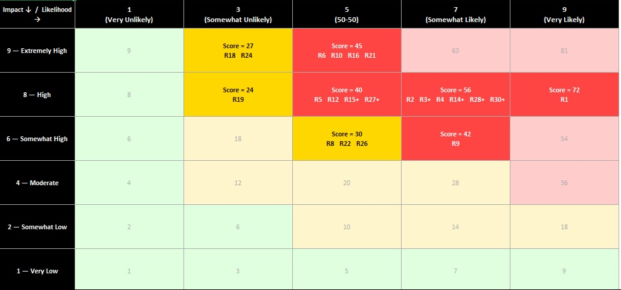
Risk Identification & Enterprise Risk Profile
01
02
03
04
SWOT Analysis
PESTLE Analysis
Risk Workshops
Scenario Analysis
30
19
11
0
Total Risks
High Priority
Medium Priority
Low Priority
Risk scores calculated using the ALY6130 Risk Calculation Sheet (Likelihood × Impact)
Highest Risk Areas:
Cybersecurity
Regulatory Compliance
Technology Integration
Operational Readiness
4 / 10

Slide 5
Top 3 Risks Selected for Analysis
R1
Data Privacy Breach
72
L=9 (Very Likely) × I=8 (High)
Negative Risk
Highest score in register. Combined financial-health data environment confirmed as active attack target (Lemonade 2022). L=9 — only Very Likely score.
R2
Regulatory & Compliance Exposure
56
L=7 (Somewhat Likely) × I=8 (High)
Negative Risk
10 independent provincial regimes plus Bill C-27 AI transparency and OSFI Guideline B-10. CIBC has no prior insurance compliance infrastructure.
R3
First-Mover Market Capture
56
L=7 (Somewhat Likely) × I=8 (High)
Opportunity Risk
CAD $187.1M EMV. 11M existing clients provide distribution advantage no insurtech can replicate. TD/RBC window is actively closing.
5 / 10

Slide 6
Qualitative Risk Assessment
01 Scenario Analytics
02 Industry Fusion Analytics
R1 Optimistic: Zero-trust controls contain breach to test data; minimal regulatory consequences
Lemonade 2022 Breach: Combined financial-health data confirmed as active attack targets → supports L=9 for R1
R1 Most Likely: Integration breach → PIPEDA notification + review → inputs: $25M / $75M / $150M
Canadian FI Regulatory Delays: FI insurance expansion faces elevated regulatory halt probability → supports L=7 for R2
R1 Pessimistic: Systemic breach → class-action, regulatory intervention, reputational damage
TD Bank Adoption Benchmarks: TD's 2019–2020 trajectory calibrated Green (>5%) and Amber (2–5%) thresholds for R3 KRI
R2 Range: Successful pre-launch compliance → regulatory halt in key provinces
PolicyMe Growth: 40% YoY growth confirmed consumer demand for digital insurance in Canada
R3 Range: Strong first-mover at 5% adoption → failed launch below 1%
McKinsey Bundled Clients: Bundled clients: 60% lower attrition and higher lifetime value — validates R3 rationale
CRISP-DM framework guided business understanding, data preparation, modelling, evaluation, and deployment of risk analytics.
6 / 10

Slide 7
Quantitative Assessment Framework
Monte Carlo Simulation (10,000 Iterations) · Sensitivity Analysis · EMV Analysis · ML Models (Isolation Forest · Gradient Boosting · LSTM)
Data Privacy Breach
R2
R3
R1
Regulatory Exposure
First-Mover Capture
Primary Method
Primary Method
Primary Method
Monte Carlo Simulation
Sensitivity Analysis
EMV Analysis
ML Enhancement
ML Enhancement
ML Enhancement
Isolation Forest
Gradient Boosting
LSTM Forecasting
Triangular distribution used for scenario-based loss modelling (10,000 iterations). Anomaly detection on SOC alert patterns — authentication failures, access frequency, data transfer spikes.
5 drivers varied ±30%. Supervised classifier predicts regulatory halt probability using compliance findings, licensing delays, and regulatory engagement signals.
4 adoption scenarios × net value. Time-series model forecasts monthly adoption rate, enabling early detection of declining trends before KRI breach.
7 / 10
All models were developed using proxy and synthetic datasets derived from the Group 7 Risk Register, RT&RP, market research, and regulatory assumptions.

Slide 8
Key Quantitative Results
R1 Data Privacy Breach
R2 Regulatory Exposure
R3 First-Mover Capture
Monte Carlo — 10,000 Iterations
Sensitivity Analysis — 5 Drivers ±30%
EMV Analysis — 4 Adoption Scenarios
Mean Loss
CAD $82.8M
Base Impact
CAD $56M
Strong First-Mover (P=70%)
CAD $168.0M
Median Loss
CAD $81.0M
#1 Regulatory Halt Prob.
±CAD $11.8M
Partial First-Mover (P=15%)
CAD $17.8M
90th Percentile
CAD $118.7M
#2 Fine Severity
±CAD $7.7M
Late Entry (P=10%)
CAD $3.0M
95th Percentile
CAD $127.8M
#3 Delay Duration
±CAD $5.0M
Failed Launch (P=5%)
−CAD $1.8M
P(Loss > $100M)
25.6%
#4 Provinces Affected
±CAD $3.5M
Total EMV
CAD $187.1M
Reserve: CAD $119M (90th pct) | Stress-test: CAD $128M (95th pct)
Regulatory Halt Probability is the dominant sensitivity driver for R2
Amber: −$150M | Red: −$165M value lost
8 / 10

Slide 9
Risk Response Strategy & KRI Framework
R1
Data Privacy Breach
KRI: Critical security vulnerabilities unpatched >72 hrs
MITIGATE
Owner: CISO / CCO
Zero unpatched
1 unpatched >72 hrs
2+ unpatched OR confirmed unauthorised access
Zero-trust architecture · 24/7 SOC + CIRT · Privacy Impact Assessment · Role-based access + DLP · Cyber insurance
AMBER: management action | RED: CEO/Board escalation
R2
Regulatory Exposure
KRI: Open compliance findings or regulatory changes unresolved >30 days
MITIGATE
Owner: Chief Compliance Officer
Zero open findings
1–2 open >30 days
3+ unresolved OR formal regulatory inquiry
Dedicated compliance officer · Province-by-province licensing roadmap · Automated regulatory monitoring · Quarterly Bill C-27 AI reviews
AMBER: management action | RED: CEO/Board escalation
R3
First-Mover Capture
KRI: Monthly digital insurance adoption rate (% of active CIBC digital banking clients)
EXPLOIT
Owner: CSO / CFO
>5% adoption at 12 months
2–5% OR TD/RBC go-live within 6 months
<2% OR competitor launches first
Accelerate market-entry without compromising quality · Dedicated digital insurance marketing budget · Advisor cross-sell incentive programme · Weekly competitor monitoring
AMBER: management action | RED: CEO/Board escalation
KRI development followed the CRISP-DM framework: from business understanding, data preparation, modelling, evaluation, and deployment.
9 / 10

Slide 10
Recommendations & Conclusion
01
02
03
04
Approve CAD $119M
Contingency Reserve
Strengthen Compliance
Oversight
Implement Continuous
KRI Monitoring
Accelerate Market
Readiness
Monte Carlo 90th percentile output. Board stress-test at CAD $128M (95th pct). Justified by 25.6% probability of losses exceeding $100M.
Regulatory halt probability is the #1 sensitivity driver (±$11.8M). Dedicated CCO embedded before integration; province-by-province licensing roadmap.
Isolation Forest (R1), Gradient Boosting (R2), and LSTM (R3) models feed real-time KRI dashboards. I&W framework enables proactive intervention.
EMV of CAD $187.1M is contingent on first-mover timing. 11M clients provide unmatched distribution advantage. TD/RBC window is actively closing.
CONCLUSION
Final Recommendation
Proceed with the acquisition, subject to enhanced cybersecurity controls, compliance oversight, and continuous KRI monitoring.
Recommendation
10 / 10

