Slide 1
Model Architecture & Pipeline
Diagrams exported from repository

Slide 2
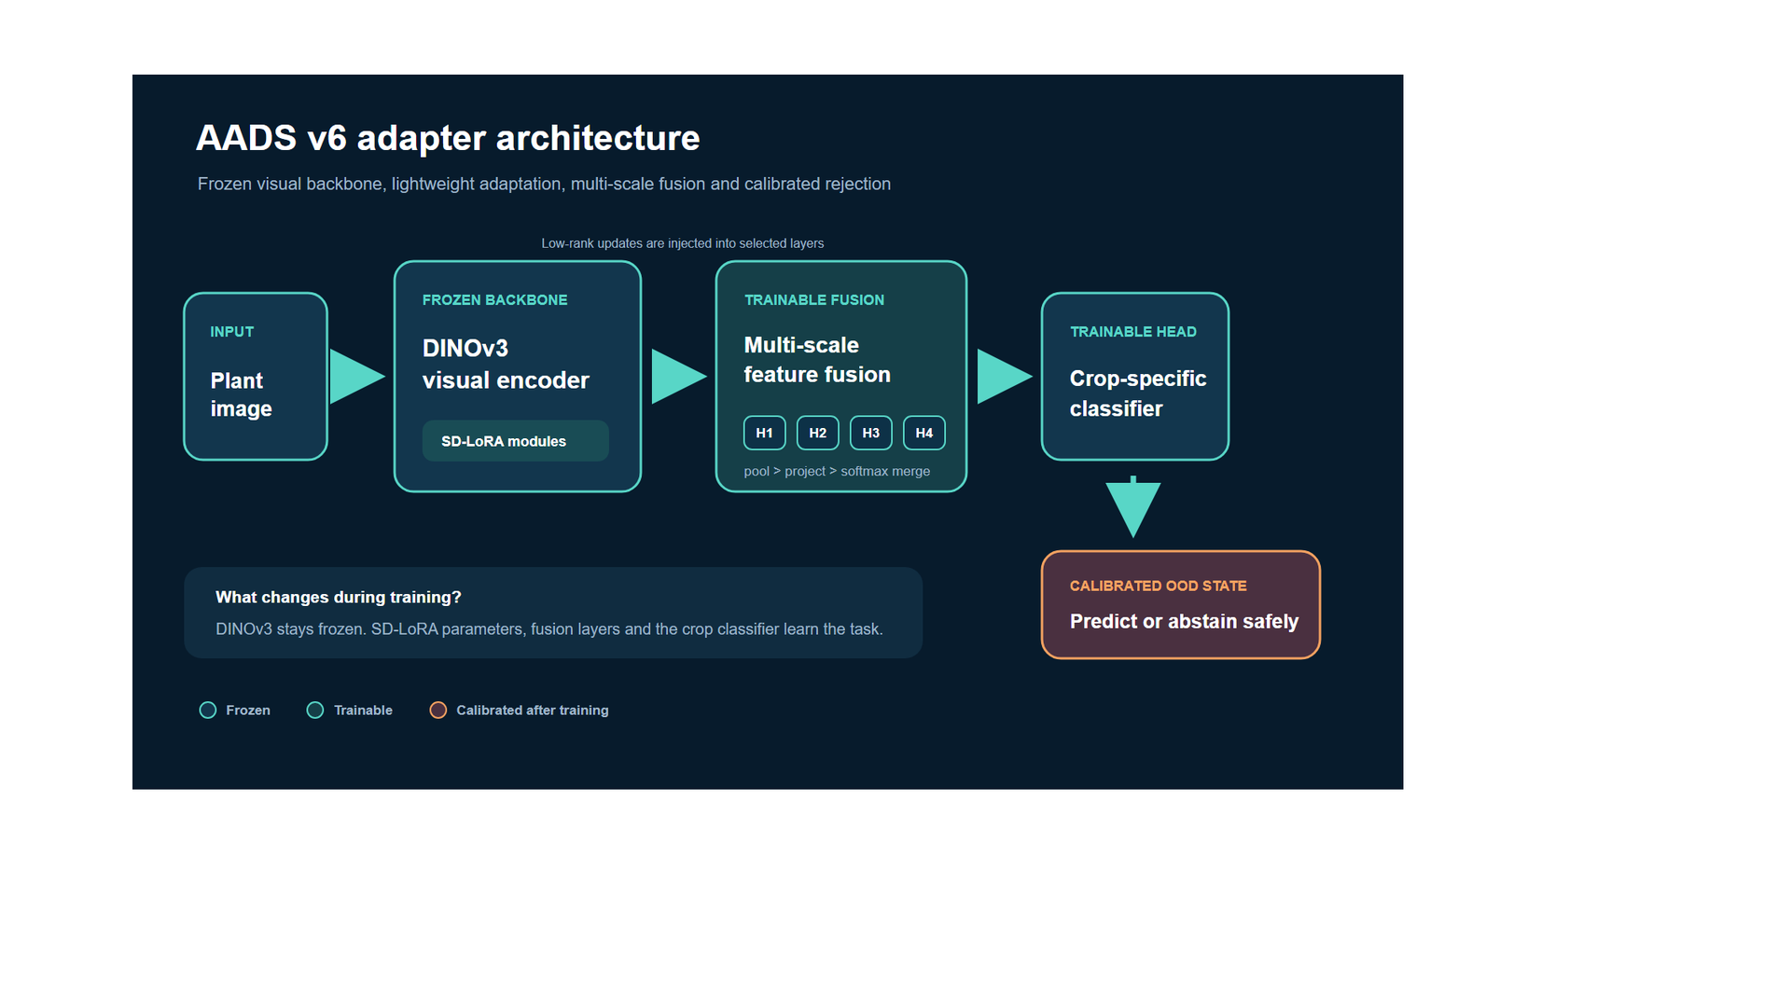
Adapter Architecture Detail

Slide 3
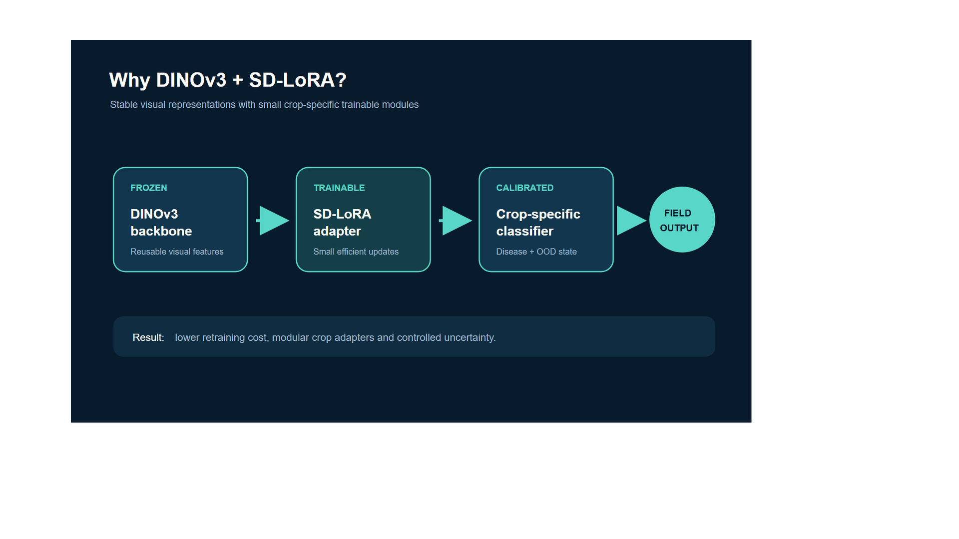
Dinov3 Sd Lora Architecture

Slide 4
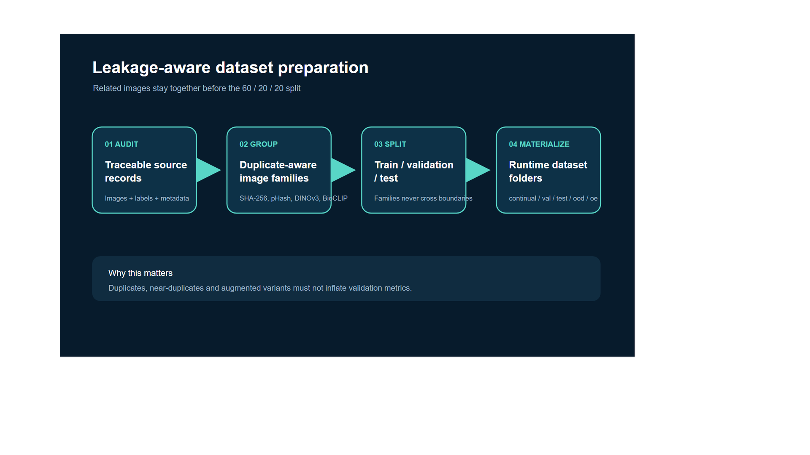
Leakage Safe Preparation

Slide 5
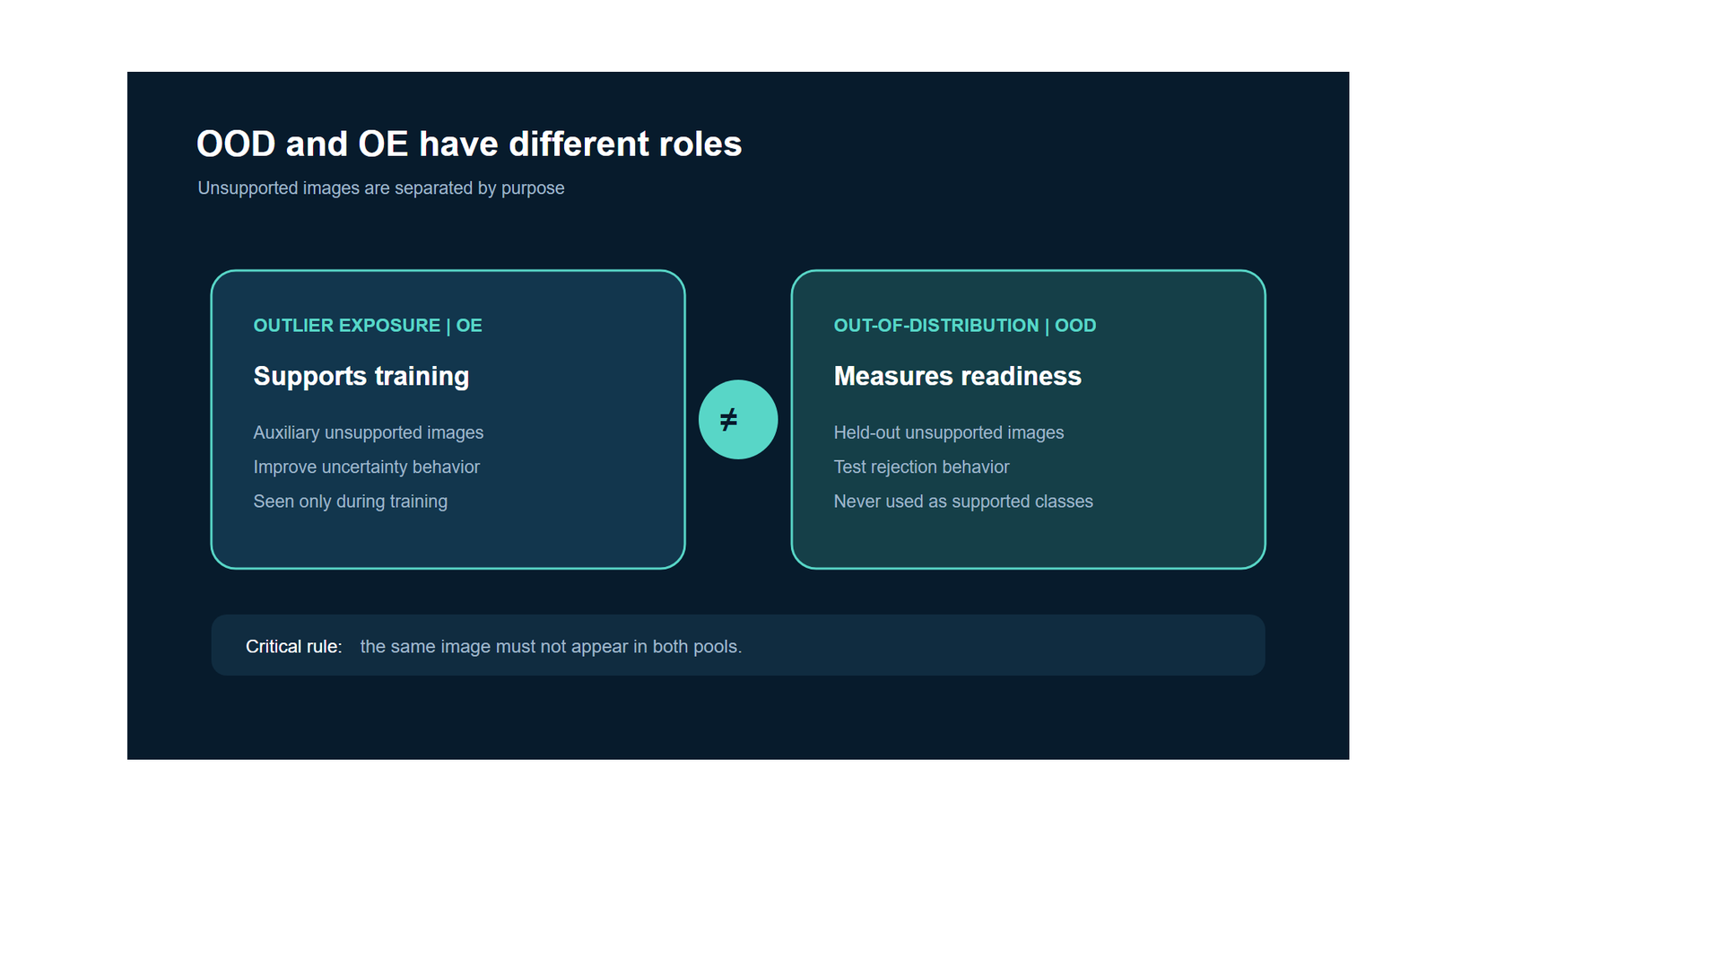
Ood Vs Oe

Slide 6
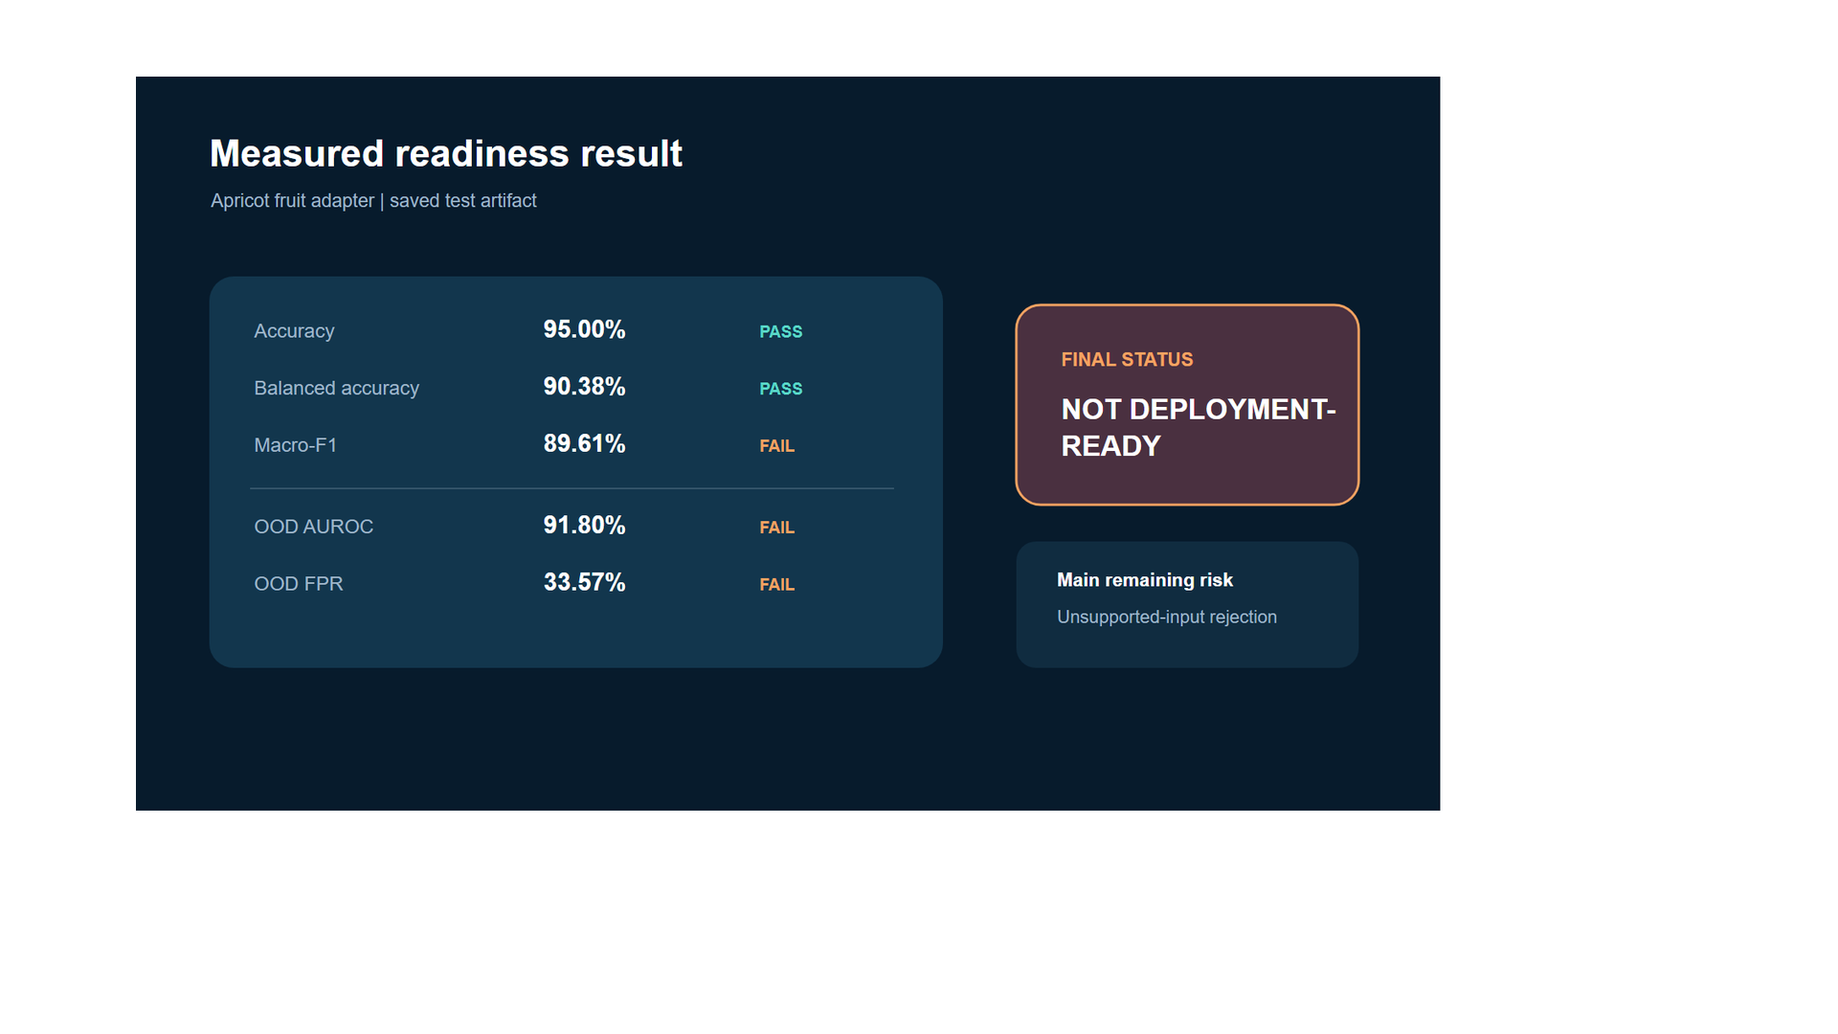
Readiness Result

Slide 7
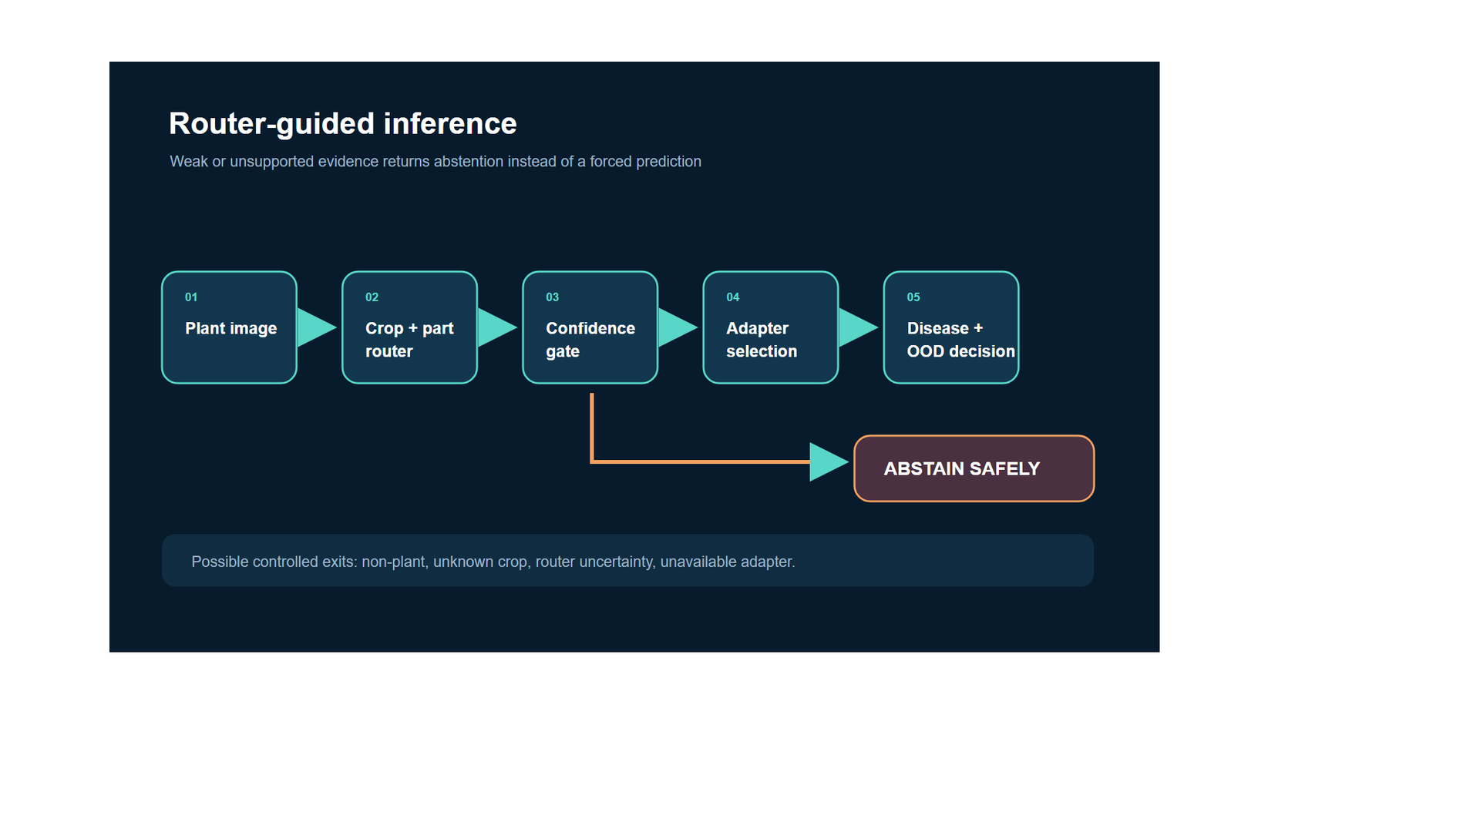
Router Guided Inference

Slide 8
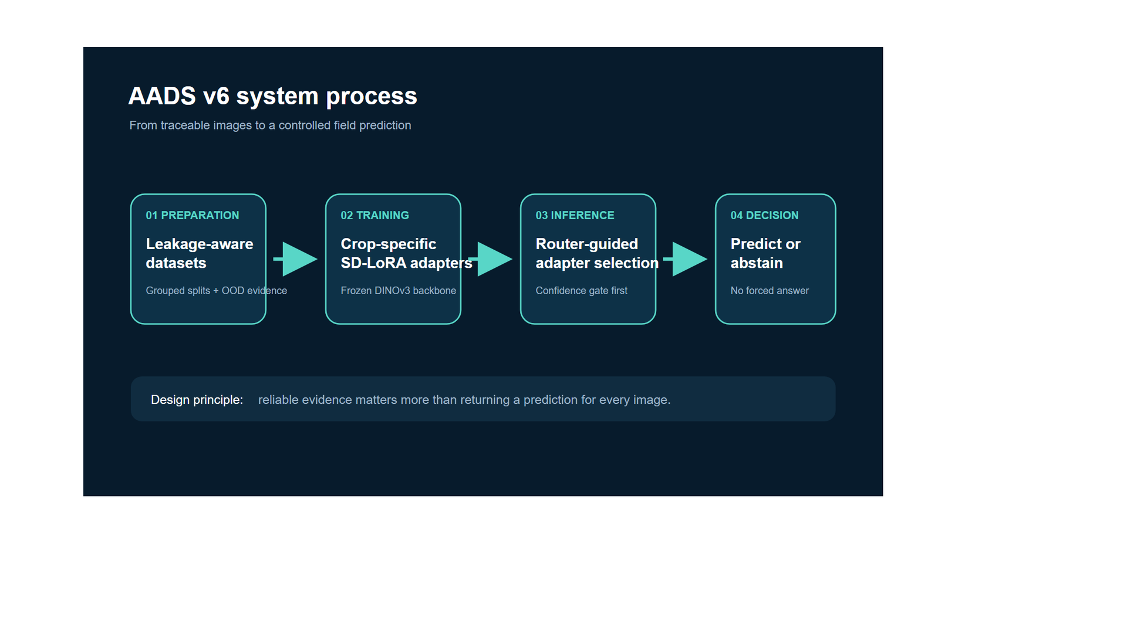
System Process

