Slide 1
Effect of Daily Activities on Sleep Duration
Efe Sarıbay 32044

Slide 2

My Data Set

Slide 3
My Motivation
The motivation behind this project is to explore the interplay between physical activity and rest. By analyzing the relationship between daily step counts and sleep duration, the project uncover how physical activity levels impact sleep can contribute to optimizing personal well-being. Additionally, visualizing data over time provides valuable information about behavioral trends and their potential impact on overall health.

Slide 4
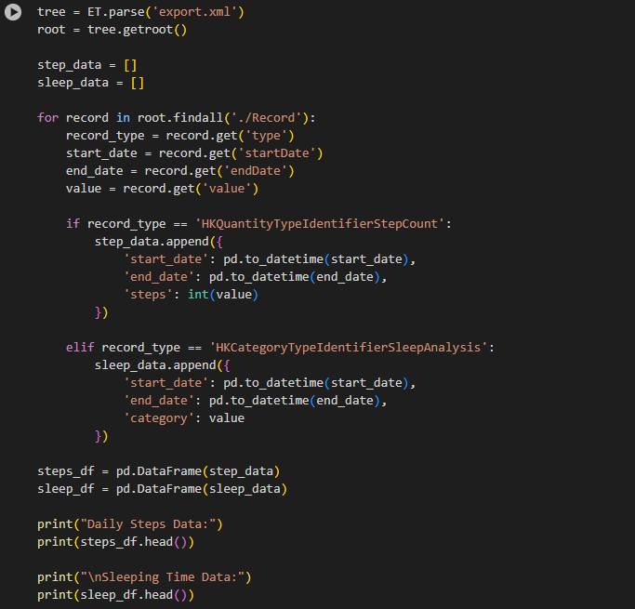
I have started exploring my health data.
To access my data I created a xml tree. Then I added data one by one to the empty lists I created

Slide 5
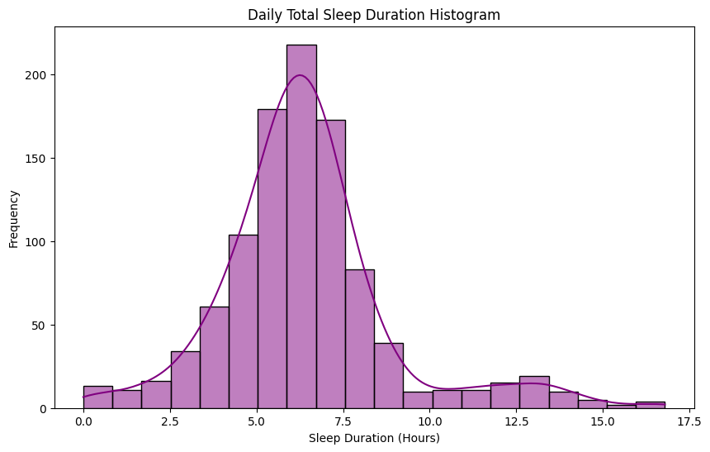
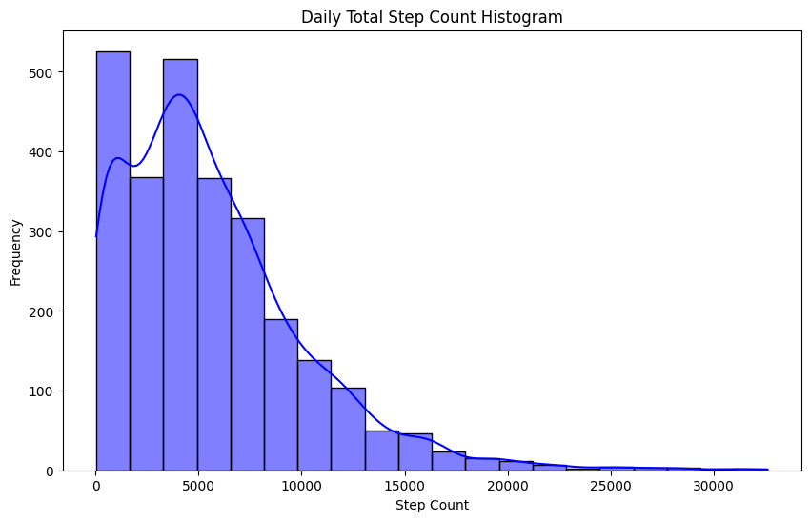
I collect daily step and sleep duration data separately and examined those data within themselves by making histograms.

Slide 6
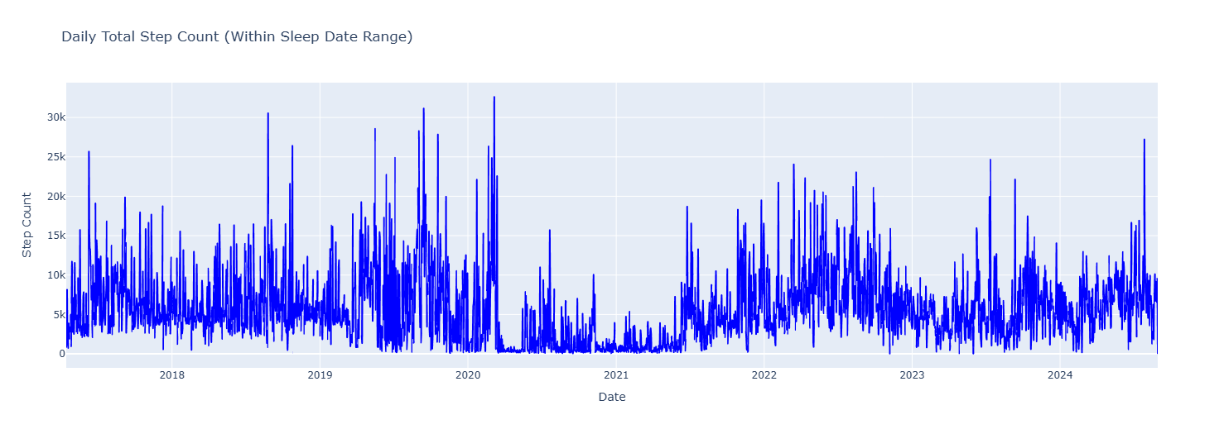
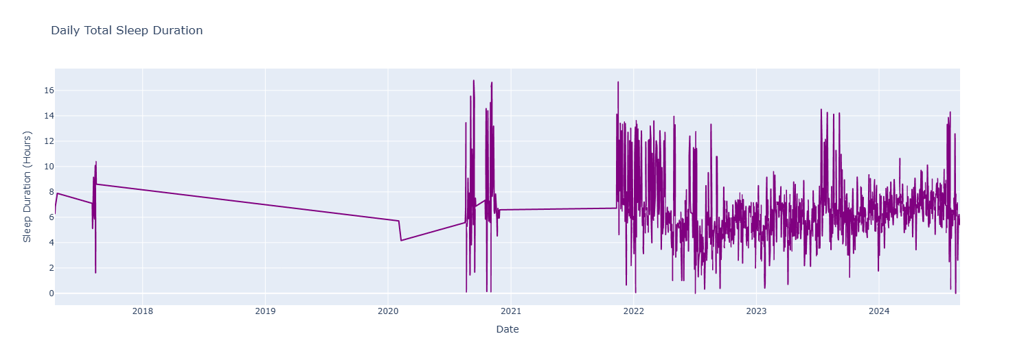
To see the relationship between the two data, I created a line graph for both data. Then, when one data started to rise or fall, I looked at what happened to the other data.

Slide 7
In some cases, there is an increase in the daily step chart and an increase in sleep time, but I cannot comment on the general situation because the same effect is not observed in other data with every increase or decrease.

Slide 8
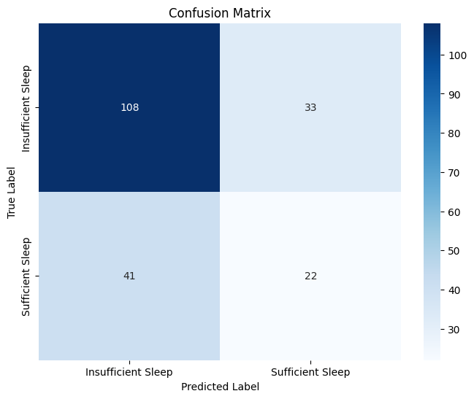
I determined an average sufficient sleep time based on the steps I took. Then I compared my own sleep times to this sufficient time and created a confusion matrix.

Slide 9
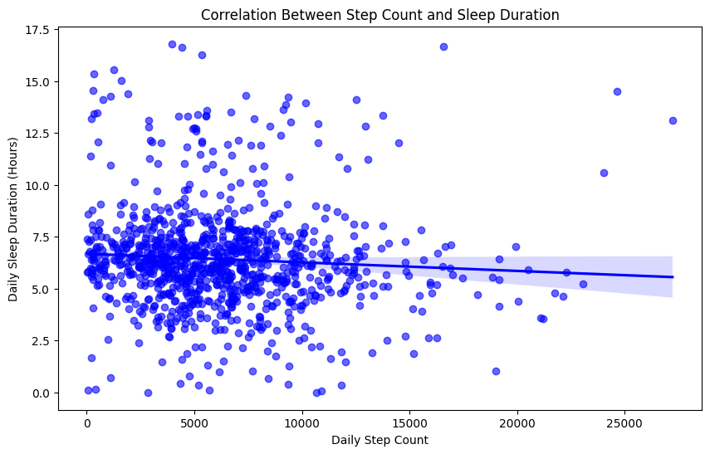
To understand more clearly whether there is a correlation between the data, I used Pearson's method. Thus, I found a coefficient and a p-value.
Since the resulting p-value was less than 0.05, I understood that I could reject my null hypothesis.

Slide 10

In conclusion I have rejected my null hypothesis according to my p-value. However, since my Pearson Coefficient is -0.07 my data also has a weak relation. So, although there is a mathematical relationship between the two data, there is a weak correlation.
I could say that there is weak relation between my daily steps and my sleep duration during a day.

Slide 11
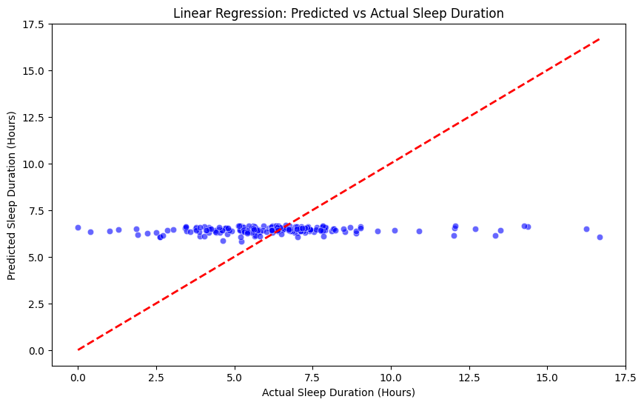
I also tried to create a Machine Learning model. To do that I tried to create a linear regression graph but since the correlation in my data is weak the model became an underfitted model.

Slide 12
Thank You for Your Time

