Slide 1



COE203 - P1
Presented By
İSMET EFE BALIK

Slide 2

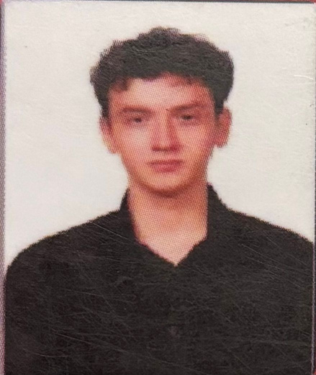
TEAM MEMBERS
TEAM LEAD
BACKEND ENG
FRONT ENG.
PM
DEVOPS

Slide 3
libraries
built-in
external
  sys
  os
  pathlib
  shutil
  tkinter
pytest

Slide 4
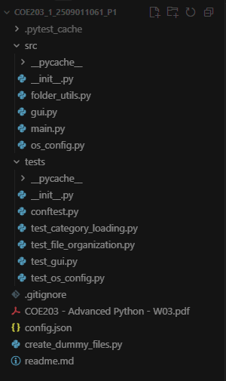
structure

Slide 5
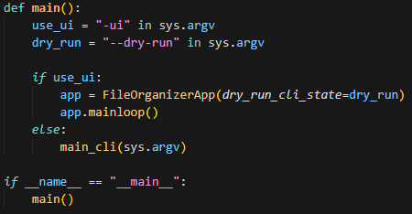
entry point

Slide 6
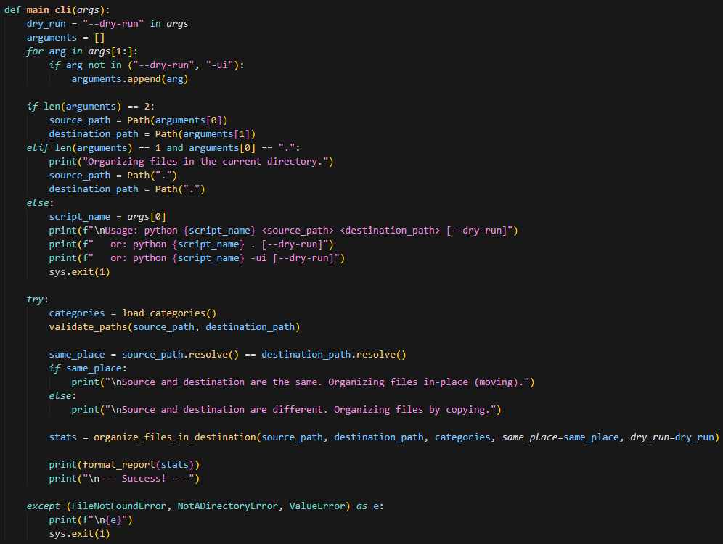
cli part

Slide 7
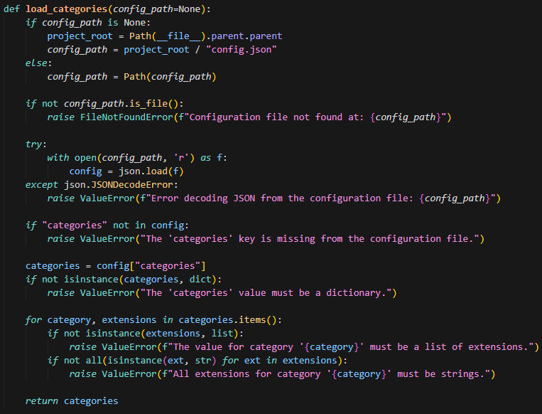
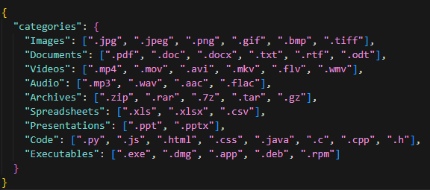
category

Slide 8
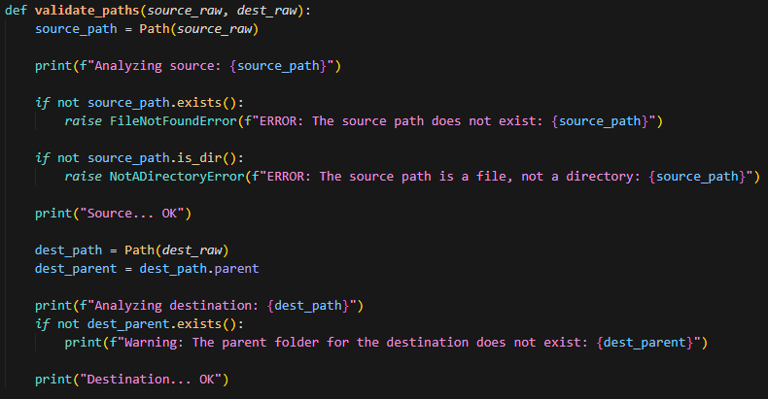
path validation

Slide 9
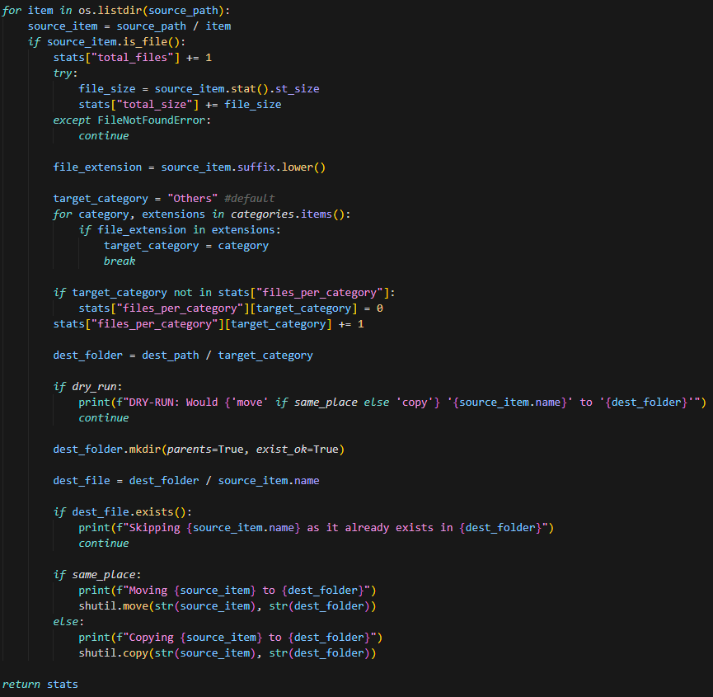
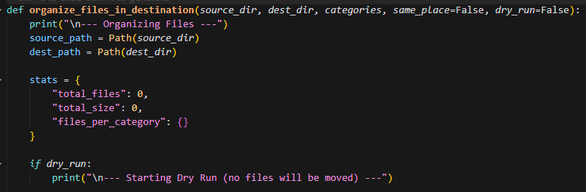
organizing

Slide 10
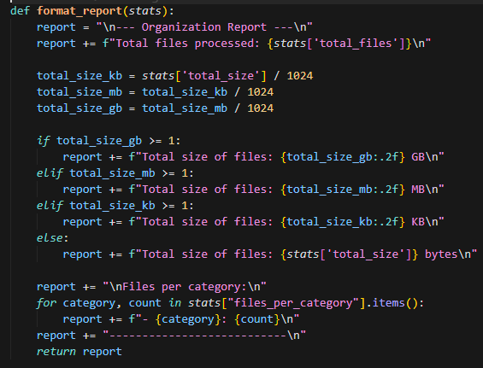
format report

Slide 11
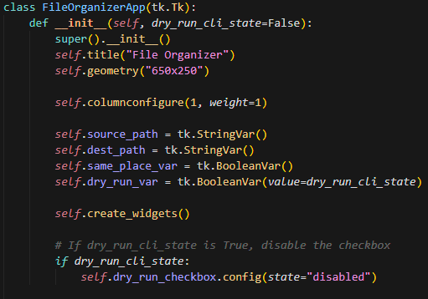
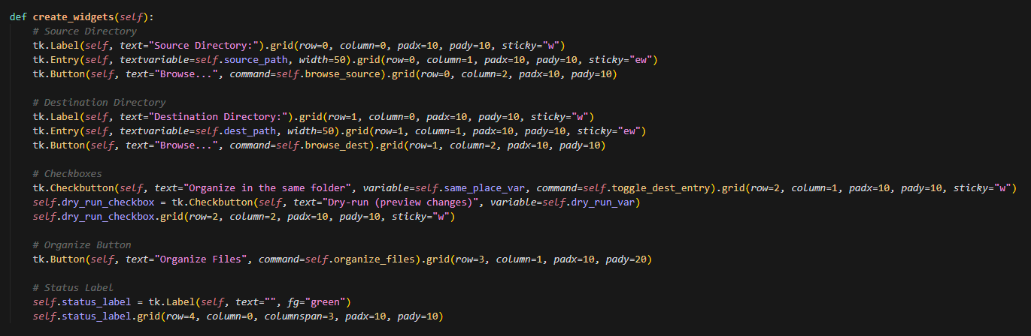
ui part

Slide 12
thanks

