Slide 1



Premier League Football Review App
Fully CRUD functional application

Slide 2
Requirements for Minimum Viable Product
Relational database with at least two tables
Full CRUD functionality
Clear Documentation
Project Board
Version Control
Testing
Automated CI Server

Slide 3
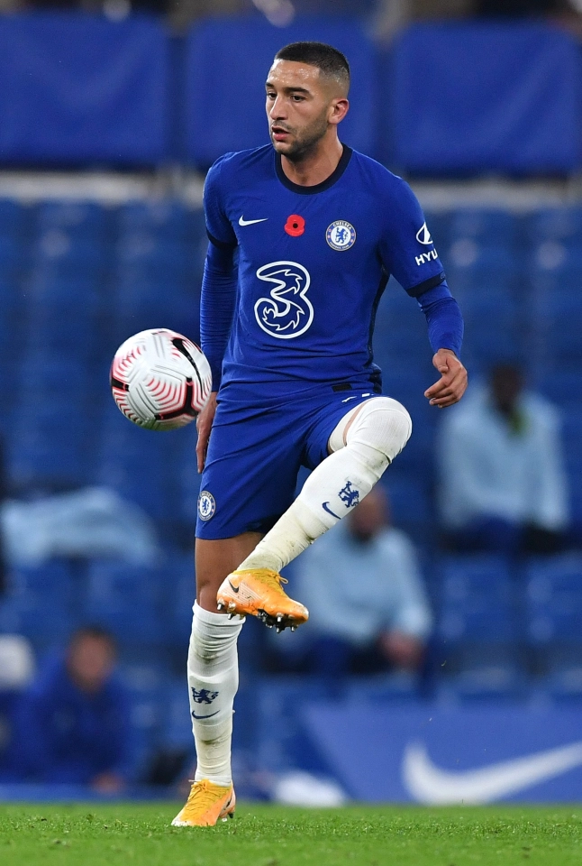
Premier League Review App
User Stories:
As a user I want to be able to choose a Premier League Footballer
As a user I want to be able to write a review
As a user I want to be able to update or delete my review

Slide 4
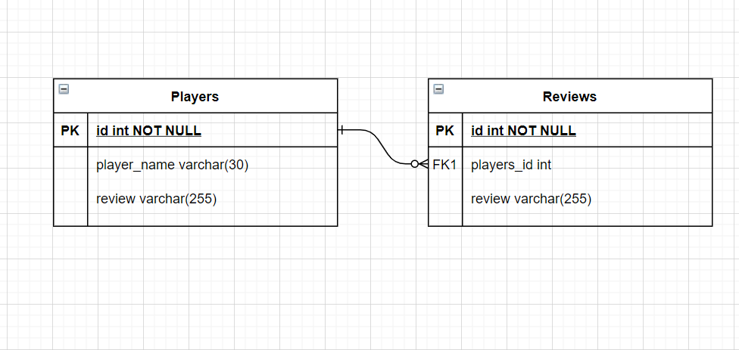
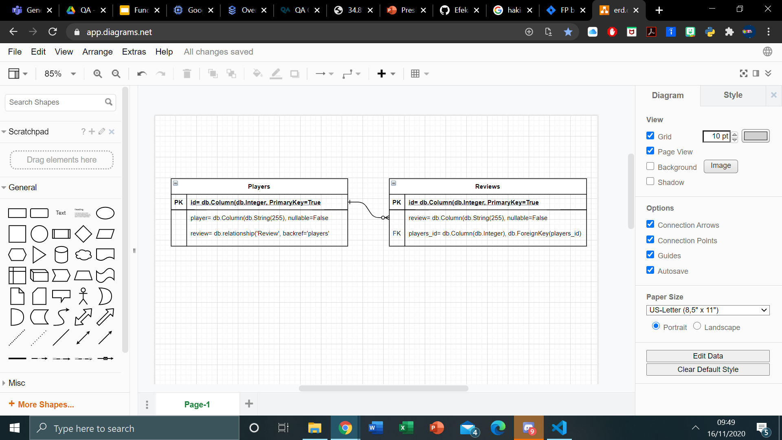
Database Tables
In order for a user to be able to write a review on a chosen footballer, I chose to implement a one to many relationship. This means that one footballer may have many reviews, but one review cannot have many footballers
I used Draw.io to construct an initial and final entity relationship diagram (ERD)
I improved upon my diagram as shown in the second image

Slide 5
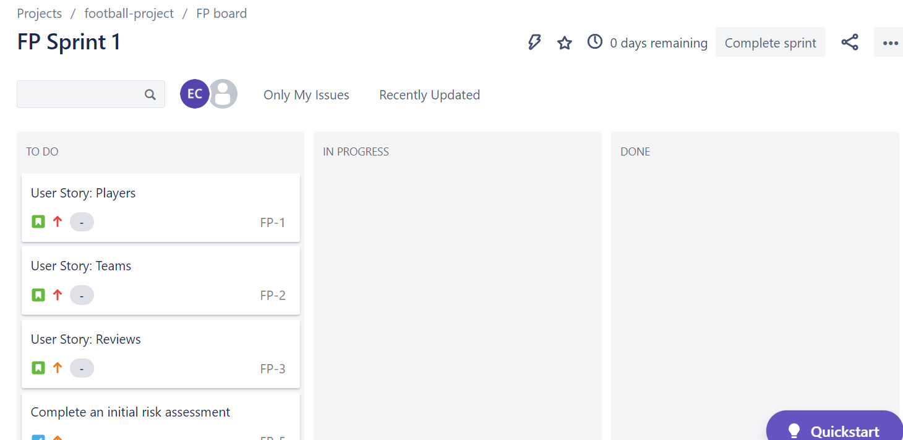
Project Board
The project board used to keep track of work was Jira

Slide 6
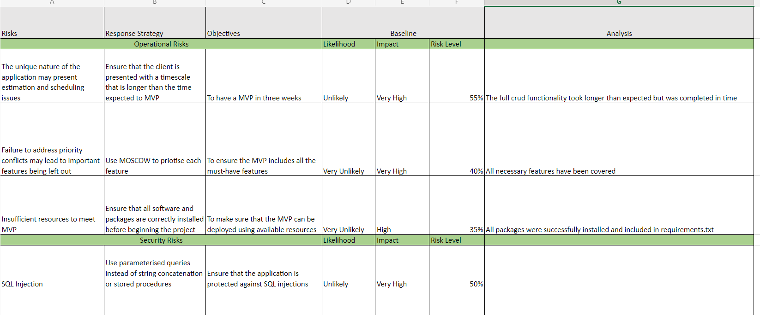
Risk Assessment

Slide 7

Version Control
Git and GitLab were used for version control
Any changes made were pushed to the repository to keep work up to date

Slide 8
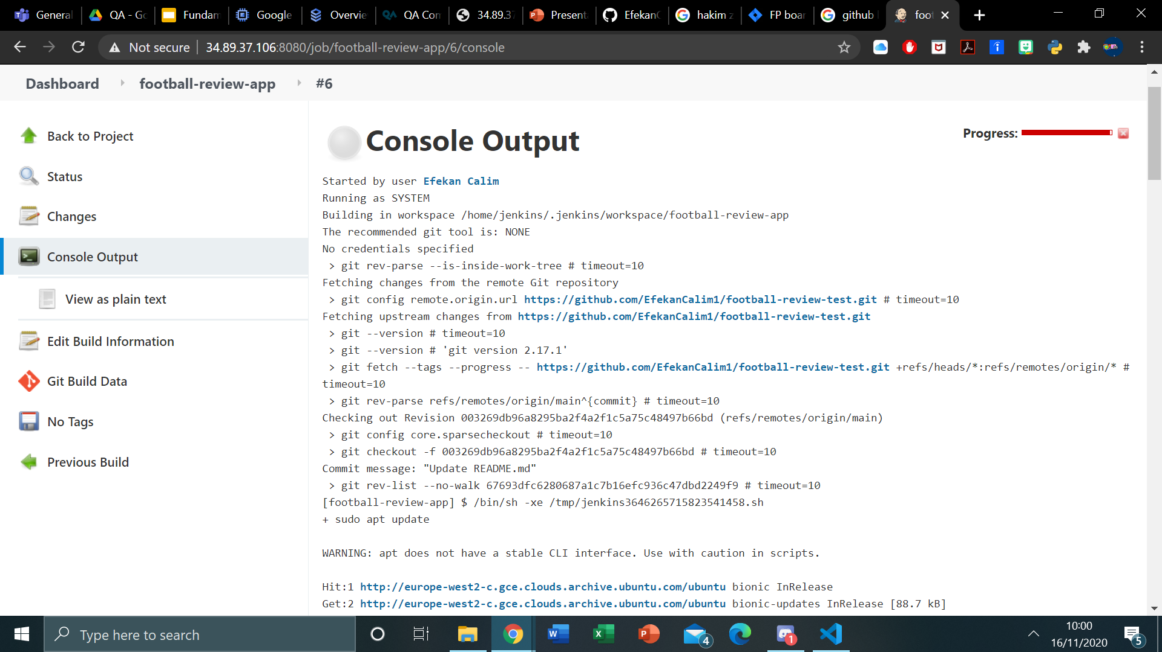
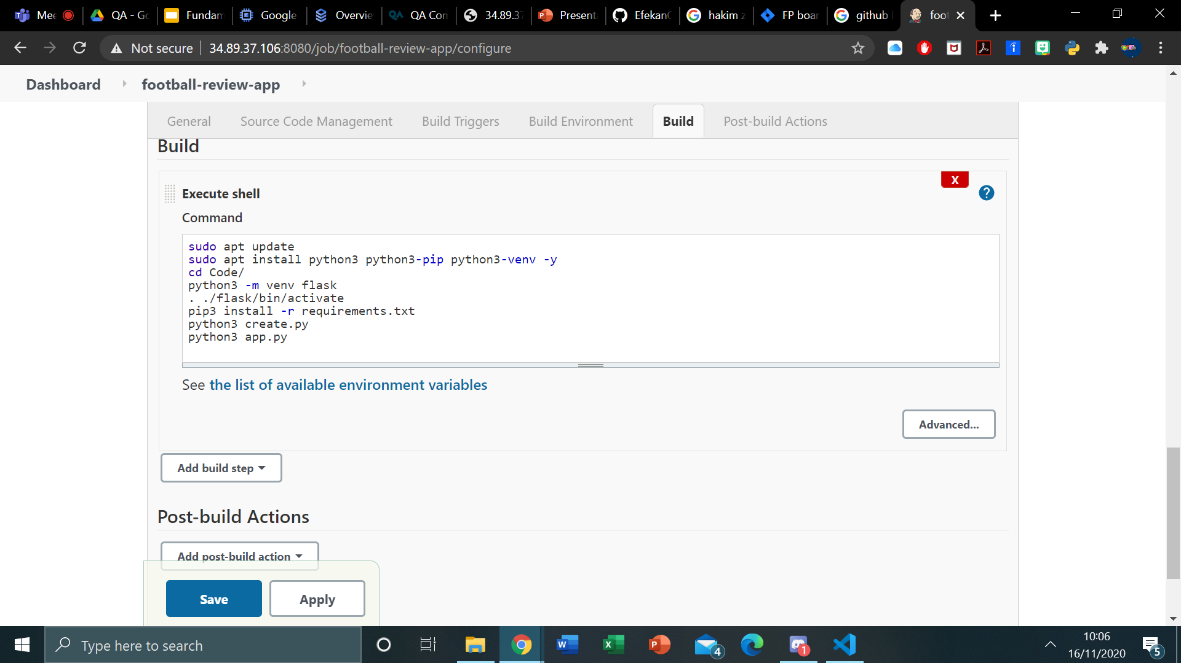
CI Server: Jenkins
Jenkins was the CI Server used to build and deploy the application
By running the script in the image below, Jenkins builds the app and deploys it

Slide 9
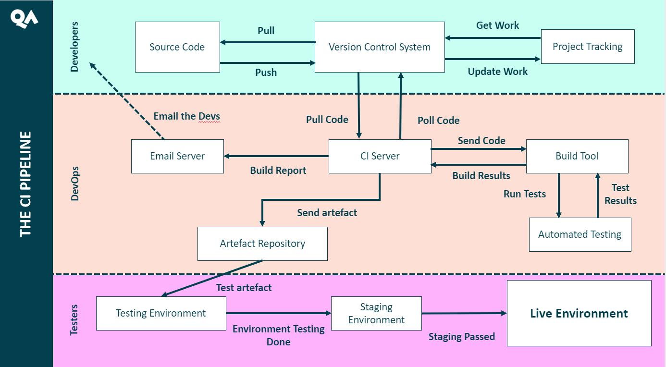
CI Pipeline

Slide 10
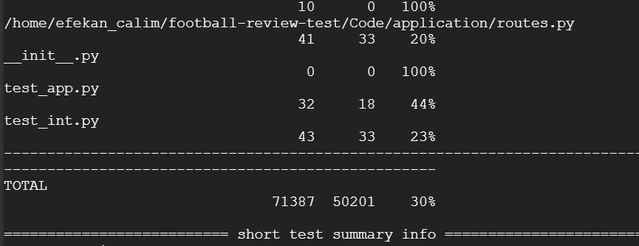
Testing
Pytest package was used to perform tests
Test coverage achieved was 30%

Slide 11
Future Improvements
In future projects, I will ensure that I have a more solid understanding of how to implement testing to achieve a greater coverage
As I spent the bulk of the allocated time ensuring CRUD was fully functional, I did not have a chance to fully explore Gunicorn and Selenium
Having become comfortable with building a CRUD functional application, I am confident I will be able to implement better testing, Gunicorn and Selenium for my next project

