Slide 1

NOVAMART PROJECT
BY ASEKHAME EFEOMO BLESSING

Slide 2
Introduction to NovaMart
• Digital-first Nigerian subscription company
• Monthly bundles: wellness kits, snacks, tech, home essentials
• Challenge: Data-rich but insight-poor

Slide 3

Business Challenges
• Unclear bundle profitability
• No customer segmentation
• Payment inconsistencies
• Scattered feedback data
• Lack of standard KPIs

Slide 4
Project Objectives
• Identify top-performing bundles
• Segment customers by loyalty & spend
• Analyze revenue/payment trends
• Link feedback to business outcomes
• Build interactive dashboards (Power BI)

Slide 5
Data & Methodology
• PostgreSQL (database restoration & SQL queries)
• Power BI (KPIs, dashboards, slicers)
• Tables analyzed: Customers, Subscriptions, Bundles, Payments, Support Tickets
• Excluded failed/pending payments & incomplete June data

Slide 6
Key KPI Definitions
• Revenue (successful payments only)
• Subscription Volume (count of bundles per category/size)
• Average Spend per Loyalty Tier
• Payment Success Rate (%)
• Ticket Rating & Resolution Analysis

Slide 7
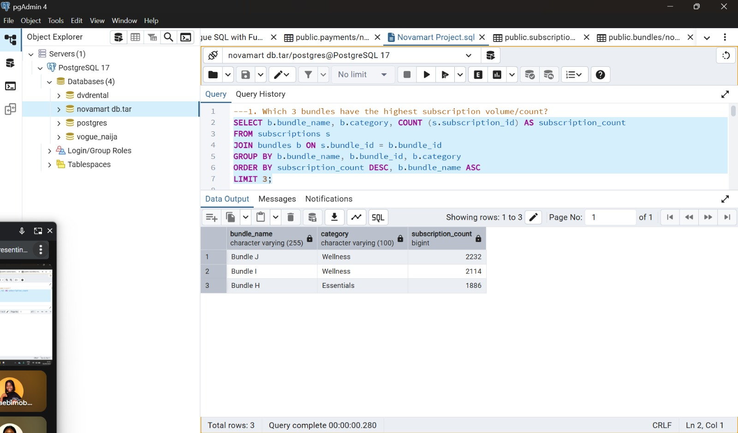
SQL Insights (Sample Findings)

Slide 8
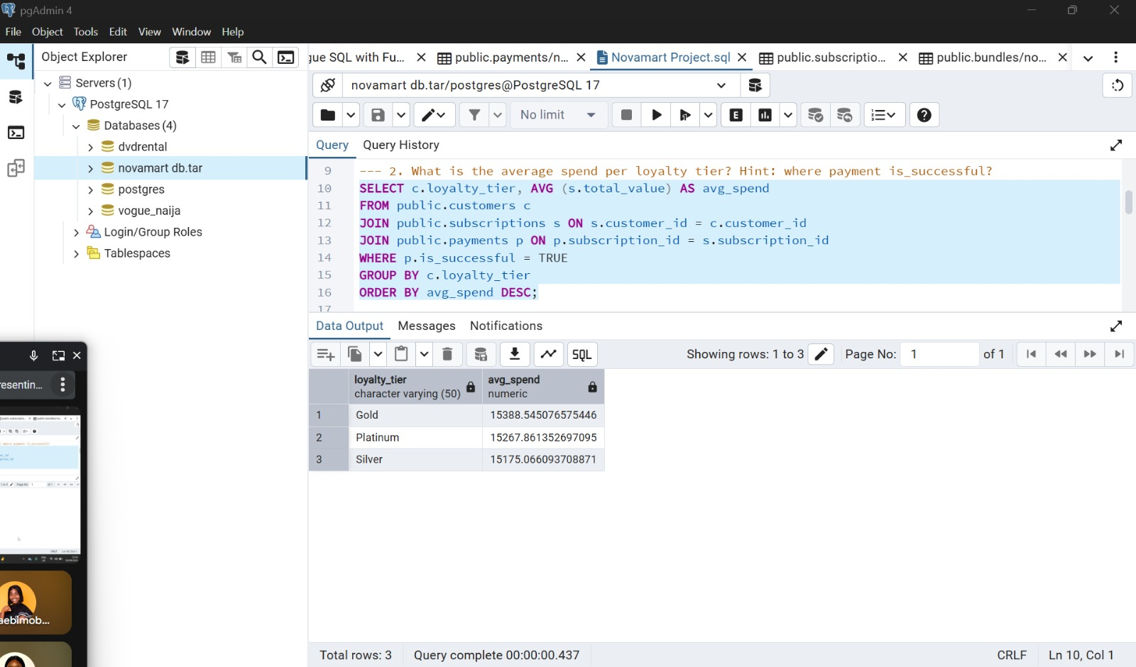
SQL Insights (Sample Findings)

Slide 9

SQL Insights (Sample Findings)

Slide 10
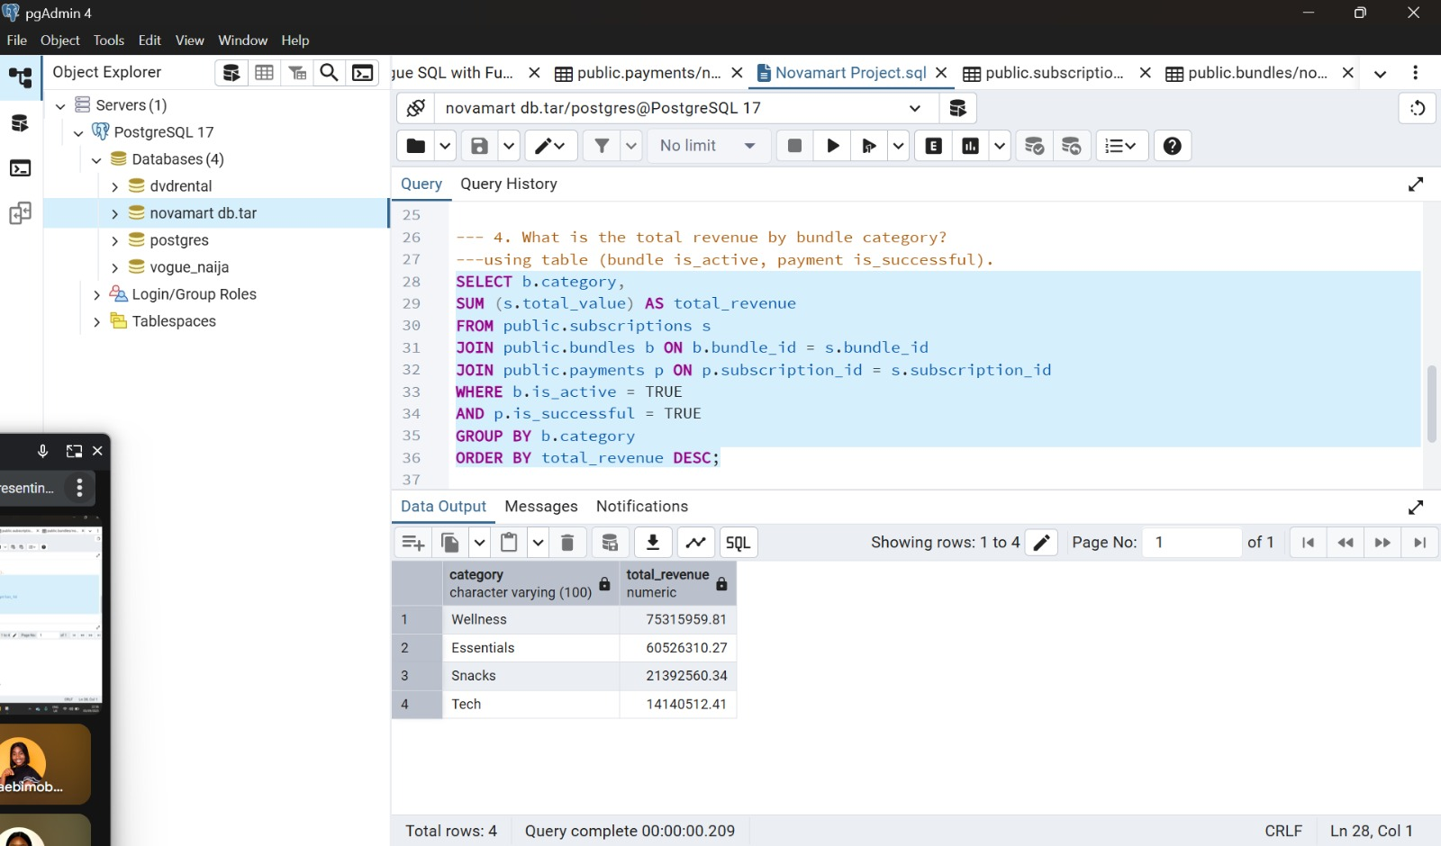
SQL Insights (Sample Findings)

Slide 11
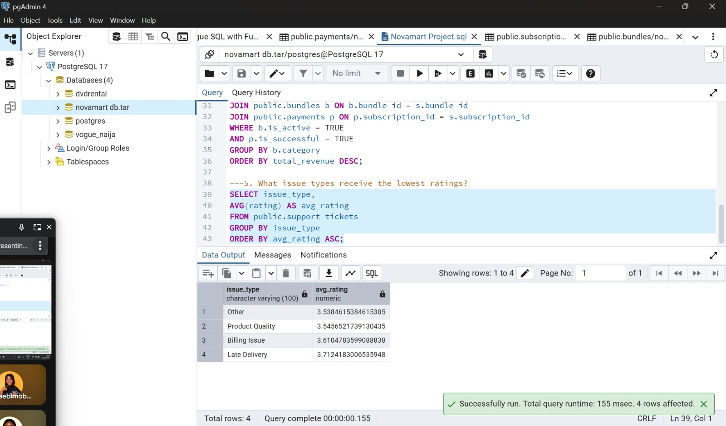
SQL Insights (Sample Findings)

Slide 12

Dashboard Highlights (Power BI)
• Monthly subscription & payment trends
• Revenue by category & bundle size
• City-level performance (Top 5 cities by volume)
• Loyalty-tier spend distribution
• Ticket ratings vs resolution status

Slide 13
Insights
• Bundles: Certain categories consistently outperform (e.g., Tech & Snacks)
• Loyalty Tiers(Gold, Platinum & Silver): Premium customers spend 2–3x more
• Payments: Failed transactions (bank transfers) impact revenue
• Feedback: Delivery-related issues drive lowest ratings
• Geography: Lagos & Abuja dominate; untapped Tier-2 cities

Slide 14
Recommendations
Bundle Optimization: Scale winning bundles, repackage/discontinue weak ones
Customer Retention: Tier-based rewards & personalized offers
Payment Reliability: Improve failure handling, promote card/wallet use
Customer Experience: Strengthen logistics, prioritize delivery
Expansion: Target Tier-2 (Platinum) cities with localized marketing

Slide 15
THANK YOU

