Slide 1
Design Patterns
Chapter 4

Slide 2
Decorator, Revisited
Remember this example?
class TextBase { public: virtual void output() = 0; }
class Quote2Text : public TextBase {
public:
Quote2Text() : tptr(0) {}
void setTextObject(TextBase* t) { tptr(t); }
void output() {
if (tptr)
{ cout << “\””; tptr->output(); cout << “\””; } }
private:
TextBase* tptr;
}
What was the problem?

Slide 3
Decorator Initialization
Complete initialization of the Quote2Text decorator took two steps
If you forgot the second step, you have at best a meaningless object
  (If you didn’t check in the output method, you might even crash the program)

Slide 4
Principle: RAII
Resource Acquisition Is Initialization
Whenever a resource is acquired, make sure it is initialized at the same time
For object acquisition (creation):
  Constructors work well to ensure RAII
  But there are limitations:

Slide 5
Object Creation Questions
How to ensure that the correct subclass gets created?
What if other things have to happen in conjunction with creation of an object?
What if you have to create two or more related objects?
And one more question: see next slide

Slide 6
Controlling Object Creation
Ultimately, the exact object of a type must be known in order to create it (duh)
  Foo f;
  Bar b = new Bar(“baz”);
But this violates an important principle:
  Program to an interface, not an implementation
    Or, program to abstractions, not concrete types
Concrete object creation is best localized in one place
  So introducing new types doesn’t cause maintenance trauma

Slide 7
A C++-specific Creation Issue
C++ allows objects everywhere
  Not just on the heap (new is not required)
Suppose we have a context that wants to force objects to be on the heap only
  Example: 3370 Program 2 (Memory Pool)
  How can we prevent non-heap object creation?

Slide 8
Static (single class) Factory
Provide a static method that returns a pointer to a heap object
Make all constructors non-public
(Visit Pool example)

Slide 9
Another Scenario
Suppose you need to serialize objects
  And you don’t have such facilities on your platform
To de-serialize objects requires creating the correct type on-the-fly
  Based on some data in the file entry for the object
(Visit 1410 Serialization example)

Slide 10
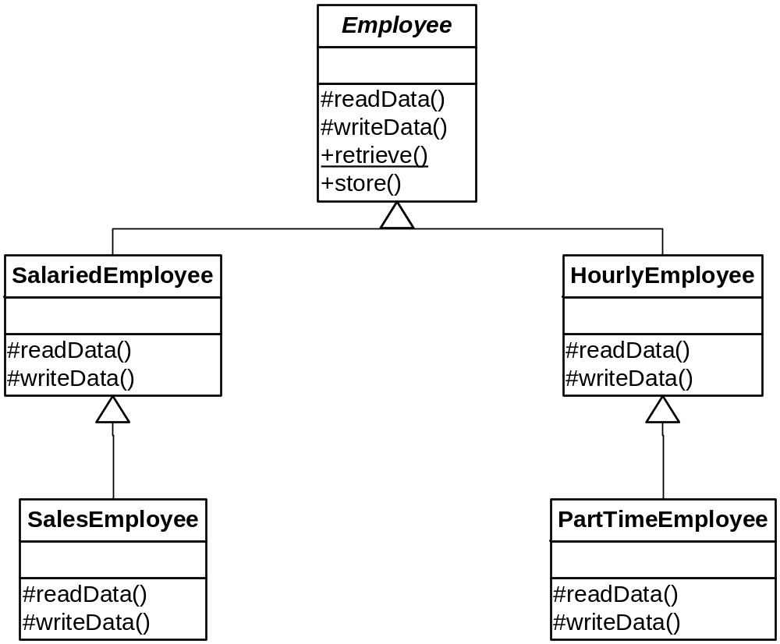
Employee Hierarchy

Slide 11
Dependency Inversion Principle www.objectmentor.com/resources/articles/dip.pdf
High-level modules should not depend on low-level modules
  Both should depend on abstractions
Abstractions should not depend on details
  Details should depend on abstractions
Why?
  So clients of abstractions are insulated from changes

Slide 12
Rules of Thumb for the DIP
No variable in an abstraction should hold a pointer to a concrete class
No class should derive from a concrete class
No method should override an implemented method of any of its base classes
  Only override abstract methods
These rules can’t be followed all the time!
  Emphasis on thumb :-)
  The key is how volatile the lower-level module is

Slide 13
Parametric Factories
The type of object created depends on dynamic information
  Either read from an input source or provided as a parameter to a factory method
The 1410 example has a major faux pas:
  Employee::retrieve( ) knows about subclasses
  Violates the DIP
    Can’t always be avoided
    But can be moved to a better place

Slide 14
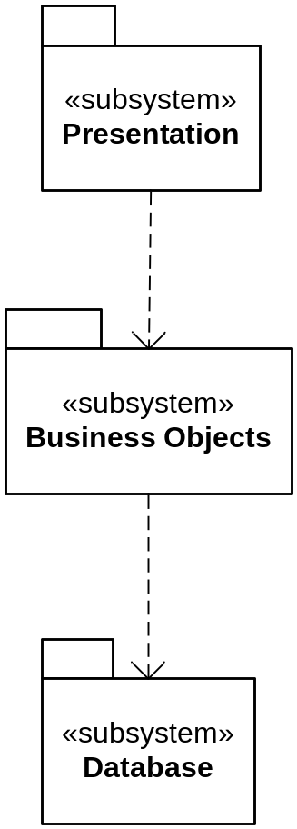
N-tier Architecture

Slide 15
N-tier Architecture
Critique
Appears to violate the DIP
This is solved by having high-level modules write to an abstraction of its lower-level service module
  So implementation can vary and not disturb the high-level client
(See next slide)

Slide 16
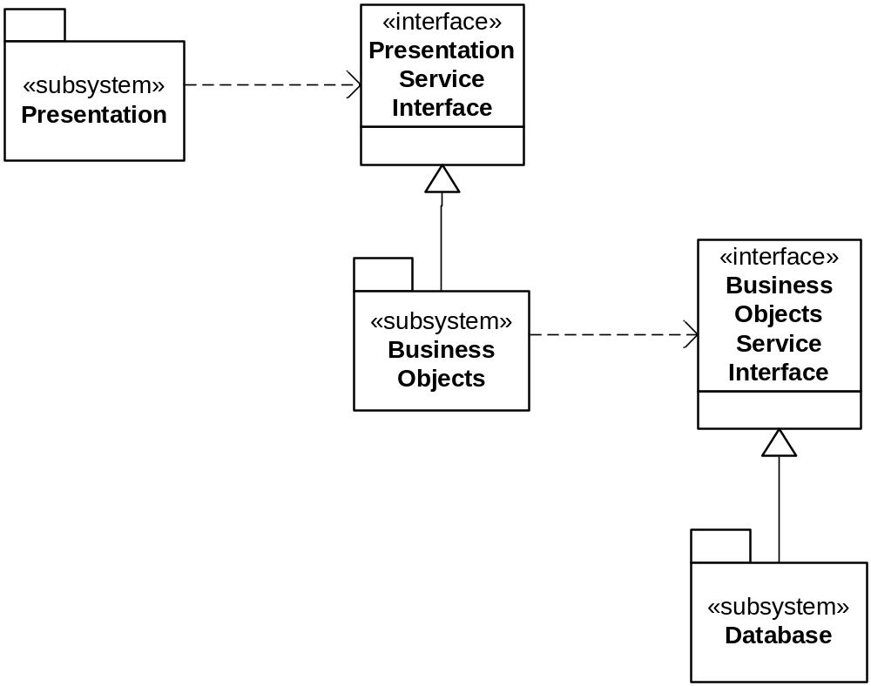
Following the DIP

Slide 17
Factories
Allow a (client) higher-level module to defer the details of object creation to its (server) lower-level service module
  Including determining the type of the object that needs to be created
“Polymorphic Factory”

Slide 18
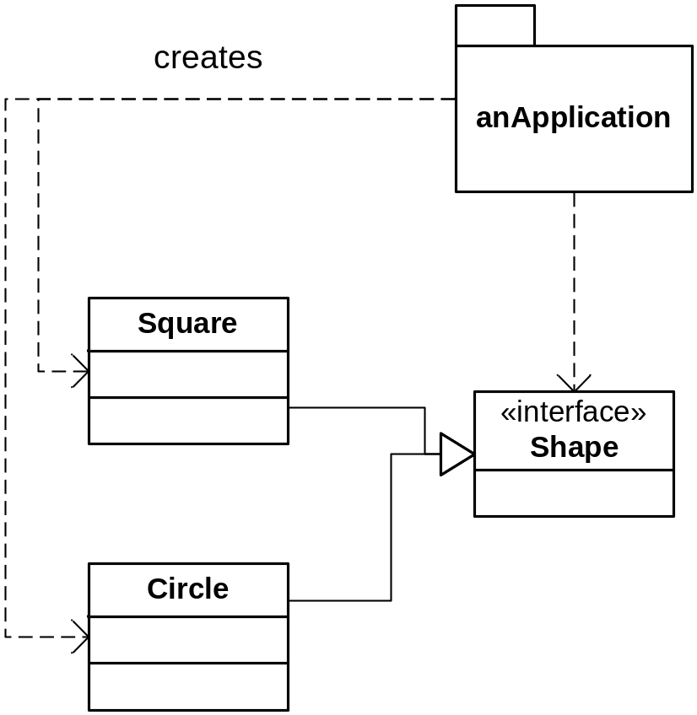
Another DIP Violation

Slide 19
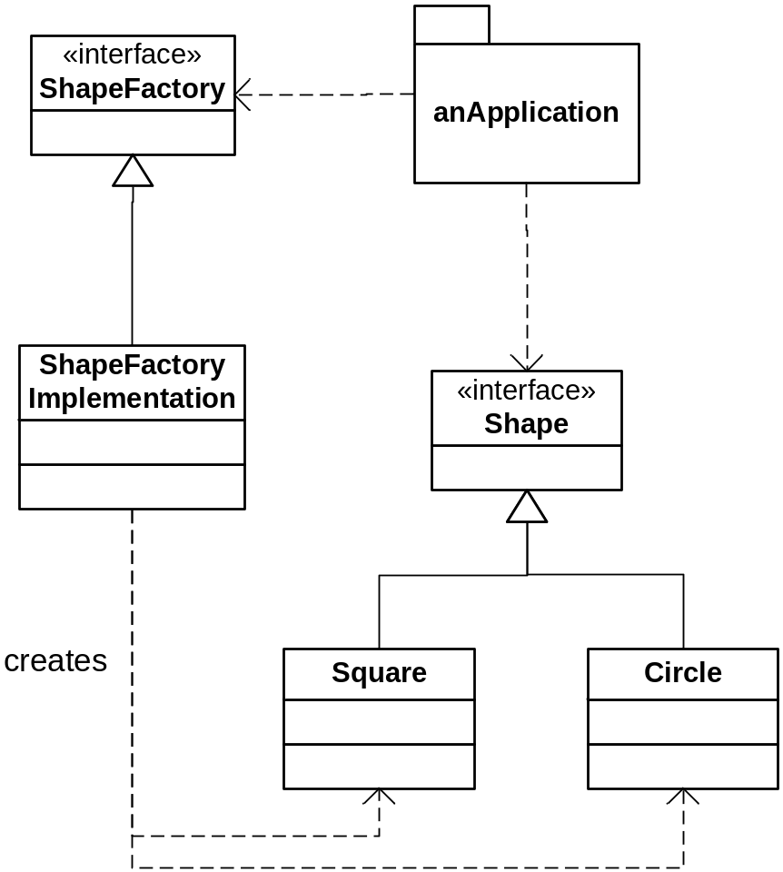
A Better Shape Scenario

Slide 20
Pizza in Objectville
public Pizza orderPizza() {
Pizza pizza = new Pizza(); // 1 type only!
pizza.prepare();
pizza.bake();
pizza.cut();
pizza.box();
return pizza;
}
What if we want to make multiple types of pizza?

Slide 21
More Pizza in Objectville
public Pizza orderPizza(String type) {
Pizza pizza;
if (type.equals(“cheese”))
pizza = new CheesePizza();
else if (type.equals(“greek”))
pizza = new GreekPizza();
(etc.)
pizza.prepare();
pizza.bake();
pizza.cut();
pizza.box();
return pizza;
}

Slide 22
Here We Go Again!
As new pizza types arrive, we must change this code
  If this is the only place it occurs, it’s not the end of the world
  Nonetheless, let’s try to…
… Separate those things that vary from those that don’t (again)
And now that we know about Open-Closed:
  Let’s try to make this code extensible while being closed to modification

Slide 23
A Pizza-Creating Class
public class SimplePizzaFactory {
public Pizza createPizza(String type) {
Pizza pizza = null;
if (type.equals("cheese")) {
pizza = new CheesePizza();
} else if (type.equals("pepperoni")) {
pizza = new PepperoniPizza();
} else if (type.equals("clam")) {
pizza = new ClamPizza();
} else if (type.equals("veggie")) {
pizza = new VeggiePizza();
}
return pizza;
}
}

Slide 24
Refactoring orderPizza( )
public class PizzaStore {
SimplePizzaFactory factory;
public PizzaStore(SimplePizzaFactory factory) {
this.factory = factory;
}
public Pizza orderPizza(String type) {
Pizza pizza = factory.createPizza(type);
pizza.prepare();
pizza.bake();
pizza.cut();
pizza.box();
return pizza;
}
}

Slide 25
Revisiting Employee:
The Simple Factory
We were uncomfortable with the switch-based factory inside the abstract Employee
Good call!
Move it out to its own class
  EmployeeFactory
  Thereby we separate object creation from object use (decoupling clients from future factory changes)
  See next slide

Slide 26
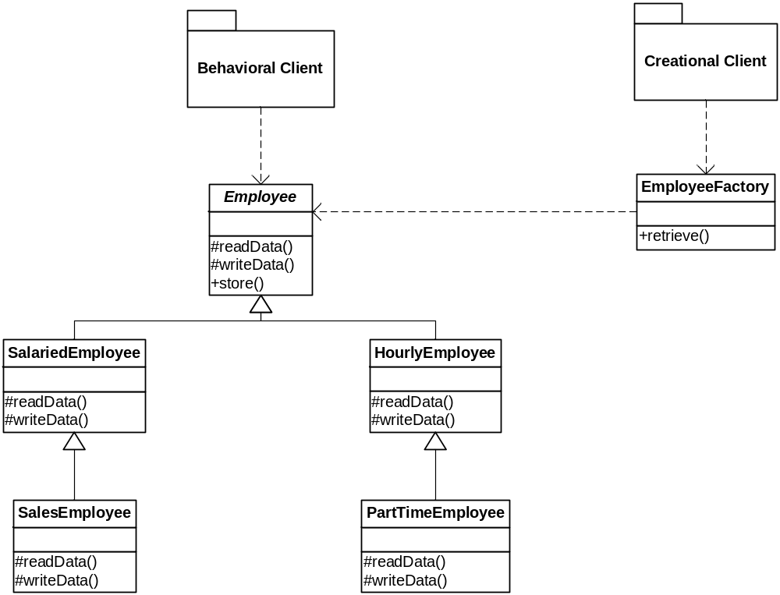
A Better Employee Hierarchy
See code now…

Slide 27
A Variation on SimplePizzaFactory
We could just use a static method to return the correct type of Pizza:
  SimplePizzaFactory.createPizza(String)
In any case, it should be available to other potential clients
  PizzaShopMenu, for example
  So it should be in its own class
    So changes are isolated from clients
See page 117

Slide 28
Limitations of a Static Factory
You can’t override a static method
Therefore you can’t have polymorphic creation
  But you can have parametric creation
  (We’ll do both soon)
Take your Pick

Slide 29
And Now… Life Happens
There are different “styles” of pizza
  A New York style Cheese differs from a Chicago style
  Your business savvy says you should support both

Slide 30
One “solution”
if (style == “New York”) {
if (type == “cheese”)
return new NewYorkCheesePizza();
else if (…)
…
}
else if (style == “Chicago”) {
if (type == “cheese”)
return new ChicagoCheesePizza();
else if (…)
…

Slide 31
Don’t Repeat Yourself!
We’re cutting and pasting code again
  Stop it!
Create different types of factories instead
  One for each style
  But they of course implement a common interface
Where should the factories reside?
  That is, how shall they be called polymorphically?

Slide 32
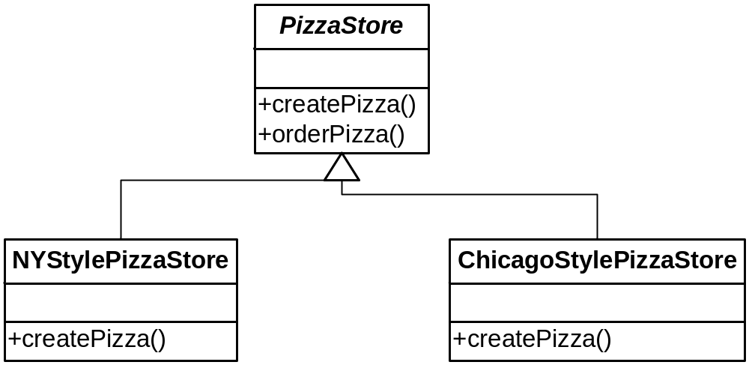
A Polymorphic Factory
The correct createPizza( ) is called by polymorphism.

Slide 33
Using the Factory Method
public abstract class PizzaStore {
protected abstract Pizza createPizza(String type);
public Pizza orderPizza(String type) {
Pizza pizza = createPizza(type);
pizza.prepare();
pizza.bake();
pizza.cut();
pizza.box();
return pizza;
}
}

Slide 34
But Not Much Change Here
public class NYPizzaStore extends PizzaStore {
Pizza createPizza(String item) {
if (item.equals("cheese")) {
return new NYStyleCheesePizza();
} else if (item.equals("veggie")) {
return new NYStyleVeggiePizza();
} else if (item.equals("clam")) {
return new NYStyleClamPizza();
} else if (item.equals("pepperoni")) {
return new NYStylePepperoniPizza();
} else return null;
}
}
That’s the breaks with polymorphic factories. It allows us to vary the concrete Pizza type in one place, however.

Slide 35
Factory Method
Creational
Intent:
  Lets a class defer object instantiation to subclasses.
Context:
  A module uses an abstraction, so you want to follow the DIP and not depend on concrete details. The client module may not even know which class to instantiate.
Solution:
  Define an interface for creating a family of objects, but let subclasses decide which class to instantiate.

Slide 36
Factory Method
Good Definition: p. 134
Problem Statement: (you fill it in)
  (see POSA* vol. 4, p. 529)
  * POSA: Pattern-Oriented Software Architecture

Slide 37
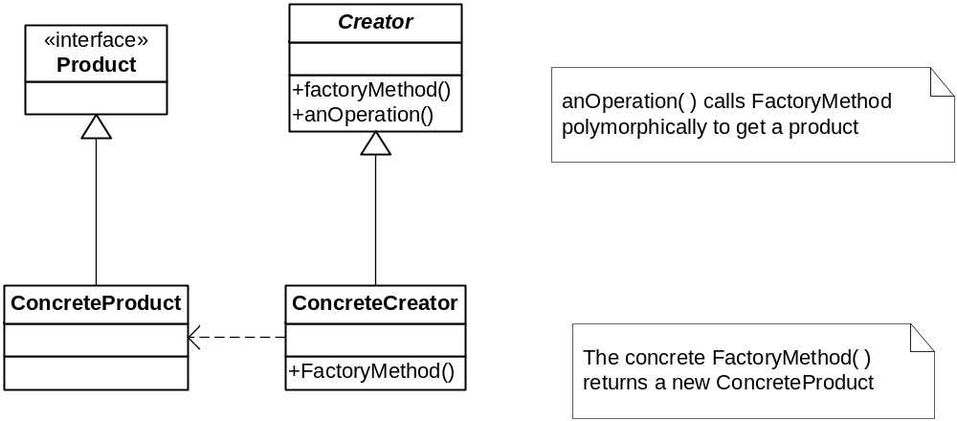
Factory Method
Class Sketch

Slide 38
Parallel Hierarchies
A hierarchy for the products
A hierarchy for the creators
  With a polymorphic factory method
See page 132

Slide 39
More Changes Afoot
Franchisees have been using inferior ingredients
  Infidels!
So you want more control over how pizzas get made
  While still allowing for stylistic differences
So we’re drilling down a little deeper to how pizzas are actually made

Slide 40
Controlling Ingredients
Pizza ingredients come in families:
  Sauce, cheese, dough, toppings
  They all have these components
    But with differences (e.g., parmesan vs. mozarella)
You want to ship ingredients together
So we need a factory to build families of ingredients
  Note: my diagrams differ from the book’s
  They’re better!

Slide 41
PizzaIngredientFactory
Will have a factory method for each ingredient type
  createDough, createSauce, etc.
These will be specialized in concrete subclasses by region
  NYPizzaIngredientFactory, etc.
So we’re talking families of factory methods

Slide 42
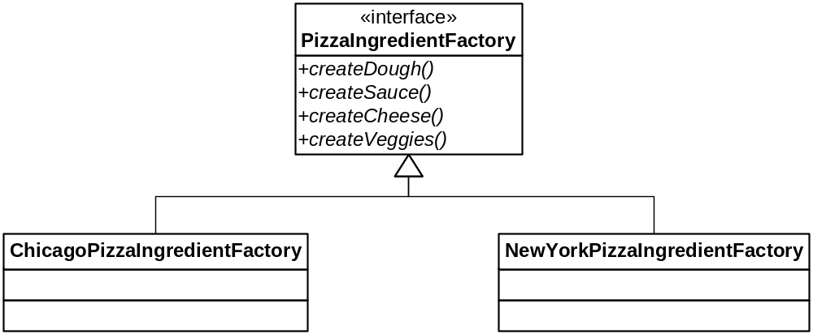
The Ingredient Factories

Slide 43
Refactoring Pizza
Pizza needs to collect the right kind of ingredients
We’ll just put this into the prepare method
  But we’ll make it abstract so subclasses can override it
    (This actually isn’t totally necessary, as you’ll see. It could just be implemented in Pizza)
  What is necessary is that the correct ingredients are obtained

Slide 44
Getting the Right Ingredients
Somewhere (in prepare for now) we say:
  sauce = ingredientFactory.createSauce( );
  cheese = ingredientFactory.createCheese( );
  etc.
These are fields in Pizza
  Before we just had a list called toppings
  Now we’re taking over what those toppings are

Slide 45
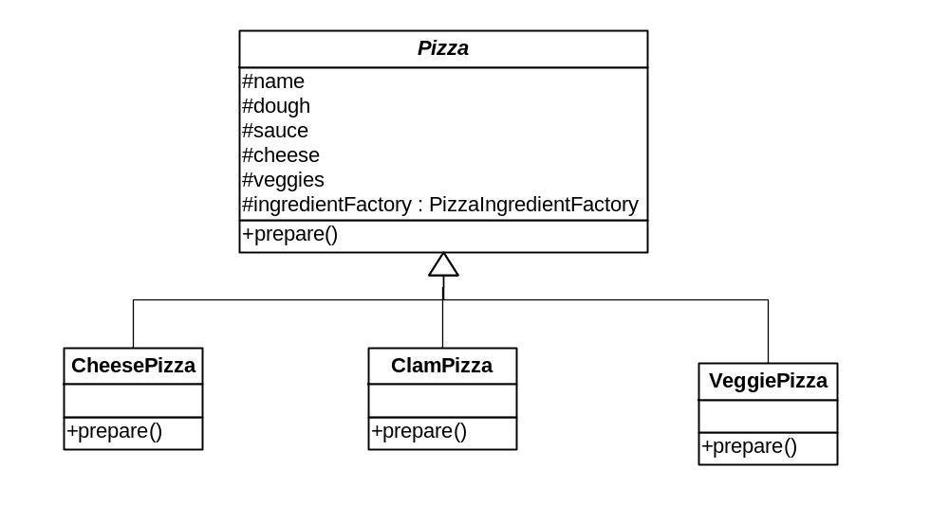
The Pizza Hierarchy
No more NYCheesePizza, ChicagoCheesePizza…

Slide 46
What about PizzaStore?
This is what establishes the ingredientFactory
  And passes it to the pizza it creates with its (independent) Factory Method

Slide 47
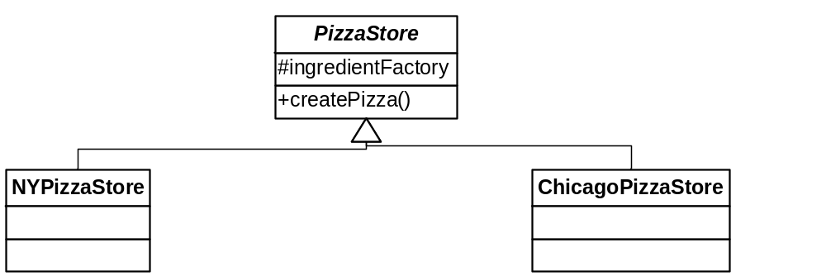
The PizzaStore Hierarchy

Slide 48
NYPizzaStore
Setting up A parametric factory method
public class NYPizzaStore : extends PizzaStore {
PizzaIngredientFactory ingredientFactory;
public NYPizzaStore() {
ingredientFactory = new NYPizzaIngredientFactory();
}
…

Slide 49
NYPizzaStore.createPizza( )
A parametric factory method
protected Pizza createPizza(String item) {
Pizza pizza = null;
if (item.equals("cheese")) {
pizza = new CheesePizza(ingredientFactory);
pizza.setName("New York Style Cheese Pizza");
} else if (item.equals("veggie")) {
pizza = new VeggiePizza(ingredientFactory);
pizza.setName("New York Style Veggie Pizza");
} else if (item.equals("clam")) {
pizza = new ClamPizza(ingredientFactory);
pizza.setName("New York Style Clam Pizza");
} else if (item.equals("pepperoni")) {
pizza = new PepperoniPizza(ingredientFactory);
pizza.setName("New York Style Pepperoni Pizza");
}
return pizza;
}

Slide 50
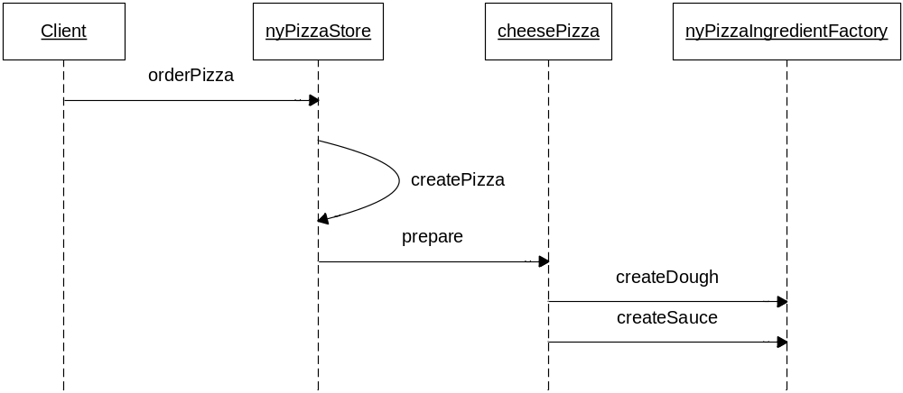
The Process
createPizza passes the correct ingredientFactory to CheesePizza

Slide 51
Abstract Factory
Creational
Intent:
  Provide an interface for creating families of related or dependent objects without specifying their concrete classes.
Context:
  Your system needs to be configured with one of multiple families of products, but it should be independent of how its products are created and assembled.
Solution:
  Declare an abstract type with methods for creating each type of component. Subclasses create the correct concrete types for the family they represent.

Slide 52

Abstract Factory
Class Sketch

Slide 53
Factory Method vs. Abstract Factory
Factory Method creates a single object
  It can decay into a single static method
  The abstract root often has a processing method that calls the factory method
    i.e., the factory method is in the key abstraction the client uses
Abstract Factory creates families of related objects
  It requires multiple polymorphic methods
  Therefore clients must use a factory object
See pages 156-157, 160-161

Slide 54
Disposal Methods
It is often necessary to destroy objects
  Especially if they own resources other than memory
In some cases:
  Just letting the garbage collector do its job isn’t sufficient (e.g., you have to explicitly release a resource)
  Calling, the object’s destructor isn’t enough, or leads to excess coupling (e.g., you have destroy calls in several places.)

Slide 55
Disposal Methods
Provide disposal methods that encapsulate details of object disposal
Mirror of Factory Method
  Can have a static destroy
  Can have a polymorphic destroy
  Can have an “automatic” destroy in C++
    RAII – uses destructors
    shared_ptr: a pointer proxy that deletes its data
  Members of abstract factories can have corresponding disposal methods

Slide 56
Complex Factory: Builder
Some objects are complex enough that they can’t be created in a single atomic step.
  Stepwise creation
  Often separated by time
  May be different each time
  Usually involves different sub-objects

Slide 57
Builder
Therefore, use a Builder object that manages the creation of the object:
  Provides methods for creating (and maybe disposing) the parts
  May return a the completed complex object

Slide 58
What Factories Accomplish
They separate the creation of objects from their use
This minimizes coupling between clients and abstractions

Slide 59
Summary of Factories
Simple Factory: a single function to create the proper type of object – usually parametric
  Simple hierarchy – the most common approach
Factory Method: a hierarchy of methods to create the proper type of object
  Used when there are two dimensions of variability that determine object type (e.g., pizza type and style)
Abstract Factory: a hierarchy to create families of objects
  May create sets of (related) factory methods
Builder: an object to manage non-atomic creation of a complex object or objects

Slide 60
Principle Summary
RAII: Resource Acquisition Is Initialization
DIP: Dependency Inversion Principle
  Concrete details depend on Abstractions, not the other way around

