Slide 1
Design Patterns
Chapter 6

Slide 2
Thoughtful Query
Have you ever known anyone who likes to tell others what to do, but has no clue how to do the job themselves?

Slide 3
Master and Commander
Don’t be too hard on him/her
  Nobody knows it all
  But things still need to get done
Separating command invocation from knowledge of command internals is yet another good example of decoupling

Slide 4
Invokers vs. Invokees
Functions know what to do
But they don’t know when to do it
  They must be called from a “larger” (more informed) context
  They resemble exceptions in this regard
    throw isn’t “informed”
Consider GUIs:
  The controller generates events
  But doesn’t know event handler internals
  There are many different types of handlers

Slide 5
Responding to an Event
Consider a button press
How does an action get performed in response?

Slide 6
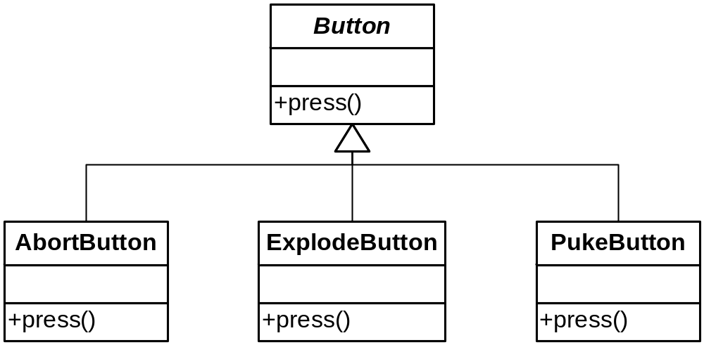
When Will You Ever Learn?

Slide 7
Callbacks
Instead, give the button a function to call
Each button gets its own response function
All callbacks must implement the same interface
  Whether implicit or explicit

Slide 8
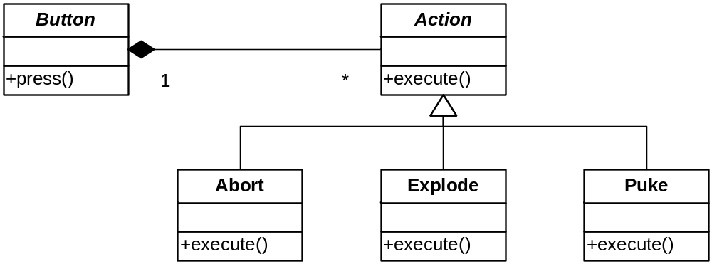
Encapsulating An Event Response

Slide 9
The Command Pattern
A Little Foreshadowing
The canonical example of the Command Pattern is a menu
Each menu item is associated with an independent action
It is also nice to be able to change those associations at runtime

Slide 10
C++ Example
We will see 5 versions of a menu implementation:
  1) C-style function pointers
  2) Callback functions attached to menu items
  3) Encapsulating Functions as Objects
  4) The Command Pattern
  5) Adding the Null Object Pattern

Slide 11
C++ Example
Version 1
Holds function pointers in an array
Associates an index with each menu item
  This holds throughout all versions
  This is what GUIs do behind the scenes
See menu1.cpp
  97 source lines

Slide 12
C++ Example
Version 2
Introduces two classes:
  MenuItem, Menu
MenuItem holds a callback
  Still just a function pointer
Menu has a vector of MenuItem*
See menu2.cpp
  124 source lines

Slide 13
Variation: initialize with a command
  See menu2a.cpp
Advantages
  Bind command name to command
  Dynamic menus
  See menu2b.cpp

Slide 14
Encapsulating Invocation
Use objects instead of functions as callbacks
  Can track state
Such “command” objects can be passed around where needed
  As long as they implement an expected interface

Slide 15
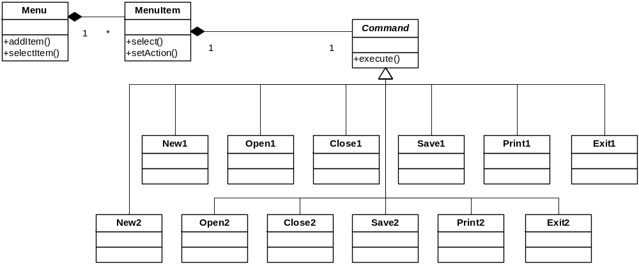
Encapsulating Invocation

Slide 16
C++ Example
Version 3
Implements previous slide
Two versions of each file command
Interchanges them at runtime
No change to Menu
Minimal change to MenuItem
See menu3.cpp
  185 source lines

Slide 17
Advantage: First class objects can do more than function pointers can
  Such as having state
  See menu3a.cpp

Slide 18
Boring Commands
Notice that our commands are static
  They are not parameterized in any way
  We could make them more flexible
Separate what we want to change
  We could have families of file commands
  Move this outside the command
  The new file command abstraction is a receiver of the invocation
    It carries out the action
    So the command is sort of an intermediary

Slide 19
The Command Pattern
Object Behavioral
Intent:
  Encapsulate a request as an object, thereby letting you parameterize clients with different requests, queue or log requests, and support undoable operations.
Context:
  You need to issue requests without knowing the details of each request. You want to decouple invokers from command details. You want to replace commands dynamically.
Solution:
  Define an interface for all commands. Concrete commands implement the interface to provide specific functionality. Commands can be parameterized by a server (receiver) that actually carries out the commands. (Command is an OO callback)

Slide 20
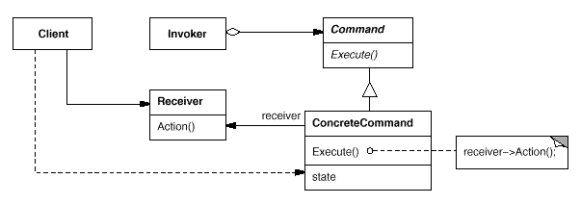
The Command Pattern
Class Sketch

Slide 21
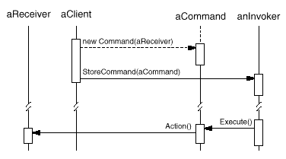
The Command Pattern
Object Sketch

Slide 22
C++ Example
Version 4
Encapsulate families of file commands into a hierarchy of command receivers
  File1 and File2
MenuItems now encapsulate the action and the receiver that performs the action
New1 + New2 => New (etc.)
See next slide and menu4.cpp
  200 lines
  Still no change to Menu or MenuItem

Slide 23
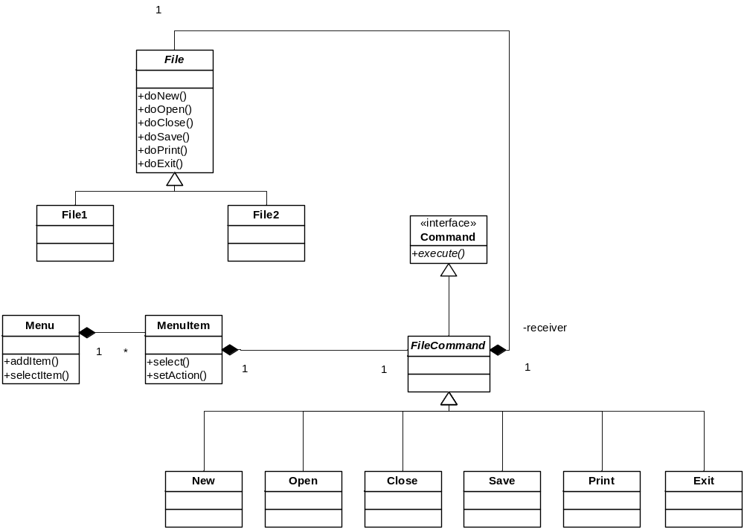
Commands and Receivers

Slide 24
Something For Nothing
What if we want nothing to happen
  A no-op
Right now we’re checking for null pointers
  We have if’s all over the place
Suppose our selection device was hardware
  Buttons or sensors
  It’s not typical to have conditional logic there
  And its even less likely that we’d want to rewire things

Slide 25
The Null Object Pattern
“Something for Nothing”
Applies when you always check before invocation
  And the default is to do nothing or some constant action (see page 214)
Just override execute with an empty body
  And replace if’s with asserts
  Or use references in C++ (loses flexibility)

Slide 26
C++ Example
Version 5
Uses NullFile and NullCommand
  Just to show that it can apply in both cases
And to make this required, we change pointers to references
  Can’t have a null reference
  But we lose runtime interchangeability of receivers and commands
  Hey, it’s just a demo!
See menu5.cpp
  196 source lines

Slide 27
Command Objects in “Real Life”
The Objectville Diner
Customer gives his order to the Waitress
  Forgive the non-PC terms :-)
The Waitress delivers the order to the Cook
  “Order up!”
The Cook responds
  Carries out the command
See page 197-202

Slide 28
Command Objects in “Real Life”
The Objectville Diner
Customer = Client
  Presses the “button”
Waitress = Controller
  The “invoker”
  Like a GUI event thread
Cook = Receiver
  Executes the command in response

Slide 29
Encapsulating an Order
The Order Slip has the instructions
  makeBurger( ), makeShake( ), whatever
The Waitress gives it to the Cook
  The Cook “receives” the command
The invocation interface is “orderUp( )”
See Restaurant.java, .cpp
  Restaurant2.cpp shows different Cooks

Slide 30
Programming a Remote Control
Buttons result in actions
  Or not (use Null Object)
But buttons are “single-valued”
  They emit a voltage surge
  Therefore we can have only one result
    “execute”
Need different command for different buttons
  See pages 193-194, 209, 214 (NoCommand), 215

Slide 31
Variations
Undo
Macro Commands

Slide 32
Undoing Commands
The command must store the previous state of the receiver
And provide an undo( ) method to restore that state
  This new method is in the Command interface
Example: CeilingFan*.java

Slide 33
Multiple Do/Undo
How can you do/undo a history of commands?
How can you implement a redo?
Notes:
Undoing a history requires keeping a stack of commands. Undo will undo the command at the top of the stack and pop it. A redo requires keeping a sequence (vector) of all commands, so you can reapply commands, moving forward in the sequence.

Slide 34
Macros
A special command which holds other commands
  Can nest arbitrarily deep (the Composite pattern)
See next slide

Slide 35
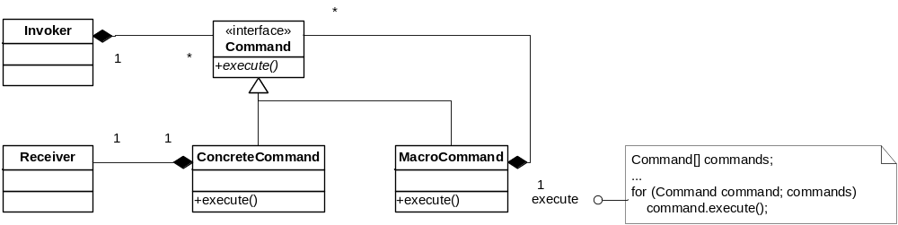
Macro Commands

Slide 36
Other Uses of Command
Batch Processing
  Save up commands and run in sequence
  Overnight, say
Recovery
  Save a log of all commands executed
  Can rollback or restore as needed

