Slide 1
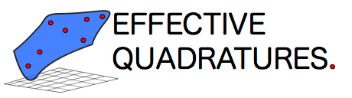
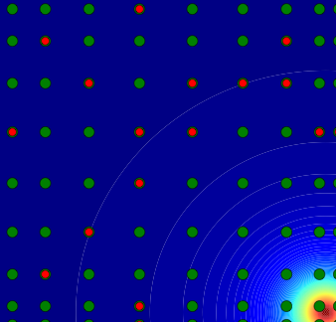
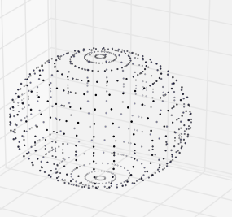
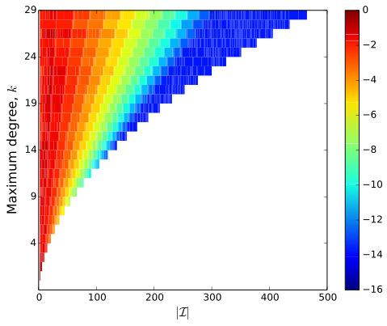
POLYNOMIALS FOR DATA ANALYTICS
Register now for the second Effective Quadratures workshop. For more information & registration do visit:
www.effective-quadratures.org/eq2017
March 24th 2016 | 9:30 am | LT6 Baker Bldg.

