Slide 1
Github Actions Example
Utilizing Github actions to create Issues.

Slide 2
Overview
In this example we will set up a remote Github repository that will access a clients repository, read it’s files and create Github issues based on the files in the repository.

Slide 3
Setting up our Repo
Our Repo will have 2 parts:
git_utils.py – Here we define a GithubHandler class that will handle connecting to and accessing the client repo.
main.py -- Here pass user input to GithubHandler and control the flow.

Slide 4
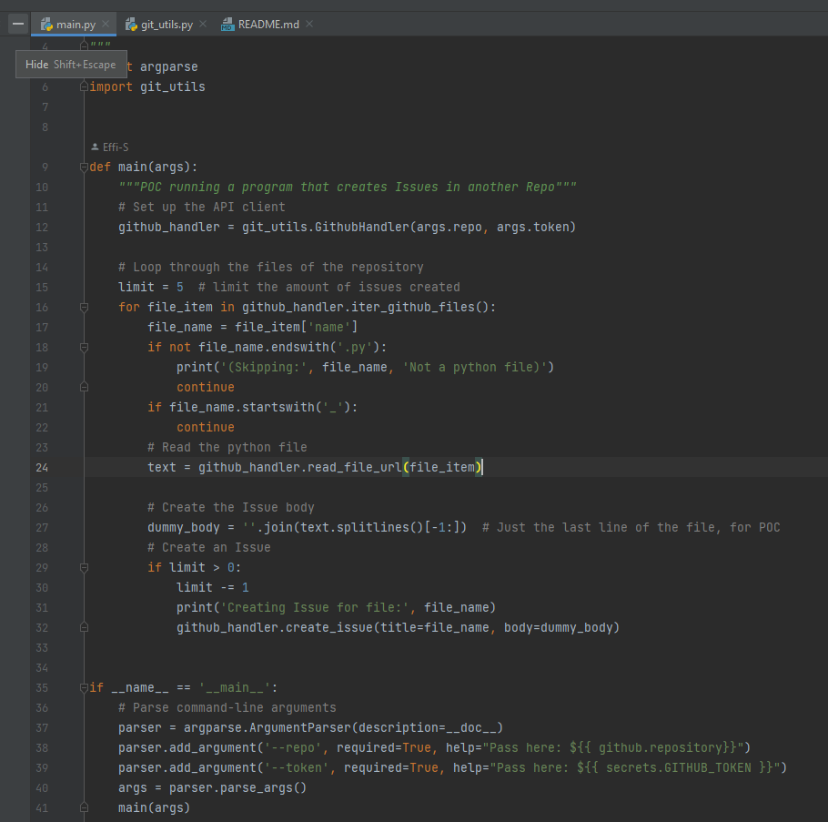
main.py Flow:
Connect to Repo
Recursively Iterate over all python files.
Read last line of each file
Create an issue with last line as body.
(limited to 5)

Slide 5
Setting up client
Add a Token to our Repo with access on a ‘Repo’ scope.
Add a Secret so we can use the Token a GithubAction.
Create .workflow directory
Add a YAML file defining our Action.
Trigger the action (by pull-request or manually)

Slide 6
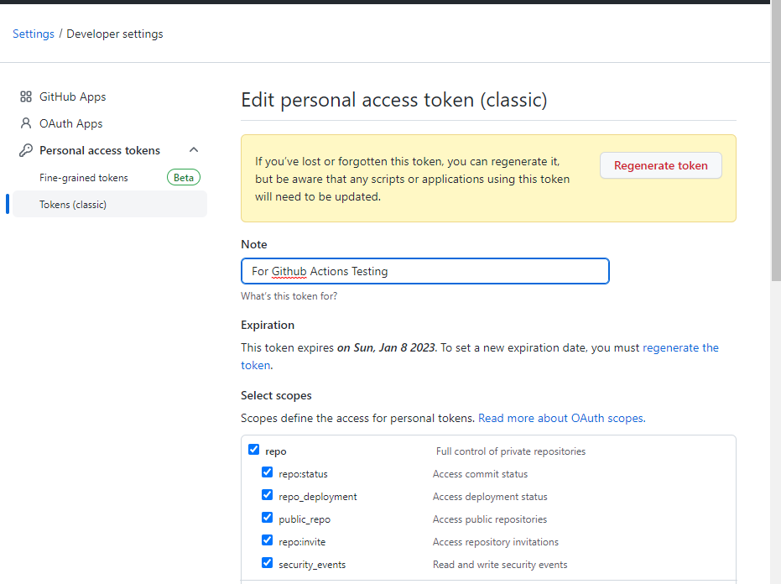
Setting up client
Add a Token to our Repo with access on a ‘Repo’ scope.

Slide 7
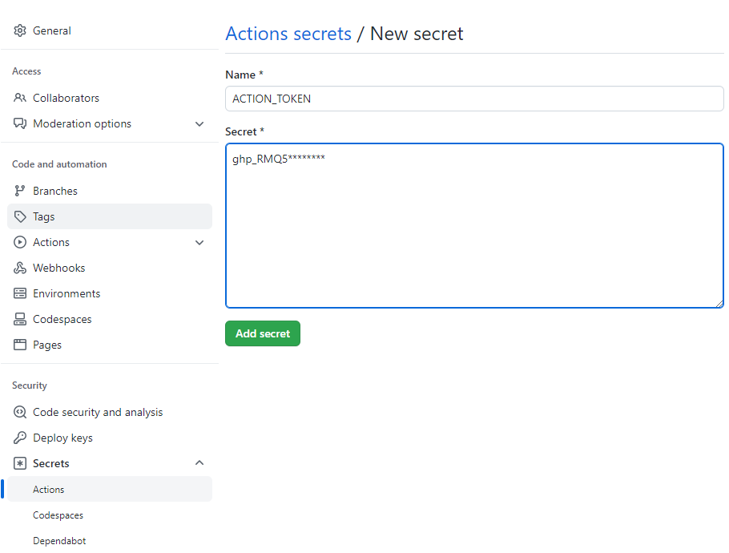
Setting up client
2. Add a Secret so we can use the Token from GithubAction.

Slide 8
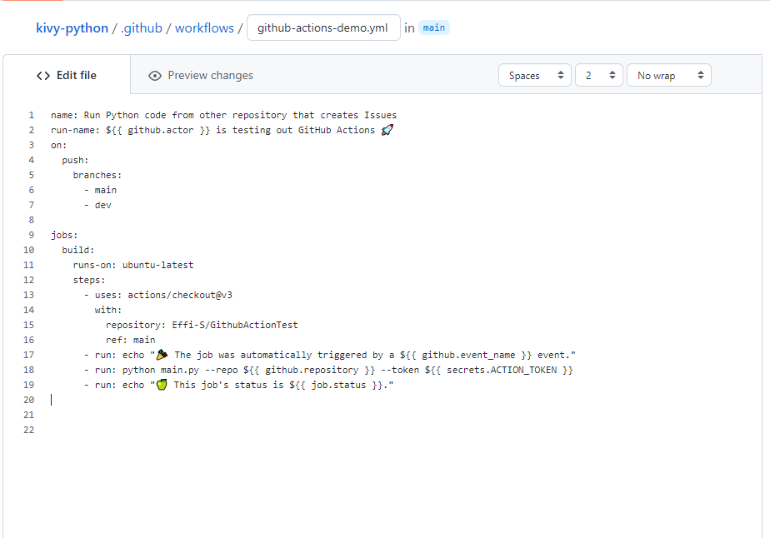
Setting up client
3. Create .workflow directory
4. Add a YAML file defining our Action.
We declare that we want to use the repo here
We call the remote repo here

Slide 9
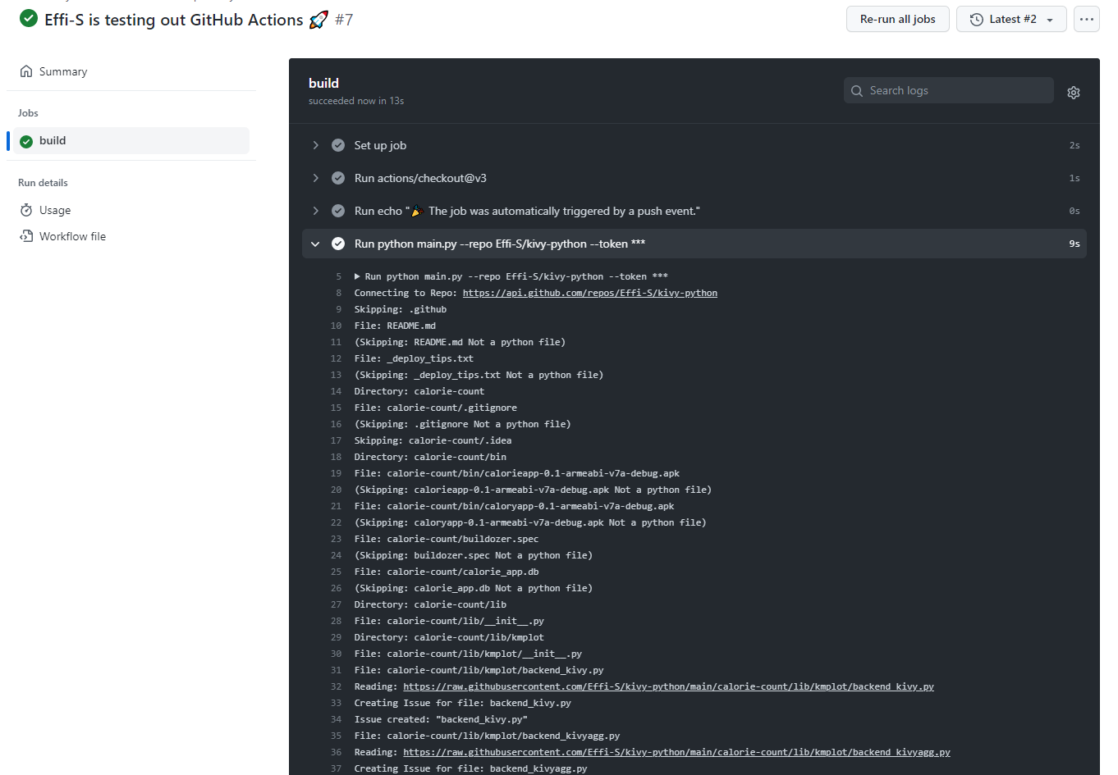
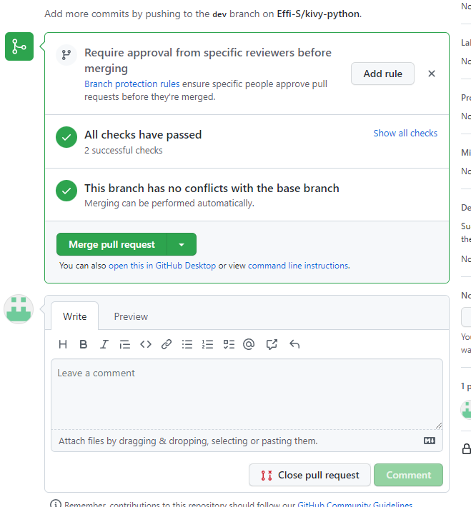
Setting up client
5.Trigger the action (by pull-request or manually)

Slide 10
Setting up client
5.Trigger the action (by pull-request or manually)

Slide 11
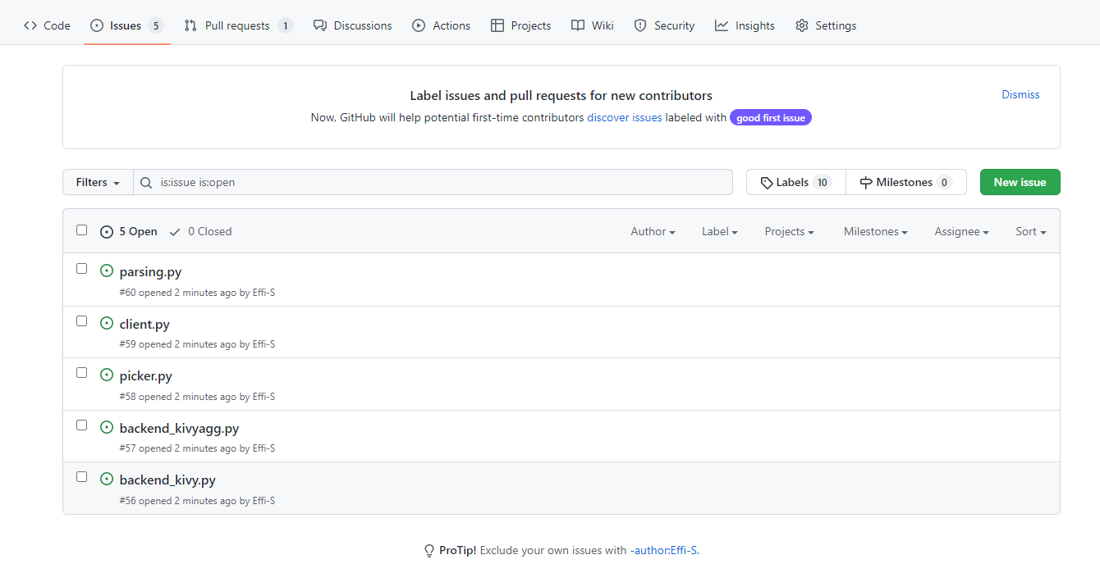
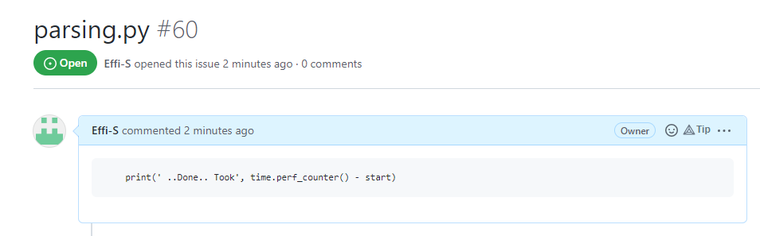
Result
5 Issues have been created in my Repo:

