Slide 1

Eurovision data mining and ml project
By Bello Effi, Golibroda Liram, and Sasson Ofek.

Slide 2


Data Sources :
We used Selenium & BS in order to crawl from :
Wikipedia
EurovisionWorld

Slide 3
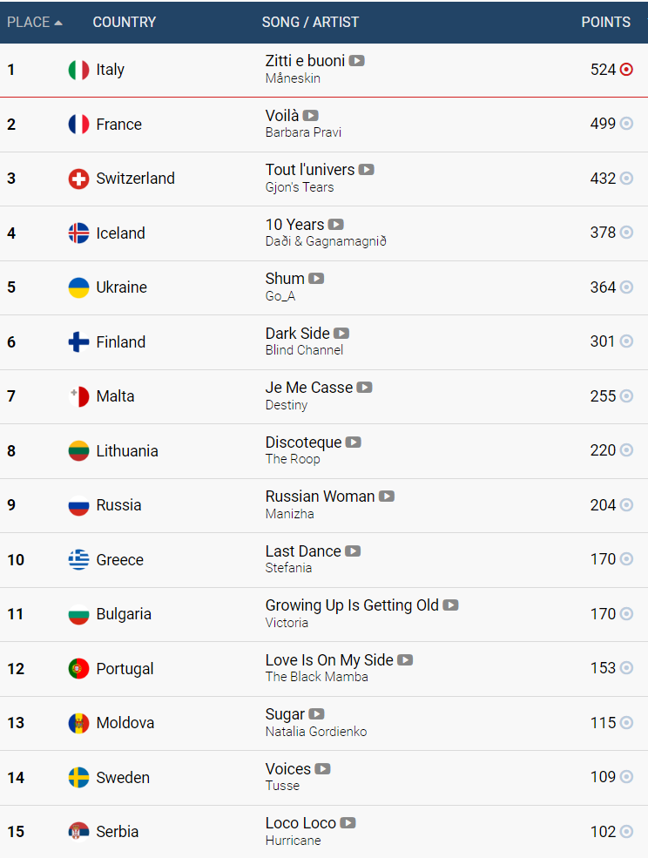
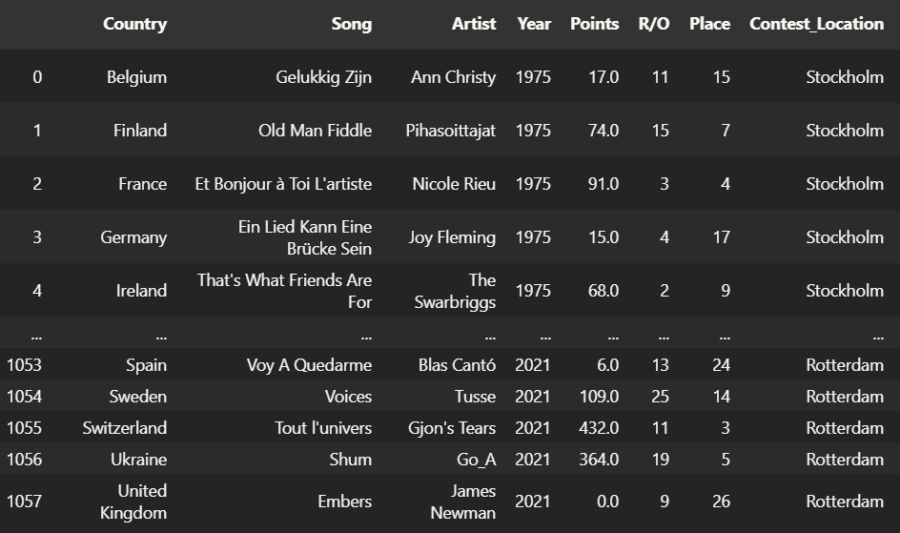
We obtained every detail on every song (with Selenium) participated in the Eurovision Since 1975, Including votes from the Jury and the crowd at home (In both Finals/Semi-Finals).
EurovisionWorld Crawler:

Slide 4
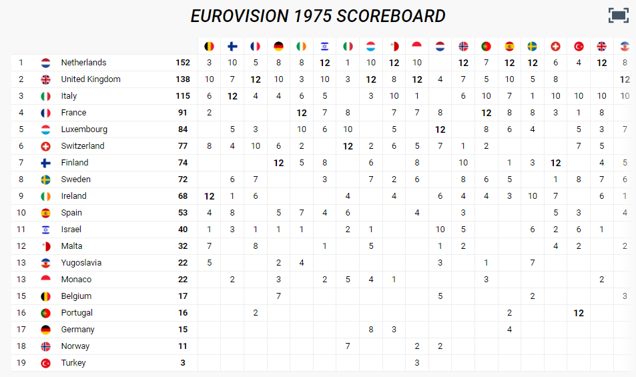
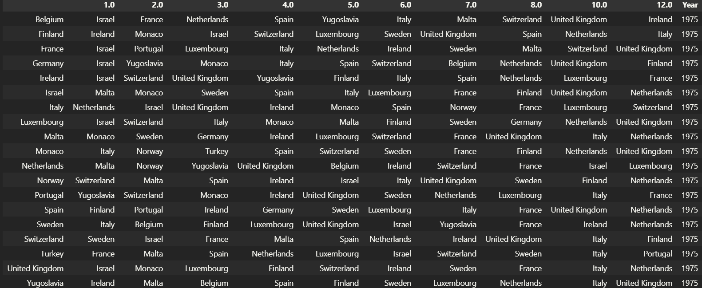
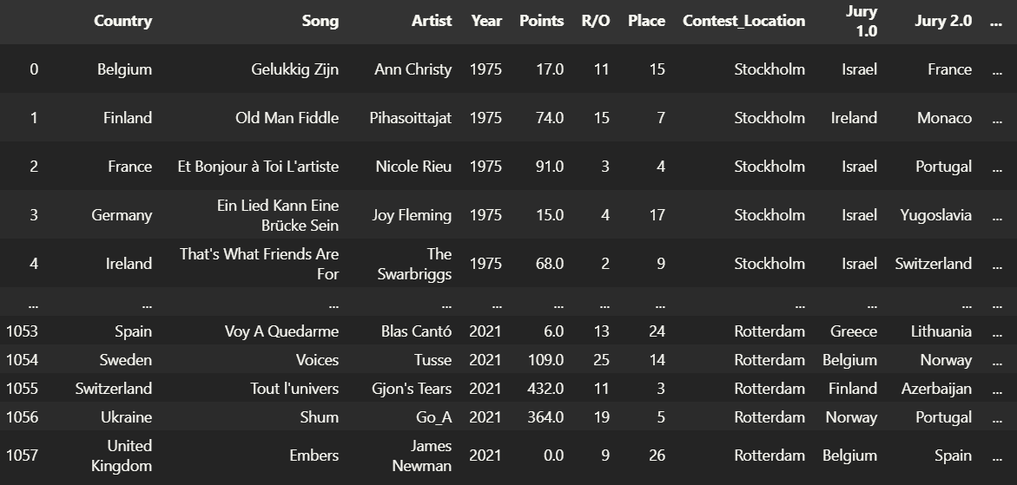
Crawling each year votes (using selenium)
Merging to main dataset

Slide 5
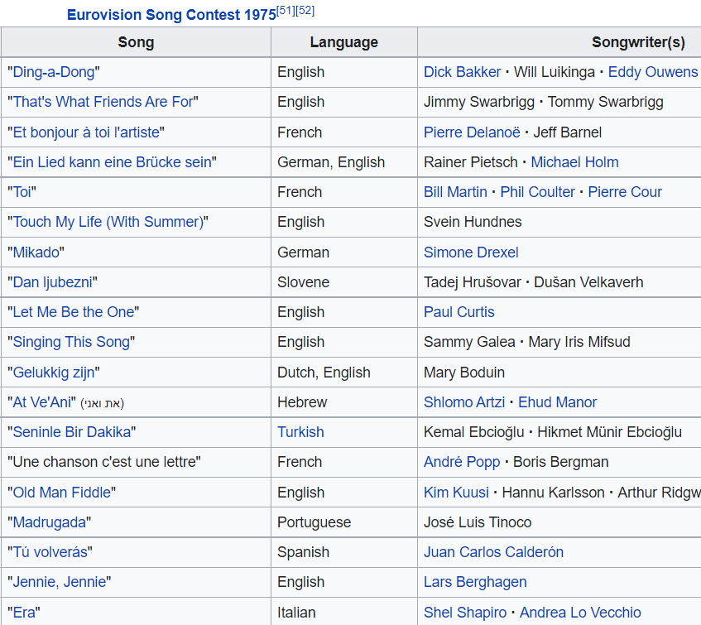

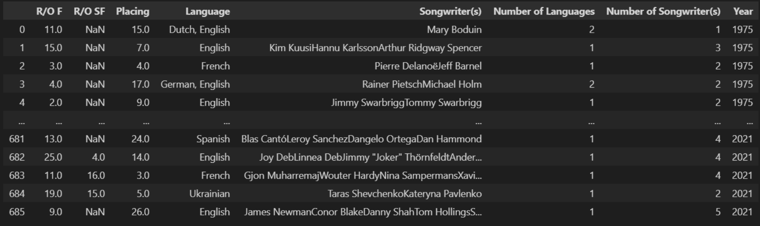
Wikipedia
Data :
We used BeatifulSoup to obtain specific features that were missing in each song (Number of writers, Language of the song etc…)

Slide 6
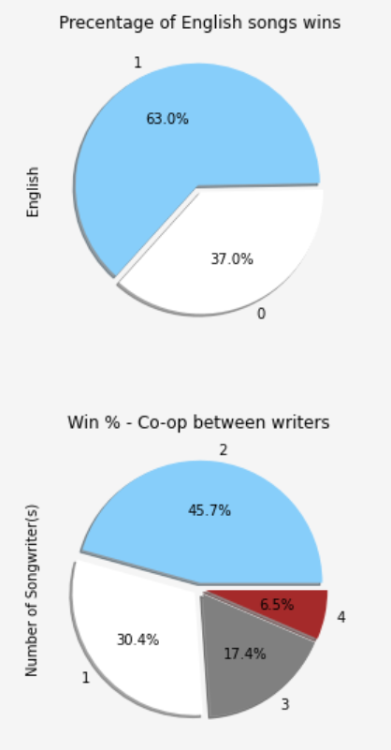

EDA – Visualizing Data:
As we can see the majority of the winning songs were written in English.
It’s optimal to let 1-2 songwriters to write the song in order to win!

Slide 7
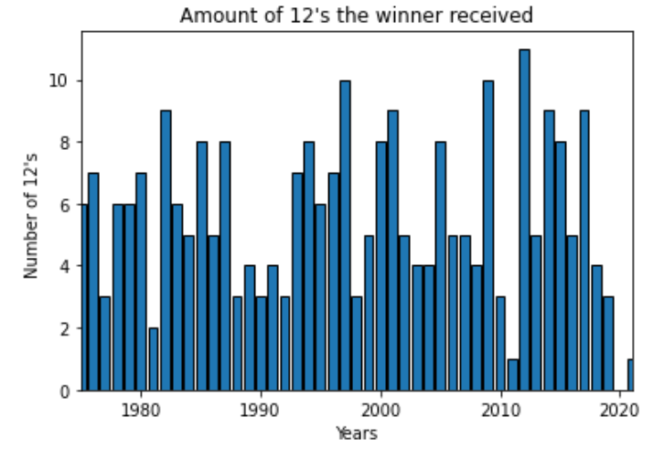
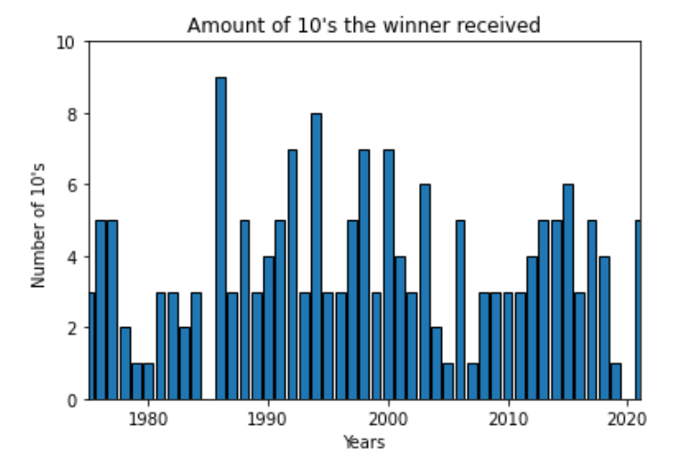
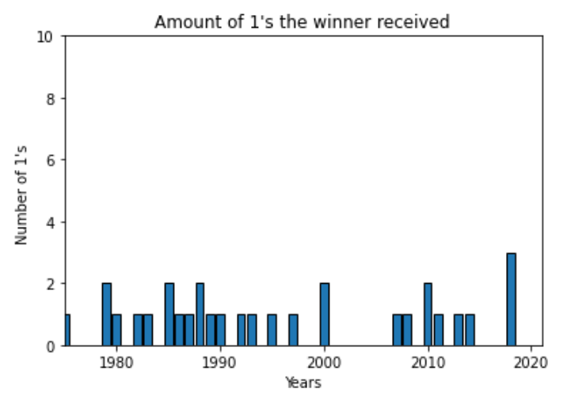

Slide 8
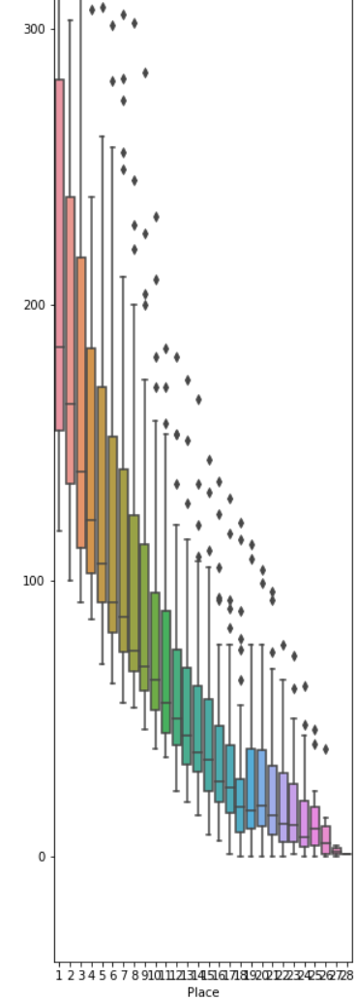
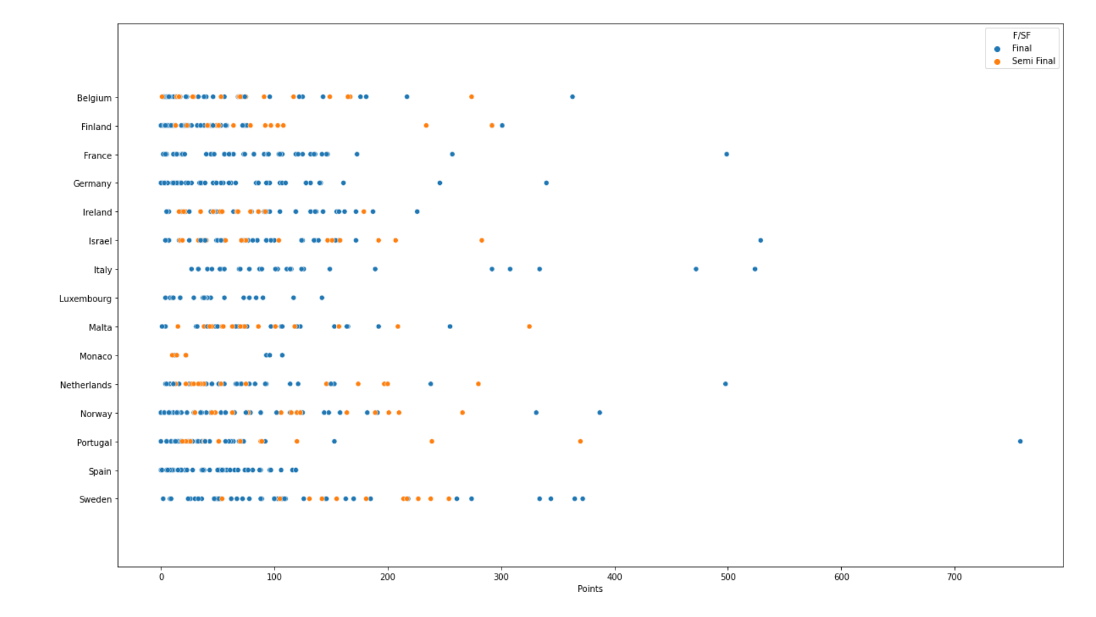
Plots, to graph the points. on the left plot we can see the correlation between mean, quartiles, and outliers.
Amount of points each country received in Finals/Semies

Slide 9
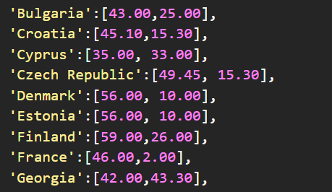
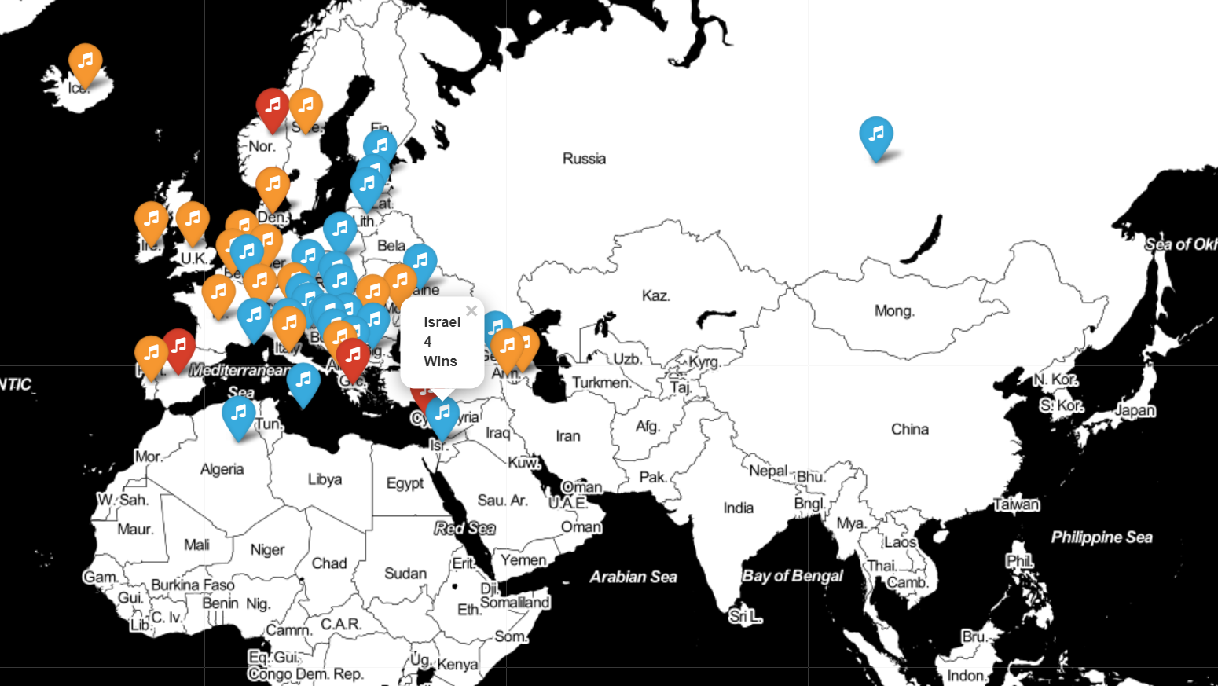
EDA – Using Folium:
We made a dictionary that contains every country’s coordinates on the globus In order to visualize them as clickable icons, sorted by colors that represent repetitive 12 points votes:
- gave more than 8 times to another country.
Orange - - Between 4-8 times
Blue - Less than 4 times
For Example, we found out that Cyprus gave 12 points to Greece 18 times!
Red
Orange
Blue

Slide 10
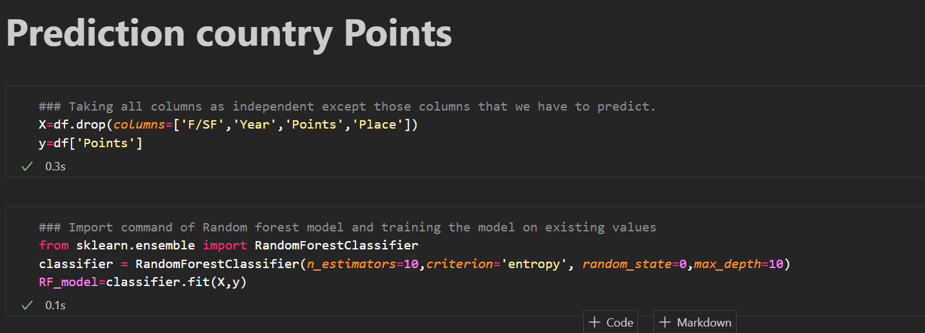
ML – Random Forest:
Prediction Questions:
Could we predict which semi-final/Final countries?
---------------------------------------------------------------------------------------------------------------------------------------------------------------------
2. Could we predict countries total points ?
---------------------------------------------------------------------------------------------------------------------------------------------------------------
3. Could we predict countries placing ?
With ‘sklearn.ensemble’ library we used RF in order to predict our questions columns, using the others (mostly voting).
Y – Our target column in every prediction.
(Changing according to the Question)

Slide 11
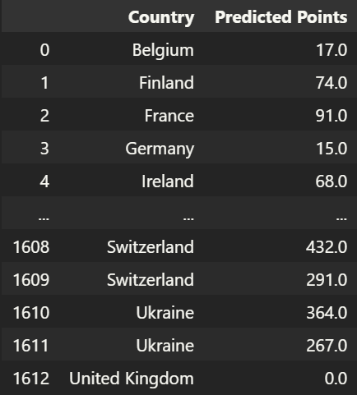
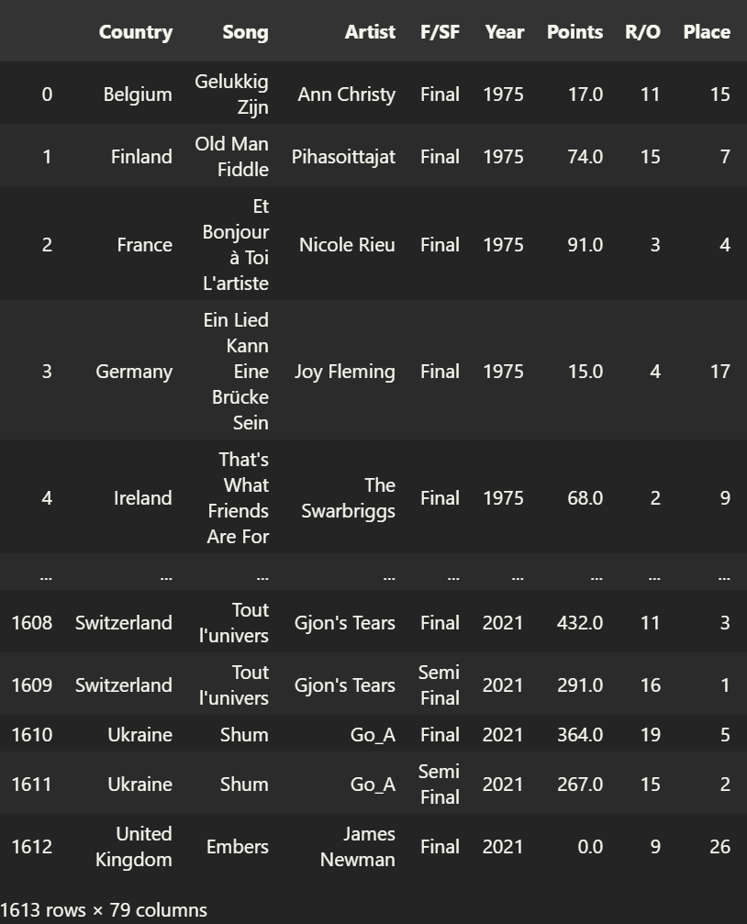
For example, we managed to predict our points column with the rest of them.

