Slide 1
Downtimeless PG upgrading
Thijs Lemmens

Slide 2
About me
Working at Xenit since 2011
Big archiving use cases
Strong interest in PostgreSQL

Slide 3
Outline
Use case
Physical Replication?
Logical replication?
PostgreSQL and logical replication
Demo

Slide 4
Use case
Upgrading large DB’s can take a long time
System needs to be always on and writable
Cloud applications
Multinationals
DBA’s who like to sleep at night

Slide 5
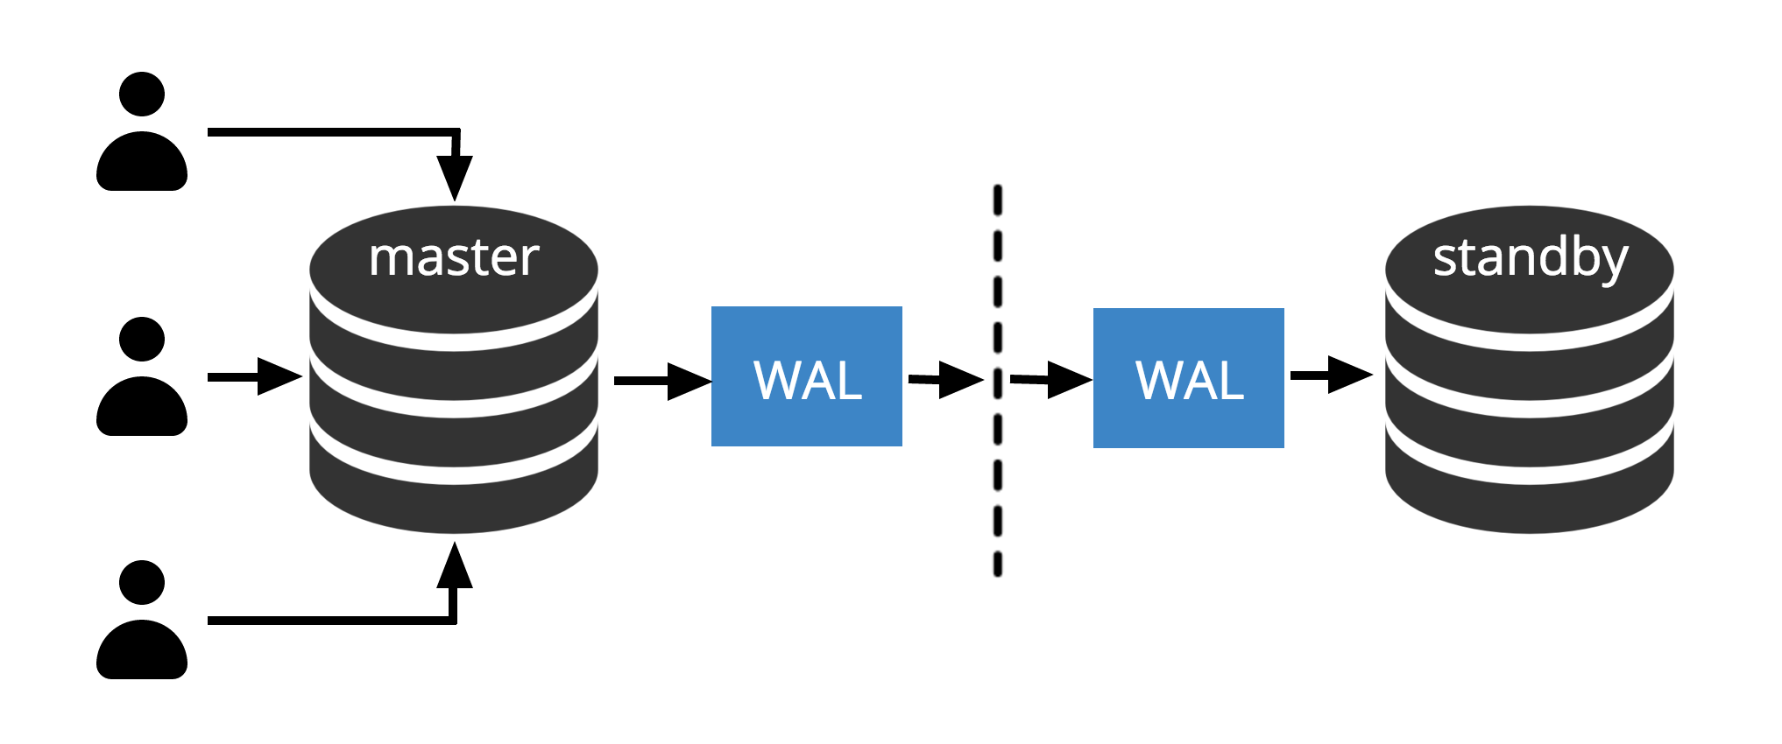
Physical Replication?

Slide 6
Logical replication?
PG1
PG2
publisher
subscriber

Slide 7
History
Trigger based solutions
Slony
Londiste
Pglogical extension
> PG 9.4
Built in logical replication
Introduced in PG 10

Slide 8
Demo
PGAdmin4
HAProxy
PG 10
PG 11

Slide 9
Demo
PGAdmin4
HAProxy
PG 10
PG 11

Slide 10
Demo
PGAdmin4
HAProxy
PG 10
PG 11

Slide 11
Do try this at home
https://github.com/thijslemmens/pg-logical-replication-presentation

Slide 12
?

