Slide 1
Downtimeless PG upgrading
Thijs Lemmens

Slide 2
About me
Working at Xenit since 2011:
Alfresco services
Products
Big archiving use cases
Strong interest in PostgreSQL

Slide 3
Outline
Use case
Physical Replication?
Logical replication?
PostgreSQL and logical replication
Demo

Slide 4
Use case
Upgrading large DB’s can take a long time
System needs to be always on and writable
Cloud applications
Multinationals
DBA’s who like to sleep at night

Slide 5
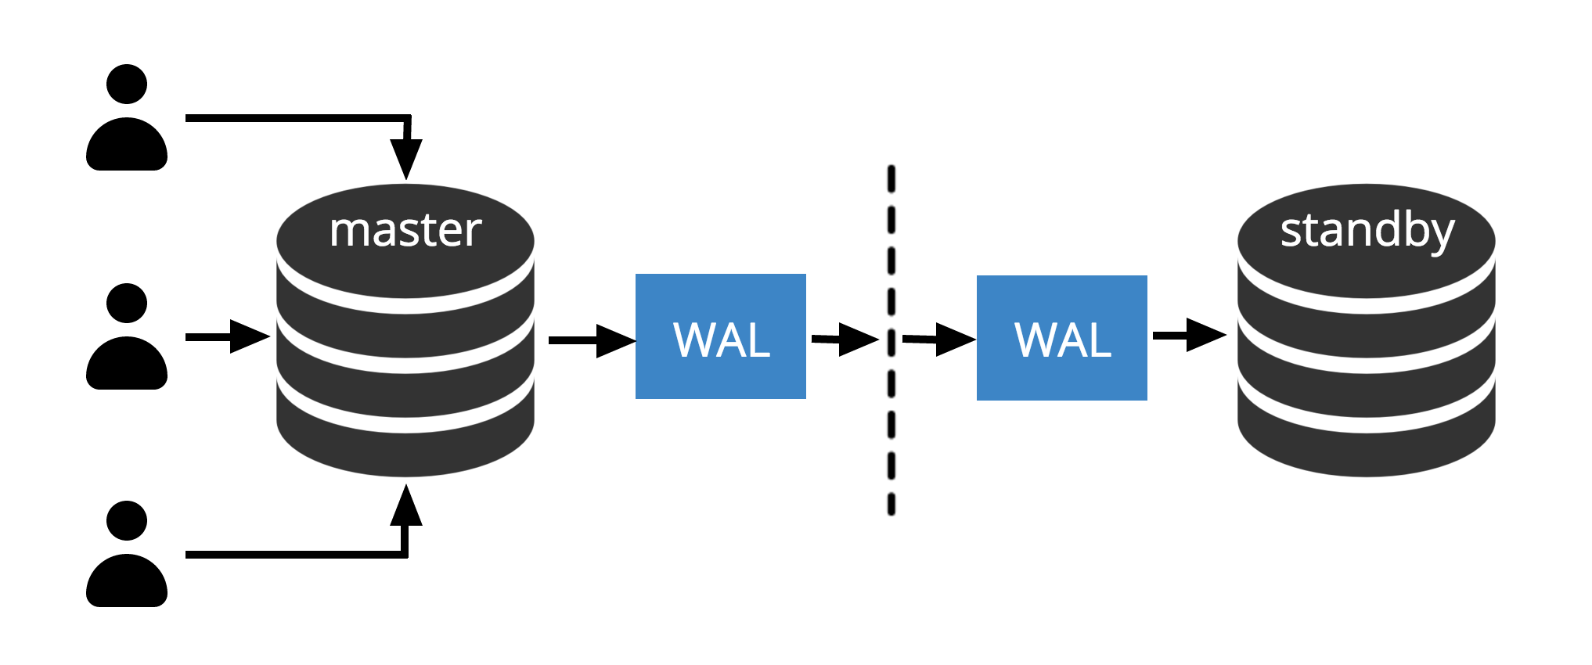
Physical Replication?

Slide 6
Logical replication?
PG1
PG2
publisher
subscriber

Slide 7
Limitations
No DDLS
No Sequences
Tables only

Slide 8
History
Trigger based solutions
Slony
Londiste
Pglogical extension
> PG 9.4
Built in logical replication
Introduced in PG 10

Slide 9
Demo
PGAdmin4
HAProxy
PG 10
PG 11

Slide 10
Demo
PGAdmin4
HAProxy
PG 10
PG 11

Slide 11
Demo
PGAdmin4
HAProxy
PG 10
PG 11

Slide 12
Do try this at home
https://github.com/thijslemmens/pg-logical-replication-presentation

Slide 13
?

