Slide 1

PostgreSQL Ecosystem
Not just a database but an Ecosystem
by Alex Aquino
Chicago PostgreSQL User Group,
October 16th, 2019
Notes:
Thank you for the opportunity.
Smile
Confidence
Quick Presentation
Introduce concept
Follow up later

Slide 2
Disclaimer
The views expressed herein are my own, and do not necessarily represent the views of my employer, or any other entity.

Slide 3
What brought me here?
About Me:
Alex Aquino, Solution Architect at WW Grainger, Inc.
Business Concerns:
Increase the capacity of an OLTP application.
Help move a old Fortune 300 company to the cloud.
Motivation:
Share back to the PostgreSQL community.
Notes:
Special thank you to this Chicago PUG, Hettie, all of you for helping me with some of the questions I had as I was going through this journey of help the company adopt PostgreSQL.

Slide 4
Why an Ecosystem Diagram?
Facilitate Solutioning, Architecture discussions
Enhance viability of PostgreSQL

Slide 5
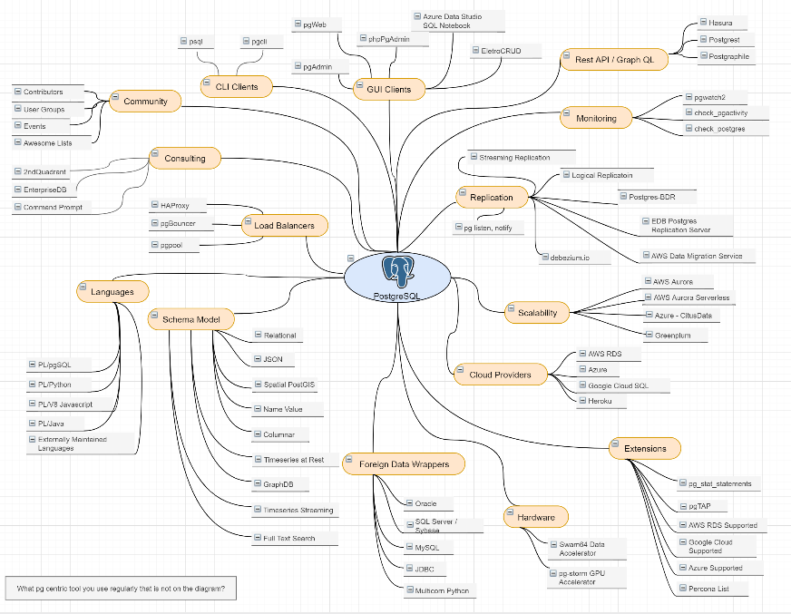


PostgreSQL Ecosystem Diagram
A diagram of the key capabilities clustered with hyperlinked entities that enable each capability.
A Work in Progress (WIP)
Open source, Collaborative
https://github.com/EfficiencyGeek/postgresql-ecosystem
draw.io
Notes:
Click from this slide -> github.com -> draw.io
Go over the main categories.
Click on AWS Approved Extensions

Slide 6
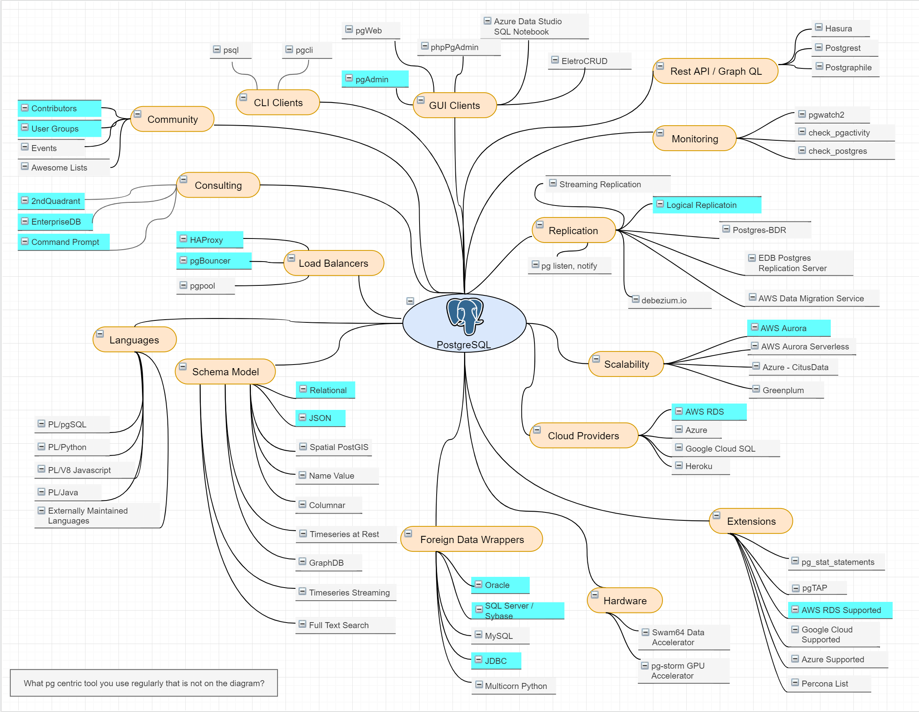
Scenario 1: Enterprise Open Source DB
Capacity
Rich Features
HA
Cloud Adoption
Vendor, Consulting Support
Community

Slide 7
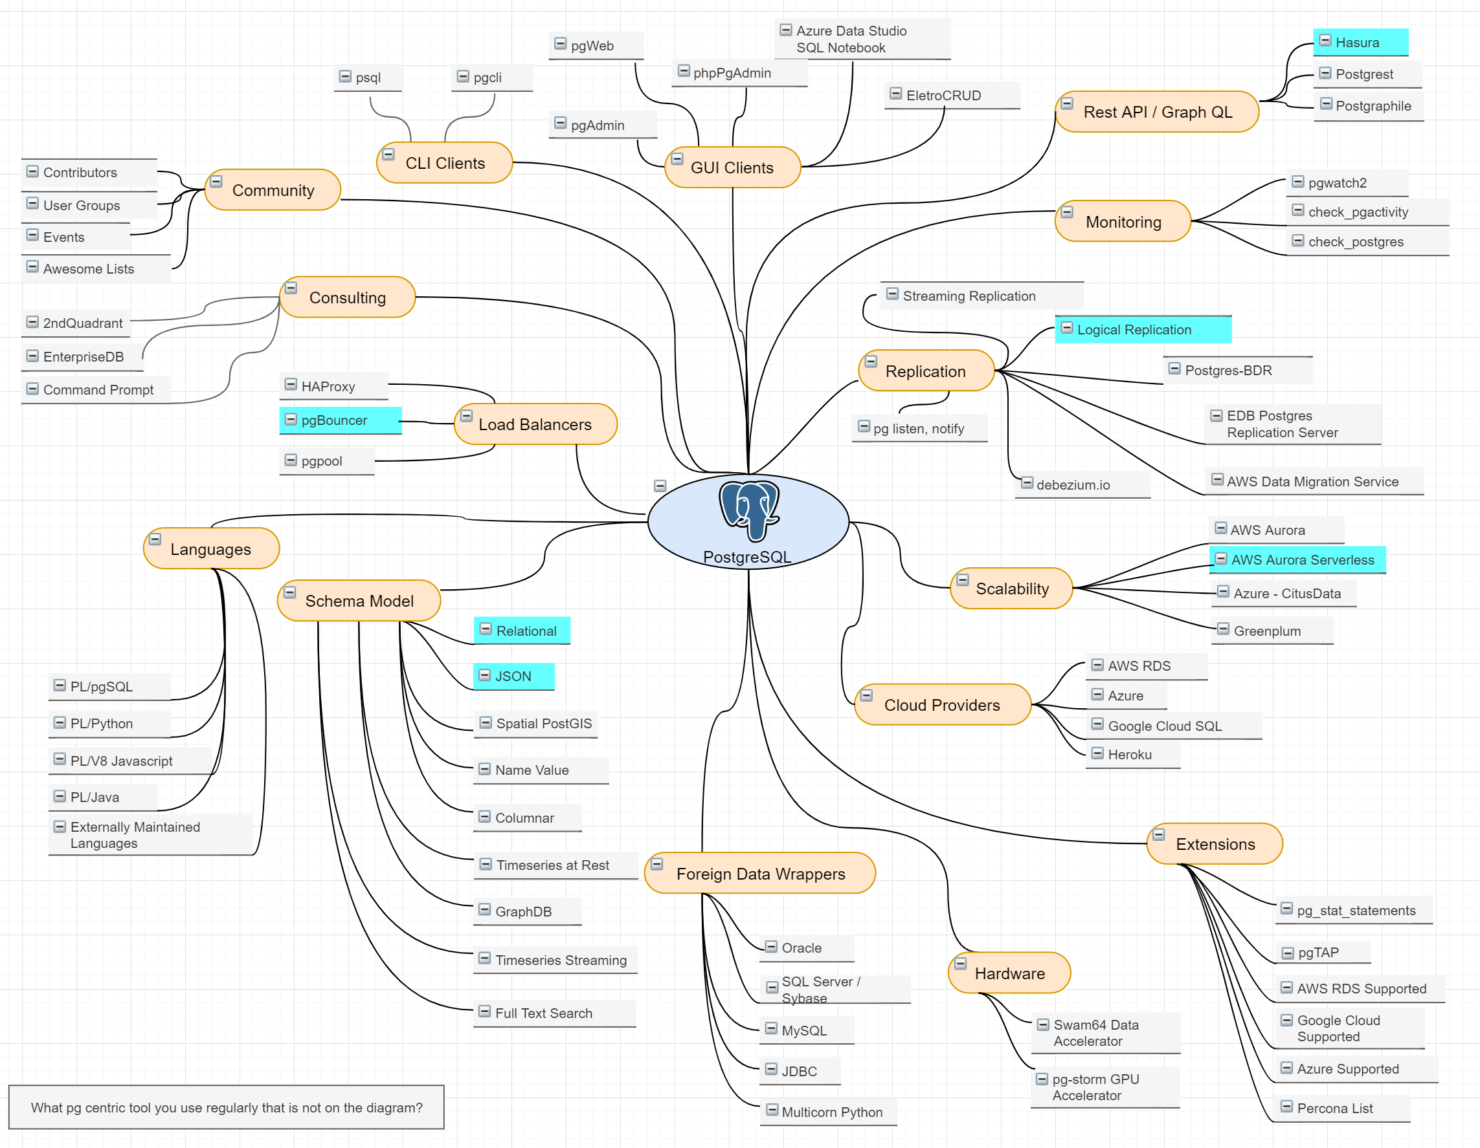
Scenario 2: Application Stack
Relational, JSON
Read Only Copy
pgBouncer
GraphQL
Serverless

Slide 8







Summary
Acquire Capabilities
Save Time
Not just a database but an Ecosystem​.
Improve Performance
Save Money

Slide 9



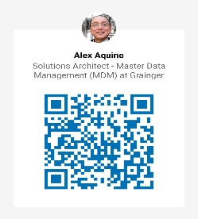
Bonus Question
Is there any PG centric tool you like that is not in the diagram?
https://www.linkedin.com/in/alexaquino
Email: alex@efficiencygeek.com

