Slide 1
Stock Prediction Capstone – Sprint 2
By: Will Lin

Slide 2

Problem Statement
How can I use data science to predict future stock prices?
Solution:
Use machine learning models that cater to regression problems.
Start off with baseline models and add two more complex models

Slide 3

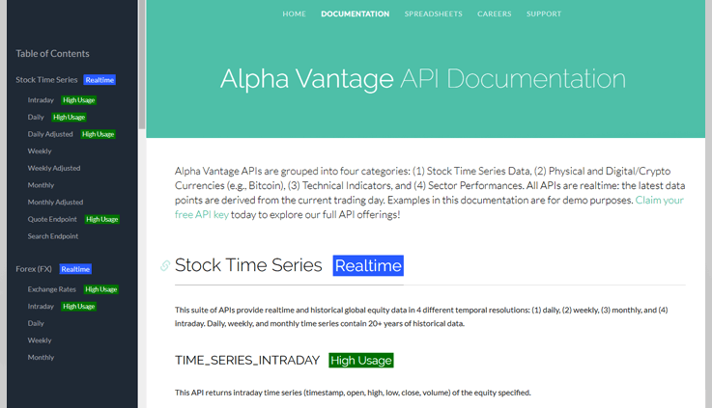
Overview of Datasets
Obtained premium access to a new API called Alpha Vantage
Obtained the adjusted price datasets that accounts for price splits
Able to pull Technical Indicators which I can add to potentially improve modelling

Slide 4
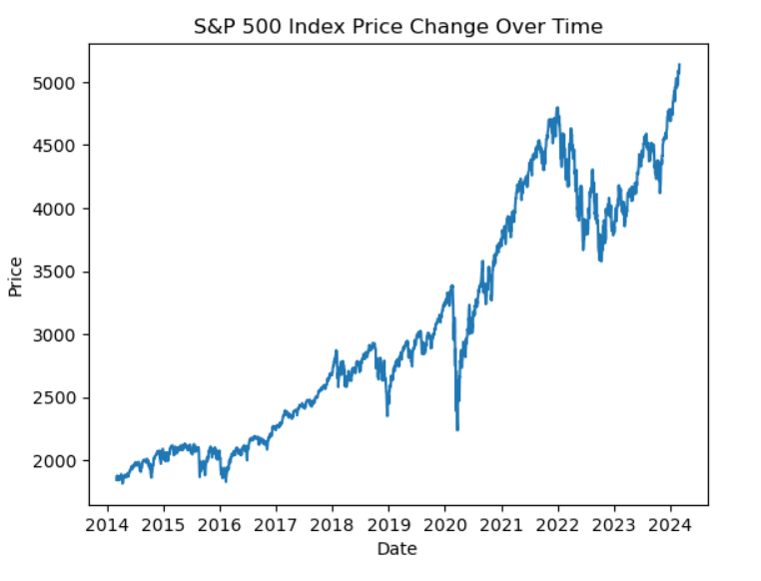
EDA
Time is your friend in investing
Over a long period of time, your money will grow

Slide 5
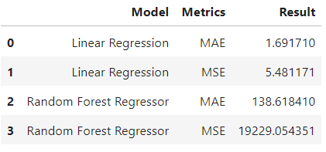
Baseline Models
Linear Regression
Random Forest Regressor

Slide 6

Plan and Next Steps
Identify Area of Interest and Problem Statement
Acquire a dataset
Basic EDA/Preprocessing
Modelling
Model Tuning & Adding features for better predictions

