Slide 1
Reducing household energy use with
Smart Meters

Slide 2
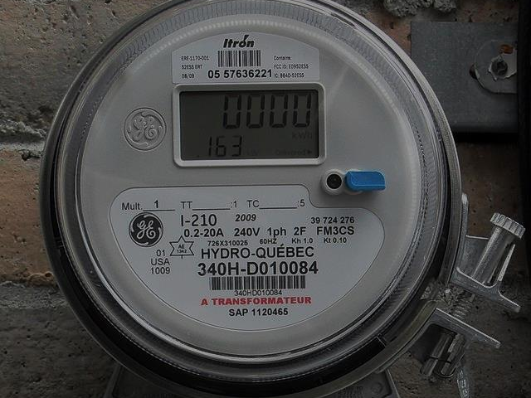
CURRENT SITUATION

Slide 3
CURRENT SITUATION
Why?
Smart meters being installed across Illinois
How can they help consumers?
Inform, evaluate, act, reduce

Slide 4
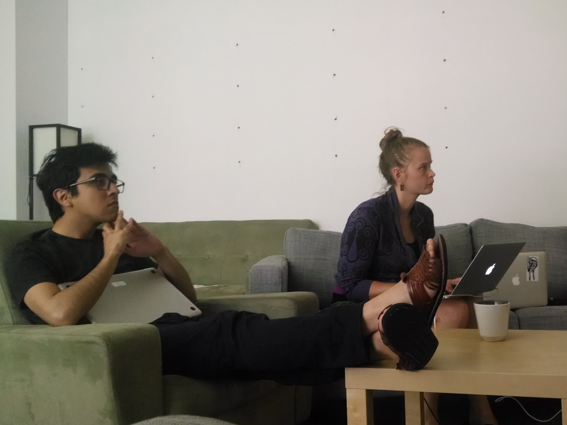
OUR WORK

Slide 5
OUR WORK
Meter
Data
Algorithms
A/C
TV

Slide 6



Donut not yet eaten
Donut Eaten
DONUT VISUALIZATION

