Slide 1
Question: How well can we train an ML- algorithm with time- and weather features?

Slide 2
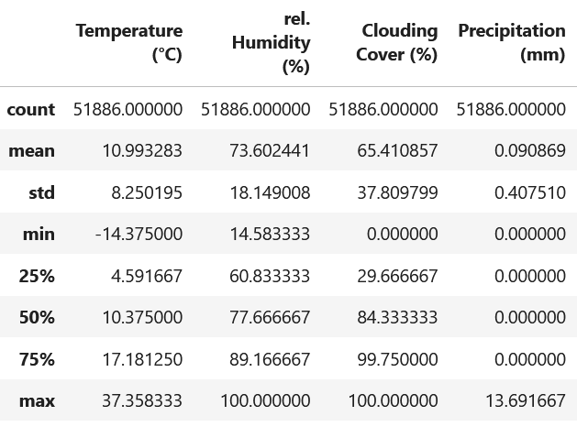

Dataframe - Features
Weather – Features
(numerical)
Time – Features
(categorical)

Slide 3
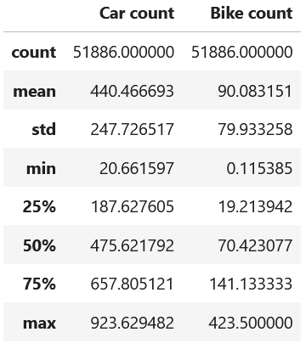
Dataframe - Labels

Slide 4
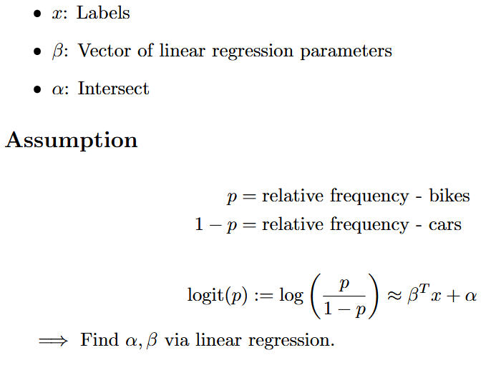
Go-to Algorithm - Binomial Logit Regression

Slide 5
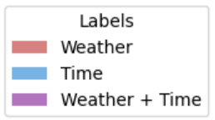
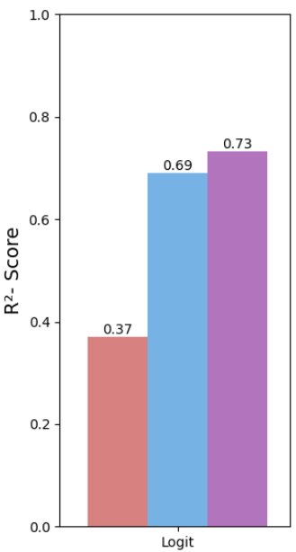
Logit - Evaluation

Slide 6
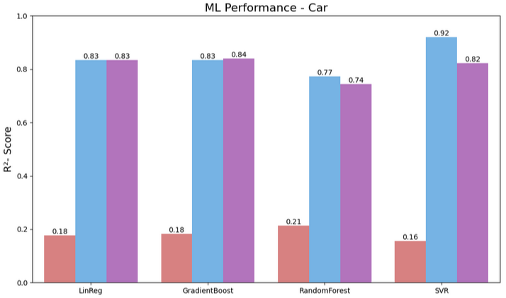
Evaluation - ML Algoriths

Slide 7
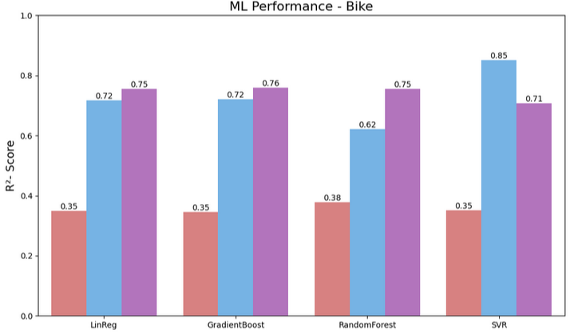
Evaluation - ML Algoriths

Slide 8
Must Successful Algorithm - SVR
Car
Features: Time
[kernel, C, epsilon] = [rbf, 20, 1]
σ = 70,1 R² - Score = 0,92
Bike
Features: Time
[kernel, C, epsilon] = [rbf, 20, 1]
σ = 30,9 R² - Score = 0,85

Slide 9
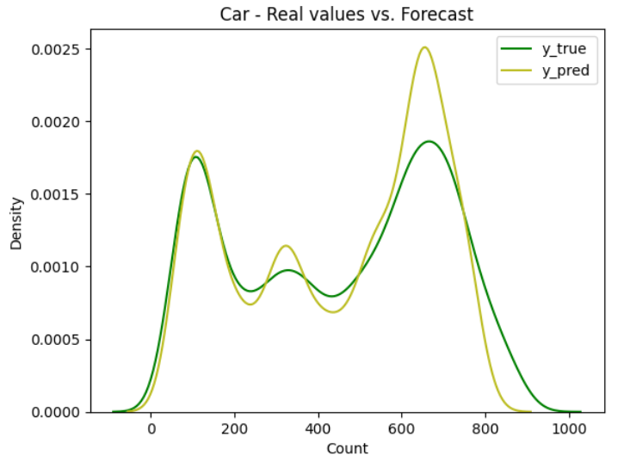
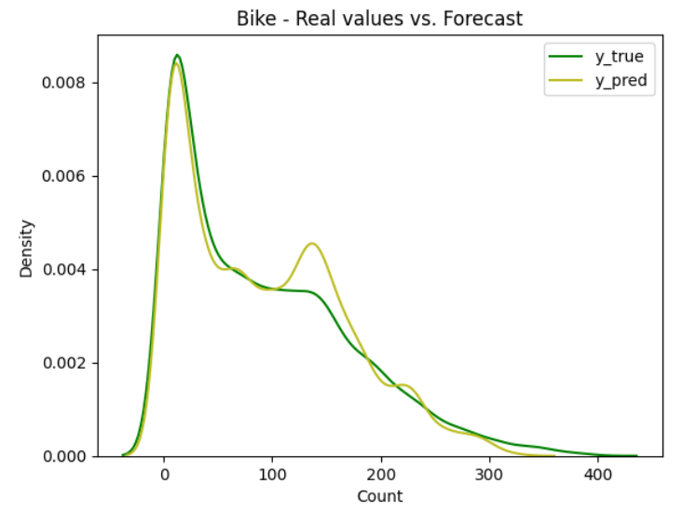
Must Successful Algorithm - SVR
Car
Features: Time
[kernel, C, epsilon] = [rbf, 20, 1]
σ = 70,1 R² - Score = 0,92
Bike
Features: Time
[kernel, C, epsilon] = [rbf, 20, 1]
σ = 30,9 R² - Score = 0,85

Slide 10
Final Notes
Further questions
Consider public transport, pedestrians as additional modes of travel
Consider singular boroughs, include demografical data
Compare car data before and after 2020
Refine the most succesful ML algorithm
Sources
PKW: https://daten.berlin.de/datensaetze/verkehrsdetektion-berlin
Fahrrad: https://daten.berlin.de/datensaetze/radzahldaten-in-berlin
Wetter: https://open-meteo.com/en/docs/historical-weather-api

