Slide 1
Software Skills Working efficiently with software
Data Engineering
School of Data Science
University of Virginia

Slide 2
CI-CD
Meaning of the acronym
Continuous Integration
Continuous Delivery
The IDEAS have been around for long time, but the tools have evolved
From simple `build` tools to all in one tools
From simple command line to cloud cluster size

Slide 3
Early Days
Early days programs were small, and languages were ‘compiled’ into binaries.
Enter -> Make
Part of the linux family of tools
Goal was to compile different portions of a program and `redo` only parts that were touched
It can be used as a basic ‘runner’ but…
Fully capable of running tasks in a DAG (Directec Acyclic Graph), which is what makes it powerfull

Slide 4
DAG Directed Acyclic Graph
DAGs show up everywhere, git, airflow, make, rake, most all build and ci/cd tools.
A DAG is a set of nodes
Directed connections
NO LOOPS
Much like a tree, but I suppose it can have multiple roots

Slide 5
Make is useful for a couple of reasons
Reminds users of `what can be done` in script/program
Reminds users of `steps` in order
Compacts commands into nicknames
Make is built to look for ‘build files’, but we can leverage this any way we want.
It is almost like a recipe, being able to repeat steps that are needed if they are missing.
However it is archaic in syntax, and for larger tasks there are better tools

Slide 6
Jenkins
Installable program with LOTS of options
Can be run locally or through web
Uses web server to front UI in browser
As expected…. It relies on running tasks as DAGS
Can run any language run at the command line
Great logging
Graphs
Easy to share dashboards
Matrix plugin

Slide 7
Common uses for these tools
Activities
BUILD
TEST
DEPLOY
C++ type of ‘build’ - Make started with this
‘Build’ and test management - Jenkins
Web serviced, build/test/deploy - CircleCI
Data processing DAG including build/test - Airflow
Airflow is an example of a tool that is starting to specialize
Whereas the other three can be seen as general

Slide 8
CircleCI
Easy to configure, you use a yaml file in your git repo and it runs in the cloud
Can be used for running tests, or deploy
Common use is to use it as a `gate`, if tests don’t pass you don’t deploy
We’ll be adding our package repo to CircleCI for the lab

Slide 9
Focus on goal of ACRONYMS CI, CD
In Waterfall code/test and deliver/qa were in long cycles.
Agile pushes for shorter iterations. In the `Extreme`, if something is good, do it all the time. So TDD for example is a practice from Agile.
Testing, Delivery, Building… automating these to go on shorter and shorter cycles is an agile practice.
The less time it takes to catch an issue the easier it is to fix.

Slide 10
Continuous Integration
What do we mean by this?
If you build one script there is really no integration. However, in the old days…
C++ modules had to be compiled with other modules built by other developers. Thus ‘integration’
Today:
Your python module needs to run in a multi-language environment for final app/product. Thus ‘integration’

Slide 11
Continuous Delivery
What do we mean by continuous delivery
Providing a finished app/product with the latest code ready to test by QA
And/Or most importantly…
Providing a finished app/product with the latest code pushed out to your end users!
In the old paradigm releases came every few weeks/months/years. In CD, we could see a new version per day!

Slide 12
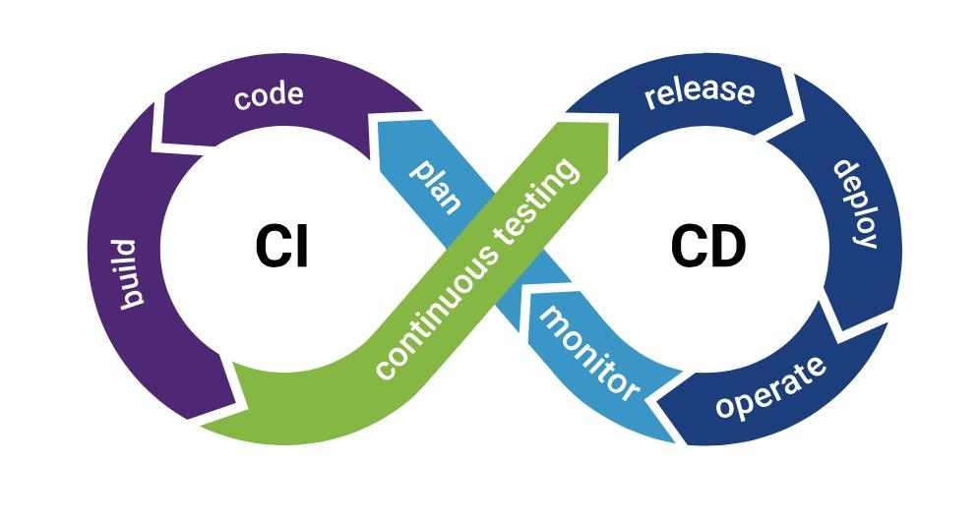
CICD typical cycle

Slide 13
Key element to `continuous`-> TESTS!
If you have a good set of tests…
The shorter the time between code/testing the easier it is to catch issues.
The shorter the time between releases, the easier it is to isolate new issues.
So why not just make this continuous? In the extreme case, goal:
Git commit triggers CircleCI to run tests
If tests pass, CircleCI pushes out new version
New version triggers final QA tests
If QA tests pass, you push out a new version to users
This can happen multiple times per day

