Slide 1
Airflow Data Pipeline and ETL
Data Engineering
School of Data Science
University of Virginia

Slide 2
Airflow, or more properly Apache Airflow
Airflow is workflow automation
Open source
Programmatically author
Schedule
Monitor
Three basic tasks of a pipeline, ETL
Extract
Transform
Load
Manage dependencies, logs, code, trigger and chain tasks

Slide 3
Manage details of a single pipeline
Single pipeline for ETL where every step uses differen tool
Extract data via an API
Load data into database
Transform data
What happens if your API goes offline?
Or if the database access is down?
Or there is an error in the transform code?
Airflow allows you to manage this, and rerun steps

Slide 4
Manage many data pipelines
Once you set up one DAG, or sequence of tasks
Diverge at certain tasks to create different pipelines
Run similar pipelines in parallel
Railroad analogy, you can create a central origin with many destinations
Or create parallel and similar tracks

Slide 5
Some advantages of using Airflow
Ubiquitous Data Pipeline tool
Open source with a large community
Uses a dynamic language… python!
Scalable to large number of tasks
Comes with a UI for monitoring
Extensible - you can write your own plugins!

Slide 6
Airflow Components
Scheduler
Web Server
Metastore
Triggerer
Executor
Queue
Worker

Slide 7
Airflow: Core Concepts
DAG - no cycles permitted in our workflow
Operators (Encapsulate an action
Action - Execute an action, function, operation
Transfer - Move data between storage
Sensor - Monitor and execute on a trigger

Slide 8
Airflow: What it is not…
Airflow is meant to manage tasks, workflows, but not do the heavy lifting.
Streaming, processing should be triggered by
But not done by Airflow
For example, let Airflow trigger a multi server pyspark deployment, and allow pyspark and EMR to do what they are best at.

Slide 9
Two Architectures
Single server - Runs everything, great for learning. This is what we’ll try out
Multiple server - Airflow can run on multiple servers, with separate components. For High Reliability we run a system of distributed servers, running systems of distributed servers!
We’ve installed Airflow docker for single server in last lab.

Slide 10
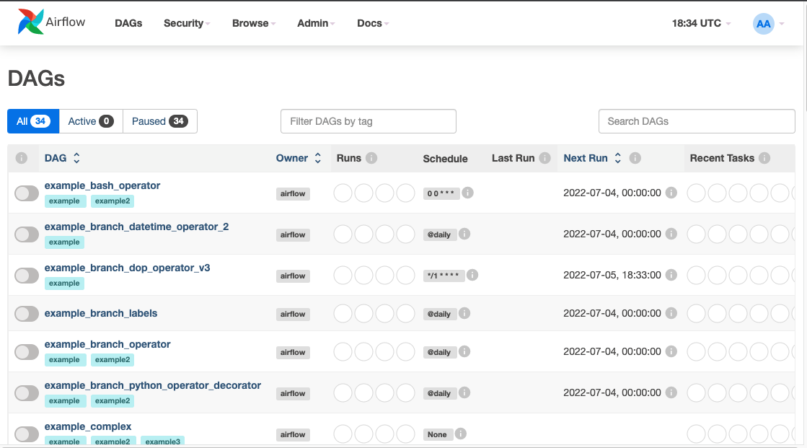
DAG View

Slide 11
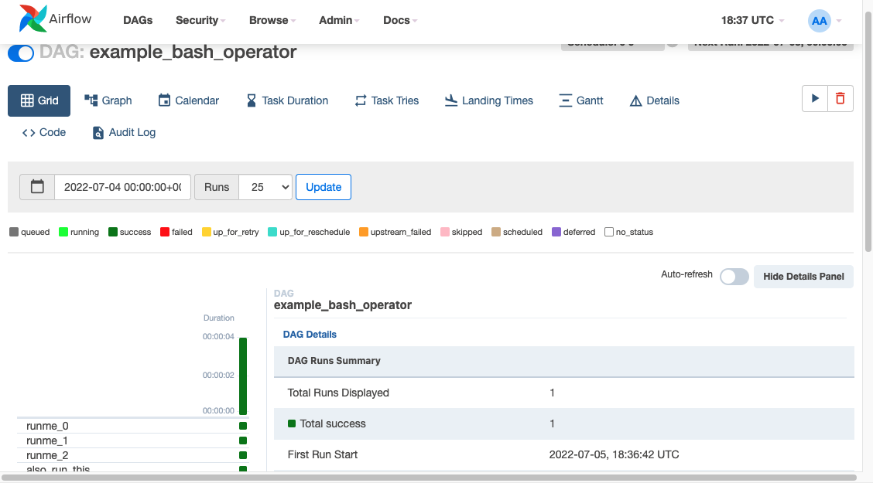
The GRID View

Slide 12
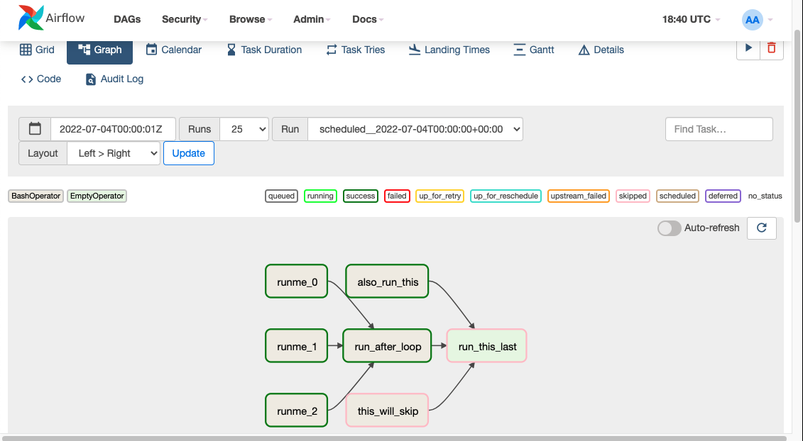
The Graph View

Slide 13
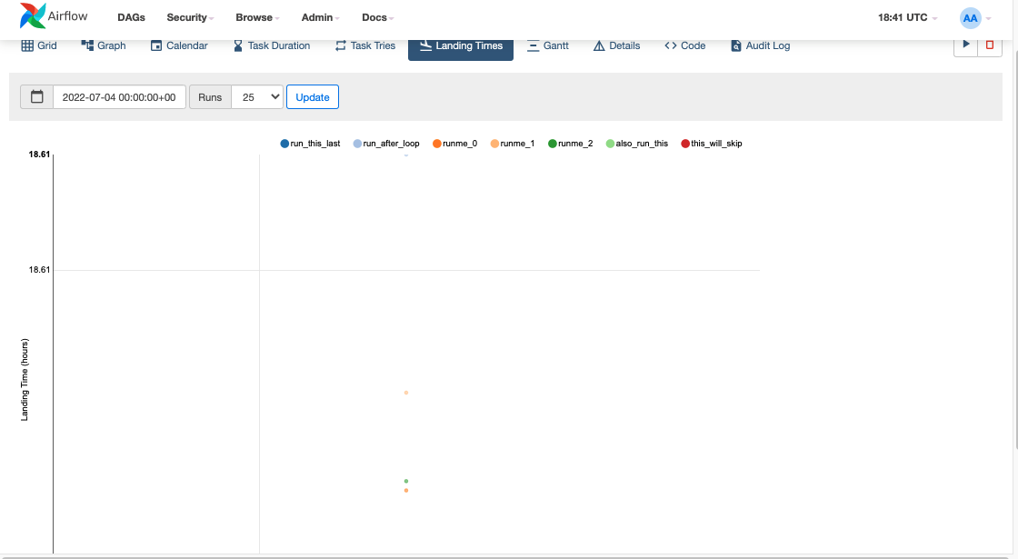
The Landing Time View

Slide 14
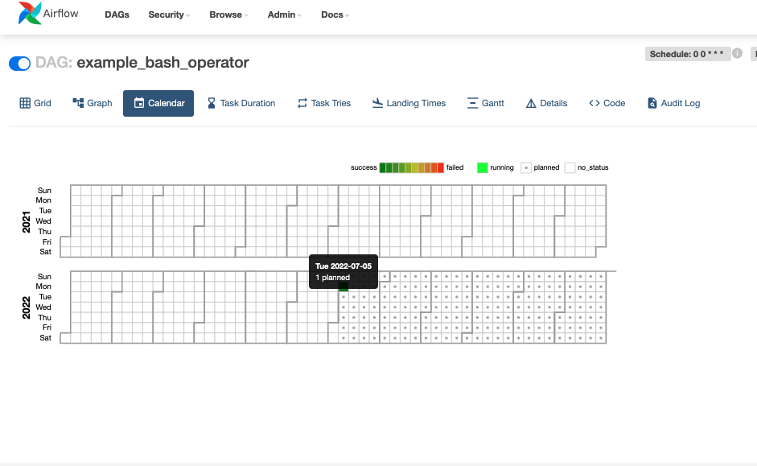
The Calendar View

Slide 15
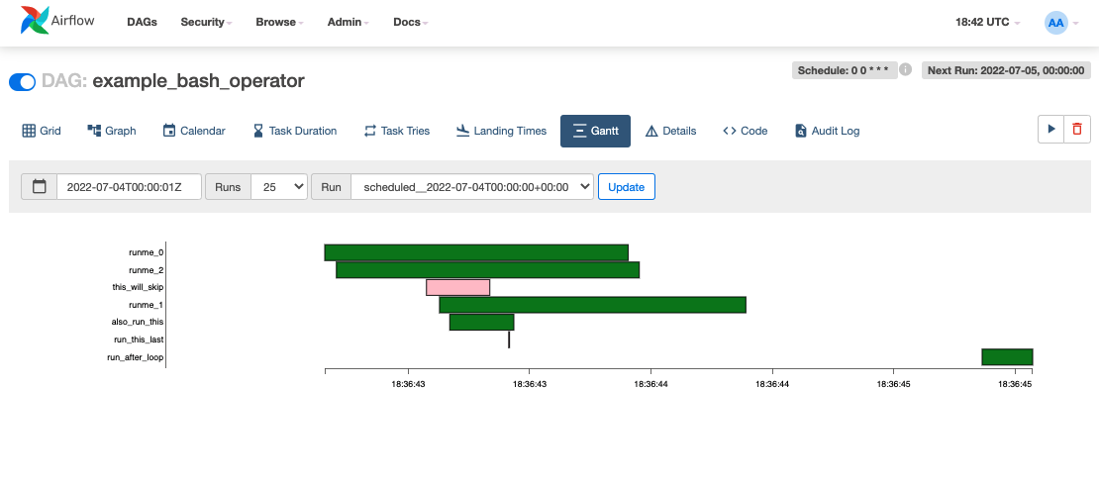
The Gantt View

Slide 16
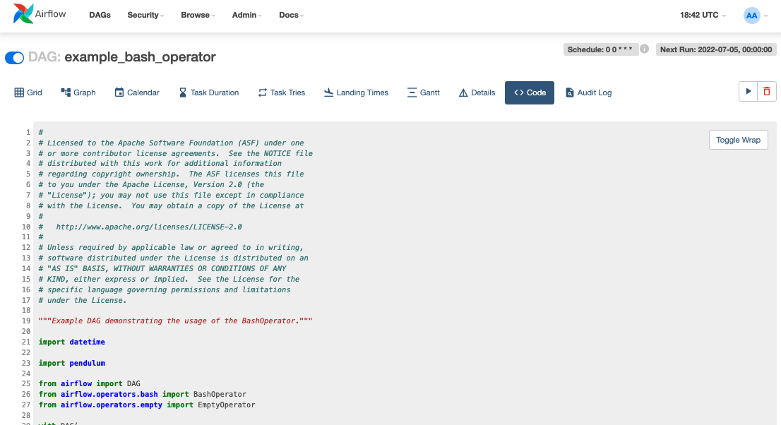
The Code View

Slide 17
Lab Description

