Slide 1
Database Design
Data Engineering
School of Data Science
University of Virginia

Slide 2
Table of Contents
Goals of Effective DB Design
Database Types
Relational DB Fundamentals
Understanding User Needs

Slide 3
Goals of Effective DB Design
Properly designing a db makes it more useful
A db has CRUD properties: CREATE, READ, UPDATE, DELETE
Considerations include scalability, redundancy, consistency, backups guarding against invalid data, security and permissioning
Transactions should be atomic: either all updates happen or not

Slide 4
Database Types
Our work will cover relational dbs: contains tables with rows & columns The tables may be related based on one or more columns
Most dbs are relational. This means they can leverage SQL.
Other types include spreadsheets, hierarchical dbs, XML, Graph dbs, Object dbs, and Document dbs.
The alternative databases can leverage specific data structures (or lack of structure for document db).

Slide 5
Database Types – Relational DBs
Some of the important features:
Data Types – each column uses one data type
Constraints – examples include NON-NULL values, foreign key
Referential Integrity – based on constraints, the db may prevent you from entering invalid data
Joins – related records from multiple tables may be combined

Slide 6
Relational DB Fundamentals
Tables contain rows (tuples, records) and columns (attributes, fields)
Tables use keys for identifying records
Primary key: one or more fields to uniquely identify records
Foreign key: A key that is used in another table
Indexes: a structure used for efficient search of records
Constraints: restrictions on the data
Next, we provide details for each of these

Slide 7
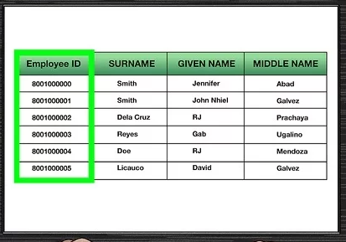
Relational DB: Primary Key
The primary key is a unique identifier for a record. It can’t be null.
Multiple fields may be used as the primary key (example: ticker, date)

Slide 8
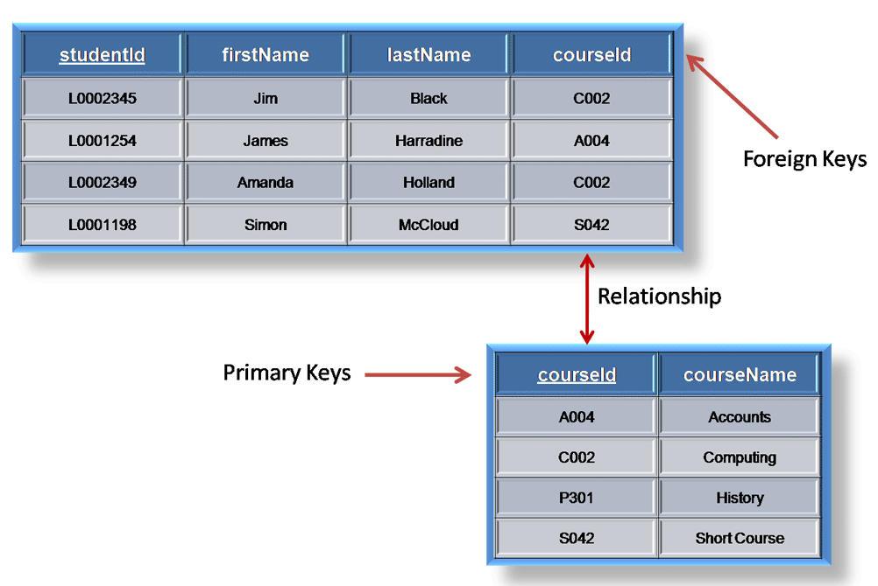
Relational DB: Foreign Key
The bottom table contains course data including the primary key: courseId The top table includes student data and the courseId. Since courseId originates in the course table, it is a foreign key in the top table.
The foreign key helps preserve referential integrity. Example: If a value isn’t in the original table, it cannot be inserted into the table containing the foreign key.

Slide 9
Relational DB: Indexes
Indexes allow efficient search (example: index at the back of a book)
Provides a lookup based on one or more fields
Primary key is an index by default
They must be built and maintained. Only build indexes if you’ll use them.

Slide 10
Relational DB: Constraints
Basic constraints: not null, invalid data type
Check constraints: field-level constraint, table-level constraint
Primary key constraint: two records in table can’t have same primary key
Uniqueness constraint: can add this requirement to preserve uniqueness
Foreign key constraint: a record’s values in one table must match the values in another table

Slide 11
Understanding User Needs
Design is a Translation Process
Bring a List of Questions to understand: functionality, data needs, data integrity, security, environment
Meet the People and Learn Who’s Who Executive Champion is highest ranking customer driving the project – very important to have one!
Pick the Customers’ Brains
Get to Understand the Current User’s Experience

Slide 12
Understanding User Needs, contd.
Write the Requirements Document: spell out what you’re planning to build and what it will do
Make Use Cases: this is a script the user can follow to solve a particular, realistic problem they will need to solve. includes Goals, Summary, Actors, Pre- and post-conditions
Decide Feasibility: take a step back and decide whether the project is feasible

