Slide 1
Snowflake Data Lake in the Cloud
Data Engineering
School of Data Science
University of Virginia

Slide 2
Snowflake: Database, Data Lake …
What is Snowflake?
Fully managed SaaS (Software as a Service)
Single platform for data warehousing
Data Lake
Data Engineering
Data Science
Data app development
Data Sharing

Slide 3
Software As A Service or SaaS
PROS:
No software to install
Always ‘on’
Low maintenance
Automatically updated
CONS:
If it breaks, you can’t fix it (no association here with SF)
Not usually Open Source
Most importantly, most usually costs $$

Slide 4
Snowflake Data Cloud
Founded in 2012
Aimed at Big Data solutions
Designed from the start to be a
Cloud Based Relational Database Management System or Cloud Based RDBMS
Self described as Snowflake Data Cloud
Started as SQL database engine with auto tuning

Slide 5
Snowflake Architecture
There are 3 main layers in its architecture
Cloud Services = metadata, authentication, security, optimization
Compute = Virtual *Wharehouses* or clusters of servers
Storage = Micro-partitioned and compressed. Accessed by compute layer

Slide 6
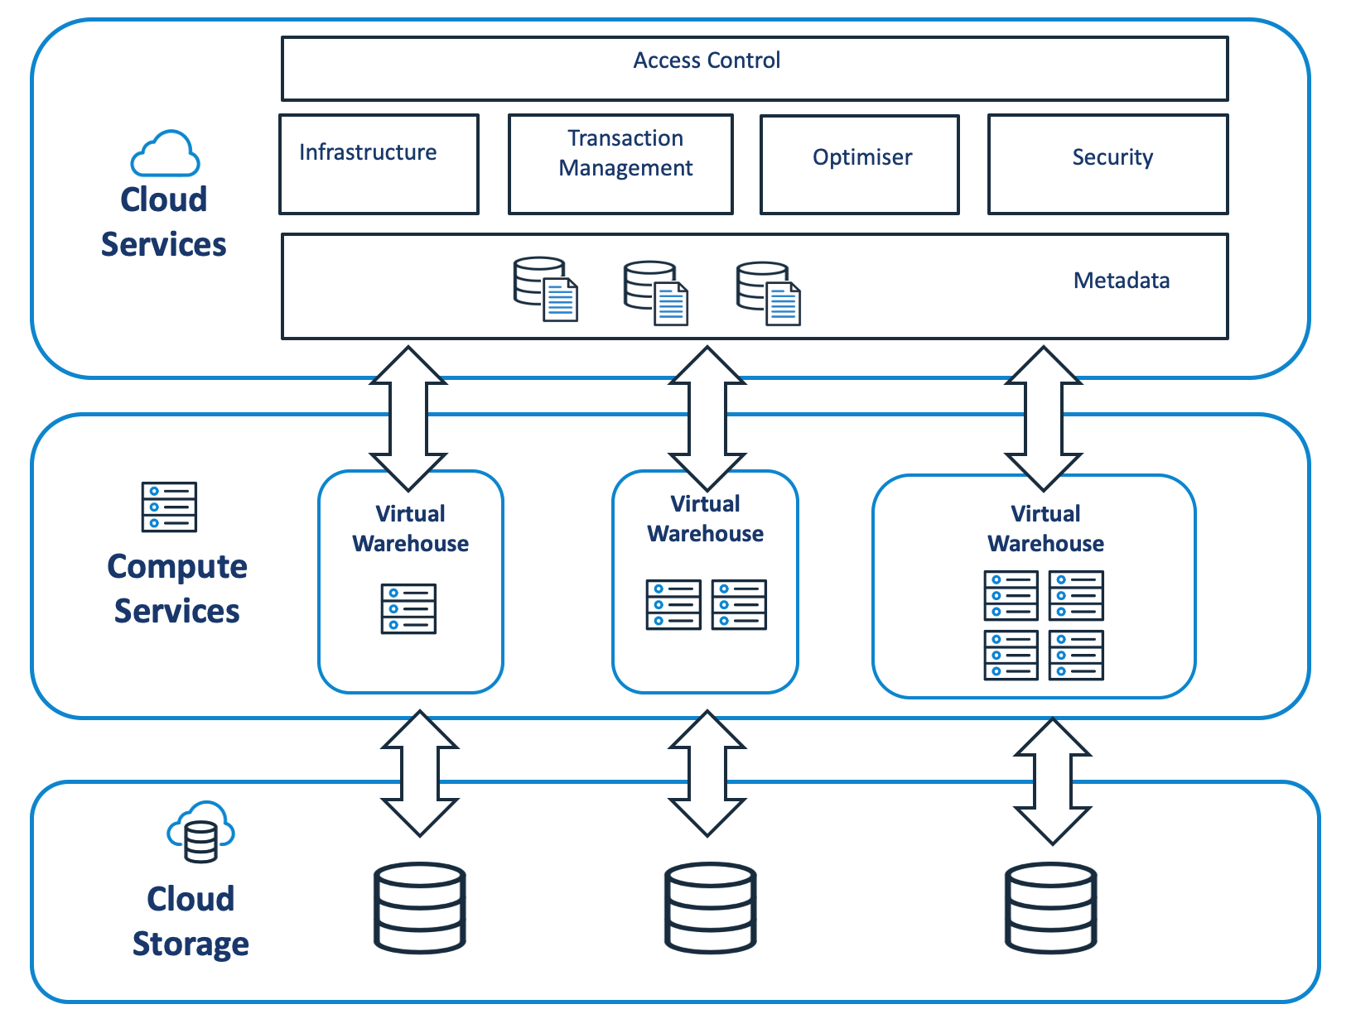
Snowflake: 3 Layer Architecture

Slide 7
Separate compute from storage
Key design decision
Allows `Pay As You Go` compute opening door to small to mid size users
Cloud backed availability
Backups in the cloud in different regions
Cloud Enabled Scaling
Manages warehouses or clusters for you

Slide 8
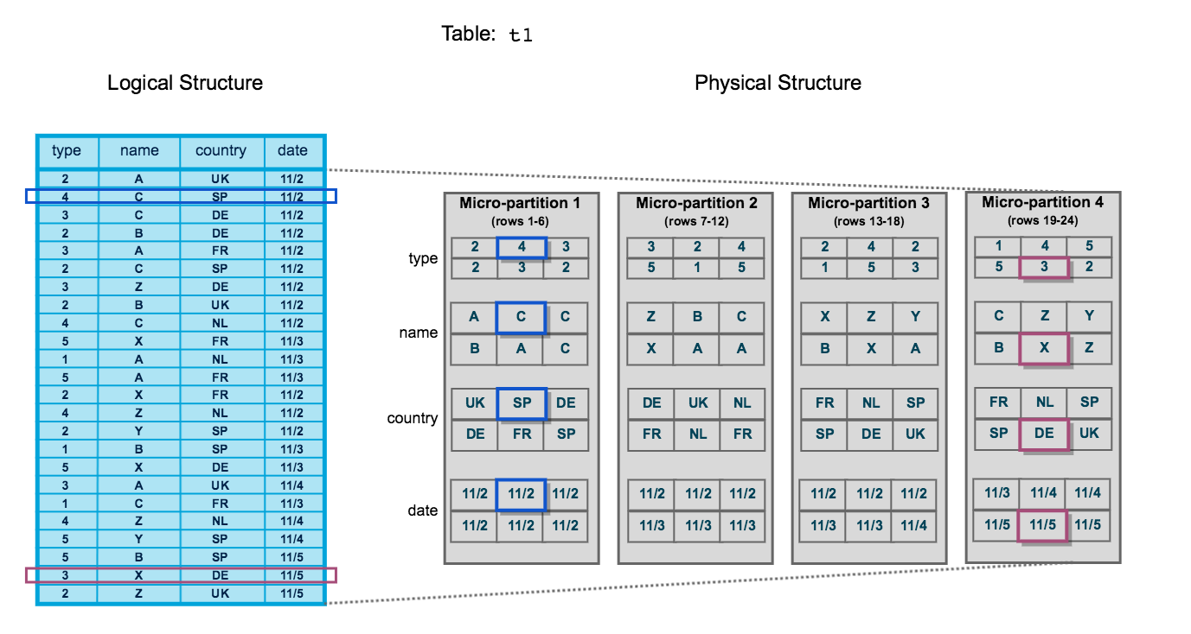
Snowflake’s Micro Partitioning

Slide 9
Snowflake Data Sharing
Allows easy access to other companies or users tables
Sharing versus Replicating
Sharing is easy and pretty much free in same region
Sharing across regions requires replication
In other words, best way to access shared data in AWS Oregon region is to have a Snowflake account in AWS Oregon

Slide 10
Snowflake Time Travel
In the Enterprise version this feature is fully developed
Allows you to ‘rewind’ your database to a previous point

Slide 11
Snowflake: SQL is universal language but…
Snowflake allows UDFs and procedures.
UDF = User Defined Functions that can take variables
Procedures are like scripts inside snowflake
UDFs currently support SQL, javascript, java, and python.
This is very useful for automation, and pipelines

Slide 12
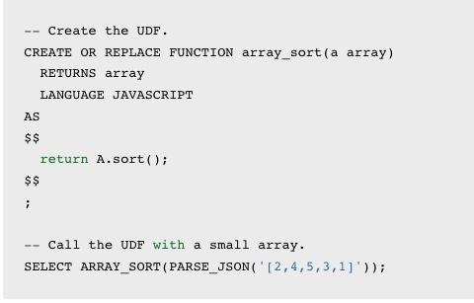
Snowflake: Sample UDF in js
You use SQL to create a UDF
The ‘body’ in this case javascript
is in `$$` quotes
Called just like a function
Means you can build and version
functionality to load into snowflake
easily. Version it in github.

Slide 13
This weeks lab
We’ll get familiar with Snowflake
Create a trial account
Explore loading data from our hard drive
Run SQL statements
As you will see it is quite fast and easy to get up and running
Next lecture, we’ll look at DBT, and how DBT/Airflow and Snowflake can work together!

